Slide 1
Finance management system
501-01 (Advance Web Designing)

Slide 2
Project description
Frontend in this project is built from React js.
Backend in this project is built from PHP.
MYSQL is the database where website entire data are stored.
Data comes in website using API calling in react js.

Slide 3
Overview of the system
If user is first visitor of site than user first can register and then can login. If the user nor registered they cannot login.
Main objective of the system is to buy best bussiness management software & any customized software that needs to improve bussiness.
In the home page include just basic info of service & software name, about us with story and vision along with testimonial and also, it’s included services and contact us.
Next page is user dashboard , in this page include all deep information about service like how costly is it and many more information about services.
After that next page is admin dashboard where admin do all changes over a website and manage services and many more functionality.

Slide 4
objectives
The main purpose of Finance management system is to create modern system.
On Finance management system provide an attereactive environment where you can manipulate data and information about bussiness and employee easily.
The purpose of this project is to built an application program to reduce the manual work for managing the Bussiness activity,Employee information and resources and etc.
Reliable for Admin to easily give addmission without any complex process.
To reduce paper work .
Data security.
Increase accuracy and reliability.

Slide 5
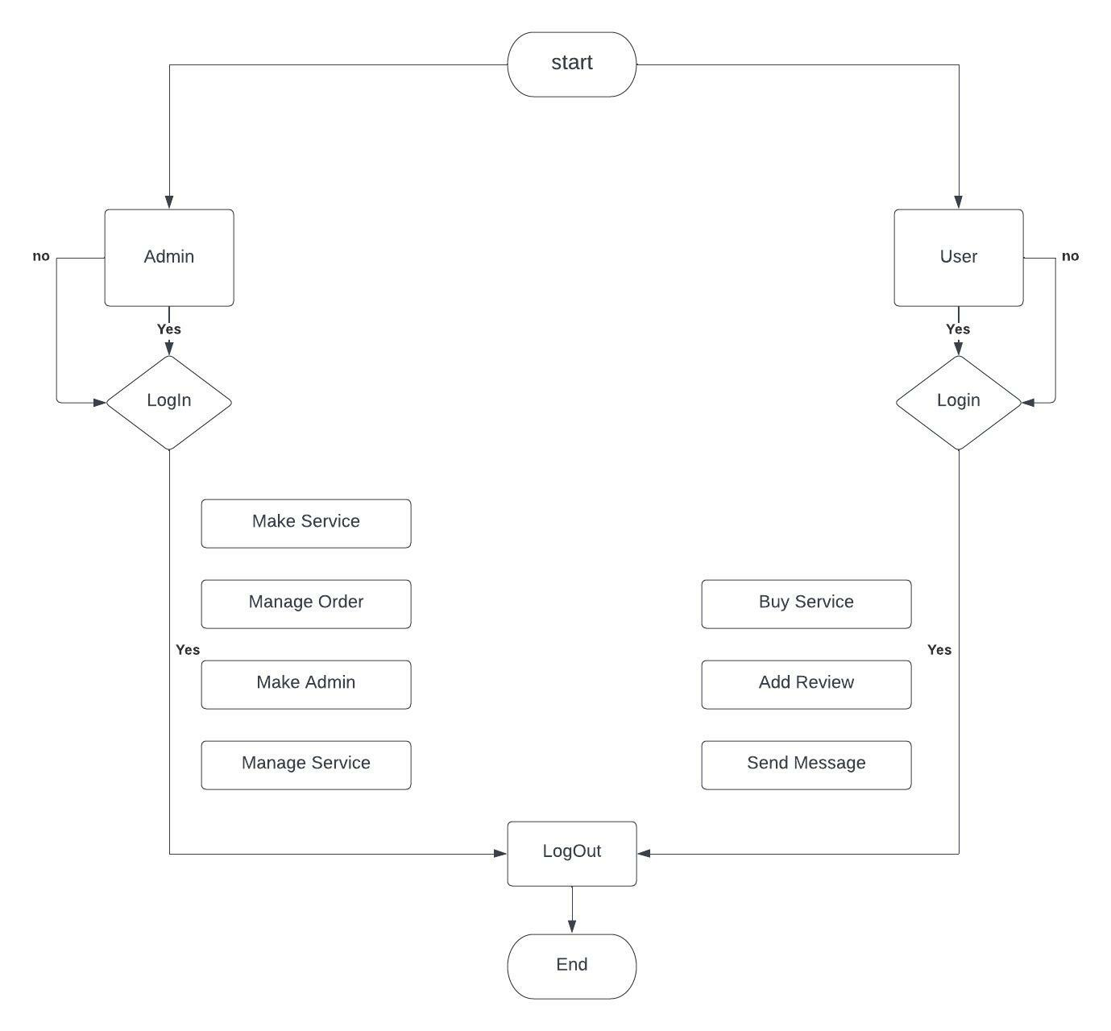
Flow of system

Slide 6
List of modules
Admin Side
User Side

Slide 7
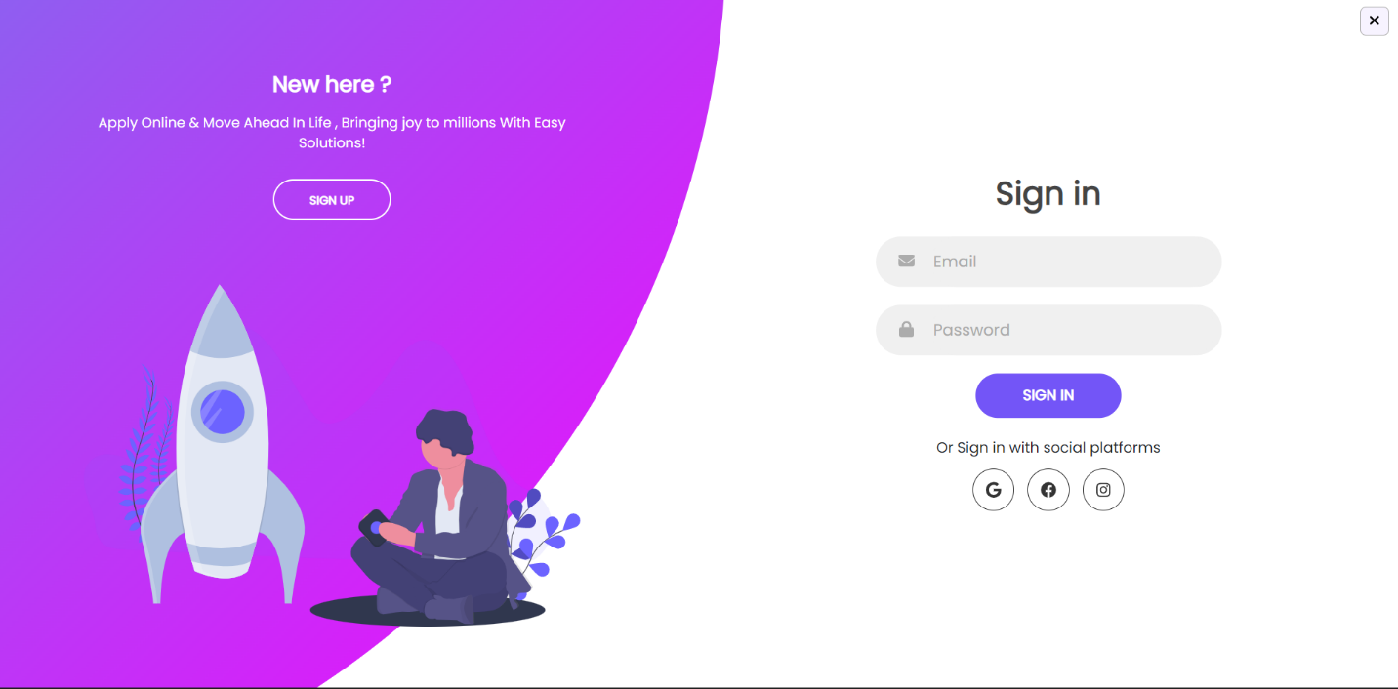
Admin & User Log in
First of all, admin can login in the system with their admin username and password.
User can register their self in system and then login in the system.
User can login with their registered username and password.

Slide 8
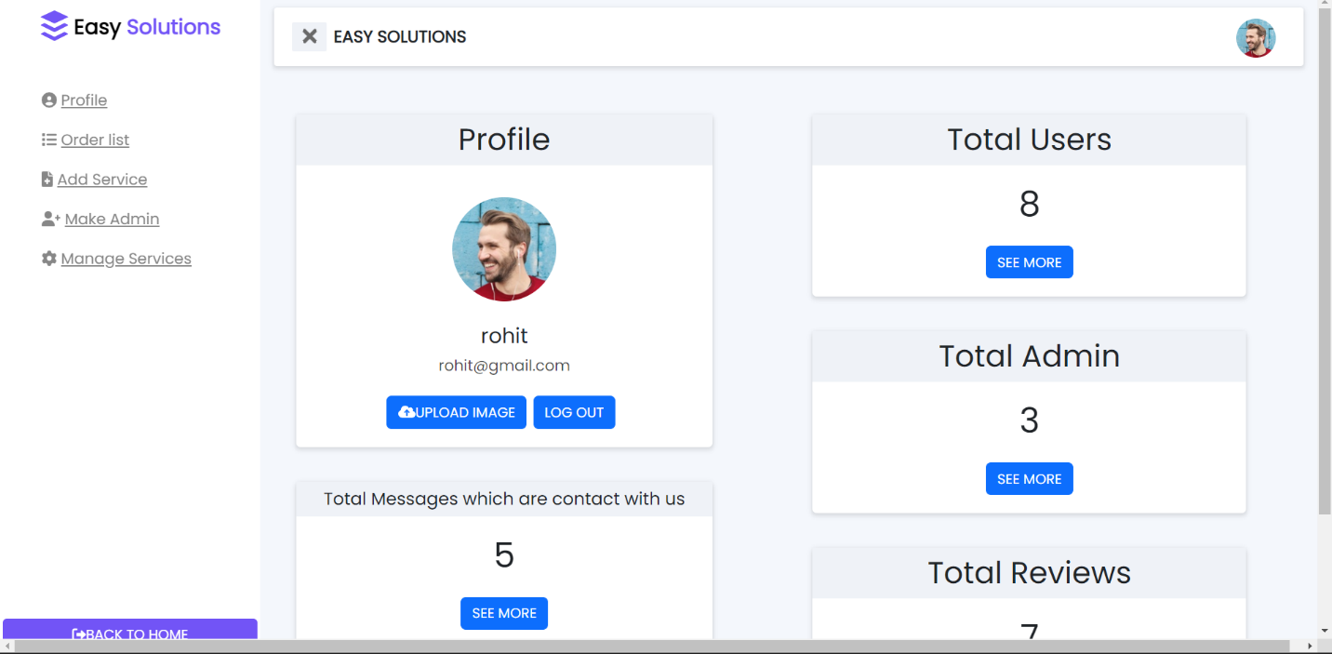
Admin Dashboard
Admin can update profile picture.
Admin can read the messages or issue which are send by user.
Admin can view list of users , admin , contact us reports , services.

Slide 9
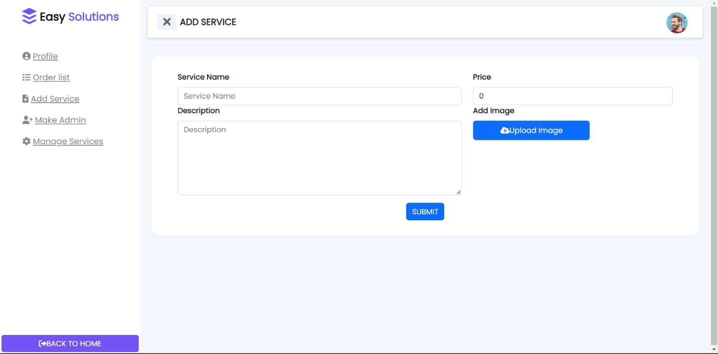
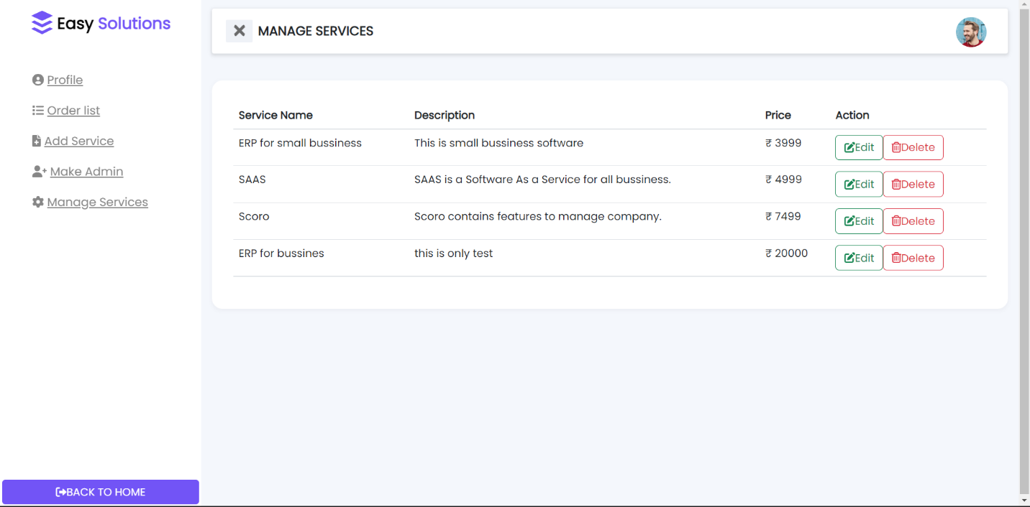
Make & manage services

Slide 10
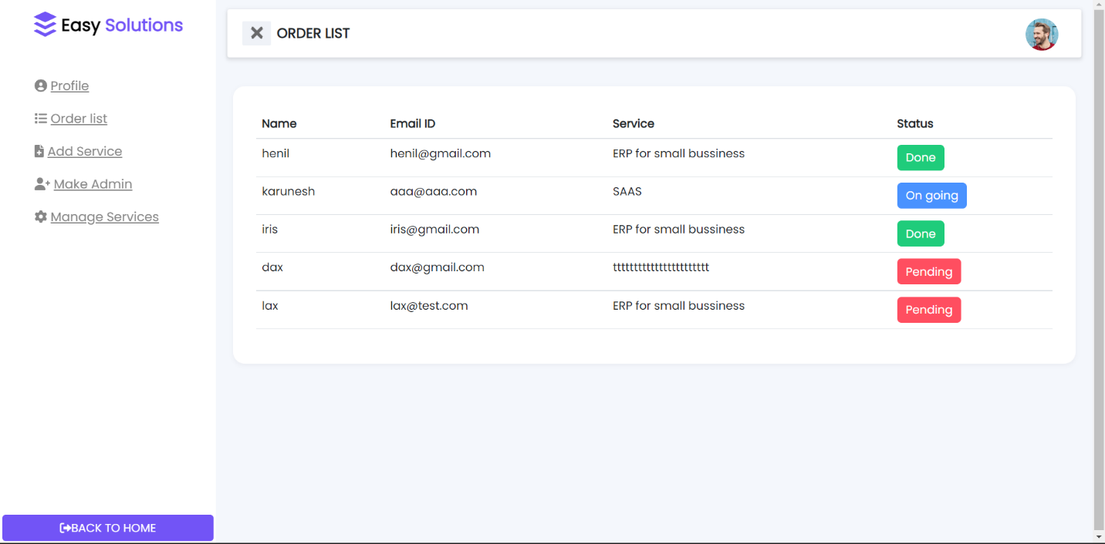
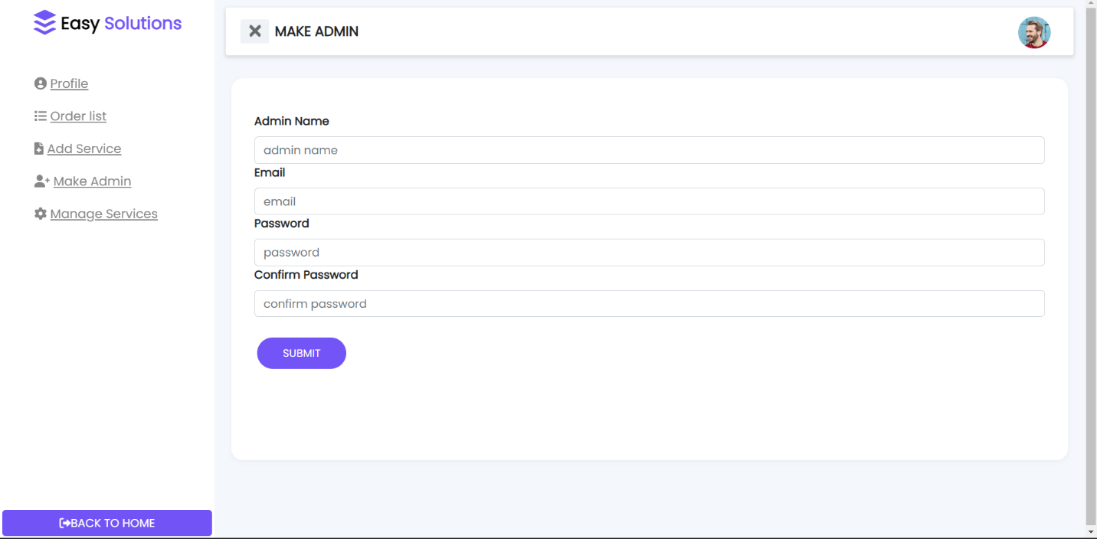
Manage orders & make admin
Admin can manage orders also labelled as pending , on going and done.
Also make a new admin.

Slide 11
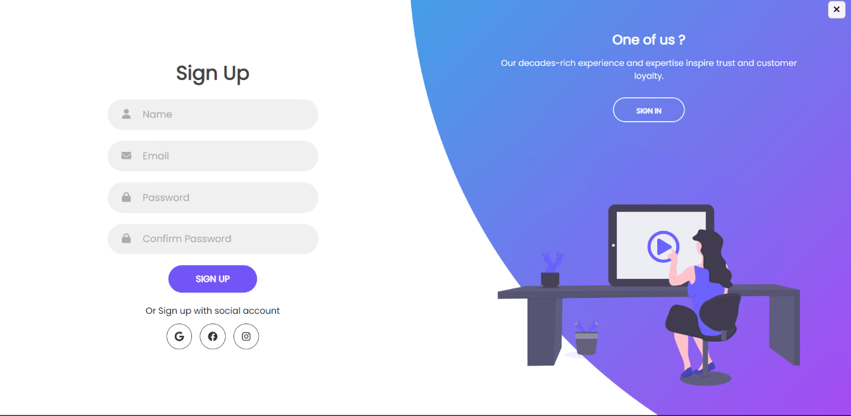
User registration & log in
New user can register himself by adding ditails.
And then sign in by adding user name and password.

Slide 12
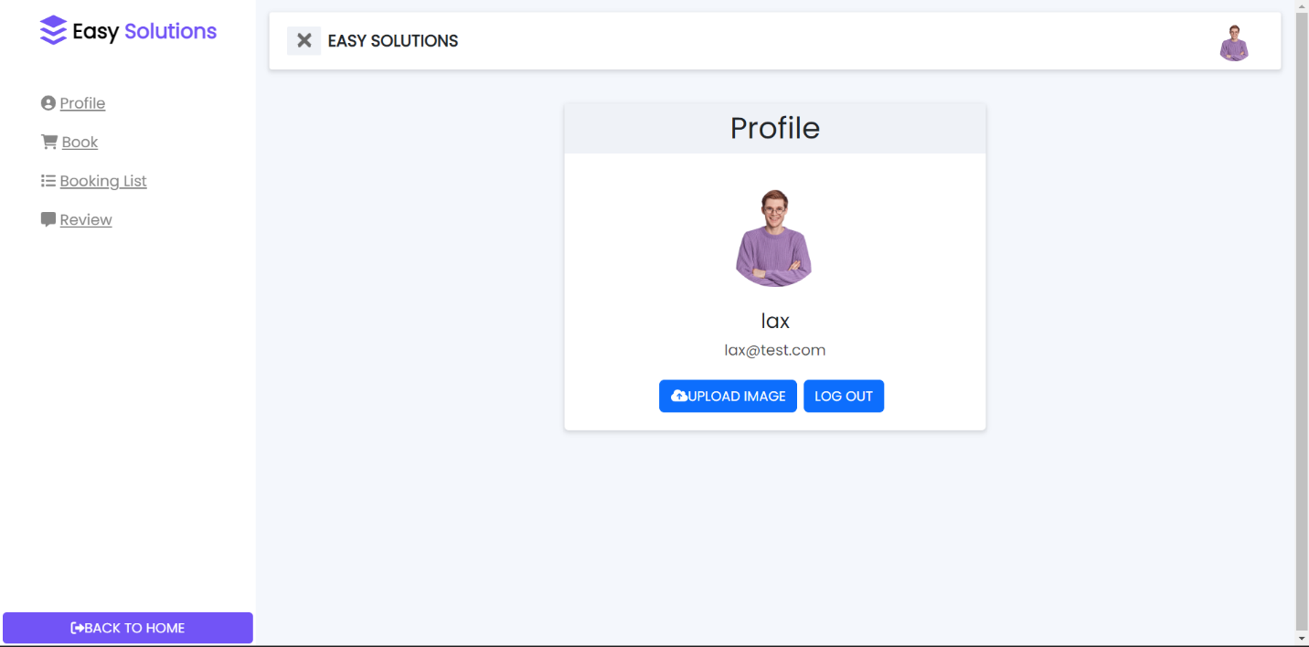
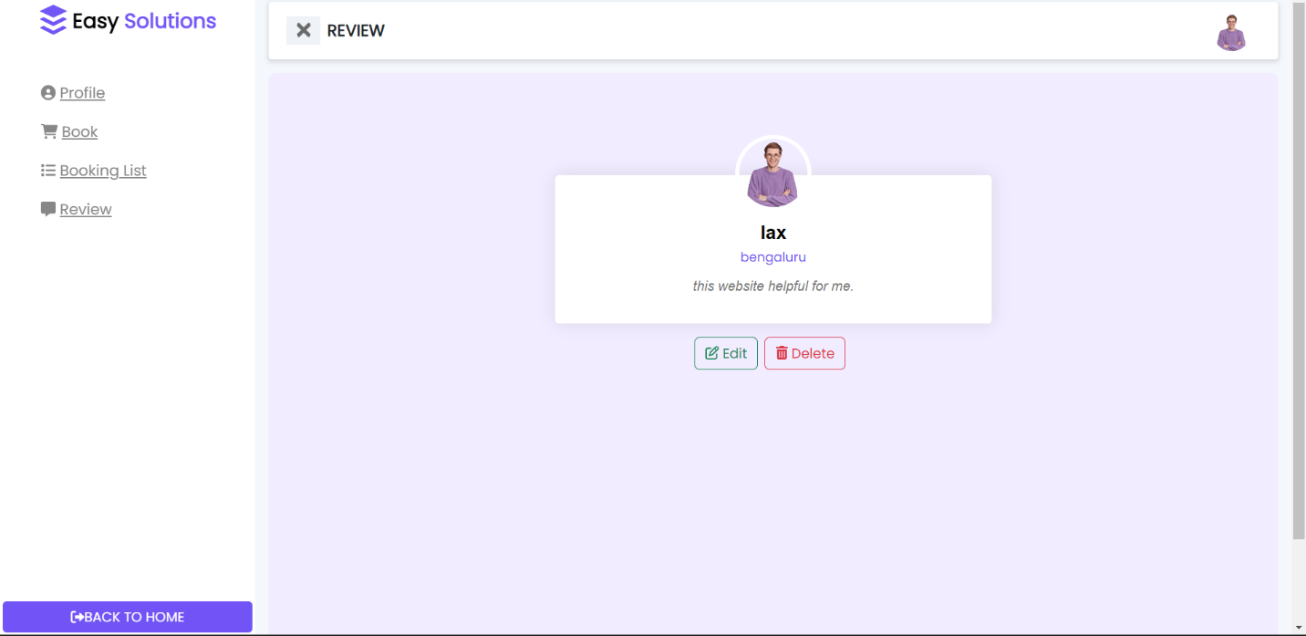
User dashboard & add review

Slide 13
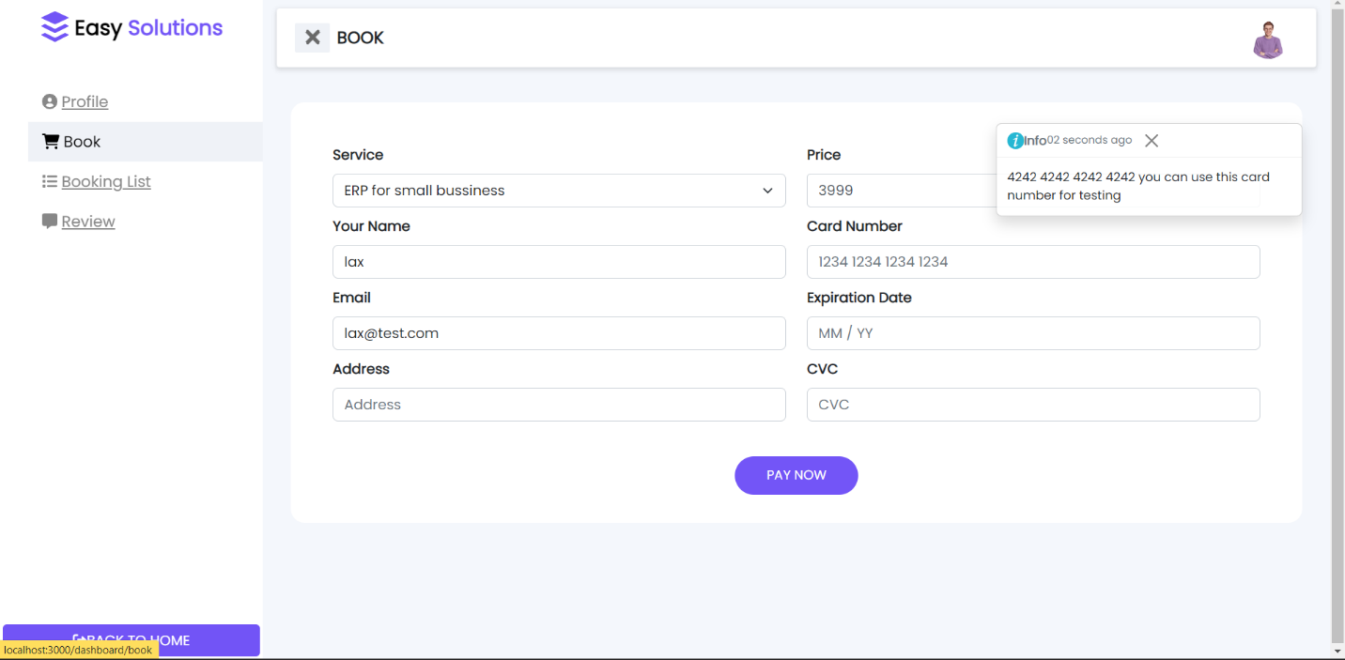
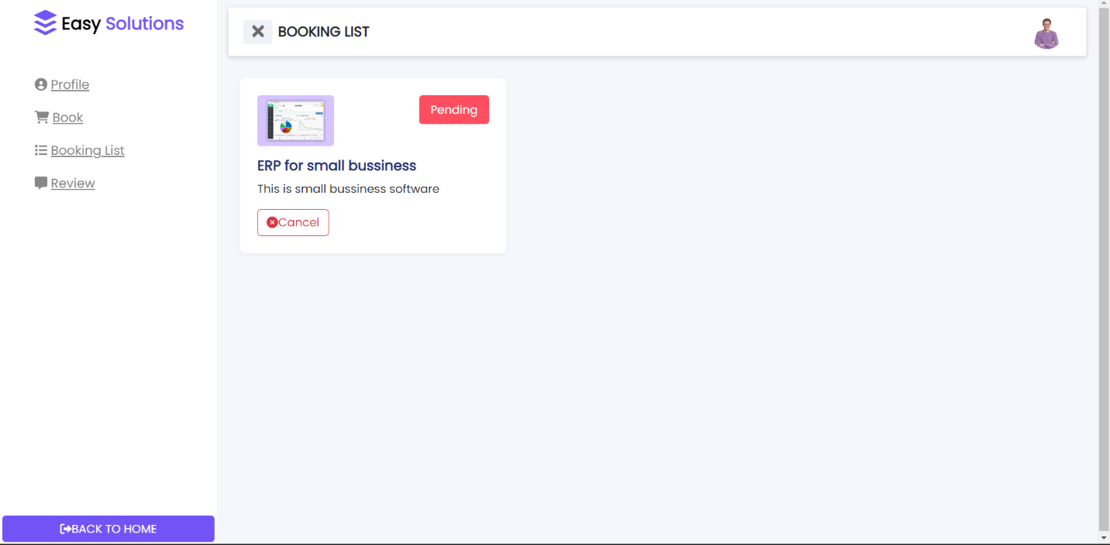
Make order payment & see status
User can make payment of selected service by card and see status of that service and also cancel it.

Slide 14
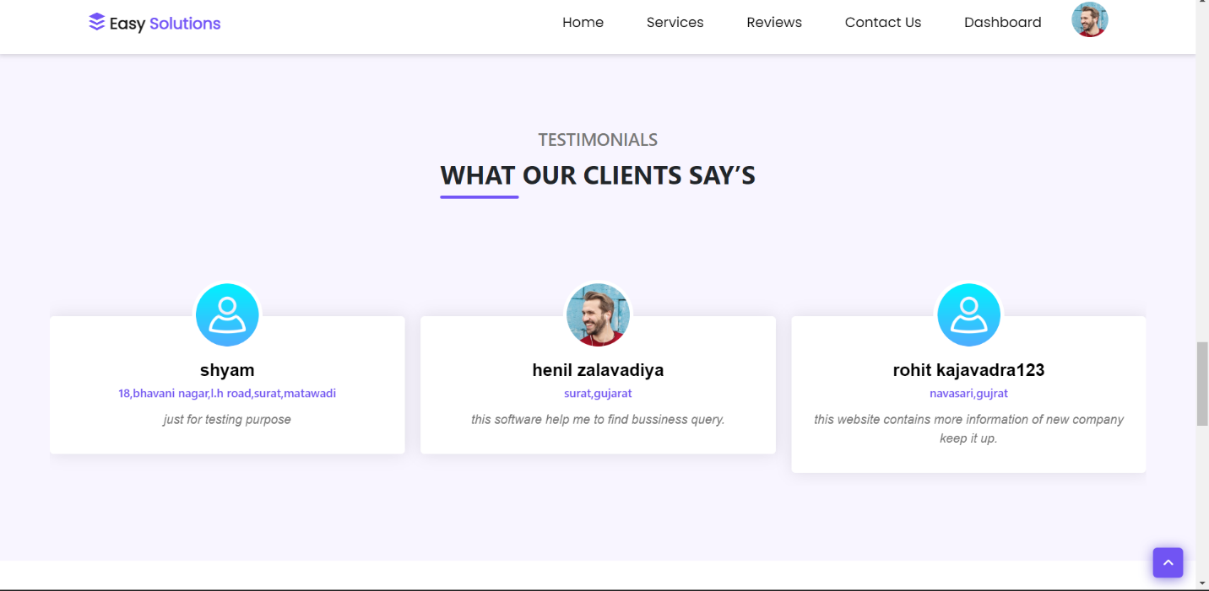
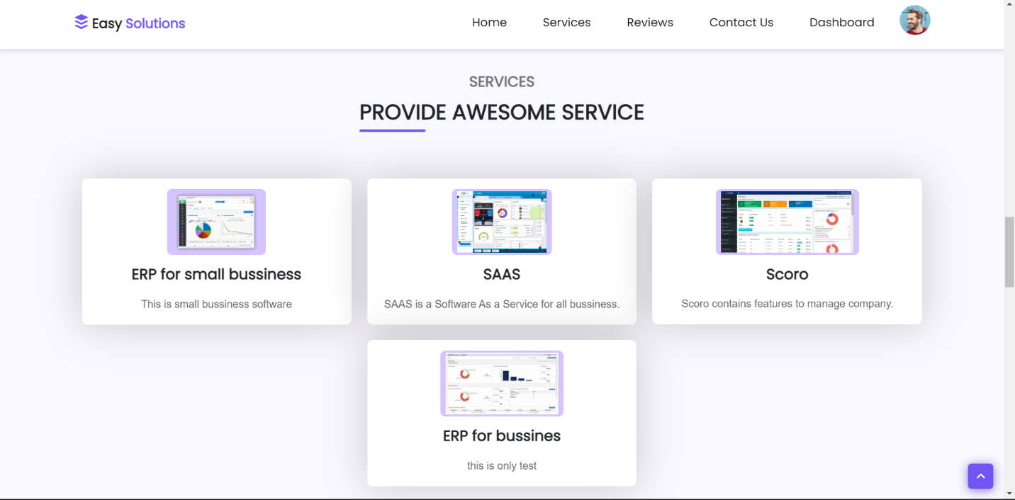
Reviews & services
Admin & user see first look of website.

Slide 15
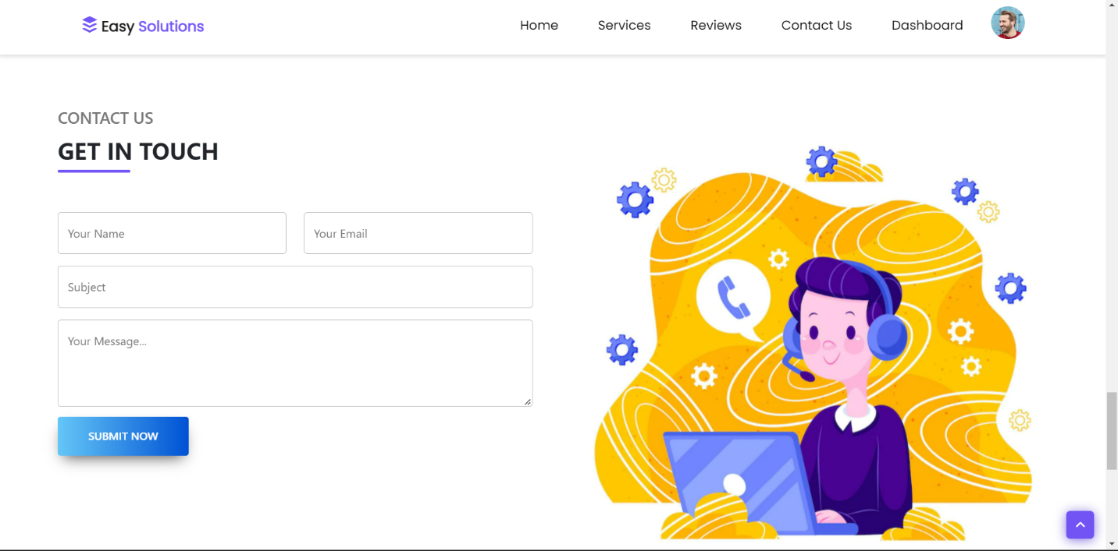
Add review

Slide 16
Database design
MYSQL

Slide 17
 | User & admin registration (usernnfo)
No | Field Name | Data type | Constraints
1 | id | Int (50) | Primary key
2 | Name | Varchar (255) | Not null
3 | Email | Varchar (255) | Not null
4 | Password | Varchar (255) | Not null
5 | imgUrl | Varchar (255) | Not null
6 | Updated_at | default | Not null
7 | isAdmin | Varchar (255) | Not null
 | Service Booking (tblservice)
no | Field name | datatype | Constraints
1 | id | Int (50) | Primary key
2 | Service_name | Varchar (255) | Not null
3 | description | Varchar (255) | Not null
4 | price | Varchar (255) | Not null
5 | imgUrl | Varchar (255) | Not null
6 | Updated_at | default | Not null
 | order (tblorder)
No | Field Name | Data type | Constraints
1 | orderId | Int(255) | Primary Key
2 | uname | Varchar (255) | Not null
3 | email | Varchar (255) | Not null
4 | address | Varchar (255) | Not null
5 | sname | Varchar (255) | Not null
6 | price | Varchar (255) | Not null
7 | description | Varchar (255) | Not null
8 | imgUrl | Varchar (255) | Not null
9 | paymentMethod | Varchar (255) | Not null
10 | status | Varchar (255) | Not null
11 | updated_at | default | Not null

Slide 18
 | User reviews (tblreview)
No | Field Name | Data type | Constraints
1 | _id | Int (255) | Primary Key
2 | name | Varchar (255) | Not null
3 | email | Varchar (255) | Not null
4 | imgUrl | Varchar (255) | Not null
5 | address | Varchar (255) | Not null
6 | description | Varchar (255) | Not null
7 | updated_at | default | Not null
Contact us (contactus)
No | Field Name | Data type | Constraints
1 | id | Int (255) | Primary Key
2 | name | Varchar (255) | Not null
3 | email | Varchar (255) | Not null
4 | subject | Varchar (255) | Not null
5 | message | Varchar (255) | Not null
6 | Updated_at | default | Not null

Slide 19
Thank you
Your name

