Slide 1
Bridging Chemical and Biological Space: “Target Fishing” Using 2D and 3D Molecular Descriptors

Slide 2
3D method (FEPOPS) shows promise for providing pharmacophoric alignment of the small molecules’ chemical features consistent with those seen in experiment ligand/receptor complexes.
The researchers’ computational study is designed toward a goal: that is identifying the molecular target for a single chemical entity, or “target fishing”, based on similarity of a new compound to structure where activities against a broad panel of target is already known.

Slide 3
The goal of the research paper are: - to examine methods for predicting a chemical probe’s biological target based upon similarity to a reference compound. The second goal is to examine the ligand-based 3D alignments to actual 3D receptor binding.
They found that one hypothesis, supported by the results, is that the 2D methods are favored in case of close analogues, but that 3D methods often advantages below a certain similarity threshold.

Slide 4
Methods: - database, bioactivity data, and database preparation – they have over 100,000 unique structures described as SMILES and over 240,000 biological activities in separate ISIS databases.
After filtering they have 57,505 unique chemical structures associated with 544 biological targets.
2D target fishing – MDL Structural Keys and ECFP_6 fingerprints – All WOMBAT – the 2D similarity protocols, using each descriptor type, were run against the filtered database using the complete set of 47, 505 chemical structures as probes.

Slide 5
3D target fishing: FEPOPS. All 47,505 unique compounds were input as SMILES strings. FEature POint PharmacorphoreS (FEPOPS) were compounds and stored as text in a 3D descriptor database (3DDD) yielding 8,15,676 records with compound IDs and associated feature point information.
Fishing for Chemical Diversity with 3D Descriptors: - 1, Nearest Neighbors Misses (NNmiss) – first the researchers need to access the 3D performance in cases where 2D fails.

Slide 6
Second, the smaller number of probes reduced computing times and allowed for multiple conditions to be examined.
Third, using a randomly selected subset of the total nearest neighbor misses as probes left the remainder of the 2D misses in the 3DDD.
2, Similarity Filters – it explores the added value of 3D FEPOPS method for finding correct probe/reference pairings with low structure similarity.

Slide 7
Modeling of 3D Ligand Alignments in biological space was the examine of the binding mode for probe/reference drug pairs having dissimilar chemical scaffolds, but similar biological activity.
Results and Discussion: - 2D and 3D Target Fishing. The 2D Nearest Neighbor (2DNN) analysis was performed using MDL and ECFP descriptor keys as described in Methods and was run on both the full and 5% data sets.

Slide 8
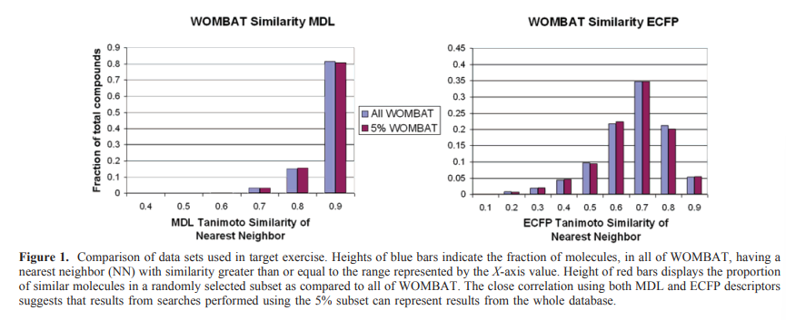

Slide 9
Form the above figure we can see that the MDL public key method was one of the first and is still a widely used tool in cheminformatics. The “public” keys describe a chemical entity based upon the presense or absence of 166 substructural fragments from a predefined library.
The researchers find that the results of filtering above the 0.85 level using either 2D descriptor did not return appreciably better structural diversity.

Slide 10
Pharmacophore and 3D-QSAR-based methods have also shown promise for both identification of potential nontarget interactions and scaffold hopping within a given target but the have a dependence upon the external knowledge used to train the models.
The researchers hypothesized that the maximally overlapped feature points derived from exploring the chemistry space of molecules that effect the same target should correlate with the biological space of the actual target.

Slide 11
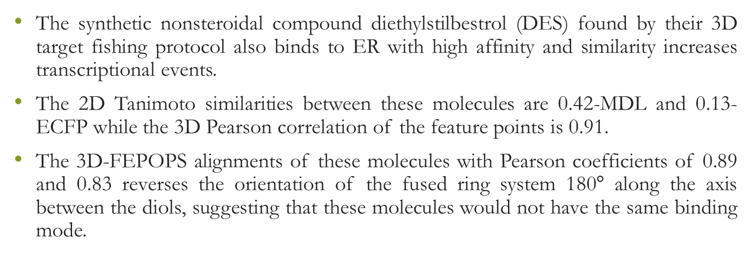
The synthetic nonsteroidal compound diethylstilbestrol (DES) found by their 3D target fishing protocol also binds to ER with high affinity and similarity increases transcriptional events.
The 2D Tanimoto similarities between these molecules are 0.42-MDL and 0.13-ECFP while the 3D Pearson correlation of the feature points is 0.91.
The 3D-FEPOPS alignments of these molecules with Pearson coefficients of 0.89 and 0.83 reverses the orientation of the fused ring system 180$°$ along the axis between the diols, suggesting that these molecules would not have the same binding mode.

Slide 12
The Tanimoto scores of 2D similarity are very low, the Pearson coefficient of distances between the aligned FEPOPS of 5 and 7 is > 0.92.

Slide 13
Reaction Classification and Yield Prediction using the Differential Reaction Fingerprint DRFP

Slide 14
The researcher presents the differential reaction fingerprint DRFP. The DRFP algorithm takes a reaction SMILES as an input and creates a binary fingerprint based on the symmetric difference of two sets containing the circular molecular n-grams generated from the molecules listed left and right from the reaction arrow, respectively, without the need for distinguishing between reactants and reagents.

Slide 15
The researchers’ differential reaction fingerprint (DRFP) search and categorized the reaction as well as predict the yield.
The reaction fingerprints DRFP borrows the categorization of circular substructures from a molecule and the subsequent hashing of their SMILES representations from the chemical fingerprints ECFP and MHFP, respectively.

Slide 16
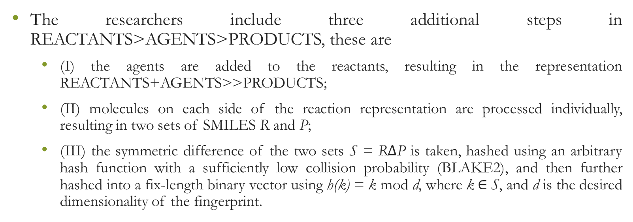
The researchers include three additional steps in REACTANTS>AGENTS>PRODUCTS, these are
(I) the agents are added to the reactants, resulting in the representation REACTANTS+AGENTS>>PRODUCTS;
(II) molecules on each side of the reaction representation are processed individually, resulting in two sets of SMILES R and P;
(III) the symmetric difference of the two sets S = R$∆$P is taken, hashed using an arbitrary hash function with a sufficiently low collision probability (BLAKE2), and then further hashed into a fix-length binary vector using h(k) = k mod d, where k$∈$ S, and d is the desired dimensionality of the fingerprint.

Slide 17
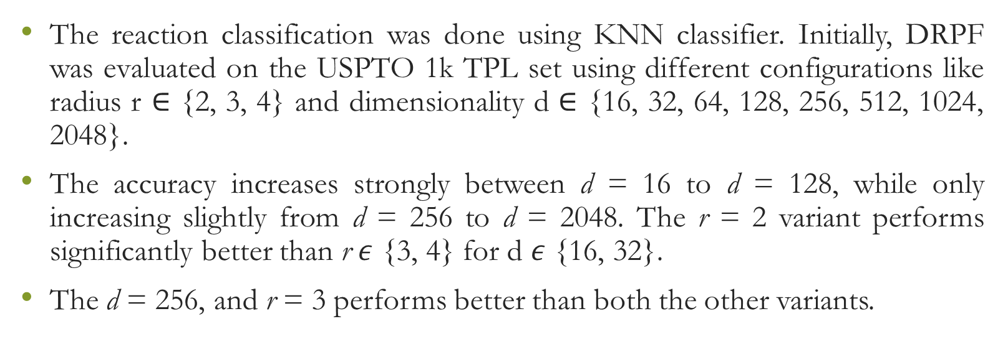
The reaction classification was done using KNN classifier. Initially, DRPF was evaluated on the USPTO 1k TPL set using different configurations like radius r $∈$ {2, 3, 4} and dimensionality d $∈$ {16, 32, 64, 128, 256, 512, 1024, 2048}.
The accuracy increases strongly between d = 16 to d = 128, while only increasing slightly from d = 256 to d = 2048. The r = 2 variant performs significantly better than r $ε$ {3, 4} for d $ε$ {16, 32}.
The d = 256, and r = 3 performs better than both the other variants.

Slide 18
Evaluating the kNN classification benchmark on the TPL data set, DRFP outperforms the structures-based fingerprint AP3 256 by a factor of 3.1 and reaches 93% of the performance of the learned fingerprint rxnfp. If the kNN classifier replace with a simple multilayer perceptron (MLP), then the DRFP reaches 9% of the performance of the rxnfp.
Reaction Yield Prediction: - DRFP outperforms Yield-BERT, an augmented version of Yield-BERT, as well as a DFT-based method, in a yield prediction task on a data set of Buchwald Hartwig reactions.

Slide 19
DRFP performs better on the random splits than the DFT-based fingerprint with random forests and Yield-BERT but is outperformed by the augmented Yield-BERT by a narrow margin.
The DEFP reaches a compelling performance in yield prediction using a gradient boosting regressor that does not require hyperparameter tuning between different sets.
DRFP, based on a simple 4-step process comprised of extracting circular n-grams, XORing, hashing, and folding.

Slide 20
Methods: - Molecular n-grams: - Molecular n-grams are generated from SMILES using the RDKit library. The radius r, iterate over the heavy atoms in an input molecule and extract sub-SMILES centred on each atom with radii 0 to r, where a radius of 0 is the single central atom.
Gradient Boosting: - for the gradient boosting, they use the python library xgboost, and for hyperparameter tuning was carried out on the rand 70/30 set of the Buchwald-Hartwing reaction data set.

Slide 21
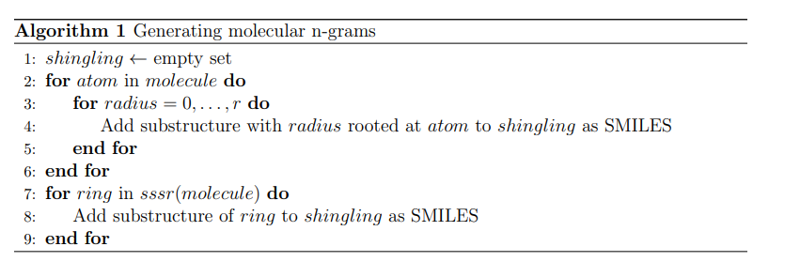

Slide 22
Learning continuous and data-driven molecular descriptors by translating equivalent chemical representations

Slide 23
Molecular fingerprints encode structural or functional features of molecules in a bit string format and are commonly used for tasks like virtual screening, similarity searching and clustering.
The circular fingerprint like the extended-connectivity fingerprints (ECFPs) were introduced to model quantitative structure-activity relationships (QSAR) for biological endpoints by way of classical machine learning approaches as well as for ligand-based virtual screening (VS).
The purposed DNNs have in common that they use pre-extracted molecular descriptors (mostly ECFPs) as input features.

Slide 24
By training a DNN directly on a comprehensive and low-level representation, it can automatically learn to extract useful descriptors best suited for the specific task it is trained on, resulting in a specific descriptor set for a given dataset.
Gomez-Bombarelli proposed a variational autoencoder to convert the discrete SMILES representation.
They show that the representations could also be used as descriptors for a downstream classification task. Xu proposed a related unsupervised approach based on sequence to sequence learning.

Slide 25
There is risk with autoencoder that an autoencoder on reconstructing a sequence which represents a molecule bears the risk that the network solely focuses on syntactic features and repetitive patterns of this sequence, neglecting its semantics and failing to encode higher-level concepts such as molecular properties.
Neural Machine Translation (NMT) model first reads the whole input sequence and encodes it into an intermediate continuous vector representation (latent representation) which is then used by the decoder to emit a respective translation.

Slide 26
The researchers propose a model that can extract the information contained in a comprehensive but discrete and variable-sized molecular representation and transform it into a continuous and fixed-sized representation.
Methods: - molecular representation: - the InChI notation represents molecular structures as a sequence of characters divided into layers and sub-layers providing different types of information such as the chemical formula, bonds and charges.

Slide 27
Translation model: - for the encoder network, the researcher tried both convolutional neural network (CNN) and recurrent neural network (RNN) architectures of different size and depth followed by a fully connected layer that maps the output of the CNN or the concatenated cell states of the RNN to the latent space, respectively.
Like Gomez-Bombarelli method, this classification model takes the latent representation of the translation model as the input and predicts certain molecular properties which can be directly deduced from the molecular structure.

Slide 28
The complete model is trained on minimizing the cross-entropy between these probability distributions and the one-hot encoded correct characters in the target sequence as well as minimizing the mean squared error in predicting the molecular properties.
To select the best combination of translation task and architecture, they used the predictive performance of machine learning models built on two QSAR datasets using the respective latent representations as descriptors.

Slide 29
Datasets and preprocessing: - the translation model was pretrained from ZINC15 and PubChem datasets. They take only those data who falls under these criteria: - only organic molecular weight between 12 and 600, more than 3 heavy atoms and a partition coefficient log P between – 7 and 5.
For each molecule, nine molecular properties were extracted: log P, the maximal and minimal partial charge, the number of valence electrons, the number of hydrogen bond donors and acceptors, Balaban’s J value, the molar refractivity and the topological polar surface area.

Slide 30
For the final translation model, they performed eight QSAR and two VS experiments. Two of the datasets were used to validate the different translation models’ architectures. The remaining eight datasets were solely used for evaluating the final model.
Evaluation and baseline: - the researchers compare three different approaches: - classical machine learning models applied on descriptors and on circular fingerprints of different radii and folding as implemented in RDKit as well as an end-to-end molecular graph convolution method as implemented in DeepChem.

Slide 31
In this each dataset was split into two different ways for the validation. The random CV corresponds to five random splits while the cluster CV corresponds to five clusters obtained by K­-means clustering with K=5 on MACCS fingerprints.
For selecting the best combination, they specifically looked at the coefficient of determination (r²) and the area under the receiver operating characteristic curve (ROC AUC) for the regression and classification tasks.

Slide 32
For the ligand-based virtual screening experiments, they followed the benchmarking protocol proposed by Riniker for each target in both VS databases, five active compounds were picked randomly and the remaining compounds were ranked according to their similarity to the active set as measured by a similarity metric in the respective descriptor space.

Slide 33
Results and Discussion: - the translation model is data-driven model that generates meaningful compound representations by forcing translation of all necessary information between two sequence-based representations of a molecule into a low dimensional continuous embedding.
Pretraining: - The translation model is forced to store all important information necessary to do the translation in the bottleneck of the network: the latent representation.

Slide 34
The overall best performance was achieved with a translation model based on an RNN architecture for the encoder network that was trained on translating from a SMILES representation to its canonical version.
The translation models cannot simply store sequence-based features or patterns in the latent space, but have to learn to extract the information that both the input and output sequences have in common: the molecule they are both representing.

Slide 35
The graph-convolution method outperforms the models based on the baseline fingerprint in predicting these physico-chemical endpoints. In the case of cluster splits, the graph-convolution model apparently fails to generalize on the hold-out clusters.
The graph-convolution method is trained end-to-end, it has to learn to extract meaningful features for each dataset from scratch which could lead to overfitting, if training data are limited.

Slide 36
Virtual screening: - the goal of ligand-based virtual screening (VS) is to rank a large set of compounds with respect to their activity on a certain target based on their similarity to some known active query compounds.
Exploring the continuous descriptor space: - the proposed descriptor is continuous and the encoding into the descriptor space is reversible, due to the decoder part of the translation model.

Slide 37
The first principal component of their pretraining dataset correlates with the size of molecules: adding or subtracting a value along this axis corresponds to adding or removing atoms from the structures.
The second principal component of the pretraining dataset seem to be correlated with altering the molecule’s polarity.
The researcher observed that there is a clear correlation between the (Euclidean) distance in their descriptor space and the (Tanimoto) distance in the circular fingerprint space.

Slide 38
They find that if the most probable output of the model’s beam search decoder results in an invalid SMILES, they observe that it is likely that one of the next most probable sequences results in a valid SMILES (>99%).
Conclusion: - the researcher proposed a novel methodology that is able to learn to extract meaningful molecular descriptors, solely by an unsupervised training on a large dataset of molecular structures.

Slide 39
They show that molecular descriptors extracted by their method significantly outperform state-of-art molecular fingerprints in a ligand-based virtual screening (VS) experiment. They also show that ML models based on their descriptor perform similar to various quantitative structure-activity relationships (QSAR tasks), compare to multiple state-of-the-art molecular fingerprints and computationally expensive graph-convolution models.
The researcher’s model learns its own extraction method in the data-driven way.

Slide 40
Molecular Transformer: A Model for Uncertainty-Calibrated Chemical Reaction Prediction

Slide 41
Molecular Transformer makes predictions by inferring the correlations between the presence and absence of chemical motifs in the reactant, reagent, and product present in the data set.
There are three salient challenges in predicting chemical reactivity and designing organic synthesis. First, simple combinatorics would suggest that the space of possible reactions is even greater than the already intractable space of possible molecules.

Slide 42
Second, reactants seldom contain only one reactive functional group. Predicting subtle reactivity differences is challenging because they are often dependent on the what other functional groups are nearby.
Third, organic synthesis is almost always a multistep process where one failed step could invalidate the entire synthesis.

Slide 43
Template-based methods use a library of reaction templates or rules. These templates describe the atoms and their bonds in the neighborhood of the reaction center before and after the chemical reaction has occurred.
The key steps in all template-based methods are the construction of templates and the evaluation of how likely the template is to apply.
The problem with the template-based paradigm is that templates themselves are often of questionable validity.

Slide 44
Atom-mapping is based on templates and templates are based on atom mapping, and ultimately, seemingly automatic techniques are actually premised on handcrafted and often artisanal chemical rules.
Jin characterizes chemical reactions by graph edits that lead from the reactants to the products.

Slide 45
There reaction prediction is a two-step process. The first network takes a graph representation of the reactants as input and predicts reactivity scores. On the basis of those reactivity scores, product candidates are generated and then ranked by a second network.
Bradshaw separated reactants and reagents and included the reagents only in a context vector for their gated graph neural network. They represented the reaction prediction problem as a stepwise rearrangement of electrons in the reactant molecules.

Slide 46
Sequence-based techniques have emerged as an alternative to graph-based methods.
The key idea is to use a text representation of the reactants, reagents, and products and treat reaction prediction as machine translation from one language to another language.
The researchers show that a fully attention-based model adapted from Advances in Neural Information Processing Systems with the SMILES representation, the Molecular Transformer, outperforms all previous methods while being completely atom-mapping independent and not requiring splitting the input into reactants and reagents.

Slide 47
The researchers model reaches 90.4% top-1 accuracy (93.7% in top-2 accuracy) on a common benchmark data set. It can also estimate its own uncertainty. The uncertainty score predicted by the model has an ROC-AUC of 0.89 in terms of classifying whether a reaction is correctly predicted.
Jin increased their top-1 accuracy by 6% when they removed the reagents from the first step, where the reaction centers were predicted. It was shown that the model performs better when the reagents are tagged.

Slide 48
Molecular Transformer: - the model is based on the transformer architecture. The main architectural difference compared with seq-2-seq models previously used for the reaction prediction, is that the RNN component was completely removed, and it is fully based on the attention mechanism.
The transformer is a stepwise autoregressive encoder-decoder model composed of a combination of multihead attention layers and positional feed forward layers.

Slide 49
The main advantage of the transformer architecture compare with seq-2-seq models is the multihead attention, that allows the encoder depending on its preceding outputs.
The sequential nature of the data is encoded with positional encodings. Positional encodings add position-dependent trigonometric signals to the token embeddings of size d_{emb} and allow the network to know where the different tokens are situated in the sequences.

Slide 50
The researchers observed that at least four attention heads are required to achieve accuracies. They use eight head and for training they use the ADAM optimizer and varied the learning rate using 8000 warm up steps.
Results and Discussion: - the researchers double the training set by generating a copy of every reaction in the training set, in which molecules are replaced by an equivalent random SMILES.
The results also improved by averaging the weights over multiple checkpoints, as well as increasing the training time.

Slide 51
Comparison with Previous Work - They find that if one was to use a reaction prediction algorithm to plan an N-step synthesis, then the probability of getting the scheme right would be p^{N}, where p is the probability of a single-step prediction being correct.
The results also shows that Molecular Transformer is not simply memorizing the data and can leverage information inferred from more common reactions to make predictions on rarer reactions.

Slide 52
Molecular Transformer can furnish the right product by inferring the reactivity of this complex pattern of distant functional groups. The reduction of 5 using excess DIBAL-H was expected to lead to the unselective reduction of the secondary and the tertiary amides.
The find that the next challenge is regioselectivity – Molecular Transformer can deal with complicated examples such as the bromination of 7 with N-bromosuccinimide, affording 8.

Slide 53
It can successfully deal with transition-metal-catalyzed reactions as well. It can predict the reactive reactivity of the different C-CI bonds in 2,4,5-trichloropyrimidine 9 in the successive Suzuki coupling reactions with phenylboronic acid.
They use the Molecular Transformer to predict the stereoselectivity of organic reactions, the Molecular Transformer successfully predicted the fused bicyclic ketone 13 by lithium aluminum hydride gives the major diastereoiser 14.

Slide 54
Comparing Molecular Transformer with Quantum-Chemistry-Based Predictors – the researcher attempts to address a limited question that is, can Molecular Transformer, trained on diverse reactions harvested from patents, make accurate predictions on a specific class of challenging reactions where the state-of-the-art predictors are quantum -chemistry calculations motivated by physical organic chemistry insights.
The state-of-the-art model RegioSQM, employs quantum-chemistry calculations and achieves a top-1 accuracy of 81% in predicting the site of halogenation.

Slide 55
The Molecular Transformer also achieve top-1 accuracy of 83% and top-2 accuracy of 91% on the same data set when predicting on the 445 reactions that are not in the training set of the Molecular Transformer and have a single reactive site.
Comparison with Human Organic Chemists – the Molecular Transformer achieve a top-1 accuracy of 87.5% significantly higher than the average of the best human (76.5%) and the best graph-based model (72.5%).

Slide 56
Uncertainty Estimation and Reaction Pathway Scoring – the organic synthesis takes multistep to process, for a reaction predictor to be useful it must estimate its uncertainty. The Molecular Transformer model provides a natural way to achieve this: the product of the probabilities of all predicted tokens can be used as a confidence score.
The uncertainty estimation metric allows them to estimate the likelihood of a given reactant-product combination, rather only predicting products given reactants, and this could be used as a score to rank reaction pathways.

Slide 57
Chemically Constrained Beam Search – because no chemical knowledge was integrated into the model, technically, the model could perform “alchemy”, for example, turning a fluoride atom in the reactants into a bromide atom in the products, which was not in the reactants.
Conclusions: - a multihead attention Transformer network, the Molecular Transformer, outperforms all known algorithms in the reaction prediction literature, achieving 90.4% top-1 accuracy (93.7% top-2 accuracy) on a common benchmark data set.

Slide 58
Molecular Descriptors

Slide 59
Molecular descriptors have two main categories, experimental and theoretical descriptors.
Quantitative structure-activity relationships (QSAR) and the similar quantitative structure-property relationships (QSPRs) are chemoinformatic techniques that allow establishing a relationship between the molecular structure and a defined endpoint.
Experimental descriptors are all the experimental measurements such as octanol-water partition coefficient, molar refractivity, polarizability, and in general, any physicochemical property obtained applying a well-specified experimental procedure.

Slide 60
The major drives that foster the development of QSAR are essentially two: - first one is the rapid growth of number of available chemicals together with freely accessible databases collecting experimental data.
The second stimulus comes from institutions. REACH regulation on the registration, evaluation, authorization, and restriction of chemicals in Europe promotes the use of QSAR methodologies to predict not available experimental data.

Slide 61
A molecular descriptor must:
Be invariant to atom labeling and numbering
Be invariant to the molecule roto-translation
Be defined by an unambiguous algorithm
Have a well-defined applicability on molecular structures
Also, a molecular descriptor should meet the following requirements:
Should have structural interpretation

Slide 62
Should have a good correlation with at least one experimental property
Should not have trivial relation with other molecular descriptors
Should not be based on experimental properties
Should preferably be continuous
Should preferably show minimal degeneracy
Should preferably be simple
Should preferably be applicable to a broad class of molecules

Slide 63
Should preferably be able to discriminate among isomers
Should preferably have calculated values in a suitable numerical range for the set of molecules where it is applicable to.
A molecular descriptor should have an applicability domain; it means that it should be clear to which class of molecules can be applied.

Slide 64
The recent challenge for the molecular descriptors is that it should face with the possibilities to be applied on different classes of compounds like salts, ionic liquids, peptides, polymers, and nanostructures.
The topology representation is the most popular one. It is a two-dimensional representation that, in addition to the atomic composition, includes the information about connectivity of atoms in the molecule in terms of a molecular graph.

Slide 65
In 3D representation every atom of the molecule is associated with a set of three-dimensional coordinates determining its own position in the three-dimensional space.
4D representation takes also into account molecular properties deriving from electron distribution and the interactions of the molecules with probes.

Slide 66
Molecular Structure Curation: - the fundamental assumption at this basis of molecular descriptor calculation is the correctness of the molecular structures on which calculations algorithms are applied.
Data curation is usually composed of different steps to be applied to a whole dataset. Chemical structure curation has been recently detailed and has been split in five main steps:
Removal of chemical structures that cannot be treated by the considered application or software, typically inorganics, mixtures, and eventually organometallics

Slide 67
Structural conversion and cleaning
Standardization and normalization of specific chemotypes
Removal of duplicates
Final manual checking.
The third step of the curation procedure tasks into account the fact that a molecule, or even a single fragment, can be represented either in Kekulé or aromatic form; since the representation is different, in principle it can affect the molecular descriptor values even if the chemical information is identical.

Slide 68
The last step concerns the final check of all the codified molecular structures, which has to be done manually and, consequently, could be tedious and time demanding especially for big datasets.
Constitutional Descriptors: - Constitutional descriptors are the simplest molecular descriptors that can be calculated starting from a molecular structure. It comprises all those descriptors representing a molecular structure, which take into account only chemical composition and do not encode information about the overall topology and geometry.

Slide 69
Topological Indices (TIs): - topological indices are two-dimensional descriptors derived from the topological representation of molecular structures; no information spatial distribution of the atoms is considered in the calculation of these descriptors.
Molecular Graph: - a normal 2D representation of the molecules is molecular graph in which G = (V, E), is a representation of a set V of objects, called vertices, and a set E of links between vertices, called edges.

Slide 70
Application of graph theory on molecular structure permits to handle chemical graphs adopting well-defined algorithms useful to explore structural properties of the molecules.
A graph theory can be used to extract information from the molecular graph, such as the calculation of matrices depending on graph connections and the definition of graph invariants that ate those properties that depend only on the abstract structure of the graphs and do not depend from graph representations.

Slide 71
Matrix-Based Representation: - Adjacency matrix is just one of the possible matrices that can encode information about a molecular graph.
Graph-theoretical matrices can be classified as vertex matrices, edge matrices, or incidence matrices. Vertex matrices are those matrices whose rows and columns refer to graph vertices, the atoms, and each element of the matrix encodes a property associated to a pair of vertices.

Slide 72
Generalized Topological Indices: - Topological indices are single invariants derived from a graph-based representation of a molecular structure.
Topological indices are usually calculated on an H-depleted molecular graph, and depending on their definition, they are responsive to one or more structural graph, and depending on their definition, they are responsive to one or more structural features of the molecule, like size, shape, symmetry, and ring system characteristic.

Slide 73
In this research the Wiener index is defined as the sum of the topological distances between all the atom pairs, but it is commonly calculated as the half-sum of the distance matrix entries.
The most known autocorrelation descriptors are the Moreau-Broto, Moran and, Geary autocorrelation descriptors.
Moreau and Broto applied for the first time the spatial autocorrelation function to a molecular graph to measure the distribution of atomic properties on the molecular graph.

Slide 74
In the researchers’ software unlike Moreau-Broto autocorrelation descriptors (ATS), they explicitly take into account the mean and the standard deviation of the properties used as the atom-weighting scheme.
Values between 0 and 1 reveal positive autocorrelation, while values larger than 1 are associated to negative spatial autocorrelation.
Atom-type autocorrelation descriptors are discrete descriptors, while Moreau-Broto, Moran, and Geary descriptors are continuous functions.

Slide 75
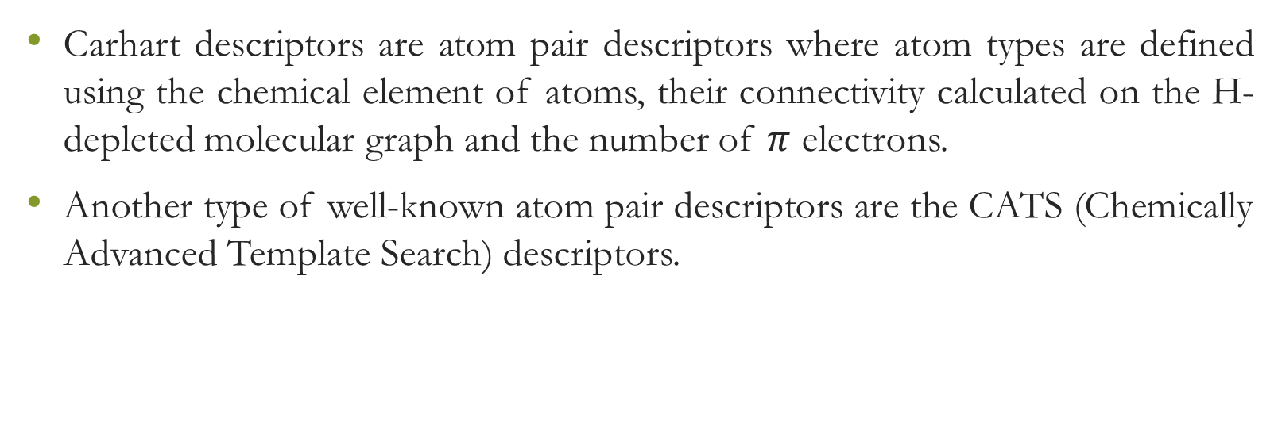
Carhart descriptors are atom pair descriptors where atom types are defined using the chemical element of atoms, their connectivity calculated on the H-depleted molecular graph and the number of $π$ electrons.
Another type of well-known atom pair descriptors are the CATS (Chemically Advanced Template Search) descriptors.

Slide 76
The atom-type definition in CATS is related to the concept of “potential pharmacophore points” (PPP), where a PPP is a generalized atom type defined considering some physicochemical aspects.
Five PPP have been originally proposed for the calculation of CATS: hydrogen-bond donor (D), hydrogen-bond acceptor (A), positive (P), negative (N), and lipophilic (L).

Slide 77
The relative scaling, using the sum of the occurrences of the PPP, highlights rare PPP considering them as possible important contributors of the pharmacophoric aspect of the molecules with respect to abundant PPP pairs like the lipophilic atom types.
Three-dimensional autocorrelation descriptors are based on Euclidean interatomic distances, while the property is still defined as an atomic property.

Slide 78
Geometrical Descriptors: - Geometrical descriptors are those molecular descriptors calculated taking into account the three-dimensional structure of the molecule, i.e., the position of the atoms in the three-dimensional space.
Two most commonly known classes of three-dimensional descriptors are the WHIM (Weighted Holistic Invariant Molecular) descriptors and the GETAWAY (Geometry, Topology, and Atom-Weights Assembly) descriptors.

Slide 79
WHIM descriptors encode three-dimensional information on size, shape, symmetry, and atomic property distribution.
WHIM descriptors are invariant to roto-translation: they are invariant to translation as a result of the centering of the atomic coordinates and to rotation as long as the principal axes are unique.
Directional WHIM descriptors consider the three eigenvalues separately providing information on the molecular size, shape, density, and symmetry along the principal axis, while global WHIM descriptors consider the relationships among the eigenvalues to describe molecular properties along the three principal directions in the molecule.

Slide 80
GETAWAY descriptors are three-dimensional descriptors that encode information about the influence that each atom has in determining the whole shape in the molecule and evaluate the interactions among atoms with respect to their geometrical position in the three-dimensional space.

Slide 81
Structural Keys and Molecular Fingerprints: - structural keys and molecular fingerprints try to describe a chemical capturing different local aspect of a molecular structure. Specifically, these approaches identify a set of structural fragments participating in the molecule composition.
Structural keys are a predefined set of structural features, atom pairs, functional groups, ring systems, and atom-centered fragments that have been prepared in order to be able to discriminate among molecules and eventually be able to highlight chemical properties of a molecule.

Slide 82
The most known structural keys are the two sets of MACCS keys comprising 960 and 166 structural features, respectively, and the PubChem structural keys, which include 881 bits reflecting the presence or absence of 881 structural features.
The molecular fingerprints are identified exploding the molecular structure in all possible substructure patterns following a set of rules.

Slide 83
Two major types of patterns can be identified: paths and atom centered, also known as circular patterns. Then two classes of fingerprints can be calculated, path and extended connectivity fingerprint, also known as Morgan or circular fingerprint.
The first parameter to be set once the type of fingerprint has been defined is the maximum path length or the maximum radius of the patterns to be identified. Then, additional options can be set in order to increase or decrease the discrimination power of substructures.

Slide 84
A hash function is any function that can be used to reduce a variable-length Boolean vector to a fixed-length one.
Fingerprint hashing is introduced when it is not possible to assign a particular bit to each pattern, as for structural keys, due to the huge number of possible identifiable patterns.
Hashing functions enable the definition of a fixed-length vector but introduce the so-called bit collision; this means that, under a predefined set of rules, a specific fragment will always be associated to a defined set of bits in the fingerprint, but two different fragments may share one or more bits among their bit sets.

Slide 85
It is quite recent, and now able to provide solid answers to real problems. Molecular descriptors theory is facing new challenges requiring both chemical and mathematical skills. The description of structures not considered before, like disconnected structures and nanomaterials, is one of these challenges.
One of the challenges that molecular modeling is facing is the capability to be applied not only on small organic molecules but also on different kinds of chemicals, like disconnected structures.

Slide 86
Molecular Descriptors for Nanostructures: - Nanomaterials are usually defined as those materials of which a single unit size is between 1 and 100 nanometers. QSAR applied to nanomaterials, named nano-QSAR or QNAR (quantitative nanostructure-activity relationships), is an emerging research field whose preliminary steps have been moved.

Slide 87
Mold², Molecular Descriptors from 2D Structures for Chemoinformatics and Toxicoinformatics

Slide 88
The Mold² software was developed to enable the rapid calculation of a large and diverse set of descriptors encoding two-dimensional chemical structure information.
Molecular descriptors are used to extract the structural information in the form of numerical or digital representation that is suitable for model development, serving as the bridge between the molecular structures and physicochemical properties or biological activities of chemicals.

Slide 89
Mold² molecular descriptors are easily and quickly calculated with no missing values, a common problem with most existing commercial systems.
MOLD² DESCRIPTORS: - 1D molecular descriptors present bulk properties of compounds, such as the number of specific atoms, molecular weight, etc., and can be calculated solely on a molecular formula.
2D molecular descriptors present structural information that can be computed from 2D structure of a molecule, such as the number of benzene rings, the number of hydrogen bond donors, etc.

Slide 90
3D molecular descriptors present structural information that has to be derived from 3D representation of a molecule, such as solvent accessible surface area with positive partial charge in the structure.
The 1D descriptors are calculated solely based on the molecular formula. The atom counts include numbers of different atoms and the total number of atoms in the molecule. The physicochemical properties are molecular weight and average molecular weight.

Slide 91
The 2D descriptors are calculated from the 2D structure of a molecule, though some of them such as lop and fragment counts are called 1D descriptors.
Types of carbon atoms in the 2D descriptors are distinguished based on hybridization status, such as primary carbon, tertiary carbon on ring structure, unsubstituted aromatic carbon, and so on.
Descriptors such as the cyclicity index and average cyclicity index are part of the detour index that is calculated from the detour distance matrix of a molecule.

Slide 92
Descriptors extracted from the eigenvalues of an adjacent matrix and other matrices of a molecule are classified into the group of eigenvalue-based descriptors, including the Lovasz-Pelikan index, the folding degree index, the characteristic root index, and so on.
Descriptors related to molecular walk counts are calculated based on the graph walks. They are extracted from the adjacency matrix of a molecule. Total walk count, weighted walk degrees, and walk connectivity indices are examples.

Slide 93
Descriptors related to the topological charge index are derived from the adjacency matrix and distance matrix of a molecule.
The Wiener index was firstly defined only for acyclic graphs. The Wiener index descriptors in Mold² are derived from the Wiener matrix modified from the distance matrix of a molecule.
Generation of Mold² Descriptors: - Mold2 accepts an SDfile of the molecules for which descriptors are to be calculated. Other formats for representing molecular structure have to be converted to an SDfile format for use by Mold².

Slide 94
The main part of Mold2 is a module for computing the 779 descriptors. A set of generalized functions is used to speed up calculations. Among the most important ones is a module for the perception of the smallest set of smallest rings (SSSR) that is adopted from a previously reported algorithm.
After, all 779 molecular descriptors for a molecule are calculated, results are output to a file; molecules are serially processed until all molecules in the SDfile are processed

Slide 95
Evaluation of Mold² Descriptors: - There are three ways of evaluating the utility of descriptors. The first is to assess information that is presented in a data set represented by a set of descriptors.
In general, higher variance in the descriptors corresponds to a high probability of developing a valid model using the descriptors.
The second is to make sure that there are not any redundant descriptors and not many highly correlated descriptors.

Slide 96
The third is with a comparative analysis of sets of descriptors when the same modeling approach is applied to the same data set; the differences in modeling results can then be used to differentiate the efficacy of two sets of descriptors.
Shannon entropy analysis was conducted for comparing Mold² descriptors with three sets. First, descriptors nor having a value across all the chemicals in a data set were discarded.

Slide 97
Next, descriptors were binned for each descriptor in the data sets and the probability distribution calculated using 20 even bins that spread from the minimum to the maximum values of the descriptor.
Lastly, the comparison of descriptor sets was done assuming that mean Shannon entropy was proportional to the average information encoded in different sets of descriptors for the same data set.

Slide 98
The distribution of Shannon entropy is another important property of the descriptors, as it is expected that the higher entropy descriptors are, the better a data set is represented by the descriptors.
Correlations between Descriptors: - if it is not preferable that there are many redundant or highly correlated descriptors in a set of descriptors. Correlation coefficients (r) between the descriptors in each of the compared descriptor’s sets were calculated for the four data sets.
The weak correlations (0.25 < r² < 1) are less than 15% for all the compared descriptors sets in all the data sets. The high correlations (r² > 0.8) are less than 1%.

Slide 99
Ten-fold cross-validation was used, where the data set was first randomly divided into ten equal portions, and each portion was then successively excluded from the training set and predicted by the model developed from the remaining nine portions.
The 10-fold cross-validation was repeated 100 times to achieve a statistically unbiased estimation of predictive accuracy, sensitivity, and specificity.

Slide 100
PaDEL-Descriptor: An Open Source Software to Calculate Molecular Descriptors and Fingerprints

Slide 101
PaDEL-Descriptor is a software for calculating molecular descriptors and fingerprints. It calculates 797 descriptors and 10 types of fingerprints.
PaDEL-Descriptor was developed using the java language and consists of a library component and an interface component. The software uses a Master/Worker pattern to take advantage of the multiple CPU cores that are present in most modern computers to speed up calculations of molecular descriptors.

Slide 102
A good descriptor calculation software should posses most of the following features:
Free or cheap to purchase so that is easily available to researchers.
Open source so that researchers could add in their own descriptor calculation algorithm
Has a graphical user interface (GUI) for easy usage and a command line version to allow the software to run in computer clusters through a software to run in computer clusters through a software job scheduler.
Able to work on multiple platforms such as Windows, Linux, and MacOS.
Able to calculate many types of descriptors.

Slide 103
The PaDEL-Descriptor has two component- a library component and an interface component. The library component is self-contained and it can be easily integrated into other QSAR software to provide the descriptor calculation feature.
The library component also included 4 molecular descriptors and three fingerprint algorithms. These include atom type electrotopological state descriptors, McGowan volume, molecular linear free energy relation descriptors, ring counts, count of chemical substructures identified by Laggner, and binary fingerprints and count of chemical substructures identified by Klekota and Roth.

Slide 104
The master thread starts the calculation process by reading molecular files and creates a job description for each molecule.
The jobs are added to a shared job queue and each worker thread will retrieve a job from the shared job queue and calculates the descriptors and fingerprints for the molecule specified in the job descriptors.
The Master thread also provides functions to set the type of preprocessing tasks to be done, the type of descriptors and fingerprints to calculate, and the number of worker threads.

Slide 105
The only disadvantage of PaDEL-Descriptor is that it does not calculate as many descriptors as some software like DRAGON, MODEL, Molconn-Z, and PreADMET Descriptor.
Conclusion: - it is a multithreaded software which make full use of the multiple CPU cores in modern desktop computers to increases the speed of calculation of molecular descriptors.

Slide 106
Improving Chemical Autoencoder Latent Space and Molecular De-novo Generation Diversity with Heteroencoders

Slide 107
Chemical autoencoders are attractive models as they combine chemical space navigation with possibilities for de-novo molecule generation in areas of interest.
Using the output from the bottleneck in QSAR modelling of five molecular datasets shows that heteroencoder derived vectors markedly outperforms autoencoder derived vectors as well as models built using ECFP4 fingerprints, underlining the increased chemical relevance of the latent space.

Slide 108
The encoder compresses and changes the input information into a bottleneck layer and a decoder decoder part recreates the original input from the compressed vector representation.
The issue which autoencoder based on SMILES strings is that is the latent space a representation of the molecules or is it a condensed representation of the SMILES strings representing the molecules?
One way to solve this challenge could be to use special engineered networks and graph-based approaches for molecular generation.

Slide 109
By translating from one format or representation of the molecule to the other, the encoder-decoder network is forced to identify the latent information behind both representations.
An optimized and expanded heteroncoder architectures trained on ChEMBL23 datasets are used to extract latent vectors for subsequent use an input to QSAR models of five different molecular datasets.
These datasets are: - GDB-8, ChEMBL23, QSAR datasets (for QSAR four dataset IGC50, BDF, MP, LD50 have downloaded).

Slide 110
1D and 2D Vectorization – vectorization was done similar to the vectorization used in Chemception networks with the following modifications: A PCA with three principal components was calculated on atomic properties from the Mendeleev python package.
Neural Network Modeling for GDB-8 Dataset – the final internal memory (c) and hidden layer (H) states were concatenated and used as input to a dense layer of 64 neurons with the rectified linear unit activation function (ReLU).

Slide 111
After training in batch mode, three models were created from the parts of the full model. A decoder model from the initial input to the output of the bottleneck layer. A model to calculate the initial states of the LSTM cells in the decoder, given the output of the bottleneck. Lastly, a stateful decoder model was constructed by creating a model with the exact same architecture as the decoder in the full model, except the LSTM cells were used in stateful mode and the input vector reduced to a size of one in the sequence dimension.

Slide 112
Similarity metrics – SMILES strings sequence similarities were calculated as the alignment score reported by the pairwise global alignment algorithm of the Biopython package.
Enumeration Challenge – the encoder was used to calculate the latent space of the test set, the latent space coordinates of the non-canonical SMILES were calculated with the encoder and transformed and projected onto the visualization of the principal components from the PCA analysis.

Slide 113
QSAR Modeling – QSAR modelling was performed using the machine learning capabilities of the Open Science Data Repository. The hyper parameter search for a neural network was performed using Tree of Parzen Estimators algorithm as implemented in Hyperopt with the search space bounds.
Results – GDB-8 dataset-based models: - the models trained on enumerated SMILES output have a markedly larger final loss, but all models show a low degree of malformed SMILES when sampling the latent space vectors calculated from the test set.

Slide 114
Molecular and sequence similarity: - Morgan fingerprints and sequence alignment scores, followed by calculation of SMILES alignments coefficients (R²).
Both the sequence alignment score and the fingerprint-based similarity have correlation with the latent space similarity, which shows that the latent space is at least somehow related to our traditional understanding of similarities between molecules.

Slide 115
The models with a decoder trained on canonical SMILES show a markedly larger correlation between the latent space and the SMILES sequence similarity metric than between the fingerprint-based similarity and the latent space.
Error analysis: - the use of enumeration in the input and output significantly increases the percentage of the outputs where the decoded molecule is not the same as the encode molecule.

Slide 116
Training the encoder with enumerated SMILES strings gives the tightest clustering, showing that the encoder has learned to recognize the same molecule independent on actual serialization of the SMILES string.
The researchers observed that approximately 40% of the neurons of the bottleneck layer for each configuration are never activated.
Discussion: - The model could in principle memorized all graph structure instead of learning the rules behind the graph scaffolds, and then simply assign a specific sequence of atoms to the memorized graph.

Slide 117
The model trained on enumerated data may have struggled because of low neural network fitting capacity.
With heteroencoders the molecule reconstruction rate becomes a more relevant term to measure than the SMILES validity rate, as the former can diverge a lot, while the SMILES validity error rate is still low.
The image to sequence model produces a very low percentage of invalid SMILES and also has a low error rate with respect to molecule reconstruction, but is also decoding to canonical SMILES, which is an easier task then decoding to enumerated SMILES.

Slide 118
The heteroencoder architecture may be useful for architecture experiments with large unlabeled datasets to find better architectures and suitable deep learning feature extractions for training on 2D embeddings of molecules.
Using enumeration techniques or other formats for the decoder will influence that latent space the most.
Training autoencoder on enumerated or different data further seems to improve the latent space with respect to its relevance for QSAR modelling.

Slide 119
Conclusion: - The canonical SMILES for the decoder give a latent space representation which seem closer correlated to the SMILES strings than the molecular graphs.
The latent space properties were mostly found to be influenced by the choice of training data and representations used as the decoder targets.
The improved performance when using the latent space vectors from heteroencoders for QSAR modelling, further emphasizes their increased relevance, not just being a more SMILES independent representation of the molecule, but also for a better description of the chemical space relevant for biological as well as physico-chemical properties.

Slide 120
Junction Tree Variational Autoencoder for Molecular Graph Generation

Slide 121
The researcher’s junction tree variational autoencoder generates molecular graphs in two phases, in first it generates a tree-structured scaffold over chemical substructures and then combines them into a molecule with a graph message passing network.
The researchers decomposed the challenge into two complementary subtasks: learning to represent molecules in a continuous manner that facilitates the prediction and optimization of their properties; and learning to map an optimized continuous representation back into a molecular graph with improved properties.

Slide 122
Prior designs have two critical limitations, first, the SMILES representations are not designed to capture molecular similarity. Second, essential chemical properties such as molecule validity are easier to express on graphs rather than in linear SMILES representations.
The researchers hypothesize that operating directly on graphs improves the generative modeling of valid chemical structures.

Slide 123
Junction Tree Variational Autoencoder: - the researchers’ model extends the variational autoencoder to molecular graphs by introducing a suitable encoder and a matching decoder.
The key advantage of this view is that the decoder can realize a valid component and how they interact, rather than trying to build the molecule atom by atom through chemically invalid intermediaries.

Slide 124
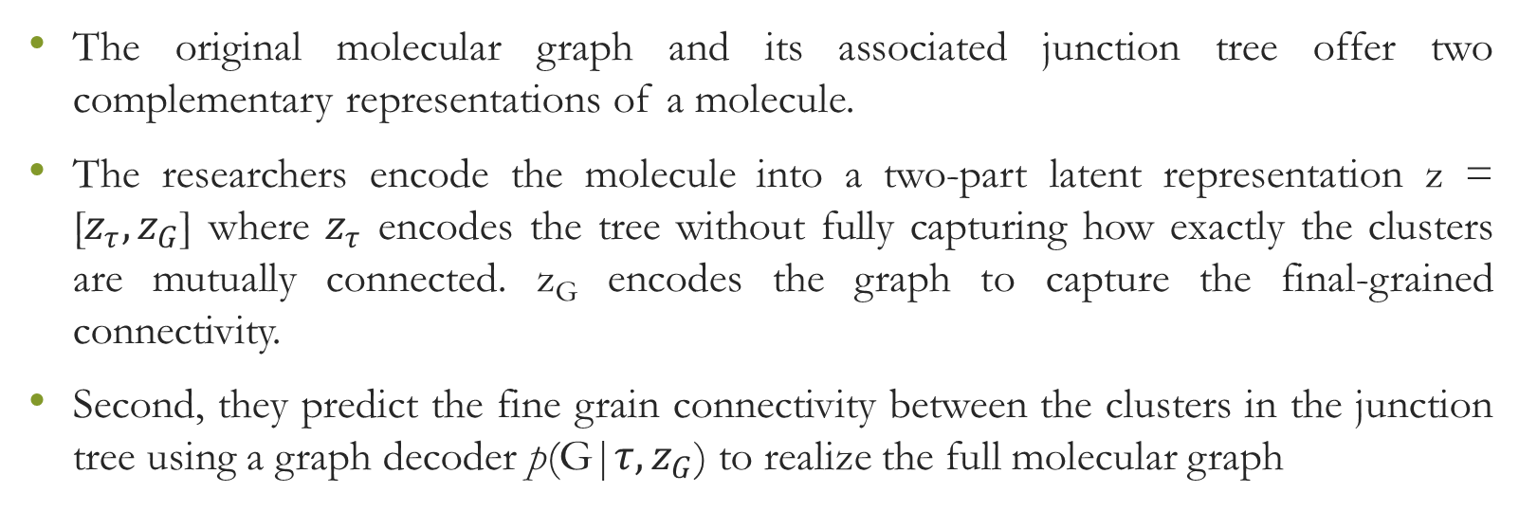
The original molecular graph and its associated junction tree offer two complementary representations of a molecule.
The researchers encode the molecule into a two-part latent representation z = [$z_{τ},z_{G}$] where $z_{τ}$ encodes the tree without fully capturing how exactly the clusters are mutually connected. z_{G} encodes the graph to capture the final-grained connectivity.
Second, they predict the fine grain connectivity between the clusters in the junction tree using a graph decoder p(G|$τ, z_{G}$) to realize the full molecular graph

Slide 125
Junction Tree: - A tree decomposition maps a graph G into a junction tree by contracting certain vertices into a single node so that G becomes cycle-free.
They first find all the simple cycles, of graph G, and its edges not belonging to any cycles.
Two simple rings are merged if they have more than two overlapping atoms, as they constitute a specific structure called bridged compounds.
Next, a cluster graph is constructed by adding edges between all intersecting clusters.

Slide 126
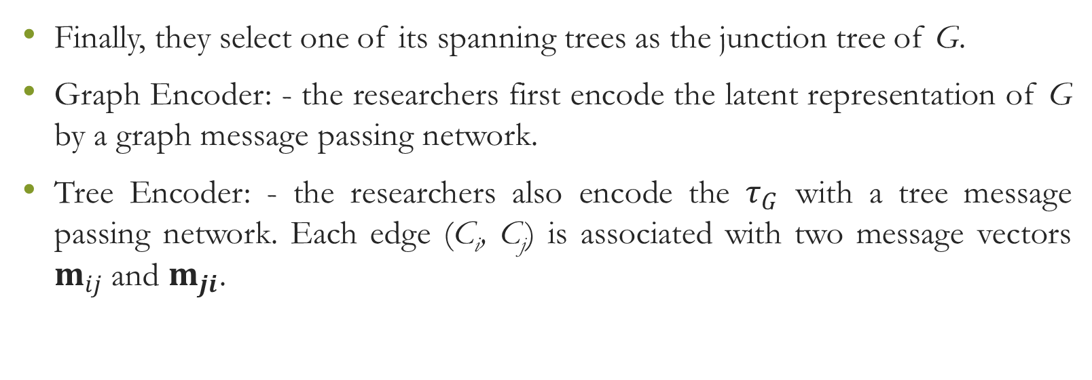
Finally, they select one of its spanning trees as the junction tree of G.
Graph Encoder: - the researchers first encode the latent representation of G by a graph message passing network.
Tree Encoder: - the researchers also encode the $τ_{G}$ with a tree message passing network. Each edge (C_{i}, C_{j}) is associated with two message vectors $m_{ij}$ and $m_{ji}$.

Slide 127
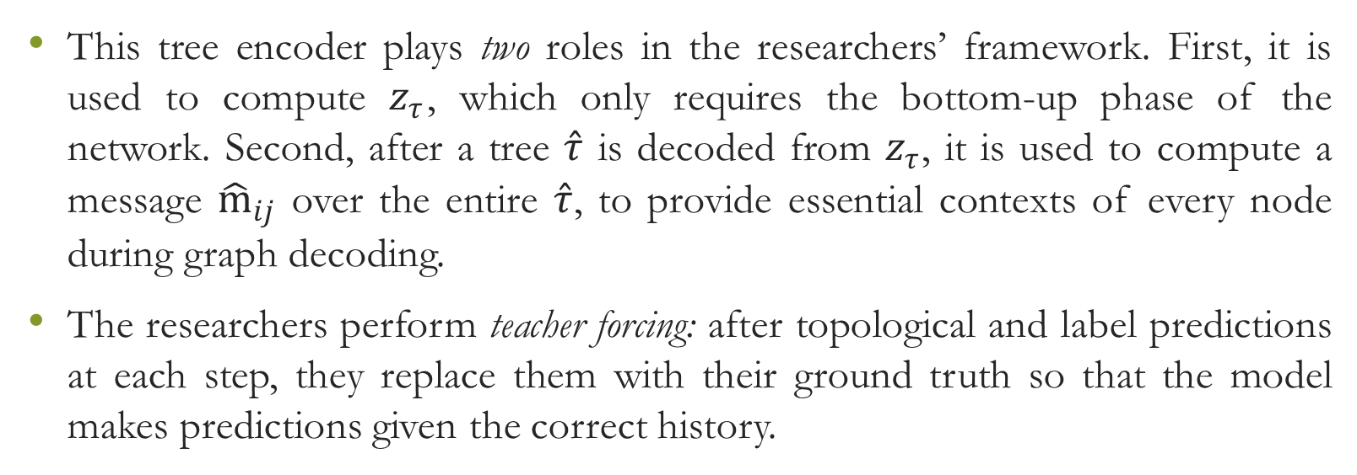
This tree encoder plays two roles in the researchers’ framework. First, it is used to compute $z_{τ}$, which only requires the bottom-up phase of the network. Second, after a tree $\hat{τ}$ is decoded from $z_{τ}$, it is used to compute a message ${\hat{m}}_{ij}$ over the entire $\hat{τ}$, to provide essential contexts of every node during graph decoding.
The researchers perform teacher forcing: after topological and label predictions at each step, they replace them with their ground truth so that the model makes predictions given the correct history.

Slide 129
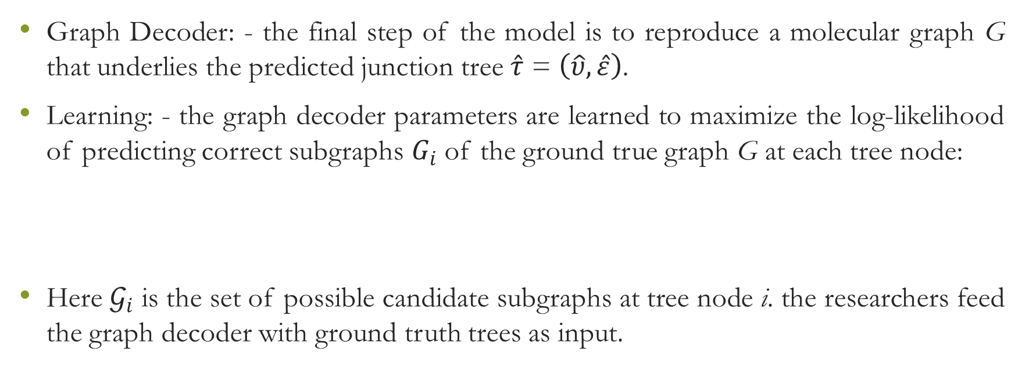
Graph Decoder: - the final step of the model is to reproduce a molecular graph G that underlies the predicted junction tree $\hat{τ}$ = $\left(\hat{υ},\hat{ε}\right)$.
Learning: - the graph decoder parameters are learned to maximize the log-likelihood of predicting correct subgraphs $G_{i}$ of the ground true graph G at each tree node:
Here $𝒢_{i}$ is the set of possible candidate subgraphs at tree node i. the researchers feed the graph decoder with ground truth trees as input.

Slide 130
Bayesian optimization: - the researchers test how the model can produce novel molecules with desired properties. They perform Bayesian optimization in the latent space to search for molecules with specified properties.
Constrained molecule optimization: - it modifies the given molecules to improve specified properties while constraining the degree of deviation from the original molecule.

Slide 131
Data: - the researchers use the ZINC molecule dataset for their experiment.
Baseline: - they compare their approach with a SMILES-based baseline, (1) Chapter VAE (CVAE) which generates SMILES strings character by character; (2) Grammar VAE (GVAE) that generates SMILES following syntactic constraints given by a context-free grammar; (3) Syntax-directed VAE (SD-VAE) that incorporates both syntactic and semantic constraints of SMILES via attribute grammar.

Slide 132
For molecular generation task, they compare with Graph VAE which directly generates atom labels and adjacency matrices of graphs, as well as an LSTM-based autoregressive model that generates molecular graphs atom by atom.
The encoding and decoding process is stochastic, and the researchers estimate reconstruction accuracy by the Monte Carlo method: each molecule is encoded 10 times and each encoding is decoded 10 times.

Slide 133
The researcher’s model shows that their neighborhood does not contain molecules with huge rings, which rarely occur in the dataset.
They also highlight two groups of closely resembling molecules that have identical tree structures but vary only in how clusters are attached.
To perform the Bayesian optimization (BO), the researchers first train a VAE and associate each molecule with a latent vector, given by the mean of the variational encoding distribution.

Slide 134
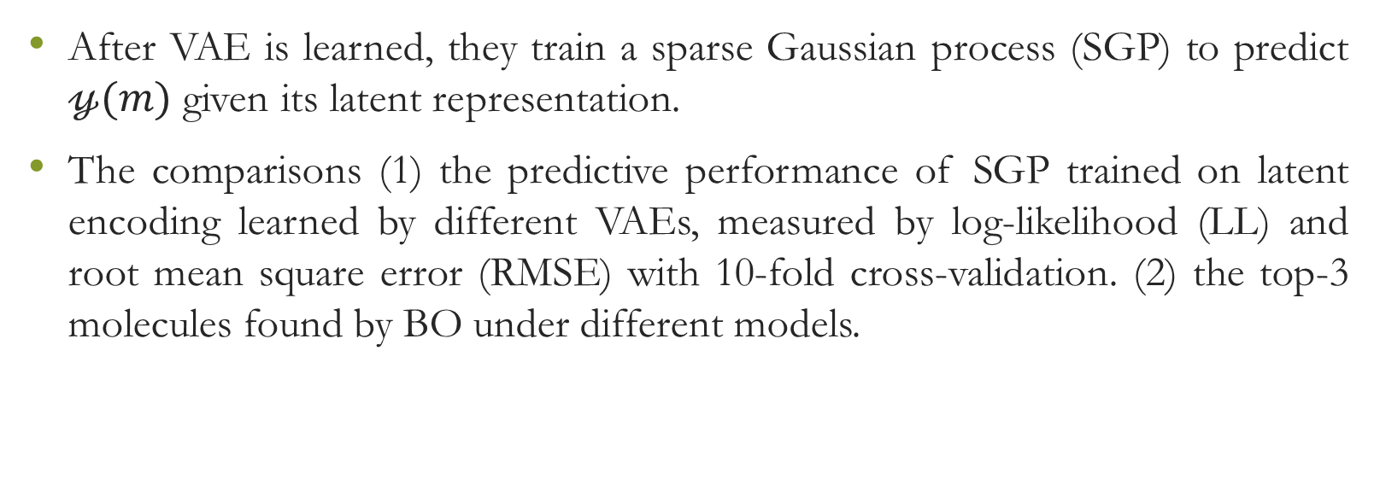
After VAE is learned, they train a sparse Gaussian process (SGP) to predict $𝓎(m)$ given its latent representation.
The comparisons (1) the predictive performance of SGP trained on latent encoding learned by different VAEs, measured by log-likelihood (LL) and root mean square error (RMSE) with 10-fold cross-validation. (2) the top-3 molecules found by BO under different models.

Slide 135
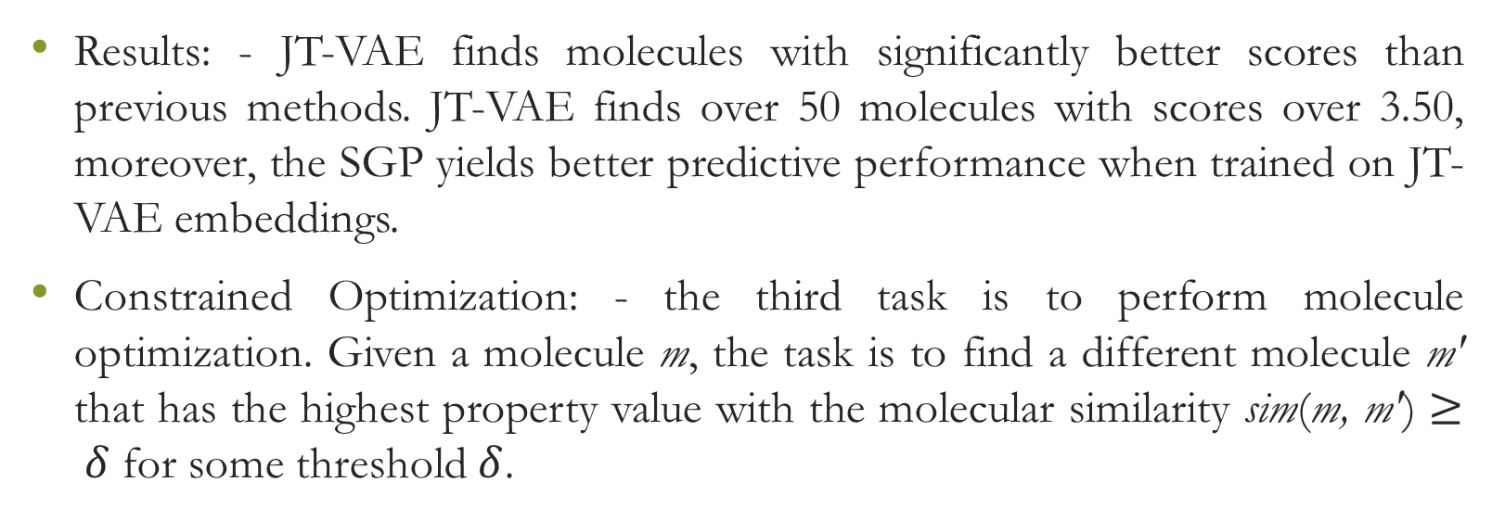
Results: - JT-VAE finds molecules with significantly better scores than previous methods. JT-VAE finds over 50 molecules with scores over 3.50, moreover, the SGP yields better predictive performance when trained on JT-VAE embeddings.
Constrained Optimization: - the third task is to perform molecule optimization. Given a molecule m, the task is to find a different molecule mʹ that has the highest property value with the molecular similarity sim(m, mʹ) $≥ δ$ for some threshold $δ$.

Slide 136
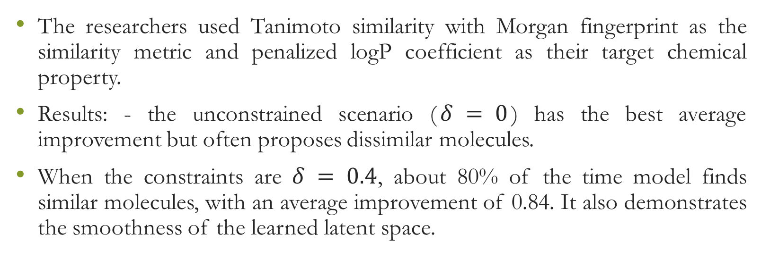
The researchers used Tanimoto similarity with Morgan fingerprint as the similarity metric and penalized logP coefficient as their target chemical property.
Results: - the unconstrained scenario ($δ = 0$) has the best average improvement but often proposes dissimilar molecules.
When the constraints are $δ = 0.4$, about 80% of the time model finds similar molecules, with an average improvement of 0.84. It also demonstrates the smoothness of the learned latent space.

Slide 137
Deep mining heterogeneous networks of biomedical lined data to predict novel drug-target associations

Slide 138
Deep learning reveals feature of vertices of a large network that can be adapted in accommodating the similarity-based solution to provide of a large network that can be adapted in accommodating the similarity-based solutions to provide a flexible method of drug-target prediction.
The researchers proposed a similarity-based drug-target prediction method that enhances existing association discovery methods by using a topology-based similarities measure.

Slide 139
DeepWalk is a deep learning method, is adopted in the study to calculate the similarities within Linked Tripartite Network (LTN), a heterogeneous network generated from biomedical linked datasets.
After utilizing the DeepWalk they demonstrate that: (i) this method outperforms other existing topology-based similarity computation methods, (ii) the performance is better for tripartite than with bipartite networks and (iii) the measure of similarity using network topology outperforms the ones derived from chemical structure (drugs) or genomic sequence (targets).

Slide 140
The recent development in chemical databases present challenges to the researchers, to overcome these limitations, researchers have to adopt diverse machine learning methods, such as classification methods, and rule-based inference methods to predict drug-target associations.
Similarity measure are fundamental to these methodologies. For example, the similarity measures of drug-drug and target-target pairs can be utilized for the weighting of potential associations, or to generate distinct kernel functions to train the different classification models.

Slide 141
Topology-based methods are incapable of computing the topological similarities between biological entities; they cannot be reused and adapted in the existing similarity-based methods.
The researchers propose a DeepWalk, to calculate the similarities for drug-drug and target-target pairs based on the topology of heterogeneous network named Tripartite Linked Network (TLN), derived from the existing linked open datasets in biomedical domain.

Slide 142
The researchers evaluate their method in following benchmark: -
Performance of a deep learning method compared to other topology-based similarity methods,
Value of multipartite (tripartite) network over bipartite networks and
Performance of topology-based similarity method over the ones relying on chemical structure and genomic sequence.

Slide 143
The drug-target prediction method researchers propose is based on the topology of multipartite network of the existing drugs and protein targets.
The association discovery pipeline can be separated into three steps: (i) Data preparation and benchmarking, (ii) similarity learning and (iii) association discovery.

Slide 144
At start, a multipartite network which contain the topological interactions of the existing drugs and targets is constructed with the biomedical linked data.
After that the similarity scores of the drug-drug and target-target pairs are learned based on the topology of the network.
At, last new drugs-target associations are discovered and evaluated based on these similarities.

Slide 145
The researchers take data from DrugBank.
To create the LTN, they extracted the diseases, drug-disease and disease-gene associations from a human disease network named Diseasome, and merged these associations with the bipartite network they obtained from DrugBank.
The disease-target association was created by mapping targets of DrugBank to the genes of the disease-gene associations in Diseasome based on Bio2rdf, Uniprot, HGNC and OMIM.

Slide 146
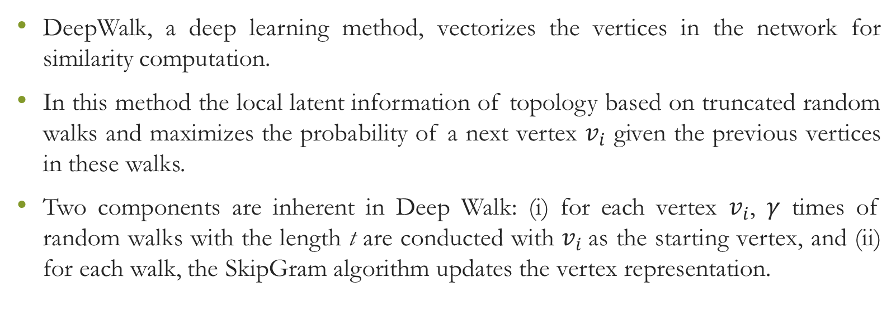
DeepWalk, a deep learning method, vectorizes the vertices in the network for similarity computation.
In this method the local latent information of topology based on truncated random walks and maximizes the probability of a next vertex $v_{i}$ given the previous vertices in these walks.
Two components are inherent in Deep Walk: (i) for each vertex $v_{i}$, $γ$ times of random walks with the length t are conducted with $v_{i}$as the starting vertex, and (ii) for each walk, the SkipGram algorithm updates the vertex representation.

Slide 147
The researchers adapted two popular rule-based inference methods, drug-based similarity inference (DBSI) and target-based similarity inference (TBSI), to discover the drug-target associations with the similarities.
The researchers evaluated the predictions using three kinds of validation methods based on internal and external references.
For internal validation, they implemented a 10-fold cross-validation, where conventionally a dataset is partitioned into 10 subsets: 1 for testing and 9 for training.

Slide 148
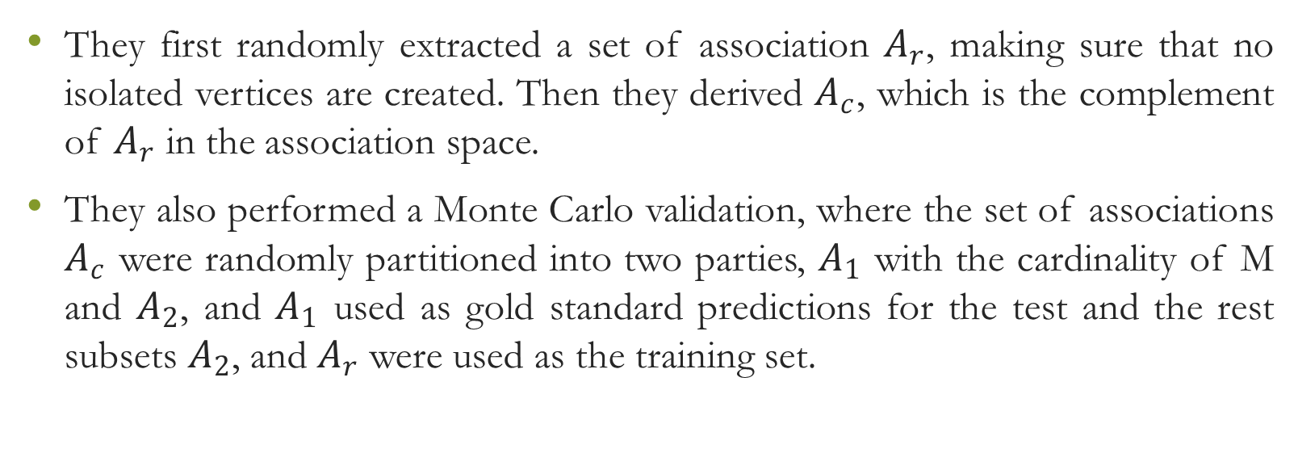
They first randomly extracted a set of association $A_{r}$, making sure that no isolated vertices are created. Then they derived $A_{c}$, which is the complement of $A_{r}$ in the association space.
They also performed a Monte Carlo validation, where the set of associations $A_{c}$ were randomly partitioned into two parties, $A_{1}$ with the cardinality of M and $A_{2}$, and $A_{1}$ used as gold standard predictions for the test and the rest subsets $A_{2}$, and $A_{r}$ were used as the training set.

Slide 149
For the validation with the external reference, they used the whole dataset as their training set and validated the predictions with the newly discovered drug-target associations.
Results: - the researchers compute six association indices used for similarity computation in bipartite networks, which were Jaccard, Simpson, Geometric, Cosine, Pearson Correlation Coefficient (PCC) and Hypergeometric, and compared them with the DeepWalk results.

Slide 150
They also observed that DeepWalk performed best when the top 500 and 1000 predicted associations were considered; other methods performed best with top 10, 20, 50, 100 predicted associations.
To check the performance of the DeepWalk the researchers applied both bi- and tripartite networks, SimRank and Line.
SimRank computes vertex similarity with the structural context in a network based on a graph-theoretic mode and is applicable in any domain with object-to-object relationships.

Slide 151
Line is a graph embedding method that represents the vertices in a network structure, local and global, to capture the first-order proximity and second-order proximity between the vertices.
The researchers used two variants of Line obtained, Line (1st) and Line (2nd), which utilizes first-order and second-order proximity respectively.

Slide 152
Tripartite networks improved DeepWalk’s performance: from 84.23% to 87.83% with DBSI and from 85.75% to 90.31% with TSBI in the ten-fold validation; from 83.86% to 86.41% with DBSI and from 82.94% to 86.23% with TSBI in the external source-validation.
They observed that DeepWalk achieved the best RF scores in all top K (except 5%) percentage and top N (500 and above) predicted associations.

Slide 153
In order to determine the respective influence of drug-disease and disease-target associations in the tripartite network, they partitioned the network into two main components: (i) fully connected, and (ii) partially connected component, to generate training and test sets of associations.

Slide 154
Two types of pairs were analyzed based on the contribution to DBSI and TBSI models in prediction: (i) positive pairs, which similarity is used to predict true drug-target associations, and (ii) negative pairs, which lack of similarity is used to confirm false drug-target associations.
Testing the influence of the data richness required performing a Monte Carlo cross-validation, where M drug-target associations were randomly removed from the bipartite and tripartite networks as validation data and the remained data were used for training, respectively.

Slide 155
The drug-target associations contributed both to the similarity computation and association discovery methods, while the drug-disease and disease-target associations contributed only to the similarity computation

Slide 156
They designed three types of removal strategies: - (i) ‘drug-target removed’: removing drug-target associations while preserving all the vertices connected, thus without creating isolated drug vertices or isolated target vertices. (ii) ‘disease conserved’ which removed drug-disease or disease-target associations without isolating disease from the drugs and targets. (iii) ‘disease conserved’ which removed drug-disease or disease-target associations without consideration of keeping diseases connected after the removal.

Slide 157
The DeepWalk has some limitations they are - the proposed method can predict the associations between the drugs and targets that exists within the network, but may not predict new drugs or targets in some practice use scenarios.
Secondly, compared to DeepWalk, the traditional topology-based method, SimRank, shows potential for top N predictions, which can serve as an alternative method for these prediction efforts.

Slide 158
In conclusion, we can say that the propose method assembles the similarity measure with the rule-based inference methods, DBSI and TBSI, for drug-target prediction.

