Slide 1
Predicting Solubility of Chemical Compounds Computationally: An Ensemble Approach Using QSAR Models

Slide 2
The biopharmaceutical classification system (BCS) is a classification system which divides drugs into four classes based on their solubility and permeability.
Class I drugs are orally available; these are soluble and permeable drug. There oral bioavailability is marked by their ability to reach the absorption sites.
In next category is where the oral bioavailability is limited by gastrointestinal tract (GI) because of the barrier properties, constitutes the class III of drugs which are soluble and poorly permeable.
The last category, drugs have the limitations held by classes II and III, these are low on solubility and poorly permeable.

Slide 3
Temperature is also very important in relationship with solubility.
If we are able to determine solubility characteristic at a proportionate rate, we will be able to identify the soluble and more efficient drug candidates.

Slide 4
Higuchi and connors proposed shake-flask method. It is most authentic and extensively used thermodynamic method. It follows five steps: -
Preparation of sample
Equilibrium
Phases separation
Analysis of saturated solution and the excess solid
Data Analysis

Slide 5
Preparation of Sample: - An excess amount of drug is added to the solubility medium. The amount should be added carefully in a way to make the solution saturated at equilibrium with the solid phase.
Equilibrium: - equilibrium is affected by the dissolution rate and the type of agitation. For any drug, maximum window to reach equilibrium is 24 hours.
Phase Separation: - for phase separation two popularly used methods are centrifugation and filtration. Dissolution profile of the drug is important for equation.

Slide 6
Analysis of saturated solution and the excess solid: - for solubility determination, UV spectrophotometric analysis is an easy analytical method. Other than this, high-performance liquid chromatography (HPLC) acts in isocratic and gradient elution mode.
Data Analysis: - it is a very important step. Solubility is a very sensitive property. It will get affected by any uncalibrated, any temperature variation etc. will result in unusual solubility value for a given drug for a given solvent at a given temperature.

Slide 7
A flow injection analysis (FIA) was also analyses, this can be accounted as a semithermodynamic method in which a predissolved drug is poised for problems with phosphate buffer overnight prior to the analysis.
Mathematical models take decisions based either on the theoretical inspection or thermodynamics on how the constituent molecules interact in fluid solution or solid state, or they can be empirical in nature.

Slide 8


A solution obeying Raoults law is known as an ideal solution and enthalpy of fusion of solute (Δ$H_{m}^{f}$) and $∆C_{p}$ (the difference of the heat capacities of this solid and its supercooled liquid) can give its solubility using the Hilderbrand and Scott equation expressed as

Slide 9

Here X = mole fraction solubility at temperature T
$T_{m}$ = melting point of the solute
$∆C_{p}$ = $C_{p}^{1}, C_{p}^{s}, where C_{p}^{1}$ = model heat capacities of the liquid and
$C_{p}^{s}$ = model heat capacities of the solid forms, respectively

Slide 10
Kennedy and coworkers suggested that bad pharmacokinetics with poor physiological conditions will result in expensive later-stage in drug discovery.
They observed that due to issues in pharmacokinetics 40% of the drug discovery programs are abandoned.
Rafael and others used FDAMDD and PHYSPROP databases to select the properties of compounds that can help them predict if a given compound is drug-like or not.
Computational chemistry is used when a mathematical method is sufficiently well developed such that it can be automated for implementation on a computer.

Slide 11
There are two different aspects to computation chemistry:
Computational studies try to find the beginning point for a laboratory synthesis, or to help in understanding the experimental data. It used to predict the possibility of till now unknown molecule or explore reaction mechanisms not readily studied via experiments.
Several major areas may be distinguished within computational chemistry: the prediction of the molecular structure of molecules by the use of the simulation of forces, or more accurate quantum chemical methods, to find stationary points on the energy surface as the position of the nuclei is varied.

Slide 12
The main problem with design of oral drugs lies in their bioavailability. This bioavailability is further dependent on many factors like, drug permeability, dissolution rate, aqueous solubility, presystemic metabolism, first-pass metabolism etc.
Knowing the solubility of the compounds is an important aspect for process of drug formulation too. It is affected by many factors: -
Polarity
Temperature
Pressure

Slide 13
Following are the gaps that are identified during literature survey: -
Thermodynamic methods are not attrainable in early phase of drug discovery because of the requirement of large samples, laboratory-based sample preparation and low throughput levels.
Kinetic solubility methods cannot completely substitute method of thermodynamic determination. Kinetic method involves the drug to be dissolved in dimethyl sulfoxide (DMSO). During dissolving, the drug tends to lose its lattice energy and the polymorphic forms of the drug. For this reason, thermodynamic methods are more suitable for drug development stage and for drug discovery, kinetic methods perform well.

Slide 14
Rafael and others used QSAR models for drug-like compounds using FDAMDD and Physprop database. There QSAP model gives the range of solubility and not the approximate values.
Also, Rafael and others found the solubility only related to drug-like compounds.

Slide 15
InChl: - it stands for International Chemical Identifier. It is an identifier in form of text for chemical substances drafted to provide a human-readable way to encode molecular information which will help to search for such information in databases and on the web.
The 3-dimensional atom information is not represented in InChl. Therefore, in this case PDB is used for 3-D information. InChl uses an algorithm to convert the input information into a unique identifier.

Slide 16
The algorithm popularly is a three-step process: - First set is the normalization; redundant information is removed from here. Step two talks of canonicalization, i.e., to generate a unique number label for each atom. Last step does the serialization to generate a string of characters.

Slide 17
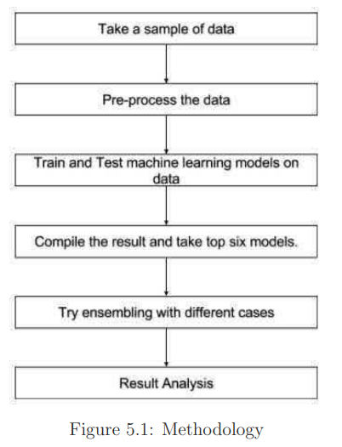
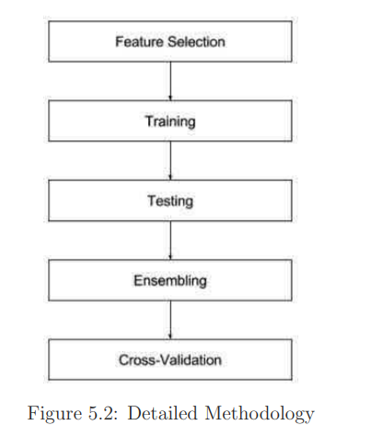

Slide 18
All the features are not very important in dataset so the researchers need to ignore the unnecessary features from the dataset, this process is called feature selection. Its order is followed by: - InChl > assays > SMILES > SD of Kinetic Solubility > Substance
Ensemble: - ensembling is technique that creates multiple models and then combine them to produce improved results. Ensemble has two methods.
Voting – Applies to problems of classification
Averaging – Applies to regression problems

Slide 19
Existing QSAR models were applied on the dataset. By performance the models were ensembled in different patterns and successfully built a better model.
This model gives an idea about the solubility of various compounds based on their structures. The result of computational model can’t be solely be trusted, this approach at least gives an outer edge with helping some information rather than having nothing at hand.

Slide 20
Deep Learning of Activation Energies

Slide 21
The researchers develop a template-free deep learning model to predict the activation energy given reactant and product graphs and train the model on a new, diverse data set of gas-phase quantum chemistry reactions.
Activation energy is an important kinetic parameter that enables quantitative ranking of reactions for automated reaction mechanism generation and organic synthesis planning.

Slide 22
Their training data were taken from Reaction Mechanism Generator (RMG) database which have only two reaction families: hydrogen abstraction and addition of a radical to a multiple bond.
The researchers aim to build a deep learning model which predict activation energies across a wide range of reaction types that does not depend on any additional input and requires only a graph representation of reactants and products.

Slide 23
This type of model would useful as first-step in deep learning-based estimation of kinetics for automated reaction mechanism generation or would allow for quantitative ranking of reaction candidates that were generated via combinatorial enumeration of potential products given a reactant.
To know about activation energy we need to know about Yang’s method in this method a directed message is passing a neural network (D-MPNN) for molecular prediction, which is a type of graph convolutional neural network.

Slide 24
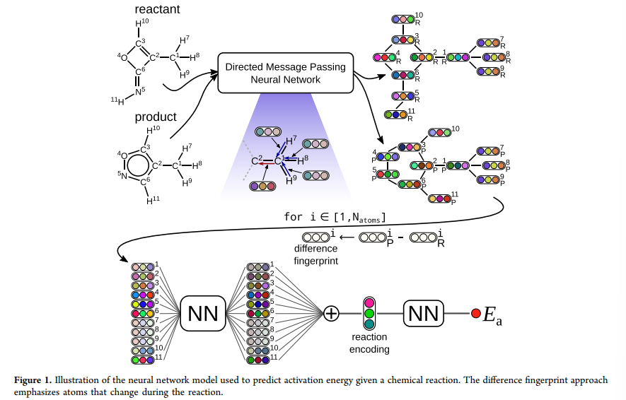

Slide 25
Graphs natural represent molecules in which atoms are vertices and bonds are the edges.
It constructs a learned representation of a molecule by passing information between elements of the graph using messages associated with directed edges/bonds.
A hidden representation for each directed bond embeds initial atom features, such as atomic number, and initial atom features, such as bond order, using a neural network.

Slide 26
Other neural networks iteratively update these hidden representations by incorporating the information from neighboring bonds.
Then it transform the hidden bond vectors into hidden atom vectors and sum them to obtain a molecular feature vector.
However, this type of summation may lose information about the order of atoms, which is necessary to encode reactions effectively.

Slide 27
The researcher solves this issue with D-MPNN to encode the reactant and product into the intermediate representation given by the hidden atom vectors.
After that the researchers pass each of the fingerprints through the same neural network and aggregate them into a reaction encoding.
The last step of the process is the readout phase, in this the network learns a linear combination of the elements in the reaction encoding to give an estimate of the activation energy.

Slide 28
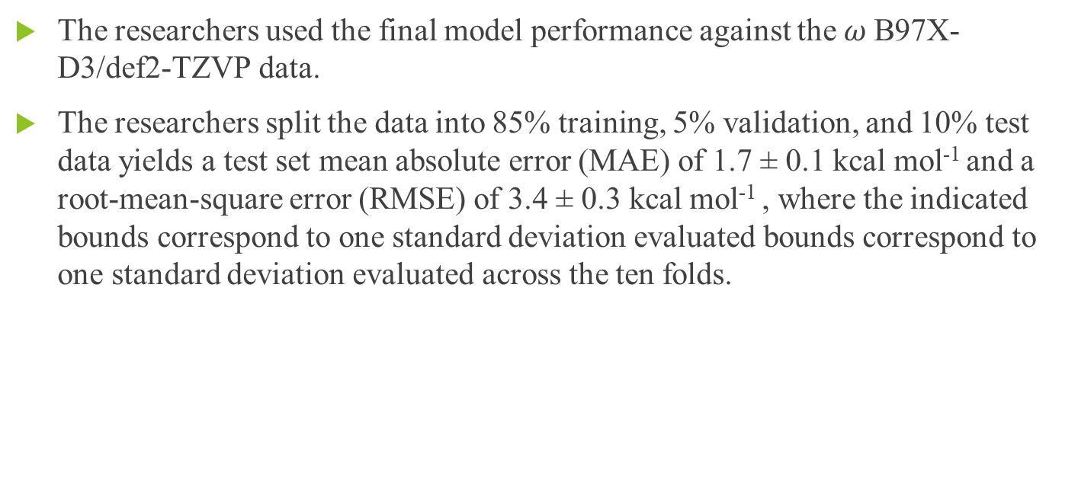
The researchers used the final model performance against the $ω$B97X-D3/def2-TZVP data.
The researchers split the data into 85% training, 5% validation, and 10% test data yields a test set mean absolute error (MAE) of 1.7 ± 0.1 kcal mol⁻¹ and a root-mean-square error (RMSE) of 3.4 ± 0.3 kcal mol⁻¹ , where the indicated bounds correspond to one standard deviation evaluated bounds correspond to one standard deviation evaluated across the ten folds.

Slide 29
There is no statistically significant difference between the deep learning model performance on RMG-type reactions and on non-RMG-type reactions (p ≤ 0.05), which shows that the template-free model can be applied to many reactions that do not fit into expected reaction families and may be useful for discovering new and unexpected reactions.
The researchers shows that the activation energies for a diverse set of gas-phase organic chemistry reactions can be predicted accurately using a template-free deep learning method.

Slide 30
Predicting Organic Reaction Outcomes with Weisfeiler-Lehman Network

Slide 31
The empirical approach is particularly limiting for the goal of automatically designing efficient reaction sequences that produces specific large molecule(s), a problem known as chemical retrosynthesis.
A chemical reaction transforms input molecules (reactants) into new molecules (products) by performing a set of graph edits over reactant molecules, adding new edges and/or eliminating existing ones.
A reaction template specifies a molecular subgraph pattern to which it can be applied and the corresponding graph transformation.

Slide 32
In this approach the multiple templates can match a set of reactants, another model is used to train the filter candidate products using standard supervised approaches.
It requires a large number of templates to ensure that at least one can reconstitute the correct product. These templates are either hand-crafted by experts or generated from reaction databases with heuristic algorithms.

Slide 33
The researchers propose a template-free approach by learning to identify the reaction center, a small set of atoms/bonds that change from reactants to products.
The forward-prediction approach is then divided into 2 key parts: - (a) learning to identify reaction centers and (b) learning to rank the resulting enumerated candidate products.
The researchers’ approach builds on neural embedding of the Weisfeiler-Lehman isomorphism test. They also propose a novel Weisfeiler-Lehman Difference Network to learn to represent and efficiently rank candidate transformations between reactants and products.

Slide 34
Template-based Approach – this approach differ in the way templates are specified and, in the way, the final product is selected from multiple candidates. The Wei learns to select the 16 pre-specified, hand-encoded templates, given fingerprints of reactants and reagents.
More recent model demonstrates much power like Segler and Waller and Coley use a data-driven approach to obtain a large set of templates, and then employ a neural model to rank the candidates.
In Segler and Waller, model the molecules are represented based on their Morgan fingerprints, while in Coley’s model represents reactions by the features of atoms and bonds in the reaction center.

Slide 35
Template-free approach – Kayala presented a template-free approach to predict reaction outcomes.
The researchers approach differs from Kayala approach in many ways. First, Kayala operates at the mechanistic level – identifying elementary mechanistic steps rather than the overall transformations from reactants to products.

Slide 36
The researchers’ approach operates at the graph level-predicting transformation from reactants to products in a single step.
Second, mechanistic descriptions of reactions are not given in existing reaction databases. Therefore, Kayala created their training set based on a mechanistic-level template-driven expert system.
The researchers’ model is learned directly from real-world experimental data.

Slide 37
Third difference is that the Kayala uses feed-forward neural networks where atoms and graphs are represented by molecular fingerprints and additional hand-crafted features. The researchers’ approach builds from graph neural networks to encode graph structures.
Molecular Graph Neural Networks – in computational chemistry, molecules are often represented with Morgan fingerprints, Boolean vectors that reflect the presence of various substructures in a given molecule.

Slide 38
The researchers’ model is derived from the Weisfeiler-Lehman kernel that produced isomorphism-invariant representations of molecular graphs.
Chemical Reaction - The researcher’s model bypasses the reaction templates by learning a reaction center identifier. In other words, the researchers train a neural network that operates on the reactant graph to predict a reactivity score for every pair of atoms.

Slide 39
The researchers build model on Weisfeiler-Lehman Network (WLN) that has shown superior results against other learned graph representations in the narrower setting of predicting chemical properties of individual molecules.
The Weisfeiler-Lehman Network is inspired by the Weisfeiler-Lehman isomorphism test for labeled graphs. The architecture is designed to embed the computations inherent in WL isomorphism testing to generate learned isomorphism-invariant representations for atoms.

Slide 40
WL Isomorphism Test – The key idea of the isomorphism test is to repeatedly augment node labels by the sorted set of node labels of neighbor nodes and to compress these augmented labels into new, short labels.
In each iteration, the label is augmented with the element labels of its neighbors. A multi-set label is compactly represented as a new label by a hash function.
WL network - The discrete relabeling process does not directly generalize to continuous feature vectors.

Slide 41
Reaction Centers with WLN – the researcher presents two models to predict reactivity: the local and global models.
The local model is based directly on the atom representation c_{u} and c_{v} in predicting label y_{uv}.
The global model, selectively incorporates distal chemical effects with the goal of capturing the fact that atoms outside of the reaction center may be necessary for the reaction to occur.

Slide 42
The researchers used the USPTO dataset for training which is collected by Lowe. After filtering the data, the researchers obtained a set of 480K reactions, this dataset is then divided into 400K, 40K and 40K for training, development, and testing.
They compute the coverage as the proportion of reactions where all atom pairs in the true reaction center are predicted by the model, that is where the recorded product is found in the model-generated candidate set.
Atom-level features include its elemental identity, degree of connectivity, number of attached hydrogen atoms, implicit valence, and aromaticity.

Slide 43
Bond-level features include bond type (single, double, triple, or aromatic), whether it is conjugated, and whether the bond is part of a ring.
This approach employs frequency-based heuristics to construct reaction templates and then uses a neural model to rank the derived candidates.
The presence of certain functional groups (structural motifs that appear frequently in organic chemistry) far from the reaction center can promote or inhibit different modes of reactivity.

Slide 44
The reactivity is often influenced by the presence of reagents, which are separate molecules that may not directly contribute atoms to the product.
The researchers compare the coverage of the generated candidates with the template-based model.
The template-based baseline requires 5006 templates extracted from the training data to achieve 90.1% coverage with an average of 482 candidates per example.

Slide 45
The massive number of templates required for high coverage is a serious impediment for the template approach because each template application requires solving a subgraph isomorphism problem.
The template model takes on average 7 seconds to apply the 5006 templates to a test instance, while the researchers’ model takes 50ms.
The WLDN outperforms the baseline in top-1 accuracy. Its result also demonstrates that the WLDN model consistently outperforms the WLN model.

Slide 46
The researchers first predict a small set of atoms/bonds in reaction center, and then product candidate products by enumerating all possible bond configuration changes within the set.
The researcher’s reaction center identifier and candidate ranking model build from Weisfeiler-Lehman Network and its variants that learn compact representation of graphs and reactions.

Slide 47
Molecular Descriptors

Slide 48
A descriptor is a number, a vector or a matrix and may be other data formats like character strings etc.
Types of Descriptors:
OD Descriptors (This class regroups all molecular descriptors that do not provide any information about the molecular structure or connectivity of atoms).
1D Descriptors (This class regroups the molecular descriptors that can be calculated from a set of substructures such as functional groups).

Slide 49
2D Descriptors (This class regroups all descriptors that provide information on molecular topology based on the graph representation of the molecules).
3D Descriptors (This class regroups all geometrical descriptors that provide information about the special coordinates of atoms of a molecule).
4D Descriptors

Slide 50
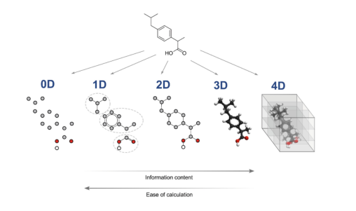

Slide 51
Generation of Molecular Fingerprints Using Convolutional Neural Networks: A “fingerprint” is a vector that represents a property of a chemical compound.
For this the most commonly used algorithm is the extended-connectivity fingerprint it is also known as circular fingerprint or Morgan fingerprint.
A SMILES representation, referred to as a SMILES string, enables the straightforward application of “convolutional neural networks (CNN)” to virtual screening of chemical compounds and identification of functional substructures.

Slide 52
The primary idea of researchers’ method is that they represent a SMILES string as a distributed representation termed a SMILES feature matrix, and apply CNN to the matrix in a way similar to the application of conventional CNNs to image data.
The CNN transform the SMILES feature matrix into a low-dimensional feature vector termed the SMILES convolution fingerprint (SCFP).

Slide 53
First, the input compound is represented by a SMILES string. After that each symbol in the SMILES string, a feature vector that is a distributed representation of the symbol is calculated.
SMILES convolution fingerprint (SCFP): - the researchers’ model not only used as prediction methods but also as a method to compute a fingerprint.
The researchers propose to use SCFP as an alternative to conventional fingerprints such as ECFP. The advantage of SCFP over ECFP is that it can represent important features acquired from training.

Slide 54
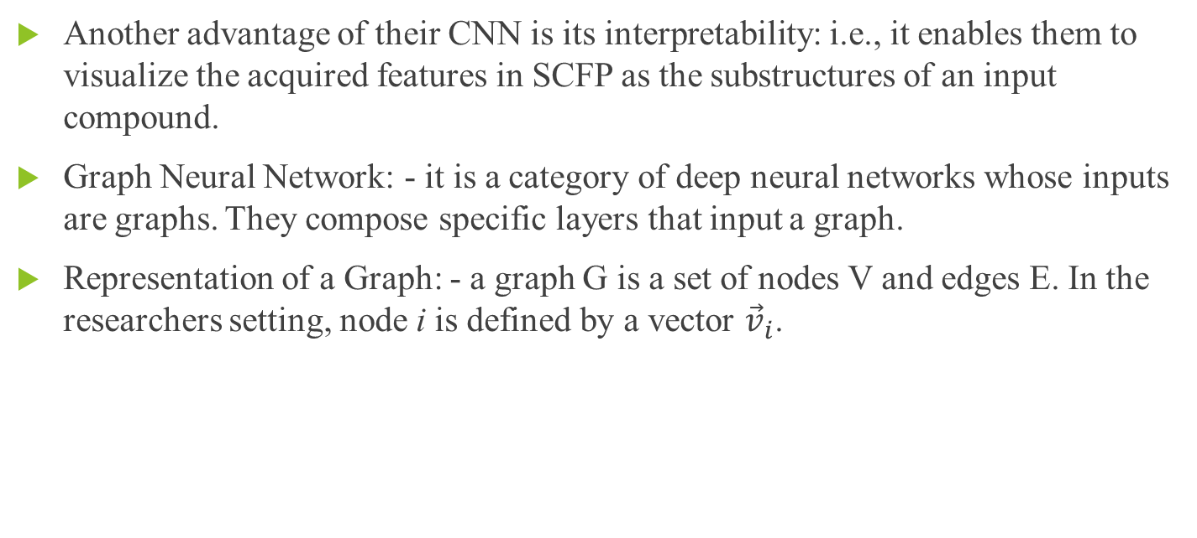
Another advantage of their CNN is its interpretability: i.e., it enables them to visualize the acquired features in SCFP as the substructures of an input compound.
Graph Neural Network: - it is a category of deep neural networks whose inputs are graphs. They compose specific layers that input a graph.
Representation of a Graph: - a graph G is a set of nodes V and edges E. In the researchers setting, node i is defined by a vector ${\vec{v}}_{i}$.

Slide 55
A graph neural network (GNN) is a neural network with two defining attributes:
Its’ input is a graph
Its’ output is permutation invariant.
A simple GNN: - Most GNNs implement a specific layer that can deal with graphs, therefore the researchers only concerned with these layers.

Slide 56
They assumed that a standard graph-based machine learning setup: -
They first require a convolutional and a pooling layer. They also require a readout layer, that converts the learnt representations into a fixed-size vector representation, to be used for final prediction.
The layers are (i) Convolutional layer, (ii) Pooling layer, (iii) Readout layer.

Slide 57
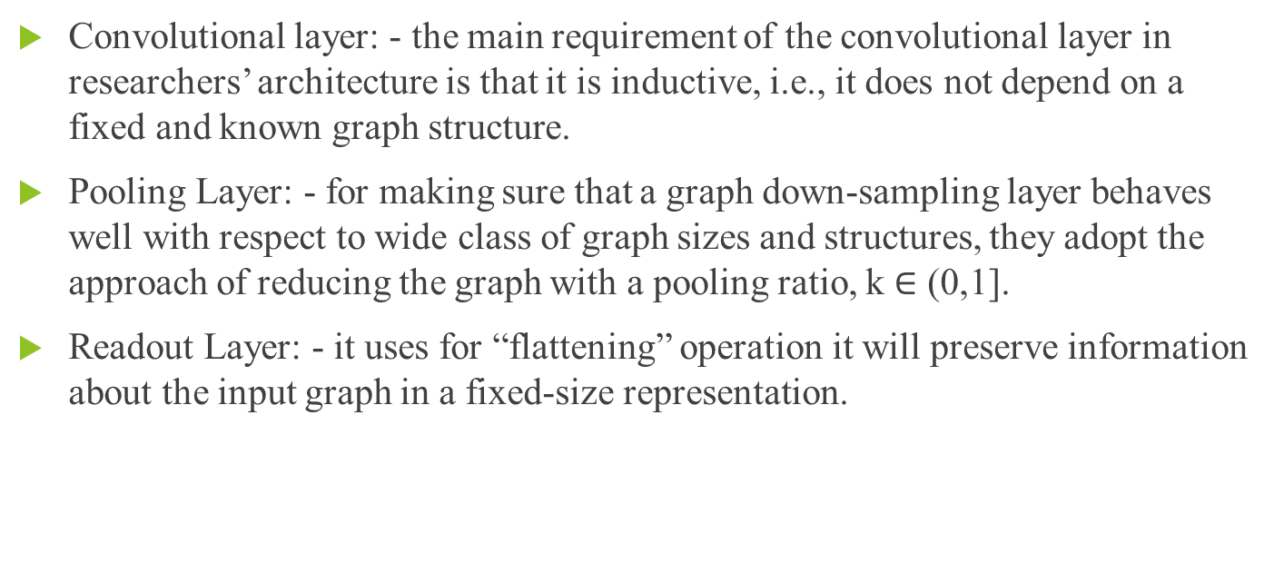
Convolutional layer: - the main requirement of the convolutional layer in researchers’ architecture is that it is inductive, i.e., it does not depend on a fixed and known graph structure.
Pooling Layer: - for making sure that a graph down-sampling layer behaves well with respect to wide class of graph sizes and structures, they adopt the approach of reducing the graph with a pooling ratio, k $∈$ (0,1].
Readout Layer: - it uses for “flattening” operation it will preserve information about the input graph in a fixed-size representation.

Slide 58
The researchers find that the aggregation across layers is important, not only to preserve information at different scales of processing, but also to handle efficiently retaining information on smaller input graphs that may quickly be pooled down to a too small number of nodes.
Molecular Graph Neural Networks: - In computational chemistry, molecules are often represented with Morgen Fingerprints, Boolean vectors that reflect the presence of various substructures in a given molecule.

Slide 59
The researchers train a Weisfeiler-Lehman Network (WLN), a type of graph convolutional neural network, and analyze the reactant graph to predict the likelihood of each pair to change to each new bond order, including 0th order bond also called no bond.
Variational Auto-encoders (VAE): - VAE is an autoencoder whose encoding distribution is regularized during the training on order to ensure that its latent space has good properties allowing us to generate some new data.

Slide 60
To understand VAE we need to know the following terminologies: -
Dimensionality reduction
Principal components analysis (PCA)
Autoencoders
Dimensionality reduction: - Dimensionality reduction is the process of reducing the number of features that describe some data. It reduction is done either by selection or by extraction.

Slide 61
Principal components analysis (PCA): - The main thinking behind to build the PCA is that the n_e new independent features that are linear combinations of the n_d old features and so that the projections of the data on the subspace defined by these new features are as close as possible to the initial data.
We can say that PCA is looking for the best linear subspace of the initial space such that the error of approximating the data by their projections on the subspace is as small as possible.

Slide 62
Autoencoders: - these are pretty simple and they consist of setting an encoder and a decoder as neural networks and they learn the best encoding-decoding scheme using an iterative optimization process.
At every iteration we feed the autoencoder architecture with some data, and compare the encoded-decoded output with the initial data and backpropagate the error through the architecture to update the weights of the networks.

Slide 63
Variational autoencoders (VAEs) are autoencoders that tackle the problem of the latent space irregularity by making the encoder return a distribution over the latent space instead of a single point and by adding in the loss function a regularization term over that returned distribution in order to ensure a better organization of the latent space.
Variational Graph Auto-Encoders: - it is framework for unsupervised learning on graph-structured data based on the variational auto-encoder (VAE). This model makes use of latent variables and is capable of learning interpretable latent representations for undirected graphs.

Slide 64
The autoencoder is trained to minimize error in reproducing the original string; i.e., it attempts to learn the identity function.
For optimization in the latent space to work, points in the latent space must decode into valid SMILES strings that capture the chemical nature of the training data.
The decoder fed into three layers of gated recurrent unit (GRU) networks with hidden dimension of 488. They used the QM9 data set.
The last layer of the RNN decoder defines the probability distribution over all possible characters at each position in the SMILES string.

Slide 65
Variational Autoencoder for Molecular Graph Generation: - Junction tree variational autoencoder generates molecular graphs in two phases, first generating a tree-structured scaffold over chemical substructures, and then combining them into a molecule with a graph message passing network.
The main challenge of drug discovery is to find the target molecules with desired chemical properties.

Slide 66
The researchers decompose the challenge into two subtasks: learning to represent molecules in a continuous manner that facilitates the prediction and optimization of their properties; and learning to map an optimized continuous representation back into a molecular graph with improved properties.
The researcher proposes to generate molecular graphs in two phases by exploiting valid subgraphs as components.

Slide 67
They find that each molecule as having been built from subgraphs chosen by vocabulary of valid components. They used as building blocks both when encoding a molecule into a vector back into valid molecular graphs.
The advantage of this view is that the decoder can realize a valid molecule piece by piece by utilizing the collection of valid components and how they interact, rather than trying to build the molecular atom by atom through chemically invalid intermediaries.

Slide 68
Bayesian Optimization: - the second task done by researchers is to produce novel molecules with desired properties, their target chemical property y(.) is octanol-water partition coefficients (logP) penalized by the synthetic accessibility (SA) score and number of long cycles.
For Bayesian Optimization (BO) they train VAE and its associate each molecule with a latent vector, given by the mean of the variational encoding distribution.

Slide 69
When VAE is learned they train a sparse Gaussian process (SGP) to predict y(m) given its latent representation. Then they perform five iterations of batched BO using the expected improvement heuristic.
Topological or path-based fingerprints are specifically designed for pre-filtering in substructure searching, making such fingerprints are specifically designed for pre-filtering in substructure searching, making such fingerprints particularly useful for clustering which conforms to how medicinal chemists would divide compounds into structurally related groups.

Slide 70
Circular fingerprints perform similarity searching and measurement of one full structure, contributing to the evaluation of compound diversity and analyzing chemical space of particular interest.
The 3D molecular encoders: - it is also known as shaped-based molecular encoders. Its aim is to encode the information of the 3D molecular shape, including: (1) atomic-distance based encoder, (2) atom-centered Gaussian-based encoders, and (3) surface-based encoder.

Slide 71
Deep learning molecular encoder: - it aims to discover a mapping that embeds molecular characteristics as points in a low-dimensional vector space.
DL models have been constructed not only using the inputs from the previously mentioned 2D or 3D molecular encodings, but also using the simple input of SMILES or a molecular graph.

Slide 72
Four DL based molecular encoders are used by researchers are as follows: -
Sequence based encoders
Fingerprint-based encoders
Graph-based encoder
Interaction-based encoders

Slide 73
Sequence based encoders: Based on symbol characters similar to SMIFP, SMILES2-VEC uses a deep recurrent neural network (RNN) to generate intermediate vectors that are relevant for predicting a variety of chemical properties.
They are specially designed for four training data sets to make accurate predictions of molecular properties.

Slide 74
Fingerprint-based molecular encoders: - Mol2vec aims to learn a set of meaningful vector representations from Morgan fingerprints, in which chemically related substructures have a certain degree of cosine similarity.
Graph-based molecular encoders: - it is inspired by discrete circular fingerprints, a learnable encoder of NGF was designed to encode substructure into a compressed and meaningful feature vector.
It can encode property-related features for better supporting molecular property prediction tasks.

Slide 75
Fingerprinting: - Molecular fingerprints are used for the representations of the chemical structures originally designed to assist in chemical database substructure but in later stage it is used for analysis tasks, like similarity searching, clustering, and classification.
Topological fingerprints were developed for substructure and similarity searching. Extended-connectivity fingerprints (ECFPs) were developed specifically for structure-activity modeling.

Slide 76
Extended-connectiVity fingerprints (ECFPs) are a recently developed fingerprint methodology explicitly designed to capture molecular feature relevant to molecular activity.
Initial assignment of atom identifiers – the generation of ECFPs for a molecule begins with the assignment of initial atom identifiers. In this the hydrogen atoms and bonds to hydrogen atoms are ignored.
The initial atom identifier for the standard “ECFP” fingerprint uses atom information from the Daylight atomic invariants rule.

Slide 77
The Daylight atomic invariants are six properties of an atom in a molecule that do not depend on initial atom numbering.
These properties are: the number of immediate neighbors who are “heavy” (non hydrogen) atoms; the valence minus the number of hydrogens; the atomic number; the atomic mas; the atomic charge; and the number of attached hydrogens (both implicit and explicit).

Slide 78
Iterative Updating of Identifiers: - it generates features that represent each atom within larger and larger circular substructural neighborhoods.
Duplicate Structure Removal: - after several iterations, it is possible for two different atoms to contain information about identical structural regions of a molecule, as defined by the set of bonds covered by the atom-centered environment it is also called structural duplication.

Slide 79
Deep Learning for Toxicity Prediction: - DL is ideal for multi-task learning, it is common setting for toxicology prediction: in this the same compound is often go under investigation for several types of toxicity, and each of these types is its own prediction task.
It offers two advantages: (a) it naturally allows for multi-label information and therefore can utilize relations between task; (b) it allows to share hidden unit representations among prediction tasks.

Slide 80
DNN Architecture: this model takes a numerical descriptor of a given compound as input, and tries to predict several different types of toxic effects at the same time.
Hyperparameters: - ECFP4 features were either scaled by tanh or sqrt nonlinearities. The researcher additionally used a simple thresholding scheme to filter very sparse features, which helped to bring the number of features down into a manageable range.

Slide 81
Input features: - input features are crucial for any ML applications, a vast variety of different methods exist, it is used to calculate numerical features of the typical graph-based storage format used for chemical compounds.
The researchers used a high-dimensional binary representation using Extended Connectivity FingerPrint (ECFP4) features, which is the current best performing compound descript in drug design.

Slide 82
Deep Reinforcement Learning In Chemistry: Molecules Optimization Using DRL: - it is a subfield of artificial intelligence (AI). A new design for molecule optimization is introduced by combining chemistry domain knowledge and reinforcement learning. It is called Molecule Deep Q-Networks (MolDQN). Using the Markov decision process (MDP) the researchers optimize the molecules.
Methods: Molecule modification as a markov decision process: it is done in stepwise fashion.
Bond addition
Atom addition
Bond removal

Slide 83
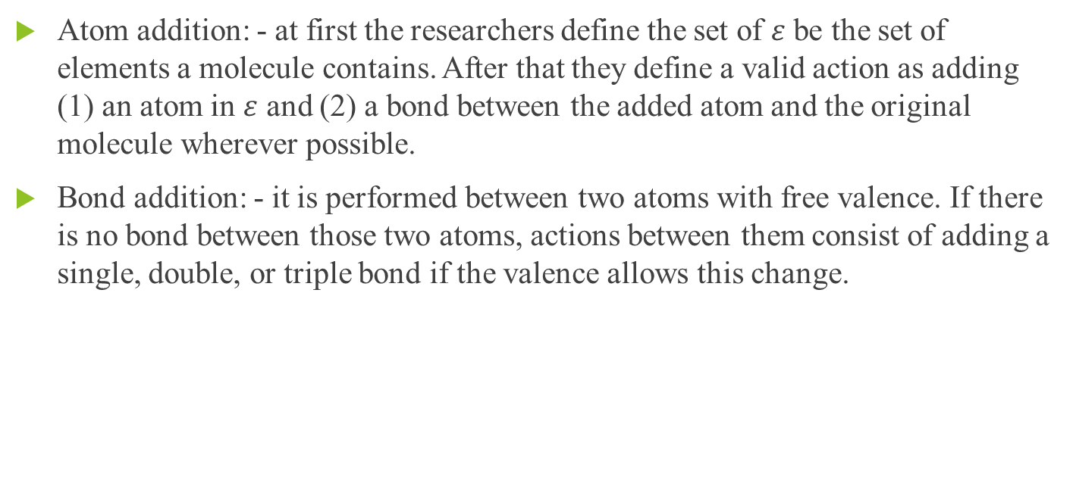
Atom addition: - at first the researchers define the set of $ε$ be the set of elements a molecule contains. After that they define a valid action as adding (1) an atom in $ε$ and (2) a bond between the added atom and the original molecule wherever possible.
Bond addition: - it is performed between two atoms with free valence. If there is no bond between those two atoms, actions between them consist of adding a single, double, or triple bond if the valence allows this change.

Slide 84
Bond removal: - the valid bond removal action set as the actions that decrease the bond order of an existing bond. The transitions include:
Triple bond – {Double, Single, No} Bond.
Double bond – {Single, no} Bond.
Single bond – {No} Bond.

Slide 85
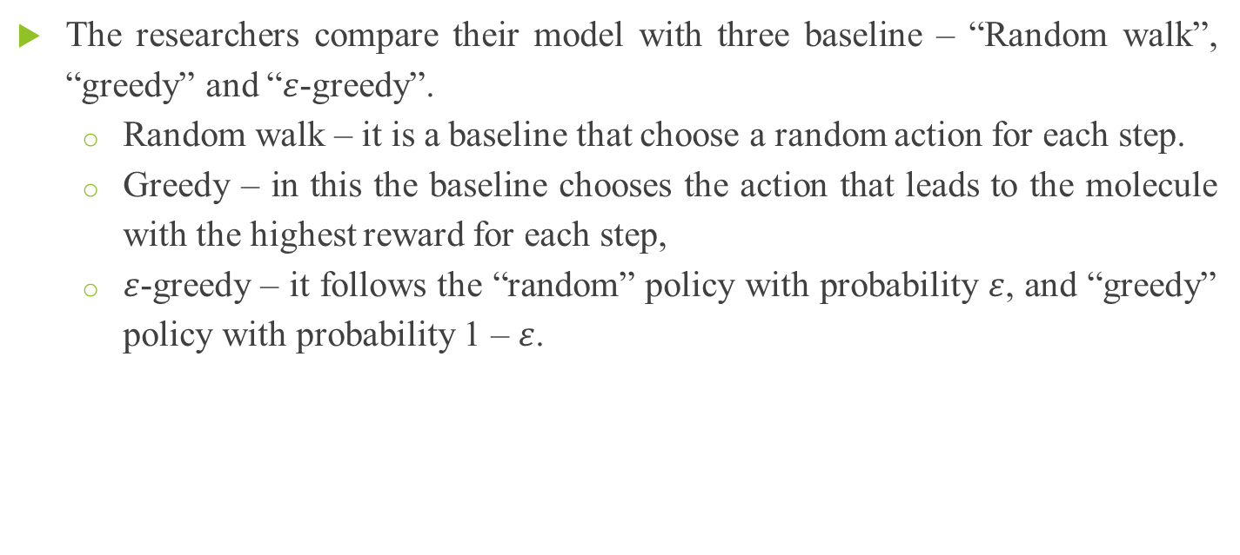
The researchers compare their model with three baseline – “Random walk”, “greedy” and “$ε$-greedy”.
Random walk – it is a baseline that choose a random action for each step.
Greedy – in this the baseline chooses the action that leads to the molecule with the highest reward for each step,
$ε$-greedy – it follows the “random” policy with probability $ε$, and “greedy” policy with probability 1 – $ε$.

Slide 86
Result: - the researchers compare their MolDQN with the following state-of-the-art models:
Junction Tree Variational Autoencoder (JT-VAE) is a deep generative model that maps molecules to a high-dimensional latent space and performs sampling or optimization in the latent space to generate molecules.
Objective-Reinforced Generative Adversarial Networks (ORGAN) 15 is a reinforcement learning based molecule generation algorithm that uses SMILES strings for input and output.
Graph Convolutional Policy Network (GCPN) 18 is also a reinforcement learning based algorithm that operates on a graph representation of molecules in combination with a MDP.

Slide 87
Defining and Exploring Chemical Spaces

Slide 88
Chemical space can be thought of as the set of all possible molecules or materials.
‘Drug-like chemical space’ is used in the context of drug discovery to reflect the vast number of molecules that have physical properties similar to those of existing small-molecule therapeutics.
The goal is to identify one or more molecules that exhibit a set of desirable properties. The two primary considerations one must make are: (i) how to define the space; and (ii) how to explore the space.

Slide 89
One approach to molecular discovery is to explore a predefined chemical space: an enumerated list of candidate molecules.
In this setting, two stages of (i) defining the space and (ii) exploring the space are entirely decoupled.
In Bayesian optimization, predictions of performance and model uncertainty are both considered to balance the exploration of uncertain candidates and the exploitation of candidates likely to be high performing; simpler optimization schemes may simply perform a greedy search.

Slide 90
GAs are popular class of technique for finding optimal molecules. GAs are model- and derivative-free optimization routines that ‘evolve’ candidate solutions through stochastic mutation and crossover events.
In an exemplary study, Venkatasubramanian and colleagues define chemistry-informed operators that allow two parent molecules to cross over, two to be merged, one to randomly permute its backbone or side chains, and one to have functional groups inserted, removed, or translocated.

Slide 91
Jensen and coworkers said that, a relatively small number of generations are required to transmute any one molecule into another, making them remarkably efficient for exploration.
Prototypical frameworks for generation include variational autoencoders (VAEs) or recurrent neural networks operating on SMILES string representations, VAEs operating on molecular graphs or junction trees, RL agents composing graphs atom by atom, and many adaptations thereof.

Slide 92
The autoencoder-based methods encode/decode molecular structures to/from numerical representations, latent space optimization can indirectly optimize the molecules that latent vectors correspond to; this is typically done with a fixed decoder network, but the decoder can also be updated on the fly.
Autoregressive generation limits the molecules’ sizes but they still produce a massive chemical space. These initial spaces can used to train and any natural inductive biases of the models influence the structures proposed.

Slide 93
In this the benchmark for ‘distribution learning’ setting where not optimize f(x), it shows that these models are effective at proposing novel molecules that exhibit properties similar to those of their training set.
Synthetic constraints can be incorporated into GAs by restricting mutation operations or by taking advantage of the structured nature of synthetic routes.

Slide 94
In recent years, synthetically aware models have emerged that integrate reaction-based de novo design with machine learning-based generation by reframing molecular optimization as the optimization of synthetic routes.
For VAEs or generative adversarial networks, this requires modifying the decoder to produce multiple reactant molecules and/or reaction steps; for RL approaches, this requires changing the action space to the selection of reactants and reaction types or templates.

Slide 95
MoleculeChef uses a VAE that operates on sets of molecules. Reactants are proposed by a recurrent decoder that selects available starting materials from a discrete list of options.
Markov decision process – a sequence of actions that correspond to reaction steps in a linear synthesis - and train RL agents to learn a policy that yields optimal products.

Slide 96
As the training progresses and more products are evaluated, the agents’ policies are updated to reward strategies that yield higher-performing molecules.
The approach one should select for chemical space exploration will depend on the nature of the evaluation function f(x), the extent to which domain expertise can narrow down the problem-relevant chemical space, and the time/cost budget.
Closing the loop – is a promising paradigm for accelerated scientific discovery. The ability of automated platforms to make truly novel and impactful discoveries has been limited by their inability to generate and test hypotheses without human intervention.

Slide 97
In the context of molecular discovery, experimental testing requires that proposed candidates can be physically obtained: for manual evaluation, that they be purchasable or synthesizable from commercial starting materials, and for automated evaluation, that they be available or synthesizable from an on-hand chemical inventory given experimental constraints.
As computer-aided synthesis planning and predictive chemistry tools become increasingly sophisticated, detailed considerations of synthesis time, ease of parallelization, and utilization of common intermediates might be able to be factored into batched molecular design.

Slide 98
The more important than the size of a chemical space is its diversity and whether it contains molecules that satisfy the researchers’ design objectives.
‘diversity’ is not well defined so one can consider it as it is a diverse chemical space as one where a high-performing molecule can be found for multiple distinct discovery tasks.
Diversity-oriented synthesis (DOS) is an orthogonal approach, where the reactions themselves introduce a high degree of structural complexity; good modulation of reaction conditions can lead to dozens of unique products even given simple amine and carboxylic acid building blocks.

Slide 99
The combination of both is most likely to lead to the most useful compound sets.
The limitation of most of the algorithms for on-the-fly generation is their ability to handle stereoisomerism.
Stereoisomers can exhibit drastically different properties, and yet SMILES and graph representations are fundamentally unable to distinguish configurational isomers defined by more than tetrahedral chirality and cis/trans bond isomerism.

Slide 100
The researchers require new benchmark tasks that; (i) contain complex design objectives that are less smooth with respect to molecular structure, exhibit more local optima, and require tradeoff between competing design objectives; (ii) require the generation of individual stereoisomers; (iii) include metrics of sample efficiency; and (iv) have variable experimental costs of candidate molecules.
Human filters and manual selection of compounds is almost always an intermediate step between computational predictions and physical experiments and should remain so until we can capture those considerations algorithmically.

Slide 101


