Slide 1
Neural-Symbolic Machine Learning For Retrosynthesis And Reaction Prediction

Slide 2
Reaction prediction and retrosynthesis are the cornerstones of organic chemistry.
To rationally synthesize new molecules, two intimately related problems, i.e. reaction prediction and retrosynthesis must be solved.
The standard methodology for retrosynthesis and reaction prediction are rule-based expert systems.
The role-based expert system is straightforward to interpret but they cannot think or predict outside of their knowledge which prevents them to discover novel chemistry.

Slide 3
The reaction rules have to be annotated with additional information about tolerated functional groups and selectivity to filter and prioritize the rules when a match has been found.
An Additional limitation of rules is that they lack an inherent ranking mechanism.
Aires de Sousa and co-workers proposed to combine machine learning with rule-based approach. In this the model was trained on the reactant or product molecules to predict which is the most probable rule, which can then subsequently apply to the molecules.

Slide 4
In this model they first encode the molecules by unsupervised pre-training of self-organizing maps, it is then serves as an input to the random forest classifier.
They propose a novel neural-symbolic model, which can be used for both reaction prediction and retrosynthesis. This model uses neural network to predict the most likely transformation rules to be applied to the input molecules.

Slide 5
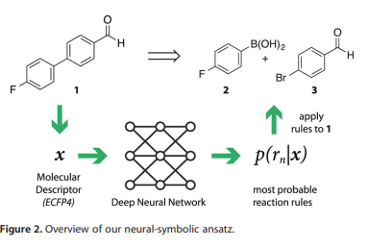

Slide 6
The researcher check their model with various measures like top-n accuracy, mean reciprocal rank, weighted precision etc.
Accuracy shows how many reactions are correctly predicted when the rule with highest predicted probability is evaluated.
Mean reciprocal rank (MRR) is a metric from information retrieval. It measures the ability of a system to highly rank the correct result. A value of 1.0 means perfectly ranked, a value of 0.5 could arises if all results are ranked second.
Weighted precision (w. Prec.) measures the ability of the system to not create false positives.

Slide 7
For reaction prediction, the accuracy of the rule-based system is 0.07, whereas the model reaches the accuracy of 0.92.
In the retrosynthesis, the expert system yields an accuracy of 0.05 and an MRR of 0.01 whereas the model with single layer neural network reaches the accuracy of 0.78 and MRR of 0.87.
The accuracy of best neural-symbolic model is 0.78.
If the model allowed to propose just 10 different routes, then the mean reciprocal rank is 0.75 which indicates good ability to prioritize the reactions.

Slide 8
The researcher observes several things: -
The neural-symbolic models outperform expert systems in all experiments because the rule-based systems matches tens or hundreds of rules, in which most of the rule are irrelevant or even incorrect because of reactivity conflicts
On the other hand, the neural-symbolic models have learnt to focus on the relevant rules, in-directed by the high MRR and top-n accuracy scores.
After seeing millions of examples, the neural network has not only learned which functional groups are involved in rule, but also which molecular contexts are tolerated.

Slide 9
A model with 137 algorithmically extracted rules performed better than the system which have 103 hand-coded reactions.
The rule-based system tries to match all the 8720 rules against the input molecule, whereas the neural symbolic system looks at the query molecules once to calculate the fingerprint, then runs the neural network to determine the 20 most relevant rules, which are subsequently applied.

Slide 10
The first limitation of the model is that it cannot predict anything outside its rules base.
It can’t be able to solve the dilemma of rules: that is, one defines rules that are too general, which would generate a lot of noise or rules that are too specific, which can only predict the substrate used to derive the rule.
The second limitation of the system is that system does not take stereochemical addressed in traditional rule-based expert system.

Slide 11
The researchers shows that limitation of rules can be overcome with a model of chemical reasoning based on knowledge graphs.
The researchers report that on a hybrid neural-symbolic approach for both retrosynthesis and reaction prediction that can be trained with large reaction sets from databases.
The experiment shows that neural networks can learn to which molecular context particular rules can be applied, and can prioritize the rules for the both retrosynthesis and reaction prediction using either hand-coded or automatically extracted rule sets.

Slide 12
In their classifier, the researcher evaluate different neural network architectures with one or more fully connected hidden layer(s), and highway networks.
For the non-linearity, they apply the exponential linear unit developed by Hochreiter and co-workers.
The last layer of the neural-network is a softmax which give the probability distribution over the reaction rules.

Slide 13
Planning Chemical Synthesis With Deep Neural Networks And Symbolic AI

Slide 14
The researchers use Monte Carlo tree search and symbolic artificial intelligence (AI) to discover retrosynthesis routes.
To guide the search in promising directions, heuristic best first search has been employed, in which hand-designed heuristic functions determine position values.

Slide 15
It is difficult to strong heuristic for three reasons: -
First, chemists tend to disagree on what constitutes a good position.
Second, it is generally desirable to simplify the molecules; it can be tactically beneficial to temporarily increase complexity by the use of protecting or directing groups.
Third, the position value depends highly on the availability of suitable precursors.

Slide 16
Monte Carlo tree search (MCTS) has emerged as general search technique for sequential problems with large branching factors without strong heuristic, such as games or automated theorem proving.
MCTS uses rollouts to determine position values. In this random search steps are performed without branching until a solution has been found or a maximum depth is reached.

Slide 17
The researchers combine three different neural networks together with MCTS to perform chemical synthesis planning (3N-MCTS).
The first neural network guides the search in promising directions by proposing a restricted number of automatically extracted transformations.
The second neural network then predicts whether the proposed reactions are actually feasible.
To estimate the position value, transformations are sampled from a third neural network during the rollout phase.

Slide 18
Two sets of rules were extracted. The rollout set comprises rules that contain the atom and bonds that changed in the course of the reaction and the first-degree neighboring atoms.
Rule extraction associates each reaction, and thus each product, with a transformation rule, this allows to train neural networks as policies to predict the best transformations given the product, or in other words, the best reactions with which to make the product.
The researchers sum the probabilities of the predicted actions, starting from the highest-ranked transformation. When the cumulative probability reaches 0.995, they stop further expansion, even if fewer than 50 actions have been expanded.

Slide 19
The researchers trained a deep neural network as a binary classifier to predict whether the reactions corresponding to the transformations selected by the policy network are actually feasible.
The expansion procedure and the rollout policy are incorporated in the respective phases of an MCTS algorithm that make 3N-MCTS.

Slide 20
The MCTS phases iterated to build the search tree: -
In the first 3N-MCTS phase, that is the root node of the search tree, the algorithm sequentially selects the most promising next position within the tree until a leaf node is reached. The algorithm balances the selection of high-value positions and unexplored positions. If a leaf node is visited for the first time; it is directly evaluated by a rollout. If it is visited for the second time, then it is expanded by processing via the expansion policy.

Slide 21
Expansion: - the possible transformations determining the follow-up positions of the current position are selected by applying the expansion procedure. The predicted follow-up positions are added to the tree as children of the leaf node, and the most promising position is selected for rollout.
Rollout: - this phase starts with checking the status of the position. If it is already solved, the algorithm directly receives a reward greater than 1 to encourage exploitation. Non-terminal states are subjected to a rollout, where actions are sampled from the rollout network recursively, until the state has been deconstructed into building blocks or a maximum depth is reached.

Slide 22
Update: - if a solution has been found during rollout, a reward of 1 is received. Partial rewards are given if some, but not all, molecules in the state are solved. If no solution was found, a reward of –1 is received. In this bespoke, scoring functions for the problem at hand such as process chemistry or small-scale medicinal chemistry, can also be supplied.
These four phases of 3N-MCTS are iterated until a time budget or maximal iteration count is exceeded.

Slide 23
They perform BFS with the cost calculated by the policy network, and all algorithms use the same set of automatically extracted transformations. Models are trained only the data which are published before 2015.
The Monte Carlo search solved 89.54% of the test set. UCT is an MCTS variant that uses the expansion policy network only to narrow down the possible transformations, but not to guide the search via the predicted probability of the transformation. Through this method 87.12% of the test set is solved only highlighting the important of rollouts.

Slide 24
The main criticism of retrosynthesis systems has that the proposed routes often contain what chemists immediately recognize as chemically unreasonable steps.
This approach solves more problems and is faster than established search methods. It also performs better qualitatively.
They also observed that traditional heuristic BFS without neural network guiding did lead to many unreasonable steps being proposed in the routes, while the 3N-MCTS approach proposed more reasonable routes.

Slide 25
The test was double-blind that means the contestants and the conductors do not know the origin of the routes.
In the first test, the participants had the choice between a route reported by expert chemists in the literature, and a route generated by the 3N-MCTS algorithm for the same target molecule.
The researchers found that the experts did not (P=0.26) prefer the literature route (43.0%) over the program route (57.0%).

Slide 26
In the second test, the participants had to report their preferences for either routes found by 3N-MCTS or routes generated by a baseline system, which uses heuristic BFS and the same transformation rule as 3N-MCTS. But it lacks the policy network to preselect promising transformation and an in-scope filter to exclude unlikely steps.
In this the participants significantly (P=0.01) preferred the routes generated by the MCTS algorithm (68.2%) over the baseline system (31.8%).

Slide 27
The researchers demonstrate that MCTS combined with deep neural networks and symbolic rules can be used effectively to perform chemical synthesis planning.
The double-blind AB test suggest that, for the first time, organic chemists should consider the quality of retrosynthetic routes generated by a machine to be on par with reported routes for molecules of practical relevance.

Slide 28
PHONENICS: A BAYESIAN OPTIMIZER FOR CHEMISTRY

Slide 29
The Bayesian optimization schemes consist of two major steps: -
First, an approximation (surrogate) to the merit landscape of the conditions is constructed.
Second, a new set of conditions is proposed for the text evaluation based in this surrogate.

Slide 30
The challenges in the deployment of Bayesian optimization is: -
The domain specified by surrogate model: - GPs works well with continuous objective landscapes, while RFs well fit with discrete and quasidiscrete landscapes. Unknown experimental response landscapes are more amenable to methods which perform well on large verity of data.

Slide 31
Another challenge is the parallelization capabilities: - traditionally, Bayesian optimization methods are sequential in nature, which stops it for parallel evaluations of the objective functions. To work parallel operation, it needs more computational power compare to traditional approach.

Slide 32
The computational efficiency is another challenge: - optimization strategies involving substantial additional computation are only applied efficiently if the time required to suggest a new set of conditions does not significantly exceed the execution time to the experiment.

Slide 33
The researchers propose an inexpensive acquisition function, which enables intuitive search strategies for efficient parallelization.
This can be achieved by simultaneously proposing multiple parameter points with different sampling policies at negligible additional cost.
The researchers highlight the applicability of their approach on the Oregonator, a model system for chemical reactions, on which they demonstrate the deployment of the proposed optimizer for practical problems in chemistry.

Slide 34
Bayesian optimization is a gradient free strategy for the global optimization of possibly noisy black-box functions, which is denoted by f.
It consists two major steps: -
Construct a surrogate to f.
Propose new parameter points for querying f based on this probabilistic approximation.
In the first step, the surrogate model is constructed by conditioning f on a prior 𝜙prior(𝜃) over the functional form, which is described by parameters 𝜃.
In the second step of the general Bayesian optimization procedure, this surrogate model is used to propose new conditions for future evaluations via an acquisition function.

Slide 35
Training a GP is computationally costly as it involves the inversion of a dense covariance matrix, which scales cubically with the number of observations. Due to this the GP is mainly used with low dimensional dataset.
Bayesian neural networks (BNNs) have been employed for Bayesian optimization, retaining the flexibility of GPs at a computational scaling comparable to RFs.
The BNNs trained by updating the distributions from which weights and biases are sampled. Which is different from traditional approach where these two are sampled from distribution.

Slide 36
The ideal acquisition function finds the adequate balance between exploration and exploitation.
One of the earliest and most widely applied acquisition function is expected improvement and variants.
It aims to measure the expected amount by which an observation of a point in parameter space improves over the current best value.
Exploration and exploitation are implicitly balanced based on the posterior mean and the estimated uncertainty.

Slide 37
The upper confidence bound method exploits confidence bounds for constructing an acquisition function which minimizes regret.
Predictive entropy estimates the negative differential entropy of the location of the global optimum given the observation, and has been shown to outperform expected improvement and upper confidence bound acquisitions.
All the proposed batch optimization methods require substantial additional computation compared to sequential evaluation strategies.

Slide 38
Phoenics combines ideas from Bayesian optimization with concepts from Bayesian kernel density estimation (BKDE).
The researchers suggest the use of BNN to estimate the parameter kernel density from the observed parameter points in an autoencoder-like architecture.
It uses a nonlinearly estimate the density of the observed parameter points x.
It guarantees the flexibility in the approximation.

Slide 39

The kernel density pk(x) generated from a single observed parameter point x_{k} can therefore be written in closed form in equation where (.) denotes the average over all sampled BNN architectures, and x_{pred} denotes the parameter points sampled from the BNN.

Slide 40

The researchers propose an acquisition function based on the kernel densities P_{k}(x) for observations D_{n} detailed in eq. 3. The acquisition function differs from the approximation to the objective function by an additional term p_{uniform}(x) in the numerator and the denominator, which denotes the uniform distribution on the domain. In the numerator, p_{uniform}(x) is scaled by a factor λ .
.

Slide 41
The parameter λ effectively compare the cumulative height of each rescaled density estimate p_{k}(x) to the uniform distribution.
The p_{k}(x) are constructed from the knowledge they acquired from previous experiments, p_{uniform} is used as a reference to indicate the lack of knowledge in parameter space regions where little or no information is available yet.
The large positive value of λ phoenics favors exploitation, while a large negative value favors exploration. The λ = 0, the acquisition function shows no preference for a particulate sampling strategy.

Slide 42
The researcher's compare the Phoenics algorithm with four different algorithms they are: particle swarm optimization (PSO), convariance matrix adaptation evaluation strategy (CMS-ES), and with Bayesian optimization based on GPs and based on RFs.
The researchers assess the performance of these algorithms on a set of 15 benchmark functions covering a large range of qualitatively diverse response surfaces for problems in chemistry.
For reliable performance estimates they executed 20 independent optimization runs initialized with different random seed.

Slide 43
The researchers find that the Bayesian-based optimization algorithms outperforms PSO and CMA-ES. Phoenics was set with three different values for the sampling parameter, λ ϵ {−1,0,1}, to assess the effectiveness of a particular parameter choice

Slide 44
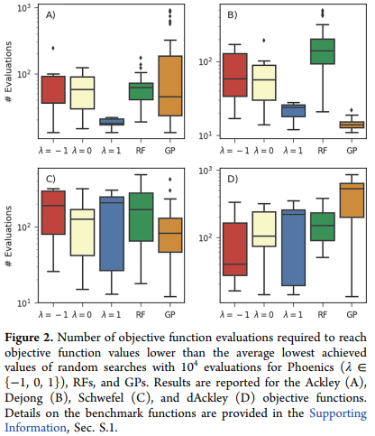

Slide 45
If λ > 0, the algorithm performs better if the objective function features narrow and well-defined funnels.
They find that both the spearmint and SMAC achieve low objective function values in fewer batches with an increasing number of points p proposed in each batch.
The researchers ran their optimizer with four different sampling strategies using sampling parameter values evenly spaced across the [-1, 1] interval.

Slide 46
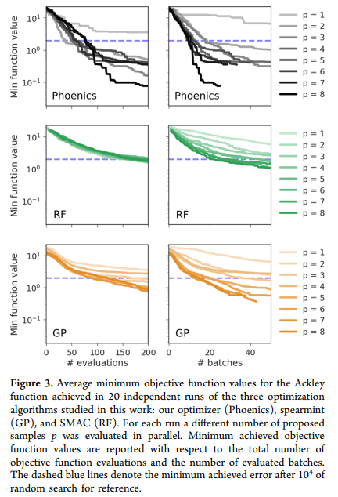

Slide 47
The exploration samples systematically samples the parameter space and ensure that the algorithm does not get stuck in local minima, while the exploitation samples explore the local environment of the current global minimum.
After finding the local minimum samples which are proposed based on a more exploitative (positive) values of the sampling parameter λ explore the local environment of this local minimum while samples proposed from more exploration (negative) values of λ explore the entire parameter space.

Slide 48
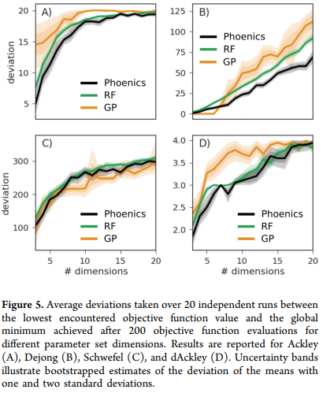

Slide 49
The Phoenics is able to propose a set of conditions for an experimental procedure. The experimental procedure can then be executed with the proposed about as well as random forest optimization for higher dimensions.
With the help of feedback, Phoenics can make more informed decisions and, thus provides more promising sets of experimental conditions.
One of the earliest discovered reactions featuring a stable limit cycle for a set of reaction conditions is the Belousov-Zhabotinsky reaction.

Slide 50
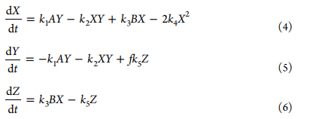
Models at different levels of complexity have been developed to describe the dynamic behavior of the Belousov-Zhabitinsky reaction. One of the simplest model of this reaction is the Oregonator.
The Oregonator consits of a set of three coupled first-odered nonlinear differential equations for three model compounds X, Y and Z.

Slide 51
Phoenics is used to reverse engineer the set of reaction conditions consisting of three initial concentrations (α0, η0, and ρ0) and four reaction constants (q, s, w, and f) from the concentration traces computed in the original publication.
The goal is 2-fold: (i) find a set of conditions for which the dynamical behavior qualitatively agrees with the behavior of the target, that is find chemical oscillations, and (ii) fine-tune these conditions such that they reproduce the dynamical behavior on a quantitative level.

Slide 52
Concentration traces for a sampled set of reaction parameters were computed with a fourth-order Runge-Kutta integrator with adaptive time stepping.
The distance (loss) between the sampled traces and the target traces is calculated as the Euclidean distance between the points in time at which a concentration trace reaches a dimensionless concentration value of 100.
Loss values between 300 and 500 indicate that the periodicity of the predicted concentration traces resembles the periodicity of the target traces; that is, the predicted traces qualitatively agree with the target.

Slide 53
Phoenics is the only algorithm reproducing qualitatively and quantitatively target dynamic behavior within 150 optimization iterations.
The algorithm is well-suited for applications where evaluations of the objective function are expensive with respect to budgeted resources such as time or money.
Phoenics improves over optimization strategies based on particle swarms or evolutionary approaches, as well as on existing Bayesian global optimization methods and aviods redundant evaluations of the objective.

Slide 54
RECONFIGURABLE SYSTEM FOR AUTOMATED OPTIMIZATION OF DIVERSE CHEMICAL REACTIONS

Slide 55
Interchanging the system among the pharmaceuticals involved designing and developing a synthetic route, selecting the appropriate types and sizes of reactors, reassembling the hardware, and optimizing the overall process.
A team of Eli Lilly described a continuous manufacturing process to support phase 1 and phase 2 clinical trials of an active pharmaceutical ingredient.

Slide 56
Burke and co-workers developed an approach that uses a cross-coupling reaction to produce milligram quantities of organic molecules by an iterative, deprotection-coupling-purification sequence.
A modular Vaportec-based approach by Seeberger streamlined the divergent multistep syntheses of five active pharmaceutical ingredients, and systems developed by Ley feature monitoring and control of multistep syntheses of several specific molecular targets.

Slide 57
To build a fully integrated, easily reconfigurable, benchtop system that enables automated optimization we need to address some challenges: -
The chemical compatibility of components and pumping mechanisms
Development of a unified, modular system for truly plug-and-play operation
Appropriate software for system control and real-time monitoring for automated feedback optimization.
Ultimately integration into a single, small-footprint platform that requires little user expertise with flow chemistry.

Slide 58
To such system the researchers targeted the development and integration of three capabilities: -
Hardware components that perform the syntheses and purifications
In-line analytical technologies that monitor reaction progress
And, a user interface that provides software control and monitoring.
This system offers the user a trio of modes to operate the system: -
Automated optimization
Synthesis of a range of substrates under user-selected conditions (e.g., to investigate the scope of the transformation under conditions obtained from an optimization).
Scale-up of a selected synthesis under conditions obtained from a previous optimization.

Slide 59
The system comprises five bays, and six different modules have been developed thus far a heated reactor (up to 120°C), a cooled reactor (to -20°C), a light emitting diode (LED)-based photochemistry reactor, a picked-bed reactor (for solid supported reagents and catalysts, as well as passive mixing), a membrane-based liquid separator (purification via extraction), and a bypass (for reagent addition in a minimal volume, mixing, or unused bay).

Slide 60
High-performance liquid chromatography (HPLC) provides the best balance of generality and instrument cost, IR spectroscopy (Mettler Toledo ReactIR), Raman spectroscopy (Marqmetrix Raman BallProbe), and mass spectrometry (Advison MS with electrospray ionization) are also compatible.
The agnostic "black-box" approach provides generality and flexibilty to the system by performing local optimization around the best conditions while continuously searching other, more distant regions to ensure that a global optimum is found.

Slide 61
The researchers began their tests of the system with a Paal-Knorr pyrrole synthesis. It provide the twofold opportunity to compare the performance of the system with others.
The same automated optimization perform in two different laboratories, after optimization of a Paal-Knorr pyrrole synthesis in one laboratory (Jensen), the system was then transferred to another (Jamison), wherein the optimization converged independently on the same reaction conditions.

Slide 62
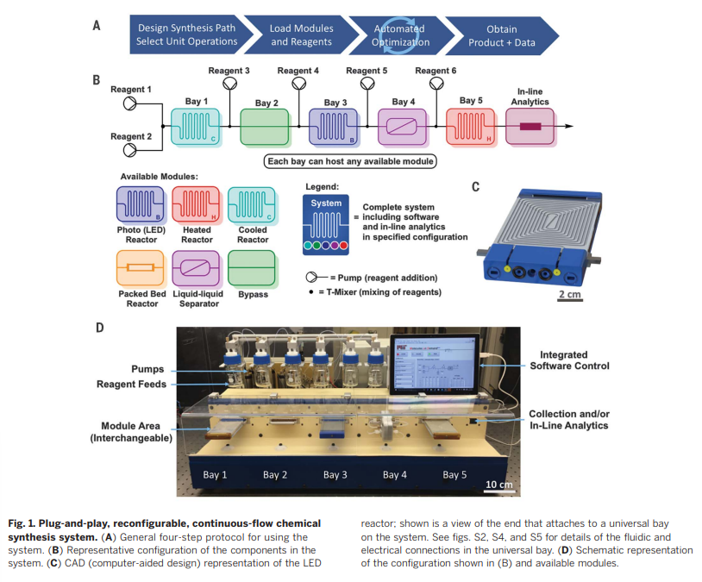

Slide 63
They use a four-step protocol in each optimization: -
Design of the reaction sequence (selecting the reagents, solvents, and catalysts),
Attachment of the appropriate module to each bay and loading of the reagents and solvent feeds.
Selection of the parameter boundaries (time, temperature, catalyst loading) within which the system will perform the optimization,
Execution of the automated optimization.

Slide 64
The Buchwald-Hartwig amination is central to many areas of chemical research including the discovery and development of pharmaceuticals, agricultural chemicals, and organic light emitting diodes.
Bays 1 and 2 were used for reagent addition and mixing, and the amination itself was performed in bay 3 using a heated reactor.
The toluene and water is introduce in bay 4 then it enabled a continuous liquid-liquid separation in bay 5.

Slide 65
A 60-nl sample of the organic layer was analyzed directly by an in-line HPLC system.
The desired secondary amine 7 was obtained in a 72% yield after the in-line purification.
The user can optimize each individual case using this automated system.
The palladium-catalyzed coupling reactions of the anilines and aryl-bromides examined proceeded with overall chemical yields of 72 to 99% and with material throughput rates of 430 to 816 mg/hour.

Slide 66
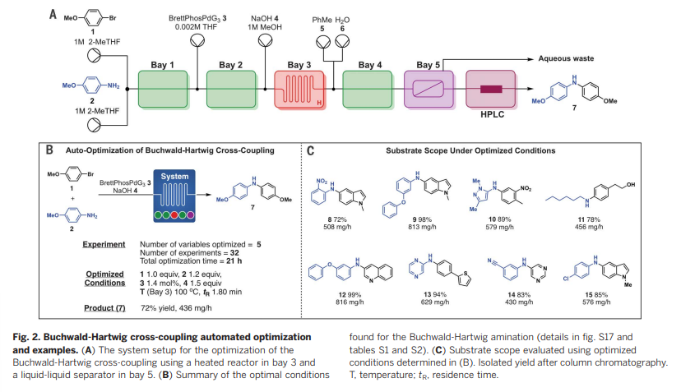

Slide 67
The following employed a unique array of modules in five universal bays: Horner-Wadsworth-Emmons (HWE) olefination, reductive amination, Suzuki-Miyaura cross-coupling S_{N}Ar, the generation of an iminium electrophile via photoredox catalysis, and ketene generation with subsequent alkene cycloaddition.
The HWE, is a two-step process and optimization in the system used heated reaction in bays 1 and 2.

Slide 68
The Suzuki-Miyaura cross-coupling optimization was performed using a packet-bed reactor containing the solid-supported catalyst siliaCat DPP-Pd.
The LED photoreactor, which includes active cooling for temperature control, was then applied to an automated optimization of a photoredox reaction that proceeds a reactive intermediate, iminium ion.

Slide 69
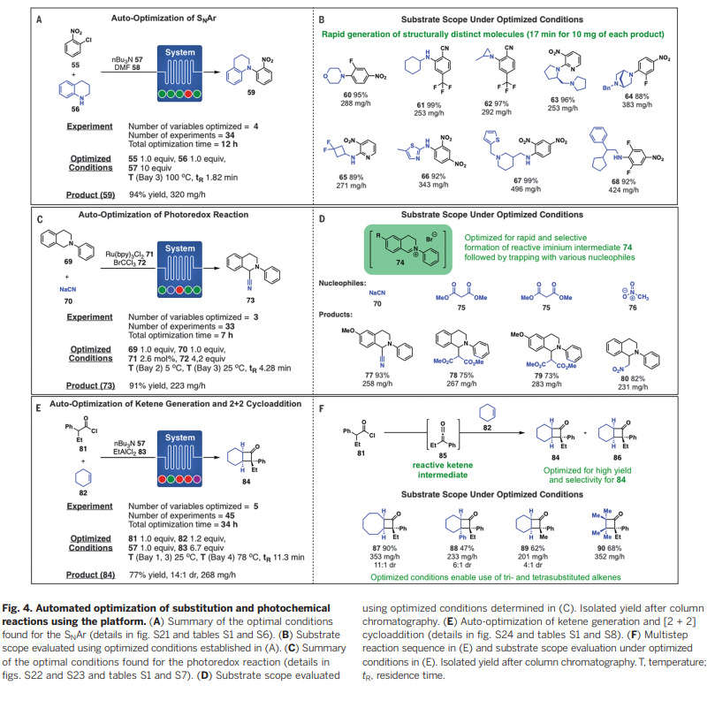

Slide 70
To check the ability of the system to optimize multistep sequences, the researchers targeted a ketene generation and Lewis's acid-promoted alkene cycloaddition to form cyclobutanones, inspired by a precedent from Brown.
The examination of the substrate scope in each of the seven reactions and multistep sequences afforded greater than 50 compounds in high yield.

Slide 71
INPAINING AS A TEACHIQUE FOR ESTIMATION OF MISSING VOXELS IN CHEMICAL SHIFT IMAGING

Slide 72
Voxelwise analyses allow localize effects of interest with greater spatial accuracy, often improve sensitivity to detect spatially restricted effects that may be diluted in region-of-interest (ROI) analyses.
The use of voxelwise analyses can come with a cost of signal-to-noise ratio (SNR).
Chemical shift imaging (CSI), enables the performance of multi-voxel MRI spectroscopy, which conferring imagers the ability to interrogate metabolite levels across a larger portion of the brain, and with higher spatial resolution, compared to single voxel spectroscopy.

Slide 73
Another solution is to minimize the problem to recover the missing data using interpolation methods.
It is commonly used in medical imaging, its performance is often affected by errors in the fitting.
An alternate traditional interpolation method is provided by image inpainting. It is also called "fill-in", this method fills in missing or corrupted parts of an image by taking into account both its global and local features.

Slide 74
The researchers used inpainting approach to restore the poor CSI data.
In this method the researchers evaluate the performance of inpainting and several common image interpolation methods on N-Acetylaspartate (NAA) CSI maps.

Slide 75
In this method tow image degradation strategies were implemented:
First, that all images were corrupted in such a way as to cause the images to randomly loss 5% to 9% of voxels.
The NAA maps used in these tests, were raw, and not thresholder to meet typical quality control (QC) standards.
These tests were performed once per % loss level for each of the available T1 or CSI images, each time with a different random distribution of missing voxel.
Second, because the low-quality CSI voxels tend to be more expected in some areas of the brain rather than being randomly distributed.
The same NAA maps were corrupted in the spatial distribution encountred in real-life scans.

Slide 76
The researchers screened and enrolled eighteen healthy controls.
MR imaging was performed in a 3T Siemens TIM Trio scanner using an 8-channel head and neck coil and included an anatomical T1-weighted volume, and CSI.
The aim of inpainting is to provide an estimation of missing/corrupted parts of an image so that it looks natural to the human eye.
The missing regions in an image might be composed of structures and textures, and separating these properties in two different steps is essential, starting by first recovering the structures and then recovering the texture.

Slide 77
The researchers use penalized least squares regression method that allows restoring missing data by means of the discrete cosine transform. It uses nearest neighbor interpolation to obtain a rough initial guess.
They used three different multivariate interpolation methods for comparison: -
Nearest neighbor
Trilinear
Tricubic interpolation.

Slide 78
The quantitative performance of the different methods was assessed by comparing the normalized root mean square error (NRMSE) computed between ground truth images and interpolated/inpainted images, using a repeated measures analysis of the variance to evaluate the effect of method, %loss and their interaction.
The researchers use one-way ANOVA to assess the real-life loss distribution scenario which is followed by paired-samples Wilcoxon signed rank tests to assess if the performance of inpainting.

Slide 79
Bonferroni-corrected T-tests were computed as follow-up tests, comparing inpainting against the other methods for each %loss level.
Inpainting outperformed the other methods in filled-in missing pixels/voxels.
The researchers also observed that a statically significant method * %loss interaction (F_{54,918} = 76.4, p’s < 0.001), and the decomposition of the interaction using post-hoc pairwise comparisons revealed that inpainting outperformed all other methods at all %loss levels up to 80%loss (p’s < 0.001).

Slide 80
The NAA maps were corrupted in the same spatial distribution encountered in a dataset from actual CSI scans. The researchers extracted masks representing "bad NAA voxels" (SD>20%) for those subject images losing more than 15% of voxels in the FOV and registered those masks presenting an excellent NAA amplitude map.
The CSI voxel estimator need to meet several minimum Quality Control (QC) criteria including, but not limited to the standard deviation of the estimators.

Slide 81
When the voxel does not meet these criteria, it is typically excluded.
The performance of inpainting approach yields significantly better results compared to traditional interpolation methods, whether the voxels to be estimated were randomly distributed or located in regions genuinely prone to voxel loss in an actual CSI dataset.
The researchers purposefully chose to apply NAA maps because the relatively low percentage of poor-quality voxels allowed them to compare the results of the various methods against a “ground truth”.

Slide 82
The limitations are: - that the method is applied in small number of datasets. The validation was performed using data from healthy control subjects. The researchers applied these methods based on the premise that when a voxel does not meet certain QC criteria it is discarded.
The low-SNR image regions may contain information and the researchers could initialize these methods based on the actual data instead of treating them as missing voxels.

Slide 83
Previous presentation doughs answers
GCN (Graph Neural Network)
GCNs are a very powerful neural network architecture for machine learning on graphs. In fact, they are so powerful that even a randomly initiated 2-layer GCN can produce useful feature representations of nodes in networks.
GCN is a type of convolutional neural network that can work directly on graphs and take advantage of their structural information.
it solves the problem of classifying nodes (such as documents) in a graph (such as a citation network), where labels are only available for a small subset of nodes (semi-supervised learning).

Slide 84
Muzero
MuZero masters Go, chess, shogi and Atari without needing to be told the rules, thanks to its ability to plan winning strategies in unknown environments.
Researchers have tried to tackle this major challenge in AI by using two main approaches: lookahead search or model-based planning.
MuZero uses a different approach to overcome the limitations of previous approaches. Instead of trying to model the entire environment, MuZero just models aspects that are important to the agent’s decision-making process.

Slide 85
Alpha Go
AlphaGo is a computer program that combines advanced search tree with deep neural networks. These neural networks take a description of the Go board as an input and process it through a number of different network layers containing millions of neuron-like connections.

Slide 86
Alpha Zero
AlphaZero takes a totally different approach, replacing these hand-crafted rules with a deep neural network and general purpose algorithms that know nothing about the game beyond the basic rules.
To learn each game, an untrained neural network plays millions of games against itself via a process of trial and error called reinforcement learning.
At first, it plays completely randomly, but over time the system learns from wins, losses, and draws to adjust the parameters of the neural network, making it more likely to choose advantageous moves in the future.

Slide 87
Beilstein Database
The Beilstein database is the largest database in the field of organic chemistry, in which compounds are uniquely identified by their Beilstein Registry Number. The database covers the scientific literature from 1771 to the present and contains experimentally validated information on millions of chemical reactions and substances from original scientific publications.

Slide 88
The electronic database was created from Handbuch der Organischen Chemie (Beilstein's Handbook of Organic Chemistry), founded by Friedrich Konrad Beilstein in 1881, but has appeared online under a number of different names, including Crossfire Beilstein. Since 2009, the content has been maintained and distributed by Elsevier Information Systems in Frankfurt under the product name "Reaxys

Slide 89
Automation creating libraries of compounds
Automating the process of library synthesis plays an important part in the economics of library synthesis.
Continuous flow chemistry can be easily automated, creating a platform for automated library synthesis.

Slide 90


