Slide 1


SHADOW PROJECT - IoT Telemetry & Anomaly Detection Platform Real-time telemetry ingestion • Kafka streaming • ML anomaly detection • Streamlit dashboard

Slide 2
Candidate Details
Candidate Name - Rohit Kumar
Candidate PS No - 40053797
BU Mentor Name - Nilanjan De
GEA Mentor Name - Datti Soniya

Slide 3
Shadow Project
Objective & Deliverables
Introduction
Project Plan
Progress & Status
Analysis
Risk and Mitigation
Summary

Slide 4

Objective and Deliverables
Objectives
Real-time IoT telemetry collection
Secure device communication
Streaming and processing of sensor data
ML-based anomaly detection
Automated anomaly alerting
Real-time dashboard monitoring

Slide 5
Deliverables
Deliverables
Azure IoT Hub & device setup
X.509 authentication
Python IoT device simulator
Kafka streaming pipeline
Telemetry consumer
ML anomaly detection model
Alert module
Data storage
Streamlit dashboard
GitHub documentation

Slide 6
Introduction
Problem: IoT devices continuously generate telemetry that needs real-time monitoring and anomaly detection.
Solution: A complete pipeline that collects, streams, processes, analyzes and visualizes IoT telemetry.
Core Flow:
IoT Device → Azure IoT Hub → Kafka → Consumer → ML → Alert → Storage → Dashboard
Technology Stack
Cloud
Microsoft Azure
Azure IoT Hub
Development
Python
6. LOG ANALYSIS & DEBUGGING
Expected Result:
Detect and resolve connectivity issues through log analysis.
Actual Outcome:
Connectivity issues identified, analyzed, and resolved successfully using Linux diagnostic tools.
8. OVERALL RESULT
Expected Result:
Achieve all project objectives successfully.
Actual Outcome:
All project objectives achieved as per the validation plan.
9. PROJECT OUTCOME
Expected Result:
Develop practical expertise in wireless connectivity validation.
Actual Outcome:
Practical expertise gained in wireless validation, debugging, driver/firmware verification, and log analysis.

Slide 7
VS Code
Git/GitHub
Streaming
Apache Kafka
Kafka Python
ML & Data
Pandas
NumPy
Scikit-learn
Joblib
Visualization
Streamlit

Slide 8
Project Plan
Initial Setup & Installation
Environment Preparation
Azure account & IoT Hub
Python 3.12
Virtual environment
VS Code
Java 22
Kafka 4.3.1
Required Python packages
Git/GitHub repository

Slide 9
Azure & Device Configuration
Azure IoT Setup
Create IoT Hub
Register device
Configure device identity
X.509 certificate authentication
Configure device connection
Verify connectivity
Device: pythondevice01

Slide 10
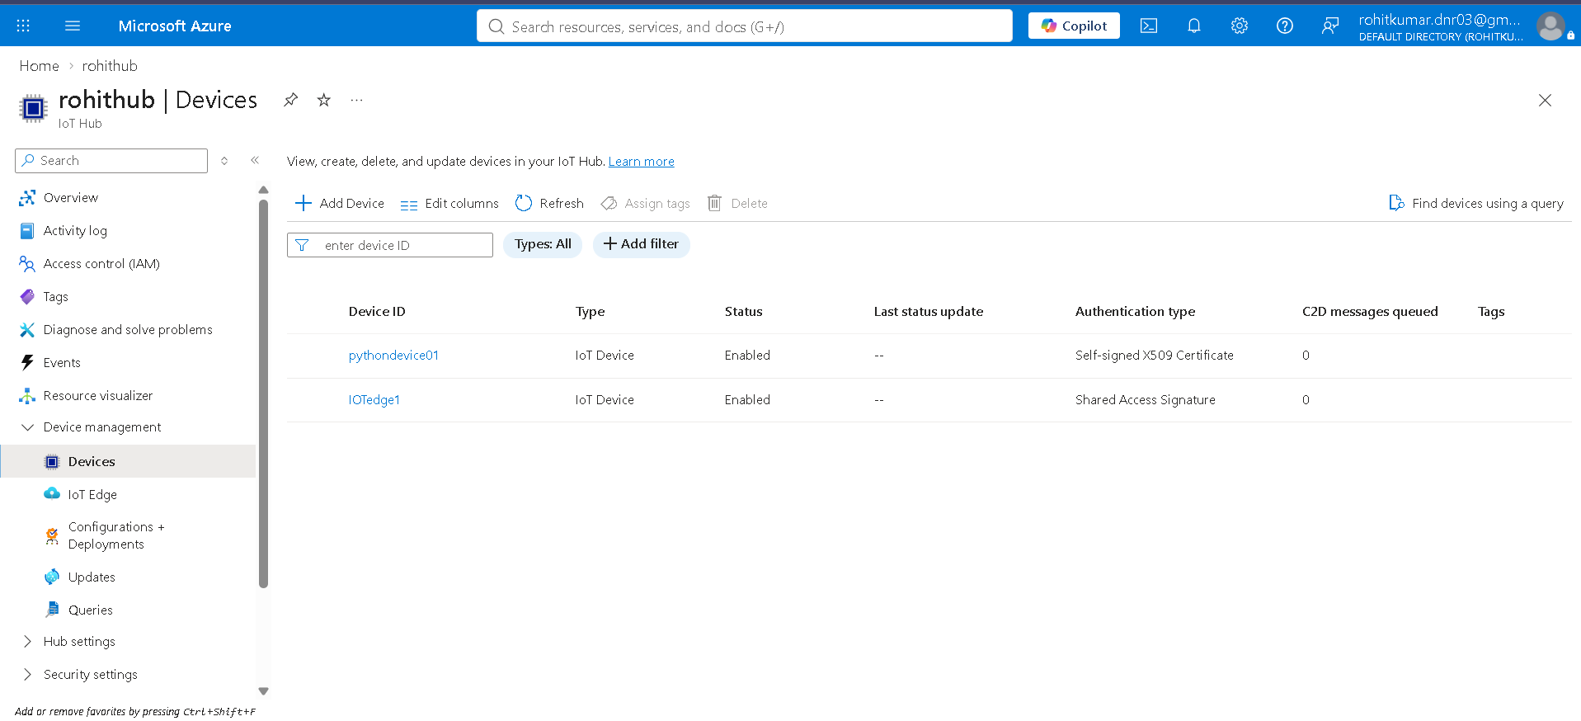

Slide 11
Project Architecture
IoT Device
↓
Sensor Telemetry
↓
Azure IoT Hub
↓
Kafka / Event Streaming
↓
Kafka Consumer
↓
Data Processing
↓
ML Anomaly Detection
↓
┌───────────────┐
Normal Anomaly
↓
Alert
↓
Data Storage
↓
Dashboard

Slide 12
Progress & Status
Device & Telemetry Module
Completed
Python sensor simulator
Continuous telemetry generation
Temperature
Humidity
Pressure
Vibration
Timestamp & Device ID
JSON telemetry format

Slide 13
Kafka Streaming & Consumer
Completed
Producer
Publishes telemetry
Kafka
Topic: iot-telemetry
Real-time message streaming
Consumer
Receives messages
Processes telemetry
Stores records
Sends data to ML model

Slide 14
ML & Alert Module
Completed
ML Model
Trained anomaly detection model
model.pkl
Real-time prediction
Anomaly score
Alert Module
Detects abnormal readings
Generates anomaly alert
Shows device and sensor information

Slide 15
Data Storage & GitHub
Data
Telemetry records
Anomaly results
Historical monitoring data
GitHub
Device
Consumer
ML
Alerts
Dashboard
Configuration
Documentation

Slide 16
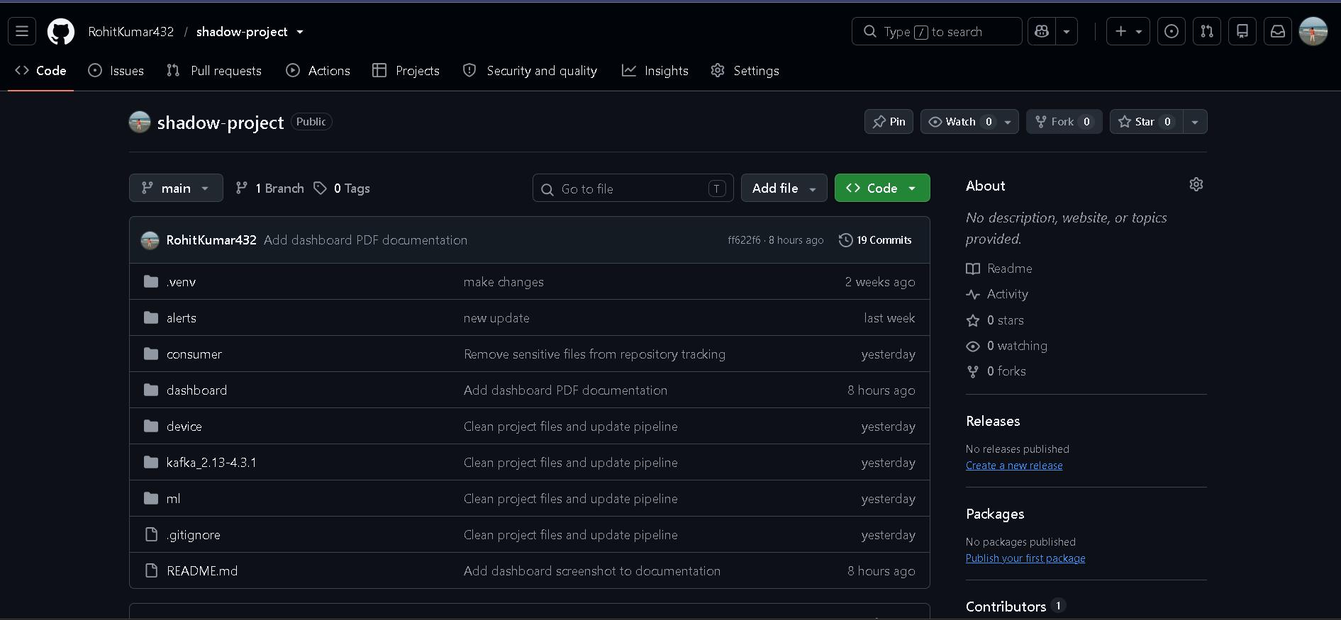

Slide 17
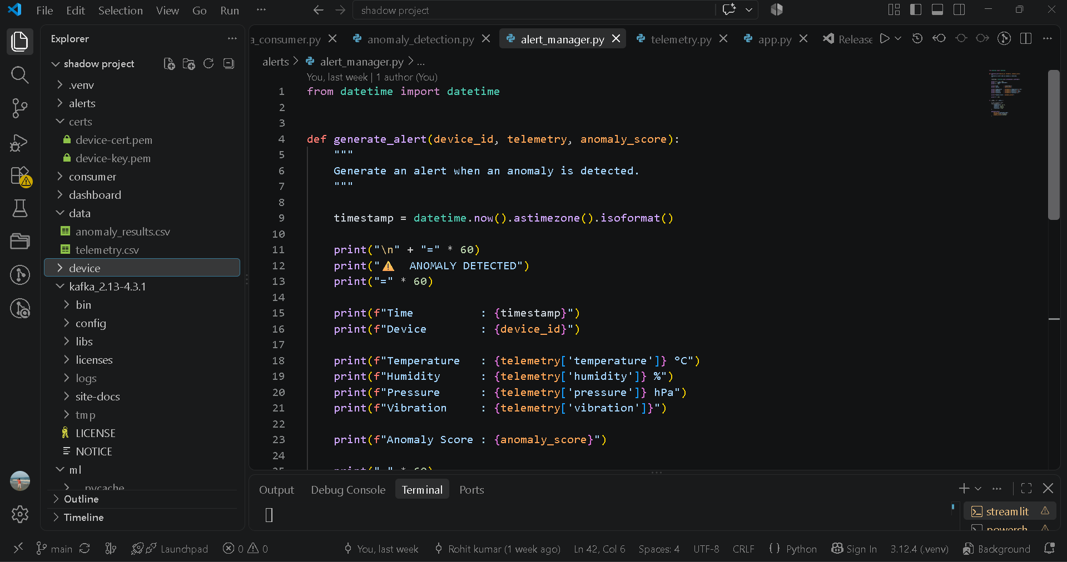

Slide 18
Analysis
Data & Anomaly Analysis
Telemetry Parameters
Parameter | Purpose
Temperature | Thermal monitoring
Humidity | Environmental monitoring
Pressure | Pressure monitoring
Vibration | Device/physical behavior
Analysis
Continuous telemetry evaluation
ML identifies abnormal patterns
Normal and anomalous readings separated
Anomaly results available for monitoring

Slide 19
Dashboard Analysis
Streamlit Dashboard
Show:
Total telemetry records
Device status
Latest readings
Sensor trends
Anomaly history
Latest telemetry data

Slide 20
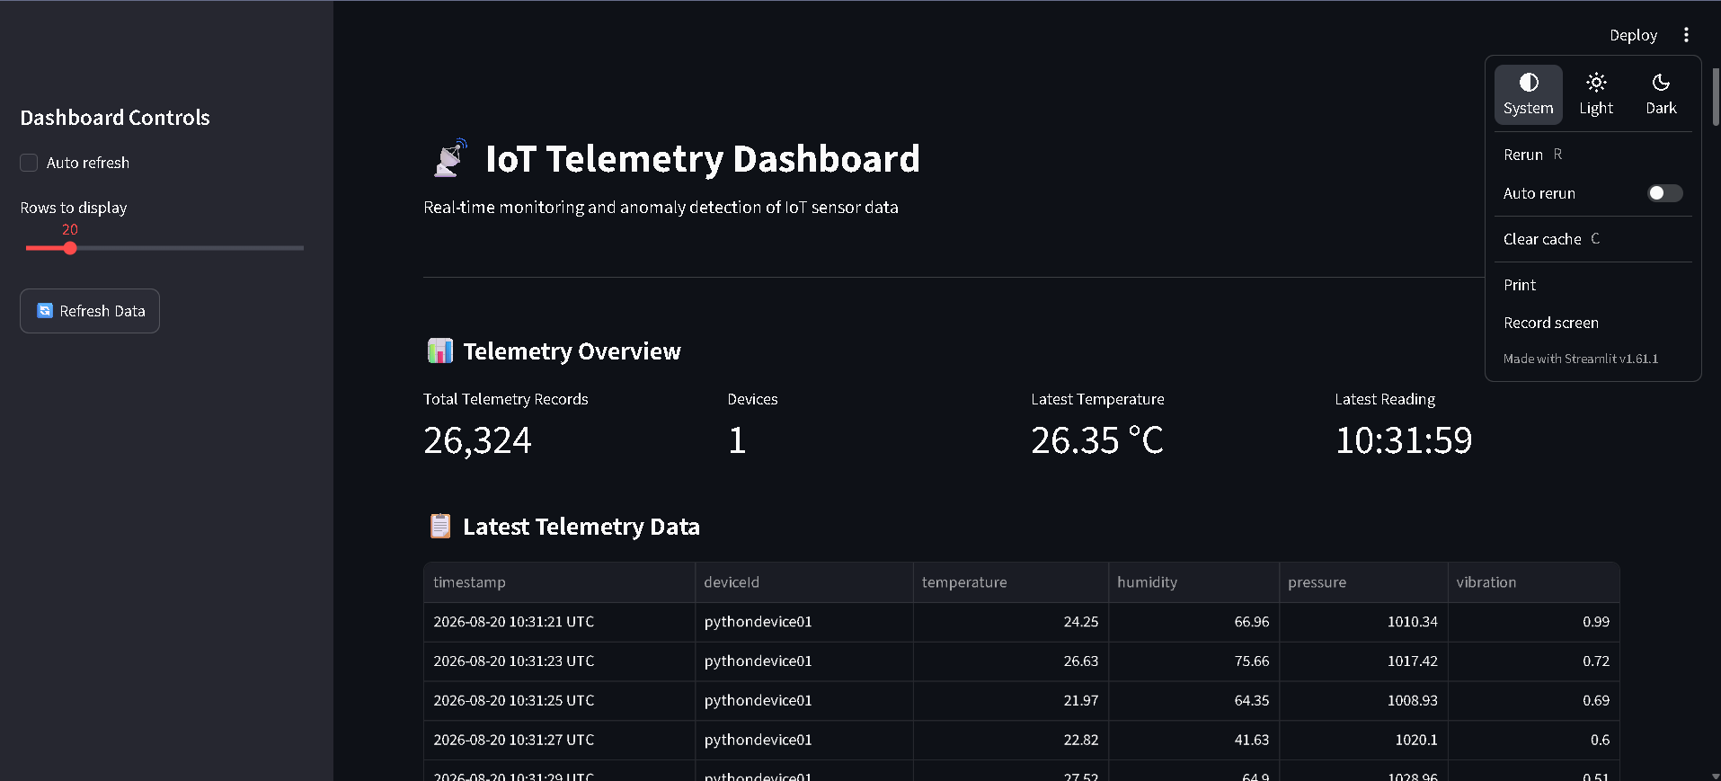

Slide 21
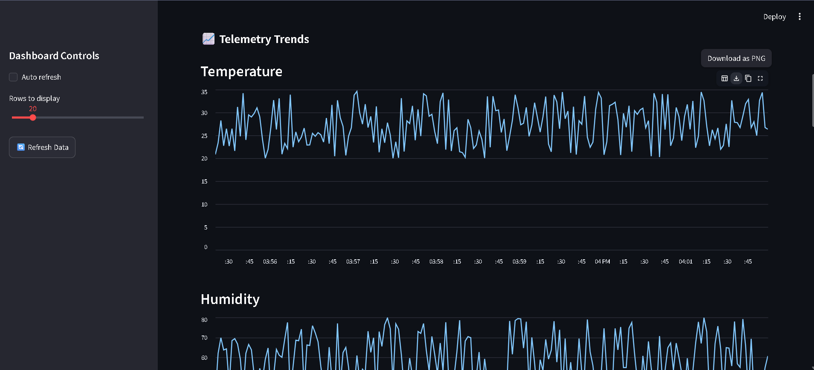

Slide 22
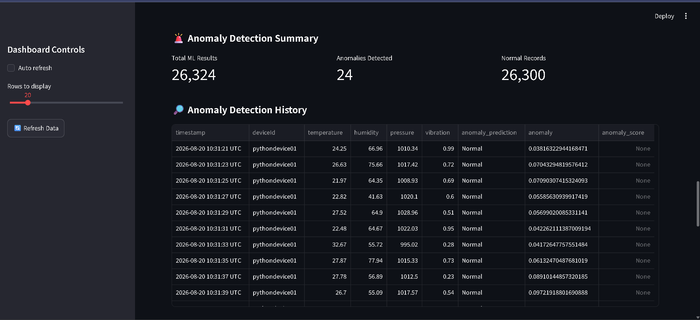

Slide 23
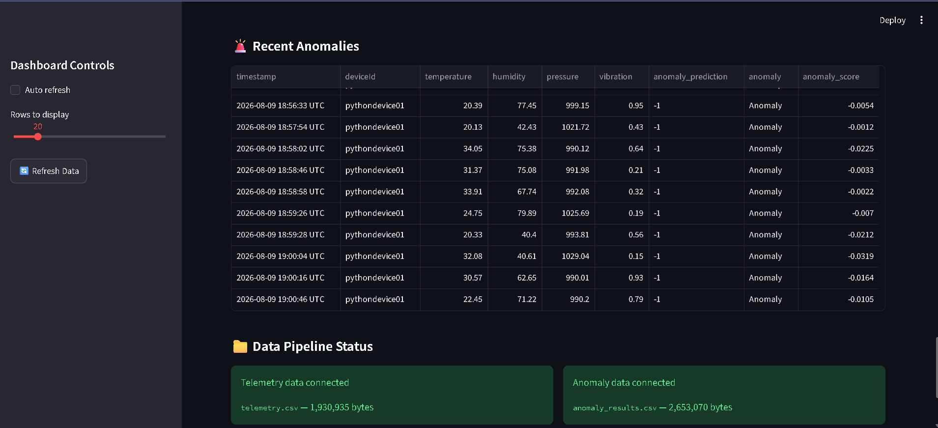

Slide 24
Risk & Mitigation
Technical Risks & Solutions
Risk | Mitigation
IoT connection failure | Verified device authentication & connectivity
Certificate issues | Configured X.509 certificates correctly
Kafka connection failure | Verified broker and topic
Invalid telemetry | Consumer-side validation
ML model failure | Model loading & prediction validation
Sensitive files exposed | .env, certificates & data excluded from Git
Dashboard data issues | Tested with live telemetry

Slide 25
Testing & Validation
End-to-End Validation
Device generates telemetry
IoT connection verified
Kafka receives messages
Consumer processes data
ML detects anomalies
Alerts generated
Data stored
Dashboard displays results
Final Pipeline Verified
Input → Processing → Detection → Output

Slide 26
Summary
Component | Status
Azure IoT Hub | Completed
Device Authentication | Completed
Telemetry Generation | Completed
Kafka Streaming | Completed
Consumer | Completed
ML Detection | Completed
Alerts | Completed
Data Storage | Completed
Dashboard | Completed
GitHub & Documentation | Completed
End-to-End Testing | Completed

Slide 27

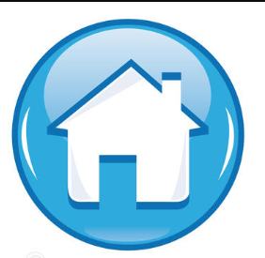
Thank You !

