Slide 1

Bike Sharing Prediction Using statistical model
By
Rohit Kumar Bandi Ravikumar
Rahul Prasad
Peter Prince

Slide 2

Problem Statement
BoomBikes, a US-based bike-sharing provider, has experienced a significant decline in revenues due to the ongoing COVID-19 pandemic. To overcome this challenge and prepare for the post-pandemic market, BoomBikes seeks to understand the factors influencing the demand for shared bikes.

Slide 3

Objective
The objective is to build a predictive model to estimate the daily demand for shared bikes based on various independent variables. This model will help BoomBikes’ management understand the dynamics of bike demand in the American market, allowing them to adjust their business strategies accordingly

Slide 4
Dataset Overview
instant: Record index
dteday: Date
season: Season (1: winter, 2: spring, 3: summer, 4: fall)
yr: Year (0: 2018, 1: 2019)
mnth: Month (1 to 12)
holiday: Whether the day is a holiday (1: yes, 0: no)
weekday: Day of the week (0: Sunday, 1: Monday, ..., 6: Saturday)
workingday: Whether the day is a working day (1: yes, 0: no)
weathersit: Weather situation (1: clear, 2: mist, 3: light rain/snow, 4: heavy rain/snow)
temp: Normalized temperature in Celsius
atemp: Normalized feeling temperature in Celsius
hum: Humidity
windspeed: Wind speed
casual: Number of casual users
registered: Number of registered users
cnt: Total number of users (casual + registered)

Slide 5
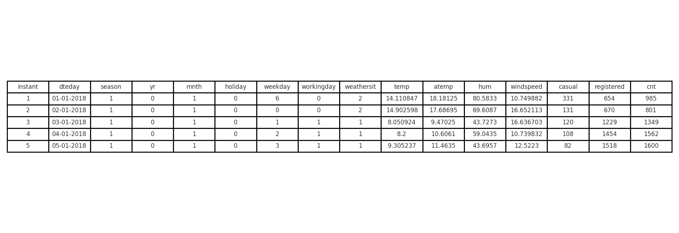
Data inspection
Shape of the dataset is (730, 16).
First few rows are:

Slide 6
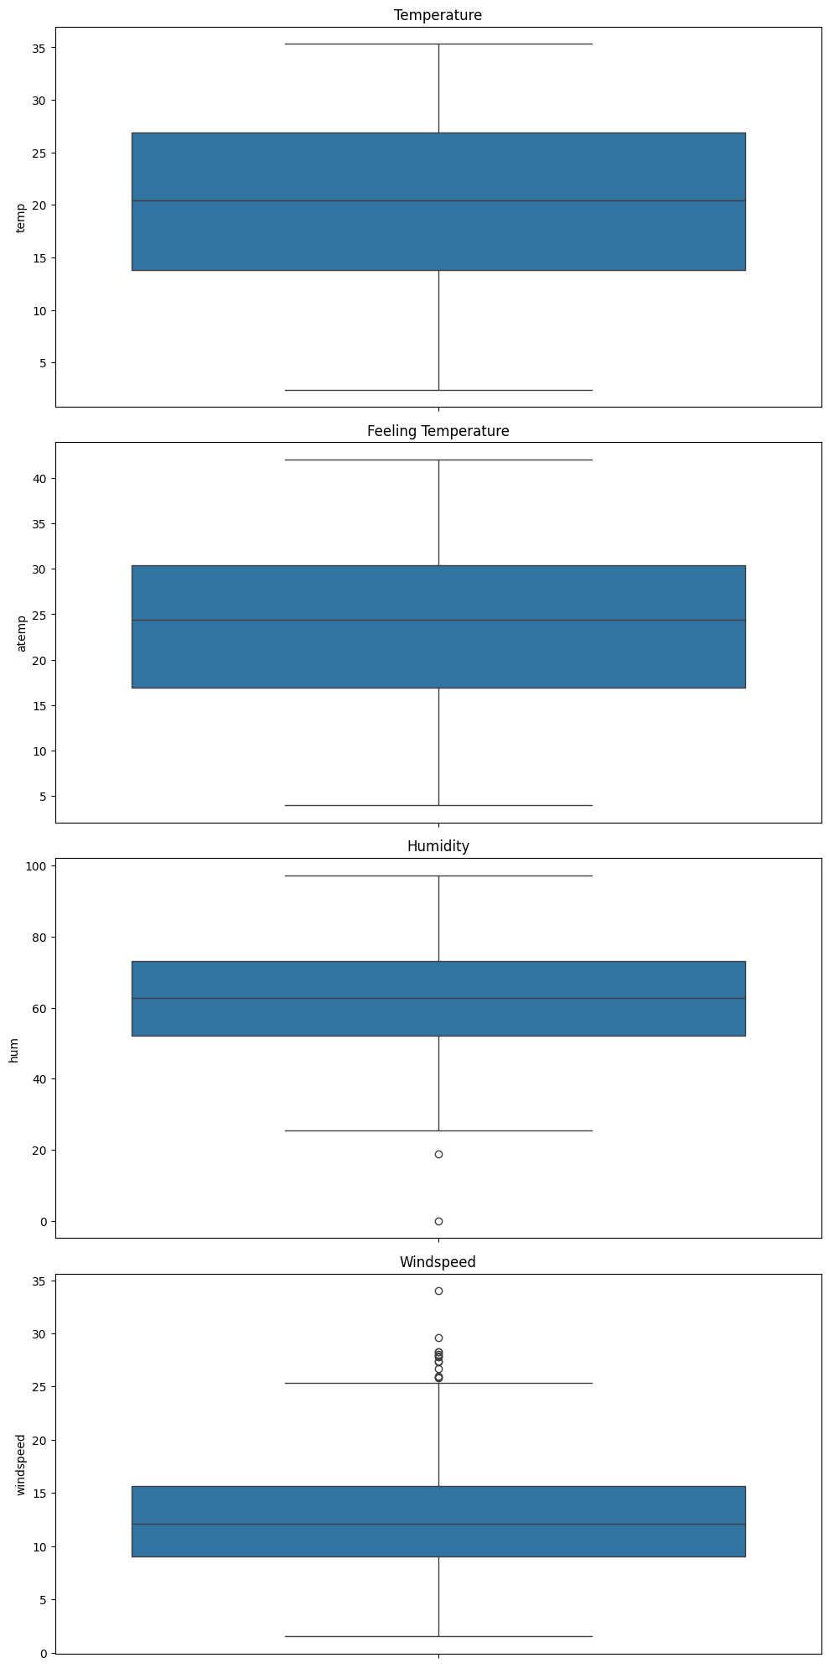
Outlier Analysis

Slide 7
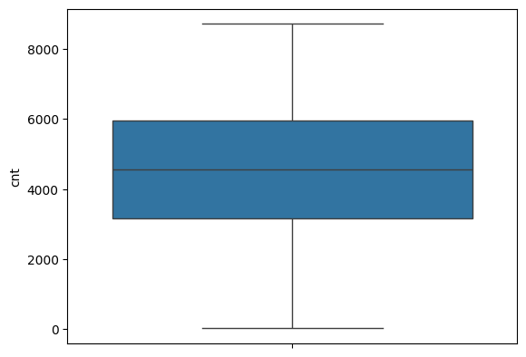
Exploratory Data (EDA)

Slide 8
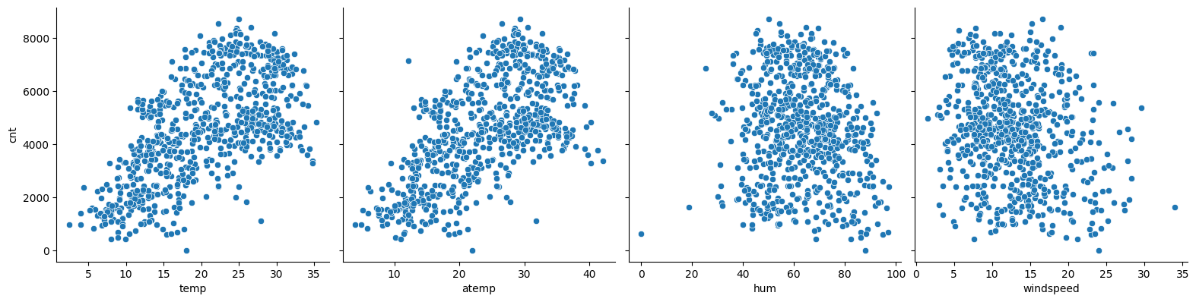

Slide 9
Model Building:
Split the data into training and testing sets.
Trained a statical model to make predictions.
Evaluated the performance of each model using appropriate metrics (e.g., RMSE, MAE, R^2 score).

Slide 10
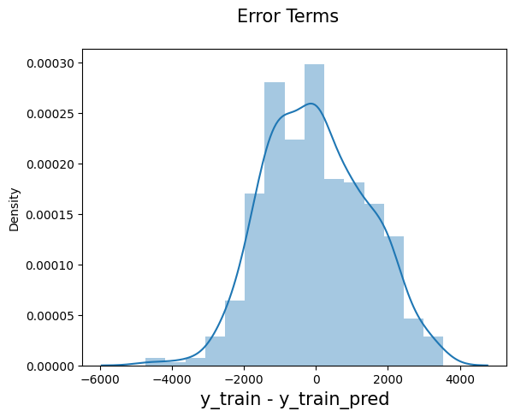
Residual Analysis

Slide 11
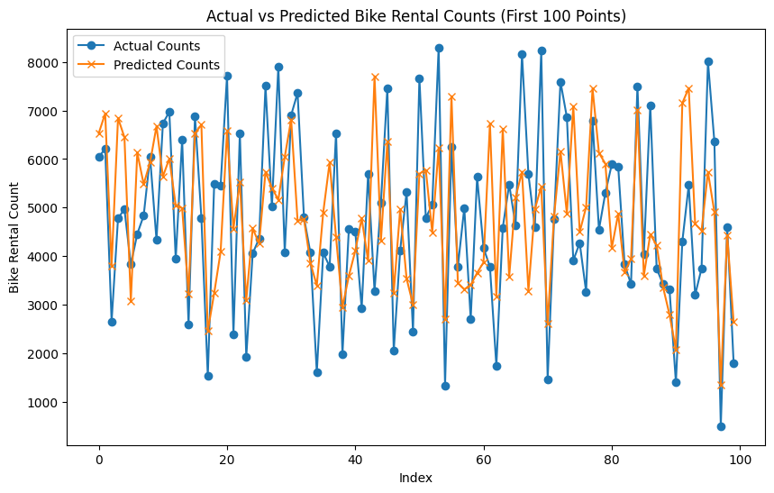
Actual vs predicted

Slide 12
Thankyou

