Slide 1
GoodBelly Sales Analysis

Slide 2






Recommendations Based on Analysis
The sales uplift from in-store demos persists for a certain time; further study is needed to pinpoint the exact duration.
In-store demo programs significantly boost sales.
Sales increase with strategic product placement within the store, such as on endcaps.
Target promotional efforts in regions with higher baseline sales for greater impact.
Regularly evaluate pricing strategies to stay competitive and profitable.

Slide 3
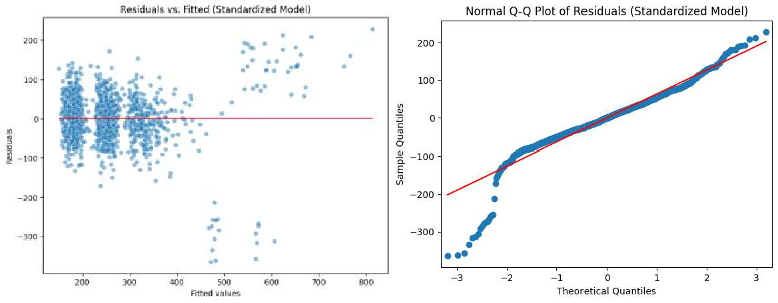
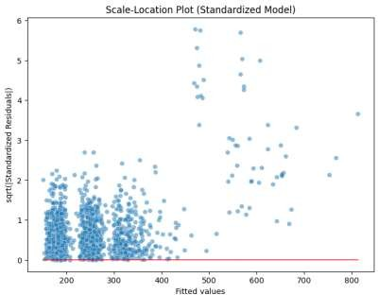
Residual Plot for Standardized Model

Slide 4
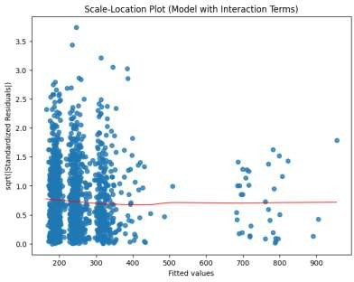
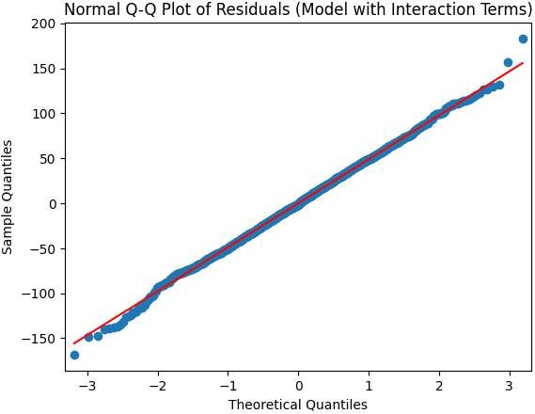
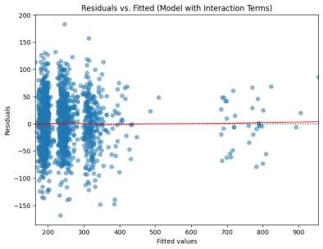
Residual Plot for Model with Interaction Terms

Slide 5




COMPETITOR PRICING AND PROMOTIONS CAN AFFECT SALES.
Other Affecting Factors
SALES FLUCTUATE WITH
SEASONAL TRENDS.
THE SUCCESS OF MARKETING CAMPAIGNS CAN IMPACT SALES PERFORMANCE.
A DIVERSE PRODUCT RANGE CAN ATTRACT MORE CUSTOMERS.

Slide 6
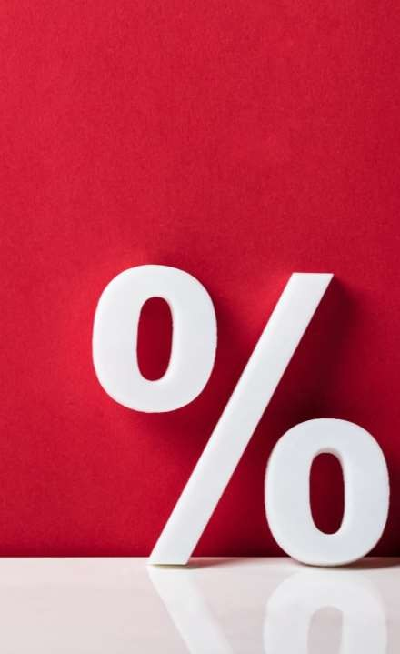
Does the in-store demo program
boost the sales? If so, for how long does the sales lift last?
Boost in Sales: In-store demonstrations significantly increase sales, averaging an additional 111.13 units.
Duration of Sales Lift: The sales uplift persists for up to five weeks following the demo, with a gradual decline over time, amounting to 73.52 units during the first three weeks and 67.57 units during weeks four and five.

Slide 7

Does the placement of the product
within the store affect the sales?
Endcap Placement: The strategic placement of products on endcaps has demonstrated a significant increase in sales, with an average uplift of 305.1021 units per product.
Natural and Fitness Sections: Placement within these sections has been observed not to yield a statistically significant impact on sales performance.

Slide 8
What other factors affect the sales of GoodBelly’s products?
Based on the regression output,
what are your recommendations to GoodBelly’s management?
Sales Performance Insights:
Sales Rep Involvement: The active participation of sales representatives correlates with a substantial increase in sales, averaging an uplift of 77.4369 units per product.
Average Retail Price: Higher retail prices exhibit a negative correlation with
sales volume, underscoring consumer sensitivity to pricing.
Recommendations:
Increase In-Store Demonstrations: Given the significant sales impact of product demonstrations, enhancing the frequency and coverage of in-store demos is recommended to stimulate sales growth.
Optimize Product Placement: Prioritize securing endcap placements to maximize product visibility and capitalize on their proven ability to drive sales. Consider reallocating resources from underperforming sections such as "Natural" and "Fitness" if they do not demonstrate significant sales impact.
Utilize Sales Representatives: Harness the influence of sales representatives by
integrating their efforts with in-store demo events. This collaborative approach

Slide 9

Suggestions to Improve and Refine the Model
01
Incorporate interaction terms to capture complex relationships between variables.
02
Continuously update the model with new data to enhance its accuracy.
03
Conduct feature engineering to develop new variables that may better explain sales variations.
04
Apply cross- validation techniques to validate the model's robustness.
05
Consider advanced modeling techniques like Random Forests or Gradient Boosting Machines.

