Slide 1
DRINK AND DELIGHT INVENTORY MANAGEMENT
Submitted by-
GROUP D
1.Rohit Kumar
2.Ritwik Sinha
3.sai jahnavi
4.Sowrasree Banerjee
5.Pushpraj kaushik

Slide 2
EPIC 1: As a System user, I need to place an order for raw materials. User Stories: 1.I will login using my supplier ID. 2. I shall get different raw material ID listed in the order. 3. I will verify the order and make payment.

Slide 3
EPIC 2: As a System user, I need to verify raw material order details. User Stories: 1.I will login using my raw material ID. 2. I shall check the raw material list and then process the order. 3. I will inquire about unit price and quantity and get the total price.

Slide 4
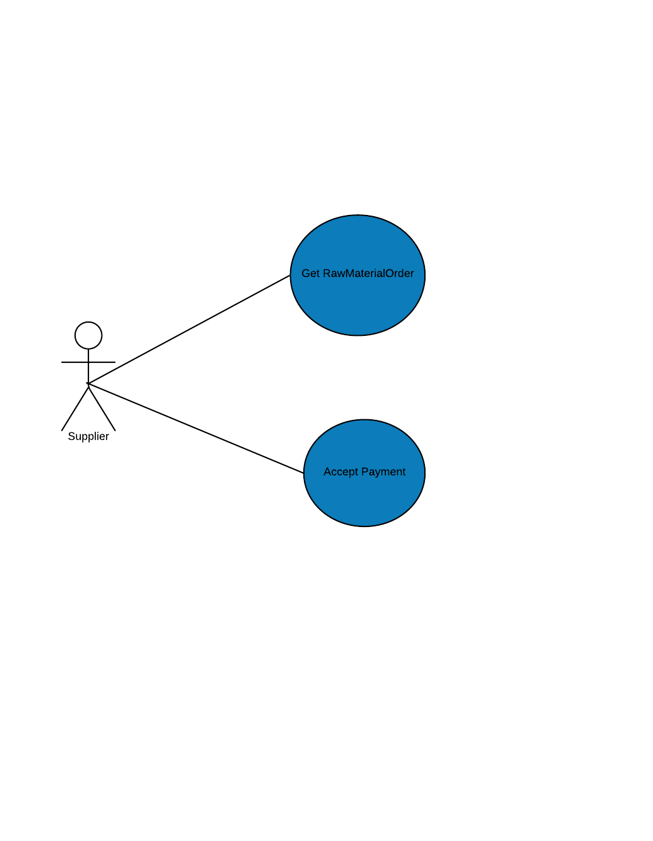

Slide 5
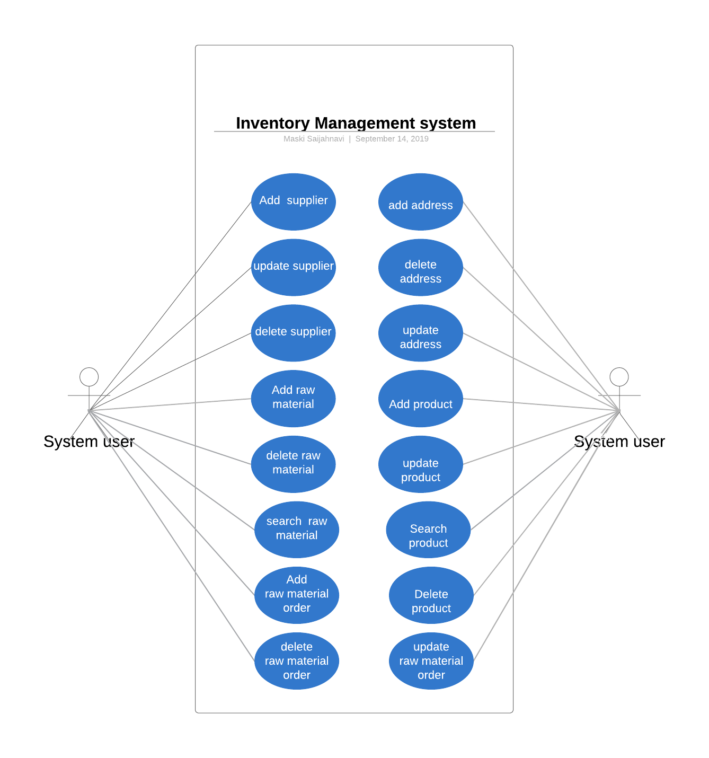

Slide 6
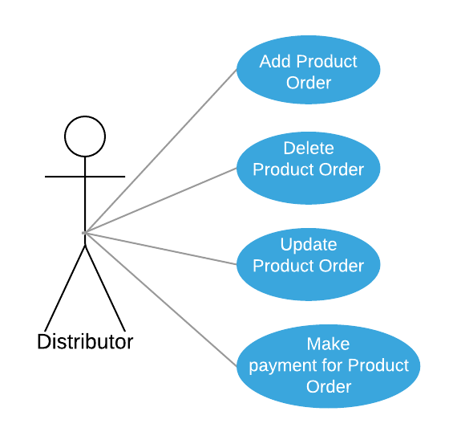
USE CASE DIAGRAM FOR DISTRIBUTER

Slide 7
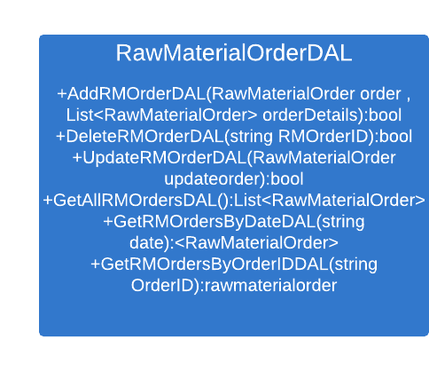
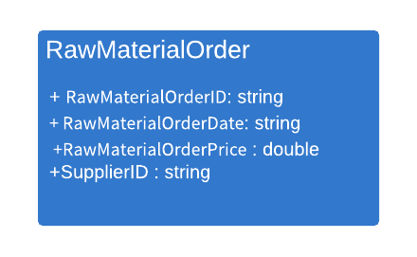
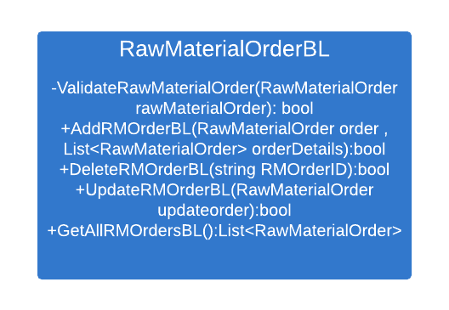
Class diagram:1

Slide 8
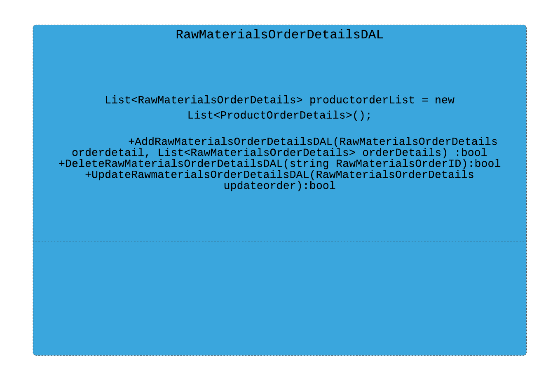
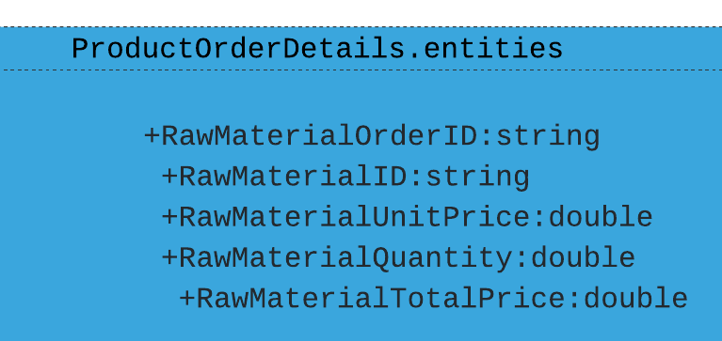
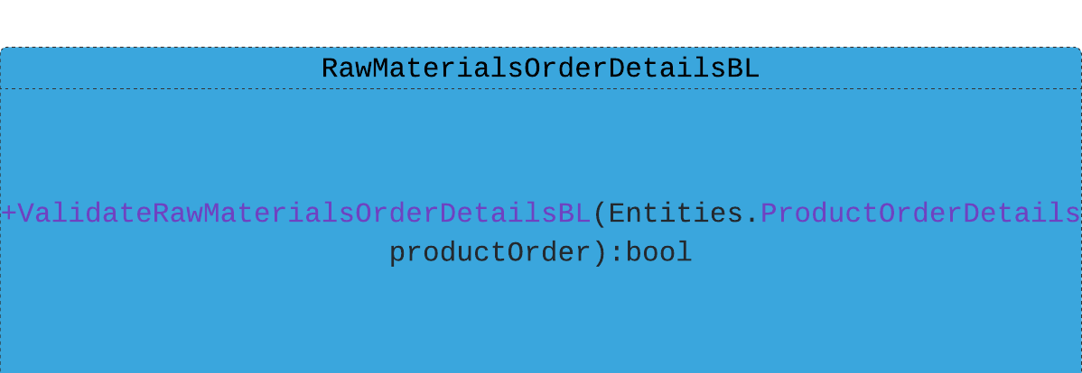
Class diagram 2

Slide 9
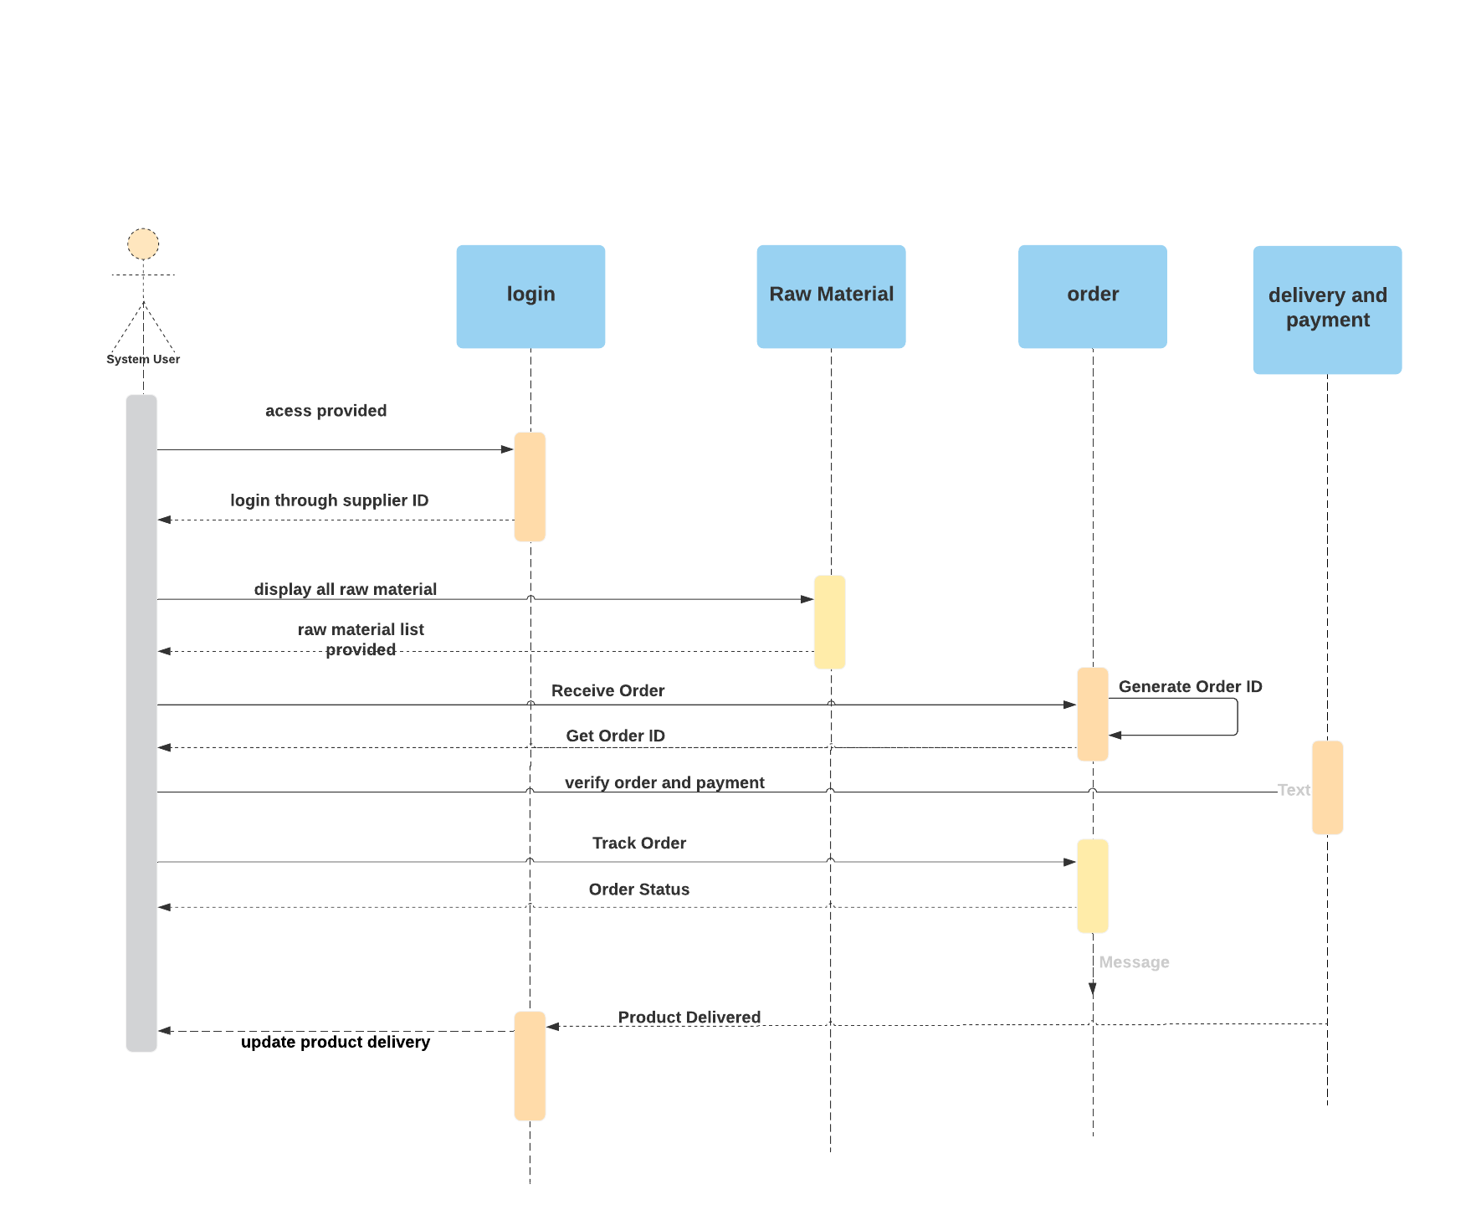
Sequence diagram 1 (rmo)

Slide 10
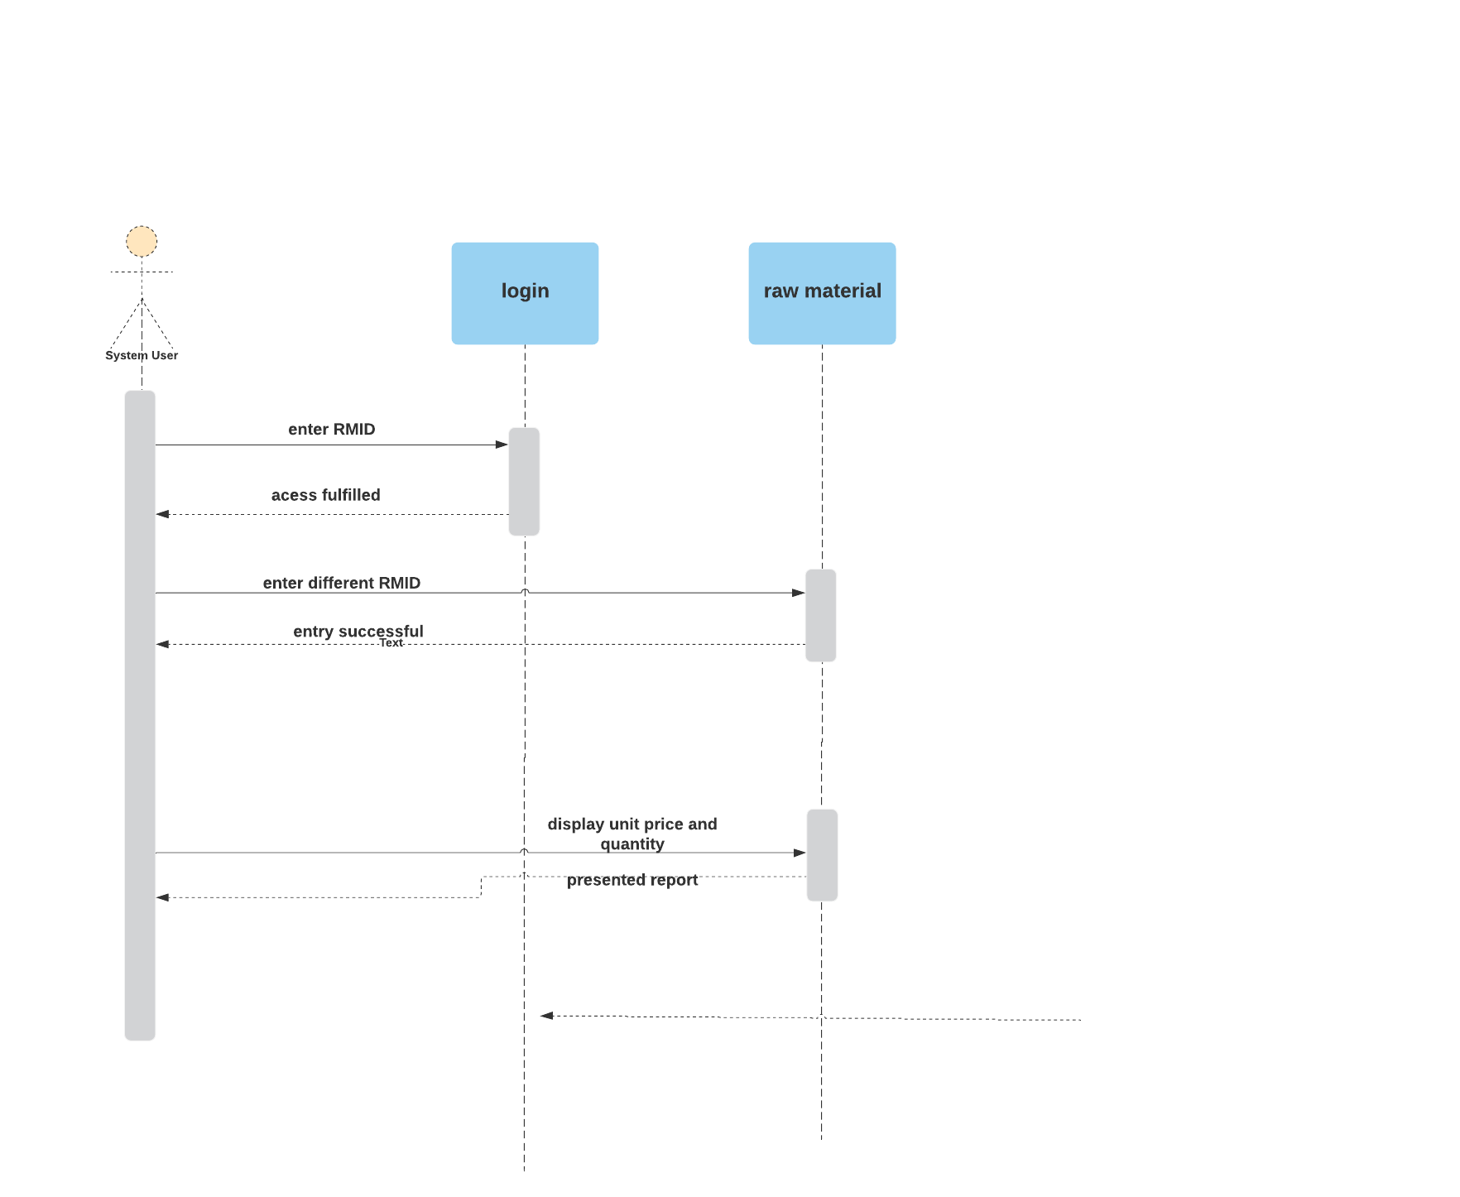
Sequence diagram 2

