Slide 1
DRINK AND DELIGHT INVENTORY MANAGEMENT
Submitted by-
GROUP D
1.Rohit Kumar
2.Ritwik Sinha
3.sai jahnavi
4.Sowrasree Banerjee
5.Pushpraj kaushik

Slide 2
EPIC AND USER STORIES
EPIC :
As a beverage company (drink and delight) , we want to give Order of raw materials to supplier.
USER STORY: User story 1: as a system user, we would check the stock and ask for supplier list.
User story 2: validate the login credentials of supplier.
User story 3: place an order to supplier and generate unique order ID
User story 4: providing supplier an address with address Id so that Order can be delivered

Slide 3
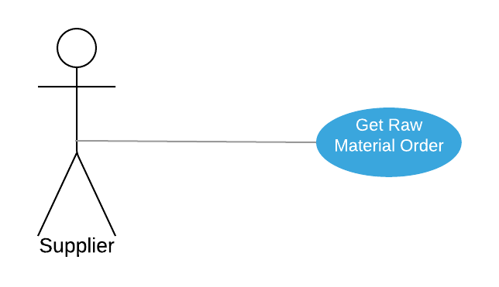
Use Case Diagram for Supplier

Slide 4
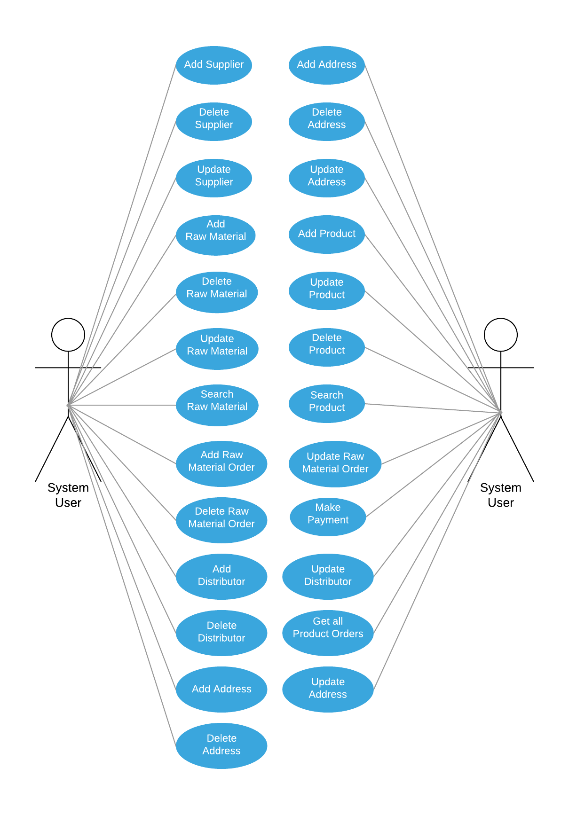
Use Case Diagram for System User

Slide 5
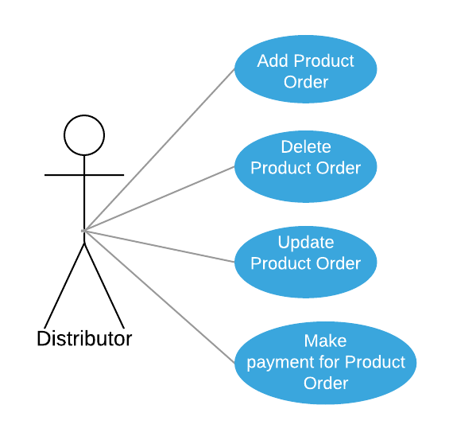
Use case diagram for Distributor

Slide 6
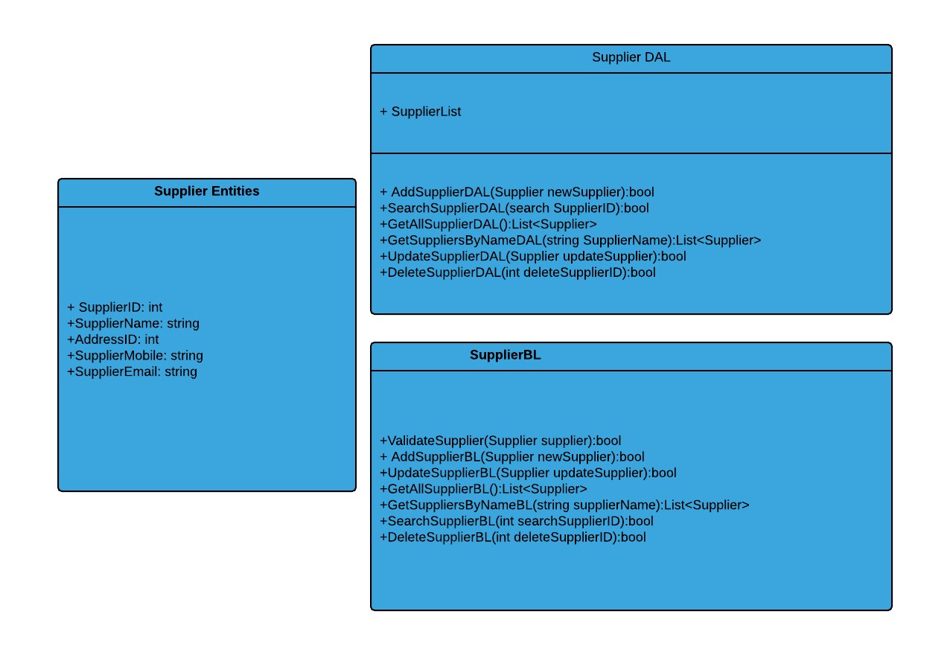
CLASS DIAGRAM: SUPPLIER

Slide 7
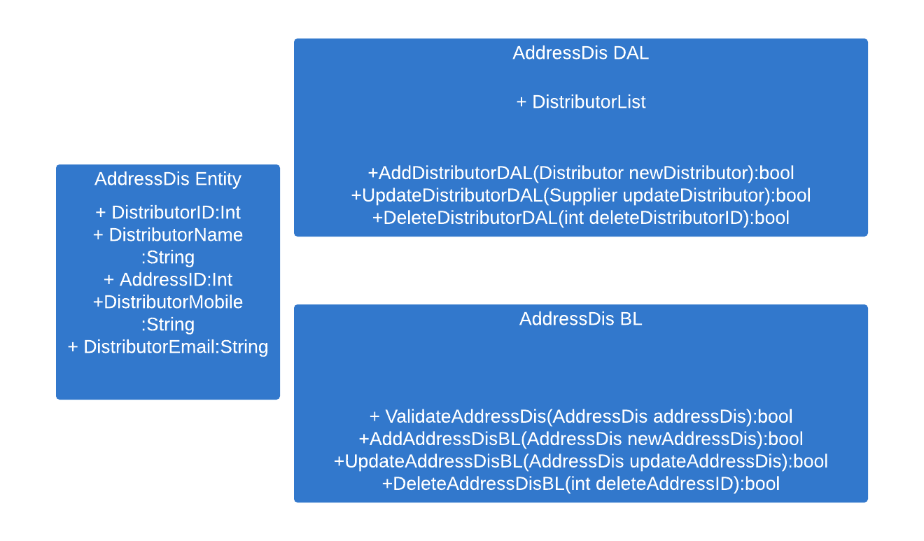
CLASS DIAGRAM ADDRESS DISTRIBUTOR

Slide 8
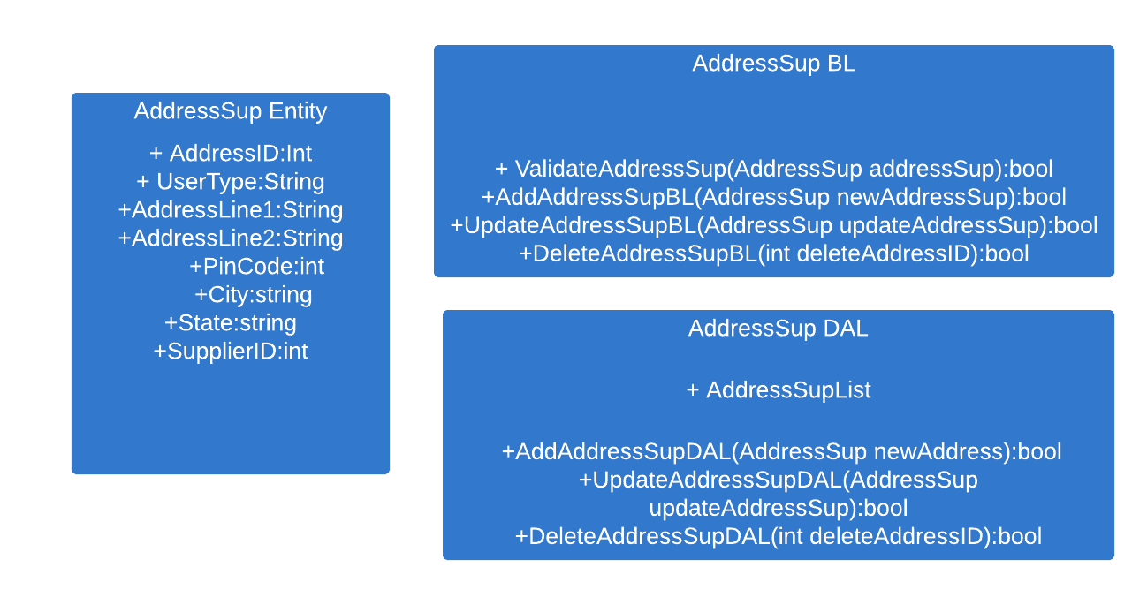
CLASS DIAGRAM :ADDRESS DISTRIBUTOR

Slide 9
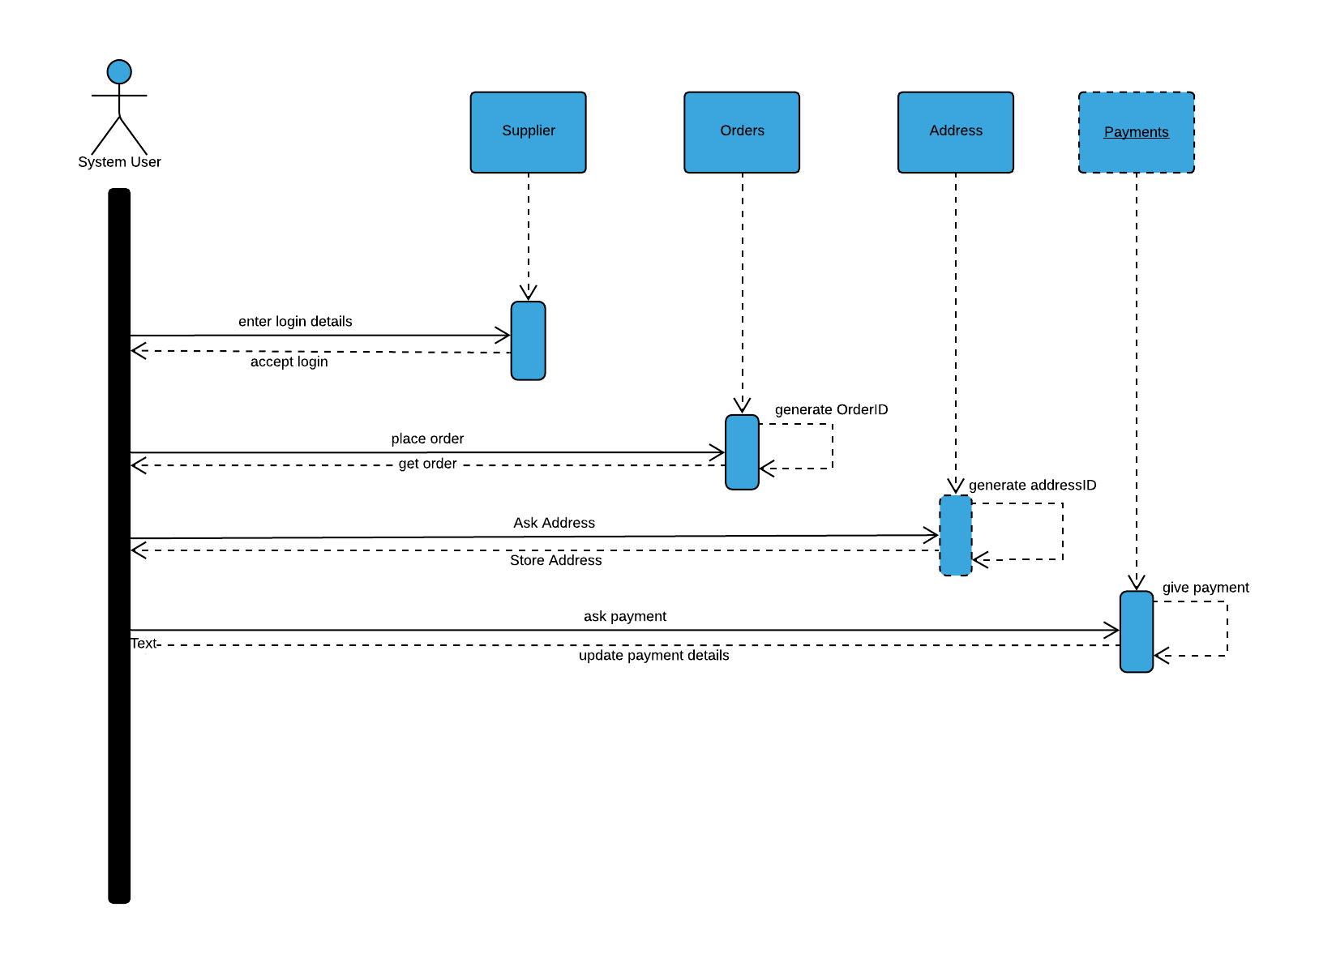
SEQUENCE DIAGRAM SUPPLIER

Slide 10
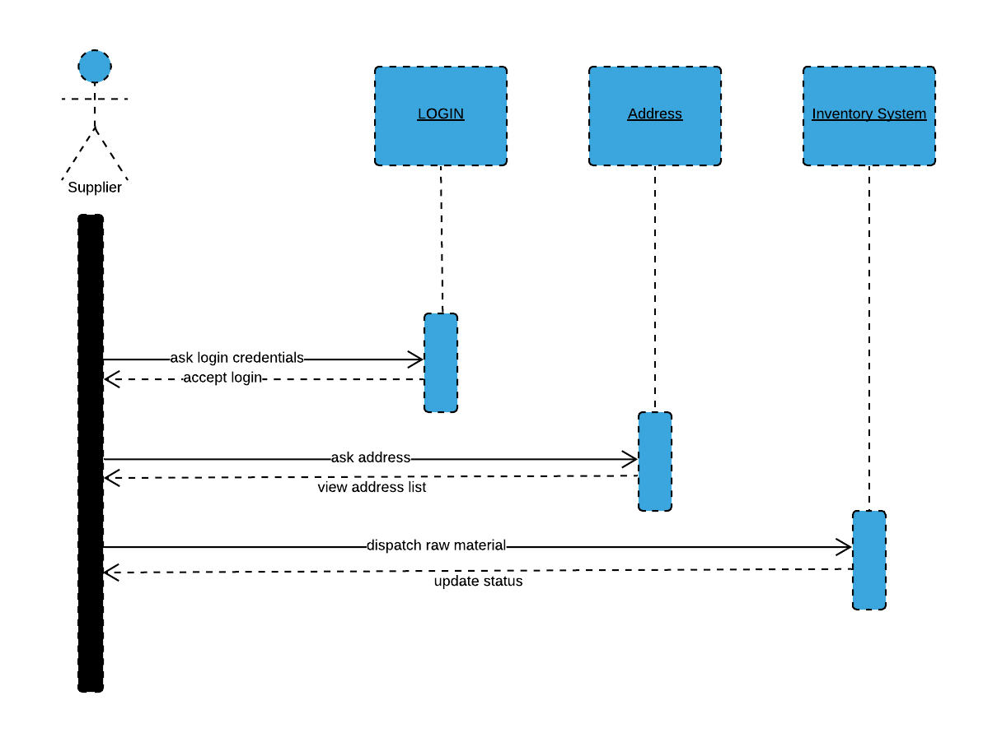
SEQUENCE DIAGRAM ADDRESS SUPLIER

