Slide 1
DRINK AND DELIGHT INVENTORY MANAGEMENT
Submitted by-
GROUP D
1.Rohit Kumar
2.Ritwik Sinha
3.sai jahnavi
4.Sowrasree Banerjee
5.Pushpraj kaushik

Slide 2
EPIC 1:As a distributer I want to buy finished products from the beverage company.
EPICS AND USER STORIES
USER STORIES:
I will login using my distributer ID.
As a distributer, I want to check the product stock in the ware house.
If the stock is present, I will place an order.
I will get a Product ID corresponding to my product order.

Slide 3
EPIC 2:As a distributer I will make the payment for the orders that I have placed.
USER STORIES:
I will get the total product price of my order.
I will make payment for my order.
My payment details will be displayed including product order date, total product price.

Slide 4
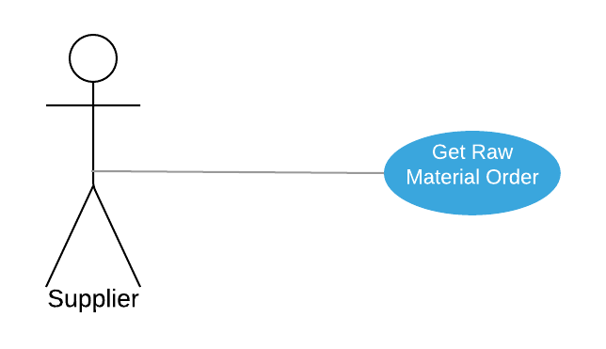
USE CASE DIAGRAM FOR SUPPLIER

Slide 5
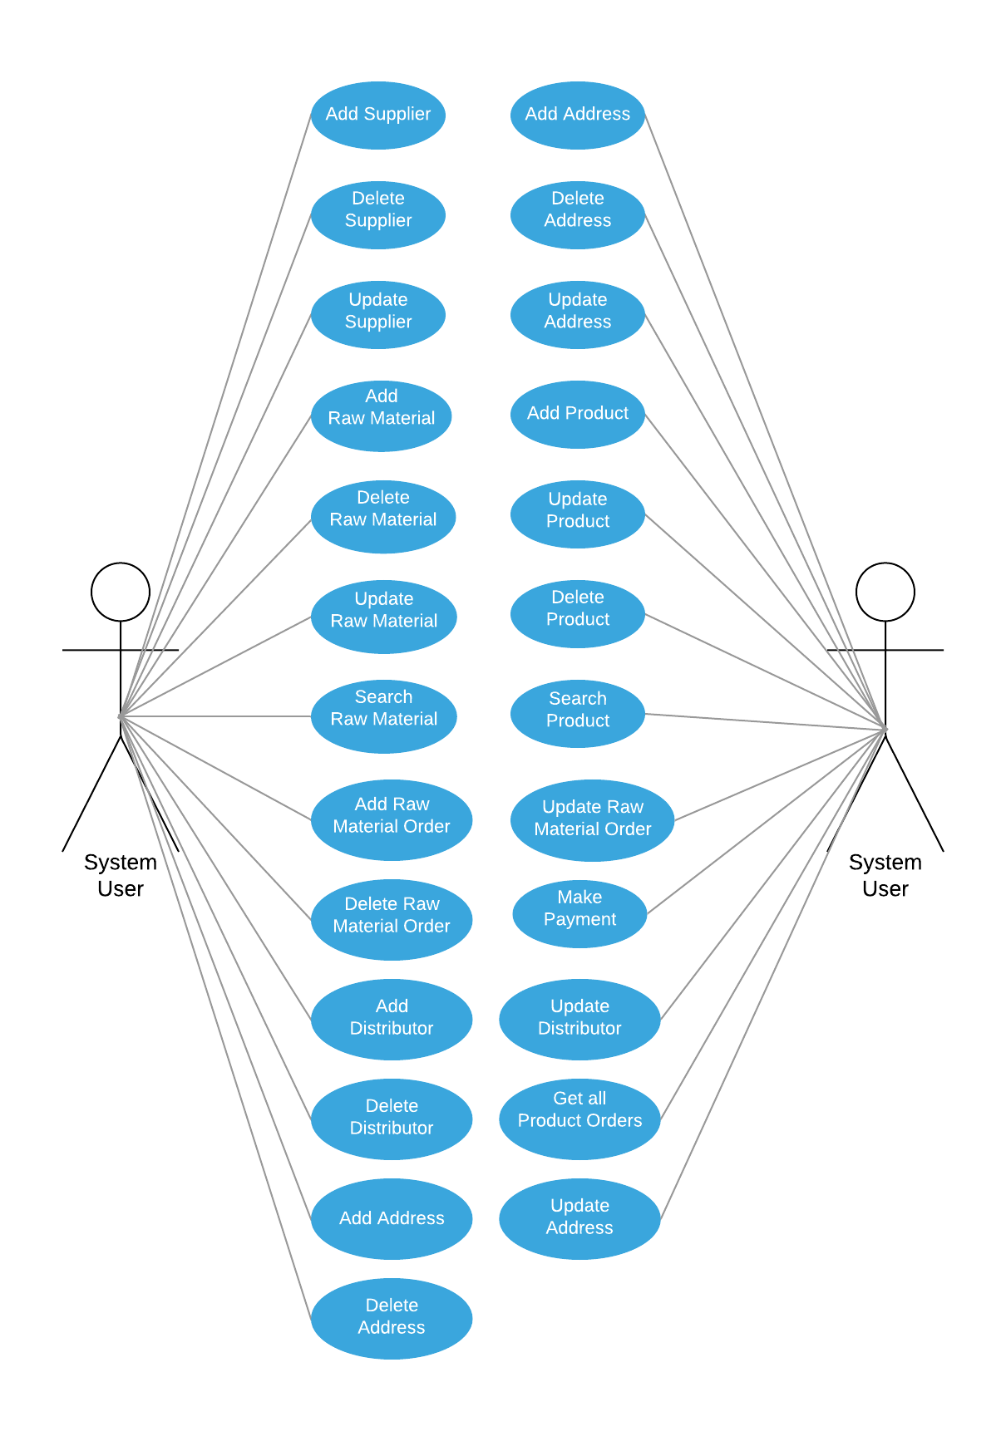
USE CASE DIAGRAM FOR SYSTEM USER

Slide 6
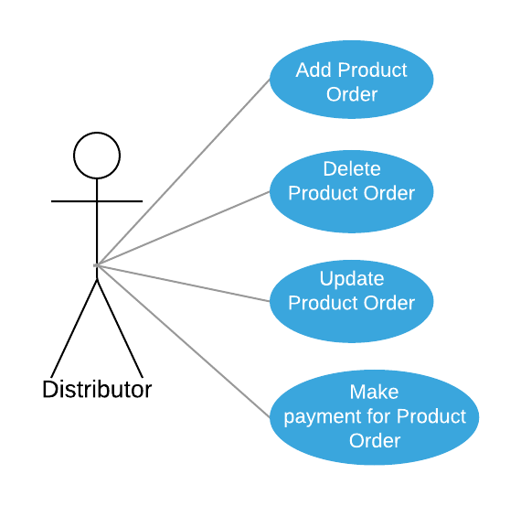
USE CASE DIAGRAM FOR DISTRIBUTER

Slide 7
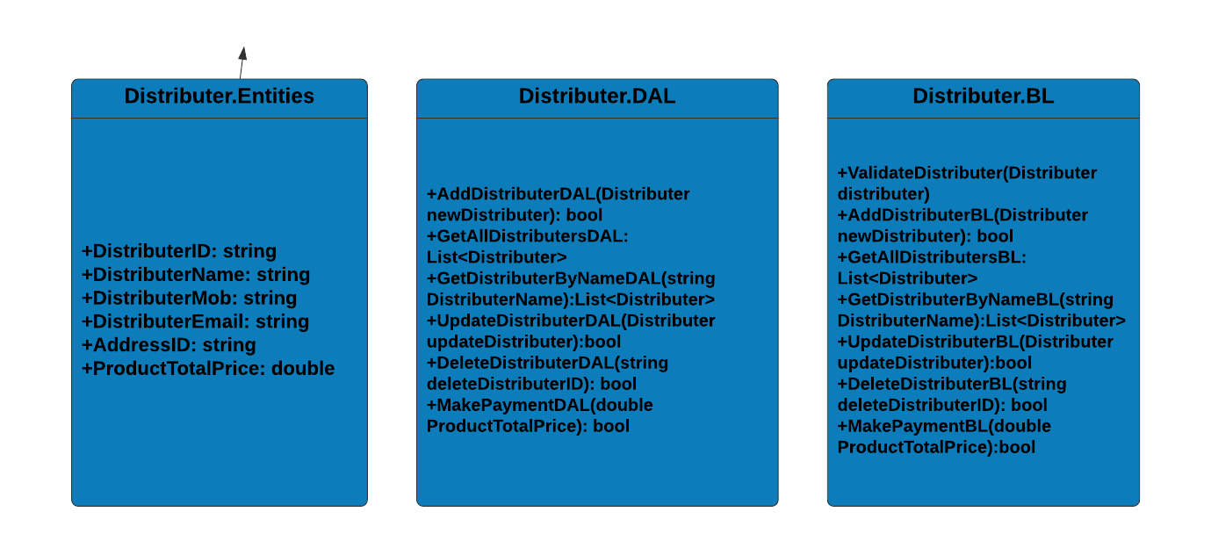
CLASS DIAGRAM FOR DISTRIBUTER

Slide 8
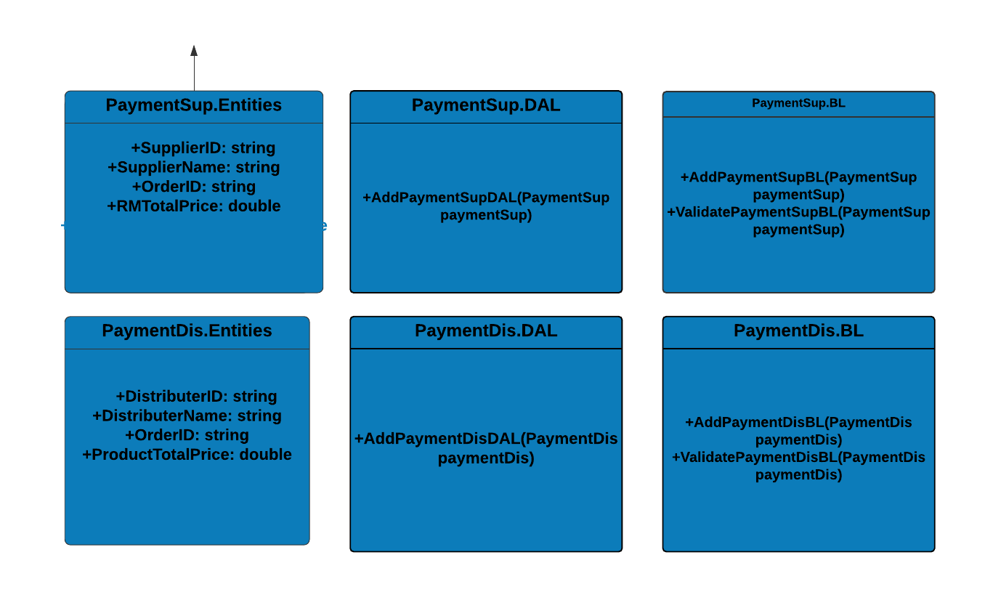
CLASS DIAGRAM FOR PAYMENTS

Slide 9
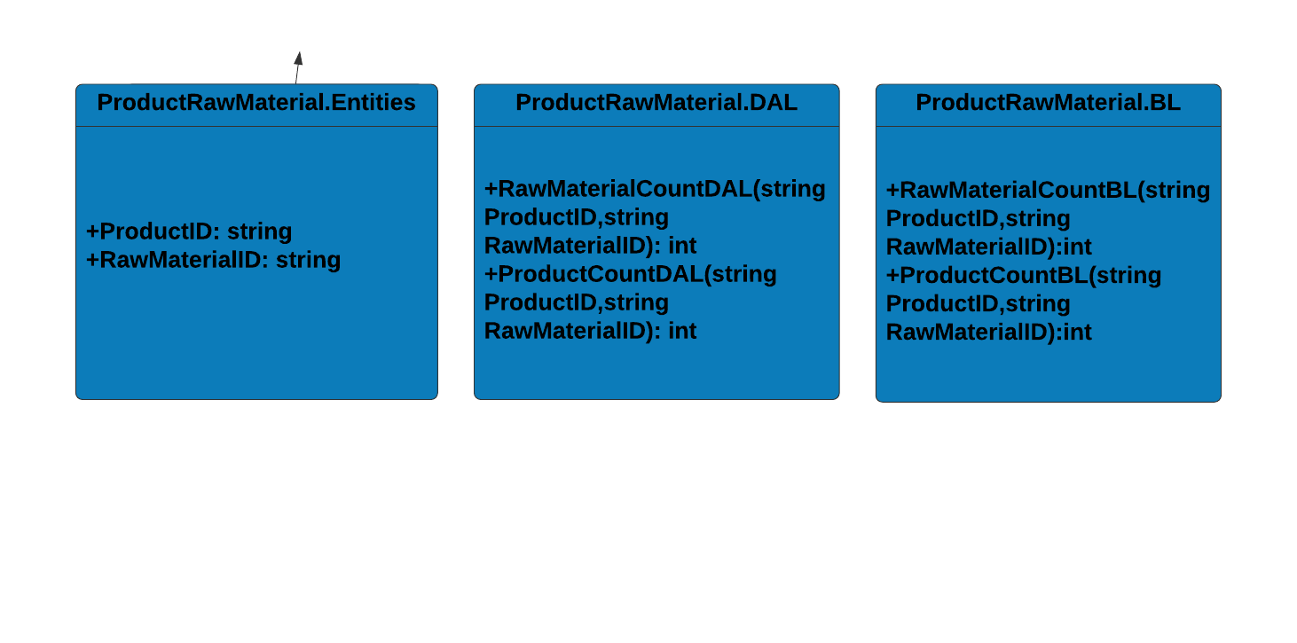
CLASS DIAGRAM FOR PRODUCT RAW MATERIALS

Slide 10
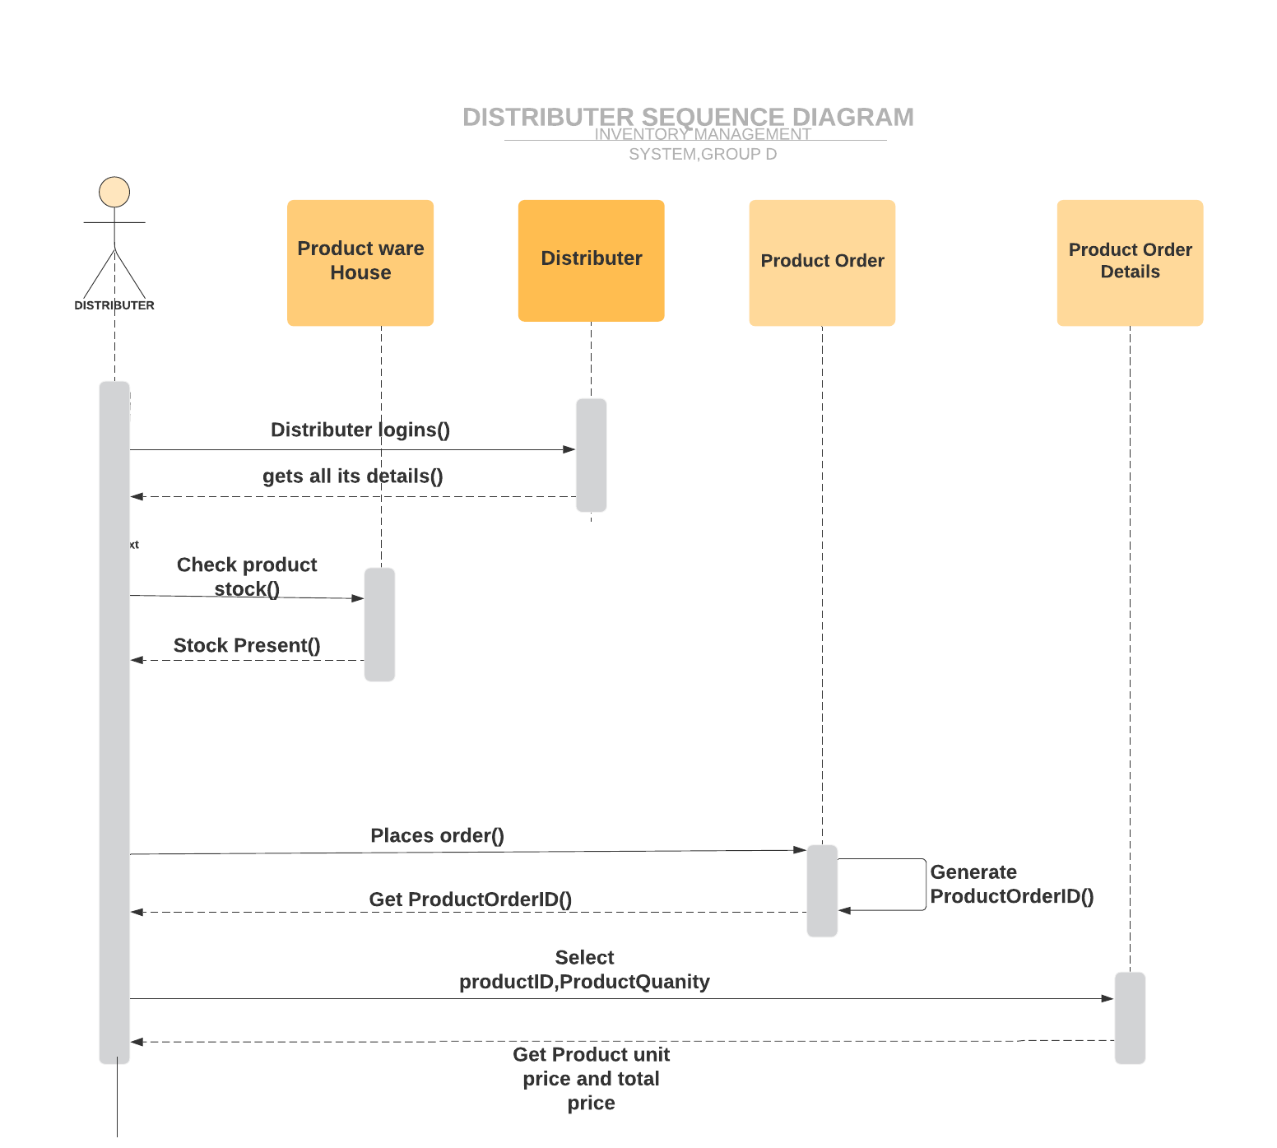

Slide 11
