Slide 1
Drinks & Delight :
Inventory Management System
Team D:
Maski Saijahnavi
Pushpraj Kaushik
Ritwik Sinha
Rohit Kumar
Sowrasree Banerjee

Slide 2
Epics & User Stories
Epic 1: As a Beverages Company (Drink & Delight), we want to manage Raw Material Stock
User Stories :
As a System user, I want to update raw material stock to maintain the stock list.
As a System user, I want to check the current raw material stock.
As a System user, I want to search for a raw material in the stock list.

Slide 3
Epic 2: As a Beverages Company (Drink & Delight), we want to manage Raw Material Stock
User Stories :
As a System user, I want to update product stock to maintain the stock list.
As a System user, I want to check the current product stock.
As a System user, I want to search for a product in the stock list.

Slide 4
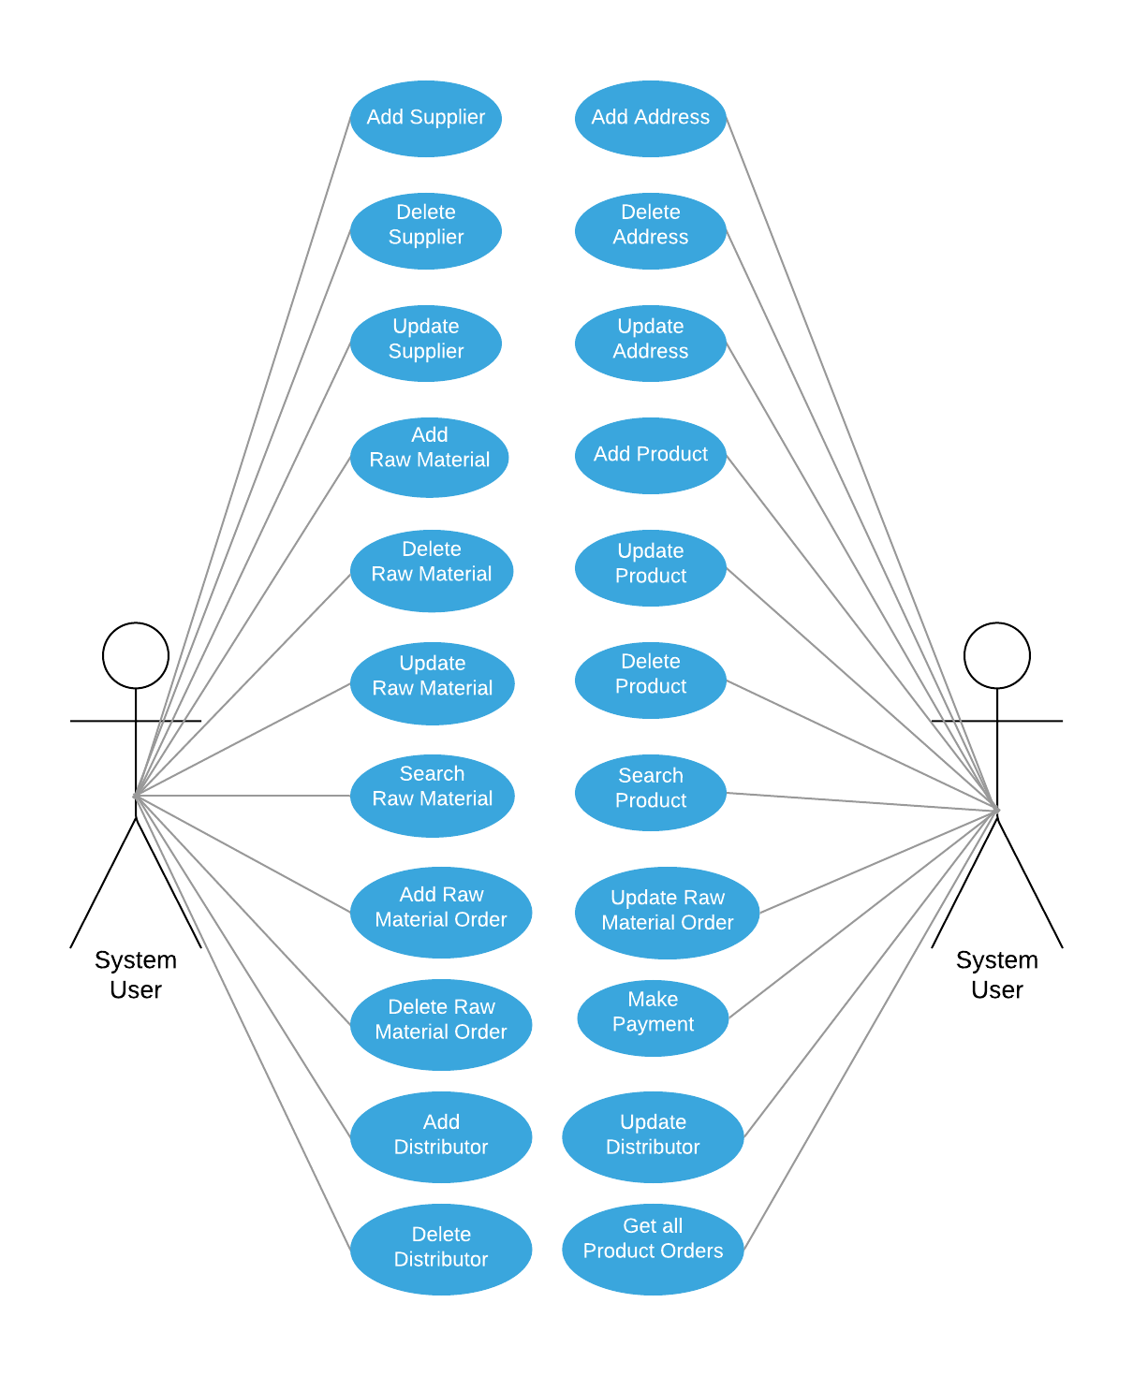
Use Case Diagrams
Use Case Diagram for System User

Slide 5
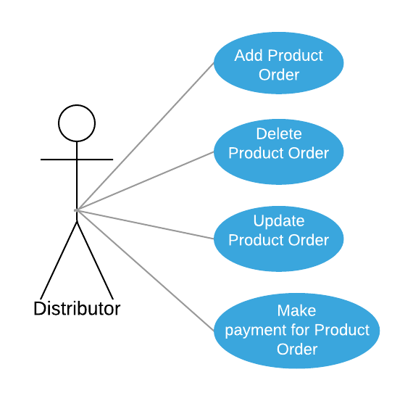
Use Case Diagram for Distributor

Slide 6
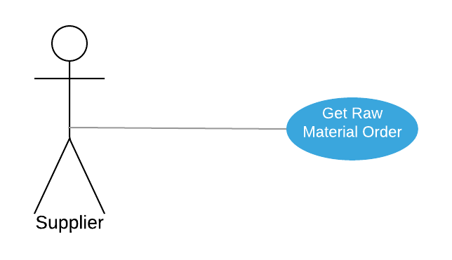
Use Case Diagram for Supplier

Slide 7
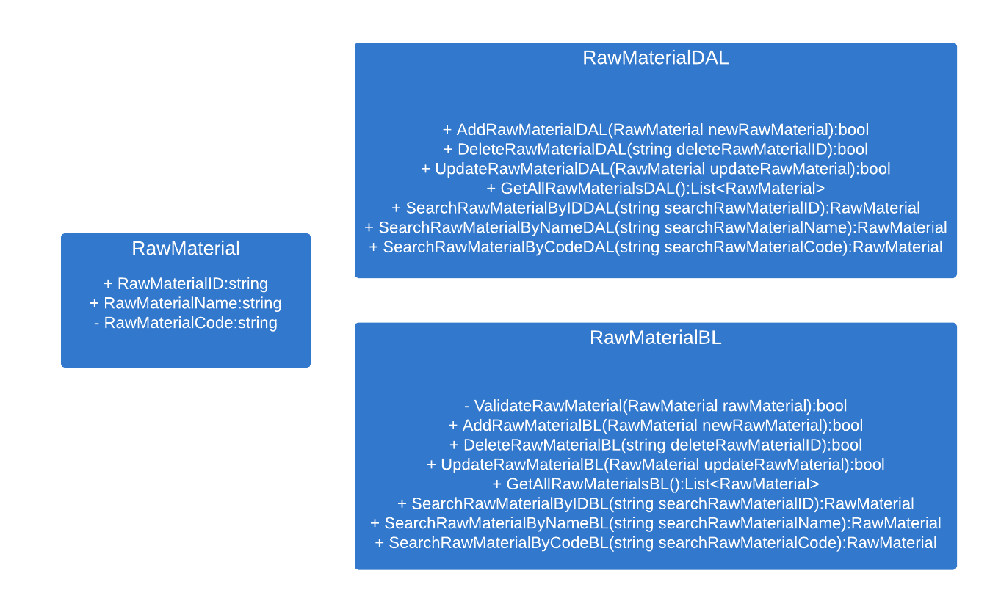
Class Diagrams
Class Diagram for Raw Material Class

Slide 8
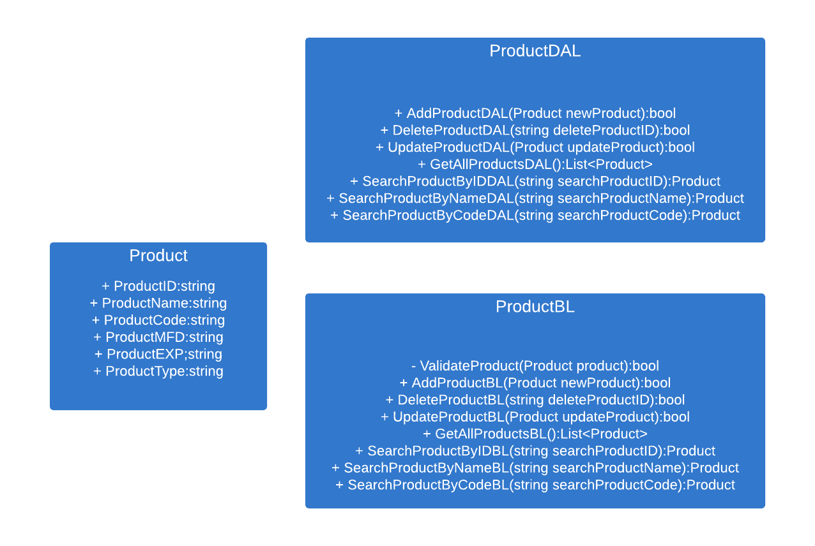
Class Diagram for Product Class

Slide 9
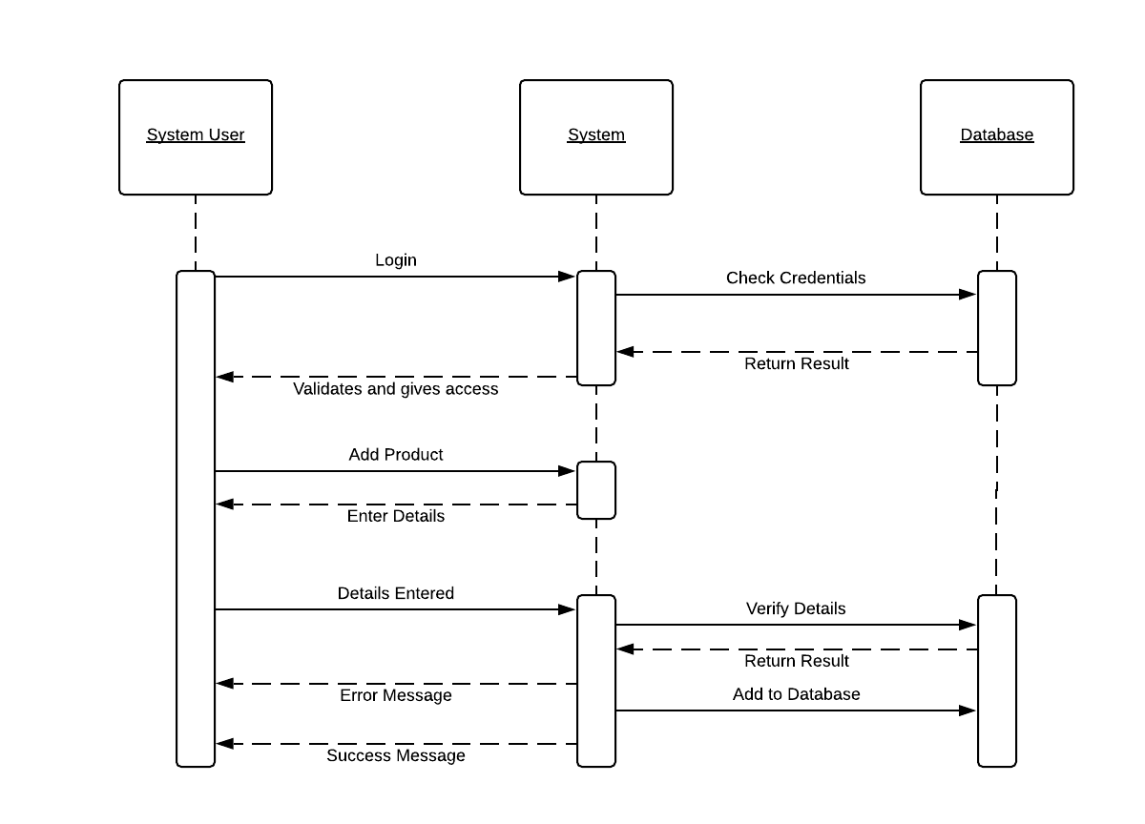
Sequence Diagrams
Sequence Diagram to add product:

Slide 10
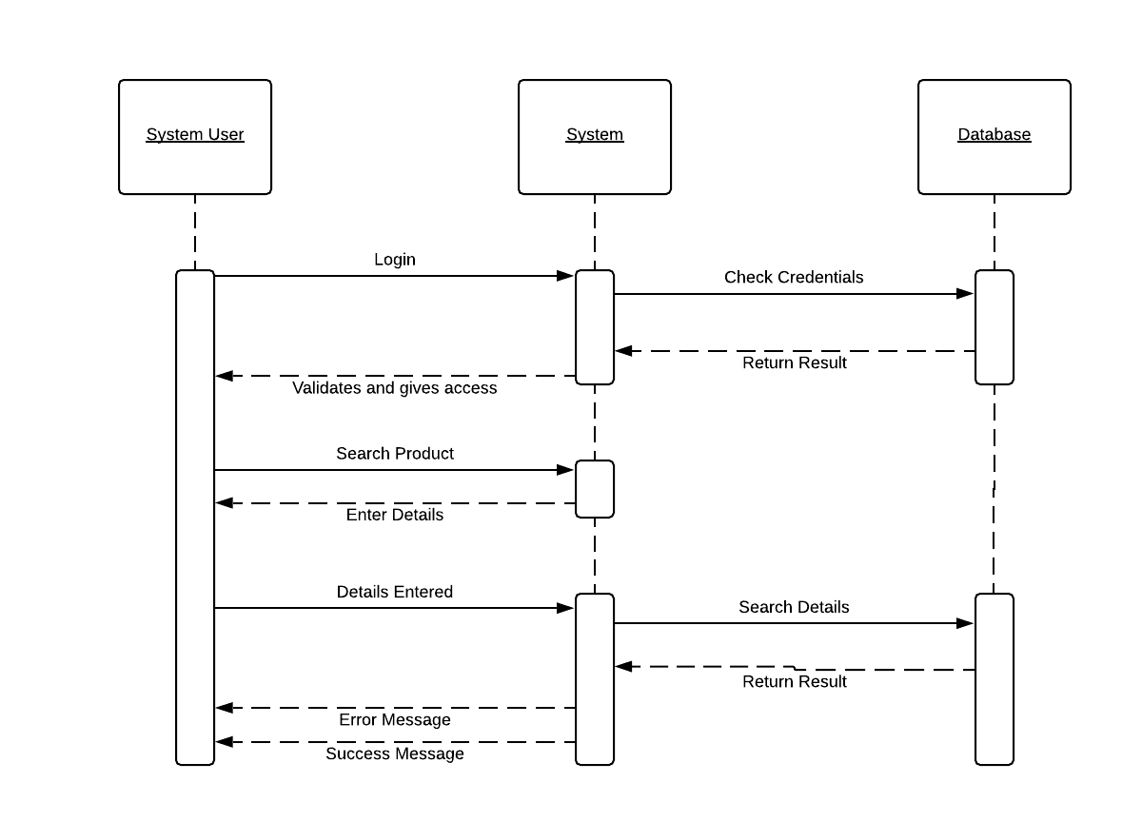
Sequence Diagram to search for product:

