Slide 1



Slide 2
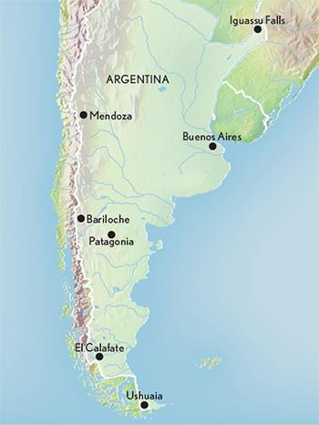
ARGENTINA
Capital : Buenos Aires
Currency : Argentine peso
Official Language : Spanish
Population: 44 million
Famous Destinations : Iguazu Falls, Los Glaciares, Ushuaia
Few famous places in Argentina

Slide 3
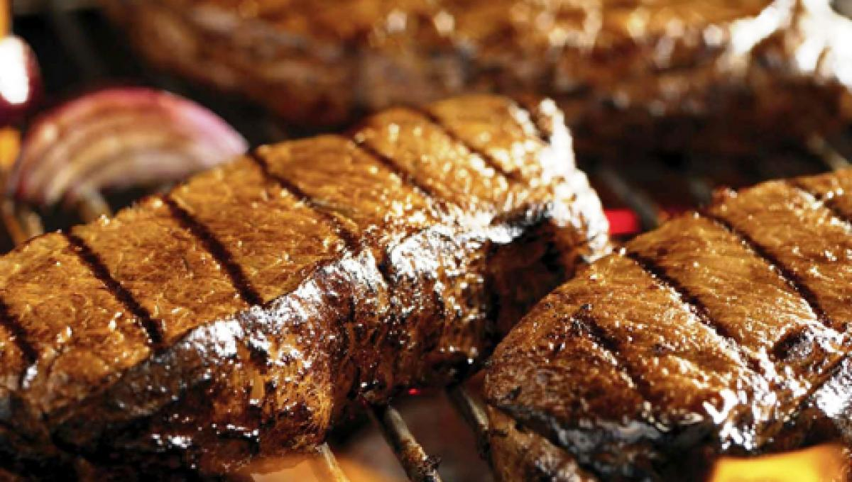
FOOD
National Dish : Asados
Strong resemblance to Spanish, French and Italian food
2nd biggest consumer of beef in the world
Asados

Slide 4
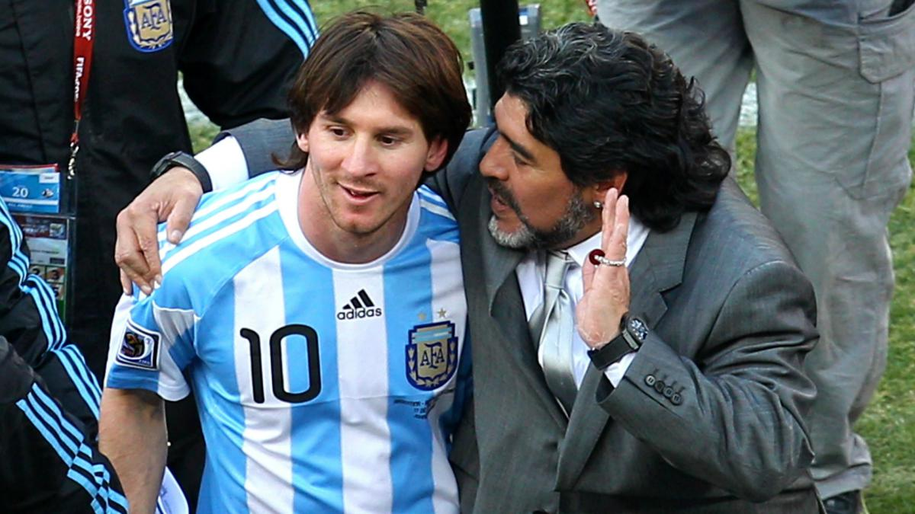
SPORTS
National Sport : Pato
Most Popular Sport : Soccer
Won 2 FIFA World Cup in 1978 & 1986
Other popular sports are car-racing and rugby
Best footballer of his generation with Messi

Slide 5
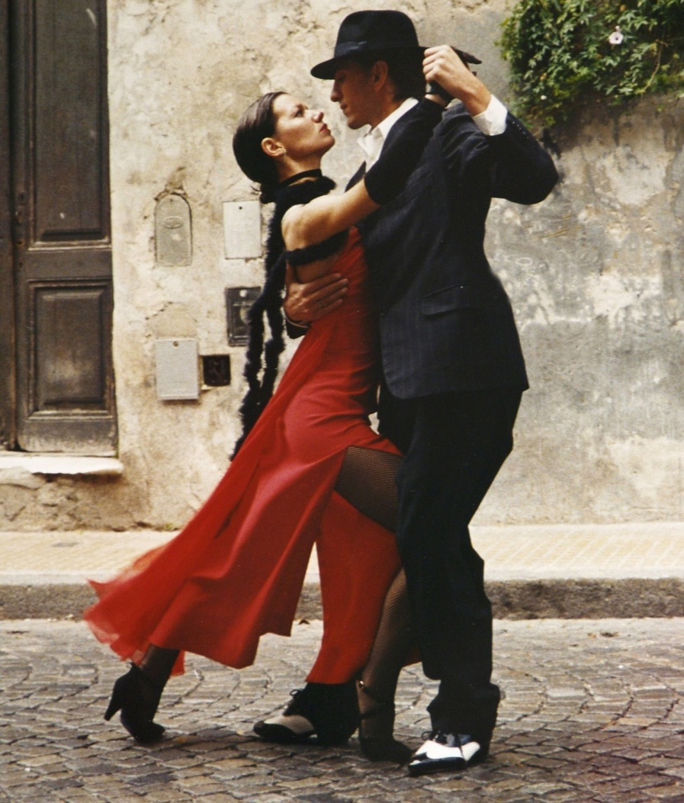
MUSIC & DANCE
Most Popular Music & Dance is Argentine Tango
Argentine folk music is today known under several names, most notably as folklore music
Argentine Tango

Slide 6
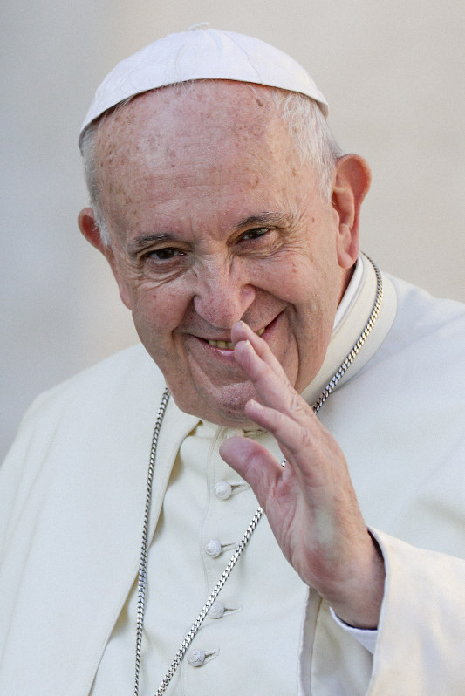
RELIGIOUS BELIEFS
Argentina is a predominately Roman Catholic Christian nation
92% of Argentine citizens are Roman Catholics
The country is quite secular, and the constitution guarantees freedom of religion.
Pope Francis
Head of Catholic Church

Slide 7
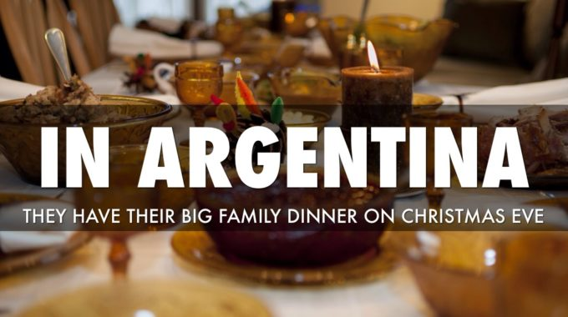
FAMILY VALUES
The family is the centre of Argentine life
Strong ties with extended family
Christmas and birthdays are celebrated with large gatherings of family members

Slide 8
Thank You
Presented By :
Rohit Kumar
Sravani

