Slide 1

Revision Buddy
An ultimate place to revise
smarter , faster and better!

Slide 2

Welcome and overview
Revision Buddy is designed to help you study more efficiently by offering tools that fit your style. Whether you prefer practicing questions or reviewing notes, we have you covered to help boost your confidence and understanding.

Slide 3

TECHNOLOGY STACK
Our tech stack powers a smooth and user-friendly experience, using modern tools designed to make revision easy and accessible. Huge thanks to our fantastic team and members who make Revision Buddy what it is—your trusted study partner!
PROGRAMMING LANGUAGE : HTML, CSS
AI TOOLS: GEMINI , SLIDESGO
PRESENTATION TOOLS: MS POWERPOINT & CANVA

Slide 4

How Revision Buddy solves these issues!
Revision Buddy offers two simple, effective ways to revise: through questions or notes. This helps you focus on what matters most, saving time and reducing stress. Our tools make learning flexible and engaging, so you can revise smarter and feel confident going into exams.

Slide 5

Revision Through Questions
Choose Revision Through Questions to test your knowledge and deepen your understanding. We offer conceptual questions to clear your fundamentals, and important questions that frequently appear in exams, helping you focus on what really counts.

Slide 6
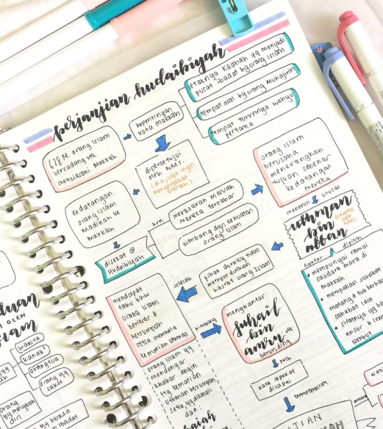
Revision Through Notes
Prefer a quick review? Try Revision Through Notes for summarized content. We include full notes with detailed explanations and short notes for quick last-minute revision, perfect for efficient learning at any stage.

Slide 7

Conclusions
Revision Buddy is here to help you study smarter and faster with the tools that fit your style. Whether you prefer questions or notes, we’ve got your back. Thanks for being part of this journey—happy revising, and good luck with your exams!

Slide 8
Thanking you
Thank you all for joining today! Your energy and participation have made this session fun and engaging. I truly appreciate your time and hope the tips shared help you revise smarter and feel more confident. Keep up the great work!
Members:
ROHIT KR. YADAV (CSE)
BOBBY RAJBHAR (AIML)
SURYANSH RAI (CSE)

