Slide 1
InnoGames
Data Analysis task

Slide 2
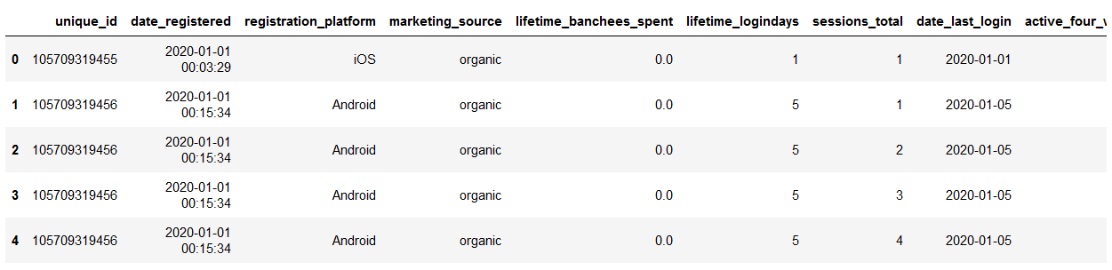
Dataset
66720 unique players
Notes:
date_registered, registration_platform, marketing_source, lifetime_branchees_spent, lifetime_logindays remain same irrespective session
''' Properties dependant upon the session of a user are listed''' elementsToAnalyze = ['session_duration','max_points', 'transactions', 'eventcount_total', 'quest_closed', 'eventcount_message', 'eventcount_fight', 'eventcount_trade', 'eventcount_build', 'eventcount_recruit', 'eventcount_ally', 'eventcount_research']

Slide 3
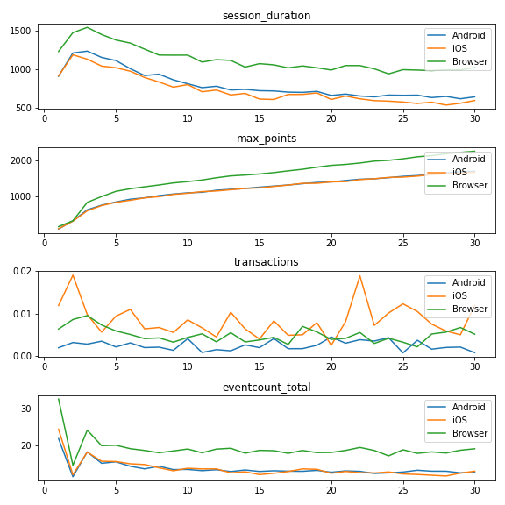
Data grouping and plotting
x axis: session number
Notes:
To analyse the user behaviour for first 30 sessions, the original data is grouped by registration_platform and session_number. This gives grouped information for each session_number per platform. An average of the attributes to be analyzed per session number, per platform is then calculated
In general, the mean session duration for browser is higher than either of the apps
Maximum points, total event count, and individual event counts are generally more in browser than in apps. This could be since the session duration is longer, the player engagement is longer which leads to more event counts
The mean session duration reduces gradually with increasing session number whereas the maximum points achieved increases. This could signify player's increasing familiarity or even advances in game leading to more points
iOS users tend to conduct more transactions per session. Tells about their spending habits & capability
Total event counts are also higher for browser based users. Could be because their session duration is longer, which leads to more activity being done per session

Slide 4
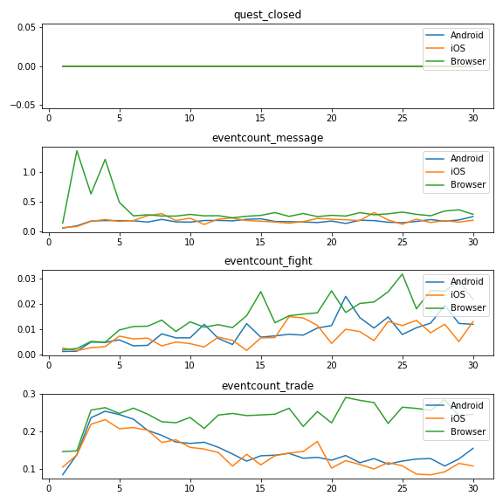
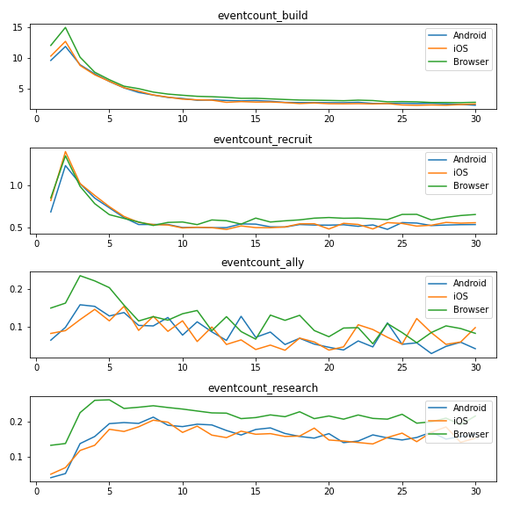
Data grouping and plotting
x axis: session number
Notes:
In earlier sessions, the amount of messages browser based players wrote is considerably high, but it reduced over time. Is it possible that because of having a keyboard and a larger typing setup, the browser based players found it easier to write texts. But reduced sending texts since it does not create much influence in the game?
Amount of fights put up increases with increase number of sessions, maybe because it is required as one advances in the game
All platform players traded resources in the beginning, but app based number of trades reduced over time whereas browser based didn't so much. Unlike messages, number of trades doesn't drop (for browser) which could mean that doing trades is important and influential. Is there need to improve at the trading interface in apps?
Recruit and Build orders went down over time for all platforms. Similar trend as session duration
Ally interaction numbers are a bit noisy, cannot infer much about the user behaviour, but the trend seems to go rather down
Research was really low in the beginning but then it increased and stayed to level. Still, the numbers are more for browser based users which might be also due to more session duration leading to more event counts
Summary
In general, the browser based player interaction (session duration) per session is longer as compared to app based, which eventually leads to more event counts, maximum points etc
iOS users spend more. Their spending habits could be exploited to generate more revenue
It seems that players tend to not use the messaging feature. Probably messaging isn't much influential in the game
Trading is as important aspect in the game as is seen from browser based players. Thus, the trading UI/ functionality in app based game needs to be improved since their trading event count is seen to reduce over time

Slide 5
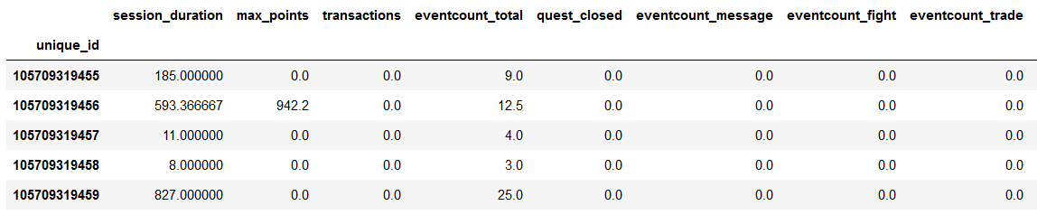
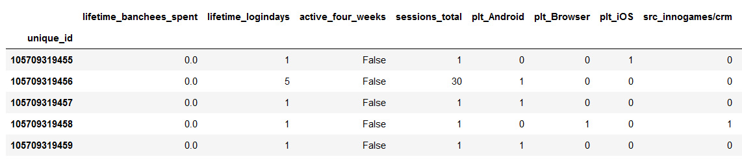
Churn analysis
Notes:
For session specific data of a particular player, a mean of each attribute for the a maximum of 30 sessions is calculated.
For performing churn analysis, categorical data like registration platform and marketing sources are one-hot encoded.

Slide 6
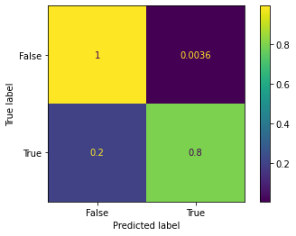
Prediction
Decision Tree
Grid Search Cross Validation
training accuracy: 0.982 and testing accuracy: 0.981
Notes:
For performing churn analysis, a decision tree model is chosen for classification. A grid search cross validation is performed in order to find out the best maximum tree depth (6)
The confusion matrix plotted above gives more information about the predictions preformed by the model.
True Positives = 0.8
False Positives = 0.0036
True Negatives = 0.9964
False Negatives = 0.2
This states that with the given trained model, if a player is predicted to be True, then there is an 80% chance of a correct prediction. On the other hand, if a player is predicted to be False, it is 99.64% a right prediction

Slide 7
Thank You

