Slide 1



EduGuardianAI
ICT304
AI System
ACADEMIC RISK PREDICTION & EARLY INTERVENTION SYSTEM
Presented by :
IZAAN SHUMAIZ - 34984006 | MOHAMED SINAN - 35078074 | ROHIT KUMAR - 35363998

Slide 2

Problem Domain
The Porblem
Core Issue
Universities often identify at-risk students only after major assessments
This results in delayed intervention and reduced chances of academic recovery
Early disengagement and declining performance patterns often go unnoticed
Manual tracking is time-consuming and inconsistent, especially in large cohorts
There is no automated, data-driven system capable of identifying at-risk students early using partial semester data.

Slide 3
Motivation
Why This Problem Matters
Opportunity
Early identification enables timely intervention and improves student outcomes
Institutions aim to improve retention and academic success rates
Academic staff require scalable and consistent decision-support tools
With the availability of LMS data and assessment records, AI can be used to detect patterns early and support proactive decision-making.

Slide 4
Proposed Solution
EduGuardian AI is a hybrid academic risk prediction system designed to analyse early-semester performance data and identify students at risk of failure.
Uses quiz scores, assignment performance, and other indicators
Generates probability-based predictions
Classifies students into LOW, MEDIUM, and HIGH risk categories
Provides actionable insights to support academic staff
This system supports decision-making rather than replacing academic judgement.

Slide 5
System Objectives
Identify at-risk students early using partial data
Provide interpretable and actionable risk predictions
Support academic staff in decision-making
Develop a complete AI system, not just a predictive model
Ensure scalability and potential integration with LMS platforms

Slide 6
Key Innovation
Hybrid AI Approach
The system combines two complementary components:
Machine Learning Models
Rule Based Risk Engine
Learn patterns from historical data
Generate probability of student failure
Uses academic logic such as quiz trends and thresholds
Provides interpretable reasoning

Slide 7
Why Hybrid?
ML alone - high performance but lacks transparency
Rule-based systems - interpretable but limited in complexity
Hybrid Approach Ensures:
Improved prediction accuracy
Greater interpretability
Increased trust and usability in academic environments

Slide 8
System Engineering Approach
System Engineering Product Life Cycle
Problem Formulation → Identifying delayed risk detection
Concept Development → Hybrid AI approach selected
System Design → Modular architecture defined
Prototype Development → CLI-based AI system
Final System Integration → Full dashboard + database
Ensures system is built as a complete solution, not just a model

Slide 9
Prototype vs Final System
Prototype System (Assignment 1)
Implemented as a command-line application
Focused on core AI components such as:
Quiz trend analysis
Machine learning classification
Output generated in textual and JSON formats
Limitations of Prototype
No persistent data storage
Limited user interaction
No system integration
Final System Enhancements
Fully developed Flask web application
Integration with SQLite database for persistence
Role-based access (staff and student portals)
Automated pipeline for preprocessing, training, and prediction
Real-time dashboard for visualisation and analysis
Demonstrates evolution from proof-of-concept to a deployable system

Slide 10
System Architecture
Presentation Layer
Web-based dashboard built using Flask
Provides user interaction for staff and students
Application Layer
Handles routing, business logic, and API communication
Connects user interface with backend processing
Data Layer
SQLite database storing:
Student records
Unit configurations
Prediction results
AI Processing Layer
Data preprocessing
Machine learning models
Rule-based risk engine
Modular design improves maintainability and scalability

Slide 11
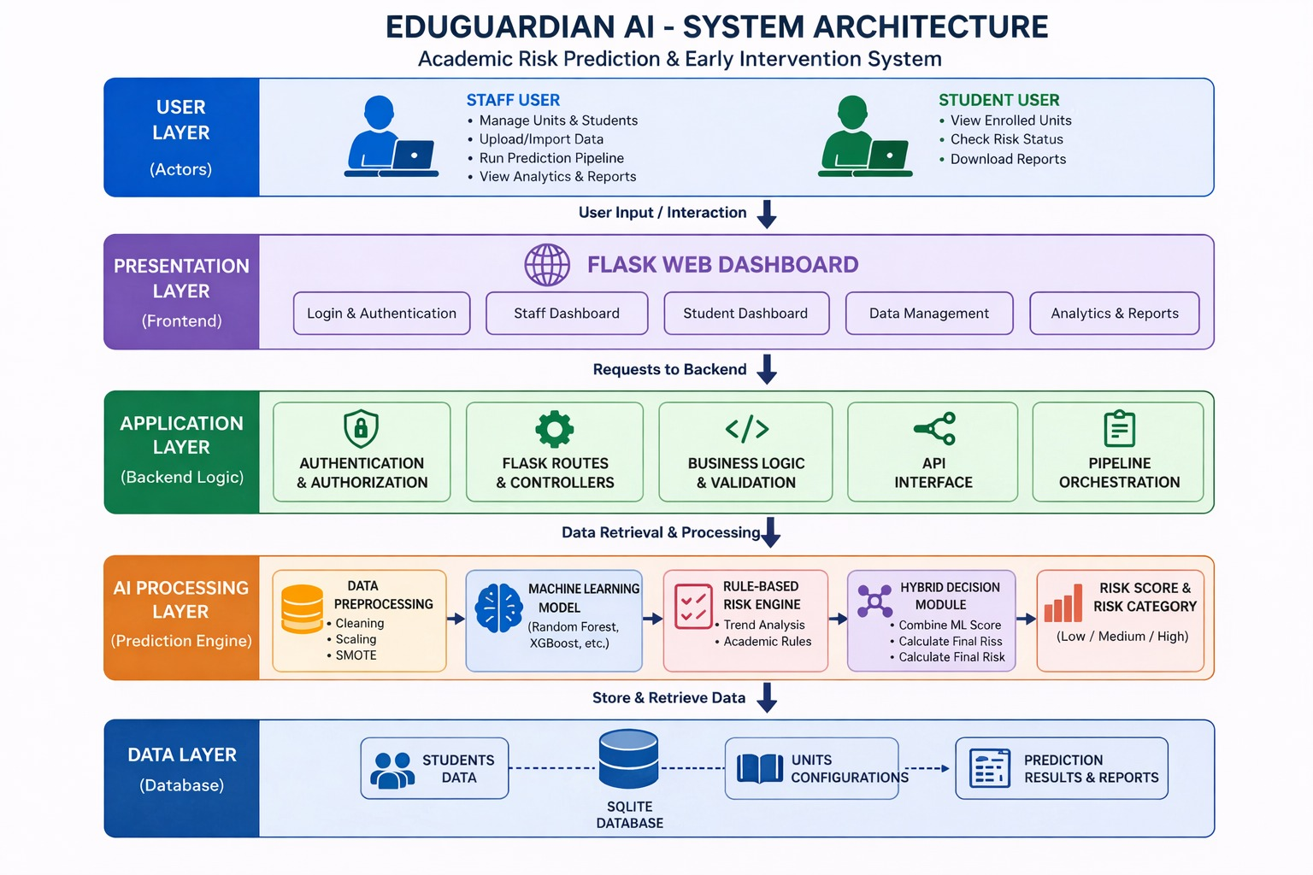

Slide 12
Data Flow
End-to-End Pipeline
User inputs student performance data through dashboard
Data is validated and stored in the database
Preprocessing module:
Cleans and standardises data
Handles missing values
Applies feature scaling
Addresses class imbalance using SMOTE
Machine Learning Model:
Generates probability of failure
Rule-Based Engine:
Evaluates trends such as declining performance
Hybrid Module:
Combines outputs into final risk score
Results:
Displayed on dashboard
Stored for future analysis

Slide 13
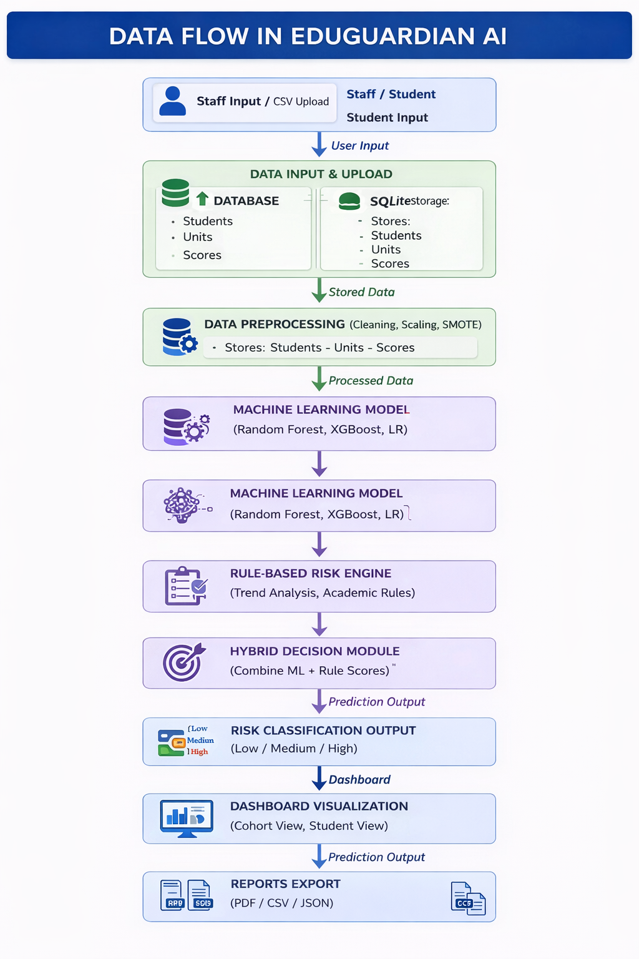

Slide 14
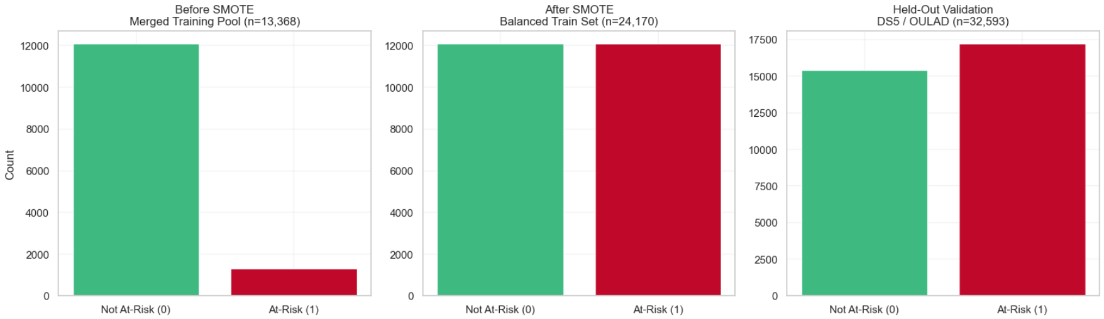

Slide 15
AI Techniques
Comparative Modelling Approach
Three models were implemented to ensure robust evaluation
LOGISTIC REGRESSION
RANDOM FOREST
XGBOOST

Slide 16
Logistic Regression
Logistic Regression was implemented as the baseline model due to its simplicity, efficiency, and high level of interpretability. It models the relationship between input features and the probability of a student being at risk using a linear decision boundary.
Key Characteristics
Provides clear feature coefficients, allowing us to understand how each variable influences the prediction
Computationally efficient and easy to implement
Serves as a benchmark for comparing more complex models
Limitations
Assumes a linear relationship between features and the outcome
Unable to effectively capture complex, non-linear interactions present in real-world academic data

Slide 17
Random Forest
Random Forest is an ensemble learning technique that constructs multiple decision trees and aggregates their outputs to produce a final prediction. This approach improves generalisation and reduces overfitting.
Key Characteristics
Captures complex, non-linear relationships between features
Robust to noise and variability in the dataset
Handles feature interactions effectively without requiring manual specification
Performance Advantage
Achieved the highest performance in this project
Demonstrated strong classification capability with high ROC-AUC score
Interpretability
Provides feature importance scores
More interpretable than boosting models but less than linear models

Slide 18
XGBoost
XGBoost is an advanced boosting algorithm that builds models sequentially, where each new model attempts to correct the errors of the previous one. This iterative learning process enables high predictive accuracy.
Key Characteristics
Strong ability to capture complex patterns in structured data
Incorporates regularisation techniques to reduce overfitting
Efficient and widely used in real-world predictive modelling
Performance
Achieved high predictive performance, second only to Random Forest in this project
Limitations
Increased complexity compared to other models
Reduced interpretability due to ensemble boosting structure

Slide 19
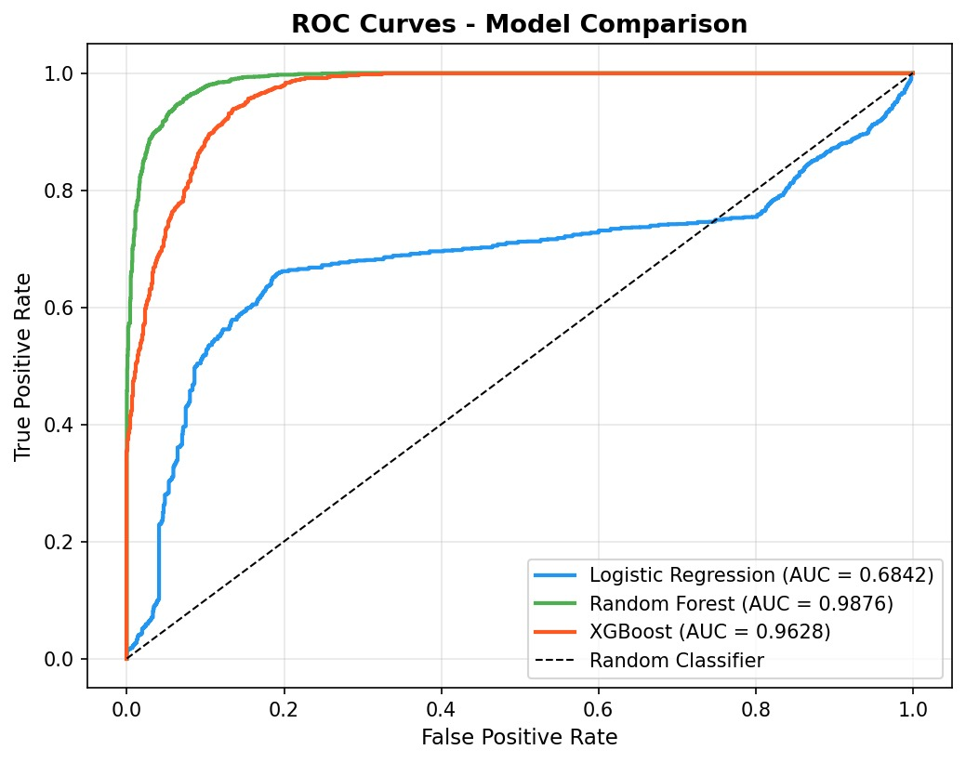

Slide 20
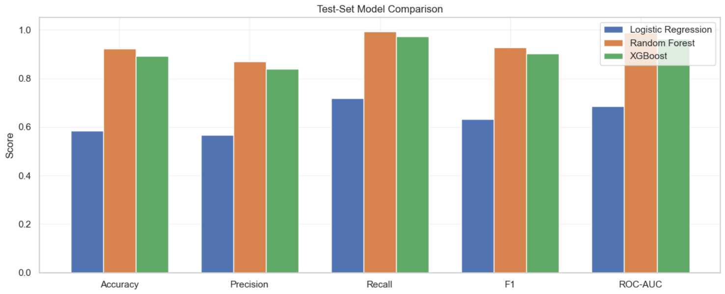
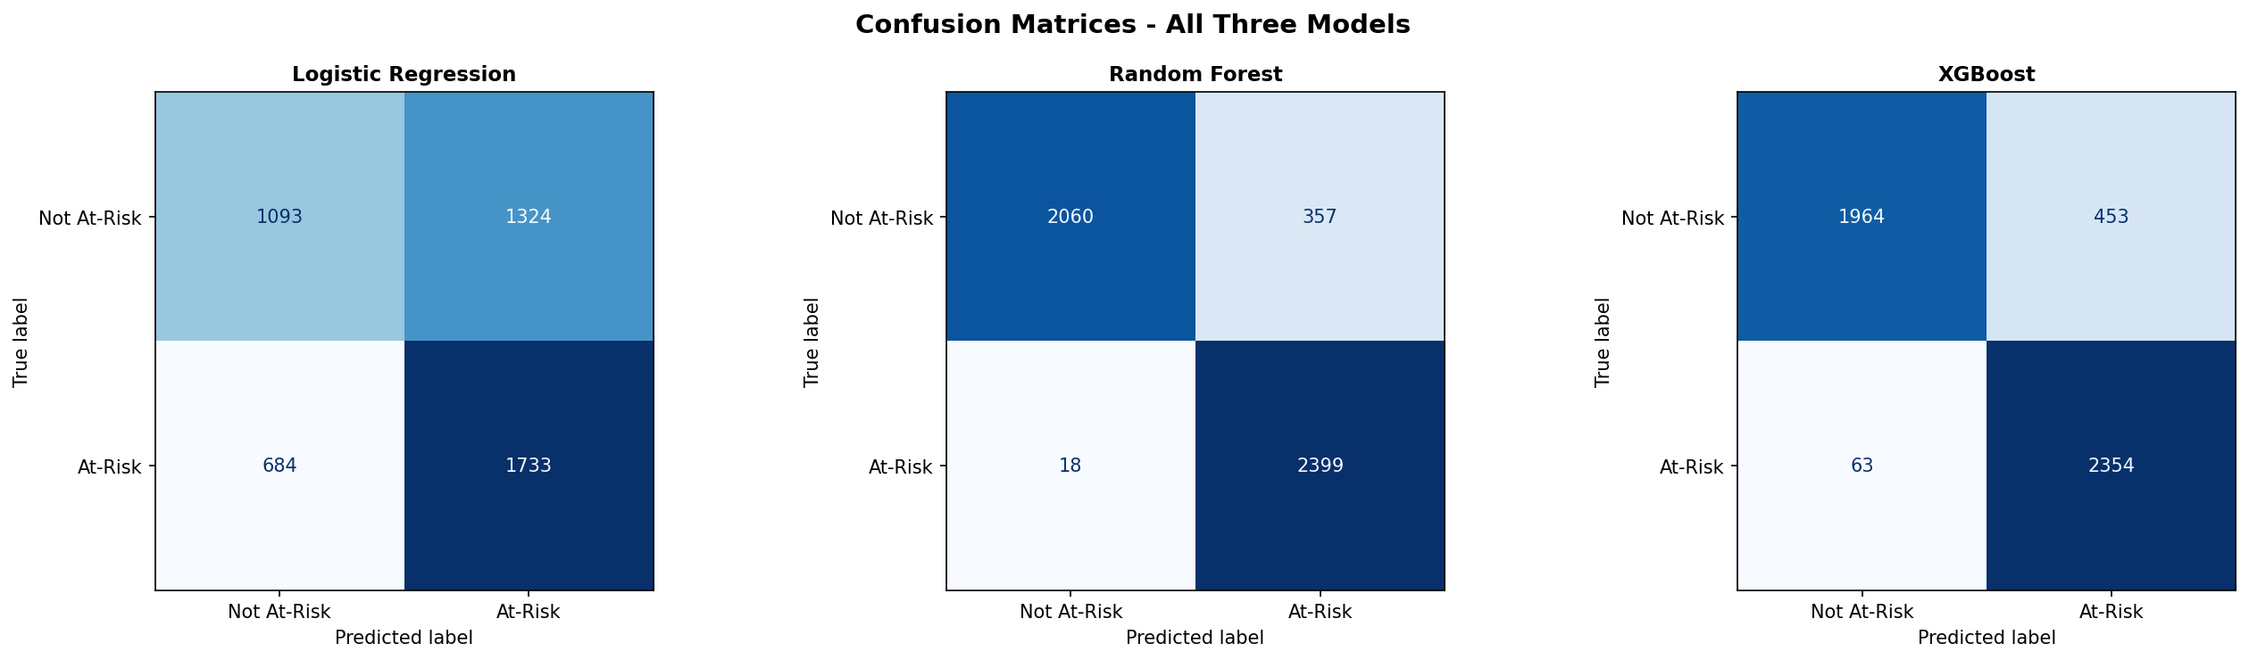

Slide 21
Feature Importance
Key Insights
Assignment performance is the most influential feature
Project and midterm scores also contribute significantly
Quiz performance shows moderate impact
Participation has relatively lower influence
Interpretation
Continuous assessment plays a major role in predicting academic outcomes
Model behaviour aligns with real-world academic expectations

Slide 22
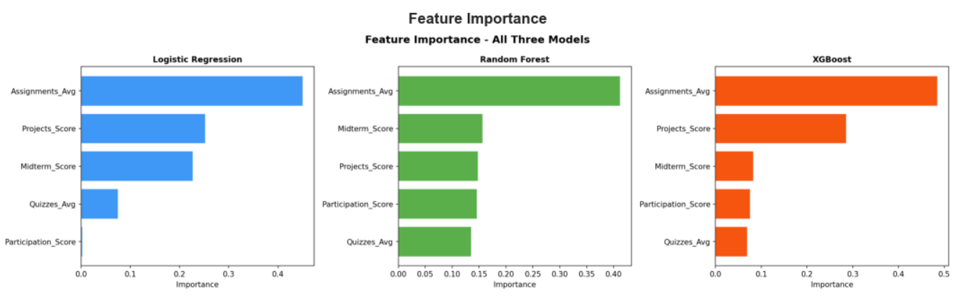

Slide 23
System Features
Staff Portal
Unit creation and configuration
Student enrolment and CSV import
Execution of prediction pipeline
Cohort-level analytics dashboard
Export of reports (PDF, CSV, JSON)
Student Portal
View enrolled units
Submit performance data
Monitor risk status
Download personalised reports

Slide 24
Evaluation Approach
Metrics Used
Precision → measures correctness of predictions
Recall → measures ability to detect at-risk students
F1-score → balances precision and recall
ROC-AUC → evaluates classification performance
Validation Strategy
Cross-validation ensures robustness
SMOTE applied to handle class imbalance
Focus is on early detection and reliability

Slide 25
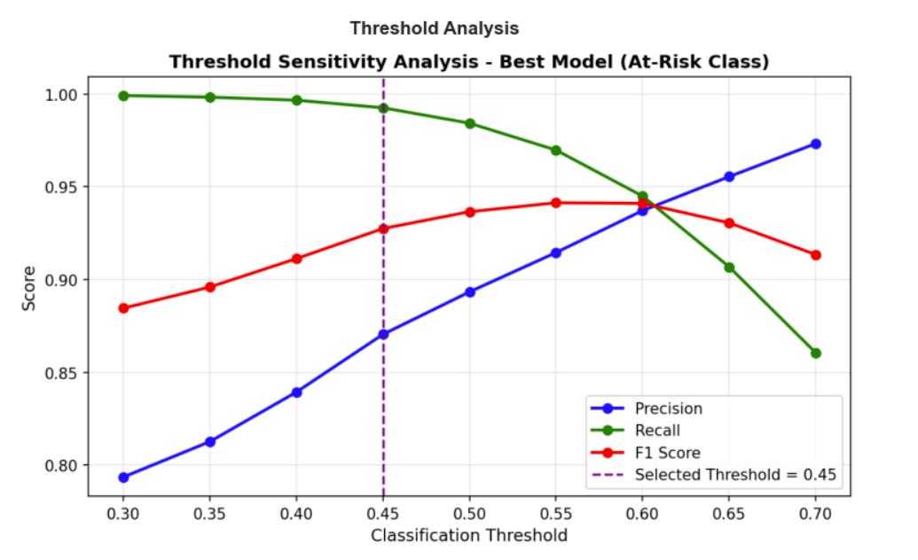

Slide 26
Limitations
Feature limitations
Does not include detailed engagement data such as LMS activity, attendance, or participation patterns
Class imbalance challenges
Although SMOTE is used, synthetic data may not perfectly reflect real at-risk cases
Simplified system security
Basic authentication and access control, not suitable for real-world deployment
Scalability limitations
SQLite and local setup may not support large-scale institutional usage
Manual data input dependency
Relies on CSV uploads rather than automated LMS integration

Slide 27
Future Work
Integration with LMS platforms
Connect the system with platforms like Moodle to enable automatic data collection and real-time monitoring
Incorporation of engagement features
Include metrics such as attendance, login activity, and time spent on learning materials to improve prediction accuracy
Real-world dataset integration
Train and evaluate the system using institutional data to improve reliability and generalisation
Scalable deployment
Deploy the system on cloud infrastructure with a more robust database to support larger user bases

Slide 28
Conclusion
EduGuardian AI demonstrates the development of a complete academic risk prediction system, integrating machine learning, rule-based logic, and a web-based dashboard
The hybrid prediction approach improves both accuracy and interpretability, making the system suitable for real-world academic environments
Random Forest achieved the best performance in this implementation, highlighting the importance of data-driven model selection
The system enables early identification of at-risk students, supporting timely intervention and improved academic outcomes
Overall, the project highlights how AI can be effectively integrated into practical decision-support systems in education

Slide 29
EduGuardianAI
ICT304
Thank You For Listening!
IZAAN SHUMAIZ - 34984006
MOHAMED SINAN - 35078074
ROHIT KUMAR - 35363998

