Slide 1
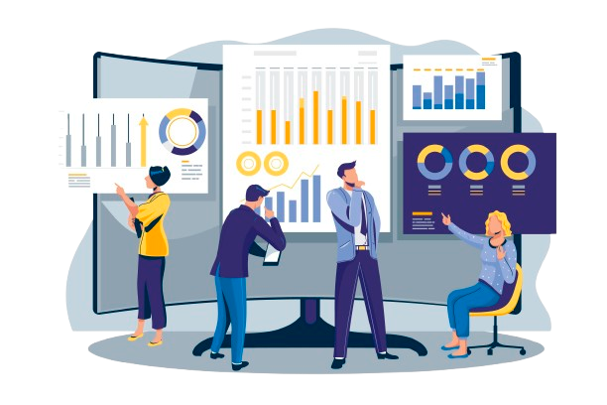
TrendWiz unlocking market trends to drive your next move
Insight-Driven Market Moves

Slide 2
GenAI-powered Solution
Analyzes customer data (e.g., past purchases, browsing behavior) to identify and segment target audiences.
Predicts customer purchasing behaviors, including seasonal or trend-driven interests, using historical and real-time data.
Continuously monitors marketing campaigns, ad performance, and customer interactions to provide actionable insights.
Learns from each interaction to improve accuracy and customer satisfaction over time.

Slide 3


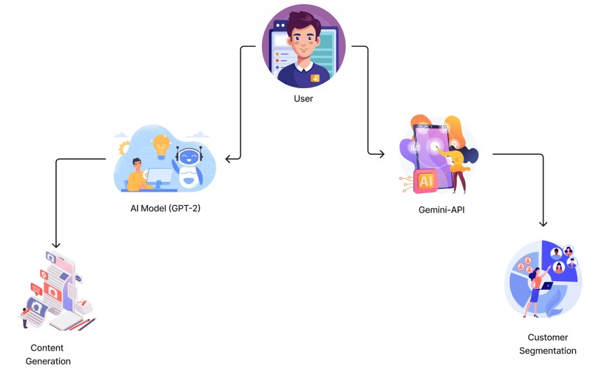





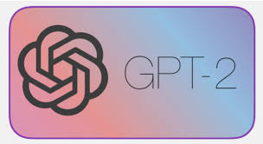
Architecture & TechStack

