Slide 1

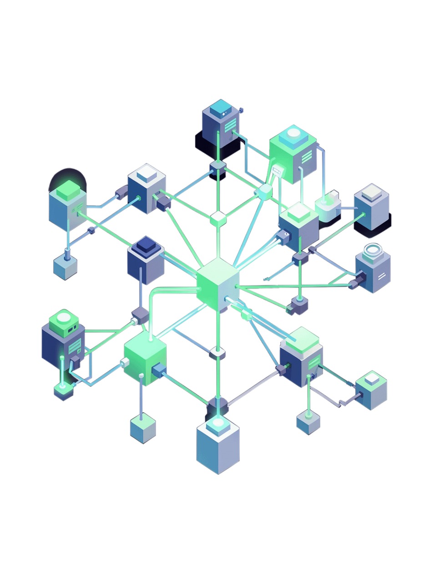

AI-ML Virtual Internship
AICTE–EduSkills Virtual Internship Program | Google AI-ML | January–March 2026
Rohit Maurya | IILM University, Greater Noida | B.Tech Artificial Intelligence and Data Science
Notes:
1

Slide 2
Internship Overview
Program
Domain
Duration
AICTE–EduSkills Virtual Internship Program
Google AI-ML
10 Weeks — January to March 2026
Format
Supported By
Structured virtual learning with practical exposure
EduSkills & Google for Developers
Notes:
2

Slide 3
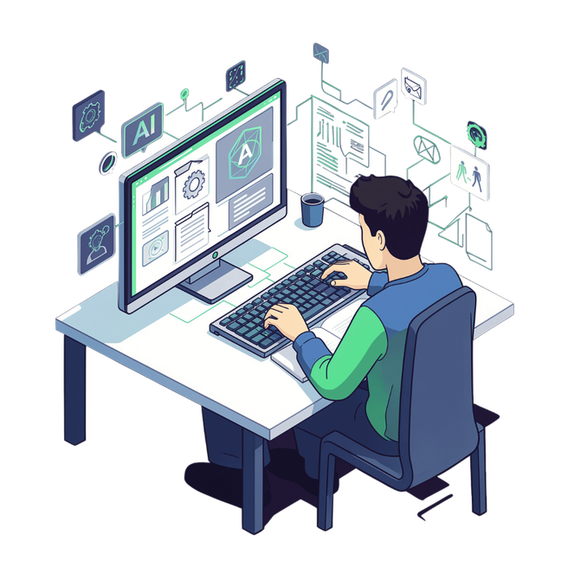
Internship Objectives
Develop foundational understanding of machine learning and AI concepts
Learn practical AI/ML technologies and frameworks including TensorFlow
Master neural networks and convolutional neural networks (CNNs)
Gain exposure to computer vision and object detection techniques
Build skills in image classification and product image search
Strengthen industry-relevant technical competencies for career readiness
Notes:
3

Slide 4




Technologies & Topics Covered
Core Framework
Computer Vision
TensorFlow — industry-standard deep learning platform for model building and training
Neural Networks, CNNs, and Object Detection pipelines for image understanding
Mobile ML
Applications
TensorFlow Lite and TensorFlow Lite Model Maker for on-device inference
Image Classification, Product Image Search, and Android app integration
Notes:
4

Slide 5
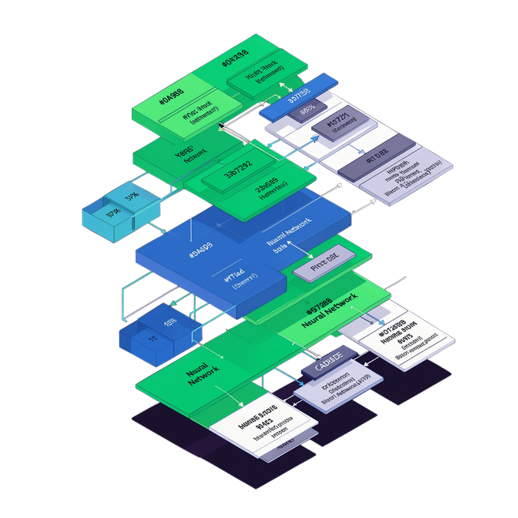
Week 1: Neural Networks with TensorFlow
MODULE 1
Program Neural Networks with TensorFlow
Machine Learning Fundamentals: Core concepts from first principles — supervised learning, loss functions, and gradient descent
Convolutional Neural Networks: CNN architecture designed for image recognition and feature extraction
Advanced Image Classification: Applying CNNs to real-world computer vision classification problems
Notes:
5

Slide 6

Weeks 2–3: Object Detection
Week 3
Custom detection via TFLite Model Maker and mobile integration
Week 2
Basics of object detection with pretrained models
Object detection skills progressed from leveraging pretrained models in Week 2 to building custom, mobile-ready detectors with TensorFlow Lite in Week 3 — laying the foundation for real-world Android deployment.
Notes:
6

Slide 7
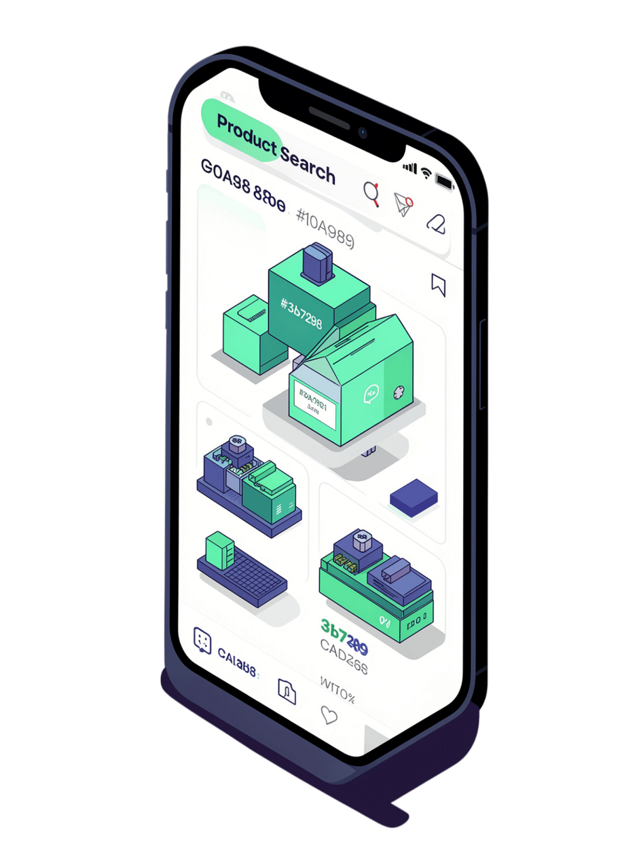


Weeks 4–6: Product Image Search
Week 4
1
Build product image search using on-device object detection capabilities
Week 5
2
Detect objects in static images and live camera feeds directly on Android devices
Week 6
3
Build and integrate a fully functional product image search backend system
Notes:
7

Slide 8
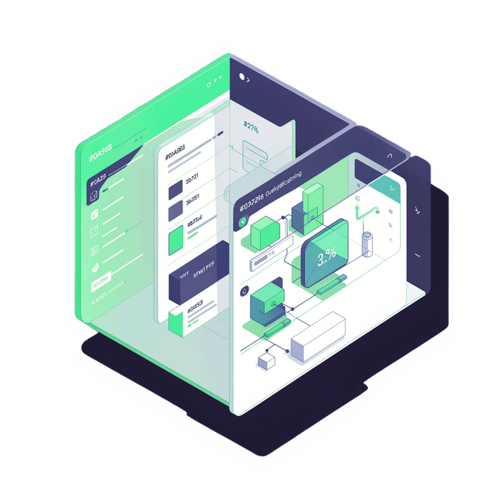
Weeks 7–8: Image Classification
WEEKS 7 & 8
Week 7: Build custom image-classification models using TensorFlow and Model Maker
Week 8: Create a custom image classifier and integrate it into a functional Android app
Practical end-to-end model development — from training to on-device deployment
Culminating module consolidating all computer vision skills acquired across the program
Notes:
8

Slide 9

Assessment & Evaluation Structure
Weeks 1–8
1
Weekly assessments tracking module progress and conceptual understanding
2
Module Submissions
Project documentation and assignments submitted for select modules throughout the program
Week 9
3
Comprehensive assessment evaluating cumulative learning outcomes across all modules
4
Week 10
Final credential validation and official certification issuance
Final grade determined by overall performance across all assessment components — weekly evaluations, project submissions, and the Week 9 comprehensive assessment.
Notes:
9

Slide 10
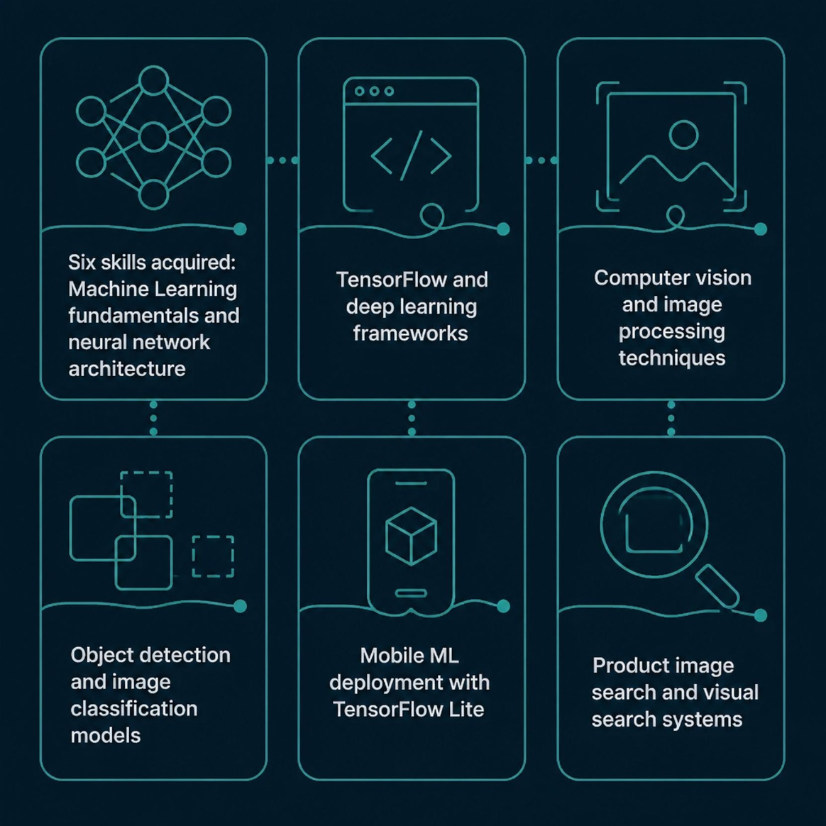
Skills & Learning Outcomes
Technical Competencies Gained
Over 10 structured weeks, this program built a comprehensive and industry-aligned AI/ML skill set spanning theory, frameworks, and real-world deployment.
Machine Learning fundamentals and neural network architecture
TensorFlow and deep learning frameworks
Computer vision and image processing techniques
Object detection and image classification models
Mobile ML deployment with TensorFlow Lite
Product image search and visual search systems
Notes:
10

Slide 11
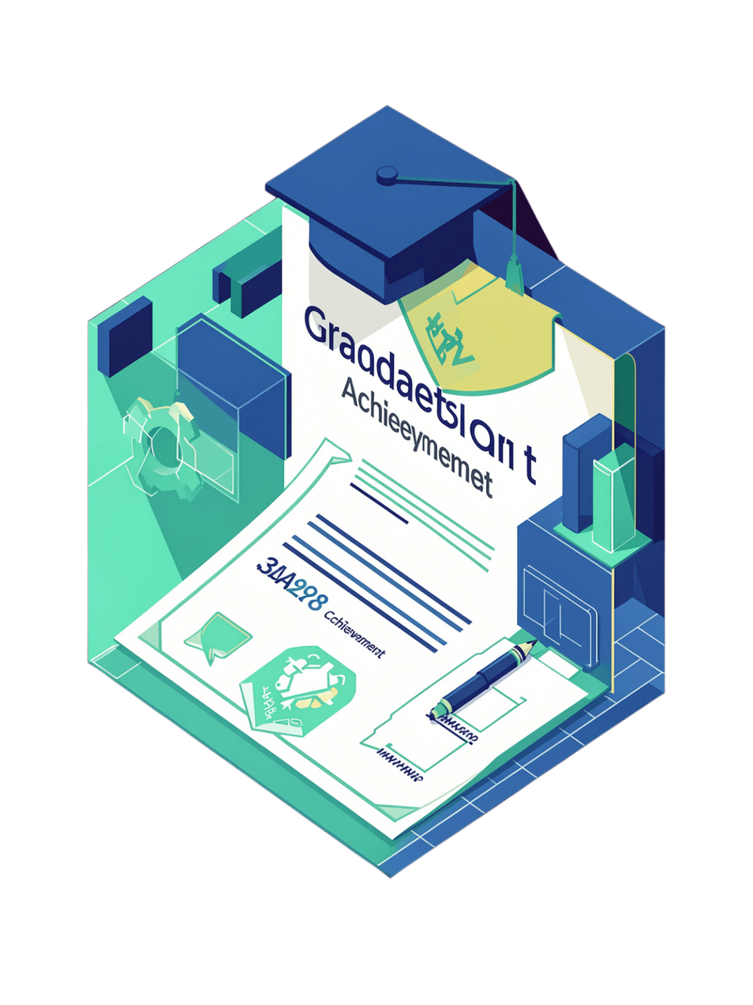
Internship Experience & Impact
Structured Learning
Week-wise curriculum with clear, progressive milestones across 10 weeks
Practical Exposure
Hands-on projects in computer vision, object detection, and AI/ML deployment
Industry-Relevant Skills
Technologies actively used by leading global technology organizations
Career Enhancement
Strengthened employability and technical confidence for the AI/ML industry
Notes:
11

