Slide 1

STUDY OF LASSO AND RIDGE REGRESSION
USING
ADMM
E ANNAPOORNA :​ AM.EN.U4AIE20123​
ROHIT NARAYANAN M :​ AM.EN.U4AIE20160​
SREEPRIYA S :​ AM.EN.U4AIE20166​
SREYA V SUJIL :​ AM.EN.U4AIE20167​
SUDHIN S :​ AM.EN.U4AIE20168​

Slide 2
Comparison of ordinary lasso and ridge regression implementation vs. ADMM implementation and finding out which is better in terms of performance, time and how the optimization will affect the result.
Regression analysis is used to estimate the relationship between a dependent variable and one or more independent variables. This technique is widely applied to predict the outputs, forecasting the data, analyzing the time series, and finding the causal effect dependencies between the variables.
Objective
Application

Slide 3

Important terms
Regression - Regression analysis is a statistical approach in which one or more independent variables are used to model the relationship between the dependent variable and the independent variable.
Multicollinearity - Multicollinearity is a statistical condition that occurs when the two or more independent variables are significantly correlated with one another.
Regularization - Regularization technique is used to avoid overfitting of data.
Penalty term - The amount of the penalty can be bettered using a constant called lambda (λ).
Cross validation - Cross validation is the procedure in regression analysis to examine the predictive validity of the regression equation.
Notes:
The first paper

Slide 4
Important terms
ADMM- The alternating direction method of multipliers is an algorithm that solves convex optimization problems by breaking them into smaller pieces, each of which are then easier to handle.
Lasso - Tibshirani (1996) proposed the least absolute shrinkage and selection operator (LASSO) for simultaneous parameter estimation and variable selection in regression analysis. LASSO selects one and reduces the others to zero. It lowers the variability of the estimates by decreasing some of the coefficients to zero, resulting in models that are simple to understand.
Ridge - The ridge regression is identical to the least-squares, except that the ridge coefficient is estimated by minimizing a slightly different amount. Ridge regression will not produce a readily interpretable sparse model when the number of predictors is big.

Slide 5
Dataset
We are using multiple high dimensional datasets.
This paper provides regression models for datasets using the Python programming language.
It includes datasets related to student performance, heart disease.
The program reads the pre-processed datasets in the form of csv file, splits it into testing and training datasets, in the ratio 3:1 (75%: 25%). Finally, regression model is created for the training dataset.
The heart disease data set is used for checking the performance of the models on classification problems and the student performance in regression problems.
https://www.kaggle.com/ronitf/heart-disease-uci
https://www.kaggle.com/spscientist/students-performance-in-exams

Slide 6
METHOD
We are using Alternating Direction Method of Multipliers (ADMM) to optimize data regression models LASSO and RIDGE
Lasso regression transforms the coefficient values to 0 means it can be used as a feature selection method. The feature whose coefficient becomes equal to 0 is less important and hence it can be dropped. Lasso regression is a type of linear regression that uses shrinkage. Lasso regression is a modified linear regression objective function. It involves an L1 regularization term.
Ridge regression transforms the coefficient values to close to 0 and not completely equal to 0. It is used to analyze any data that suffers from multicollinearity. The Ridge Regression objective is like the LASSO objective, but in this case, we use the L-2 norm squared instead of the L-1 norm as a regularization term with λ.

Slide 7
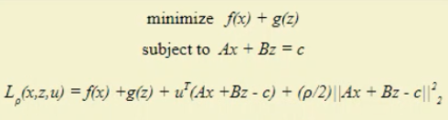
ADMM
For both regression models we apply ADMM technique in order to have a better performance where ADMM breaks down a convex optimization problem into smaller chunks.
Alternating Direction Method of Multiplier is framework for solving objecting function with divide-and-conquer approach.
ADMM technique using both series and Parallel approaches is implemented .
It splits the optimization variable into two parts X and Z and solve program of form Ax + Bz=c.
STEPS
Minimise the Lagrangian over x with Z and v fixed.
Minimise the Lagrangian over Z with x and v fixed.
Update the Lagrange multiplier using gradient ascent.

Slide 8
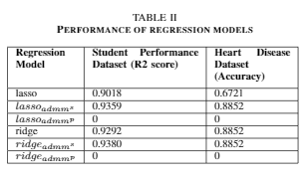
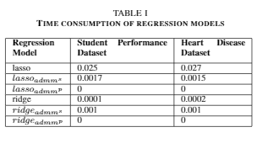
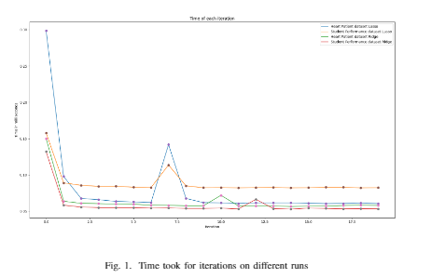
RESULTS
Table I shows the time taken for each of the model to train using the given data. As the values indicate, the time taken by standard models is greater than those optimized with Admm. We can see that Admm significantly reduces the time required for lasso and ridge.
Table II shows the accuracy and r2 score of the regression models. It is evident that as we optimize the model with Admm, the accuracy of the model improves. It can also be seen that when Admm is applied, the r2 score is higher.
The Figure 1 shows the variation in time for each iteration for the optimized regression models. The graph depicts that the time for the first iteration is higher for all the models.

Slide 9
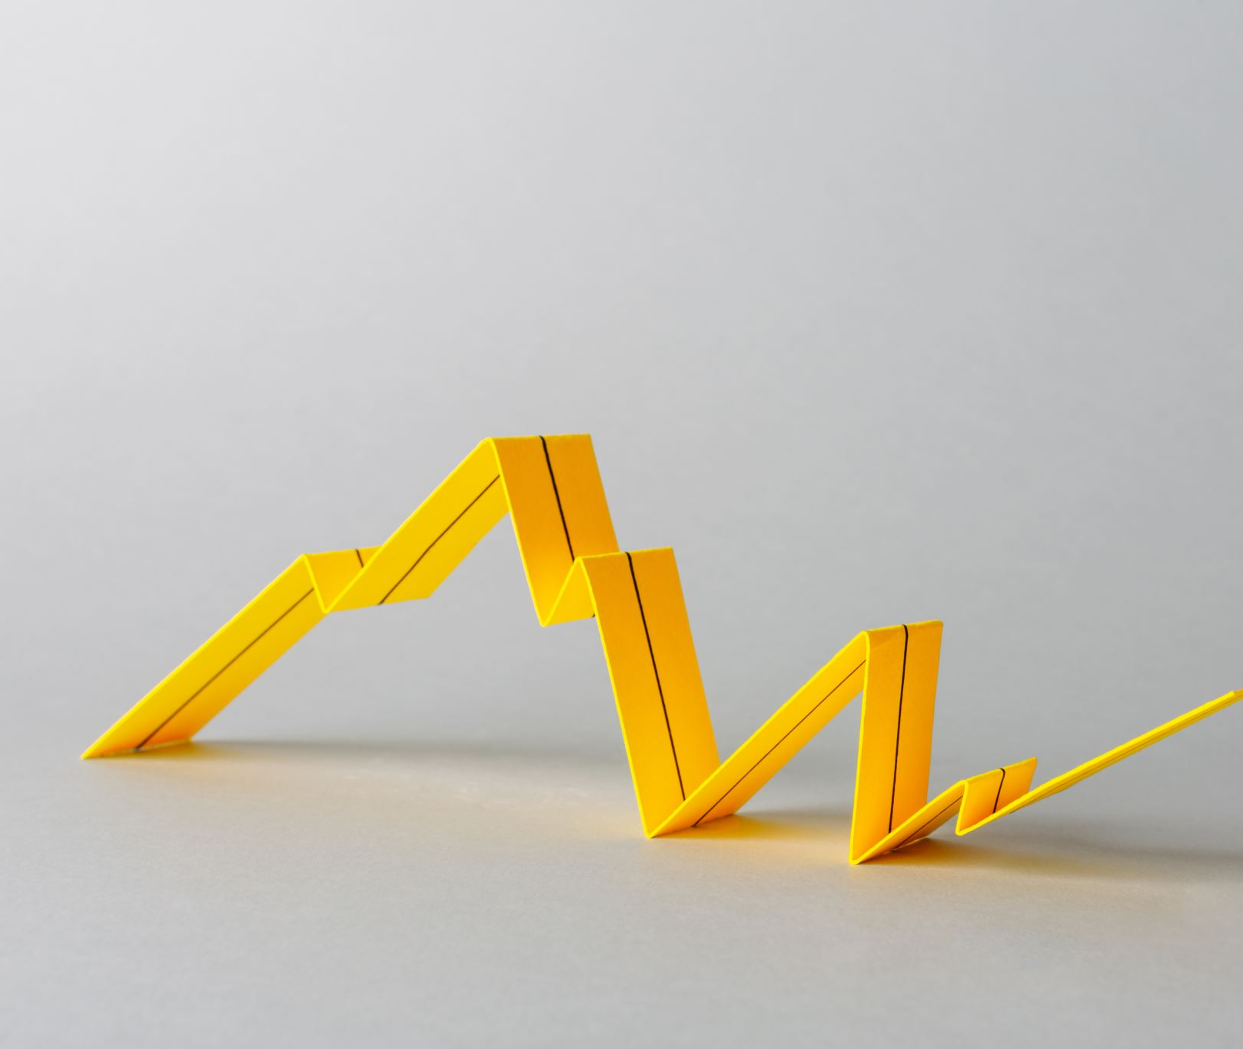
CONCLUSION
The results demonstrate that the time taken by the regression models optimised with ADMM is lower than the time taken by the standard regression models. Since two datasets were used to test the model as classification and regression problems, the accuracy and r2 score of the optimised regression models is higher than the standard models.

Slide 10

References
[1] Zaikarina, Hilda, Anik Djuraidah, and Aji Hamim Wigena. ”Lasso andridge quantile regression using cross validation to estimate extremerainfall.” Global Journal of Pure and Applied Mathematics 12.3 (2016):3305-3314.
[2] Freund, Rudolf J., William J. Wilson, and Ping Sa. Regression analysis.Elsevier, 2006.
[3] Chatterjee, Samprit, and Ali S. Hadi. Regression analysis by example.John Wiley Sons, 2013.
[4] Garc ́ıa-Nieto, Paulino Jos ́e, Esperanza Garc ́ıa-Gonzalo, and Jos ́e PabloParedes-S ́anchez. ”Prediction of the critical temperature of a supercon-ductor by using the WOA/MARS, Ridge, Lasso and Elastic-net machinelearning techniques.” Neural Computing and Applications 33.24 (2021):17131-17145.
[5] Muthukrishnan, R., and R. Rohini. ”LASSO: A feature selection tech-nique in predictive modeling for machine learning.” 2016 IEEE interna-tional conference on advances in computer applications (ICACA). IEEE,2016.
[6] Xin, Seng Jia. ”Modelling house price by using ridge regression and lassoregression.” (2018).

Slide 11
PAPER/CODE
Paper: https://www.overleaf.com/project/618aa149eed6743306391a94
Code : GitHub - RohitNarayananM/ADMM_Project

Slide 12

THANK YOU ...

