Slide 1
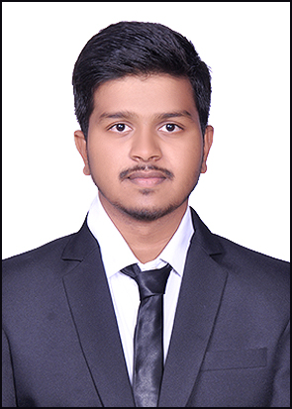



Rohit Namdev Panhale
Analyst/Software Engineer
Bachelor of Engineering
Information Technology : 2018 - 2022
Skills
Mumbai
Java 8 /J2EE | Java Basics, OOPS, Generics, Collections, Arrays, Loops, Lambda Exp, Stream API Junit, Mockito, Servlets
Spring core | IOC & Dependency Injection, Autowire
Spring REST | REST controllers, Implementation of GET, POST, PUT & DELETE, Bean Validation & Exception Handling, Testing Services, Controller & Repository layer
Spring Data JPA | Implement DAO layer using spring Data repositories, Transaction Management
Spring Boot Microservices | Spring Boot Starters, annotations, Messaging Service, Sync/Async comms, Swagger API documents
Spring Cloud | Eureka, Netflix Ribbon, Feign Client, Netflix Hystrix, Netflix Zuul & Config Server
Angular | Components, Services, Modules, Routing, Forms & Validation,
Database | MongoDB and Mysql
UI Tech | HTML 5 & CSS 3,JavaScript, ES6 & TypeScript Reusable templates, Optimized UI Designed
Tools | Git, Postman, Maven, IDE,vscode
Devops | CI/CD, Jenkins configuration, Build Pipelines, notifications, quality gate understanding
Add On skills | Communications, Team management. Peer learning
rohit-namdev.panhale@capgemini.com
+91 9604608996
A4
Full Stack Developer
Hands on experience in creating microservices with Springboot, Spring Security, Spring Cloud API Gateway, Eureka server, Payment Gateway
Proficient in creating Single page Web Application in Angular with Authentication with route guards, Angular reactive forms, angular routing, CSS, Bootstrap
Hands on experience in implementing SMS service and Email service
Experienced in practicing using tools like Mockito and Junit
In depth understanding of the concept of RabbitMQ
Basic idea of the understanding of AWS Cloud environment
E-Commerce Shopping Cart Application
Completed end to end case study of Shopping Cart Application along with OAuth, Swagger and Junit Testing, responsive UI with CSS and Angular used for user interface.
Online Bus Booking Application
Developed Online Bank Application Using spring Boot and AngularJs with MYSQl as database in agile methodology of software development model.
HTML CSS JAVASCRIPT for web developers at Coursera
Completed this course HTML5 CSS3 Bootstrap and Javascript
Check out my work on GitHub & Video Profile

