Slide 1
Job Application Object
Data Type | Field Label | Other Values
Lookup Relationship | Candidate | Related to: Candidate Related List Label: Job Applications
Lookup Relationship | Position | Related To: Position Related List Label: Job Applications
Text Area (Long) | Cover Letter | Length: 32,768 # of Visible Lines: 6
Picklist | Status | Picklist values: • New • Review Resume • Phone Screen • Schedule Interviews • Extend an Offer • Hired • Rejected

Slide 2
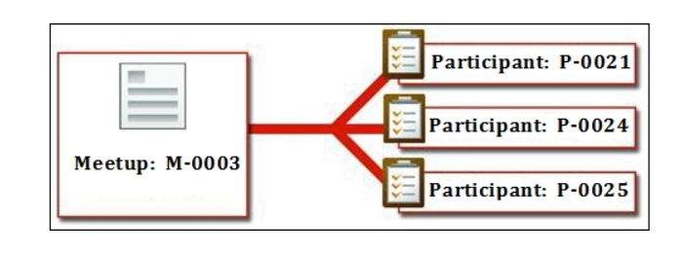
Master-Detail Relationship:
It is a strongly coupled relationship among Salesforce objects, which means if a master record gets deleted, then the child records associated with it are also deleted.
In this type of relationship, the parent record controls the behavior of the child record regarding visibility and sharing.
It means the security setting of a parent object applies to the child object.

Slide 3
Master –Detail Relationship
When there is a master-detail relationship between two objects, you can create a unique type of field over the master object, called Roll-up summary.
A roll-up summary field allows us to calculate values from child records, such as the number of child records linked to a parent record.

