Slide 1
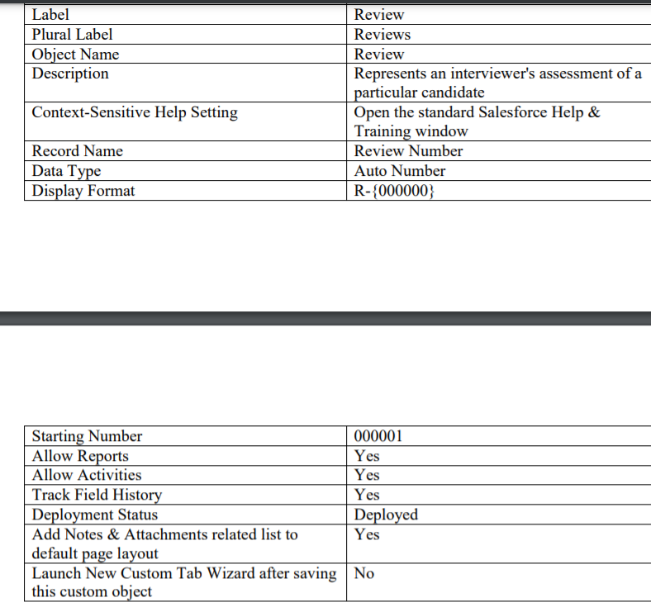
Review Object

Slide 2
Review Object
Review 1
Job Application
Review 2
Review 3
Review4

Slide 3
Review Object:
Data Type | Field Label | Other Values
Master-Detail Relationship | Job Application | Related to: Job Application Related List Label: Review
Text Area (Long) | Assessment
Number | Rating

