Slide 1

DATA ANALYSIS PROJECT
AstroSage
Call Center Analysis

Slide 2
PROJECT OVERVIEW
Objective
Tool Used
Outcome
Analyze call center trends: revenue, guru performance, user behavior, and call patterns.
Microsoft Excel: Pivot Tables, Charts, Slicers, Dashboards, and VLOOKUP.
Multi-page dashboard with KPIs, trend charts, and actionable business insights.
2

Slide 3
ABOUT
AstroSage is a technology-driven astrology platform.
Combines Vedic astrology with modern digital tools.
The platform offers horoscopes, kundli matching, and predictive insights.
Its user data helps analyze customer behavior and service performance
2

Slide 4
PROBLEM STATEMENT
AstroSage has received a 1 crore investment and aims to optimize its call center operations.
Goal: Allocate investment to maximize efficiency, satisfaction, and profitability.
Using historical call data, performance metrics, and market trends.
2

Slide 5
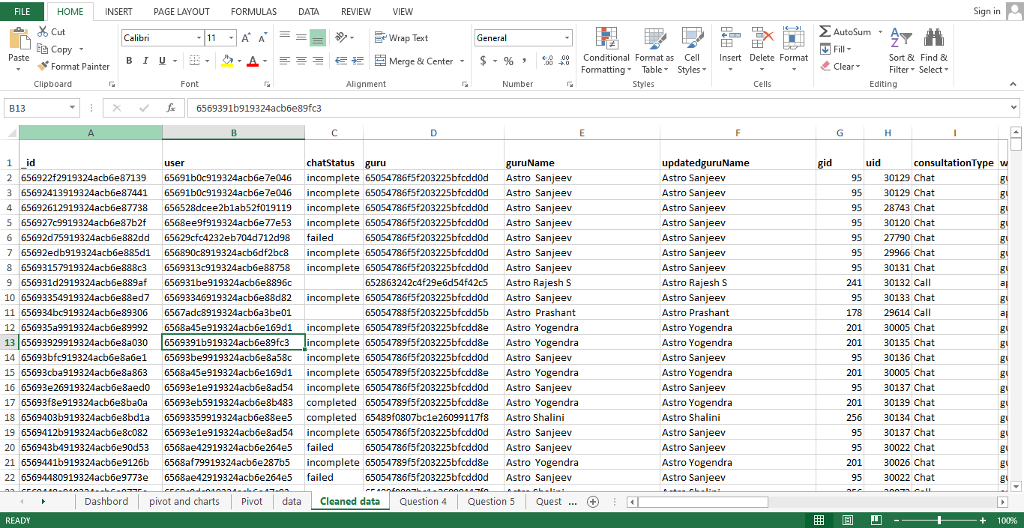
DATA SET SYNOPSIS
2

Slide 6
DATA CLEANING
  Data Inspection: Review data for completeness and accuracy.
  Handling Missing Values: Imputation (Not available (N/A), and ‘0’)
  Removing Duplicates: Identify and eliminate duplicate entries.
  Standardization: Ensure consistent formatting (e.g., date formats, categorical variables).
2

Slide 7
ANLYTICAL APPROACH
  Descriptive Analysis: Tracked call/chat counts, durations, and user engagement patterns.
  Workload Distribution: Identified imbalance in call/chat load among astrologers.
  Sentiment Analysis: Analyze customer feedback to gauge satisfaction levels.
2

Slide 8
TRAFFIC ON WEBSITE
According to the given data gurucool has more traffic compare to app
2

Slide 9
REVENUE & NET AMOUNT BY CONSULTATION TYPE
Call consultations dominate revenue; Complementary and Public Live Calls have minimal impact.
Revenue is heavily skewed toward Call consultations, with negligible returns from other types.
2

Slide 10
CALL STATUS
41% call completion rate indicates significant engagement gaps.
Deploy automated IVR and scale agent availability to improve completion rates.
2

Slide 11
HOURLY CALL RECORDS
Peak call volume: 08:00–10:00 hours.
To maximize user engagement and
drive higher revenue, it is essential to
optimize support during these peak hours.
2

Slide 12
DAY WISE CALL VOLUME
Call volume spiked on days 10 and 11.
Add staff on high-volume days for better support efficiency.
2

Slide 13
RATING REVIEW
Overall ratings are low, indicating poor customer satisfaction..
Recommend AI-powered chatbot for free chat support to enhance experience.
2

Slide 14
TOP 10 GURUS
Dr. Balkrishna: High earnings with low consultation time — exceptional efficiency.
Scale top guru practices team-wide for revenue optimization.
2

Slide 15
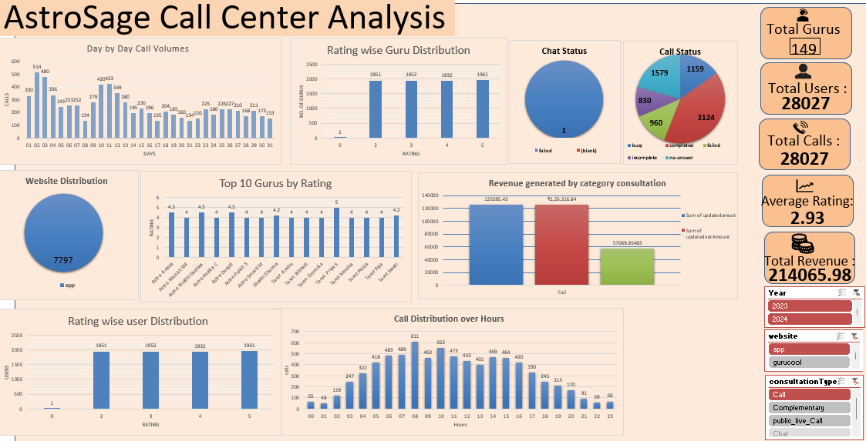
DASHBORD
6

Slide 16
KEY INSIGHTS SUMMARY
  AstroSage has strong consultation call volumes and repeat callers, showing market demand and loyalty.
  However, low customer satisfaction, poor success rates (41% calls, 29% chats), and uneven agent performance highlight service and efficiency issues.
  Revenue concentrated in select consultation types — strengths and growth opportunities exist.
4

Slide 17
POSSIBLE KEY FACTORS
01
Low First-Contact Resolution: High repeat call volumes and low chat/call success rates suggest many customer issues remain unresolved.
02
Imbalanced Agent Utilization: Dependence on a small group of agents creates operational inefficiencies and increases burnout risk.
03
Insufficient Operational Data: Missing fields such as call duration, agent–expertise mapping, and language preferences limit optimization efforts.
04
Ineffective Peak-Hour Coverage: Reduced agent availability during high-demand periods weakens response efficiency.
05
Agent Skill Alignment Gaps: Lack of specialization matching across consultation types affects service quality and call handling effectiveness.
6

Slide 18
POSSIBLE KEY FACTORS
06
Strong Performance in Paid Consultations: Paid consultation services generate stronger revenue, representing a clear strategic advantage.
07
Limited Regional and Language Insights: Inadequate visibility into language and regional demand may cause mismatches between users and agent capabilities.
08
Recurring Call Behavior: While repeat calls reflect customer engagement, they also highlight gaps in service experience that require improvement.
6

Slide 19




CONCLUSION & SUGGESTIONS
📊 CONCLUSION
AstroSage is experiencing challenges related to customer satisfaction, call completion rates, and agent utilization. Immediate measures are required to enhance agent efficiency, balance workloads, and maintain service quality during peak demand periods.
SUGGESTIONS:
₹2,14,065
8,365
28,027
149
Focused Agent Training: Implement targeted training programs to enhance resolution quality and strengthen customer handling during peak traffic periods.
Optimized Agent Utilization: Balance call distribution more effectively to prevent agent burnout and maintain consistent performance across the team.
Improved Success Rates: Review failed call and chat interactions to identify recurring issues and establish standard operating procedures for better resolution.
Peak Hour Optimization: Assign high-performing agents during peak hours to improve customer satisfaction and minimize wait times.
3

Slide 20

Conclusion
Excel pivot tables and dashboards extracted key insights from AstroSage call center data — enabling data-driven decisions on guru management, revenue, and user engagement.

