Slide 1
IPL ANALYSIS
Royal Challengers Bangalore | SQL Data Analysis Project

Slide 2
WHY THIS PROJECT?
The IPL is a data treasure.
This project analyzes match stats, player performance, and team strategies using SQL
To uncover the key patterns behind RCB’s wins and losses.
RCB — a team with legends, firepower, and passion. Yet the trophy cabinet stays empty. Why? Maybe, the answers lie in the data.

Slide 3

AGENDA
Problem Statement
Project Objectives
Subjective Question for Insights

Slide 4
PROBLEM STATEMENT
The Indian Premier League (IPL) is one of the most popular and competitive T20 cricket leagues in the world. Each season generates a large amount of match data, including player performances, team statistics, venue conditions, and match outcomes. Analyzing this data can provide valuable insights into team strategies, player contributions, and factors that influence match results.
However, due to the large volume and complexity of IPL match data, it becomes difficult to manually analyze patterns related to team performance, player efficiency, scoring trends, and venue impact. Teams and analysts need a structured approach to process this data and extract meaningful information that can support strategic decision-making.
The main problem addressed in this project is to analyze IPL match data using SQL to uncover patterns and insights related to player performance, team success, venue conditions, and match outcomes. The project focuses on using structured query language (SQL) to process and analyze multiple relational tables containing detailed ball-by-ball match data, player information, match results, and venue details.
Another important aspect of this analysis is to evaluate the performance of specific teams, particularly Royal Challengers Bangalore (RCB), in order to understand potential reasons behind their inconsistent performance across seasons. By examining factors such as batting dependency, bowling economy rates, and win percentages, the analysis attempts to identify strengths and weaknesses within the team structure.
The project also investigates key match factors such as toss decisions, home-ground advantage, and venue-based scoring patterns, which may influence match results and team strategies. Understanding these factors can help teams optimize their gameplay strategies, player selection, and match planning.
  Overall, the problem this project aims to solve is how to efficiently analyze large-scale IPL cricket data using SQL queries to generate actionable insights about teams, players, and match conditions, ultimately helping teams improve performance and make data-driven decisions.

Slide 5
PROJECT OBJECTIVES
  To analyze the IPL dataset using SQL in order to extract meaningful insights related to matches, teams, and player performance.
  To evaluate team performance across different IPL seasons by analyzing match results, win percentages, and seasonal trends.
  To analyze player performance metrics such as total runs, strike rate, wickets taken, and economy rate to identify top-performing players.
  To identify all-round players who contribute effectively with both batting and bowling, helping teams maintain balance in their squad.
  To study the impact of toss decisions on match outcomes and understand whether choosing to bat or field first influences winning chances.
  To analyze venue-based match performance to determine which stadiums produce high-scoring matches and how venue conditions affect gameplay.
  To evaluate the home-ground advantage for teams, particularly Royal Challengers Bangalore (RCB), and analyze how performance changes at home venues compared to other venues.
  To investigate team dependencies on key players, especially identifying situations where teams rely heavily on a few top performers.
  To analyze RCB’s historical performance across IPL seasons and identify potential reasons behind their inconsistent results.
  To generate data-driven insights that can help teams improve strategies, player selection, and match planning in future tournaments.

Slide 6
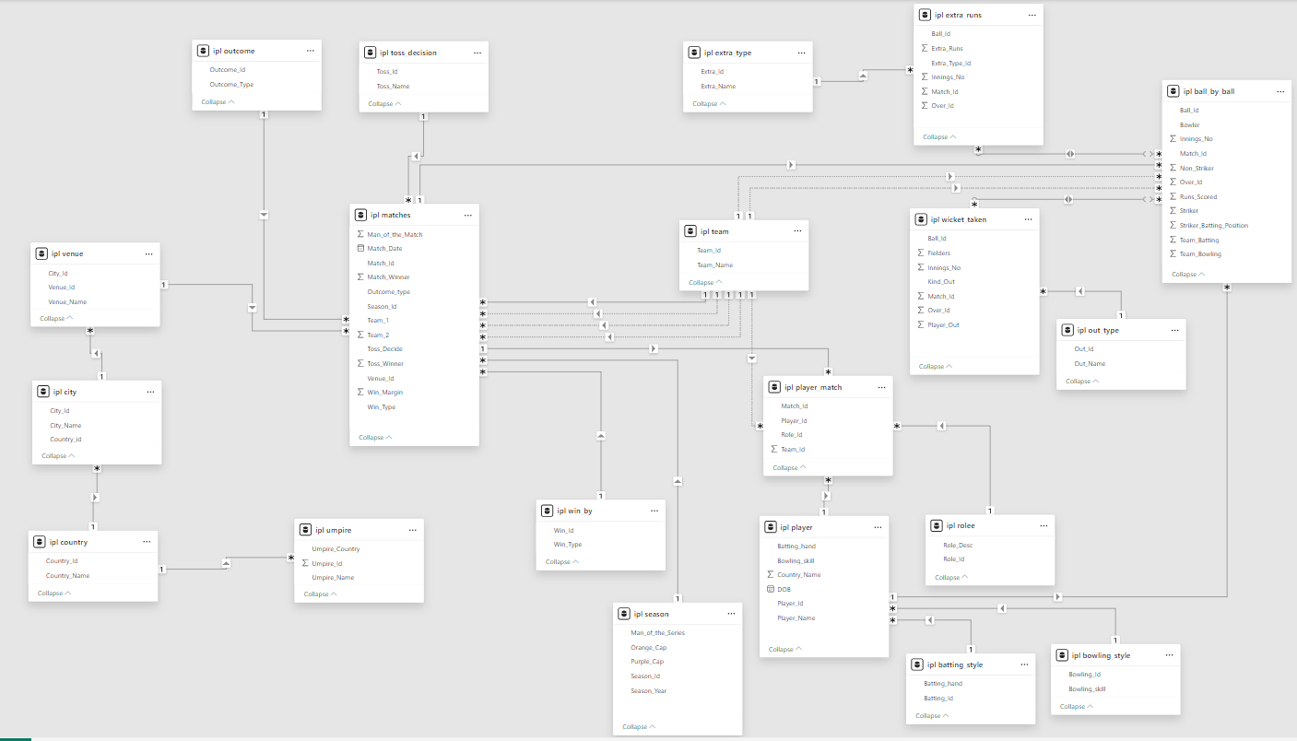
DATABASE SCHEMA

Slide 7
METHODOLOGY
The methodology of this project involves analyzing IPL match data using SQL to extract meaningful insights about team performance, player statistics, and match outcomes.
1. Data Collection :
The IPL dataset containing information about matches, players, teams, venues, and ball-by-ball events was collected. The data was organized into multiple relational tables such as Matches, Ball_by_Ball, Player, Player_Match, Venue, Season, and Wicket Taken.
2. Database Setup :
The dataset was imported into MySQL Workbench, where a database was created and tables were defined using SQL queries. Relationships between tables were established using primary keys and foreign keys.
3. Data Exploration :
Initial SQL queries were executed to understand the structure of the dataset and explore basic information such as total matches, players, runs scored, and wickets taken.

Slide 8
METHODOLOGY
4. Data Analysis :
SQL queries were written to analyze different aspects of IPL performance, including:
  Player batting and bowling performance
  Team performance across seasons
  Impact of toss decisions
  Venue-based scoring patterns
  Home-ground advantage
5. Visualization :
The results of the SQL queries were visualized using Excel / Google Sheets charts to better understand patterns and trends in the data.
6. Insight Generation :
Based on the analysis and visualizations, key insights were generated regarding team strategies, player contributions, and factors affecting match outcomes.

Slide 9
PLAYER PERFORMANCE ANALYSIS
Top Run Scorers | RCB Batting Dependency
Top Run Scorers Analysis:
This analysis evaluates the batting performance of players based on the total runs scored across matches. The chart displays the contribution of each player in terms of total runs, helping identify the most consistent and impactful batsmen.
From the visualization, it can be observed that Virat Kohli and KL Rahul have scored significantly more runs compared to other players, making them the major contributors to the team’s batting performance. Other players such as SR Watson and Mandeep Singh also contribute runs but at a comparatively lower level.
  This analysis highlights the dependency of the team on a few key batsmen for scoring runs. Such insights help teams understand player contributions and make better decisions related to batting order, player selection, and team strategy.
2,491
Kohli's Runs
1,982
KL Rahul's Runs

Slide 10
RCB BOWLING PERFORMANCE ANALYSIS
bowling economy rate of RCB :
This analysis examines the bowling economy rate of Royal Challengers Bangalore (RCB) across different IPL seasons. The economy rate measures how many runs a team’s bowlers concede per over, which is an important indicator of bowling efficiency.
From the visualization, it can be observed that the economy rate remains relatively high across multiple seasons, indicating that RCB bowlers often concede a significant number of runs. A higher economy rate suggests that the bowling unit struggles to restrict the opposition’s scoring rate.
This pattern highlights one of the major challenges faced by RCB in several seasons. Even though the team has strong batting performances, conceding more runs puts additional pressure on the batting lineup during run chases.
  Improving bowling strategies, selecting economical bowlers, and strengthening the bowling attack can help the team achieve better overall performance in future seasons.
Economy Rate Across Seasons | Bowling Efficiency Analysis
Note: Economy = Runs per Over conceded by RCB bowlers
🔴 Economy worsened from 7.23 in 2014 to 7.95 in 2016 — RCB bowlers became progressively more expensive
💡 RCB's best bowling year was 2014 (7.23 RPO). The steady rise to 7.95 in 2016 highlights the need for specialist economical bowlers.

Slide 11
ALL-ROUNDER PERFORMANCE ANALYSIS
Players Contributing with Both Bat and Ball :
This analysis focuses on identifying players who contribute effectively with both batting and bowling, commonly known as all-rounders. These players are highly valuable because they provide balance to the team by supporting both departments of the game.
The visualization compares average runs scored and average wickets taken by players. From the chart, players such as SR Watson and AD Russell demonstrate strong all-round capabilities, as they contribute significantly in both batting and bowling. Other players also show balanced contributions, indicating their ability to support the team in multiple roles.
  Identifying such versatile players is important for building a strong and flexible team lineup. All-rounders help teams maintain stability during matches and improve overall team performance by contributing in different aspects of the game.
Players Contributing with Both Bat & Ball
💡 Watson tops both categories. Russell takes most wickets. Signing quality all-rounders reduces team vulnerability.

Slide 12
TOSS DECISION PERFORMANCE ANALYSIS
Effect of Toss Decision on Match Results
Effect of Toss Decision on Match Results :
This analysis examines how the toss decision influences the outcome of matches. In cricket, winning the toss allows a team to choose whether to bat first or field first, depending on pitch conditions, weather, and match strategy.
The visualization compares the win percentage of teams that choose to bat first and teams that choose to field first after winning the toss. The results indicate that teams choosing to field first tend to have a slightly higher win percentage compared to those choosing to bat first.
This pattern suggests that chasing a target may provide a strategic advantage in many IPL matches. Factors such as dew conditions, better understanding of the target score, and pitch behavior later in the match may contribute to this advantage.
  Understanding the impact of toss decisions helps teams develop better match strategies and tactical planning.
39.95%
52.13%
Bat First
Win %
Field First
Win %

Slide 13
SEASON-WISE WIN ANALYSIS
Venue-wise Scoring Patterns :
This analysis examines how team performance varies across different venues by comparing the average win percentage at each stadium. Different venues have unique characteristics such as pitch conditions, boundary dimensions, weather conditions, and crowd influence, which can significantly impact match outcomes.
The visualization shows the average win percentage across various venues, helping identify locations where teams tend to perform better. Some venues show higher win percentages, suggesting that teams may have a competitive advantage due to familiarity with the ground conditions or favorable pitch behavior.
Understanding venue-based performance patterns allows teams to develop venue-specific strategies, such as selecting suitable players, adjusting batting or bowling tactics, and optimizing match planning based on the conditions of the stadium.
  This analysis helps teams make data-driven decisions to improve performance at different venues.
Venue-Wise Average Win Percentage | Home vs Away Performance
🥇 Sheikh Zayed: 70.8%
🥈 M Chinnaswamy: 58.3%
🥈 Brabourne: 66.7%
💡 RCB's home ground — M Chinnaswamy — has 58.3% win rate, favouring RCB's power-hitting lineup. Sheikh Zayed Stadium tops overall at 70.8%.

Slide 14
TEAM PLAYER ANALYSIS
Player Impact on Team Performance :
This analysis examines how the presence of certain players influences the team’s match outcomes. The chart compares the total number of matches played by each player with the number of matches won when that player was part of the team.
From the visualization, it can be observed that some players have a higher number of team wins relative to the matches they played. This suggests that these players may have a positive impact on overall team performance. Players such as RA Jadeja, SK Raina, and AT Rayudu show strong contributions when they are part of the playing lineup.
These players may contribute through consistent performance, leadership, experience, and the ability to perform under pressure. Identifying such influential players helps teams make better decisions related to player retention, team selection, and match strategies.
This analysis highlights the importance of selecting players who not only perform individually but also positively influence the overall success of the team.
SK Raina
Team Wins: 107 | Win Ratio: 1.62
RA Jadeja
AT Rayudu
Team Wins: 105 | Win Ratio: 1.62
Team Wins: 99 | Win Ratio: 1.65

Slide 15
SEASON-WISE WIN ANALYSIS
Season-wise Match Wins Analysis :
This analysis examines the distribution of matches won by the team across different IPL seasons. The visualization shows the percentage of matches won in each season, helping to understand the team’s performance trends over time.
From the chart, it can be observed that the team’s wins are relatively distributed across multiple seasons, with most seasons showing a similar percentage of victories. However, slight variations in win percentages indicate that the team’s performance has not been consistently dominant in any particular season.
This pattern suggests that while the team has remained competitive across seasons, maintaining consistent winning momentum has been a challenge. Understanding these seasonal performance trends helps identify areas where improvements in team strategy, player selection, and overall performance consistency may be required to achieve better results in future tournaments.
Match Win Distribution Across IPL Seasons (2013–2016)
2013: 25.8%
2014: 22.6%
2015: 25.8%
2016: 25.8%

Slide 16
RECOMMENDATIONS BASED ON ANALYSIS
Focus: Auction & Team Composition
Retain core players who consistently boost win percentage.
Prioritize all-rounders for both batting depth and bowling options.
Strengthen the fast-medium bowling unit, RCB’s most reliable wicket source.
Focus: Venue & Conditions Strategy
Maximize home advantage at Chinnaswamy, which favors strong batting.
Target bowlers who perform well in high-scoring grounds.
Use venue-specific player stats to guide selection and rotation.
Focus: Data-Driven Decision Making
• Use strike rate + economy KPIs before match selections.
• Track morale impact players — those whose presence boosts win %.
• Integrate SQL dashboards with live team analytics.

Slide 17
CONSLUSION
This project focused on analyzing IPL match data using SQL in order to extract meaningful insights related to team performance, player contributions, match strategies, and venue influence. By using structured queries and data analysis techniques, raw cricket data was transformed into valuable information that helps understand different aspects of the game.
The analysis highlighted several important patterns. Player performance evaluation showed that a small group of top players contributes a significant portion of total runs, indicating that teams often depend heavily on key batsmen. Identifying such performance trends helps teams understand the importance of maintaining a balanced batting lineup with strong middle-order support.
The bowling analysis revealed that economy rate plays a crucial role in determining match outcomes. Teams that struggle to control the opposition’s scoring rate often face additional pressure on their batting units. Strengthening the bowling attack and improving bowling strategies can significantly enhance overall team performance.
Venue analysis demonstrated that different stadiums influence scoring patterns and match results due to variations in pitch conditions, ground dimensions, and environmental factors. Understanding these venue characteristics allows teams to adapt their strategies and select players suited to specific playing conditions.
The project also emphasized the importance of all-round players and versatile team members who can contribute effectively in both batting and bowling. Such players improve team flexibility and provide greater strategic options during matches.
Overall, this project demonstrates how data analysis using SQL can provide valuable insights for sports analytics. By applying data-driven approaches, teams can make more informed decisions related to player selection, match strategy, and long-term team development. These analytical insights can ultimately help teams improve their performance and increase their chances of achieving success in competitive tournaments like the IPL.

Slide 18


