Slide 1
Linear Regression Diagnostics
Linear regression is a statistical technique to represent relationships between two or more variables using a linear equation.
It is a basic and commonly used type of predictive analysis.
The overall idea of regression is to examine two things:
Does a set of predictor variables do a good job in predicting an outcome (dependent) variable?
Which variables in particular are significant predictors of the outcome variable, and in what way do they impact the outcome variable?
In today’s presentation, the focus is majorly on,
Understanding and using a simple linear regression.
Refining data for simple linear regression.
Introducing multiple linear regression.

Slide 2
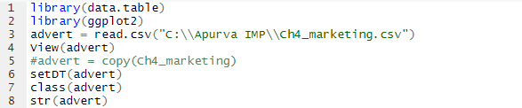
Linear Regression for solving a Business problem

Slide 3
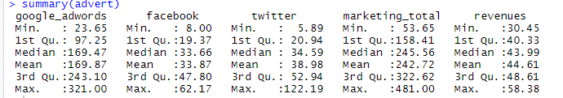
View The Numeric Distributions
We see that 3 of the columns are for advertising on the platforms google adwords, facebook, and twitter. Let us do a quick view of the distributions:
Google adwords is the most expensive and Facebook seems the cheapest, and all 3 seem equally distributed.
To determine any pattern or correlation between all the columns, we would be using the “Pairs” function.
Pairs(mark)

Slide 4
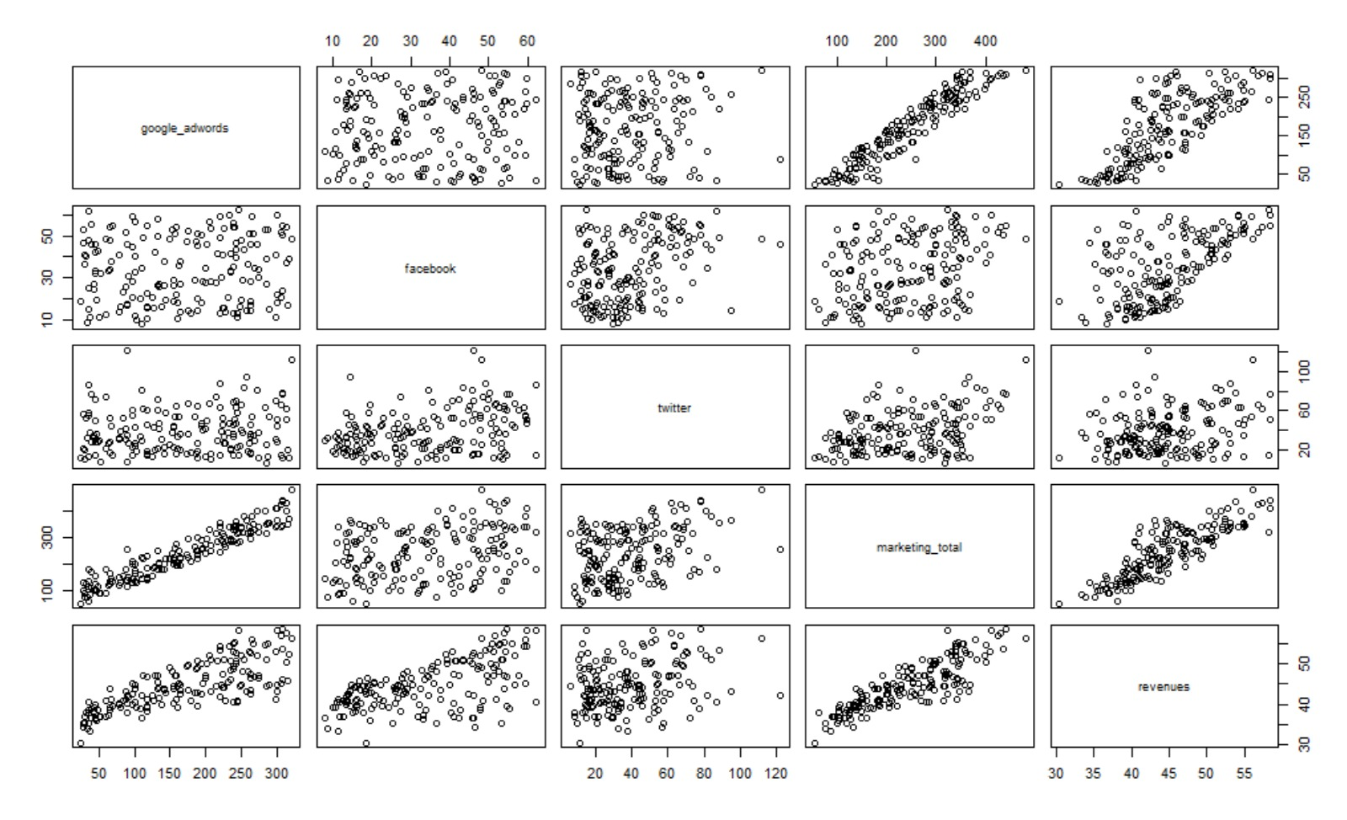
Relationship between Values
We notice a strong correlations between google adwords and marketing total, and revenue and marketing total.

Slide 5
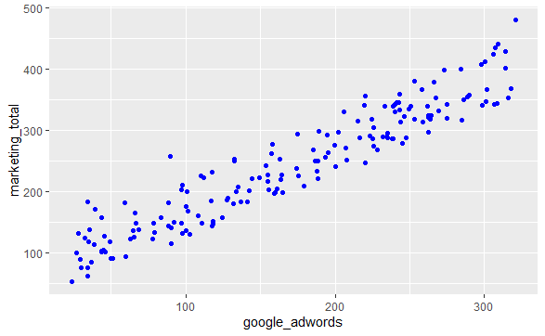
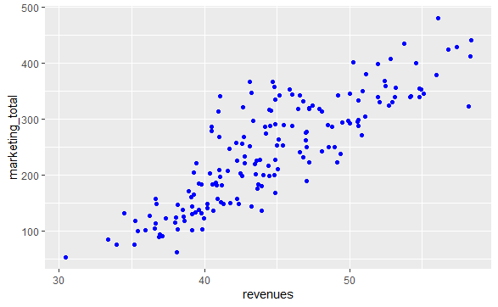
Relationship between Values - Deeper Look

Slide 6
Simple Linear Regression
Linear regressions are linear models that are constructed according to the data points used in the data points. To construct a linear regression model in R.
Regression analysis is used to:
Predict the value of a dependent variable based on the value of at least one independent variable.
Explain the impact of changes in an independent variable on the dependent variable.
Dependent variable - The variable we wish to predict or explain.
Independent variable - The variable used to predict or explain the dependent variable.

Slide 7
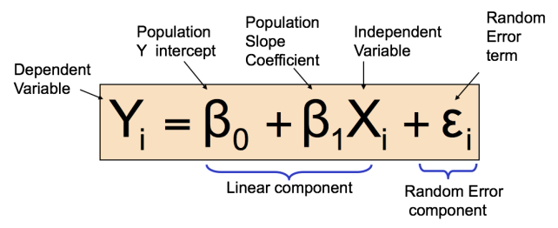
Simple Linear Regression
Only one independent variable, X.
Relationship between X and Y is described by a linear function.
Changes in Y are assumed to be related to changes in X.

Slide 8
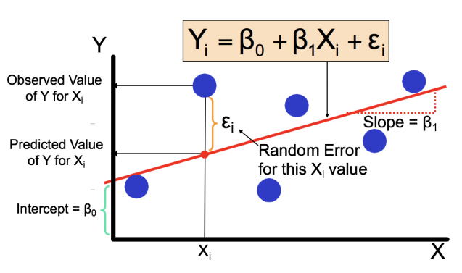

Slide 9
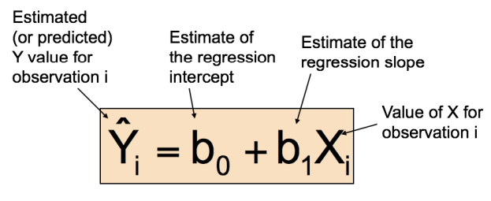
Simple Linear Regression
The simple linear regression equation provides an estimate of the population regression line.

Slide 10
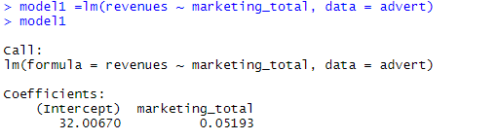
Simple Linear Regression
b0 is the estimated average value of Y when the value of X is zero.
b1 is the estimated change in the average value of Y as a result of a one-unit increase in X.
lm() function
model = lm(Y∼X, data=data.table)

Slide 11
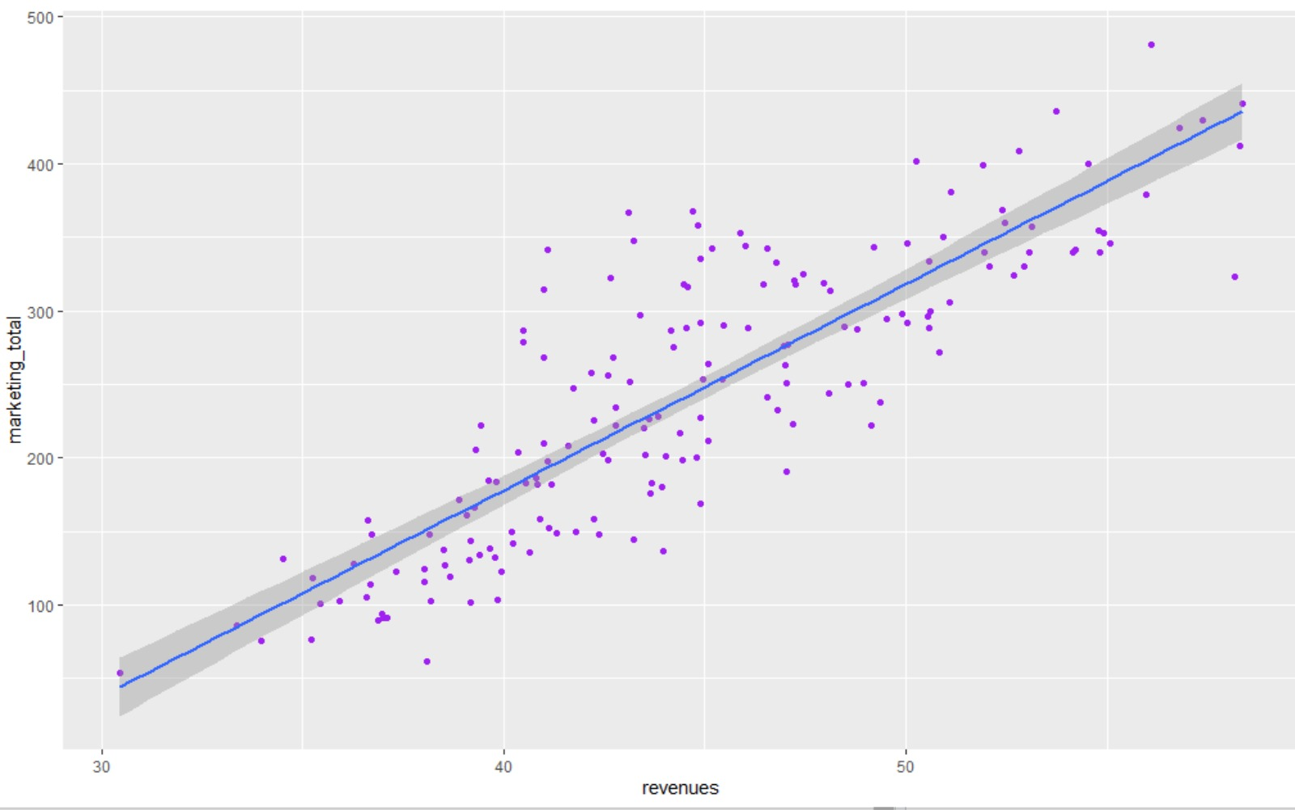
Interpreting Simple Linear Regression
Revenue increases by $51.93 for every $1,000 increase in total marketing
Revenue is $32,007 when total marketing expenditure is $0
From here we can make a prediction model:
Revenue = 32.0067 + (0.05193 ∗ marketing_total)

Slide 12
L.I.N.E Assumptions
Linearity: The relationship between predictor and response variables should be linear. We can view the same by plotting a scatter plot and check if there is an image of a linear pattern.
ggplot ( advert , aes ( x = revenues , y = marketing_total ) ) + geom_point (color ='purple') + geom_smooth ( method = "lm")

Slide 13
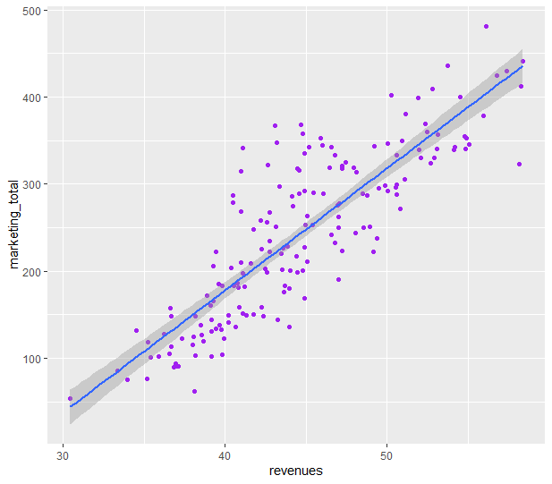
Graph showing linearity between marketing_total and revenue:

Slide 14
Independence:
The relationship between the variables should be independent of one another.
The current data uses data from different locations, its safe to say that the data from one location has effect on other locations

Slide 15
Normality
The residuals must form a normal distribution around the regression line with mean value of 0.
We can use a histogram to view the distribution of the residuals. Another plot to check the normality is the normal quantile, or Q-Q plot
The Q-Q plot is a scatterplot of the residuals of the model and the Z-scores of those residuals

Slide 16
Checking Normality from table
str ( model1 )
model1 $ residuals
We don’t need a column for the Z-score of the residuals, because ggplot() will calculate that for us
Creating table resdf, and graph the histogram:
resdf = data.table ('res'= model1$residuals )
Plotting histogram:
ggplot ( resdf , aes ( x = res ) ) + geom _ histogram ( bins =10 , fill =’purple ’, color =’black ’)

Slide 17
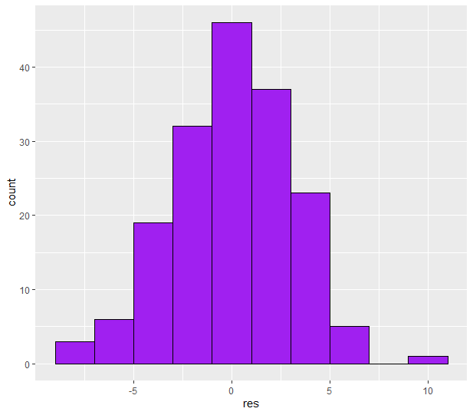
Normality Histogram:

Slide 18
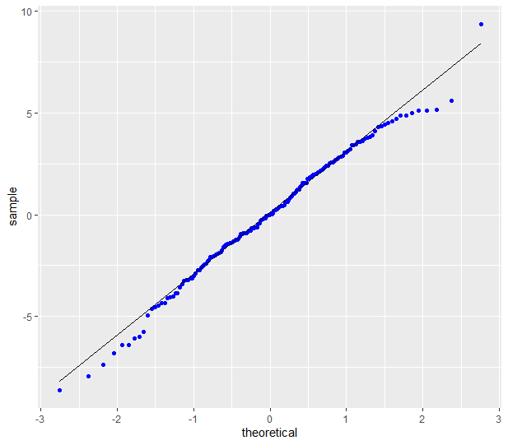
Q-Q Plot:
We graph the Q-Q plot, using the stat graphs in ggplot():
ggplot ( resdf , aes ( sample = res ) ) + stat _qq ( color =‘blue’) + stat _qq_ line ().

Slide 19
Equal Variance:
Residuals should form a random pattern distributed around a mean of 0.
The same can be visualized by plotting the residuals against predicted values of the model.
Just like the residuals, the predicted values are in model1. We can use the resdf table, we can add a column pred that has the predicted values, and then create a scatter-plot with the residuals on the y-axis and the predicted values on the x-axis.

Slide 20
R code for Equal Variance:
Extracting predicted values from model1 one and saving in pred column in resdf table:
resdf [ , pred := model1 $ fitted . values ]
Creating a scatter-plot with the residuals on the y-axis and the predicted values on the x-axis.
ggplot ( resdf , aes ( x = pred , y = res ) ) + geom _ point ( color =’ purple ’) + geom _ smooth ( method =’lm ’)

Slide 21
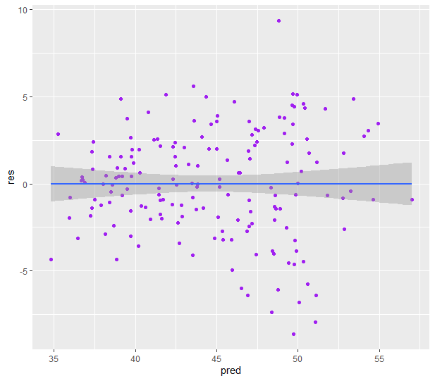
Plot for Equal Variance:

Slide 22
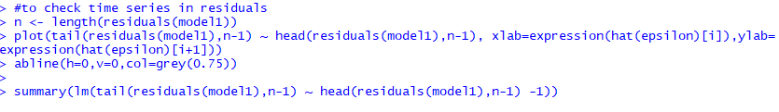
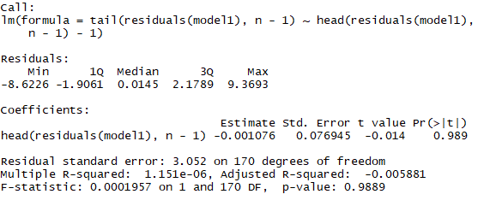

Checking Time Series In Residuals for model 1

Slide 23
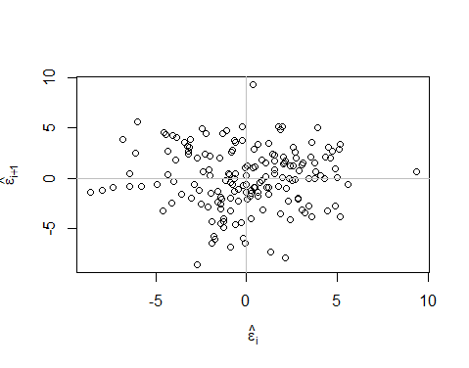
Plot

Slide 24
Predicting Outputs
You can predict outputs using the Simple Linear Regression model, this works best if you predict using inputs inside the range of the existing model. Revenues can be predicted for values within the marketing total of:
summary(advert$marketing_total)
Output:
Min. 1st Qu. Median Mean 3rd Qu. Max.
53.65 158.41 245.56 242.72 322.62 481.00
The values are between [53.65,481].
Suppose you want to predict the revenues if you want to spend $460,000 in marketing.

Slide 25
Predicting Outputs
First we check if the data has an input of 460:
advert[marketing_total>430]
Output:
google_adwords facebook twitter marketing_total revenues
1: 321.00 48.30 111.70 481.00 56.10
2: 307.43 50.23 77.83 435.49 53.73
3: 308.78 54.58 77.58 440.94 58.38

Slide 26
Predicting Outputs
advert[marketing_total>430,marketing_total]
Output:
481.00 435.49 440.94
We can use the predict.lm() function to estimate based on other inputs. You need to put your prediction(s) in a table and then run the function:
newrev = data.table(marketing_total=seq(460,470,5)) predict.lm(model1,newrev,interval = ’predict’)
Output:
fit lwr upr
55.89403 49.75781 62.03025
56.15368 50.01331 62.29404
56.41332 50.26873 62.55791

Slide 27
Predicting Outputs
For the value of $460,000 you get an estimate of revenue of $55,894. Now that can’t be an exact number because it is an estimate. That is why you are given a 95% confidence interval. What the confidence interval is saying is that if you were to make 100 predictions with marketing total being 460, then 95 out of the 100 results would fall in between 55.89403 and 62.03025. If you wanted a 99% interval, then you would use the parameter:
predict.lm(model1,newrev,level=.99,interval = ’predict ’)
Output:
fit lwr upr
55.89403 47.79622 63.99184
56.15368 48.05040 64.25695
56.41332 48.30446 64.52218

Slide 28
Confidence Intervals
Before MapReduce and Hadoop, statisticians would analyze massive datasets by taking random samples, crunching the numbers and then predicting what the values of the actual dataset would be. Because you are using a random sample of data from a larger dataset, you cannot be sure that your answer is correct, because its just an estimate of unknown data. The confint() function, allows you to see the estimate of error. For example, assume that we use 30% of the data to analyze the rest of the data:
set.seed(4510)
liladvert=advert[sample(.N,.3*.N)]
samp_model = lm(revenues~marketing_total ,data=liladvert)
samp_model
Output:
Call:
lm(formula = revenues ~ marketing_total, data = liladvert)
Coefficients:
(Intercept) marketing_total
30.65396 0.05739

Slide 29
Confidence Intervals
The sample() function takes random samples from a data container. Here is a simple example using a vector:
vv=5:15
sample(vv,5)
Output:
[1] 11 8 14 15 5
[1] 9 10 15 5 13
[1] 8 10 7 9 13
The sample() function will randomly choose 5 different values from 5 to 15. Every time you run that line of code, you will see you keep getting different values (Random).
If you are doing a particular simulation and you would like to see the same results simulated, that is when you use the set.seed() feature. You can put any number within the parenthesis (example: 4510), and it will simulate the same numbers for you.

Slide 30
Confidence Intervals
Now using the sample() function in a data.table():
liladvert = advert[sample(.N,.3*.N)]
The .N is a strange command in data.table() that replaces the function NROW(). Anywhere you see it, it is giving you the number of rows in the table. In the context of this function, it is saying from all the rows of the advert table, choose only 30% of them or only 51 rows (decimal place is dropped).

Slide 31
Confidence Intervals - Interpretation
confint(samp_model)
Output:
2.5 % 97.5 %
(Intercept) 28.2397634 33.06815353
marketing_total 0.0480053 0.06676511
This shows that if you take 100 different random samples from the advert table, 95% of them will estimate the slope of marketing total between 0.0480053 and 0.06676511.

Slide 32
Refining data for Simple Linear Regression
There are times when the L.I.N.E. (Linearity, Independence, Normality, and Equal Variance) assumptions are violated.
So, we are checking here for our variables google_adword, facebook and twitter.

Slide 33
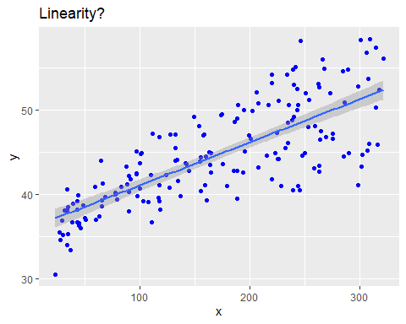
Refining data for Simple Linear Regression
## Checking L.I.N.E assumptions for revenue & google_adwords x = advert$google_adwords # independent y = advert$revenues # dependent
fit = lm(advert$revenues~advert$google_adwords) sampdt = data.table(x,y)
# Check for Linearity ggplot(sampdt, aes(x= x, y = y)) + geom_point(color = 'blue') + geom_smooth(method = "lm")+ labs(title="Linearity?")

Slide 34
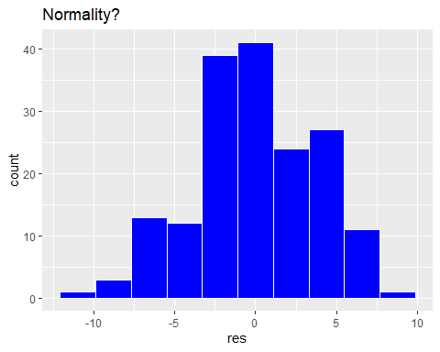
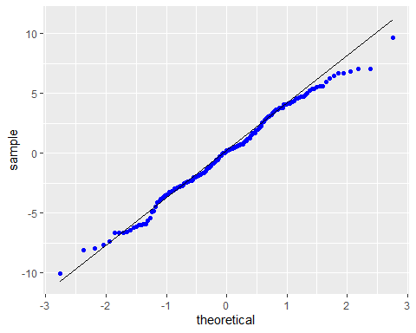
# Check for Normality ## histogram sampdt[,res:=fit$residuals] ggplot(sampdt ,aes(x=res)) + geom_histogram(bins=10,fill='blue',color='white') + labs(title= 'Normality?')
## QQ-Plot ggplot(sampdt ,aes(sample=res)) + stat_qq(color='blue')+ stat_qq_line()

Slide 35
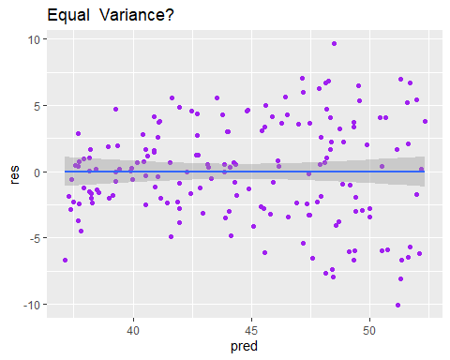
Refining data for Simple Linear Regression
# Check for Equal Varience sampdt[,pred:=fit$fitted.values] ggplot(sampdt ,aes(x=pred ,y=res)) + geom_point(color='purple') + geom_smooth(method = 'lm') + labs(title='Equal Variance?')
Here, we can see that plot shows equal variance.
As, the data points are scattered and not forming any patterns.

Slide 36
Transforming Data
The first plot shows linearity and last plot shows equal variance but the histogram and QQ plot do show some violations to the Normality properties.
This is where data transformation comes into play
##data transformation for google_adwords x = log(advert$google_adwords) # independent y = advert$revenues # dependent fit = lm(y~x) sampdt = data.table(x,y)

Slide 37
Transformation of data
# Check for Normality ## histogram sampdt[,res:=fit$residuals] ggplot(sampdt ,aes(x=res)) + geom_histogram(bins=10,fill='blue',color='white') + labs(title= 'Normality?')
## QQ-Plot ggplot(sampdt ,aes(sample=res)) + stat_qq(color='blue')+ stat_qq_line()

Slide 38
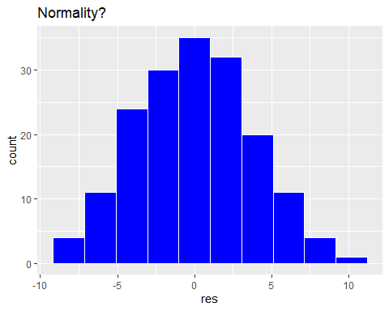
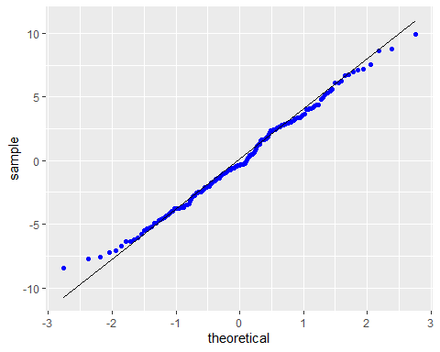
Normality?
Here, transformation works to make our model a perfect fit for Regression

Slide 39
Transformation of data
# Check for Linearity
ggplot(sampdt, aes(x= x, y = y)) + geom_point(color = 'blue') + geom_smooth(method = "lm")+ labs(title="Linearity?")
# Check for Equal Variance
sampdt[,pred:=fit$fitted.values] ggplot(sampdt ,aes(x=pred ,y=res)) + geom_point(color='purple') + geom_smooth(method = 'lm') + labs(title='Equal Variance?')

Slide 40
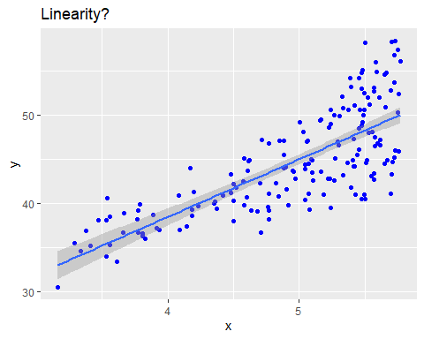

Slide 41
Refining data for Simple Linear Regression
## Checking L.I.N.E assumptions for revenue & facebook x = advert$facebook # independent y = advert$revenues # dependent fit = lm(advert$revenues~advert$facebook) sampdt = data.table(x,y) # Check for Linearity ggplot(sampdt, aes(x= x, y = y)) + geom_point(color = 'blue') + geom_smooth(method = "lm")+ labs(title="Linearity?")
##data transformation for facebook x = sqrt(advert$facebook) # independent y = advert$revenues # dependent fit = lm(y~x) sampdt = data.table(x,y) # Check for Linearity ggplot(sampdt, aes(x= x, y = y)) + geom_point(color = 'blue') + geom_smooth(method = "lm")+ labs(title="Linearity?")

Slide 42
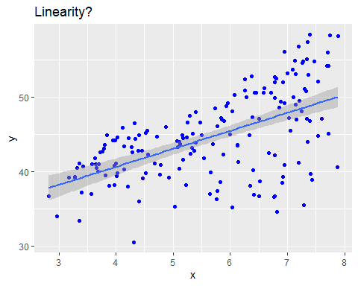
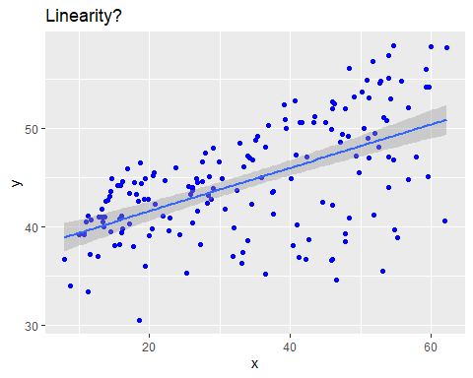
#Before sqrt Transformation
#After sqrt Transformation

Slide 43
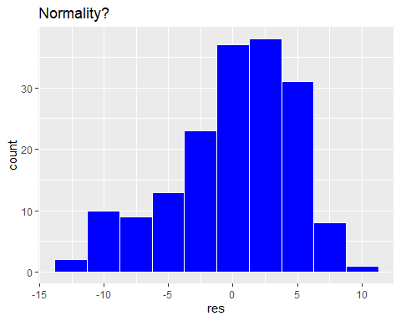
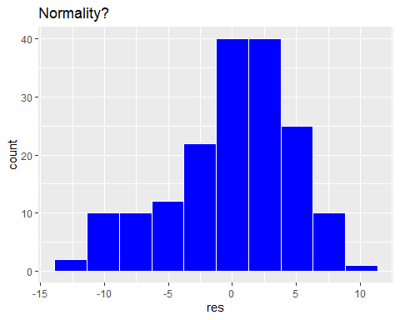
#Before sqrt Transformation
#After sqrt Transformation

Slide 44
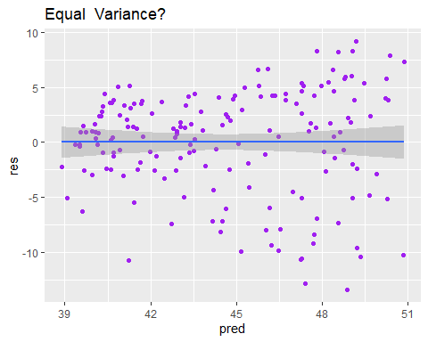
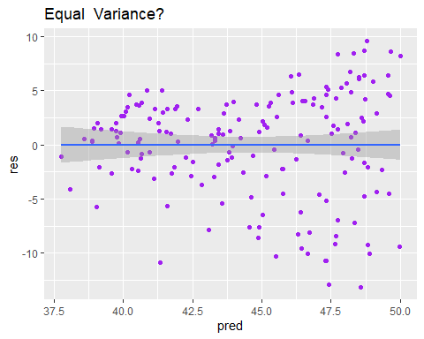
#Before sqrt Transformation
#After sqrt Transformation
Here, we can see that sqrt transformation makes our data more refine

Slide 45
Refining data for Simple Linear Regression
Lastly, we check for twitter variable and see that if there is a need for transformation or not.
## Checking L.I.N.E assumptions for revenue & twitter x = advert$twitter # independent y = advert$revenues # dependent fit = lm(advert$revenues~advert$twitter) sampdt = data.table(x,y)

Slide 46
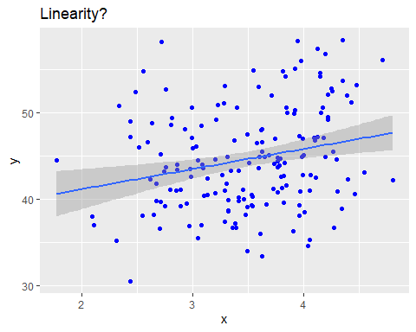
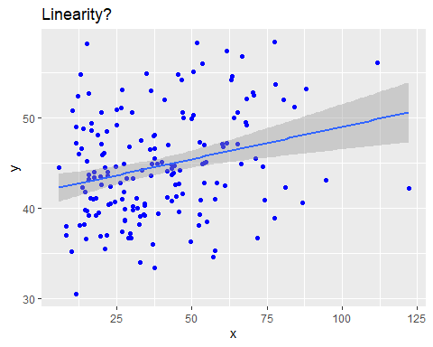
#Before Transformation
#After Transformation

Slide 47
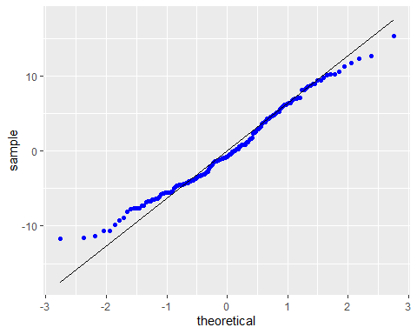
#Before log Transformation
#After log Transformation
Clearly, log transformation won’t make any difference for the normality.

Slide 48
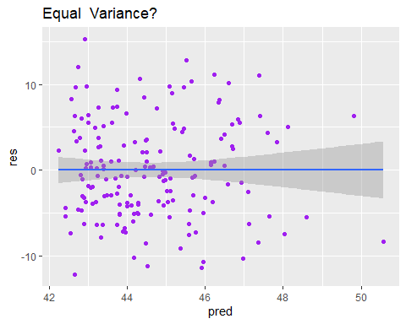
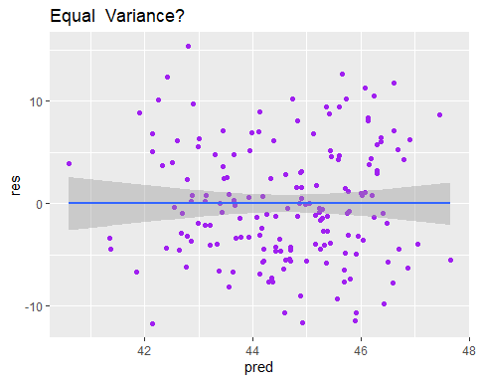
#Before log Transformation
#After log Transformation
So, here transformation is not helping and we move forward with our original datapoints.

Slide 49
Multiple Regression
The relationship between several independent or predictor variables and a dependent or criterion variable
Multiple regression equation:
y = b₁x₁ + b₂x₂ + … + b_{n}x_{n} + e.
Here, b_{i}’s (i=1,2…n) are the regression coefficients, which represent the value at which the dependent variable changes when the independent variable changes.
X’s are the independent variables.
Y is the dependent variable
e is the error.`

Slide 50
Collinearity
Collinearity is a condition in which some of the independent variables in a multiple regression model are highly correlated.
When predictor variables in the same regression model are correlated, they cannot independently predict the value of the dependent variable.
Mathematically collinearity could be calculated by calculating correlation coefficient(r) for each pair of X variables. If any of the r-values is significantly different from 0, then independent variables involved may be collinear

Slide 51
Assess presence of collinearity?
The Variance Inflation Factor (VIF) is used to check collinearity. Values of VIF that exceed 10 are often regarded as indicating multicollinearity, but in weaker models values above 2.5 may be a cause for concern.
In R we check VIF by plotting a model with all the independent variables present in the dataset by running lm() function. And then running vif() function in the model
library(faraway)
model2 = lm( revenues ~ google_adwords + facebook + twitter , data = advert )
model2
vif(model2)

Slide 52
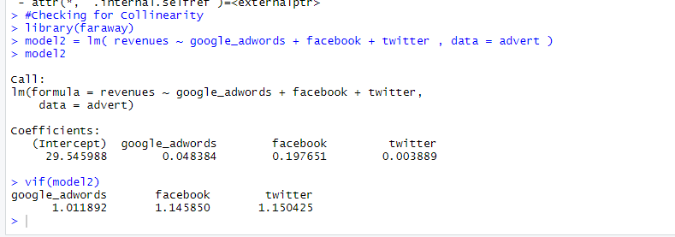
Checking collinearity in R
When we ran the above code, we could see none of the vif values for each independent variable is greater than 1.5. Hence, we do not have a problem due to collinearity in the model.

Slide 53
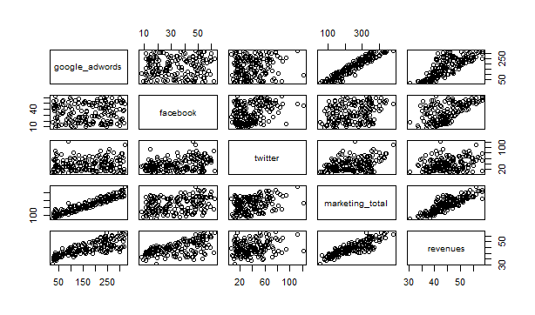
Plot the model using lm function
model2=lm(revenues~google_adwords+facebook+twitter,data=advert)
plot(advert)
Linearity:

Slide 54
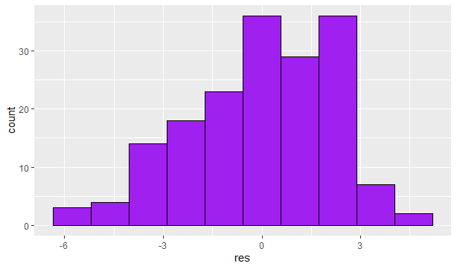
Histograms
Displays the bar with counts.
resdf2= data.table('res'=model2$residuals)
ggplot(resdf2,aes(x=res))+ geom_histogram(bins=10,fill='purple',color='black')

Slide 55
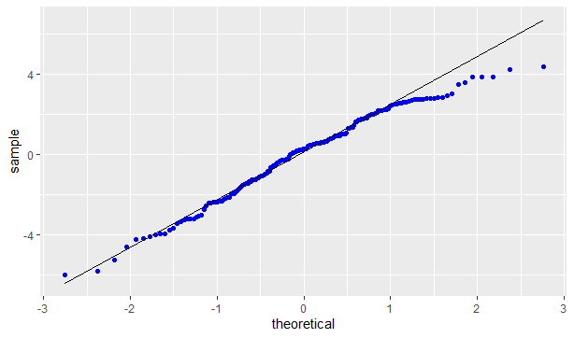
Stat_qq and stat_qq_line
Stat_qq produce quantile-quantile plots.
Stat_qq_line compute the slope and the intercept of the line connecting the points at specified quartiles
ggplot(resdf2,aes(sample=res))+stat_qq(color="blue")+stat_qq_line()

Slide 56
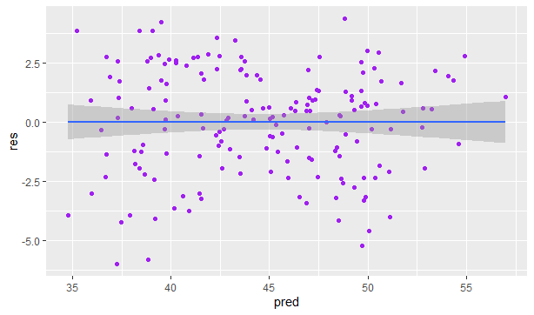
Points
The point geom is used to create scatterplots.
The scatterplot is most useful for displaying the relationship between two continuous variables.
resdf2[,pred:=model1$fitted.values]
ggplot(resdf2,aes(x=pred,y=res))+geom_point(color='purple')+geom_smooth(method='lm’)

Slide 57
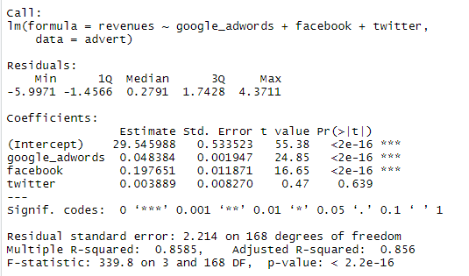
summary(model1)

Slide 58
F- Test for the overall fit of the Model
The F test is used to determine whether a significant relationship exists between the dependent variable and the set of all the independent variables.
Shows if there is linear relationship between all the X variables considered together and Y
Use F – Statistic
Hypothesis:
H₀:b₁=b₂=b₃=b_{k}=0(no linear relationship)
H1:at least one bi not equal to 0(at least one independent variable(X) affects (Y))

Slide 59
F- Test for the overall fit of the Model
The F test is used to determine whether a significant relationship exists between the dependent variable and the set of all the independent variables.
Shows if there is linear relationship between all the X variables considered together and Y
Use F – Statistic
Hypothesis:
H₀:b₁=b₂=b₃=b_{k}=0(no linear relationship)
H1:at least one bi not equal to 0(at least one independent variable(X) affects (Y))

Slide 60
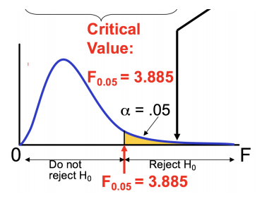
Multiple Regression - F test

Slide 61
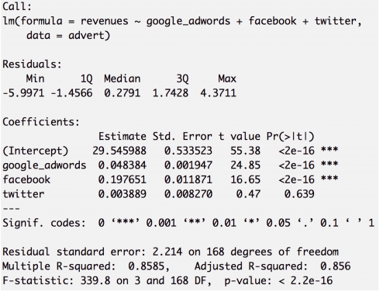
Multiple Regression - Interpreting Results
qf(.95,df1=3,df2=168)
2.658399

Slide 62
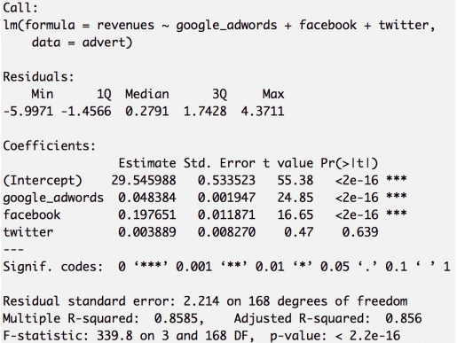
Multiple Regression - Interpreting Results
The adjusted R-squared value shows how much of the variation in the dependent variable, is explained by the variation in the independent variables. It is a good explanation of fit. Our variables explain a lot of the variance, hence, a good fit.
The 3 predictors also generate their own p-values via the t-statistic. Low p-values indicate that the variable helps explain the model better than a high p-value.

Slide 63
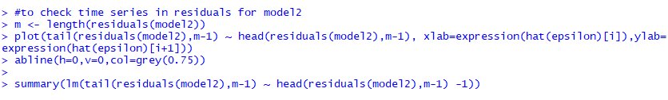
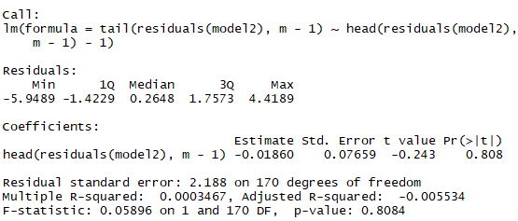
Checking Time Series In Residuals for model 2
Output:

Slide 64
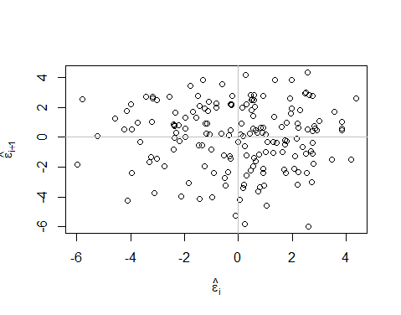
Plot

Slide 65
Regularization
What if the independent variables are not independent of each other i.e. collinearity or multicollinearity is present among the predictor variables.
When predictor variables are related, they fit well into a straight regression line that passes through many data points
It is difficult to ascertain reliable estimates of each coefficients for the predictor variables which results in incorrect conclusions.
In these cases stated above Lasso, Ridge and Elastic Net Regression comes into play to combat variance problems.

Slide 66
Lasso, Ridge, Elastic Net
Ridge Regression: It helps reduce Variance by shrinking parameters and making predictions less sensitive. It can find solution with Cross validation and Ridge Regression Penalty. Better when all variables are useful.
Sum of squared residuals + ^ * the slope²
Lasso Regression: Lasso is almost like Ridge. The big difference is that Ridge can shrink the slope close to 0 while Lasso can shrink the slope all way to 0 i.e. Lasso regression can exclude useless variables from equations.
Sum of squared residuals + ^ * |the slope|
Elastic Net Regression: In case of numerous variables, if we are uncertain whether the variables are useful or not, we could use Elastic Net. It combines the Lasso penalty with the Ridge penalty and by doing so we get both worlds and is better for correlated parameters.
^1 *|variable1| +.. +|variablex| + ^2 * variable1² +…variablex²

Slide 67
Conclusion and Citation
Conclusion: For model1 p-value < 0.05 and for model2 p-value < 0.05 indicates strong evidence against the null hypothesis, so you reject the null hypothesis. And R-squared score is 0.7261 for model1 and 0.8585 for model2, which means that this model explains 72 % and 85% of the total variance in respective models. Hence the proposed model are good models. We also did showcase future scope of this project which could be done by redefining data and using suitable regularization method if any collinearity exists or model doesn’t prove to be a good one.
Citation:
https://searchengineland.com/regression-analysis-to-improve-google-ads-performance-313898
http://sphweb.bumc.bu.edu/otlt/MPH-Modules/BS/R/R5_Correlation-Regression/R5_Correlation-Regression7.html
http://www.sthda.com/english/articles/39-regression-model-diagnostics/161-linear-regression-assumptions-and-diagnostics-in-r-essentials/
https://www.datacamp.com/community/tutorials/tutorial-ridge-lasso-elastic-net

