Slide 1
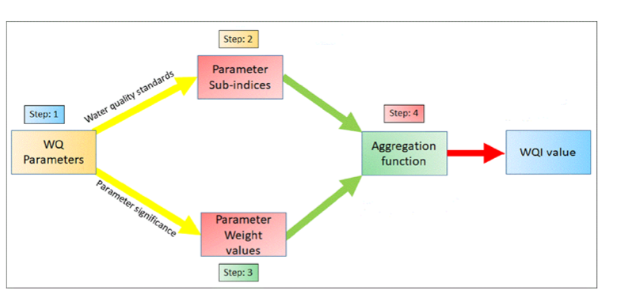
GT(pH,Sal,Am)
Band data
WQI
Predicted WQI
Predicted using SVR
Predicted GT(pH,Sal,Am)
Based on Linear regression(atm)
Can also do multivariate regression to get all set of parameters as a output

