Slide 1
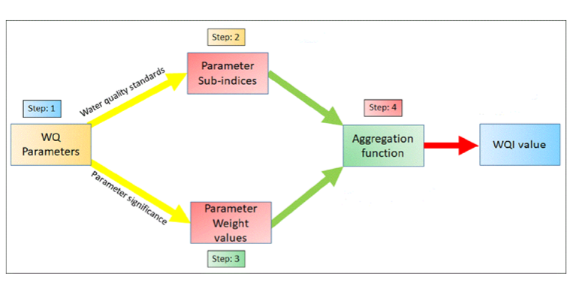
Basic Model
GT(pH,Sal,Am)
Band data
WQI
Predicted WQI
Predicted using SVR
Predicted GT(pH,Sal,Am)
Based on Linear regression(atm)
Can also do multivariate regression to get all set of parameters as a output

Slide 2
GT(pH,Sal,Am)
Updated Model
Band data
WQI
Indices(NDVI, AWEI)
Normalization
(giving better result because
of same
range as normalized band input)
Random test/train split
Predicted WQI
Predicted using SVR
Predicted GT(pH,Sal,Am)
Based on Linear regression(atm)
Normalized WQI output
Leave one dateout test/train split
Hyper Parameter tuning, Different model testing

Slide 3
Base Line model
Bands +(Water Quality Parameters)WQP
Model for pH
Lowest value of pH in data point
Bands +WQP – Lowest pH(values for respective column)
Train/Test SVR
Issue of multiple point having same value
Final pred = Predicted value + lowest pH (actual pH value)

Slide 4
Problem with base line model
Having single base line which is lowest value of particular parameter while predicating that parameters
which is the reason it was not able to perform for fresh and brackish at same time
Large dataset with high variation of WQP
Very sensitive to outliers
Not consideration of interdependency of WQP
High limitation on the scalability of the model
Advantage of base line model
Good thing about this model is less steps and complexity
Its performance comparable with WQI model on recent dataset

Slide 5
WQI model
Weights
Band data
WQI
WQP (pH,Sal,Am)
Normalization
Normalization
Random test/train split
Bands>>WQI model(SVR)
Normalized WQI output
WQI>>WQP model (pH,Sal,Am)
(LR)
Random test/train split

Slide 6
Problem with WQI model
This model is complex
Advantage of WQI model
Large dataset with high variation of is better model fitting
Some effect of outliers(not drastic)
Interdependency of WQP
Scalability of the model, where each WQP can be model based on WQI for better result after understanding relation between them
Choice of selecting WQI estimation method, like Advantage of deciding the weights

Slide 7
Results with recent data(AvantiCombined_NSR) with random train and test spilt
WQI model(bands >>WQI) = MAE 0.115 R2 =0.76
parameters | WQI (WQI>>WQP) |  | base line
pH | 0.19 | 0.71 | 0.24 | 0.52
Salinity | 1.5 | 0.9 | 1.7 | 0.83
Ammonia | 0.027 | 0.2 | 0.021 | 0.444
Results with recent data(AvantiCombined_NSR) with Date of Image = 2022-09-12 train and test spilt
parameters | WQI (WQI>>WQP)(test) |  | WQI (WQI>>WQP)(val) |  | base line
pH | 0.33 | -0.79 | 0.19 |  | 0.29 | -0.2
Salinity | 2.4 | -1.11 | 2.23 |  | 2.16 | 0.85
Ammonia | 0.04 | -3.93 | 0.02 |  | 0.017 | 0.35

Slide 8
Observation
We can keep both model in pipeline to check for large dataset.
But I am lean towards on the WQI model because I know what exactly what's happening in the model.
Addition of fuzzy logic in the model , which is work better complex model with less data points
Also, we have kind of switch on model to select for which parameter I need more accuracy as per our importance of parameter
Also, Deep learning model can be explored heavily with planet scope data

Slide 9
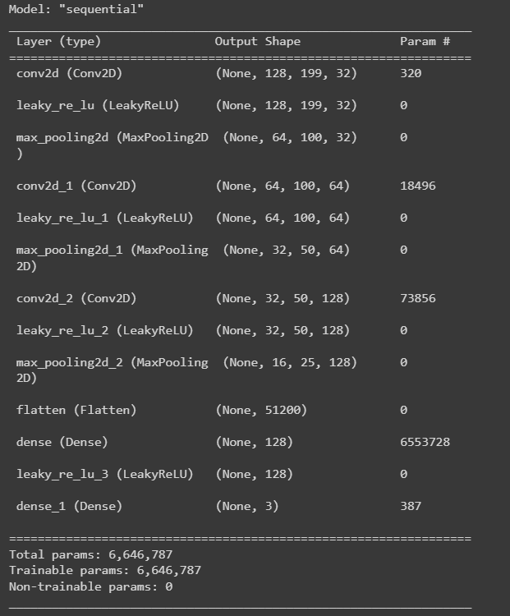
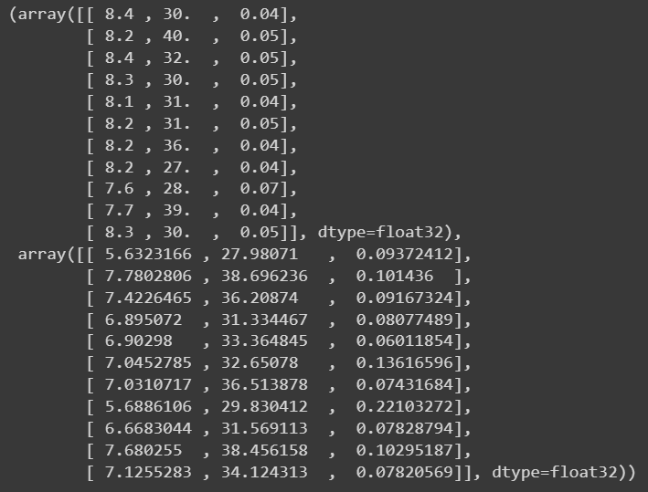
WQP estimation using DL and PlanetScope
Very basic model(No HP-tunning) with 50 epochs
PH = MAE: 1.248 RMSE: 1.460 R2: -33.124
Salinity = MAE: 2.224 RMSE: 2.557 R2: 0.608
Ammonia = MAE: 0.054 RMSE: 0.071 R2: -66.006
Dataset = NDVI with 30 points. 2023-07-09 and
2023-04-20

Slide 10
WQA Model
Aquaculture body properties
WQA model
single/multi sensor(EO/Microwave) satellite data
Predicted WQA parameters
Predicted GT(pH,Sal,Am)
Based on Linear regression(atm)
Can also do multivariate regression to get all set of parameters as a output
Machine Learning model

