Slide 1
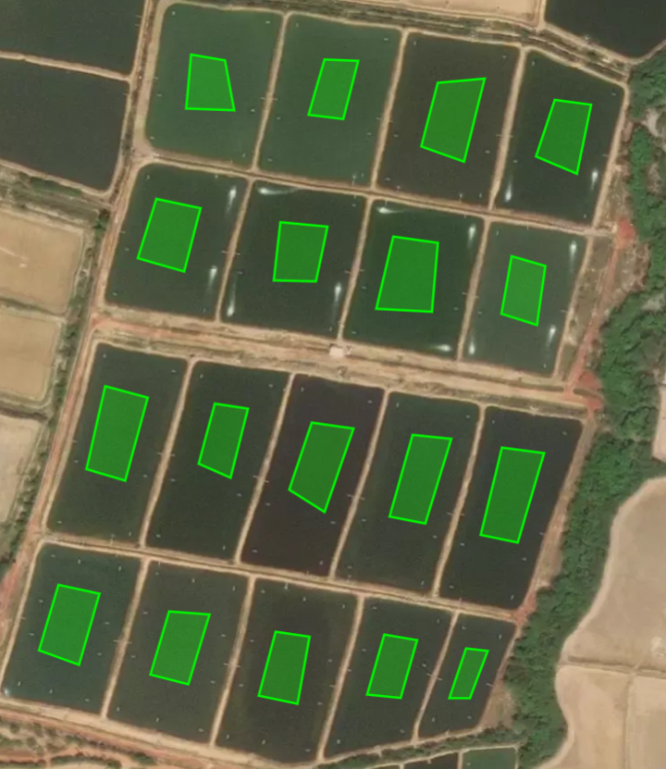
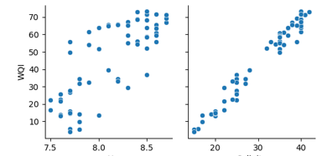
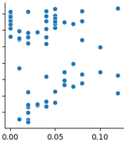
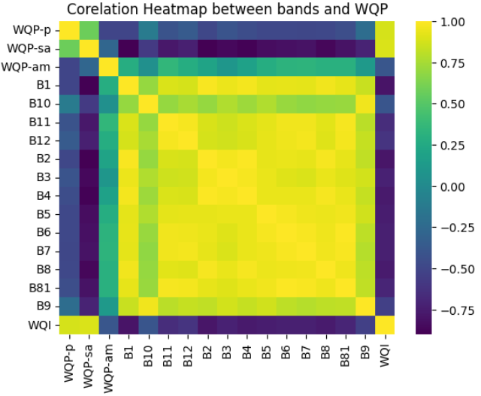
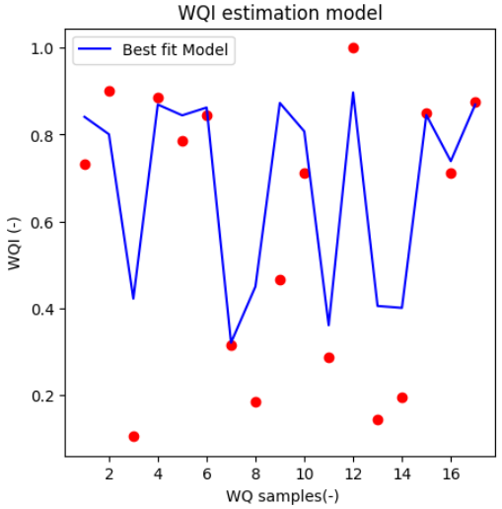
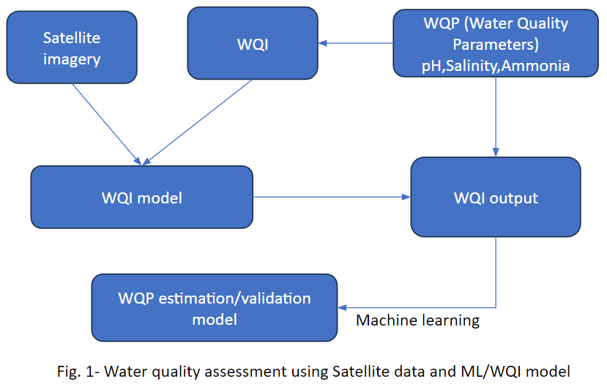
A novel approach to estimate water quality of inland aquaculture ponds using satellite data and Water Quality Index model
Authors: Rohit. P
GalaxEye Space
Introduction
Results
Results (cont.)
WQ parameters | RMSE R²
WQP-pH | 0.19 | 0.71
WQP-Salinity | 1.5 | 0.9
WQP-Ammonia | 0.027 | 0.2
A popular tool for assessing the quality of surface water is the Water Quality Index (WQI) model.
Statistical integration method of satellite data and the WQI model, improving the accuracy of water quality monitoring
WQI Model(Uddin et.al) was selected based its applicability on particular WQP.
The proposed approach integrates multispectral satellite imagery(Sentinel-2) and machine learning techniques to predict key water quality parameters.
Strong relationships between the predicted models for the individual parameters and the field measurements are shown
WQP-pH
WQP-salinity
WQI
Conclusions
WQP-ammonia
A These results collectively demonstrate the viability of the proposed approach in estimating water quality with high accuracy and robustness. The strong correlation coefficients (R² values) indicate the model's effectiveness in capturing variations
The presented results also emphasize the practical applicability of satellite data and the WQI model in addressing water quality assessment challenges across diverse aquatic environments.
Machine learning also being explored to considering the complexity and independency of data
Satellite data acquisition
Methodology
References
Uddin, et.al . "A review of water quality index models and their use for assessing surface water quality." Ecological Indicators 122 (2021): 107218.
The machine learning model is providing the best results with R² and RMSE of 0.68 & 0.12

