Slide 1
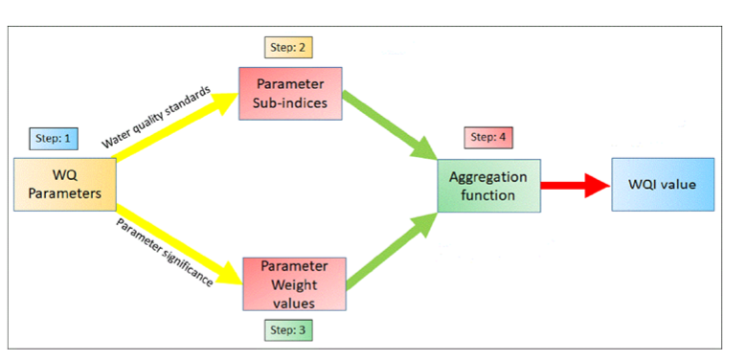
Basic Model
GT(pH,Sal,Am)
Band data
WQI
Predicted WQI
Predicted using SVR
Predicted GT(pH,Sal,Am)
Based on Linear regression(atm)
Can also do multivariate regression to get all set of parameters as a output

Slide 2
GT(pH,Sal,Am)
Updated Model
Band data
WQI
Indices(NDVI, AWEI)
Normalization
(giving better result because
of same
range as normalized band input)
Random test/train split
Predicted WQI
Predicted using SVR
Predicted GT(pH,Sal,Am)
Based on Linear regression(atm)
Normalized WQI output
Leave one dateout test/train split
Hyper Parameter tuning, Different model testing

