Slide 1
Bank of Baroda Hackathon 2024
Your Team Name : FinTechX4
Your team bio : Pavithra M A - Data Science and Machine Learning Enthusiast
Rohit P - Front End Developer
Sanjanaa I - UI/UX Designer
Siddharth M - AI specialist
Date : 30th June 2024

Slide 2
Problem Statement?
Why did you decide to solve this Problem statement?
PROBLEM STATEMENT
In the rapidly evolving banking sector, operational efficiency is often hindered by manual processes, repetitive tasks, and suboptimal resource allocation. Customers face delays in routine banking activities, leading to a lack of engagement and satisfaction. There is also a need for personalized financial advice and insights to help customers achieve their financial goals.
REASON TO CHOOSE THIS PROBLEM STATEMENT
We decided to solve this problem because it addresses key challenges in banking: enhancing operational efficiency, reducing errors, and improving customer experience. By automating routine tasks, it reduces the need for staff, allowing banks to allocate resources more effectively. Additionally, it acts as a personal finance guide for individuals, helping them manage their finances and spend effectively.

Slide 3
Pre-Requisite
The alternatives/competitive products for the problem we are solving are :
Traditional Banking System
Features: Manual processes for account creation, money deposits, withdrawals, locker facilities, currency conversion, and account management.
Drawbacks: Time-consuming, less efficient, higher chances of human error, and limited advisory services.
Mobile Banking apps
Features: Online account management, money transfers, deposits, withdrawals, locker bookings, and foreign currency conversion.
Limitations: May lack advanced AI-powered financial advisory and real-time predictive notifications.
AI-Based Financial Advisory Services (e.g., Cleo, Wallet.AI)
Features: Personalized financial advice, budgeting tools, savings prediction, expense tracking.
Limitations: Primarily focused on advisory, not full-service banking, reliance on user data privacy.

Slide 4
Tools or resources
For creating a prototype, we have planned to create a web application with AI Integration
Front-end : HTML, CSS, JAVASCRIPT or ReactJS
Back-end : Python ( For machine learning algorithms)
Intermediate : Flask ( To connect Front-End and Back-end)
Database : MongoDB
Chatbot : Microsoft Azure OpenAI
Development Tool : Visual Studio Code
Version Control Tool : GitHub

Slide 5
Any Supporting Functional Documents
Present your solution, talk about methodology, architecture & scalability
SOLUTION
Our solution is creating an application that integrates all the daily operations performed at the bank. These include the below options:
1.Creating an Account - AI Usage: Implement chatbots to guide users through the account creation process.
2. Money Deposit - Chatbot Interface: Assist users in depositing money through a user-friendly chatbot interface.
3. Money Withdrawal - Chatbot Interface: Facilitate money withdrawals with guidance from chatbots.
4. Locker Facility - Chatbot Interface: Manage locker facilities and access through the chatbot interface.
5. Conversion of Foreign Money to Indian Money - Chatbot Interface: Provide real-time currency conversion assistance.
6. Conversion of Minor Bank Account to Major Bank Account - Chatbot Interface: Help users through the process of
converting minor accounts to major accounts.
.

Slide 6
7. Additional Feature: Financial Advisory (includes Applying for housing loan, Educational loan, Trip to any specific places etc.. which are on the user's BucketList) - Data Collection: Gather user data on monthly income and expenses. - Savings Prediction: Predict user savings based on collected data. - Bucket List Completion: Notify users about opportunities to achieve their bucket list goals (e.g., travel discounts).
8. Other Options - Customization: Provide additional user-defined options and basic prompts for various banking needs.By implementing these features, the web application aims to integrate daily banking routines into a seamless and efficient user experience with the help of AI-powered chatbots and predictive financial advisory.This Application can be implemented in an ATM like machines which we named as SmartBob kiosk which can be installed at bank branches for security purposes

Slide 7
METHODOLOGY
Requirement Analysis: Gather requirements from stakeholders to understand banking processes and customer needs.
Design: Develop an architecture that integrates AI chatbots with existing banking systems.
Development: Implement AI algorithms for automating tasks. Develop secure user authentication using Caesar cipher encryption. Build financial advisory features for personalized insights.
Testing: Conduct extensive testing to ensure system reliability and security.
Deployment: Implement the solution in bank branches with the necessary hardware and software.
Monitoring and Feedback: Continuously monitor system performance and gather user feedback for improvements.

Slide 8
ARCHITECTURE AND SCALABILITY
Architecture
User Interface: Kiosk with AI chatbot.
Backend System:
AI Module: Automates tasks and provides insights.
Database: Stores user data securely.
Encryption: Protects passwords with Caesar cipher.
Integration Layer: Connects to existing banking systems.
Notification System: Sends emails/SMS for updates.
Scalability
Modular Design: Easy to expand features.
Cloud Infrastructure: Supports increased user loads.
Load Balancing: Maintains performance during peak times.
Data Analytics: Processes large volumes of data efficiently.

Slide 9
Key Differentiators & Adoption Plan
How is your solution better than alternatives and how do you plan to build adoption?
Alternatives/ competitive products | Traditional Banking System | Mobile Banking Apps | AI-Based Financial Advisory Services | Our Solution
Comprehensive Automation | Manual processes | Automate some tasks but require user interaction | Focus on advice, not operations | Automates routine tasks, reducing errors and time
Financial Advisory | Limited advisory services | Basic account management | Offers advice, not integrated with banking | Integrates financial insights with banking operations
Secure Access | Varies in security measures | Generally secure, conventional encryption | Focus on data privacy, no encryption for access | Encrypted passwords and SmartBOB kiosks provide much security
Resource Optimization | Staff occupied with administrative tasks | No impact on branch operations | No direct impact on resources | Frees staff from admin tasks, optimizing workflow

Slide 10
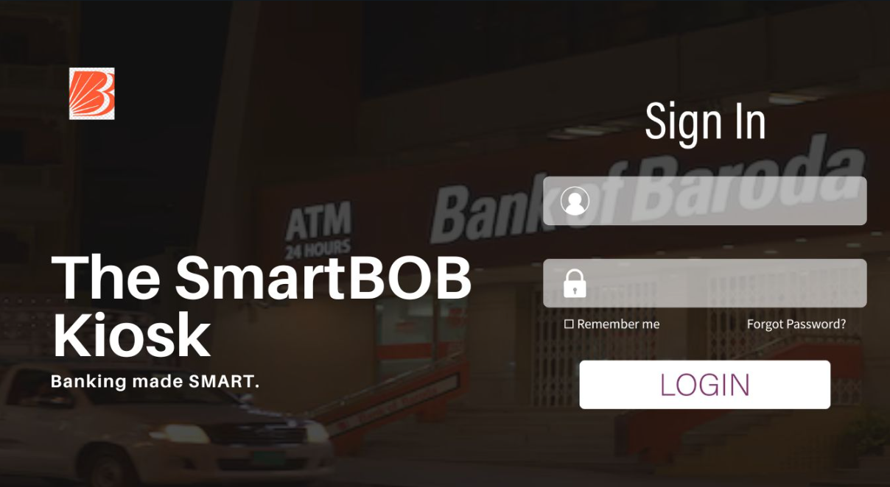
Wireframe of Our Solution

Slide 11
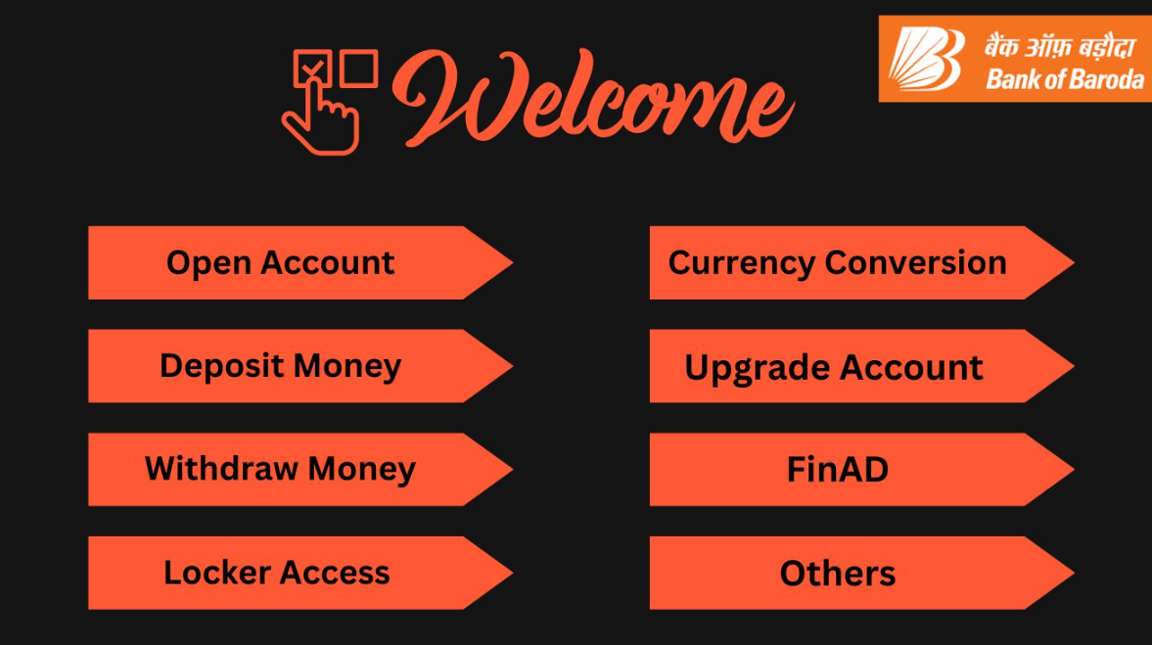
Wireframe of Our Solution

Slide 12
Business Potential and Relevance
Enhanced Customer Experience:
Reduced Waiting Times
Personalized Advice
2. Operational Efficiency:
Task Automation(freeing staff for complex issues.)
Resource Optimization: (boost productivity.)
3. Competitive Advantage:
Innovative Services (Positions the bank as a leader in technology.)
Enhanced Security (Builds customer trust.)
4. Increased Revenue:
Smooth user interface (Customer satisfaction.)
Customer Retention (Reduced churn.)
5. Market Expansion:
Scalability (Portable across branches.)
New Segments (Attracts younger and international clients.)
6. Data-Driven Insights:
Customer Analysis (valuable insights for strategic decisions.)
Tailored Marketing (based on customer behavior.)
7. Cost Savings:
Reduced Operational Costs (Lowers manual labor and errors.)
8. Regulatory Compliance:
Secure Data Handling: Ensures compliance with data protection regulations.
-Implementing the AI-powered chatbot and SmartBOB Kiosks enhances efficiency, customer satisfaction, and profitability, transforming banking operations and opening new growth avenues.

Slide 13
Uniqueness of Approach and Solution
AI and Kiosk Integration:
Combines AI chatbots with SmartBOB Kiosks for seamless digital and physical banking.
Automated Transactions:
Automates deposits, withdrawals, and currency conversions, reducing errors and time.
Advanced Security:
Uses encrypted passwords and OTP for secure transactions.
Personalized Advisory:
Provides tailored financial insights based on user data (income, expenses, goals).
User Engagement:
Sends personalized notifications via email and SMS for proactive banking.
Scalable and Flexible:
Easily scalable across branches, adaptable to specific needs.
Resource Optimization:
Frees staff for complex tasks, improving service quality.
Innovative Cross-Selling:
Analyzes data to suggest relevant products, enhancing revenue.

Slide 14
User Experience
How will our idea enhance the user experience
Reduced Wait Times:
Automated Processes: Handling routine tasks through automation reduces the need for users to wait in lines, providing quicker service.
Personalized Financial Management:
Tailored Insights and Goal Tracking: Users receive personalized financial advice and progress tracking towards their goals, enhancing motivation and satisfaction.
Multilingual Support:
Inclusive Access: The chatbot supports multiple languages, making banking services accessible to a diverse range of users.
Enhanced Security:
Secure Access: SmartBOB Kiosk and Using encrypted passwords with the Caesar cipher method ensures robust protection of user information.

Slide 15
Scalability
How effectively can your solution be scaled to accommodate growth without compromising performance?
Modular Architecture: Enables independent development and scaling of system components, facilitating seamless integration of new features and services as the system grows.
Cloud Infrastructure: Provides elastic scalability, allowing resources to be dynamically adjusted based on demand to maintain optimal performance during peak usage periods.
Load Balancing: Ensures even distribution of user requests across multiple servers or instances, preventing any single component from becoming a performance bottleneck.
Data Partitioning: Divides large datasets into smaller, manageable parts distributed across multiple storage nodes, optimizing data access and retrieval for enhanced scalability.
Microservices Architecture: Supports independent scaling of individual services, allowing each service to be adjusted in response to changing workload requirements without affecting others.
Monitoring and Optimization: Continuous monitoring of system performance metrics enables proactive scaling and optimization efforts to maintain efficient operations and high availability.

Slide 16
Ease of Deployment and Maintenance
SIMPLE IMPLEMENTATION:
AI Powered Chatbot – As we are using Azure API and ChatGPT, these Pre-built modules and APIs can be used to quickly deploy chatbots.
Data Requirements for financial advisory (additional feature) : Requires structured user data (monthly income, expenses, bucket list items), which is easily collected through the chatbot interface.
Initially our idea can be implemented as a web application and further can be implemented into SmartBOB kiosk.
MAINTENANCE:
Chatbots can be updated remotely to improve responses and add new features.
Periodic retraining of ML models with new data ensures continued accuracy.
Incorporating user feedback for continuous improvement of the user interface.

Slide 17
Security Considerations
1. Encryption:
Caesar Cipher for passwords
AES for data transmission
2. Multi-Factor Authentication (MFA):
OTP verification for added security
3. Access Control:
Role-Based Access Control (RBAC)
4. Secure Transactions:
End-to-end encryption
Real-time transaction monitoring
5. Data Privacy:
Compliance with GDPR, PCI DSS
Data anonymization
6. Regular Audits:
Secure code reviews

Slide 18
Thank You
Team member names
Pavithra M A
Rohit P
Sanjanaa I
Siddharth M

