Slide 1
RNN (LSTM) based Channel Estimation for RIS
Presentation by
Rohit D, Yashwanth R
Sri Sivasubramaniya Nadar College of Engineering

Slide 2
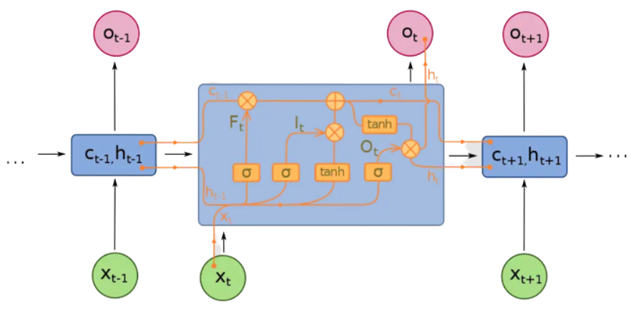
Long Short Term Memory (LSTM)

Slide 3
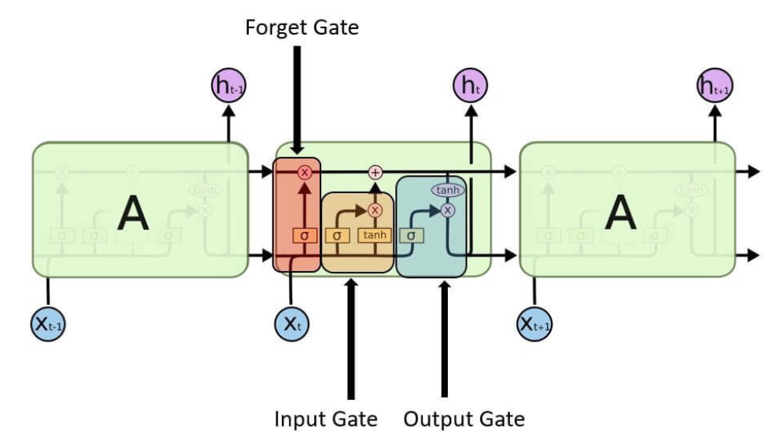
Architecture
Notes:
Student Notes:
The objective of the session is to introduce the concept of time varying signals and how these signals are described and classified further. We will also discuss various types of other classifications with examples.

Slide 4
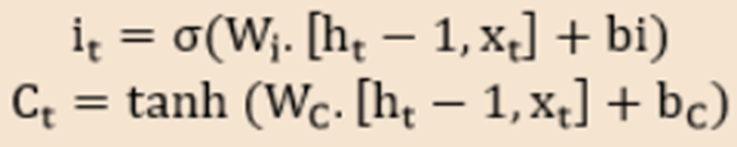

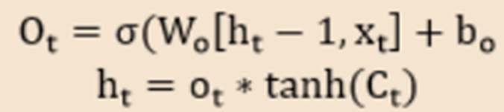
Architecture

Slide 5
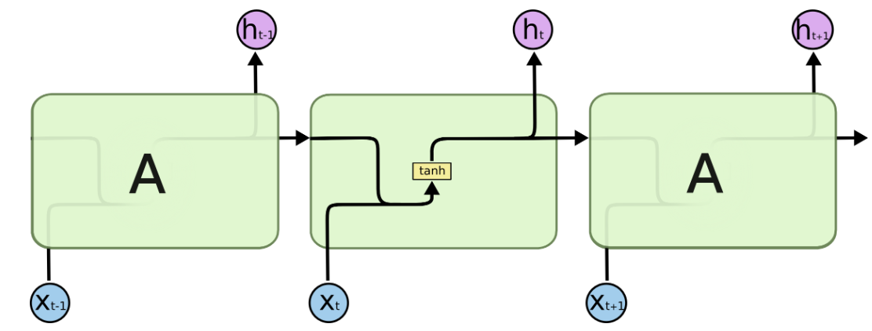
Conventional RNNs
A single layer exists in the repeating module of a conventional RNN:

Slide 6
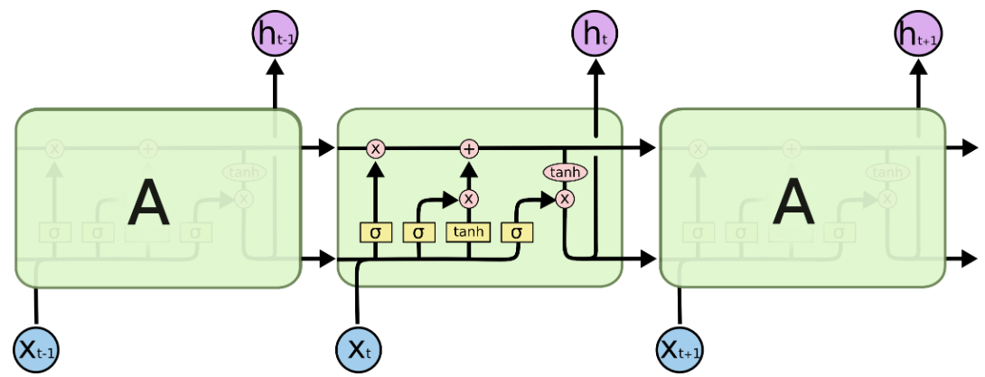
LSTM
An LSTM’s repeating module is made up of four layers that interact with one another:

Slide 7
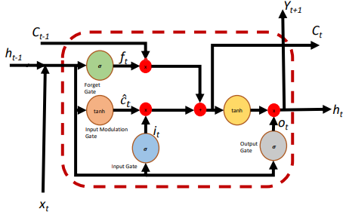
LSTM Cycle

Slide 8
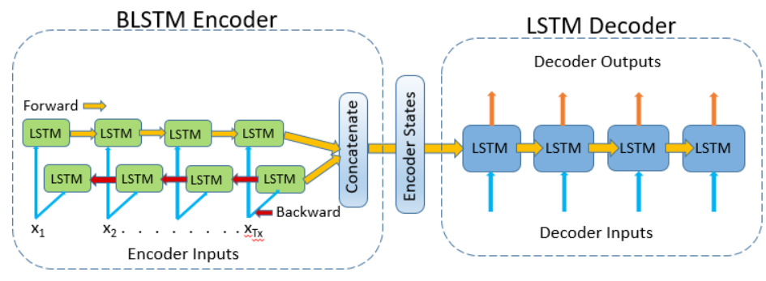
Bidirectional LSTM

Slide 9
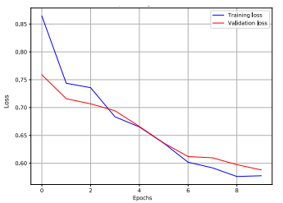
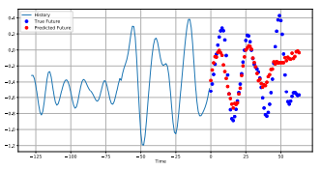
Simulation Results (LSTM)
Training and validation loss
Part prediction of a mMIMO Channel
Lemayian, Joel Poncha, and Jehad M. Hamamreh. "Recurrent neural network-based channel prediction in mMIMO for enhanced performance in future wireless communication." 2020 International Conference on UK-China Emerging Technologies (UCET). IEEE, 2020.

Slide 10
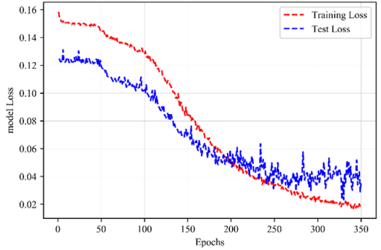
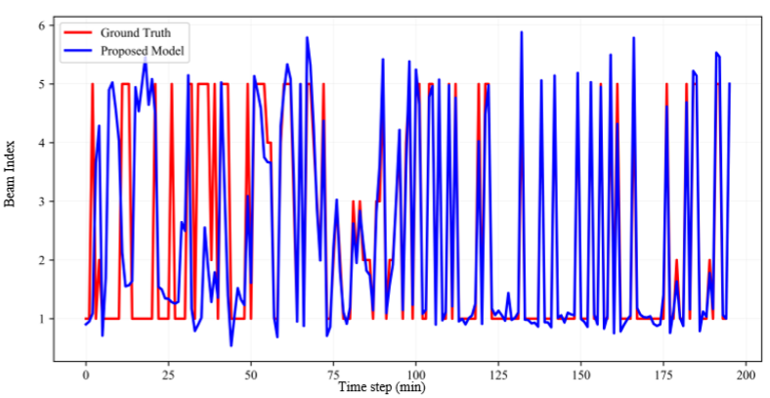
Simulation Results (BRNN-LSTM)
Beam index prediction over time
Loss model for the proposed prediction network.
Aldalbahi, Adel, Farzad Shahabi, and Mohammed Jasim. "BRNN-LSTM for initial access in millimeter wave communications." Electronics 10.13 (2021): 1505.

Slide 11
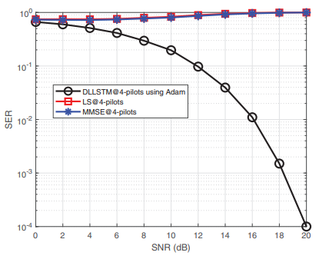
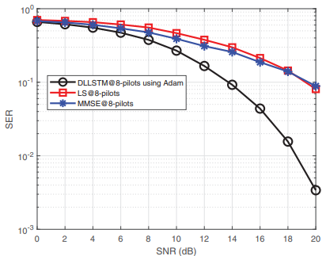
Comparative Study (LSTM)
SER curves of estimators using 4 pilots
SER curves of estimators using 8 pilots
Essai Ali, Mohamed Hassan. "Deep learning‐based pilot‐assisted channel state estimator for OFDM systems." IET Communications 15.2 (2021): 257-264.

Slide 12
References
Lemayian, Joel Poncha, and Jehad M. Hamamreh. "Recurrent neural network-based channel prediction in mMIMO for enhanced performance in future wireless communication." 2020 International Conference on UK-China Emerging Technologies (UCET). IEEE, 2020.
Essai Ali, Mohamed Hassan. "Deep learning‐based pilot‐assisted channel state estimator for OFDM systems." IET Communications 15.2 (2021): 257-264.
Aldalbahi, Adel, Farzad Shahabi, and Mohammed Jasim. "BRNN-LSTM for initial access in millimeter wave communications." Electronics 10.13 (2021): 1505.
Hamamreh JM, Hajar A, Abewa M. ”Orthogonal frequency division multiplexing with subcarrier power modulation for doubling the spectral efficiency of 6G and beyond networks.” Transactions on Emerging Telecommunications Technologies 31, no. 4 (2020): e3921.

Slide 13
Thank you !

