Slide 1

DIGITAL PAANDI PLAY MAT
(SOUTH INDIAN HOPSCOTCH)
“HOP INTO THE FUTURE”
TOY TYPE
DIGITAL
TOY THEME
Social and human values

Slide 2
ABOUT OUR GAME CONCEPT
OUR OBJECTIVE
To Redesign and Reconceptualize the Classic south Indian game of Paandi/Tokkudu Billa (indian hopscotch) and integrate technology to modernize the game. We plan to Innovate a Digital Mat with various Paandi variations integrated with an interactive app for playing Indoors.
CONCEPT OVERVIEW
To create a physical rollable mat with lighting and sensors to simulate multiple Hopscotch variations.
Create a durable robust prototype for easy convenient usage for all age groups.
Using a microcontroller in the mat to control the mat’s features with an android app’s interface.
To enable single/multi-player game modes with active leaderboards.
Let users create their own levels and share them on our platform.

Slide 3
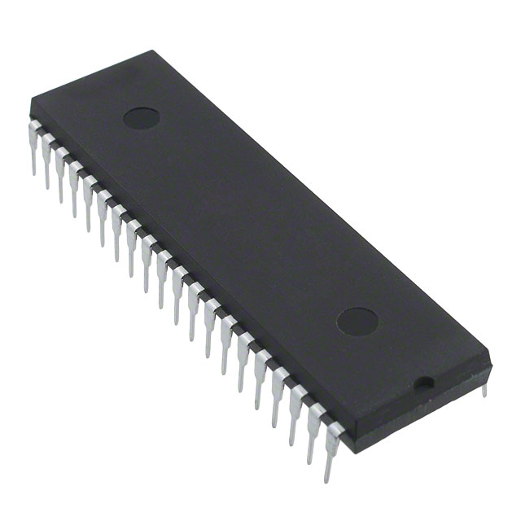
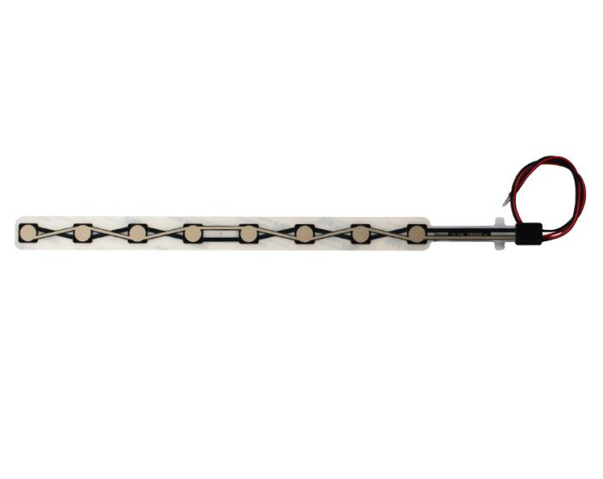

CONCEPT APPROACH
Design a rollable rubber-plastic mat of 1.5x1.5 m dimension with 36 grids lined with led strips powered by Domestic AC Supply.
LED lighting guides the players to jump through the right grid pattern.
Use a pressure sensitive sensor to detect the players movements.
Add an arduino(microcontroller) to control the lighting pattern of the grids and also to change the lights when a player steps inbetween grids.
Create app/website to enable various game modes, provide a social platform for players and an interactive experience. App to be connected to the arduino via bluetooth.
ATMEGA MICROCONTROLLER
PRESSURE SENSORS
LED LIGHT STRIPS

Slide 4
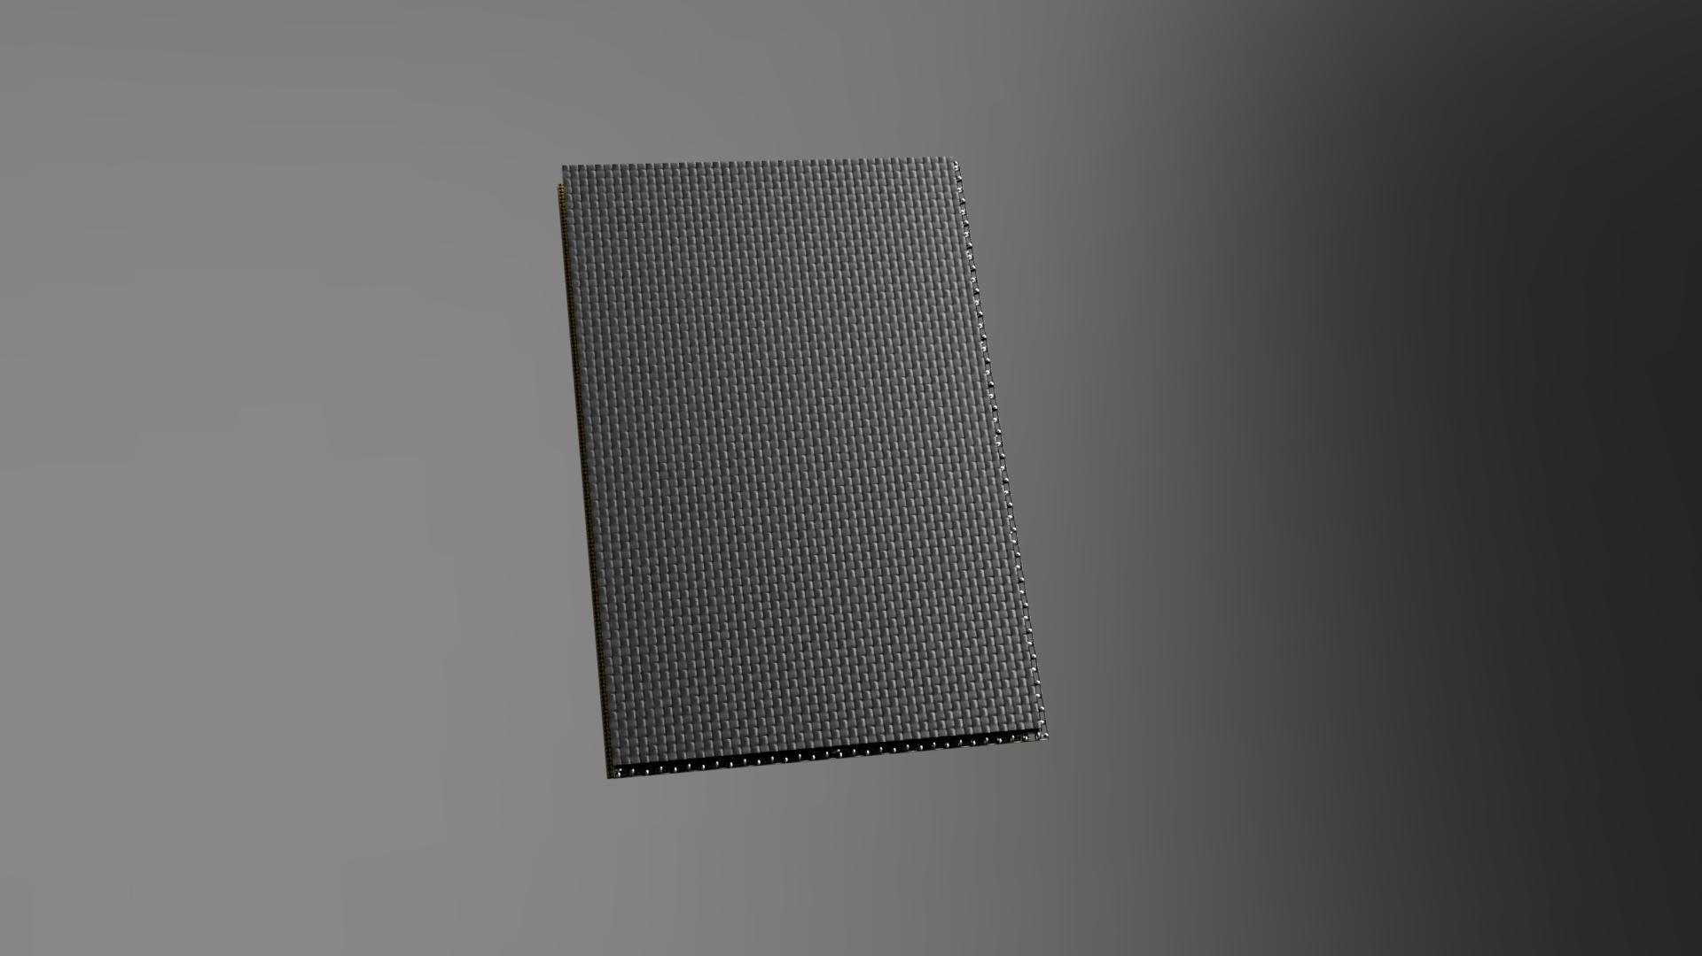
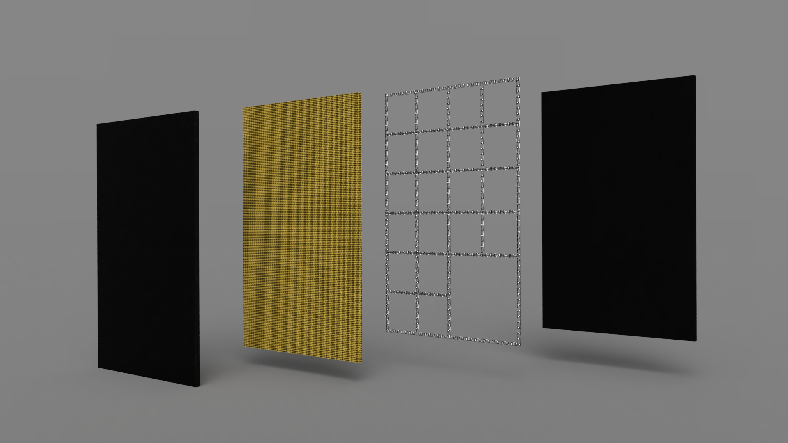
PROTOTYPE RENDERS

Slide 5
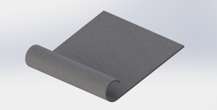
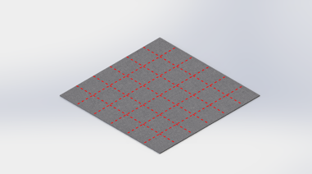



GAME FEATURES
CONVENIENT STORAGE AND TRANSPORT AS IT IS ROLLABLE:
PLUG AND PLAY TYPE DESIGN, IDEAL FOR INDOOR USAGE
UNIVERSAL CONNECTIVITY AND INTERACTION THROUGH A SIMPLE ANDROID APP.

Slide 6
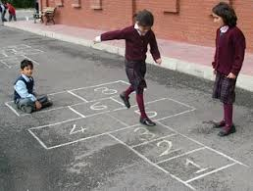
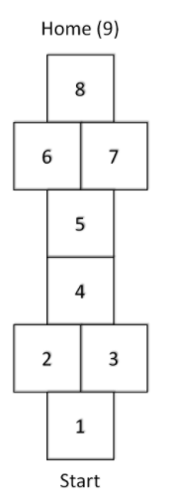
OUR TOY STORY
PAANDI-OUR INSPIRATION
RULES OF PAANDI:
The aim of pandi/tokkudu billa is to capture maximum number of squares in the grid by hopping and jumping through the court in a specific pattern without the feet touching the lines and without putting a hand down to gain balance.
A small and flat concrete area or a sandy ground would be ideal to play this game.
The grid is drawn on the ground or on the floor.
OUR MODERN TWIST ON PAANDI
We are not constricted by the need for safe space outdoors to play this sport as our digital
version works even in limited space indoors.
Instead of sticking to a fixed layout, we can have interesting layout variations as well as
modes such as disappearing grids(aids in visual memory), timed mode(tests physical capability) and competitive multiplayer mode(with a virtual leaderboard).
App enables interactivity among users(including friends) and provides social connectivity.

Slide 7
REFLECTING INDIAN CULTURE
Paandi/Tokkudu Billa is a game that is indigenous to the southern Indian states and is at the verge of becoming obsolete.
We are planning to rediscover this game and deliver it with a modern twist appealing to the younger generation while staying true to its roots.
Not only can children enjoy playing what their ancestors experienced but we are also reviving interest in a game that is irrelevant in the modern age of technology.
This game can also be enjoyed by the whole family due to its familiarity as they relive their childhood memories.
Given it can be played with other people, it can create bonds between youngsters and evoke brotherhood and empathy which are innate to indian culture.
Cities lack the close knit communities intrinsic to villages, this game has the potential to create unity among youngsters.

Slide 8
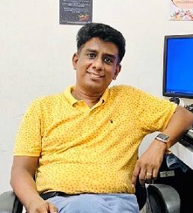
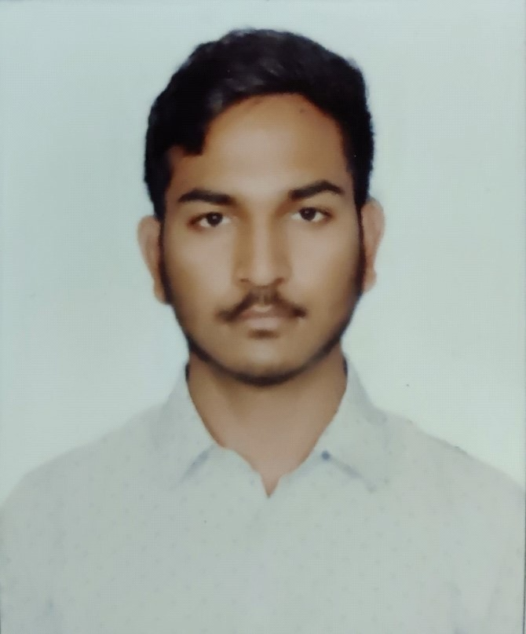
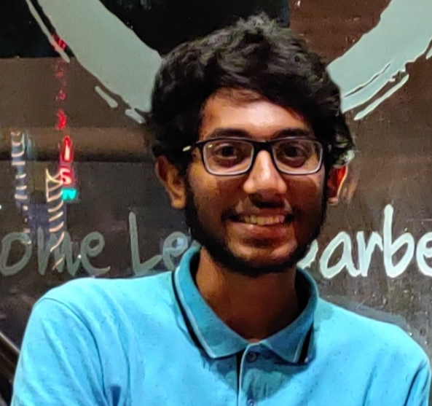




TEAM INVENTE
OUR TEAM MENTOR
TEAM MEMBERS:
TEAM INVENTE
5 Particpants and 1 Mentor
SSN College of Engineering
HEI (Track 2)
Jino Hans
B.E., M.Tech., Ph.D.,
Rohit
Rohit
03/03/2002
01/12/2001
jinohansw@ssn.edu.in
rohit19085@ece.ssn.edu.in
Team Objective
rohith19086@ece.ssn.edu.in
Conceptualize toy design and create a feasible working prototype
Dept of ECE, SSNCE, Kalavakkam,
Chennai-603103
No.1, Lalitha Garden, Sannidhi Street, Thiruvanmiyur, Chennai-41
YRA-201, Rosedale Apartment, Opp. to Hindustan Eng. College, Padur, 603103
9962520080
9789954509
7358079920

Slide 9

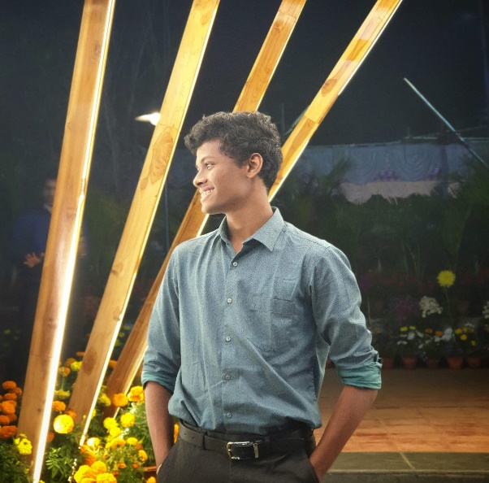
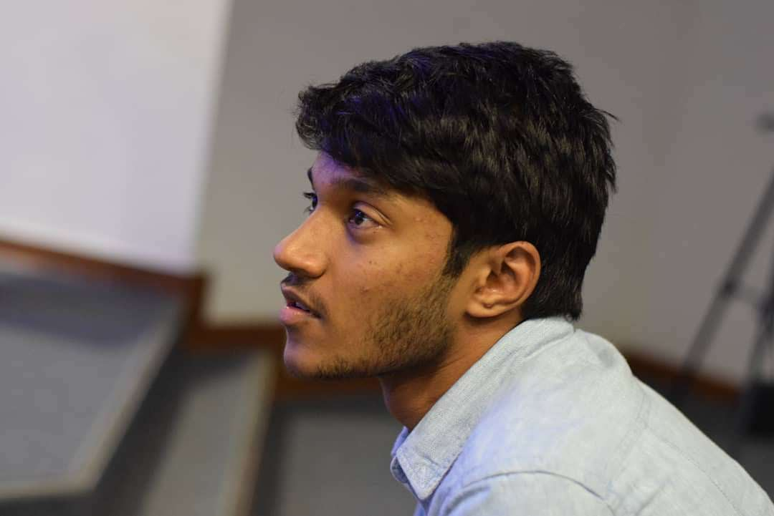
TEAM INVENTE
Aditya.R
Gokhul.vs
Akshaj
22/04/2001
13/10/2001
23.02/2002
adityar19004@it.ssn.edu.in
gokhul19046@mech.ssn.edu.in
akshaj19011@mech.ssn.edu.in
Villa no 87,Casa Grande Pavillion,Thalambur,Chennai-600130
T-1, S-4, Blossom, MG Road, Sastri Nagar, Adyar, Chennai -20
River View Apartments, Manapakkam, Chennai-89
7550085407
8825934858
7200972008

