Slide 1
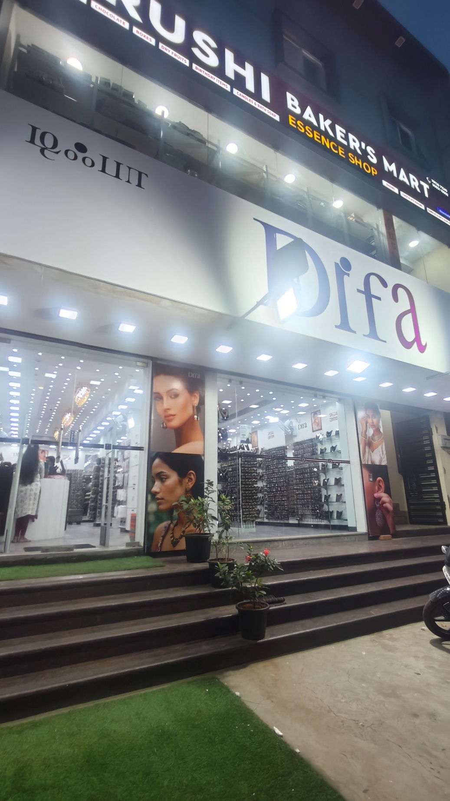


Turning sales data and campus
micro-influence into growth
for DIFA Velachery
BDM Capstone Viva Presentation
Rohit Raj(2026 Term 2) | Roll No. 23f2002469 | IIT Madras
DIFA Velachery, Chennai
Notes:
1

Slide 2
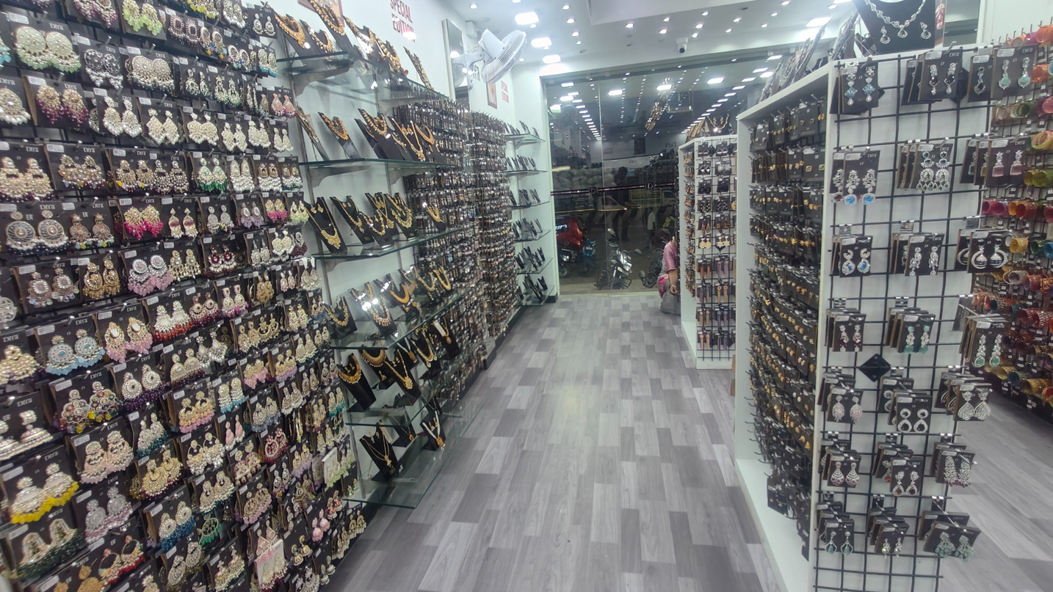
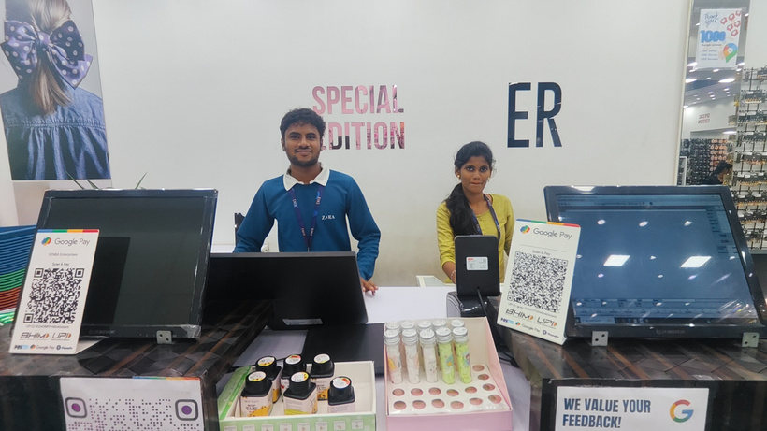
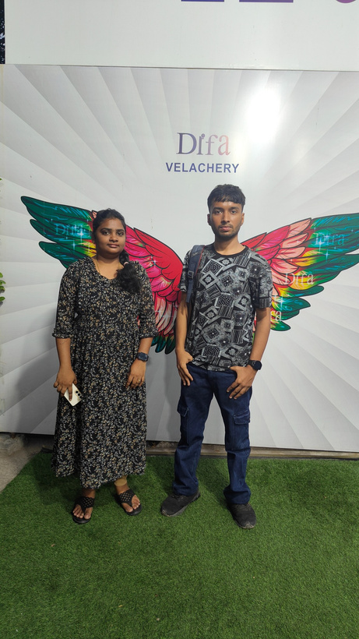
About DIFA Velachery
Business profile and store context
Affordable fashion-accessories retail
  Franchise-owned, franchise-operated store in Velachery, Chennai.
  Assortment includes earrings, neck sets, hair accessories, bangles, cosmetics, small bags and similar items.
  All sales are in-store; there is no website or delivery.
  The owner pays rent, staff and marketing; the brand and most stock come from the franchisor.
  The surrounding neighbourhood includes offices, colleges and homes.
Store interior
2
Notes:
2

Slide 3
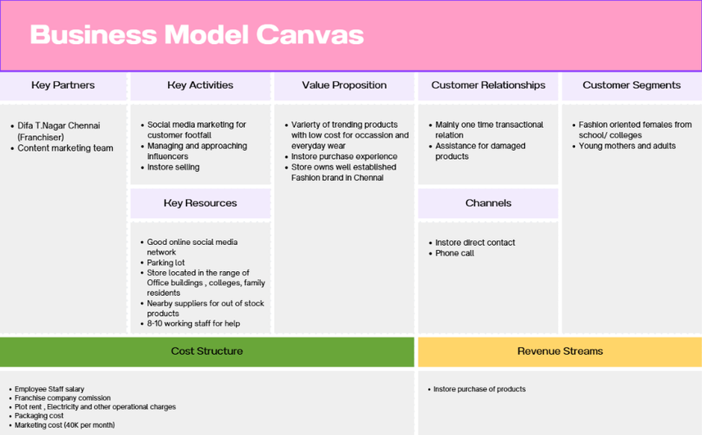
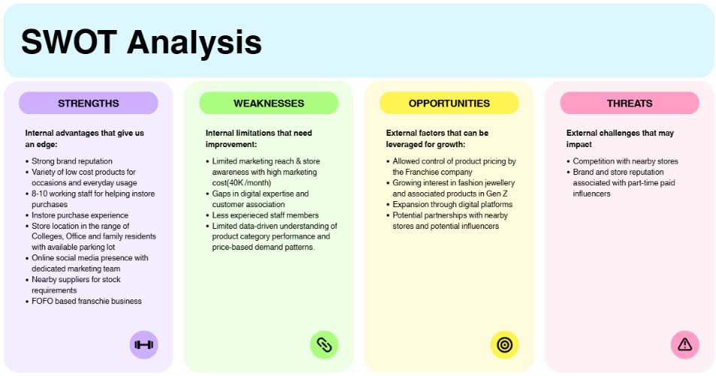
Business context, problem statements and objectives
P1 — Product & store performance
P2 — Awareness & marketing efficiency
The owner has no measured view of which categories, price points and sub-types are carrying the store; buying and display decisions are made on impression.
About ₹40,000 per month is being spent with no measured link to footfall, while the store still does not feel well known next to competitors.
Objective:1.) use business data to quantify product/store performance,2.) use a structured local micro-influencer pilot to make marketing measurable.
3
Notes:
3

Slide 4
Nature of data collected
Two data streams aligned to the two business problems
BUSINESS SALES DATA
INFLUENCER DATA
Owner-shared monthly item-level sales extract
Public Instagram profiles of NIFT Chennai students
  Each row represents one product variant in one calendar month.
  Original clean sheet: 17,898 valid item-month records, 5,888 product identifiers and 89 raw category labels.
  No customer names, customer IDs or transaction timestamps were available.
  Final analysis uses the eight full months from April–November 2025.
  After category correction: 38 merchandise categories and 5,813 active UIDs.
  15 candidate accounts collected manually from public profiles.
  Sourcing path: official NIFT Chennai pages → likes, comments, tagged posts and mutual connections.
  Snapshot taken in mid-January 2026.
  Fields: followers, posts, peak reel views, graduation year, gender and most recent post date.
  The sample is purposive, not random;
Primary measures: Sold Qty, Item Net Amount, MRP, Item Category, Sub-category, Brand, Colour, Discount, Transaction Type, UID.
Source: Final Report, Sections 2.3 and 2.6; Midterm Report, Metadata section.
4
Notes:
4

Slide 5
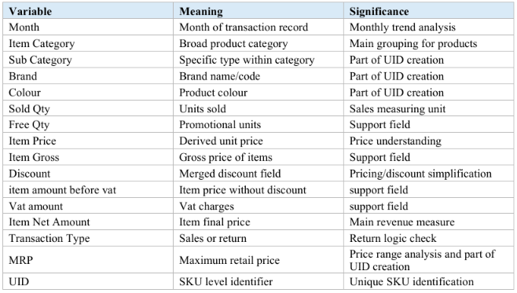
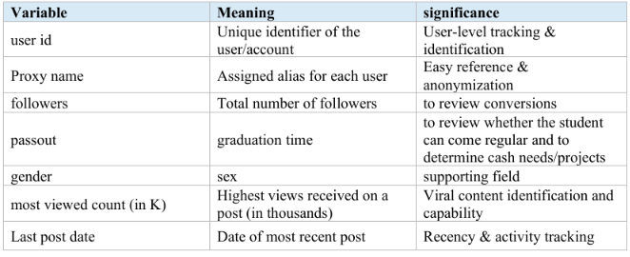
Data cleaning and preparation
1
Data cleaning
Keep the original owner-shared file unchanged; build a cleaned working sheet.
Rename Item Name → Item Category and create UID = Category + Sub-category + Brand + Colour + MRP.
Merge five discount columns only after row-wise validation; derive Item Price = Item Gross ÷ Sold Qty; remove analytically irrelevant constant fields.
Returns stay in the dataset as negative Sold Qty and Item Net Amount, so reported totals are already net of returns.
Exclude the partial December week; combine 37 CS-NP-* shade codes into NAIL POLISH; exclude packaging labels (338 units / ₹9,732).
Source: Final Report, Sections 2.2–2.5; Midterm Report, Metadata and Data Preparation sections.
5
Notes:
5

Slide 6
Descriptive statistics — final working dataset
April–November 2025 customer merchandise
₹1,05,39,048
81,520
5,813
38
Customer-merchandise revenue
Net units sold
Active product identifiers (UIDs)
Merchandise categories after correction
₹129.28
51.0%
81.8%
−3.2%
Average realised price per unit
Earring share of revenue
Revenue from the top 7 categories
Aug–Nov vs Apr–Jul average revenue
What changed between the two halves?
Revenue and units are already net of returns.
Average monthly units fell 6.6% (10,538.5 → 9,841.5). Revenue fell less, while realised price rose from ₹122.3 in April to ₹139.1 in November.
17 return rows remove 17 units and ₹5,023; no separate adjustment is required.
Source: Final Report, Table 1 and Sections 2.4, 3.1.
6
Notes:
6

Slide 7
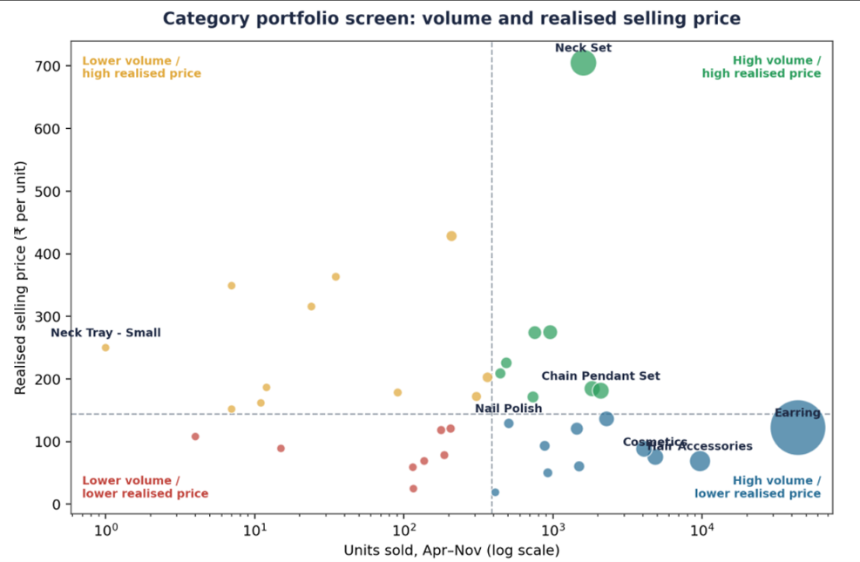
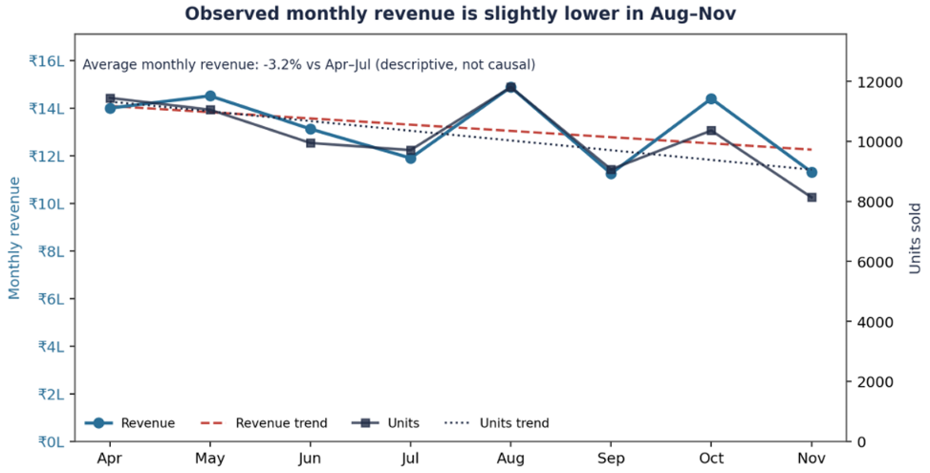
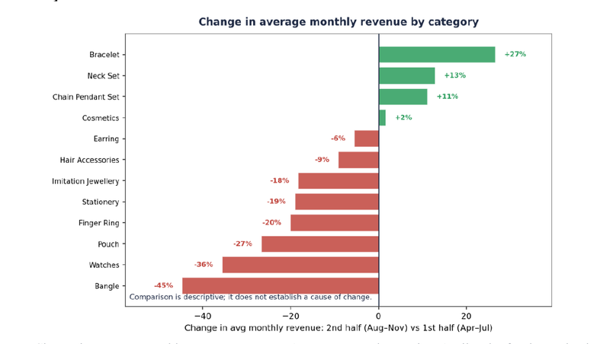
Analysis I — Store and category performance
Three views used to separate overall movement from category-level concentration and change
Source: Final Report, Figures 3, 7 and 8. (3 of maximum 5 graphs used)
7
Notes:
7

Slide 8
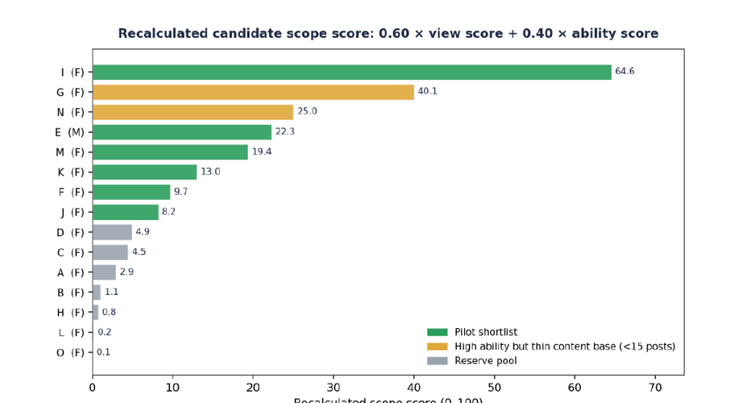
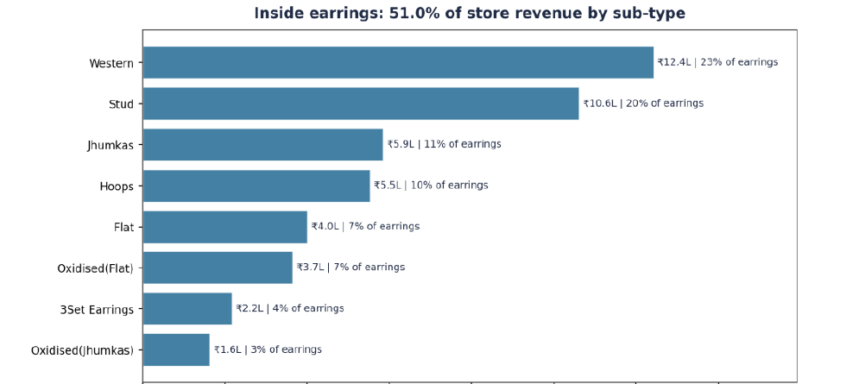
Analysis II — Hero category and influencer shortlist
Product concentration and the corrected micro-influencer scoring method
Top five earring sub-types — Western, Stud, Jhumkas, Hoops and Flat — carry 71.5% of earring revenue and 36.5% of total store revenue.
Scope = (0.60 × view score + 0.40 × ability score) × 100. Six candidates pass the corrected score plus the ≥15-post filter; G and N are held because of a thin content base.
Caution from the report: peak reel views are a best-case ceiling, audience location is unverified, and the min–max score is sensitive to extreme values.
Source: Final Report, Figures 9–10, Tables 5–7 and Section 3.8. (5 of maximum 5 graphs used)
8
Notes:
8

Slide 9
Key insights → actions
Recommendations reproduced from the Final Report
WHAT THE DATA SHOWS
ACTIONS RECOMMENDED
Revenue is highly concentrated: earrings are 51.0% of revenue; five earring sub-types alone are 36.5% of the whole store.
Put Western, Stud, Jhumkas, Hoops and Flat on a weekly stock check with written reorder triggers.
Units fell 6.6% between halves while revenue fell only 3.2%; the growing categories are the higher-value lines.
Give Neck Sets, Bracelets and Chain-Pendant Sets a better display position and track their combined monthly revenue.
Bangles (−44.8%), Watches (−35.7%), Pouches (−26.7%) and Finger Rings (−20.1%) fell most between the two halves.
Check supplier and delivery records before changing buying, because the dataset cannot separate weak demand from stock/supply gaps.
The sales file contains no stock-out field, cost price or margin data.
Start a simple stock-out log (date + item). Do not label low-volume categories unprofitable without cost and stock data.
Source: Final Report, Sections 3.5–3.7 and 4.1.
9
Notes:
9

Slide 10
30-day influencer pilot, limitations and conclusion
30-DAY PILOT
WHAT TO MEASURE
LIMITATIONS
Six shortlisted NIFT students
Reach
Content views and reach
  Only eight full months: descriptive, not seasonal or causal.
  No cost, stock or stock-out data: no profitability conclusion.
  15 Instagram accounts from one campus network; non-random sample.
  Follower geography could not be verified.
  Scope score is sensitive to extremes; the ≥15-post threshold is a judgement.
1
  Build the pilot around the earring shelf, the clearest hero product.
  Suggested deliverables: roughly two reels, stories with store location, one store visit and a styling demonstration.
  Use one unique discount code and printed QR code per creator.
  Keep the existing ₹40,000 channel running during the pilot month for a same-period comparison.
  Planning benchmark in the report: about ₹6,000 in creator fees plus product; actual payment must be negotiated.
  Collaborate with nearby complimentary stores like Woman salon, Nail and Dress stores for higher footfall
Locality
Audience city mix
2
3
Footfall
Store visits mentioning a creator
4
Conversion
Code and QR redemptions
5
Sales
Attributed sales value
Efficiency
Cost per attributed visit and per attributed sale
CONCLUSION
6
DIFA’s revenue is concentrated in a small set of hero lines. Volume is falling faster than revenue, while higher-value categories are cushioning the decline. The proposed pilot is designed to turn unmeasured marketing into attributable visits and sales.
7
Mix
Category mix of attributed sales
No ROI is claimed until the measurement framework produces 30 days of data.
Thank you
Source: Final Report, Sections 4.2–4.4 and Table 8.
10
Notes:
10

