Slide 1
Cheetah Problem
Prof. Aditya K. Jagannatham
IIT Kanpur

Slide 2
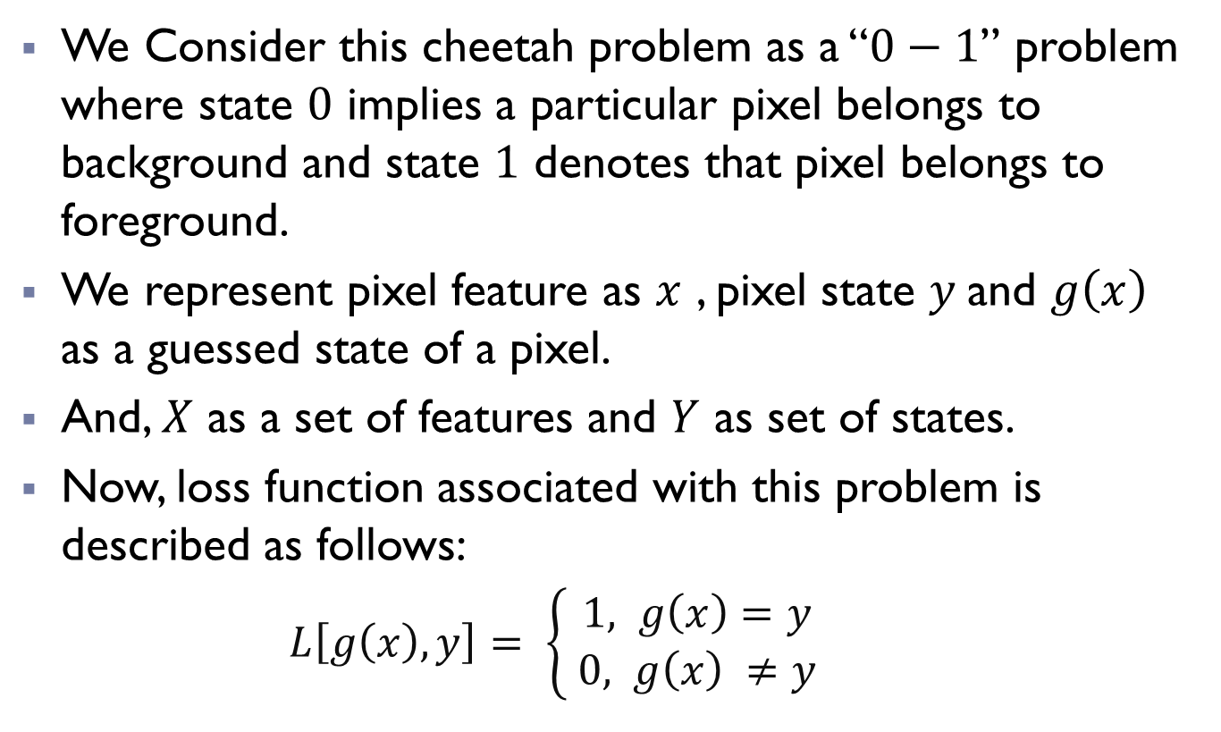
Overview:
We Consider this cheetah problem as a “$0−1$” problem where state $0$ implies a particular pixel belongs to background and state $1$ denotes that pixel belongs to foreground.
We represent pixel feature as $x$ , pixel state $y$and $g\left(x\right)$ as a guessed state of a pixel.
And, $X$ as a set of features and $Y$ as set of states.
Now, loss function associated with this problem is described as follows:
$L\left[g\left(x\right),y\right]= \left\{\begin{aligned}1, g\left(x\right)=y \\ 0, g\left(x\right) ≠y \end{aligned}\right.$

Slide 3
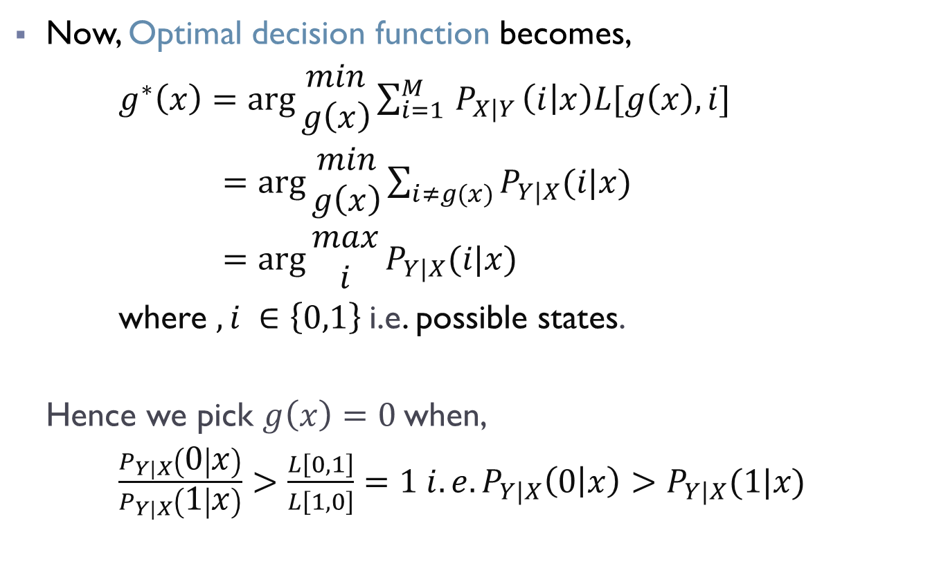
Overview:
Now, Optimal decision function becomes,
$g^{∗}\left(x\right)=\arg{\begin{aligned}min \\ g\left(x\right)\end{aligned}}\sum_{i=1 }^{M}{P_{X|Y}}\left(i | x\right)L[g\left(x\right),i]$
$=\arg{\begin{aligned}min \\ g\left(x\right)\end{aligned}\sum_{i≠g(x)}{P_{Y|X}(i|x)}}$
$=\arg{\begin{aligned}max \\ i\end{aligned}}P_{Y|X}(i|x)$
where $, i ∈\left\{0,1\right\}$i.e. possible states.
Hence we pick $g\left(x\right)=0$when,
$\frac{P_{Y|X}\left(0 | x\right)}{P_{Y|X}\left(1 | x\right)}>\frac{L\left[0,1\right]}{L\left[1,0\right]}=1 i.e. P_{Y|X}\left(0 | x\right)>P_{Y|X}(1|x)$

Slide 4
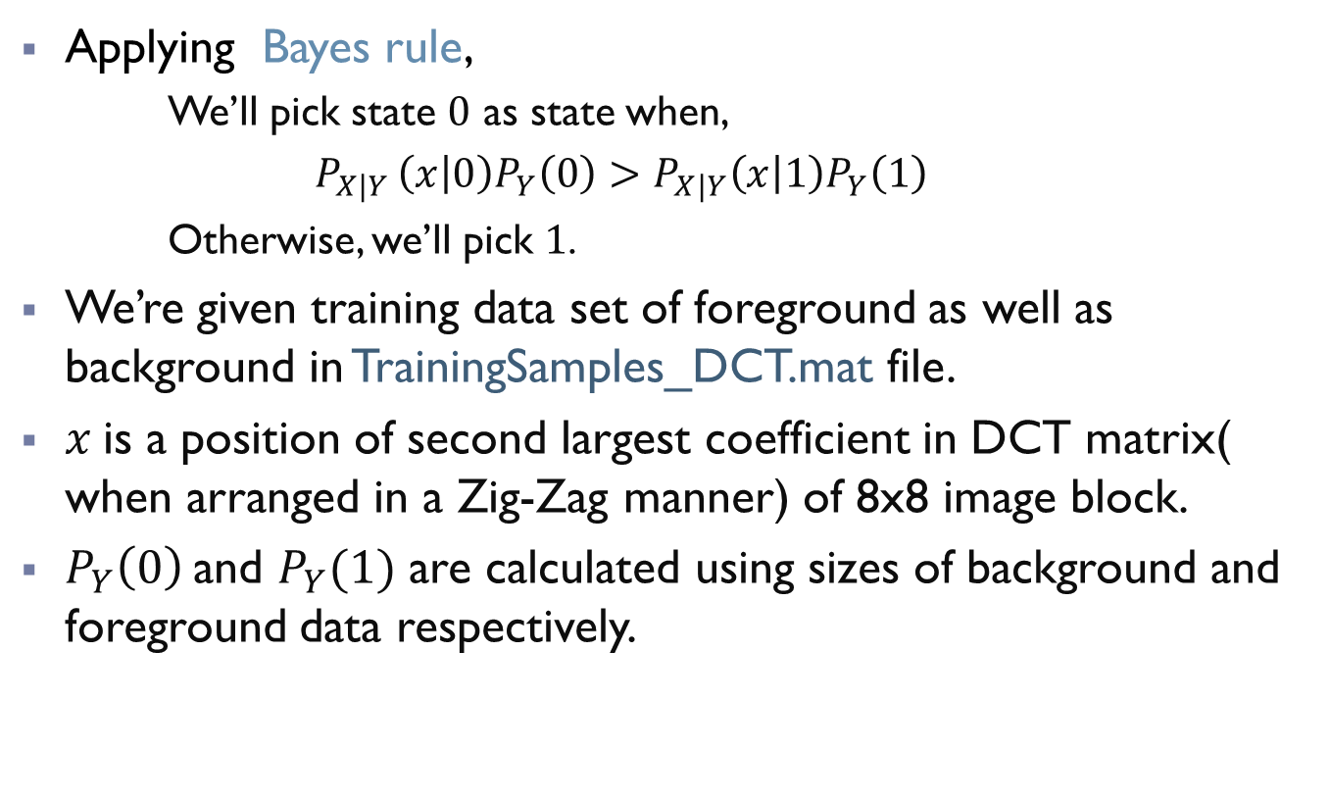
Overview:
Applying Bayes rule,
We’ll pick state $0$ as state when,
$P_{X|Y }\left(x | 0\right)P_{Y}\left(0\right)>P_{X|Y}\left(x | 1\right)P_{Y}\left(1\right)$
Otherwise, we’ll pick $1$.
We’re given training data set of foreground as well as background in TrainingSamples_DCT.mat file.
$x$is a position of second largest coefficient in DCT matrix( when arranged in a Zig-Zag manner) of 8x8 image block.
$P_{Y}\left(0\right)$and $P_{Y}(1)$ are calculated using sizes of background and foreground data respectively.

Slide 5
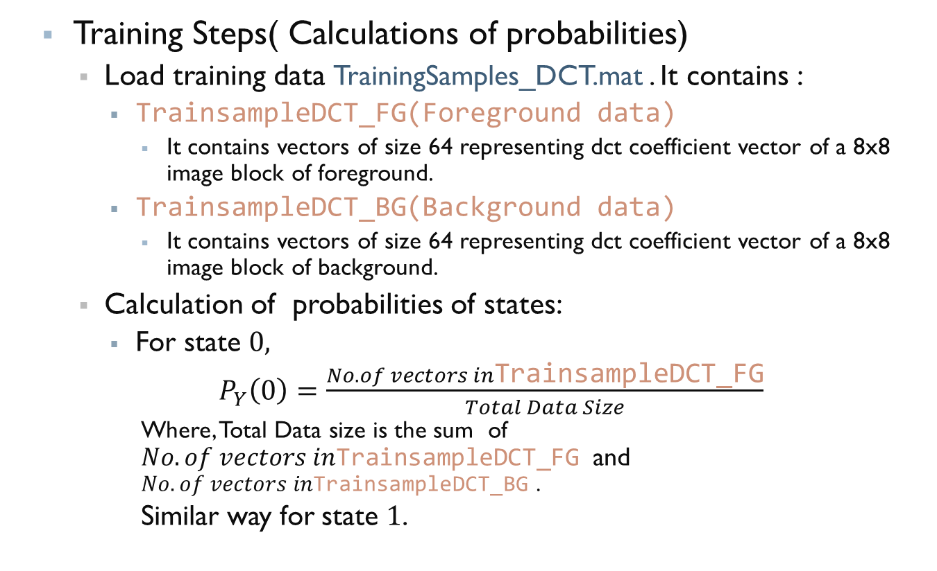
Code Steps:
Training Steps( Calculations of probabilities)
Load training data TrainingSamples_DCT.mat . It contains :
TrainsampleDCT_FG(Foreground data)
It contains vectors of size 64 representing dct coefficient vector of a 8x8 image block of foreground.
TrainsampleDCT_BG(Background data)
It contains vectors of size 64 representing dct coefficient vector of a 8x8 image block of background.
Calculation of probabilities of states:
For state $0,$
$P_{Y}\left(0\right)=\frac{No. of vectors in\text{TrainsampleDCT}\text{_}\text{FG}}{Total Data Size}$
Where, Total Data size is the sum of $No. of vectors in\text{TrainsampleDCT}\text{_}\text{FG}$and $No. of vectors in\text{TrainsampleDCT}\text{_}\text{B}\text{G}$ .
Similar way for state $1$.

Slide 6
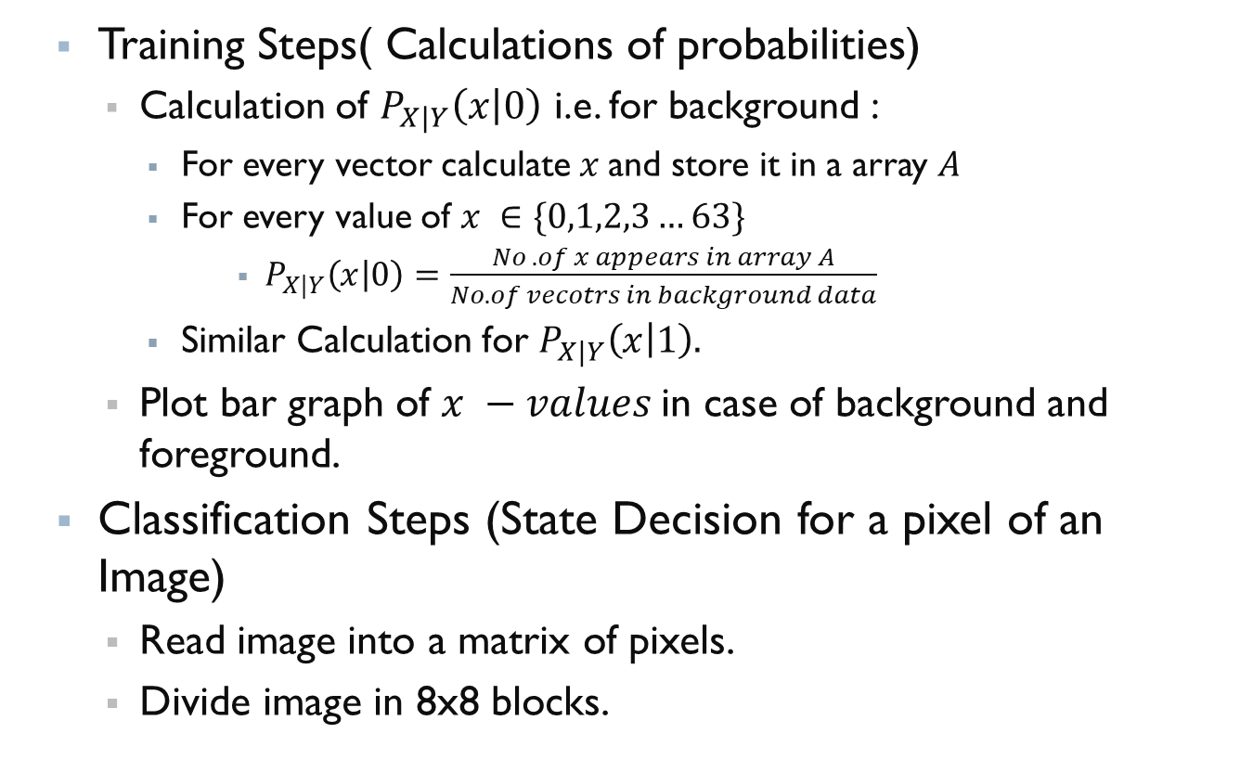
Code Steps:
Training Steps( Calculations of probabilities)
Calculation of $P_{X|Y}\left(x | 0\right)$ i.e. for background :
For every vector calculate $x$and store it in a array $A$
For every value of $x ∈\{0,1,2,3…63\}$
$P_{X|Y}\left(x | 0\right)=\frac{No .of x appears in array A}{No. of vecotrs in background data}$
Similar Calculation for $P_{X|Y}\left(x | 1\right).$
Plot bar graph of $x −values$in case of background and foreground.
Classification Steps (State Decision for a pixel of an Image)
Read image into a matrix of pixels.
Divide image in 8x8 blocks.

Slide 7
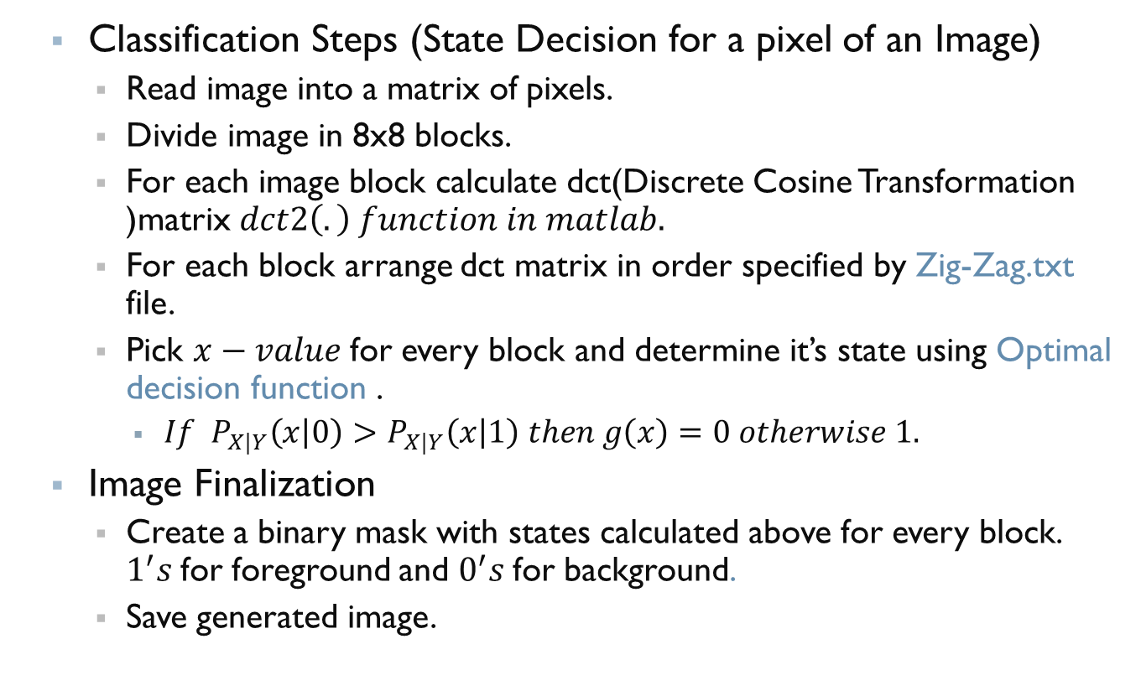
Code Steps:
Classification Steps (State Decision for a pixel of an Image)
Read image into a matrix of pixels.
Divide image in 8x8 blocks.
For each image block calculate dct(Discrete Cosine Transformation )matrix $dct2\left(.\right) function in matlab.$
For each block arrange dct matrix in order specified by Zig-Zag.txt file.
Pick $x−value$for every block and determine it’s state using Optimal decision function .
$If P_{X|Y}\left(x | 0\right)>P_{X|Y}\left(x | 1\right) then g\left(x\right)=0 otherwise 1.$
Image Finalization
Create a binary mask with states calculated above for every block. $1^{′}s$for foreground and $0^{′}s$for background.
Save generated image.

Slide 8
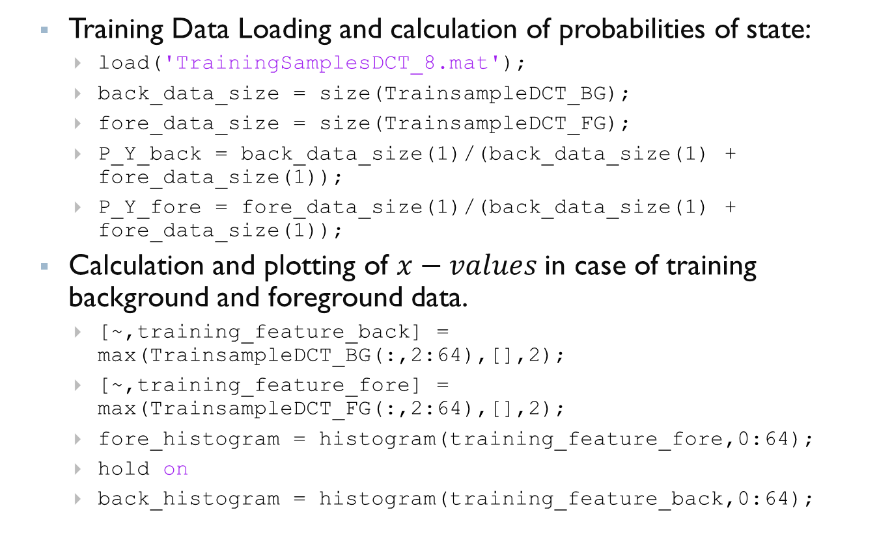
An Example Code in MATLAB
Training Data Loading and calculation of probabilities of state:
load('TrainingSamplesDCT_8.mat');
back_data_size = size(TrainsampleDCT_BG);
fore_data_size = size(TrainsampleDCT_FG);
P_Y_back = back_data_size(1)/(back_data_size(1) + fore_data_size(1));
P_Y_fore = fore_data_size(1)/(back_data_size(1) + fore_data_size(1));
Calculation and plotting of $x−values$in case of training background and foreground data.
[~,training_feature_back] = max(TrainsampleDCT_BG(:,2:64),[],2);
[~,training_feature_fore] = max(TrainsampleDCT_FG(:,2:64),[],2);
fore_histogram = histogram(training_feature_fore,0:64);
hold on
back_histogram = histogram(training_feature_back,0:64);

Slide 9
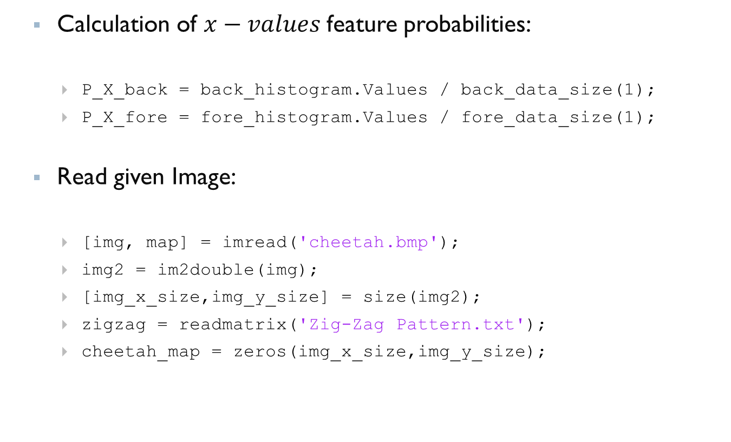
An Example Code in MATLAB
Calculation of $x−values$feature probabilities:
P_X_back = back_histogram.Values / back_data_size(1);
P_X_fore = fore_histogram.Values / fore_data_size(1);
Read given Image:
[img, map] = imread('cheetah.bmp');
img2 = im2double(img);
[img_x_size,img_y_size] = size(img2);
zigzag = readmatrix('Zig-Zag Pattern.txt');
cheetah_map = zeros(img_x_size,img_y_size);

Slide 10
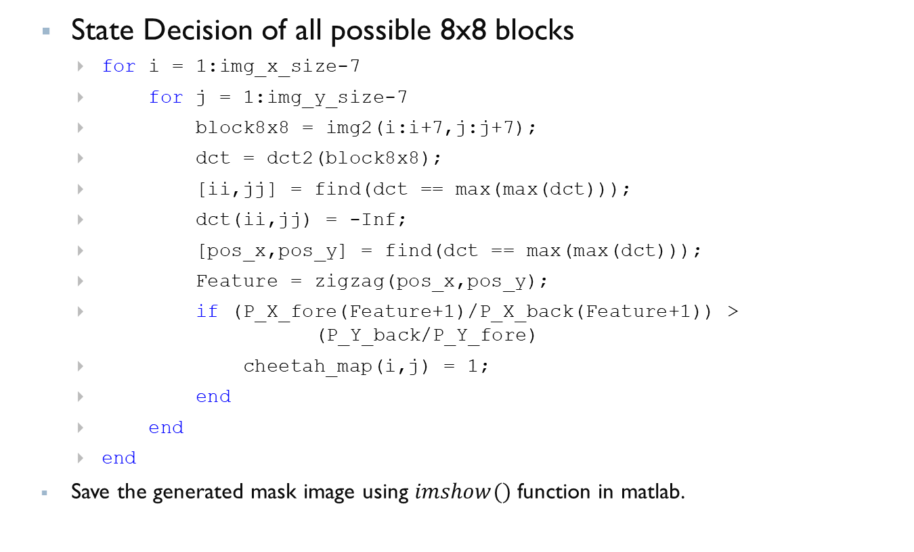
An Example Code in MATLAB
State Decision of all possible 8x8 blocks
for i = 1:img_x_size-7
for j = 1:img_y_size-7
block8x8 = img2(i:i+7,j:j+7);
dct = dct2(block8x8);
[ii,jj] = find(dct == max(max(dct)));
dct(ii,jj) = -Inf;
[pos_x,pos_y] = find(dct == max(max(dct)));
Feature = zigzag(pos_x,pos_y);
if (P_X_fore(Feature+1)/P_X_back(Feature+1)) > (P_Y_back/P_Y_fore)
cheetah_map(i,j) = 1;
end
end
end
Save the generated mask image using $imshow()$ function in matlab.

Slide 11
An Example Code in Python
Import all necessary tools and libraries
from scipy.io import loadmat
import scipy.fftpack
from matplotlib import pyplot as plt, image
import numpy as np
from matplotlib.pyplot import imread
Load training data and calculate probabilities of states.
trainingData = loadmat('TrainingSamplesDCT_8.mat')
TrainSampleDCT_FG = trainingData['TrainsampleDCT_FG']
TrainSampleDCT_BG = trainingData['TrainsampleDCT_BG']
BG_prior = len(TrainSampleDCT_BG)/(len(TrainSampleDCT_BG) + len(TrainSampleDCT_FG))
FG_prior = len(TrainSampleDCT_FG)/(len(TrainSampleDCT_BG) + len(TrainSampleDCT_FG))

Slide 12
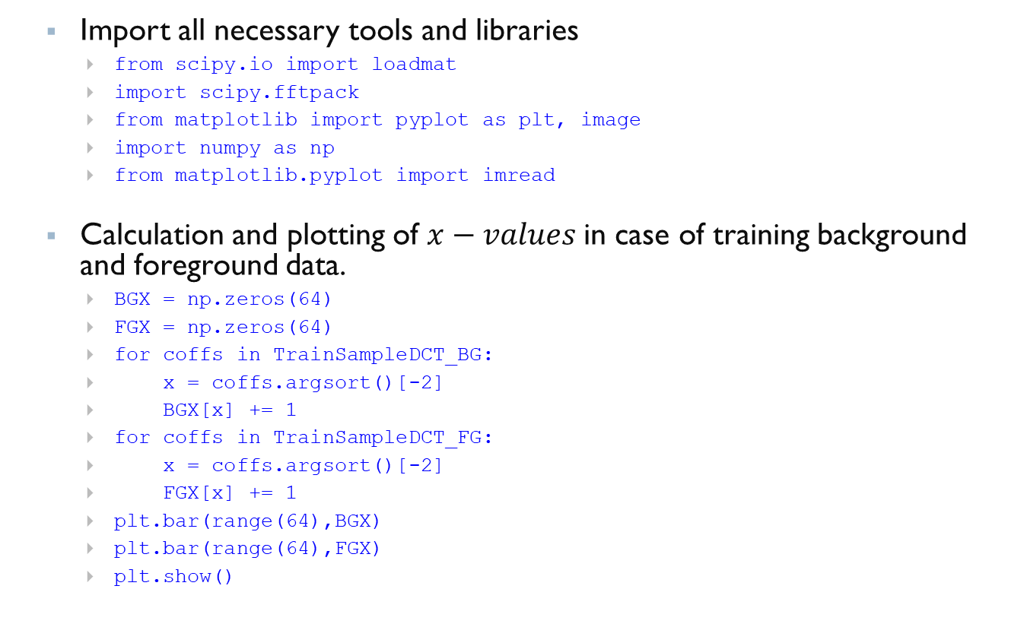
An Example Code in Python
Import all necessary tools and libraries
from scipy.io import loadmat
import scipy.fftpack
from matplotlib import pyplot as plt, image
import numpy as np
from matplotlib.pyplot import imread
Calculation and plotting of $x−values$in case of training background and foreground data.
BGX = np.zeros(64)
FGX = np.zeros(64)
for coffs in TrainSampleDCT_BG:
x = coffs.argsort()[-2]
BGX[x] += 1
for coffs in TrainSampleDCT_FG:
x = coffs.argsort()[-2]
FGX[x] += 1
plt.bar(range(64),BGX)
plt.bar(range(64),FGX)
plt.show()

Slide 13
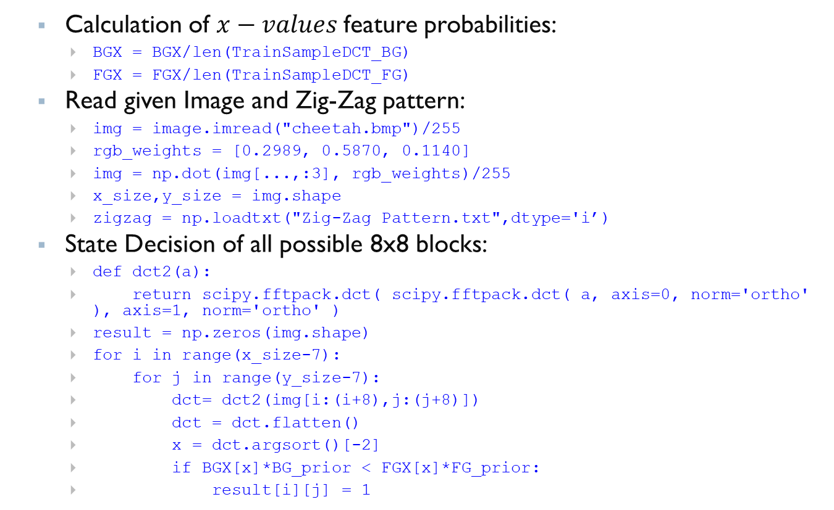
An Example Code in Python
Calculation of $x−values$feature probabilities:
BGX = BGX/len(TrainSampleDCT_BG)
FGX = FGX/len(TrainSampleDCT_FG)
Read given Image and Zig-Zag pattern:
img = image.imread("cheetah.bmp")/255
rgb_weights = [0.2989, 0.5870, 0.1140]
img = np.dot(img[...,:3], rgb_weights)/255
x_size,y_size = img.shape
zigzag = np.loadtxt("Zig-Zag Pattern.txt",dtype='i’)
State Decision of all possible 8x8 blocks:
def dct2(a):
return scipy.fftpack.dct( scipy.fftpack.dct( a, axis=0, norm='ortho' ), axis=1, norm='ortho' )
result = np.zeros(img.shape)
for i in range(x_size-7):
for j in range(y_size-7):
dct= dct2(img[i:(i+8),j:(j+8)])
dct = dct.flatten()
x = dct.argsort()[-2]
if BGX[x]*BG_prior < FGX[x]*FG_prior:
result[i][j] = 1

