Slide 1
Cheetah Problem
Prof. Aditya K. Jagannatham
IIT Kanpur

Slide 2
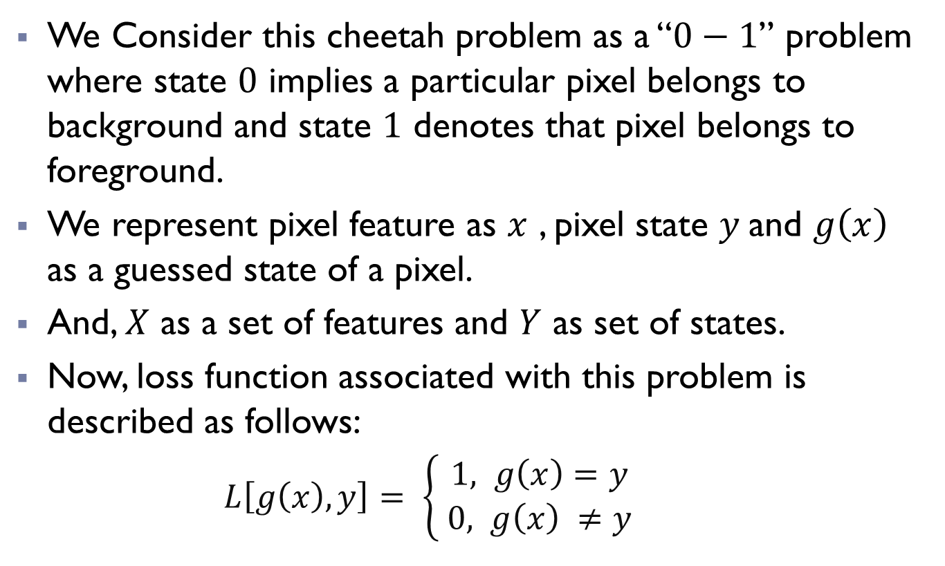
Overview:
We Consider this cheetah problem as a “$0−1$” problem where state $0$ implies a particular pixel belongs to background and state $1$ denotes that pixel belongs to foreground.
We represent pixel feature as $x$ , pixel state $y$and $g\left(x\right)$ as a guessed state of a pixel.
And, $X$ as a set of features and $Y$ as set of states.
Now, loss function associated with this problem is described as follows:
$L\left[g\left(x\right),y\right]= \left\{\begin{aligned}1, g\left(x\right)=y \\ 0, g\left(x\right) ≠y \end{aligned}\right.$

Slide 3
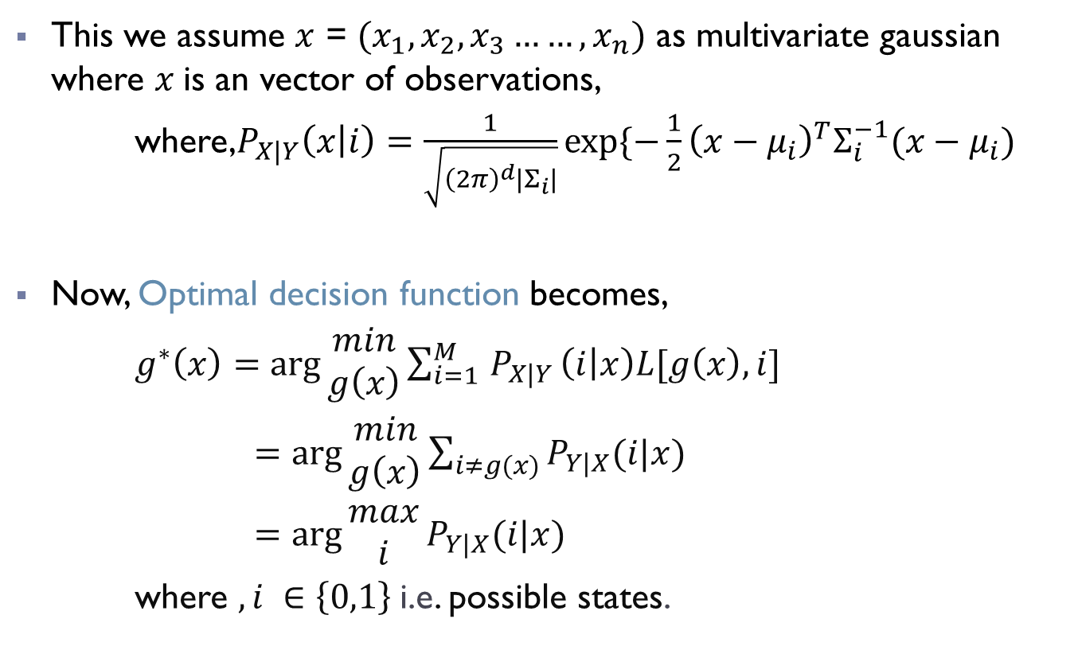
Overview:
This we assume $x$ = $(x_{1}, x_{2},x_{3}……,x_{n})$ as multivariate gaussian where $x$is an vector of observations,
where,$P_{X|Y}\left(x | i\right)=\frac{1}{\sqrt{{\left(2π\right)}^{d}\left|Σ_{i}\right|}}exp⁡\{−\frac{1}{2}{\left(x−μ_{i}\right)}^{T}Σ_{i}^{−1}(x−μ_{i})$
Now, Optimal decision function becomes,
$g^{∗}\left(x\right)=\arg{\begin{aligned}min \\ g\left(x\right)\end{aligned}}\sum_{i=1 }^{M}{P_{X|Y}}\left(i | x\right)L[g\left(x\right),i]$
$=\arg{\begin{aligned}min \\ g\left(x\right)\end{aligned}\sum_{i≠g(x)}{P_{Y|X}(i|x)}}$
$=\arg{\begin{aligned}max \\ i\end{aligned}}P_{Y|X}(i|x)$
where $, i ∈\left\{0,1\right\}$i.e. possible states.

Slide 4
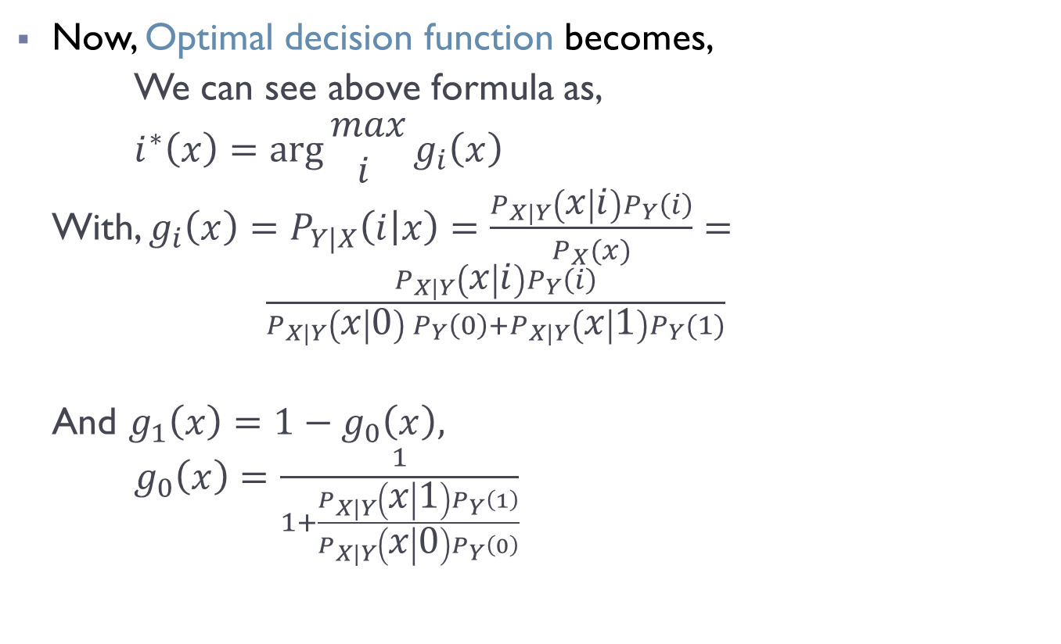
Overview:
Now, Optimal decision function becomes,
We can see above formula as,
$i^{∗}\left(x\right)=\arg{\begin{aligned}max \\ i \end{aligned}}g_{i}\left(x\right)$
With, $g_{i}\left(x\right)=P_{Y|X}\left(i | x\right)=\frac{P_{X|Y}\left(x | i\right)P_{Y}\left(i\right)}{P_{X}(x)}= \frac{P_{X|Y}\left(x | i\right)P_{Y}\left(i\right)}{P_{X|Y}\left(x | 0\right) P_{Y}\left(0\right)+P_{X|Y}\left(x | 1\right)P_{Y}(1)}$
And $g_{1}\left(x\right)=1−g_{0}\left(x\right),$
$g_{0}\left(x\right)=\frac{1}{1+\frac{P_{X|Y}\left(x | 1\right)P_{Y}\left(1\right)}{P_{X|Y}\left(x | 0\right)P_{Y}\left(0\right)}}$

Slide 5
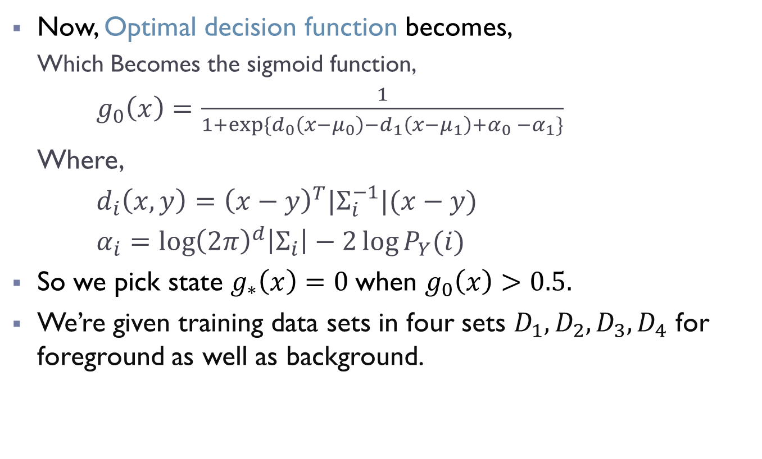
Overview:
Now, Optimal decision function becomes,
Which Becomes the sigmoid function,
$g_{0}\left(x\right)=\frac{1}{1+exp⁡\{d_{0}\left(x−μ_{0}\right)−d_{1}\left(x−μ_{1}\right)+α_{0} −α_{1}\}}$
Where,
$d_{i}\left(x,y\right)={\left(x−y\right)}^{T}{|Σ}_{i}^{−1}|(x−y)$
$α_{i}=\log{{\left(2π\right)}^{d}\left|Σ_{i}\right|−2\log{P_{Y}(i)}}$
So we pick state $g_{∗}\left(x\right)=0$when $g_{0}\left(x\right)>0.5.$
We’re given training data sets in four sets $D_{1}, D_{2},D_{3},D_{4}$ for foreground as well as background.

Slide 6
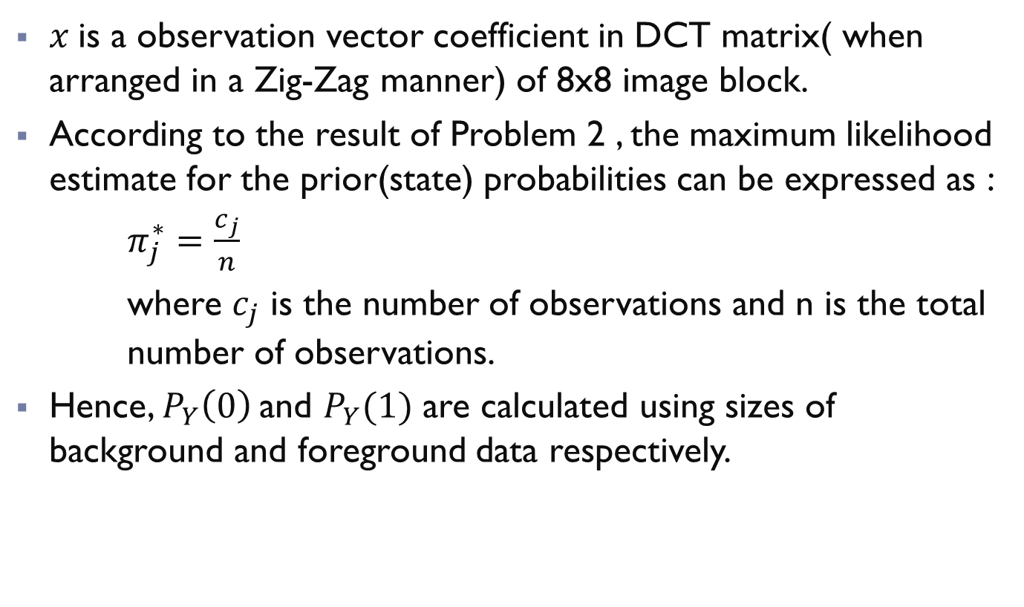
Overview:
$x$is a observation vector coefficient in DCT matrix( when arranged in a Zig-Zag manner) of 8x8 image block.
According to the result of Problem 2 , the maximum likelihood estimate for the prior(state) probabilities can be expressed as :
$π_{j}^{∗}=\frac{c_{j}}{n}$
where $c_{j}$ is the number of observations and n is the total number of observations.
Hence, $P_{Y}\left(0\right)$and $P_{Y}(1)$ are calculated using sizes of background and foreground data respectively.

Slide 7
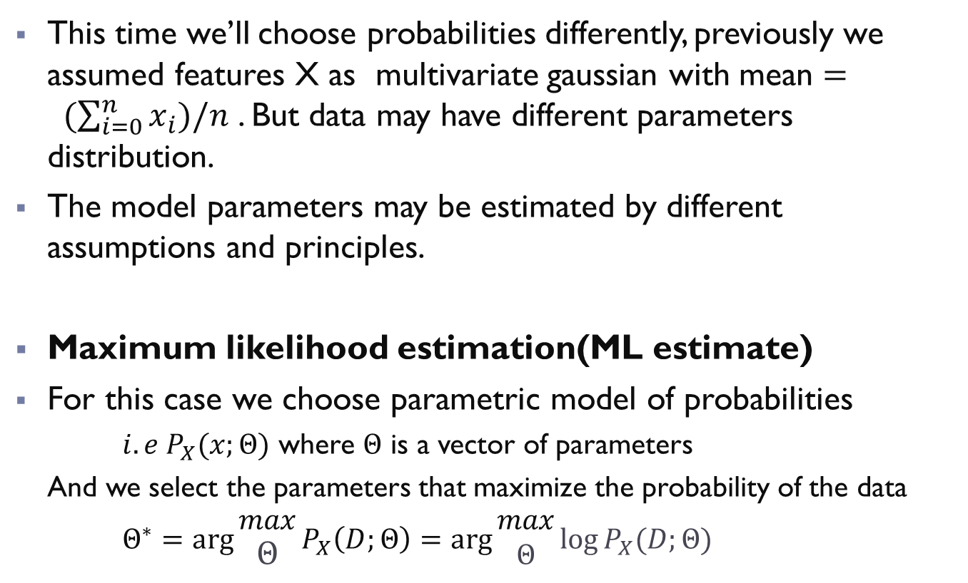
Overview:
This time we’ll choose probabilities differently, previously we assumed features X as multivariate gaussian with mean $= (\sum_{i=0}^{n}{x_{i})/n}$ . But data may have different parameters distribution.
The model parameters may be estimated by different assumptions and principles.
Maximum likelihood estimation(ML estimate)
For this case we choose parametric model of probabilities
$i.e P_{X}(x;Θ)$ where $Θ$ is a vector of parameters
And we select the parameters that maximize the probability of the data
$Θ^{∗}=\arg{\begin{aligned}max \\ Θ\end{aligned}}P_{X}\left(D;Θ\right)=\arg{\begin{aligned}max \\ Θ\end{aligned}\log{P_{X}(D;Θ)}}$

Slide 8
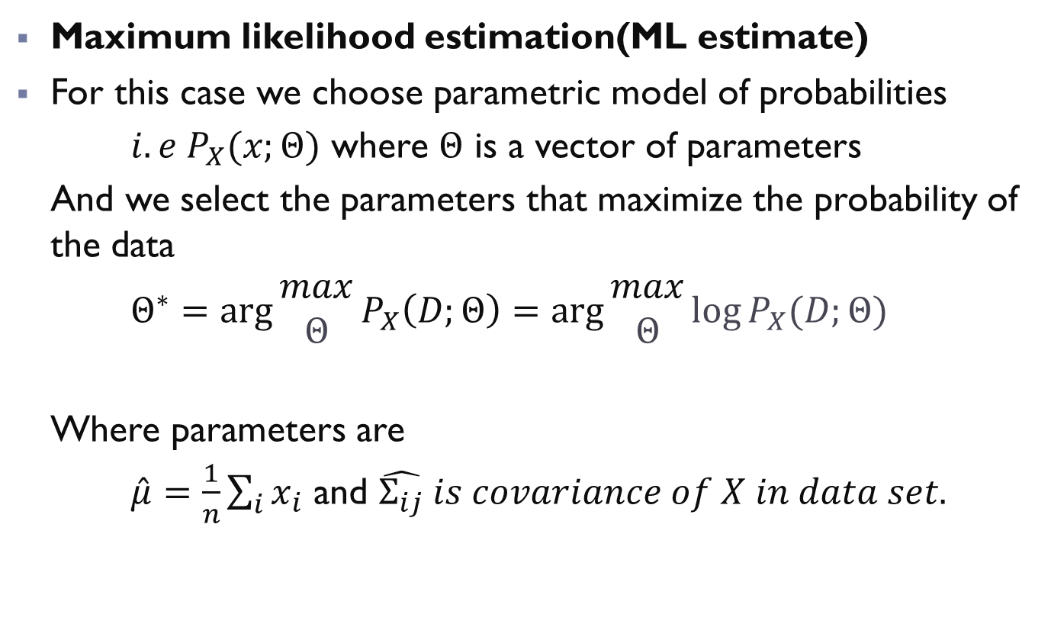
Overview:
Maximum likelihood estimation(ML estimate)
For this case we choose parametric model of probabilities
$i.e P_{X}(x;Θ)$ where $Θ$ is a vector of parameters
And we select the parameters that maximize the probability of the data
$Θ^{∗}=\arg{\begin{aligned}max \\ Θ\end{aligned}}P_{X}\left(D;Θ\right)=\arg{\begin{aligned}max \\ Θ\end{aligned}\log{P_{X}(D;Θ)}}$
Where parameters are
$\hat{μ}=\frac{1}{n}\sum_{i}{x_{i}}$ and $\hat{Σ_{ij}} is covariance of X in data set.$

Slide 9
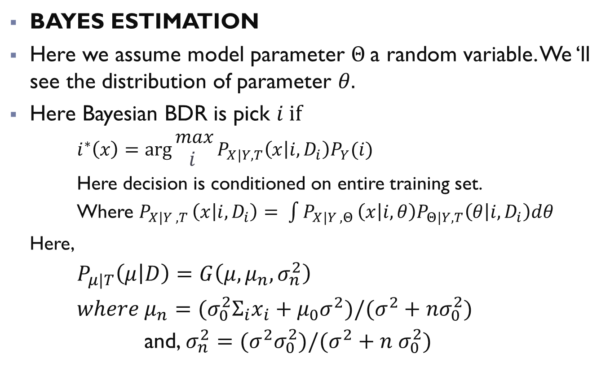
Overview:
BAYES ESTIMATION
Here we assume model parameter $Θ$a random variable. We ‘ll see the distribution of parameter $θ.$
Here Bayesian BDR is pick $i if$
$i^{∗}\left(x\right)=\arg{\begin{aligned}max \\ i \end{aligned}}P_{X|Y,T}\left(x | i, D_{i}\right)P_{Y}(i)$
Here decision is conditioned on entire training set.
Where $P_{X|Y ,T }\left(x | i,D_{i}\right)= \int{P_{X|Y ,Θ}}\left(x | i,θ\right)P_{Θ|Y,T}\left(θ | i,D_{i}\right)dθ$
Here,
$P_{μ|T}\left(μ | D\right)=G\left(μ,μ_{n},σ_{n}^{2}\right)$
$where μ_{n}={(σ}_{0}^{2}Σ_{i}x_{i}+μ_{0}σ^{2})/(σ^{2}+nσ_{0}^{2})$
and, $σ_{n}^{2}=(σ^{2}σ_{0}^{2})/(σ^{2}+n σ_{0}^{2})$

Slide 10
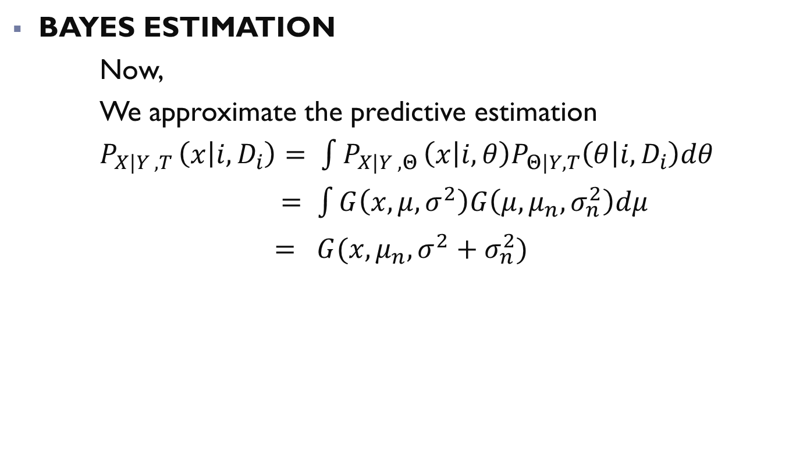
Overview:
BAYES ESTIMATION
Now,
We approximate the predictive estimation
$P_{X|Y ,T }\left(x | i,D_{i}\right)= \int{P_{X|Y ,Θ}}\left(x | i,θ\right)P_{Θ|Y,T}\left(θ | i,D_{i}\right)dθ$
$= \int{G\left(x,μ,σ^{2}\right)G\left(μ,μ_{n},σ_{n}^{2}\right)dμ}$
$= G(x,μ_{n}, σ^{2}+σ_{n}^{2})$
Notes:
$$P_{X|Y ,T }\left(x | i,D_{i}\right)= \int{P_{X|Y ,Θ}}\left(x | i,θ\right)P_{Θ|Y,T}\left(θ | i,D_{i}\right)dθ$$

Slide 11
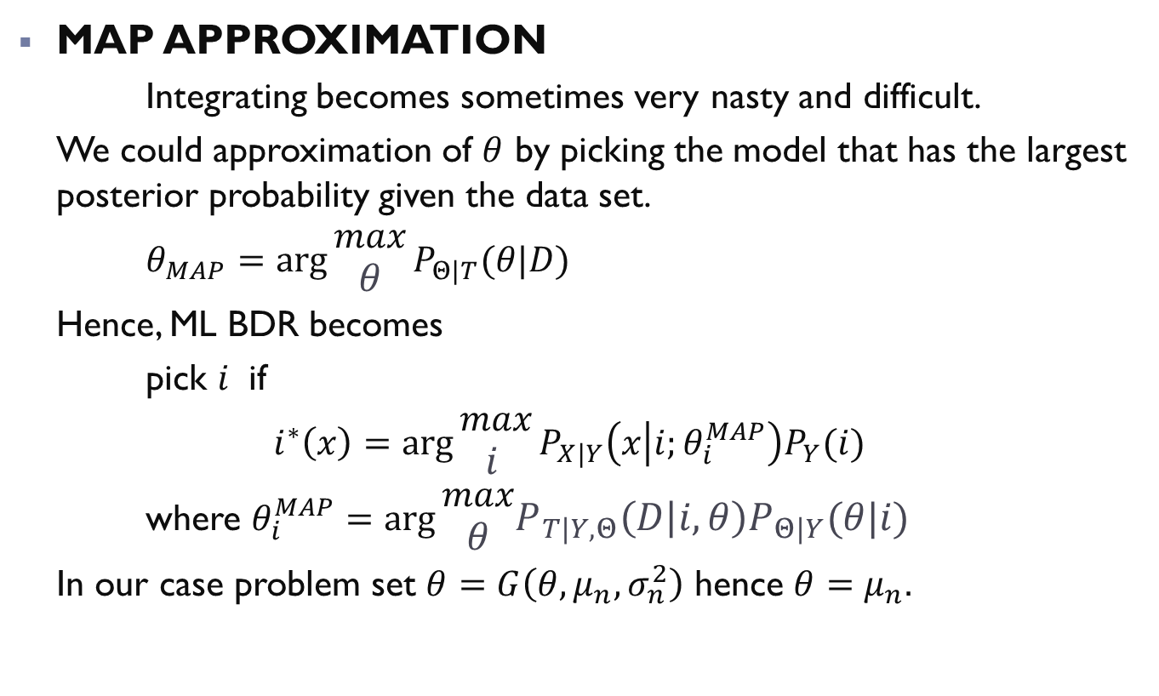
Overview:
MAP APPROXIMATION
Integrating becomes sometimes very nasty and difficult.
We could approximation of $θ$ by picking the model that has the largest posterior probability given the data set.
$θ_{MAP}=\arg{\begin{aligned}max \\ θ\end{aligned}}P_{Θ|T}(θ|D)$
Hence, ML BDR becomes
pick $i$ if
$i^{∗}\left(x\right)=\arg{\begin{aligned}max \\ i \end{aligned}}P_{X|Y}\left(x | i;θ_{i}^{MAP}\right)P_{Y}(i)$
where $θ_{i}^{MAP}=\arg{\begin{aligned}max \\ θ\end{aligned}P_{T|Y,Θ}\left(D | i,θ\right)P_{Θ|Y}(θ|i)}$
In our case problem set $θ=G\left(θ,μ_{n},σ_{n}^{2}\right)$ hence $θ=μ_{n}.$
Notes:
$$P_{X|Y ,T }\left(x | i,D_{i}\right)= \int{P_{X|Y ,Θ}}\left(x | i,θ\right)P_{Θ|Y,T}\left(θ | i,D_{i}\right)dθ$$

