Slide 1
Cheetah Problem
Prof. Aditya K. Jagannatham
IIT Kanpur

Slide 2
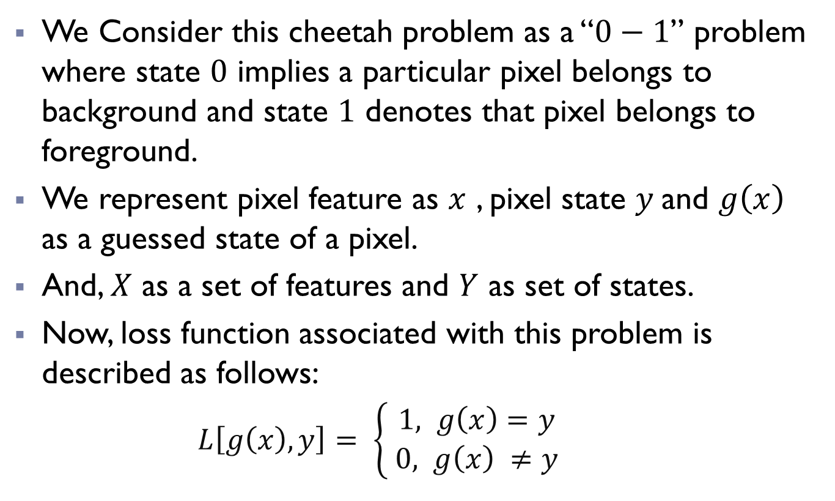
Overview:
We Consider this cheetah problem as a “$0−1$” problem where state $0$ implies a particular pixel belongs to background and state $1$ denotes that pixel belongs to foreground.
We represent pixel feature as $x$ , pixel state $y$and $g\left(x\right)$ as a guessed state of a pixel.
And, $X$ as a set of features and $Y$ as set of states.
Now, loss function associated with this problem is described as follows:
$L\left[g\left(x\right),y\right]= \left\{\begin{aligned}1, g\left(x\right)=y \\ 0, g\left(x\right) ≠y \end{aligned}\right.$

Slide 3
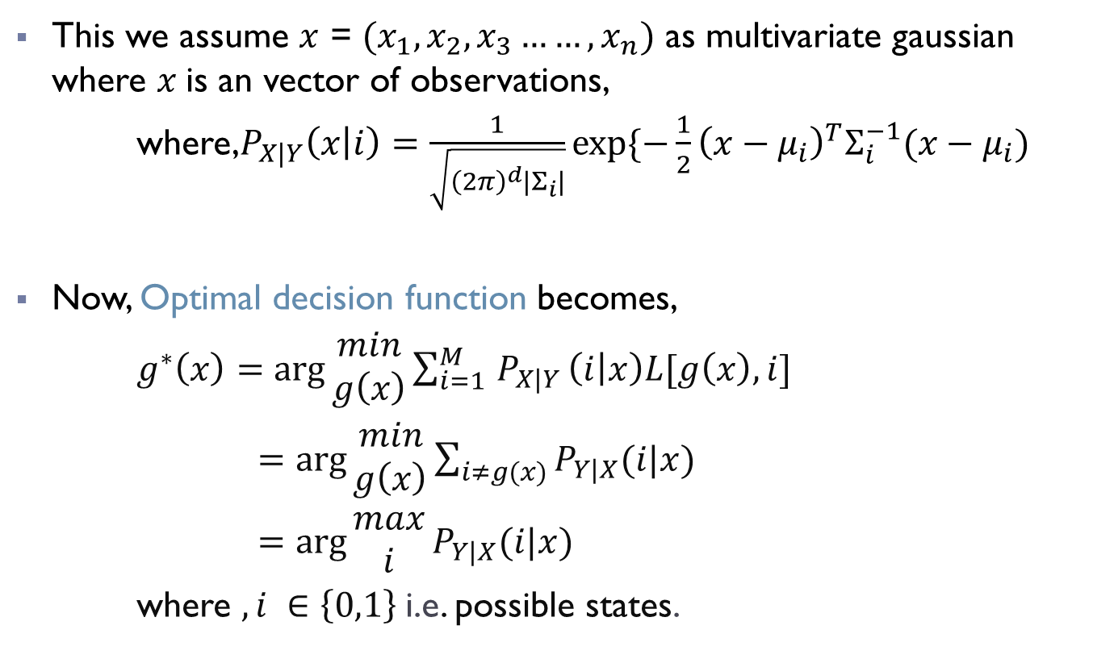
Overview:
This we assume $x$ = $(x_{1}, x_{2},x_{3}……,x_{n})$ as multivariate gaussian where $x$is an vector of observations,
where,$P_{X|Y}\left(x | i\right)=\frac{1}{\sqrt{{\left(2π\right)}^{d}\left|Σ_{i}\right|}}exp⁡\{−\frac{1}{2}{\left(x−μ_{i}\right)}^{T}Σ_{i}^{−1}(x−μ_{i})$
Now, Optimal decision function becomes,
$g^{∗}\left(x\right)=\arg{\begin{aligned}min \\ g\left(x\right)\end{aligned}}\sum_{i=1 }^{M}{P_{X|Y}}\left(i | x\right)L[g\left(x\right),i]$
$=\arg{\begin{aligned}min \\ g\left(x\right)\end{aligned}\sum_{i≠g(x)}{P_{Y|X}(i|x)}}$
$=\arg{\begin{aligned}max \\ i\end{aligned}}P_{Y|X}(i|x)$
where $, i ∈\left\{0,1\right\}$i.e. possible states.

Slide 4
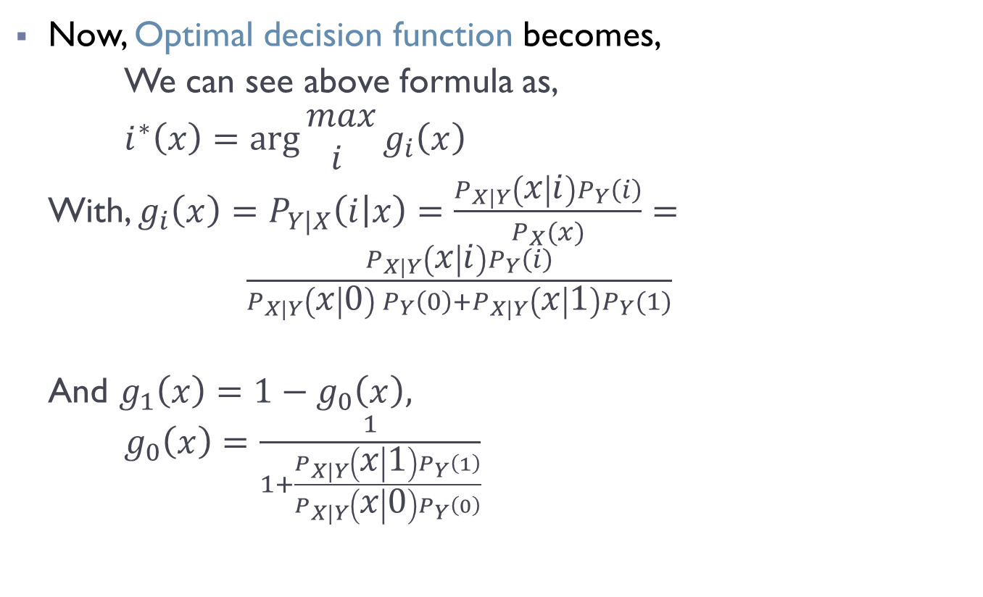
Overview:
Now, Optimal decision function becomes,
We can see above formula as,
$i^{∗}\left(x\right)=\arg{\begin{aligned}max \\ i \end{aligned}}g_{i}\left(x\right)$
With, $g_{i}\left(x\right)=P_{Y|X}\left(i | x\right)=\frac{P_{X|Y}\left(x | i\right)P_{Y}\left(i\right)}{P_{X}(x)}= \frac{P_{X|Y}\left(x | i\right)P_{Y}\left(i\right)}{P_{X|Y}\left(x | 0\right) P_{Y}\left(0\right)+P_{X|Y}\left(x | 1\right)P_{Y}(1)}$
And $g_{1}\left(x\right)=1−g_{0}\left(x\right),$
$g_{0}\left(x\right)=\frac{1}{1+\frac{P_{X|Y}\left(x | 1\right)P_{Y}\left(1\right)}{P_{X|Y}\left(x | 0\right)P_{Y}\left(0\right)}}$

Slide 5
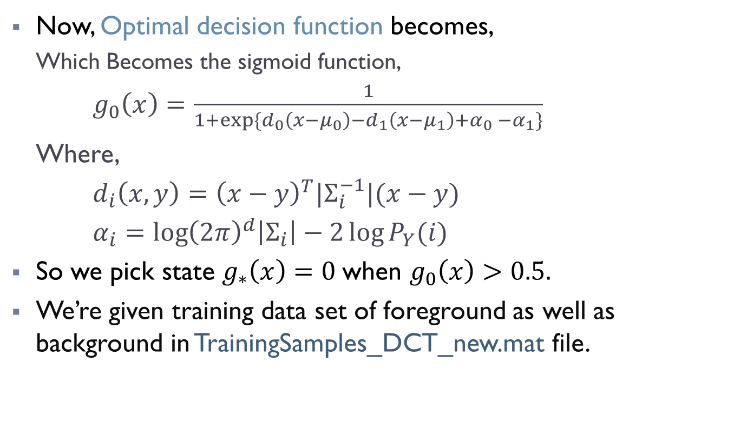
Overview:
Now, Optimal decision function becomes,
Which Becomes the sigmoid function,
$g_{0}\left(x\right)=\frac{1}{1+exp⁡\{d_{0}\left(x−μ_{0}\right)−d_{1}\left(x−μ_{1}\right)+α_{0} −α_{1}\}}$
Where,
$d_{i}\left(x,y\right)={\left(x−y\right)}^{T}{|Σ}_{i}^{−1}|(x−y)$
$α_{i}=\log{{\left(2π\right)}^{d}\left|Σ_{i}\right|−2\log{P_{Y}(i)}}$
So we pick state $g_{∗}\left(x\right)=0$when $g_{0}\left(x\right)>0.5.$
We’re given training data set of foreground as well as background in TrainingSamples_DCT_new.mat file.

Slide 6
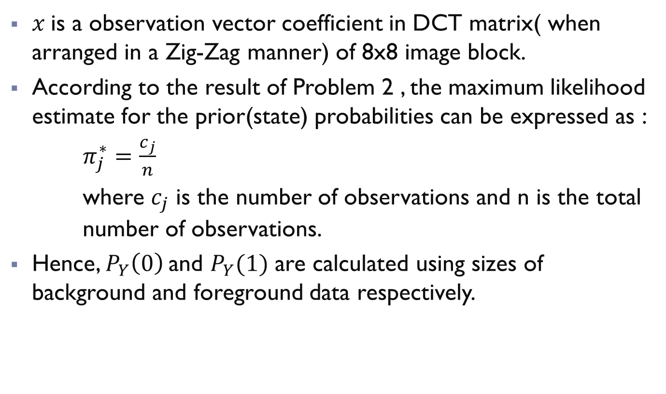
Overview:
$x$is a observation vector coefficient in DCT matrix( when arranged in a Zig-Zag manner) of 8x8 image block.
According to the result of Problem 2 , the maximum likelihood estimate for the prior(state) probabilities can be expressed as :
$π_{j}^{∗}=\frac{c_{j}}{n}$
where $c_{j}$ is the number of observations and n is the total number of observations.
Hence, $P_{Y}\left(0\right)$and $P_{Y}(1)$ are calculated using sizes of background and foreground data respectively.

Slide 7
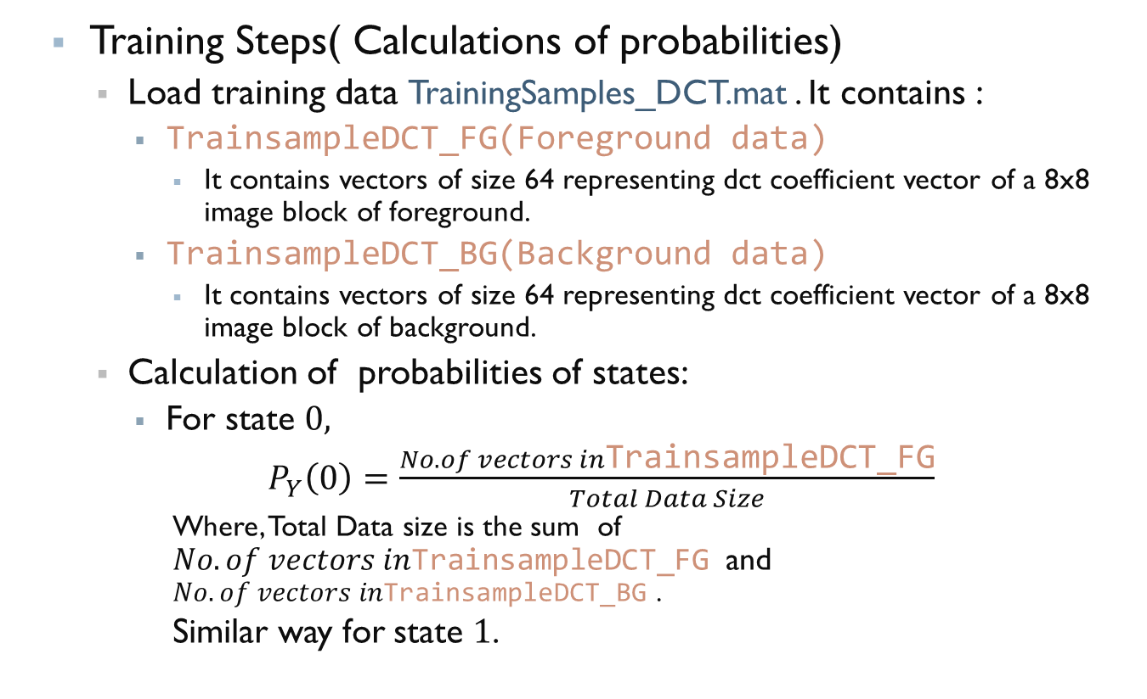
Code Steps:
Training Steps( Calculations of probabilities)
Load training data TrainingSamples_DCT.mat . It contains :
TrainsampleDCT_FG(Foreground data)
It contains vectors of size 64 representing dct coefficient vector of a 8x8 image block of foreground.
TrainsampleDCT_BG(Background data)
It contains vectors of size 64 representing dct coefficient vector of a 8x8 image block of background.
Calculation of probabilities of states:
For state $0,$
$P_{Y}\left(0\right)=\frac{No. of vectors in\text{TrainsampleDCT}\text{_}\text{FG}}{Total Data Size}$
Where, Total Data size is the sum of $No. of vectors in\text{TrainsampleDCT}\text{_}\text{FG}$and $No. of vectors in\text{TrainsampleDCT}\text{_}\text{B}\text{G}$ .
Similar way for state $1$.

Slide 8
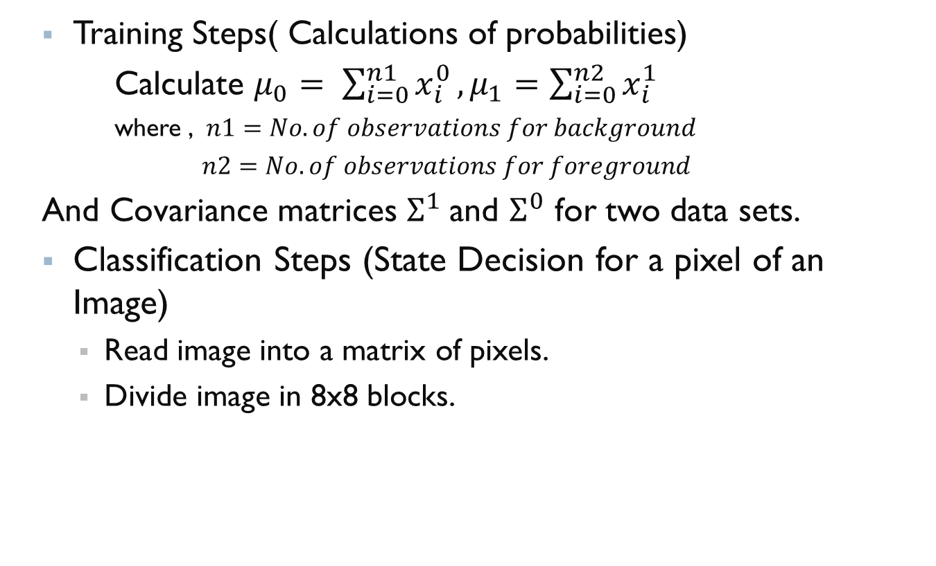
Code Steps:
Training Steps( Calculations of probabilities)
Calculate $μ_{0}= \sum_{i=0}^{n1}{x_{i}^{0}}, μ_{1}=\sum_{i=0}^{n2}{x_{i}^{1}}$
where , $n1=No. of observations for background$
$n2=No. of observations for foreground$
And Covariance matrices $Σ^{1}$and $Σ^{0}$ for two data sets.
Classification Steps (State Decision for a pixel of an Image)
Read image into a matrix of pixels.
Divide image in 8x8 blocks.

Slide 9
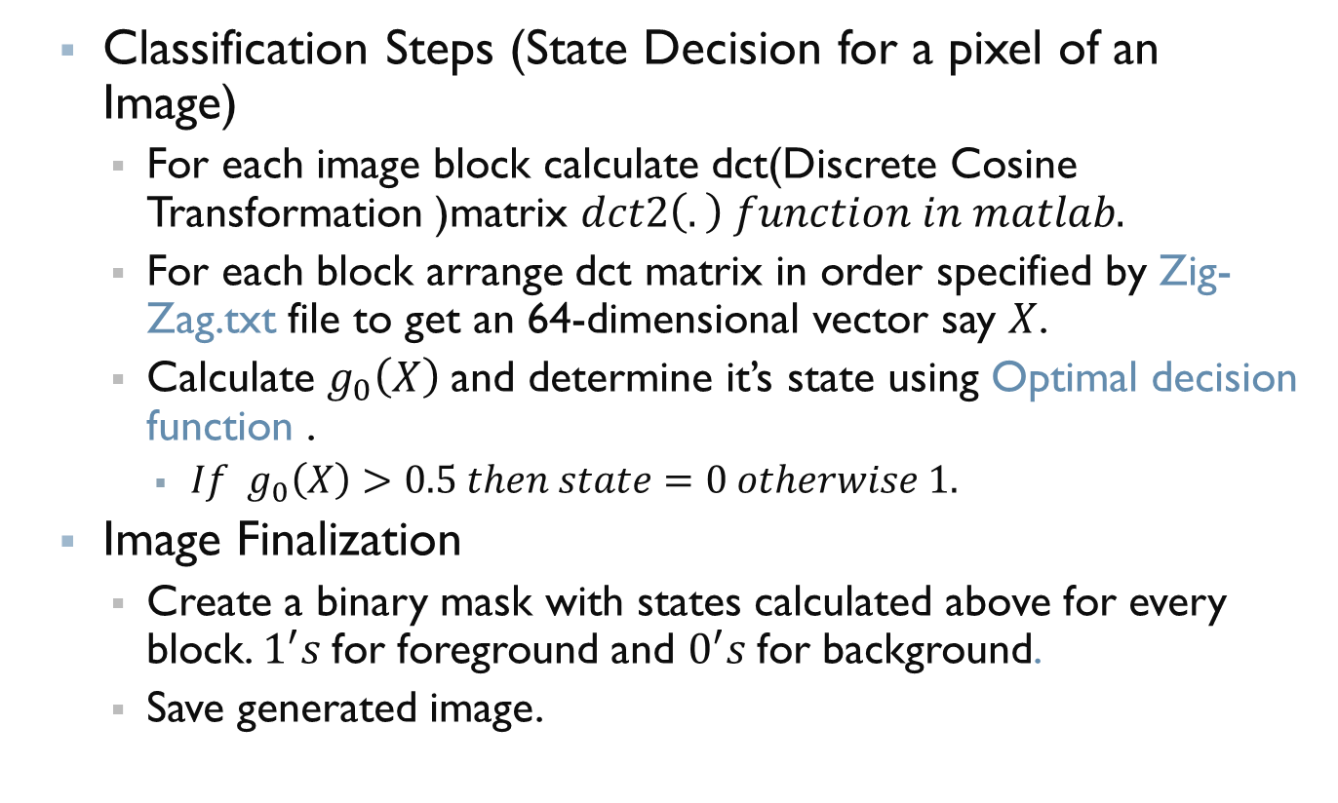
Code Steps:
Classification Steps (State Decision for a pixel of an Image)
For each image block calculate dct(Discrete Cosine Transformation )matrix $dct2\left(.\right) function in matlab.$
For each block arrange dct matrix in order specified by Zig-Zag.txt file to get an 64-dimensional vector say $X$.
Calculate $g_{0}\left(X\right)$and determine it’s state using Optimal decision function .
$If g_{0}\left(X\right)>0.5 then state=0 otherwise 1.$
Image Finalization
Create a binary mask with states calculated above for every block. $1^{′}s$for foreground and $0^{′}s$for background.
Save generated image.

Slide 10
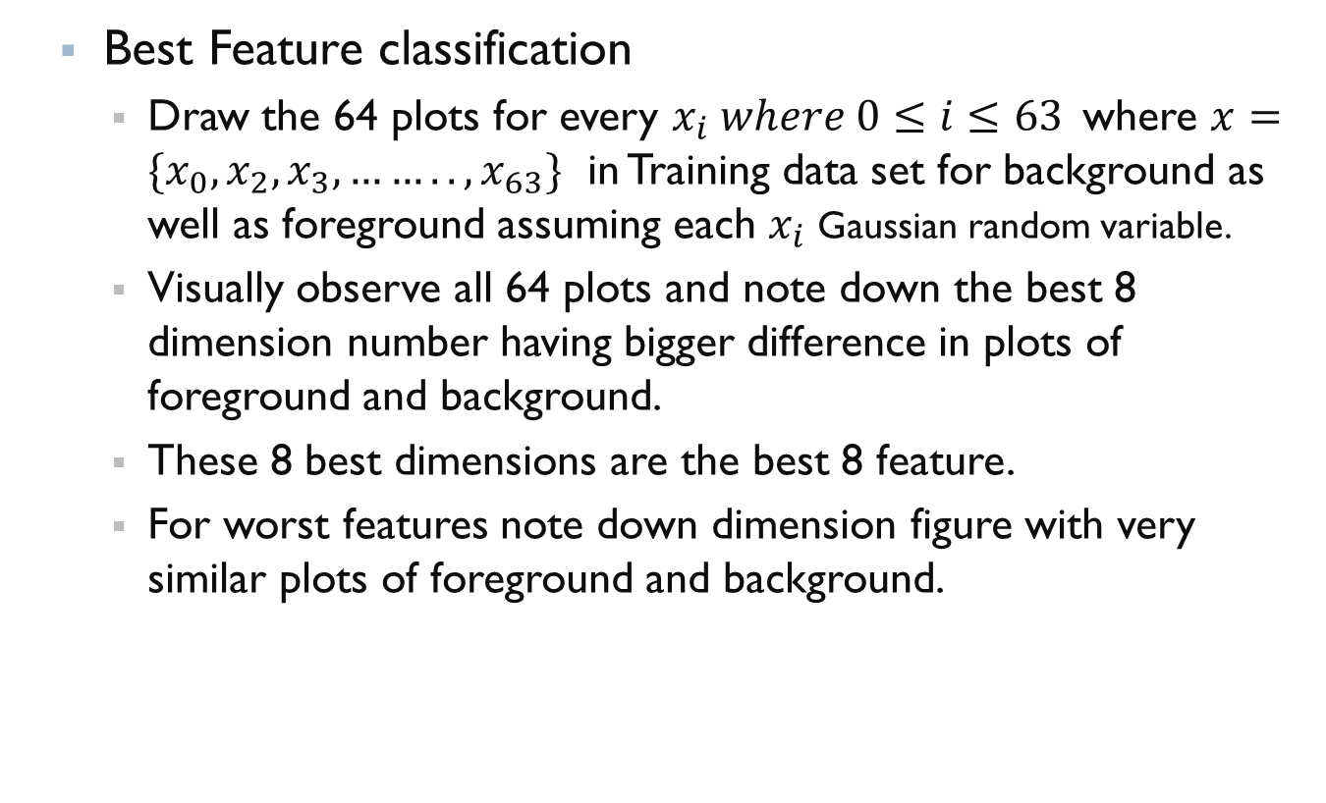
Code Steps:
Best Feature classification
Draw the 64 plots for every $x_{i} where 0≤i≤63$where $x=\{x_{0},x_{2},x_{3},……..,x_{63}\}$ in Training data set for background as well as foreground assuming each $x_{i}$ Gaussian random variable.
Visually observe all 64 plots and note down the best 8 dimension number having bigger difference in plots of foreground and background.
These 8 best dimensions are the best 8 feature.
For worst features note down dimension figure with very similar plots of foreground and background.

