Slide 1
Name: Rohit Paradkar Institution: K.J. Somaiya Institute of Engineering and Information Technology Project Name: Profit Prediction Submitted To: EXPOSYS DATA LAB

Slide 2
1.Abstract
The profit earned by a company for a particular period depends on several factors like how much R&D Spend, Administration Cost and Marketing Spend.
We have used five different machine learning algorithms :
Linear Regression
Random Forest
Decision Tree
Polynomial Regression
Artificial Neural Network
Out of five model Linear Regression model is best fit

Slide 3
2. Introduction
In today's world, data is generated everywhere and it cannot be processed by one person or even a team.
Machine learning capture all that data and provide what the user wants.
Objective:
Many ways to predict the profits of an individual company
Get the right values ​​using all the different techniques is challenge
Purpose here is to develop the best algorithms for forecasting business profits.

Slide 4
3.Existing Method
Most of people uses single algorithm to predict target variable which is not enough.
The data is not completely consumed by the most of the model.
Accuracy is less and Sigle model is not that much reliable.

Slide 5
4.Proposed method with Architecture
Combine the result of all algorithms and find the range of accuracy.
4.1 Benefits of the proposed system:
Use all the given data to predict the value of the independent variable.
Using 5 different models to predict the result will defiantly give the edge over using single model.
Use of Artificial Neural Network is also giving very accurate result.

Slide 6
5.Methodology
Steps for implementation of purpose systems:
Data visualization and Pattern evaluation:
Graphical representation of information and data
Help you understand the relation between of given attributes
Feature extraction:
Correlation is a statistical measure that how variables change together
Feature scaling:
To normalize the data within a certain range
Help speed up the calculation of the algorithm

Slide 7
Training and Cross validation:
Split the data into training and testing
Cross validate the data
Test the data
Model evaluation and selection:
Confusion Matrix, Classification Accuracy, Logarithmic loss, Area under Curve,F1 score, Mean Absolute Error, Mean Squared Error
Selection of model:
Compare performance matrix and model accuracy.
Select the best model

Slide 8
6. Implementation:
Software used : Google Colab
Data Visualization:
Matplotlib library is used
Data visualization is very important technique for data science
Feature Selection:
Correlation Method:
Features | Correlation
R&D Spend | 0.972900
Administration | 0.747766
Marketing Spend | 0.200717
Profit | 1.000000

Slide 9
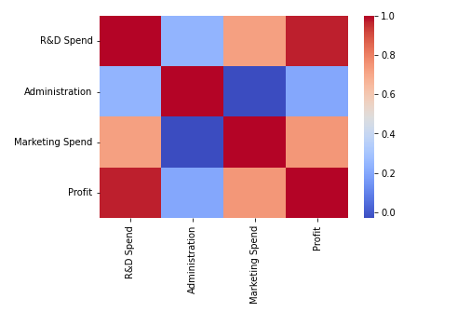
Heat map:

Slide 10
Cross-validation:
Model | Cross Validation Accuracy
Linear Regression | 0.895185
Random Forest | 0.867456
Decision Tree | 0.895185
Polynomial Regression | 0.790378
Training and Testing the model:
For model training data is split between following order:
Training – 80%
Testing - 20%
Model | Accuracy
Linear Regression | 89.5185
Random Forest | 86.7456
Decision Tree | 79.0378
Polynomial Regression | 89.5185
ANN (Artificial Neural Network) | 90.5484

Slide 11
7.Conclusion
Using all the 5 algorithms we get overall value of accuracy
Linear regression, Polynomial Regression and ANN shows more accurate results
Some times polynomial regression shows overfitting
ANN have similar accuracy to that of linear regression but it needs more processing power and it is time consuming.
Linear Regression proves to be a good algorithm

