Slide 1
Fake News Classification Pipeline using Azure AI Infrastructure and Architecture - 01
By Rohit Ravula (200625534), Rahul Kasturi (200629568)
23rd July 2025

Slide 2

Objective
The objective of this project is to implement an end-to-end data pipeline to clean, store, and visualize Fake News Classification data using Microsoft Azure services.

Slide 3
Architecture Flow
Kaggle Dataset → Data Cleaning & Preparation (Python) → Azure Blob Storage → Data Ingestion Pipeline (Azure Data Factory) → Structured Storage (Azure SQL Database) → Data Visualization (Power BI)
Why this Architecture ?
This architecture ensures scalability, efficiency, reliability, and seamless integration by leveraging Azure’s cloud services with modular, automated data pipelines and professional-grade visualization through Power BI.

Slide 4
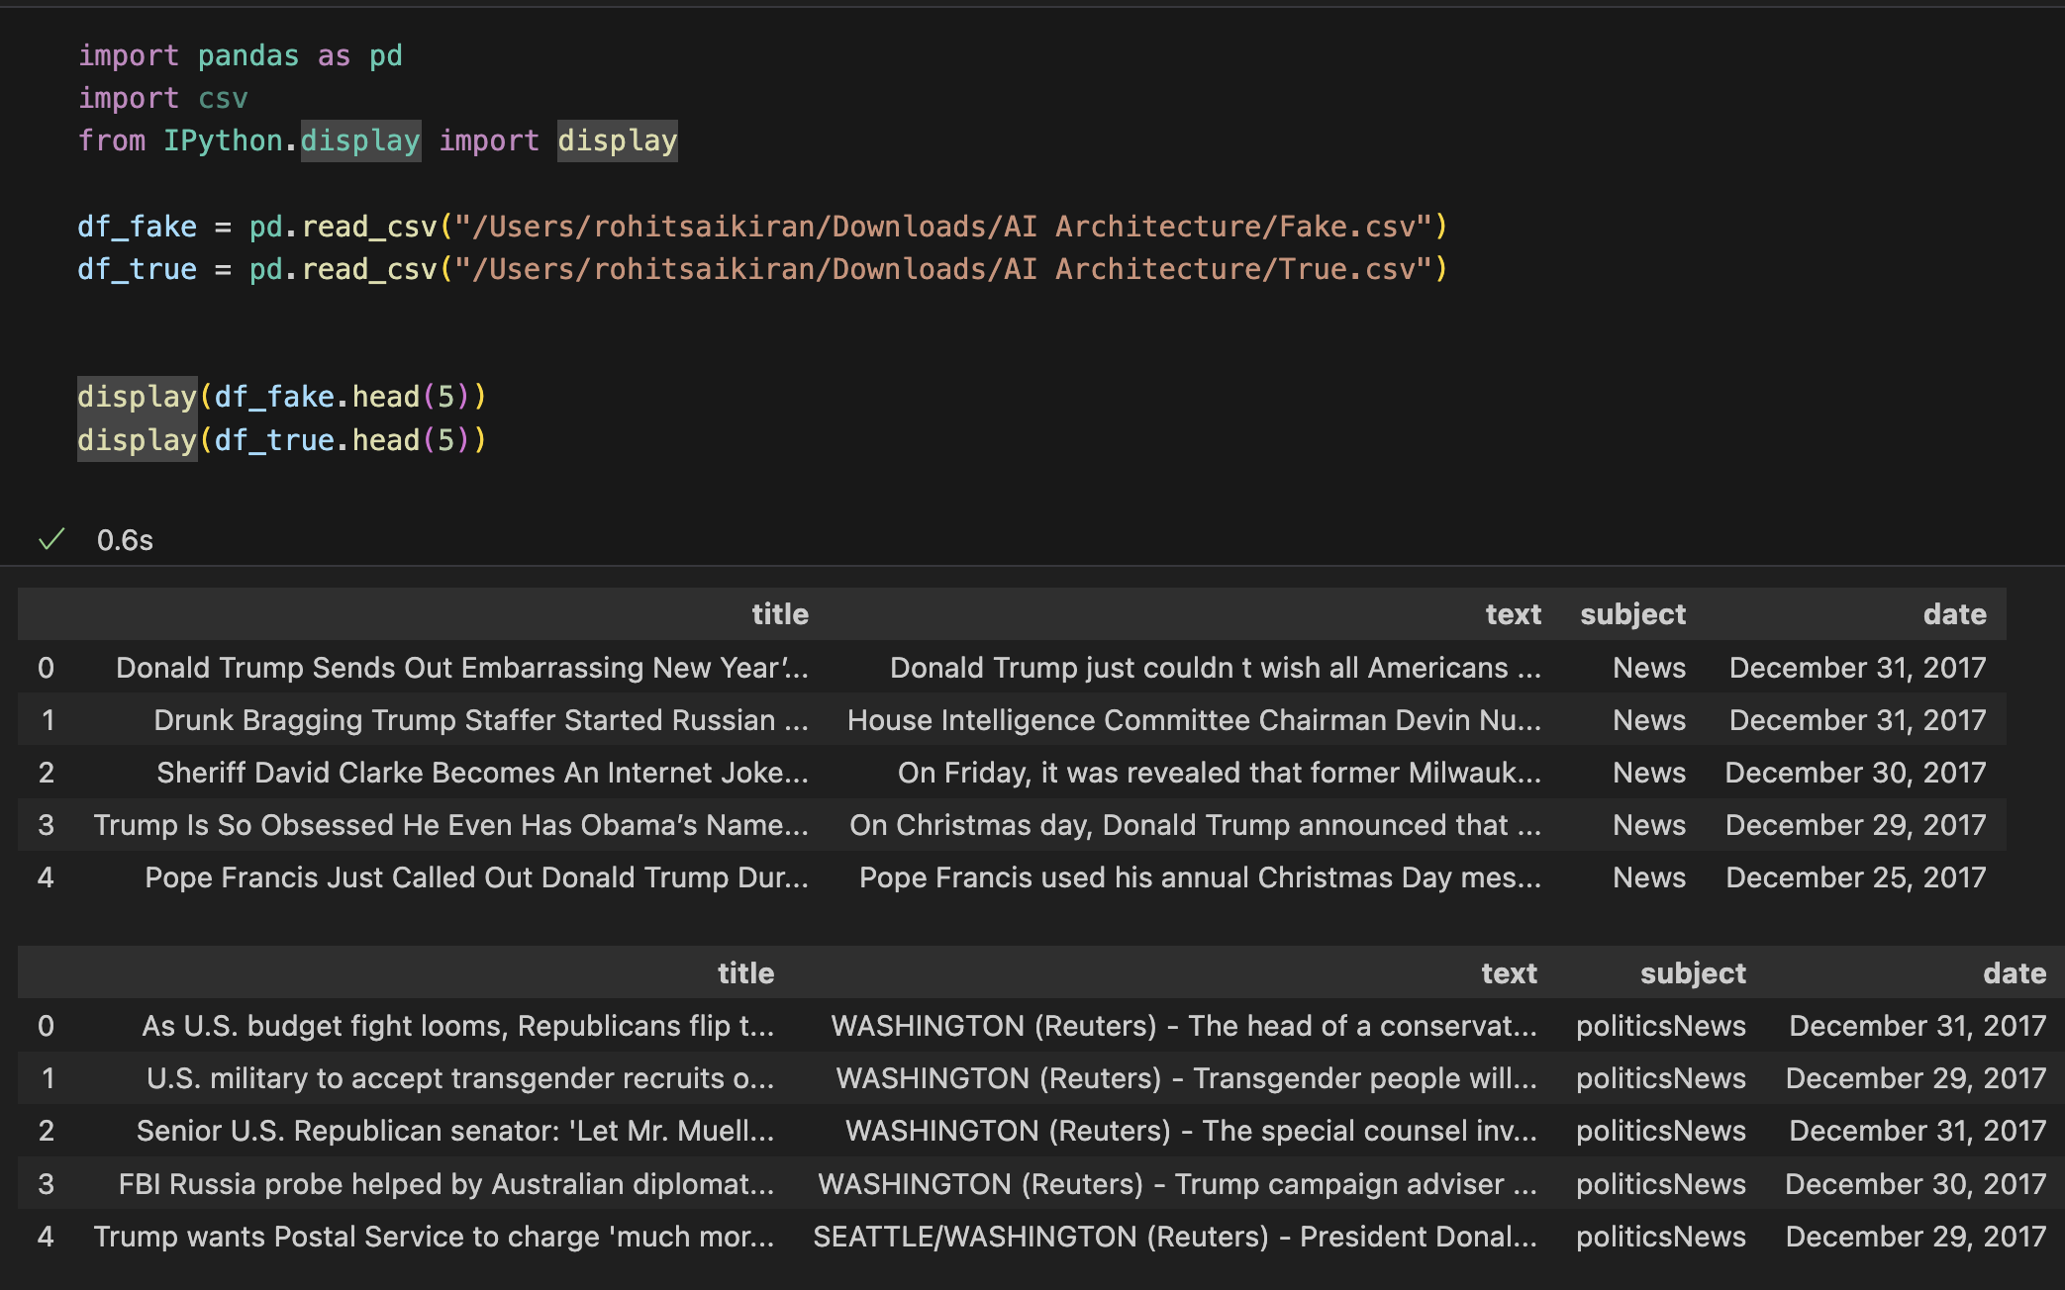
Dataset
We used Kaggle’s Fake News Detection datasets (Fake.csv and True.csv), Both of them containing news articles.

Slide 5
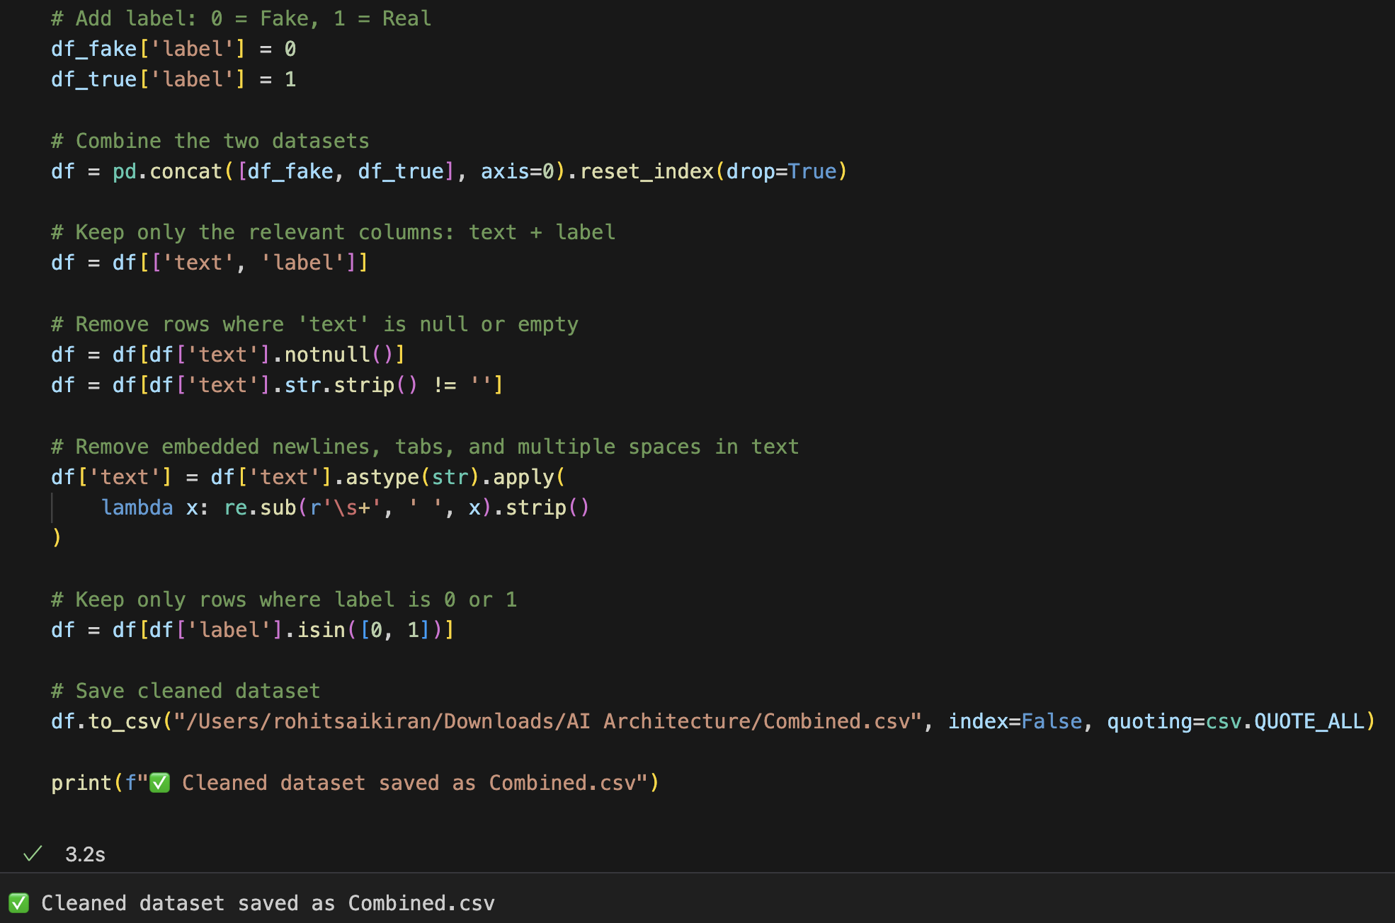
Data Cleaning
After Merging two files into one
Steps performed: Removed invalid and empty rows, Ensured only 2 columns: text & label, Replaced embedded newlines Verified labels are 0 (Fake) and 1 (Real)

Slide 6
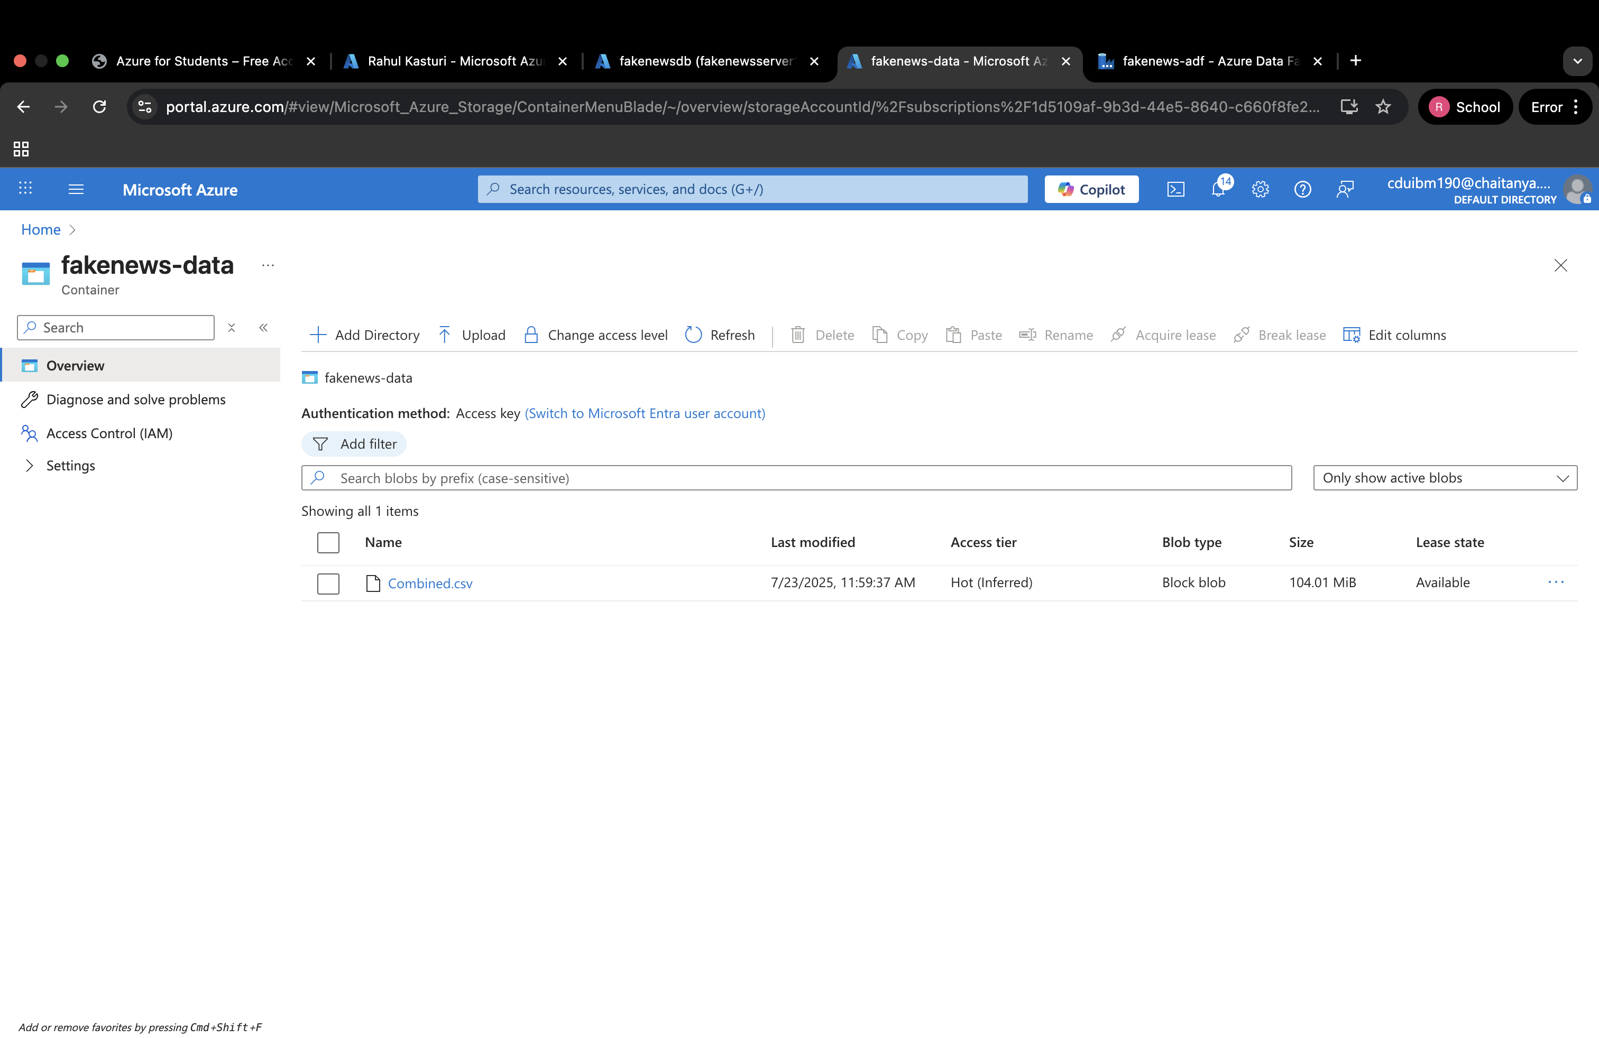
Azure Blob Storage
The cleaned dataset was uploaded to Azure Blob Storage for storage and easy access by Azure Data Factory.

Slide 7
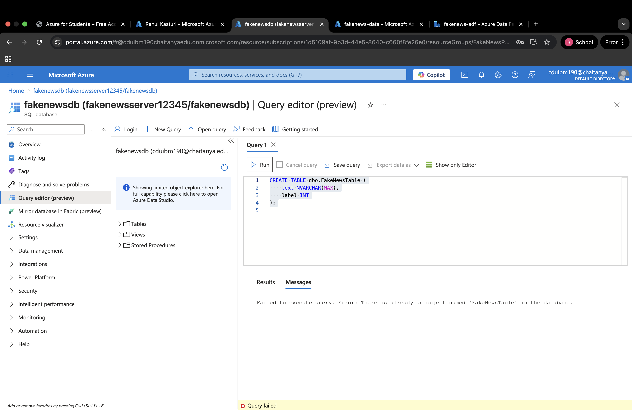
Azure SQL Database
We created an Azure SQL Database with a table FakeNewsTable to store the data ingested from Blob Storage

Slide 8
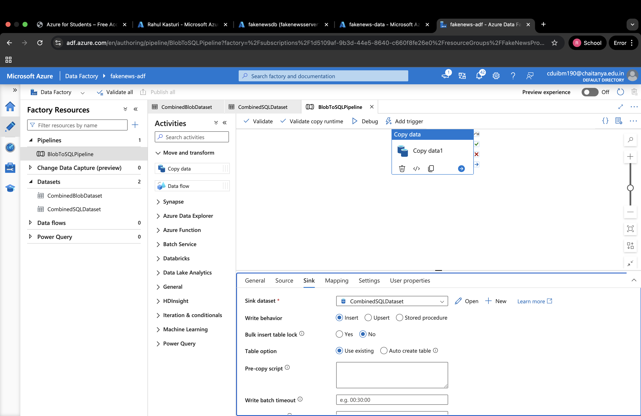
Azure Data Factory
We created an Azure Data Factory pipeline to copy data from Blob Storage to SQL Database.

Slide 9
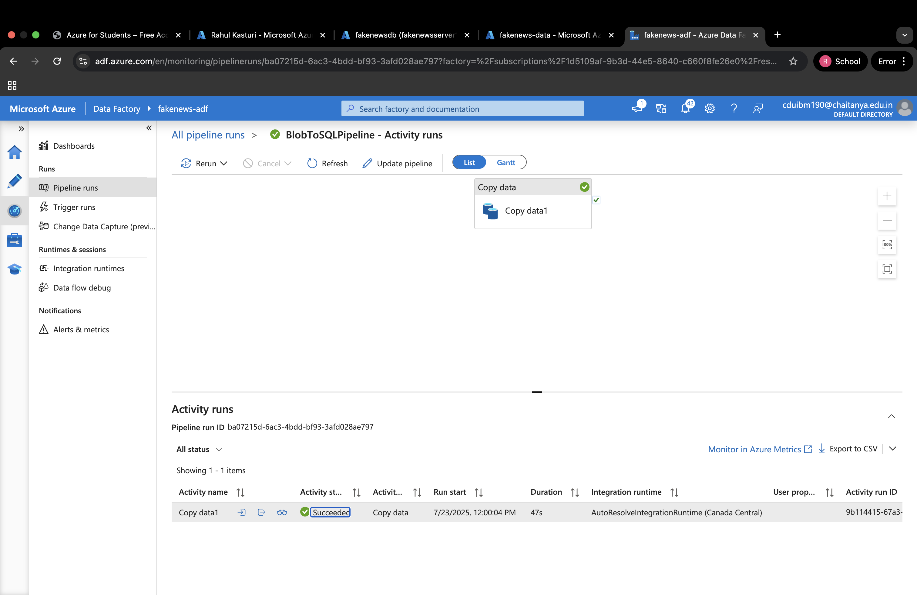
Pipeline Run Status
The pipeline was triggered and ran successfully, copying all rows to SQL Database.

Slide 10
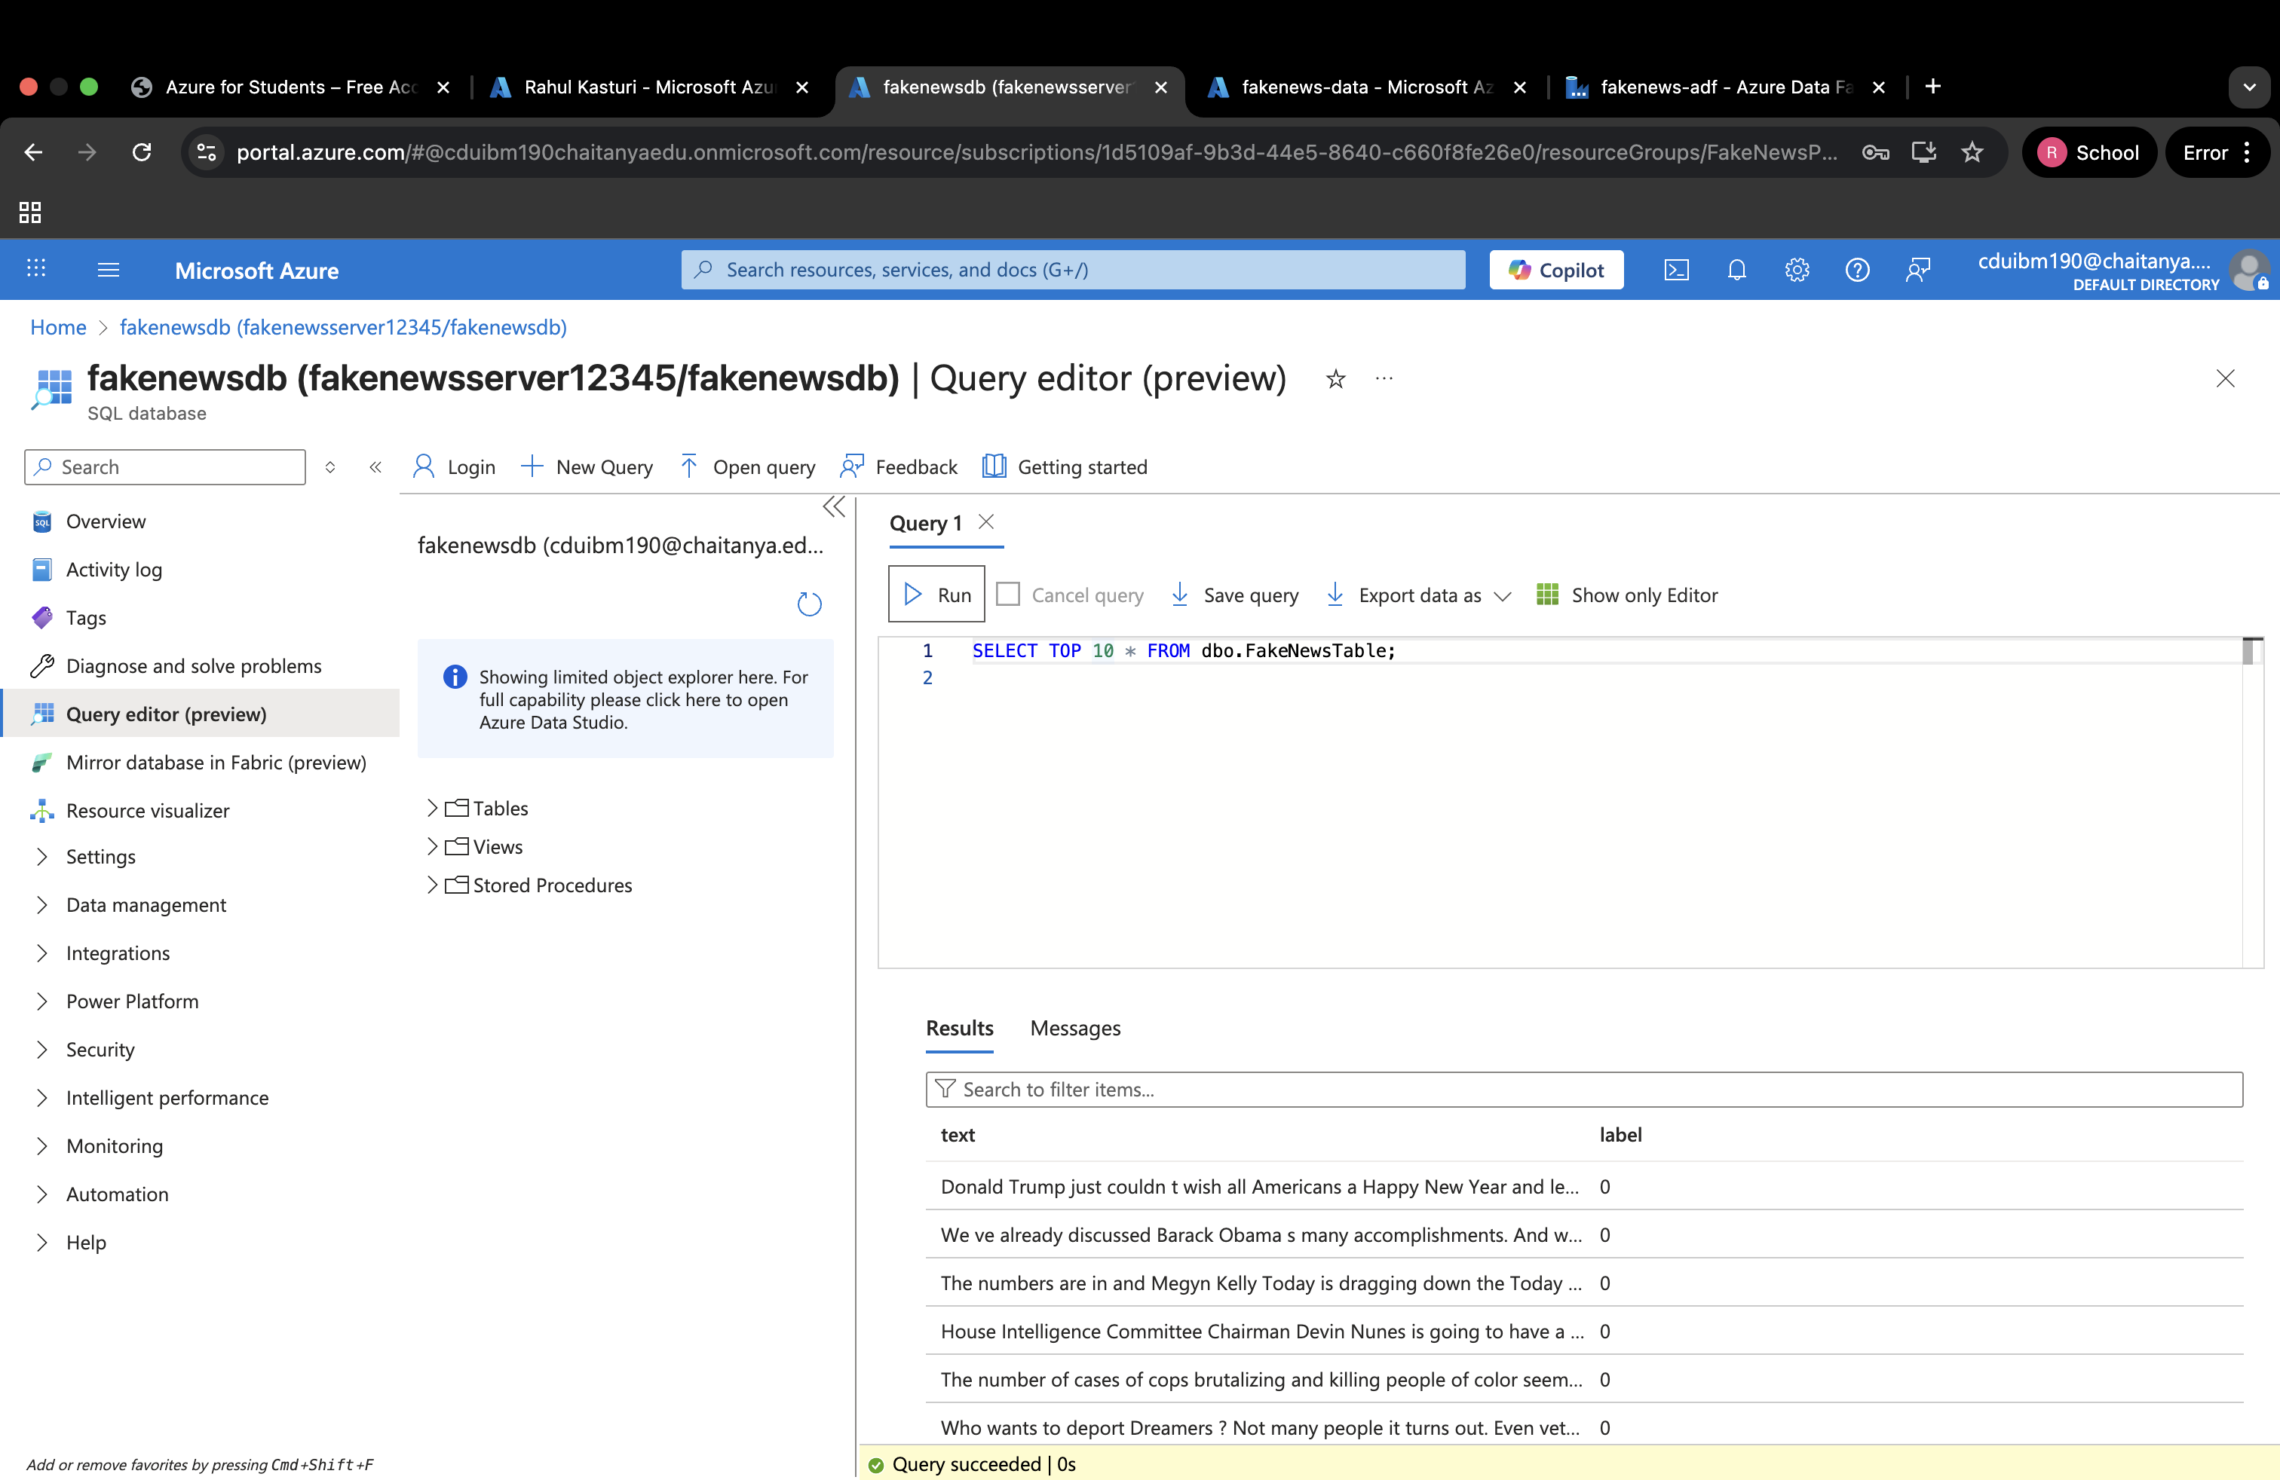
SQL Table Verification
After running the pipeline successfully, we verified that the data was loaded into Azure SQL Database.
We used the SQL query to view sample records:
The query confirmed that the FakeNewsTable was populated with the cleaned dataset.

Slide 11
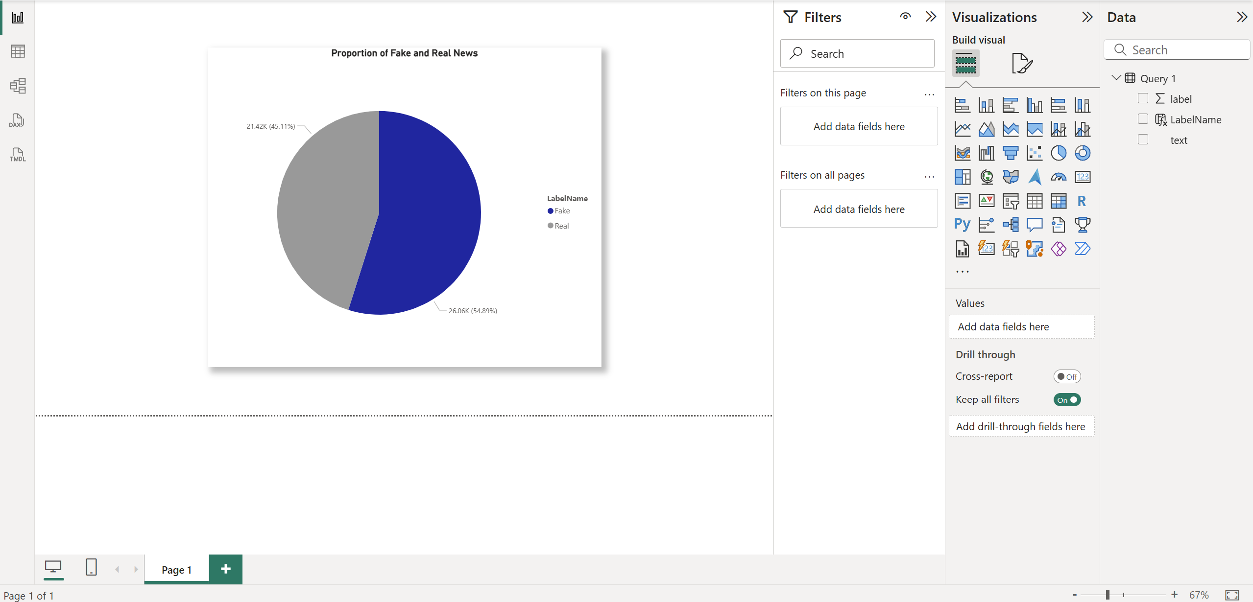
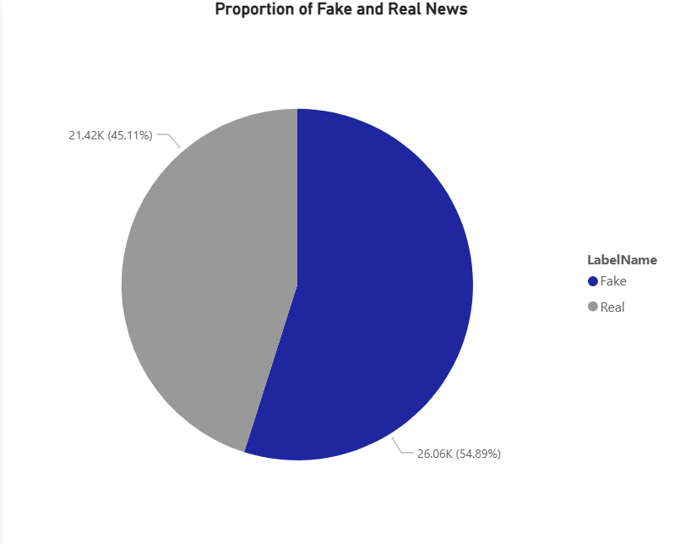
Data Visualization
Power BI was then used to connect to the Azure SQL Database and visualize the data.
The pie chart below shows the proportion of Fake and Real news articles in the dataset.
Approximately 54.89% of the articles are Fake, while 45.11% are Real.

Slide 12
Conclusion
Successfully implemented an end-to-end data pipeline for Fake News Classification using Microsoft Azure.
Cleaned and prepared data locally using Python.
Uploaded cleaned dataset to Azure Blob Storage.
Ingested data into Azure SQL Database using Azure Data Factory.
Verified data integrity and visualized results using Power BI.
This project demonstrates the power of cloud-based data pipelines for real-world analytics and decision-making.

Slide 13
References
The datasets was sourced from kaggle. https://www.kaggle.com/datasets/clmentbisaillon/fake-and-real-news-dataset

Slide 14
Thankyou

