Slide 1
Lets Start With The Pictography Game !
We created this PPT using webscrapping and Python.. Exciting isnt it !

Slide 2
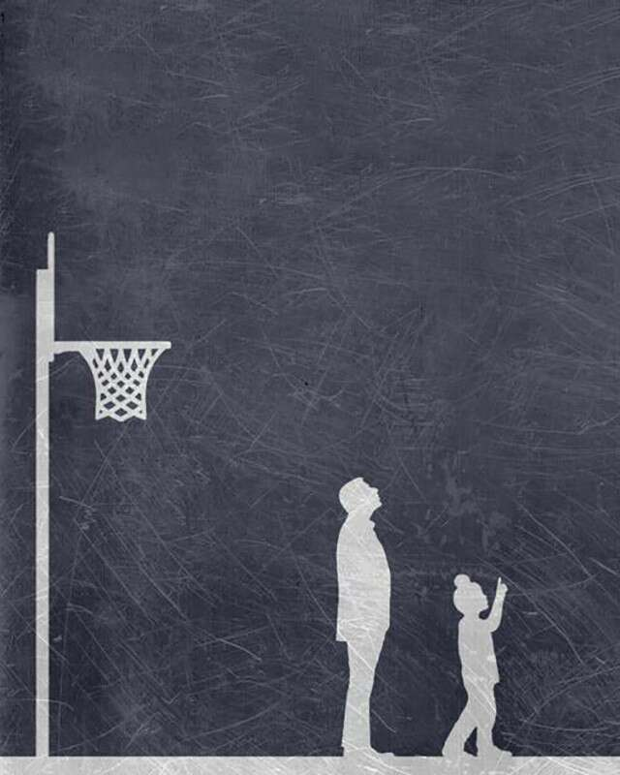

Slide 3
Let’s start with the easy ones.
Shah Rukh Khan had everyone wearing ‘cool’ neck chains and Kajol beat him at basketball.
Yup, Kuch Kuch Hota Hai!

Slide 4


Slide 5
What’s next?
One of our dashing cover girls, Taapsee Pannu says “NO means NO”.
You got it, it’s Pink.

Slide 6
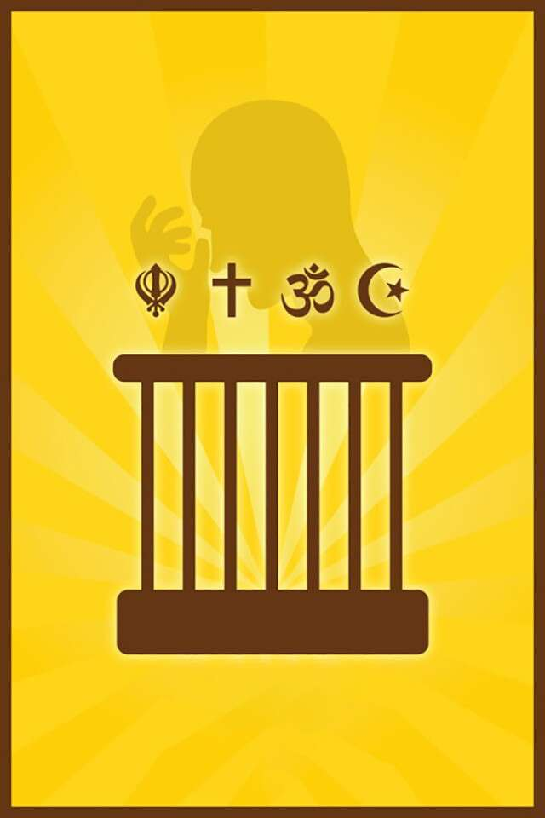

Slide 7
Moving on.
They are all one.
Oh My God!

Slide 8
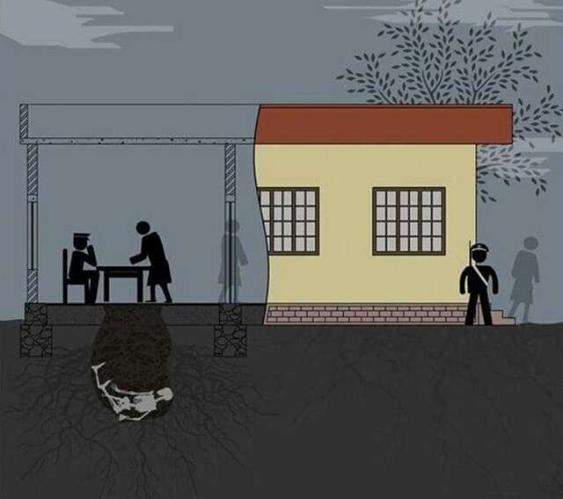

Slide 9
Warming up?
Ajay Devgn with his photographic memory.
Drishyam.

Slide 10
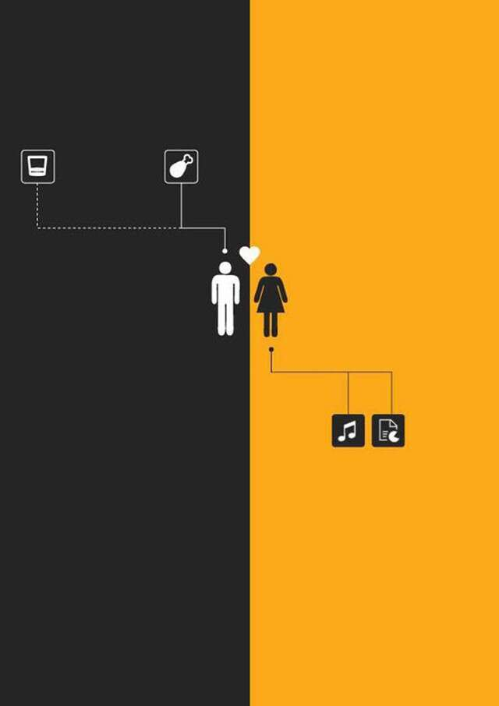

Slide 11
Oh, don’t fret. There are many more.
Arjun Kapoor up north meets Alia Bhatt down south in this Chetan Bhagat biographical story.
2 States.

Slide 12
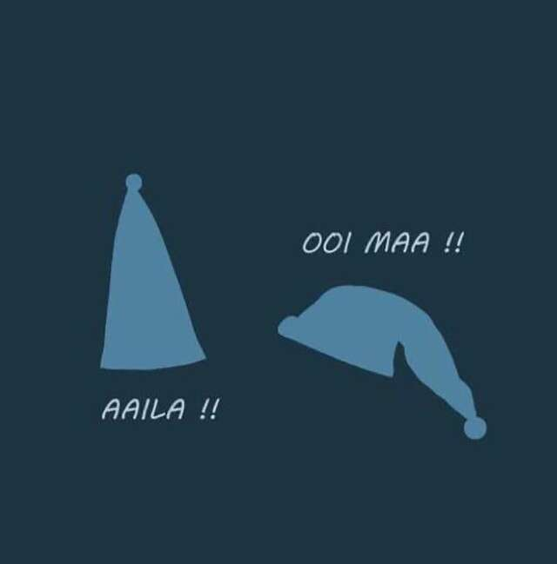

Slide 13
Now for a little bit of old?
Modern classic. Two of the three ruling Khans come together for the first time.
Andaz Apna Apna.

Slide 14
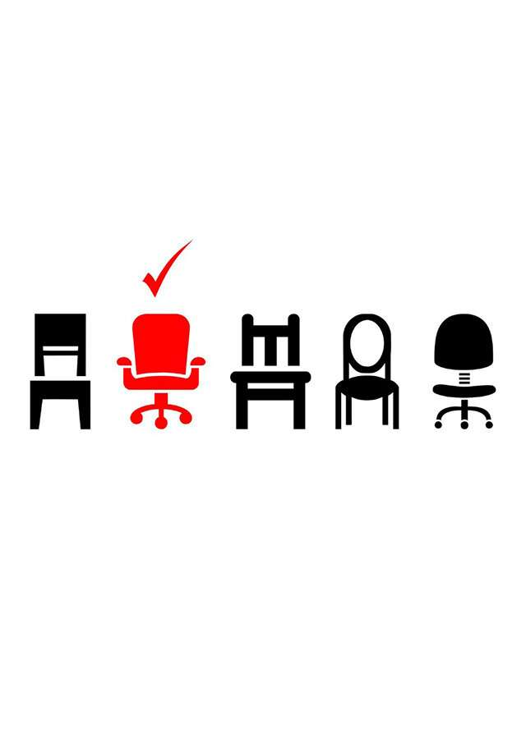

Slide 15
Let’s get on with the slightly tough ones.
“Men are like chairs. A girl must keep changing until she finds a comfortable one.” You need to love your life to know this film.
Dear Zindagi.

Slide 16
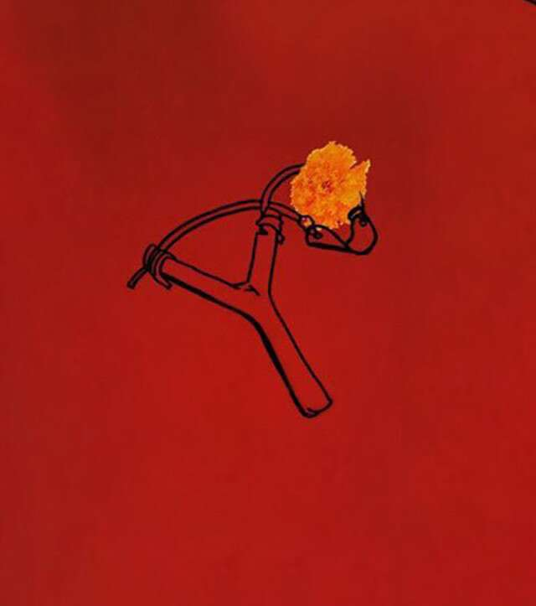

Slide 17
Are you enjoying?
The film broke all records at the box office over 25 years ago. The didis are still wanting their devars to be as endearing.
Hum Aapke Hain Koun…!

Slide 18


Slide 19
Come on, buck up!
This one was so popular, it returned with a sequel.
Hera Pheri.

Slide 20
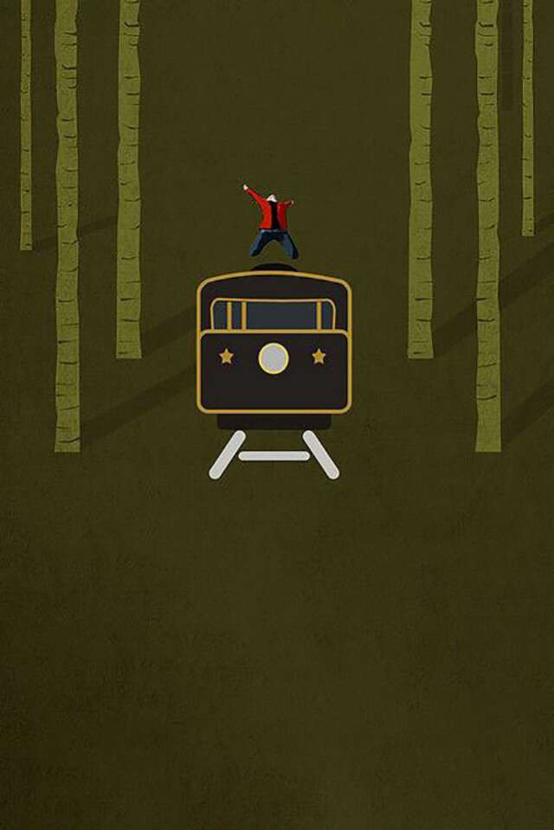

Slide 21
Do you see your family playing this?
You can spot the red jacket atop the train from a mile away.
Shah Rukh Khan going Chhaiyya chhaiyya in Dil Se.

Slide 22
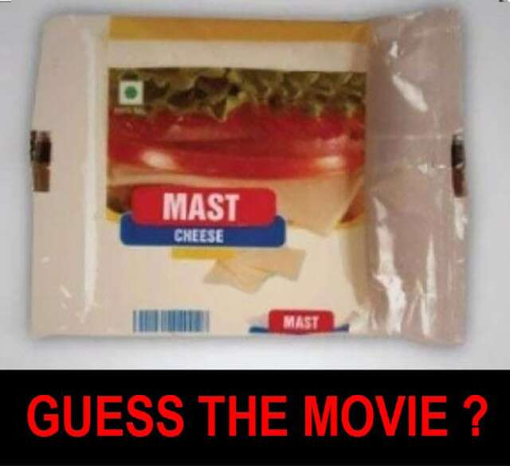

Slide 23
Are you already predicting which your cousins will win?
Need we say more?
Mohra.

Slide 24
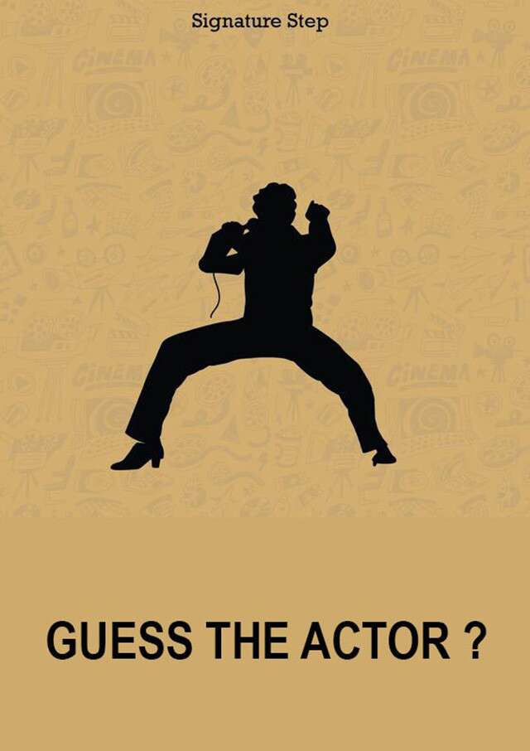

Slide 25
Come on, buck up!
A dancer like Bollywood has never seen and will never see. Bonus points for the cousin who sends in a 20-second video dancing to this tune!
Mithun Chakraborty in Disco Dancer.

Slide 26


Slide 27
A little time for our favourite classics.
Iconic. Must watch.
Gabbar’s dialogue in Sholay.

Slide 28
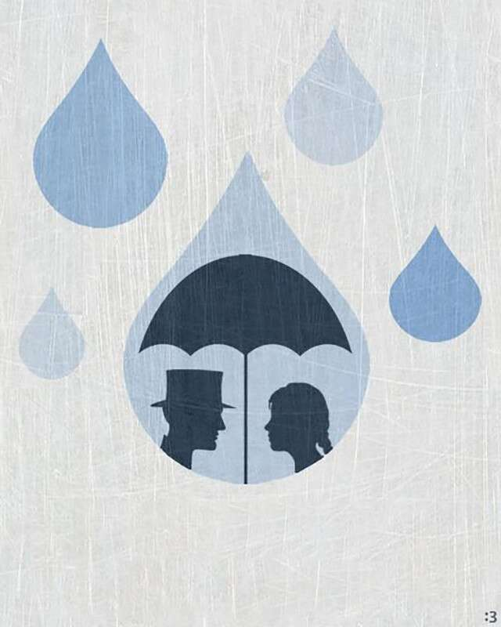

Slide 29
Ready for more?
The original Bollywood pair.
Nargis and Raj Kapoor in Shree 420.

Slide 30


Slide 31
Wait for the next one!
One of the earliest songs on a shikara.
Kashmir Ki Kali.

Slide 32
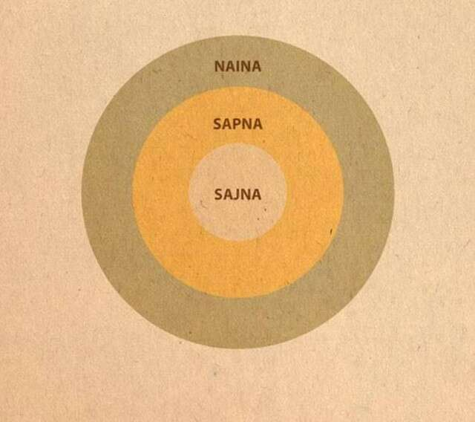

Slide 33
We’re talking of the original one.
Sri Devi and Jeetendra in their best ’80s form.
Himmatwala.

Slide 34
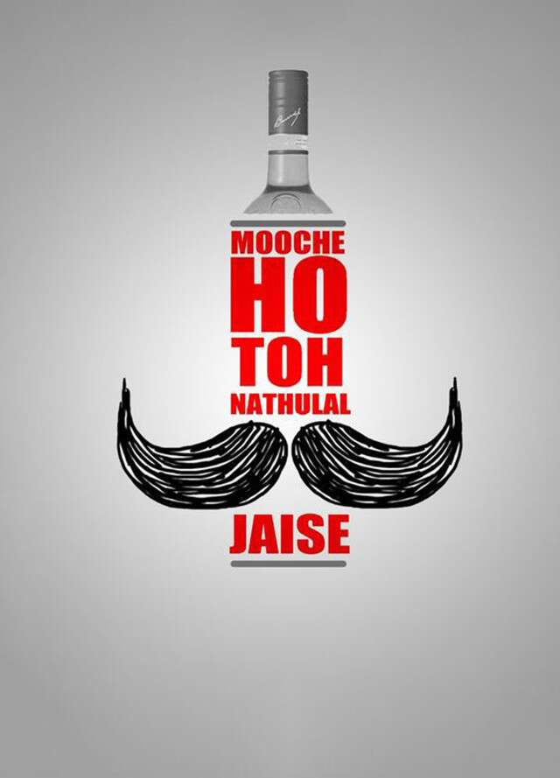

Slide 35
Now for the battle of the champions!
Amitabh Bachchan at his weepy best.
Sharaabi.

Slide 36
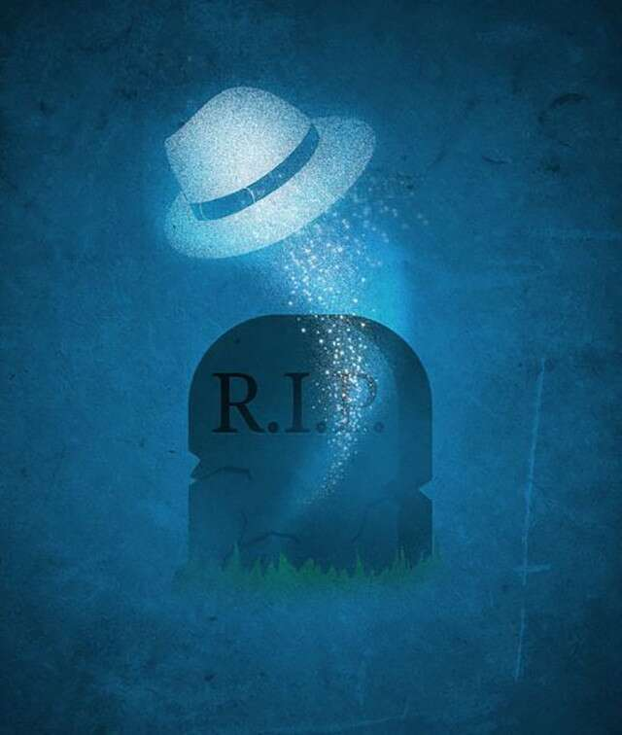

Slide 37
Feel the tricky ones coming in?
Among Shah Rukh Khan’s earliest.
Chamatkar.

Slide 38
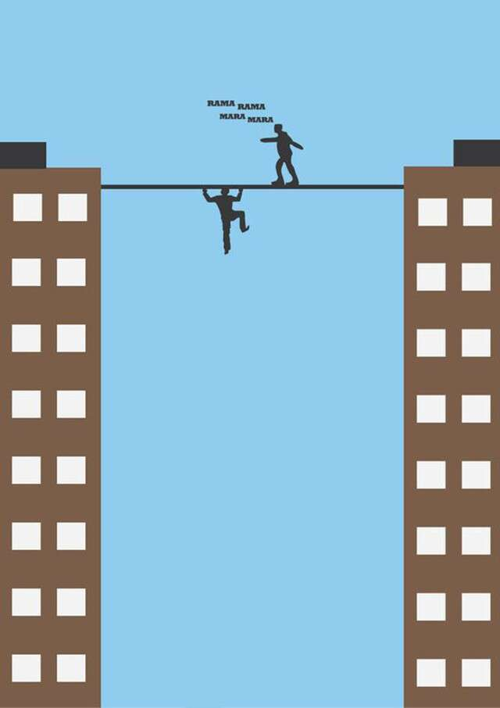

Slide 39
Penultimate one. Get set go.
Out and out entertainer in the first half, tear-jerker in the second.
Ishq.

Slide 40
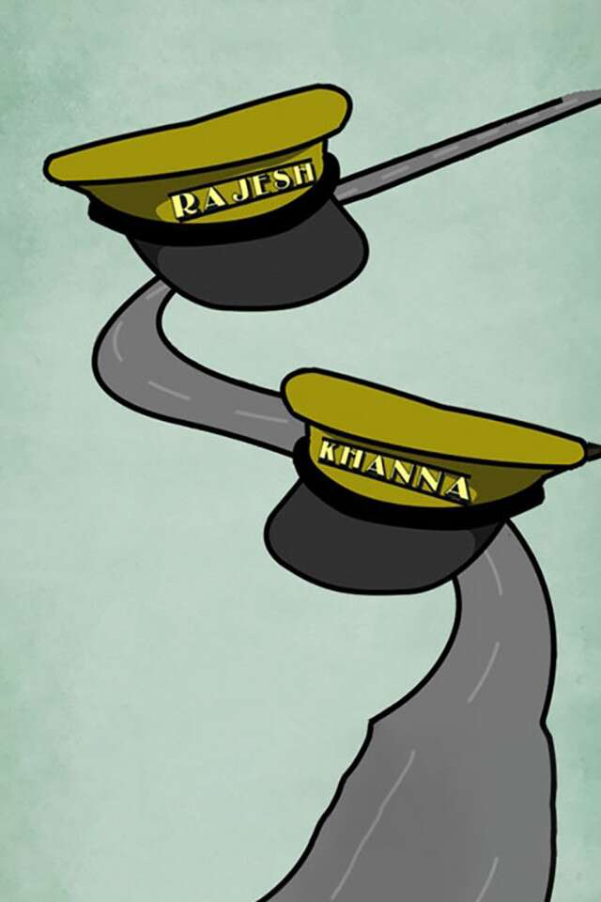

Slide 41
This one is for the best of the best.
Any ideas? Come on, don’t give up!
Bombay To Goa, a road film in which the two main characters are called Rajesh and Khanna, respectively.
So, tell us. Are you game?

