Slide 2
Image Based Plant Disease Detection Using Neural Network
Under the guidance of Dr. Ravi Tomar Sir
Submitted by:
Sahil Talreja
Rohit Singh Yadav
Vivek Raj
Animesh Singh

Slide 3
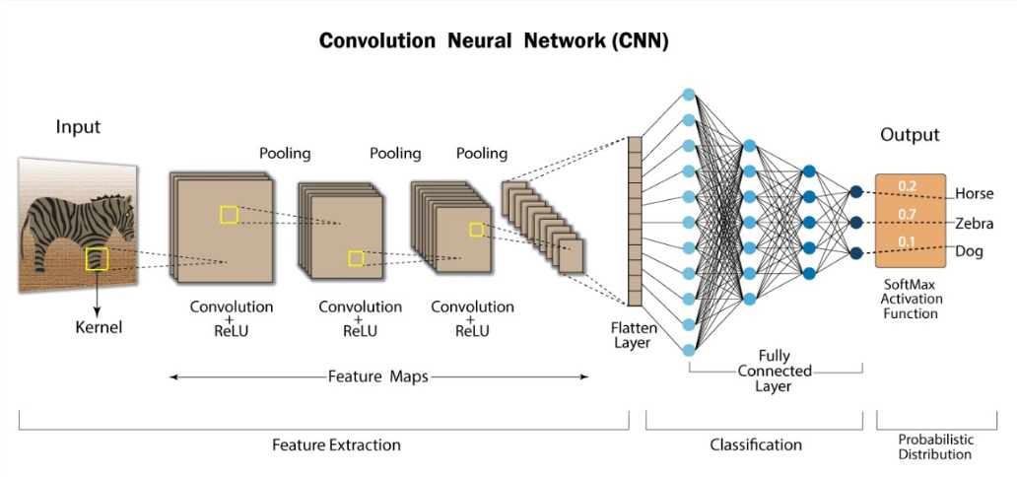
INTRODUCTION

Slide 4
Why CNN?
Deep Neural Network
Designed from Biologically driven models.
How a human eye perceives an image into the brain is in different layer that’s how CNN was designed.
Proven very efficient for all image processing and pattern recognition .

Slide 5
Problem Statements
Farming has always been a key player in GDP with a holding of more than 15.9%. Plant disease have always been a procrastinating threat for farming and indirectly for food security. As the detection has always been done through human eyes (in India from C.E) and most of the time it’s too late which makes them not fit for this kind of detection which requires high persistence. So, to reduce this threat is to design a machine which can detect Visual plant diseases and reduce the continues monitoring job and time for the farmers.

Slide 6
Objective
Main objective is to identify the plant diseases using image processing.
To design such system that can detect crop disease and pest accurately.
Which can reduce the attack of pests by using proper pesticides and remedies.
Give better accuracy of detection.

Slide 7
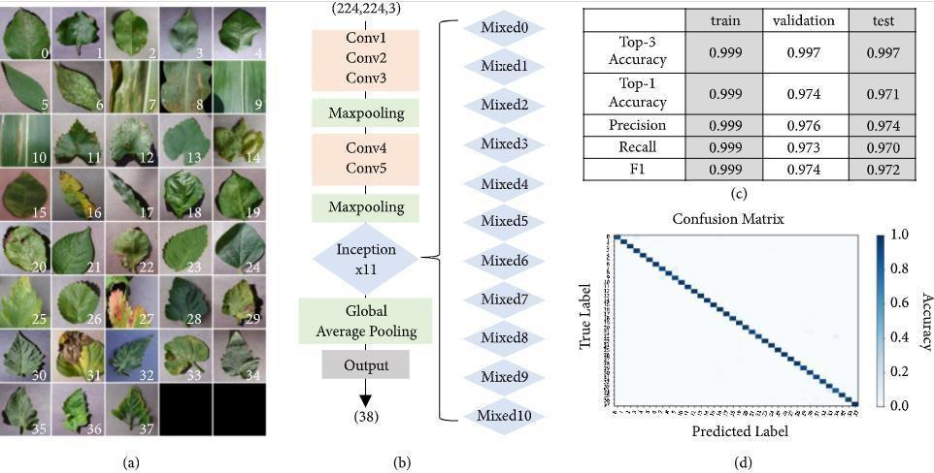
Image-based disease diagnosis training using convolutional neural networks

Slide 8
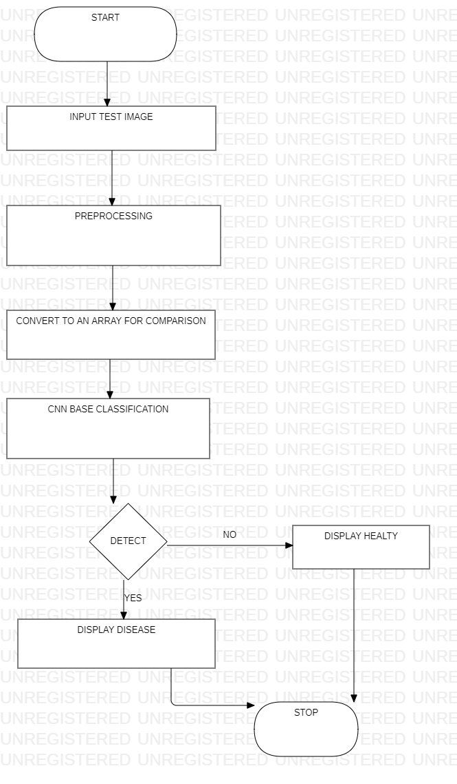
Flow Chart Explaining The Process of Machine

Slide 9
Methodology
Feasible study Phase
Requirement Analysis
Design Phase
Implementation Phase
Testing Phase
Deployment Phase

Slide 10
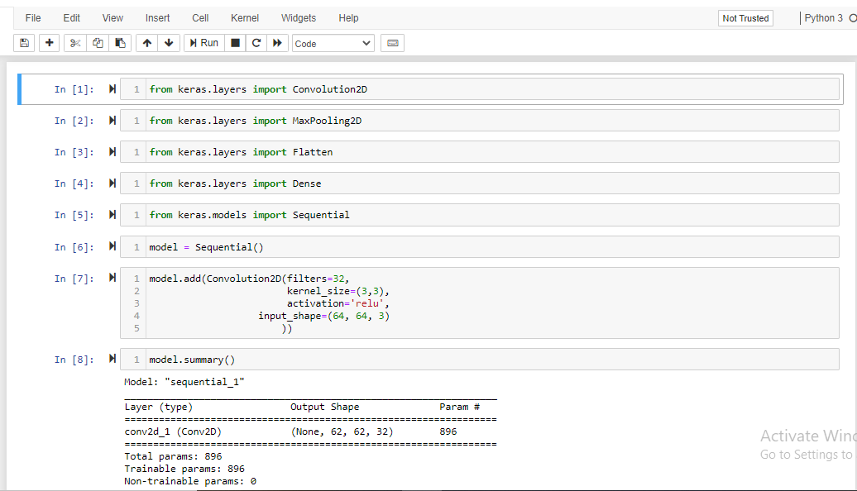
Import Modules

Slide 11

Dataset Folder Location

Slide 12


Slide 13
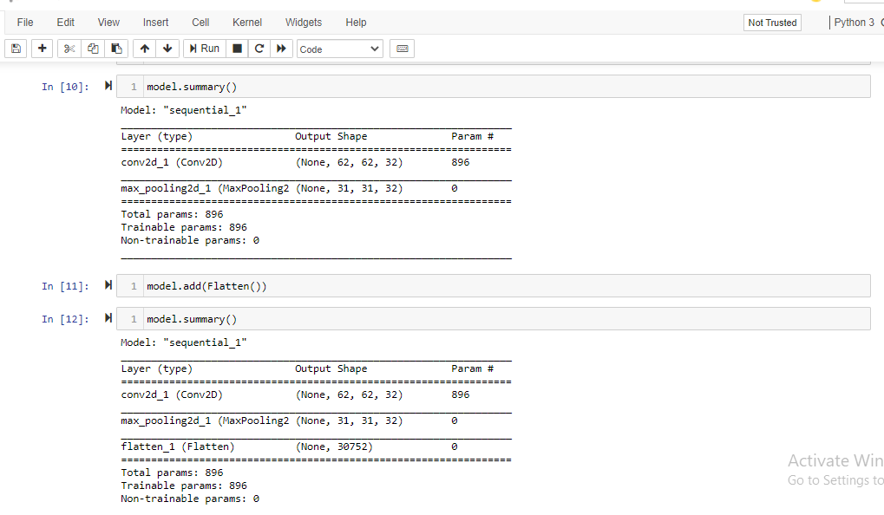
Convolutional Layers

Slide 14
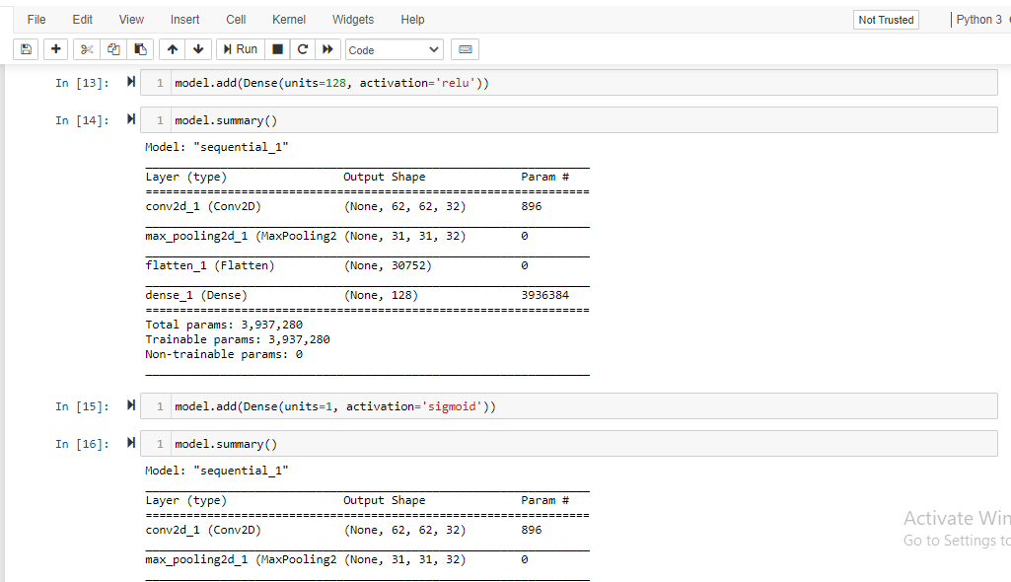

Slide 15
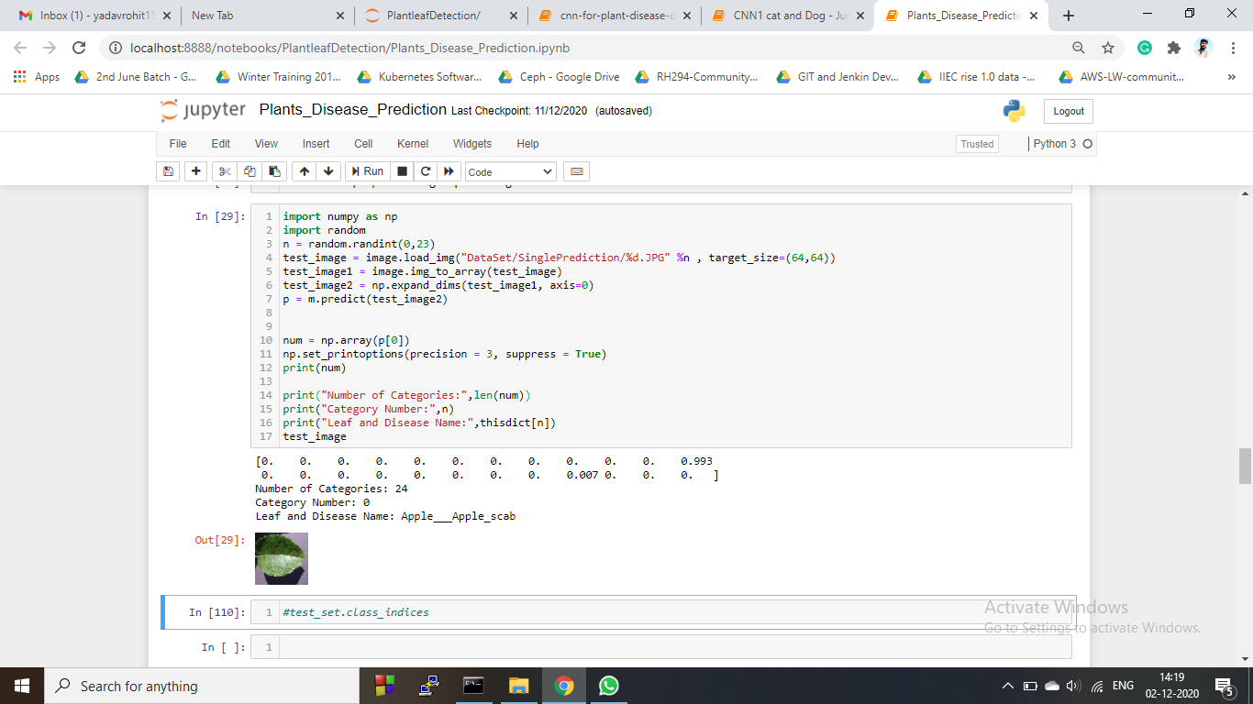
Some Predicted Output Of The Machine

Slide 16


