Slide 1
Credit Card Fraud Detection Using Machine Learning(E-commerce)
MSc. Business Analytics
Dublin Business School
Supervisor: Ms. Mina Ghahremanzamaneh
Made By： Rohit Verma
10635420
Notes:
N

Slide 2
CONTENTS
Introduction
Research Focus
Methodology
Model Implementation
Model Selection
Key Features
Results
Conclusion

Slide 3

Introduction
Welcome to our presentation on tackling one of the most critical challenges in today's e-commerce landscape: credit card fraud detection. As the realm of online transactions continues to expand, ensuring the security and integrity of these transactions has become paramount.
In this we delve into an investigative study centered around leveraging the power of machine learning algorithms to combat credit card fraud within the dynamic environment of e-commerce transactions.

Slide 4

Research Focus
The central focus of our study revolves around the application of machine learning techniques to detect fraudulent transaction activities.
Our investigation is on the dataset from Kaggle, encompassing diverse attributes such as time-series information, transaction amounts, and a wide array of features (V1-V28).

Slide 5

Methodology
We have employed five machine learning models- Naive Bayes, Logistic Regression, Random Forest, Stacking Classifier, and Xgboost, to scrutinize and tackle the issue of credit card fraud.
Our approach begins with a thorough exploratory data analysis phase, delving into the distribution patterns of classes, transaction amounts, and temporal aspects within the dataset.

Slide 6

Model Implementation
Our study elucidates the implementation process of each machine-learning model. This includes data preprocessing, feature scaling, and model training phases.
Our evaluation strategy involves an in-depth analysis of model performance using key metrics such as accuracy, precision, recall, and F1-score, shedding light on the distinctive strengths and limitations of each model.

Slide 7

Key points:
Accuracy is a good measure when classes are balanced, but it might not be the best metric when dealing with imbalanced datasets.
Precision focuses on the positive class prediction accuracy and is useful when the cost of false positives is high.
Recall focuses on how many of the actual positives were captured by the model and is important when missing positive instances is costly.
F1 Score balances precision and recall, making it a suitable metric when there is an uneven class distribution or an equal emphasis on both precision and recall.

Slide 8
Model Selection
In the model selection process, we aimed to identify the best-performing machine learning algorithm for credit card fraudulent and non-fraudulent transactions based on the preprocessed dataset.
Five models were considered for evaluation: Logistic Regression, Naïve Bayes, Random Forest Classifier, Stacking Classifier and Xgboost. Each of these models offers distinct characteristics and learning capabilities, making them suitable candidates for predicting patterns.

Slide 9
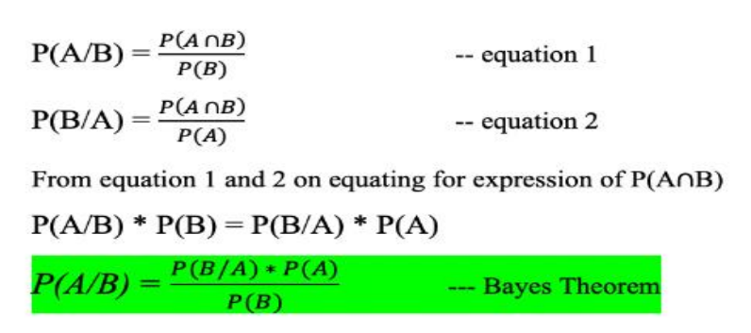
Naive Bayes Classifier:
It is a probabilistic classification algorithm known for its simplicity and efficiency in handling large datasets. This model relies on Bayes' theorem of probability to make predictions by assuming independence among features. Naive Bayes offers computational efficiency and speed, making it suitable for real-time analysis. However, its simplistic nature might lead to oversimplified representations of complex relationships in the data, potentially affecting performance in scenarios with highly correlated features.

Slide 10
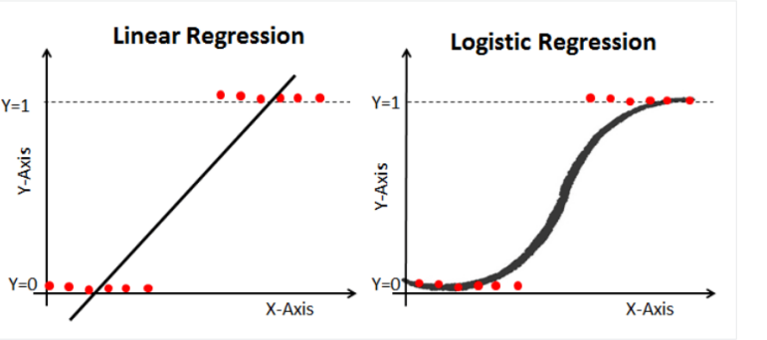
Logistic Regression:
It is a widely used statistical technique for binary classification tasks. Despite its name, it's used for classification, not regression. It models the relationship between the dependent variable and one or more independent variables by estimating probabilities using a logistic function. In credit card fraud detection, Logistic Regression provides interpretable results and works well with linearly separable data. However, its performance might be limited when dealing with complex non-linear relationships in highly-dimensional datasets.

Slide 11
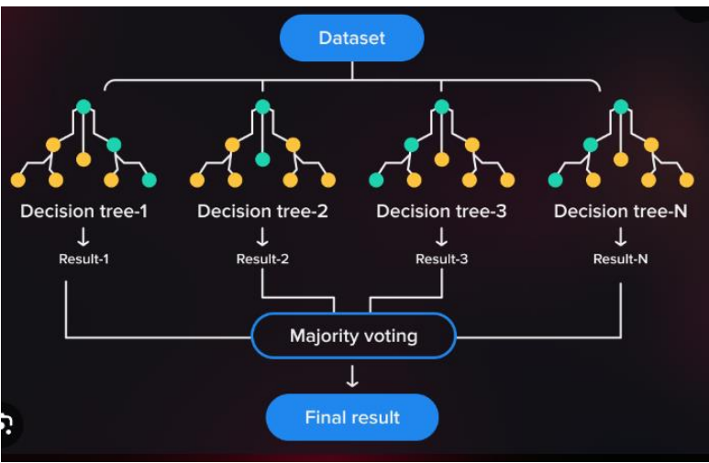
Random Forest Classifier:
An ensemble learning method that constructs multiple decision trees during training and combines their predictions through voting or averaging to make more accurate predictions. It excels in handling high-dimensional datasets and provides robustness against overfitting. In credit card fraud detection, Random Forests offer high accuracy, resilience to noise, and the ability to capture non-linear relationships between features.

Slide 12
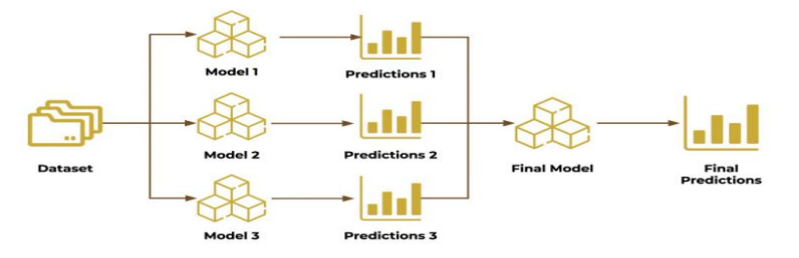
Stacking Classifier:
This is a meta-algorithm that combines multiple classification models to improve prediction accuracy. It involves training several base models and using another model (meta-learner) to learn how to best combine their predictions. In credit card fraud detection, Stacking Classifiers aim to leverage the strengths of diverse models, potentially yielding superior performance by learning to weigh the predictions of individual models effectively.

Slide 13
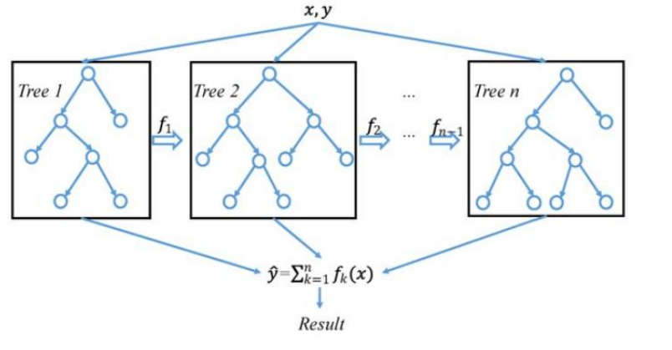
Xgboost (Extreme Gradient Boosting):
Xgboost is an ensemble learning technique that boosts the performance of weak learners (decision trees in this case) by sequentially training them to correct errors made by the previous models. It excels in both regression and classification tasks, offering high prediction accuracy and efficiency. In credit card fraud detection, Xgboost stands out for its exceptional performance, handling non-linear relationships, and robustness against overfitting

Slide 14
Key Differences:
Approach: Naive Bayes uses probabilistic assumptions, Logistic Regression models probabilities linearly, Random Forest and XGBoost use ensemble methods, and Stacking combines predictions of multiple models.
Handling Non-linearity: Random Forest, XGBoost, and Stacking can handle non-linear relationships, while Naive Bayes and Logistic Regression assume linear relationships.
Performance: Random Forest, XGBoost, and Stacking often outperform Naive Bayes and Logistic Regression, especially in complex datasets, but might require more computational resources.
Interpretability: Naive Bayes and Logistic Regression are more interpretable, while Random Forest, XGBoost, and Stacking models are more complex and harder to interpret.

Slide 15

Results:
The performance exhibited by the Stacking classifier, Random Forest, and Xgboost models showcased remarkable accuracy and precision in distinguishing fraudulent transactions. These models encountered minimal false negatives, highlighting their superior overall performance in accurately identifying and classifying fraudulent activities compared to other classifiers.

Slide 16
The evaluation and comparison of various machine learning models, including the Stacking classifier, Random Forest, and Xgboost, for credit card fraud detection, underscore their significant potential in bolstering financial security. These models exhibited exceptional accuracy, and precision, and minimized false negatives in identifying fraudulent transactions, surpassing many other classifiers. Their robust performance signifies a promising path forward in combating fraudulent activities within the intricate landscape of financial transactions.
Conclusion:

Slide 17

THANK YOU

