Slide 1
React native Architecture
by Dr. DSR Murthy

Slide 2

React Native Architecture - Fabric
Fabric is React Native's new rendering system, a conceptual evolution of the legacy render system. The core principles are to unify more render logic in C++,
improve interoperability with host platforms, and to unlock new capabilities
for React Native.
.

Slide 3
React Native Architecture - Fabric
Benefits of Fabric:
- Code quality, performance and extensibility.
- type safety
- Shared C++ code between host view and react view.
- Better host platform interop. (Android/IOS/Web)
- improved performance with consistency
- faster start-up
- less serialization of data between js and host platform.
- Improved interop between host view and react view with async. rendering
- support multi-priority and sync. events.
- Integration with React suspense more intuitive design
- Enable react concurrent feature on react native.
- Easy implementation of server side rendering.

Slide 4
Render – Commit - Mount
The React Native renderer goes through a sequence of work to
render React logic to a host platform. This sequence of work is called the
render pipeline and occurs for initial renders and updates to the UI state.

Slide 5
Render – Commit - Mount
The render pipeline can be broken into three phases:
Render: React executes product logic which creates a React Element Trees in JavaScript. From this tree, the renderer creates a React Shadow Tree in C++.
Commit: After a React Shadow Tree is fully created, the renderer triggers a commit.
This promotes both the React Element Tree and the newly created React Shadow Tree as the “next tree” to be mounted. This also schedules calculation of its layout
information.
Mount: The React Shadow Tree, now with the results of layout calculation,
is transformed into a Host View Tree.
React Native in the Facebook app is backed by the new renderer.

Slide 6
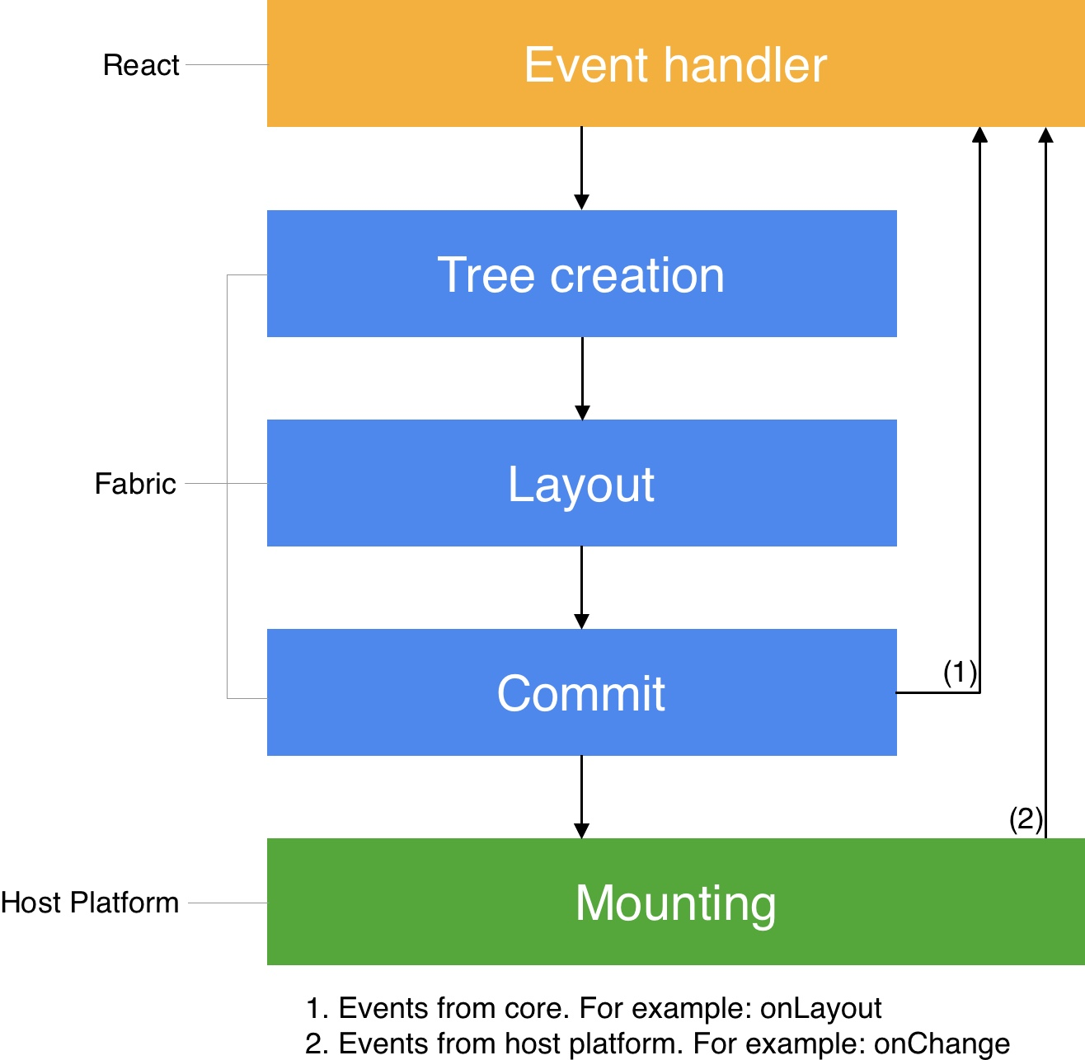
Render – Commit - Mount

Slide 7
Initial Render
For example, <MyComponent /> is a React Element.
React recursively reduces this React Element to a terminal React Host Component by invoking it (or its render method if implemented with a JavaScript class) until every React Element cannot be reduced any further.
Now we have a React Element Tree of React Host Components.
https://reactnative.dev/architecture/render-pipeline

Slide 8
Phase1 : Render
During this process of element reduction, as each React Element is invoked, the renderer also synchronously creates a React Shadow Node. The <View> leads to the creation of a ViewShadowNode object, and the <Text> leads to the creation of a TextShadowNode object.
Whenever React creates a parent-child relationship between two React Element Nodes, the renderer creates the same relationship between the corresponding React Shadow Nodes. This is how the React Shadow Tree is assembled.
The React Shadow Tree is immutable. (Clone done for every update)

Slide 9
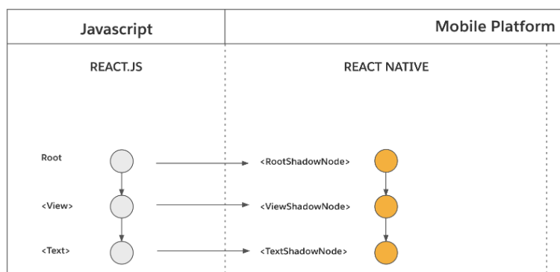
Phase1 : Render

Slide 10
Phase2 : Commit
The commit phase consists of two operations: Layout Calculation and Tree Promotion.
Layout Calculation: This operation calculates the position and size of each React Shadow Node. In React Native, this involves invoking Yoga to calculate the layout of each React Shadow Node. The actual calculation requires each React Shadow Node’s styles which originate from a React Element in JavaScript. It also requires the layout constraints of the root of the React Shadow Tree, which determines the amount of available space that the resulting nodes can occupy.

Slide 11
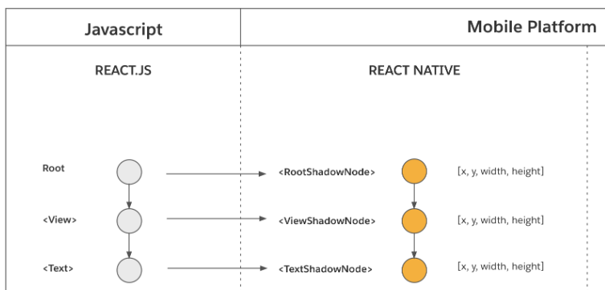
Phase2 : Commit

Slide 12
Phase2 : Commit – Tree Promotion
Tree Promotion (New Tree → Next Tree): This operation promotes the new React Shadow Tree as the “next tree” to be mounted. This promotion indicates that the new React Shadow Tree has all the information to be mounted and represents the latest state of the React Element Tree. The “next tree” mounts on the next “tick” of the UI Thread.
These operations are asynchronously executed on a background thread.
All the calculations entirely executes in C++ with host platform layer for interop.

Slide 13
Phase2 : Mount
The mount phase transforms the React Shadow Tree (which now contains data from layout calculation) into a Host View Tree with rendered pixels on the screen.
React element tree:
<View> <Text>Welcome to React Native</Text> </View>

Slide 14
Phase2 : Mount
At a high level, React Native renderer creates a corresponding Host View for each React Shadow Node and mounts it on screen.
In the example above, the renderer creates an instance of android.view.ViewGroup for the <View> and android.widget.TextView for <Text> and populates it with “Welcome to React Native”.
Similarly for iOS a UIView is created with and text is populated with a call to NSLayoutManager. Each host view is then configured to use props from its React Shadow Node, and its size and position is configured using the calculated layout information.

Slide 15
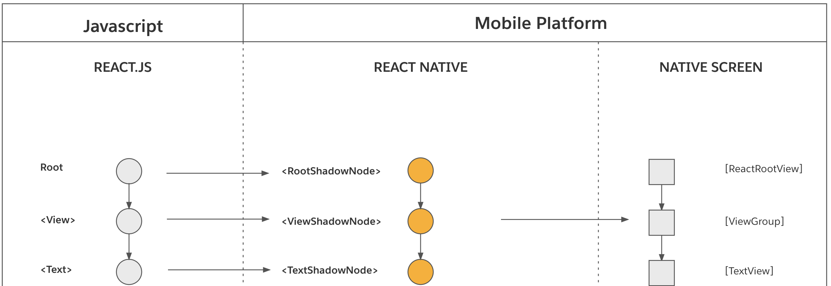
Phase2 : Mount

Slide 16
Phase2 : Mount
Tree Diffing: This step computes the diff between the “previously rendered tree” and the “next tree” entirely in C++. The result is a list of atomic mutation operations to be performed on host views. This step is also where the React Shadow Tree is flattened to avoid creating unnecessary host views.
Tree Promotion (Next Tree → Rendered Tree): This step atomically promotes the “next tree” to “previously rendered tree” so that the next mount phase computes a diff against the proper tree.
View Mounting: This step applies the atomic mutation operations onto corresponding host views. This step executes in the host platform on UI thread.

Slide 17
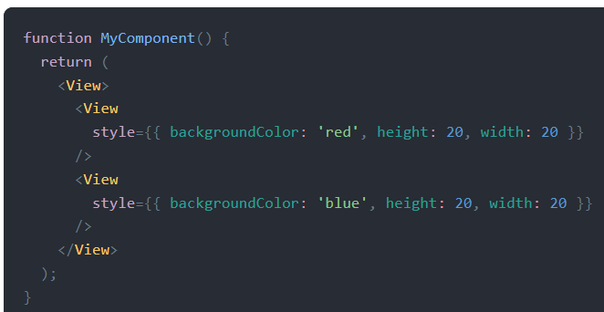
Phase2 : React State Updates

Slide 18
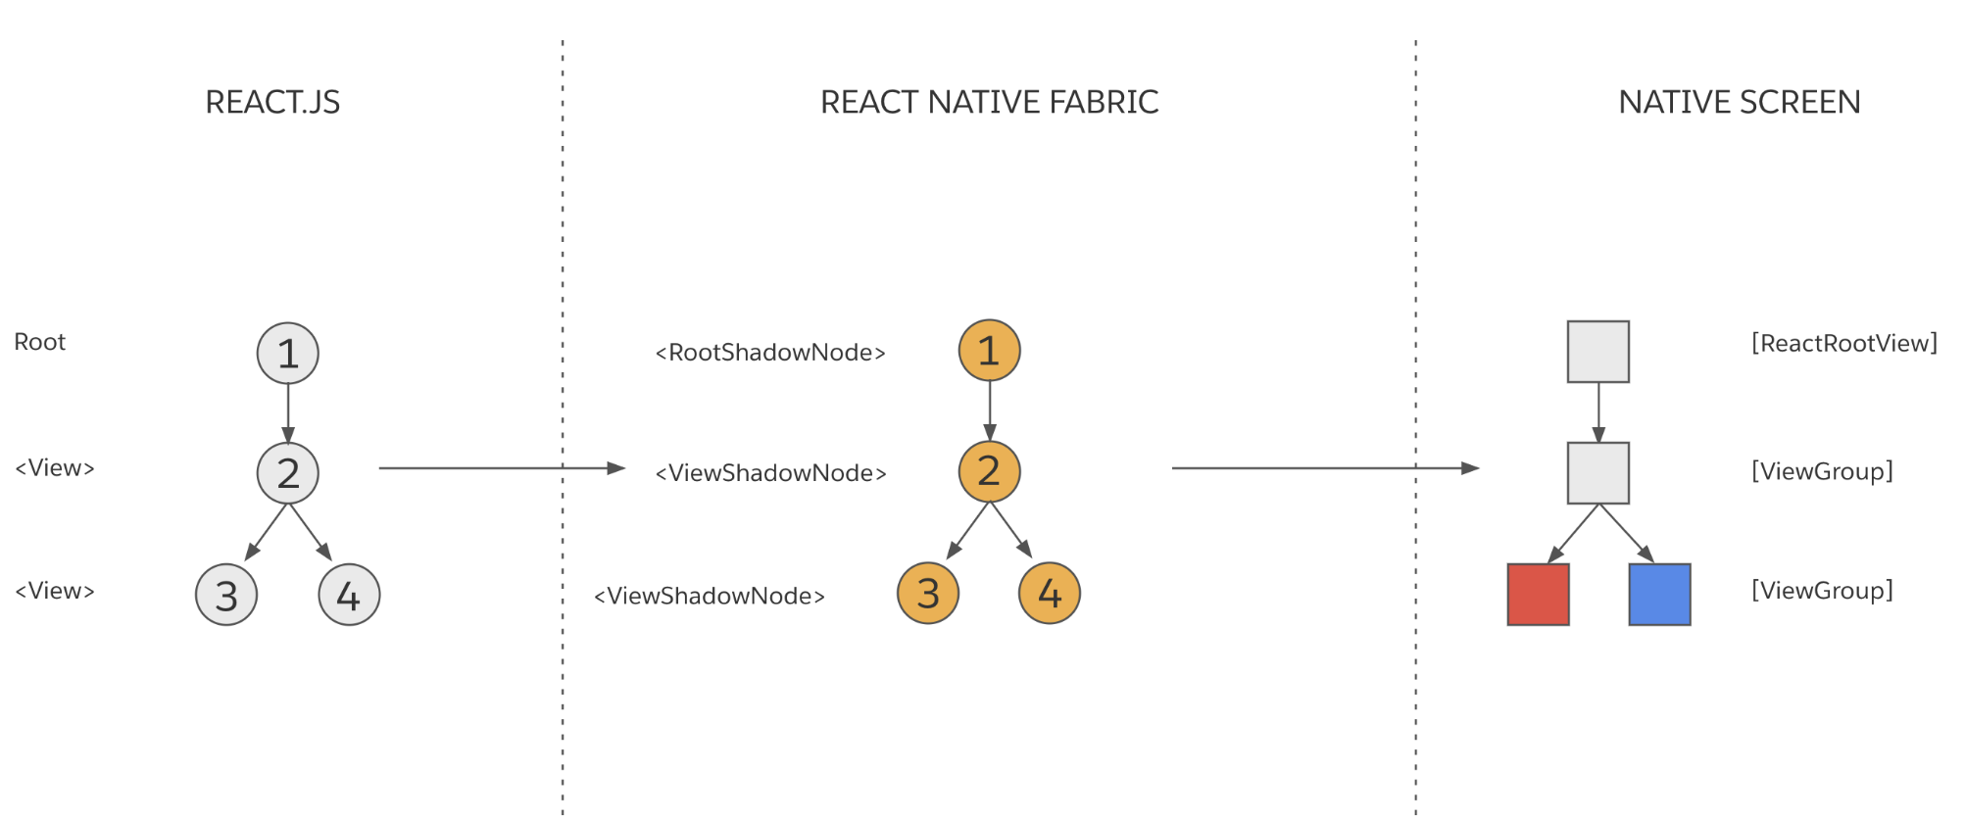
Phase2 : React State Updates
Notice that Node 3 maps to a host view with a red background, and Node 4 maps to a host view with a blue background. Assume that as the result of a state update in JavaScript product logic, the background of the first nested <View> changes from 'red' to 'yellow'. This is what the new React Element Tree might look:

Slide 19
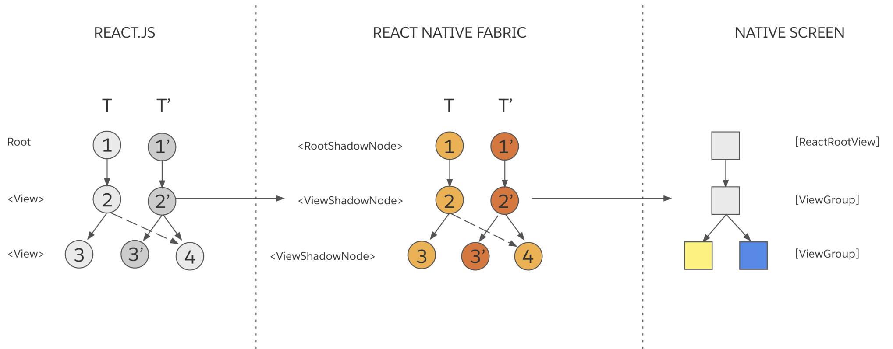
Phase2 : React State Updates
<View style={{ backgroundColor: 'yellow', height: 20, width: 20 }}/> <View style={{ backgroundColor: 'blue', height: 20, width: 20 }} />

Slide 20
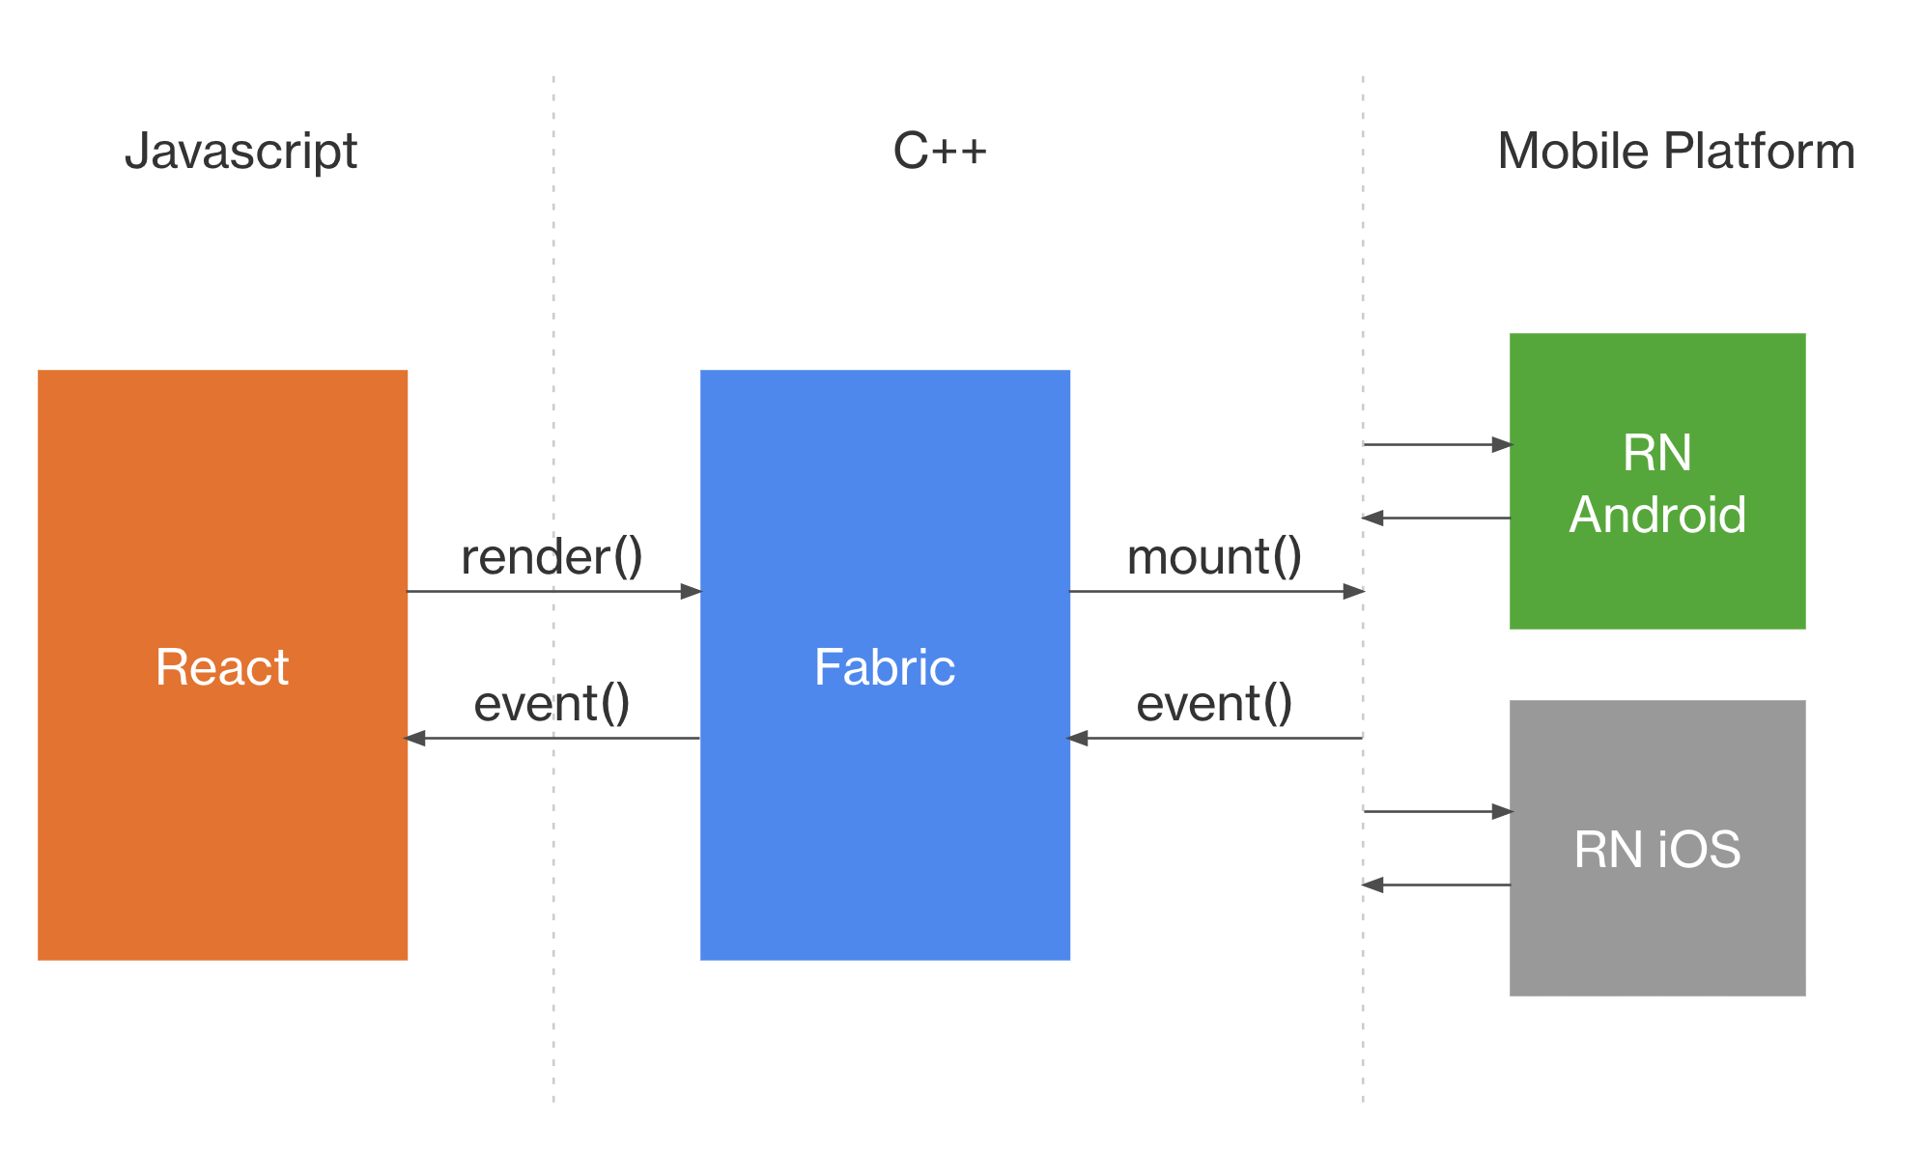
Platform interop
https://reactnative.dev/architecture/xplat-implementation

Slide 21
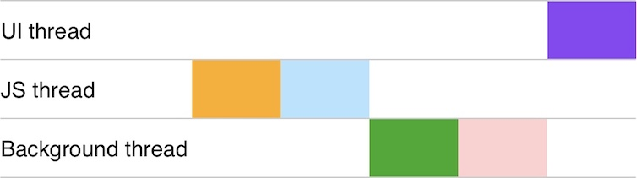
For Thread Model visit
https://reactnative.dev/architecture/xplat-implementation

