Slide 1
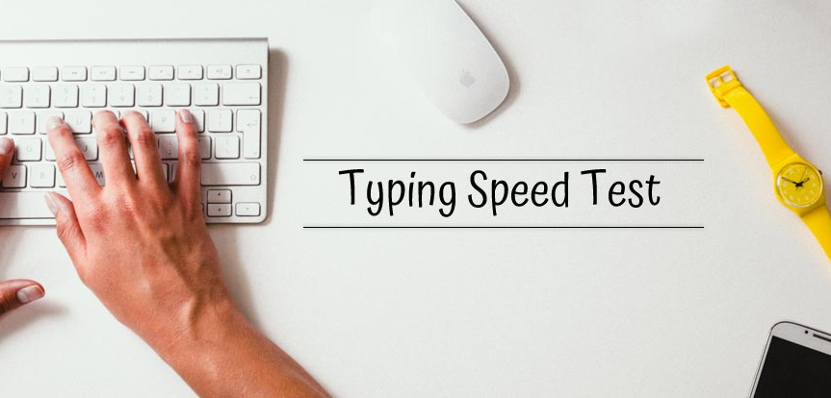

Slide 2
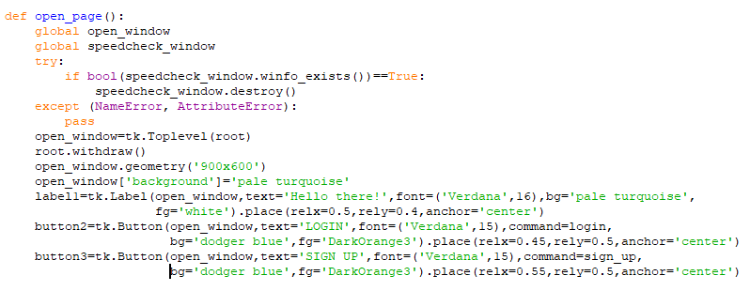
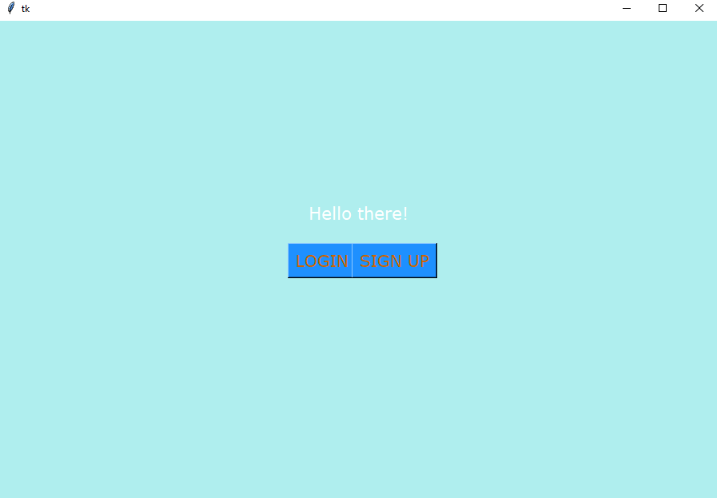
THE FIRST WINDOW
CODE
OUTPUT

Slide 3
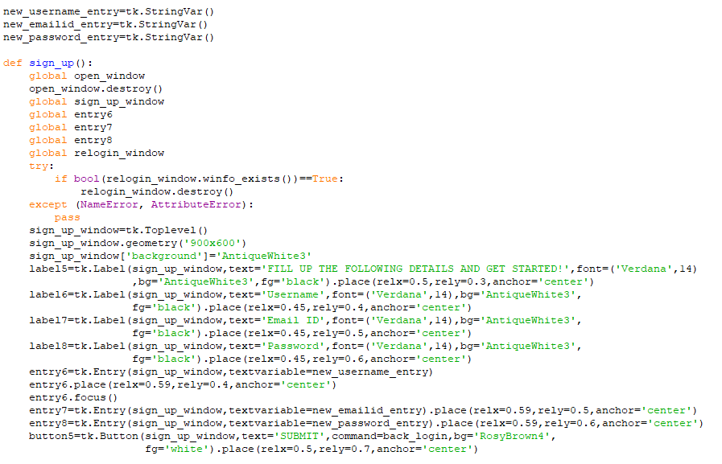
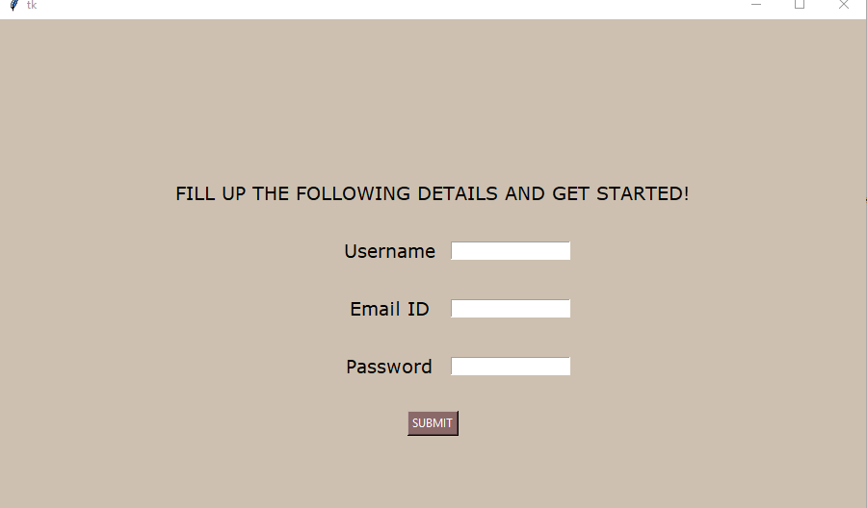
IF ‘SIGN UP’ BUTTON IS SELECTED
CODE
OUTPUT

Slide 4
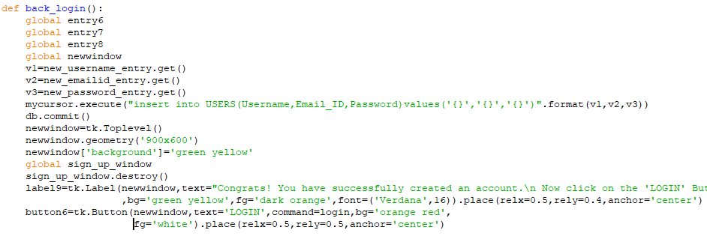
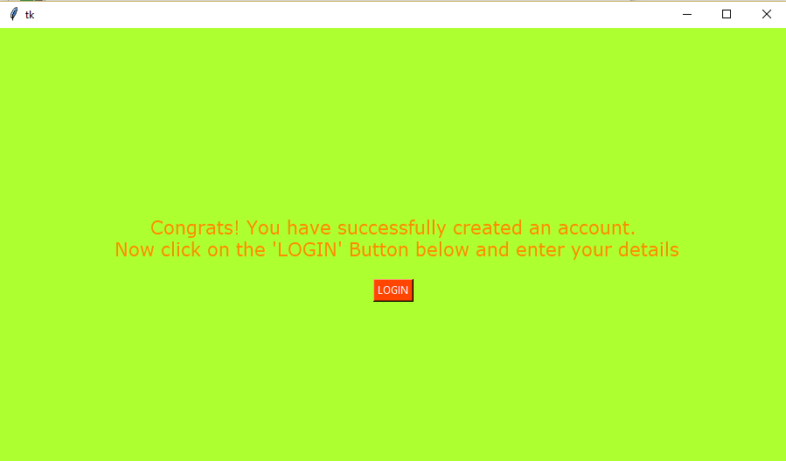
AFTER CREATING AN ACCOUNT YOU GET THIS MESSAGE
CODE
OUTPUT

Slide 5
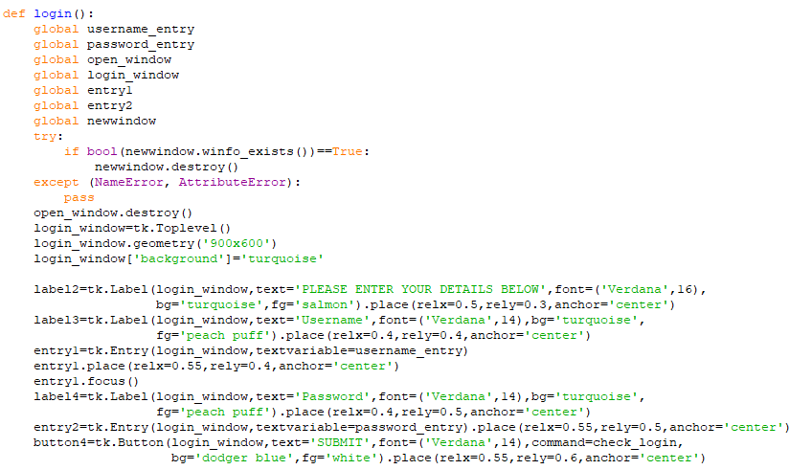
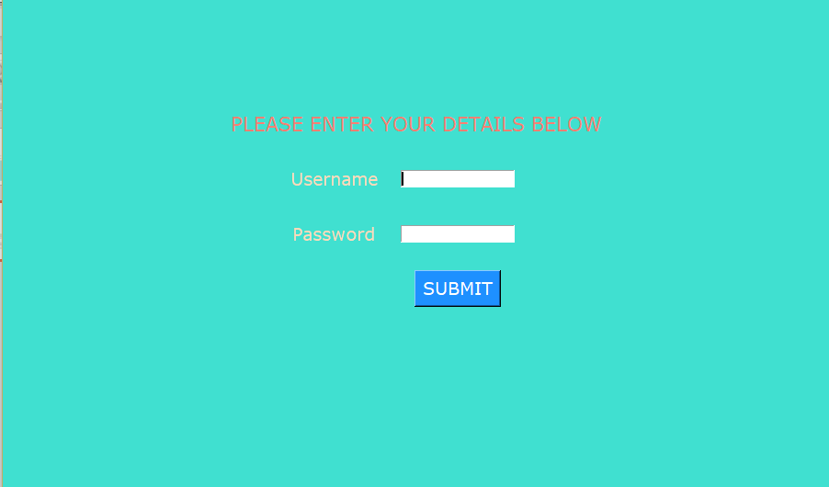
ON THE PRESS OF LOGIN [EITHER IN SLIDE 2 OR 4] THIS CODE IS IMPLEMENTED
CODE
OUTPUT

Slide 6
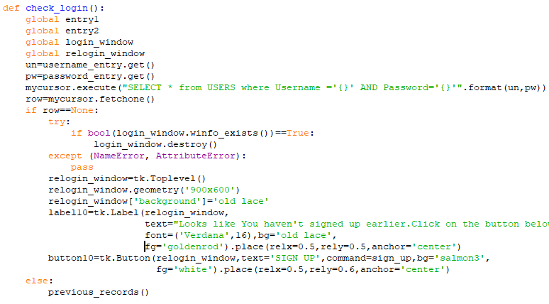
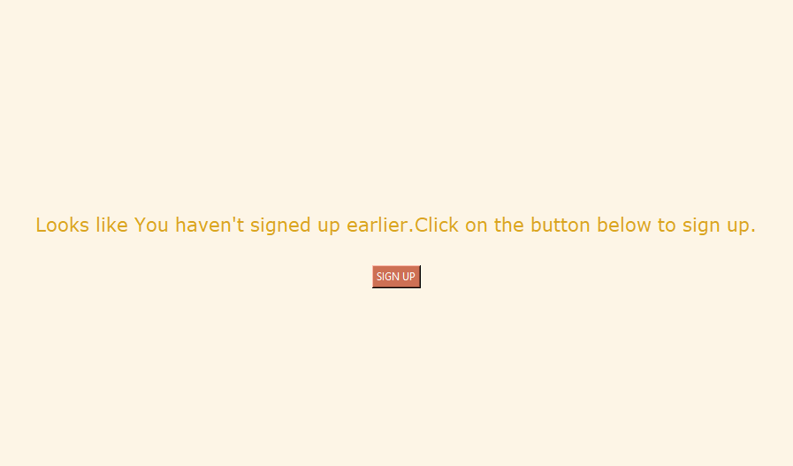
ONCE YOU ENTER YOUR USERNAME AND PASSWORD, THIS CODE CHECKS WHETHER THE ACCOUNT EXISTS,
IF IT DOESN’T EXISTS, IT GIVES THE FOLLOWING OUTPUT AND THE USER NEEDS TO SIGN UP AGAIN[FROM SLIDE3] ELSE, NEXT SLIDE
CODE
OUTPUT

Slide 7
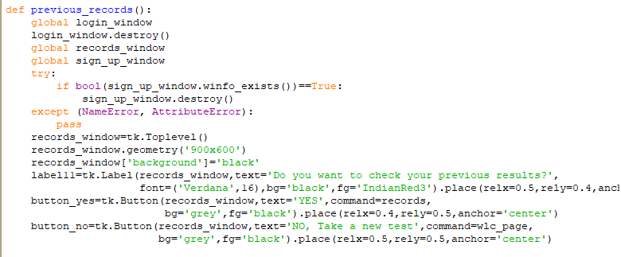
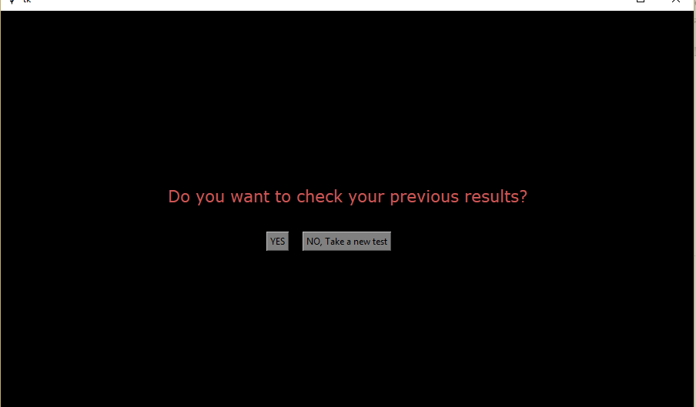
IF THE ACCOUNT EXISTS, THEN YOU CAN CHECK YOUR PREVIOUS RESULTS ELSE, SELECT ‘NO,Take new test’
CODE
OUTPUT

Slide 8
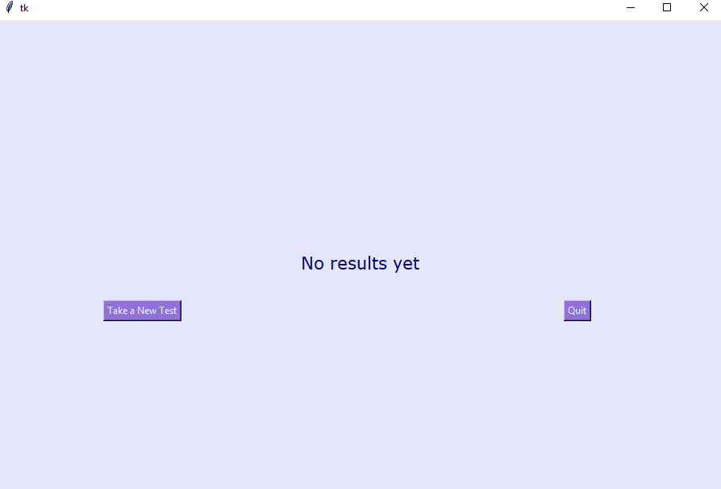
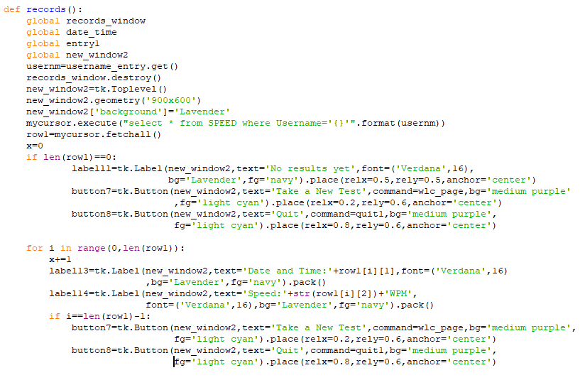
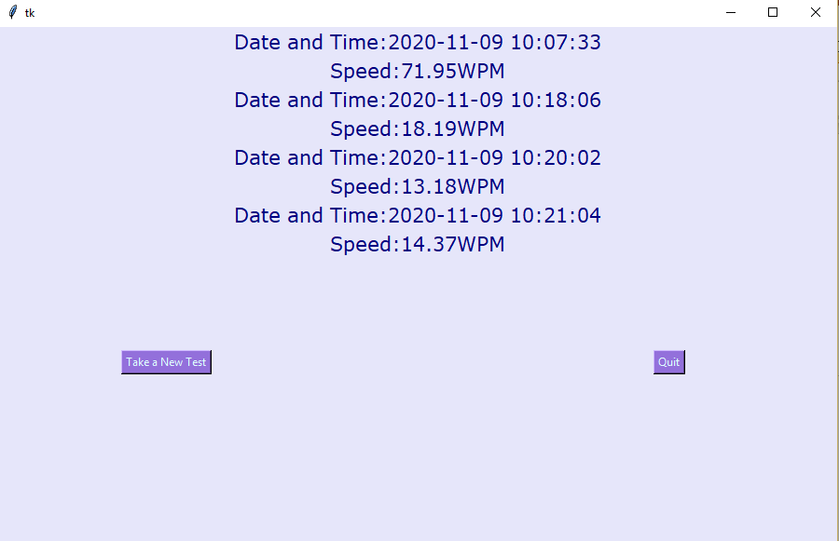
IF ‘YES’ WAS SELECTED IN PREVIOUS SLIDE, THIS IS THE OUTPUT
CODE
OUTPUTS
(IF NO PREVIOUS RECORDS)

Slide 9
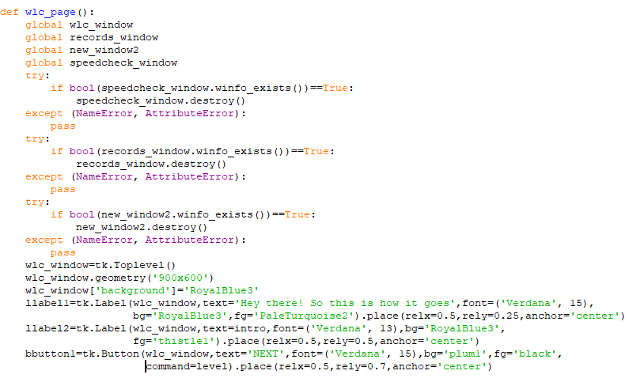
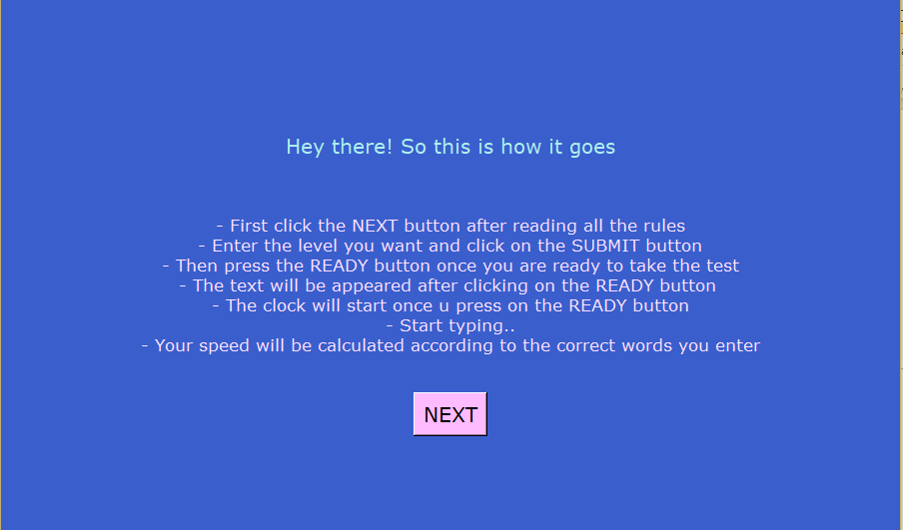
ON THE PRESS OF ‘Take a New Test’, THIS IS THE OUTPUT[SLIDE 8]
ALSO WHEN YOU PRESS ‘NO, Take a new test’ [SLIDE 7]
CODE
OUTPUT

Slide 10
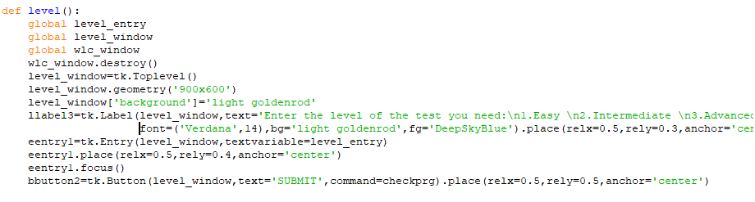
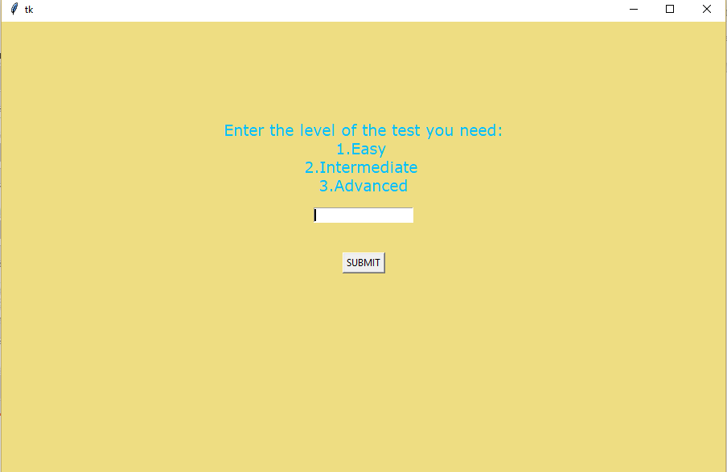
AFTER SELECTING ‘NEXT’ THE USER NEEDS TO ENTER THE LEVEL OF THE TEST THEY WANT
CODE
OUTPUT

Slide 11

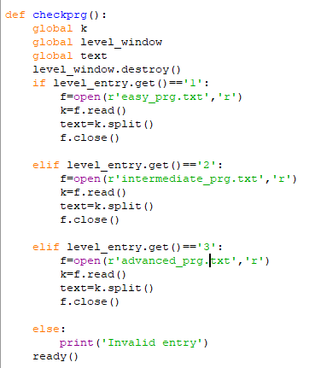
THIS PART OF THE CODE CHECKS WHETHER THE INPUT IS VALID

Slide 12
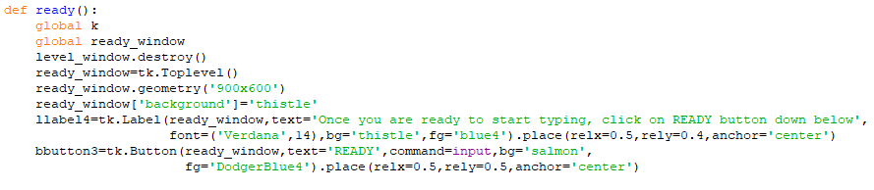
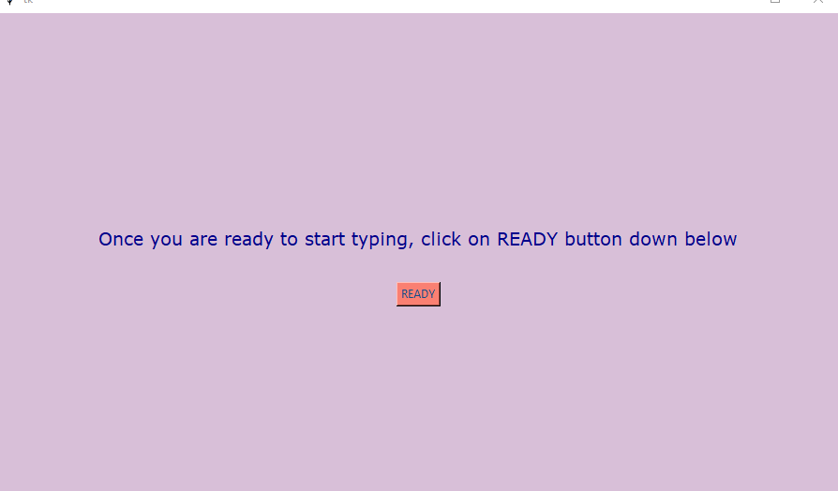
AFTER SELECTING THE LEVEL, THE USER NEEDS TO SELECT READY TO START THE TEST
CODE
OUTPUT

Slide 13
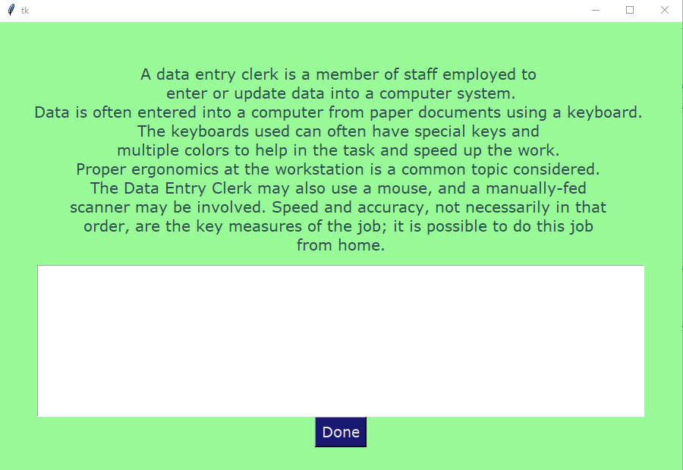
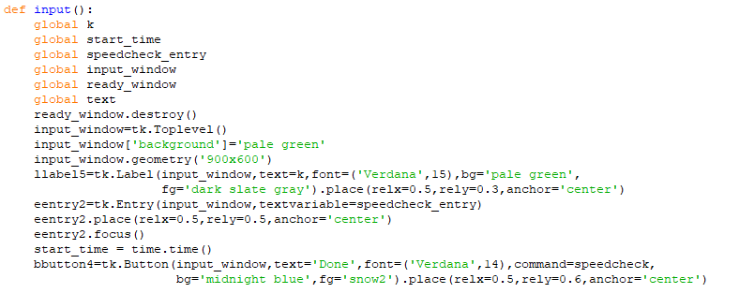
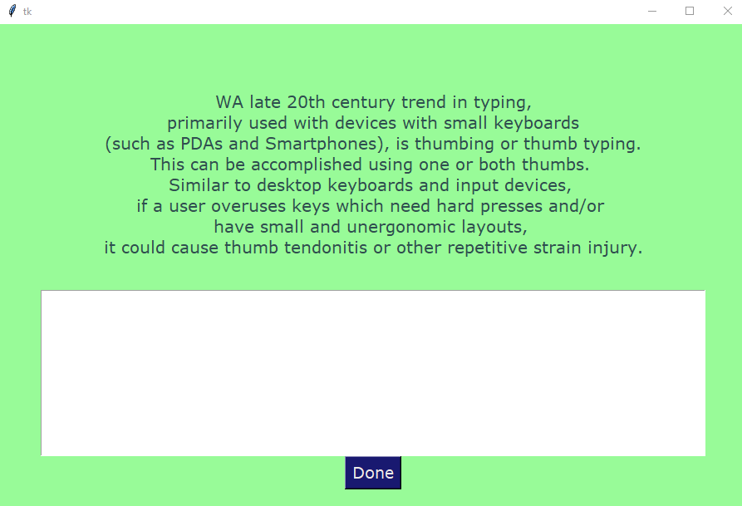
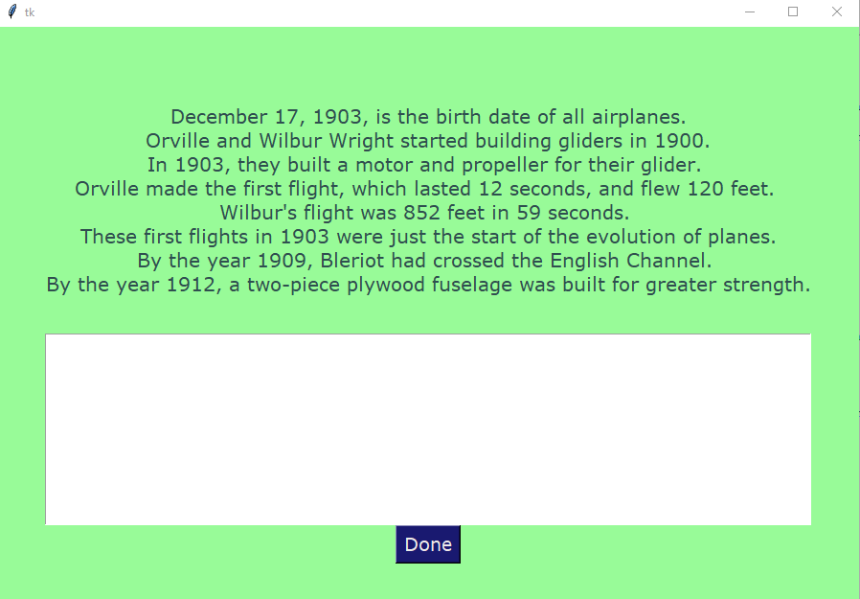
LEVEL-1
LEVEL-2
LEVEL-3

Slide 14
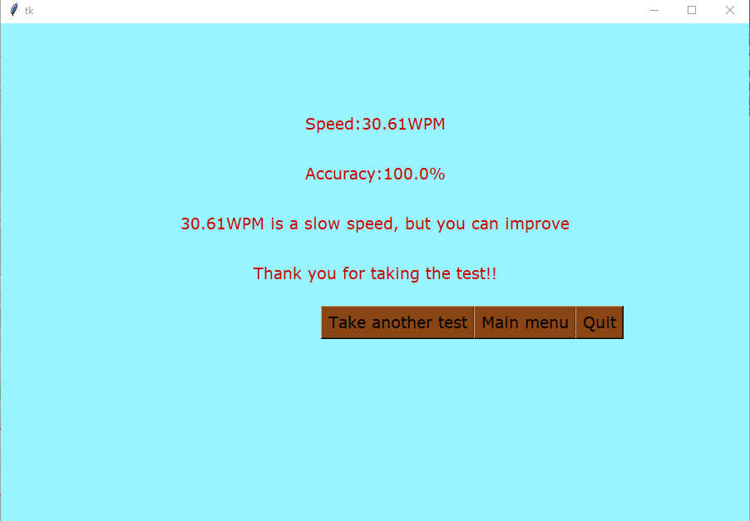
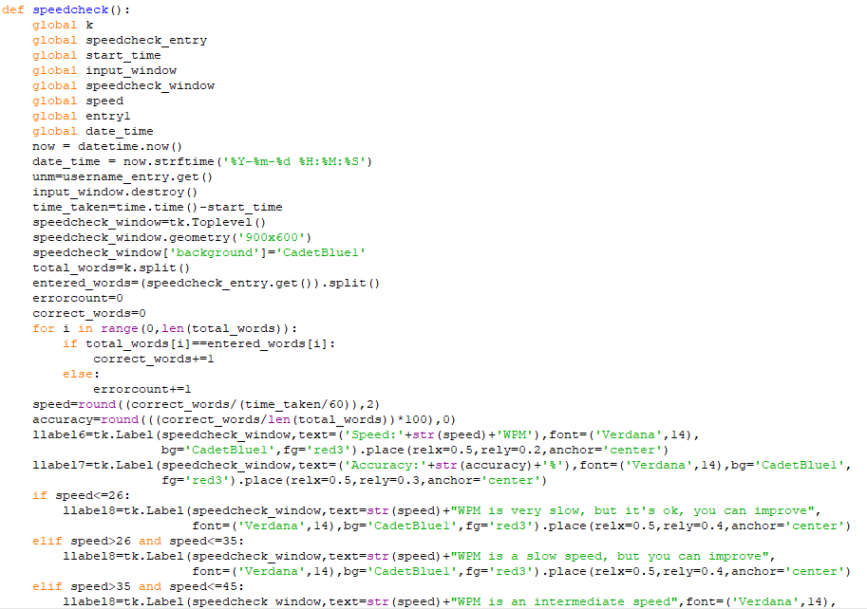
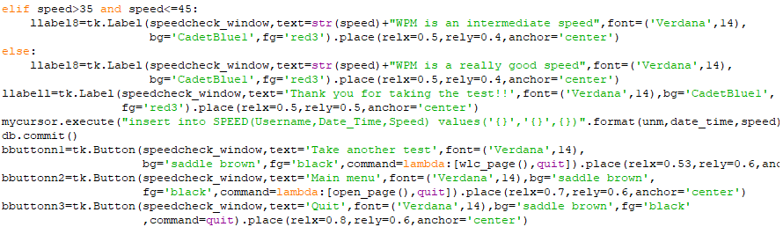
THIS IS THE RESULTS WINDOW, WHERE YOUR RESULTS ARE APPEARED
OUTPUT
CODE

Slide 15


