Slide 1
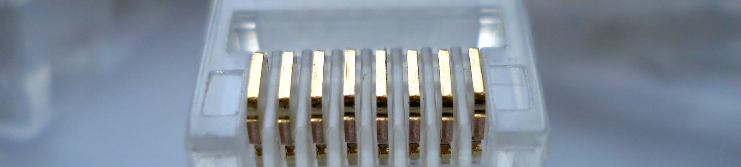
Introduction
to
Software Engineering

Slide 2
Overview
Learning Objectives.
What is software engineering?
Why is software engineering important?

Slide 3
By the end of this chapter, you will...
Understand what software engineering is.
Understand why software engineering is important.

Slide 4
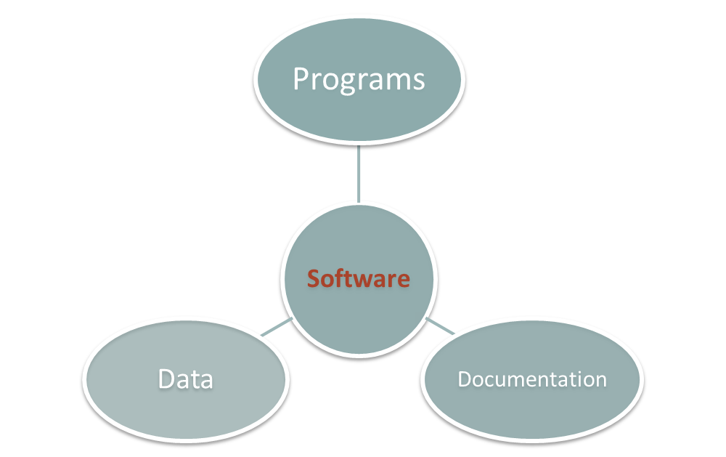
What is Software?
System Documentation
User Documentation

Slide 5
Software Engineering
The term software engineering first appeared in the 1968 NATO Software Engineering Conference and was meant to provoke thought regarding what was then called the “software crisis”..
“.. An engineering discipline that is concerned with all aspects of software production from the early stages of system specification to maintaining the system after it has gone into use.” Sommerville, pg.7

Slide 6
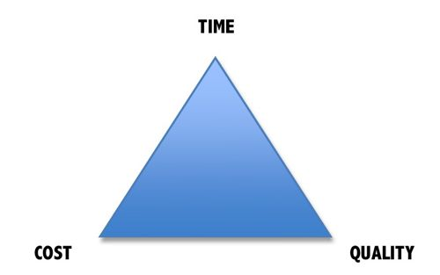
Why is Software Engineering important?
Complex systems need a disciplined approach for designing, developing and managing them.

Slide 7
Software Development Crises
Projects were:
  Late.
  Over budget.
  Unreliable.
  Difficult to maintain.
  Performed poorly.

Slide 8

Software Crisis
  Example 1: 2009,Computer glitch delays flights
Saturday 3rd October 2009-London, England (CNN)
Dozens of flights from the UK were delayed Saturday after a glitch in an air traffic control system in Scotland, but the problem was fixed a few hours later.
The agency said it reverted to backup equipment as engineering worked on the system.
The problem did not create a safety issue but could cause delays in flights.
Read more at:
http://edition.cnn.com/2009/WORLD/europe/10/03/uk.flights.delayed

Slide 9
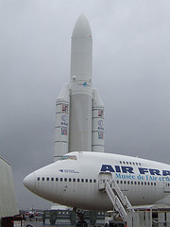
Software Crisis
  Example 2: Ariane 5 Explosion
  European Space Agency spent 10 years and $7 billion to produce Ariane 5.
  Crash after 36.7 seconds.
  Caused by an overflow error. Trying to store a 64-bit number into a 16-bit space.
  Watch the video: http://www.youtube.com/watch?v=z-r9cYp3tTE

Slide 10
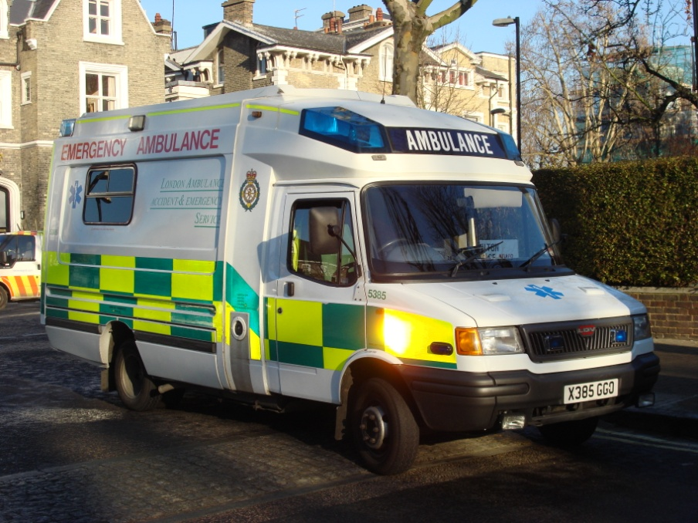
Software Crisis
  Example 3: 1992, London Ambulance Service
  Considered the largest ambulance service in the world.
  Overloaded problem.
  It was unable to keep track of the ambulances and their statuses. Sending multiple units to some locations and no units to other locations.
  Generates many exceptions messages.
  46 deaths.

Slide 11
Therefore…
A well-disciplined approach to software development and management is necessary. This is called engineering.

Slide 12
What is a Software Process Model?
Description of the software process that represents one view, such as the activities, data or roles of people involved.
Examples of views | Focus on…
Workflow | Activities = human actions. What is input, output, and dependencies.
Dataflow | Activities = transformations of information. How the input is transformed into output.
Role/Action | What is the role of people involved in each step of the process?

Slide 13
What is a Software Process?
Activities and results that produce a software product:
SW Process Activity | What is going on there?
Specification | What does the customer need? What are the constraints?
Development | Design & programming.
Validation | Checking whether it meets requirements.
Evolution | Modifications (e.g. customer/market).

Slide 14
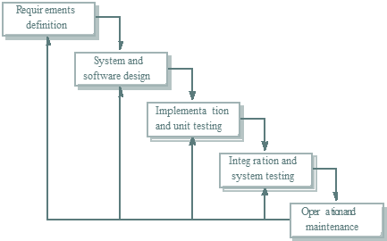
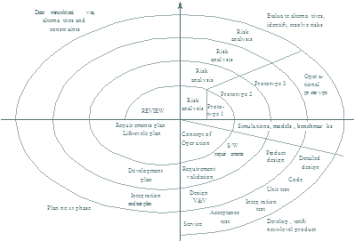
Software Process Models
Waterfall approach | Iterative development | Component-Based Software Engineering CBSE
 |  | assembled form existing components

Slide 15

Activity
Think about all the devices and systems that you encounter in your everyday life which have software controlling them…
List as many as you can
Virtually all countries depend on complex computer-based systems.

