Slide 1
Heart Disease Risk Prediction
0.93
ROC-AUC (test)
92%
A leakage-free machine-learning pipeline for clinical triage
AIDS Department · Problem-Based Learning
Rohit Dnyaneshwar Mahale
PRN 2125UDSM2043 · TY AIDS-B
Recall — sick patients caught
−65%
Specialist referrals*
*projected at 20% disease prevalence
Notes:
Introduce the project: predicting heart disease from routine clinical data so doctors can prioritise patients for cardiology referral. Headline results are from the untouched hold-out test set.

Slide 2
The problem: who gets a cardiologist first?
17.9 M
Limited
Costly
CVD deaths per year worldwide (WHO)
cardiology slots, ECG & stress-test capacity
to miss a sick patient (false negative)
Problem statement
Stakeholders
Given routine screening measurements, predict whether a patient has heart disease so clinicians can prioritise high-risk patients for referral.
GPs and screening-camp doctors: fast second opinion
Cardiology and hospital admin: better capacity use
Patients: earlier detection
Insurers and public health: lower late-stage cost
Notes:
Frame the business problem: capacity-limited referral decisions where a missed patient is far costlier than an unnecessary referral.

Slide 3
Objectives and success KPIs
Build a reproducible, leakage-free ML pipeline for HeartDisease
Prioritise recall: a missed patient is the costly error
Explain which clinical factors drive risk
Deliver Low / Moderate / High risk tiers and a web demo
KPI | Target | Achieved (test)
Recall | ≥ 0.90 | 0.92 ✓
Precision | ≥ 0.80 | 0.85 ✓
F1-score | ≥ 0.85 | 0.88 ✓
ROC-AUC | ≥ 0.90 | 0.93 ✓
Measured once on a 184-patient hold-out set never used for tuning.

Slide 4
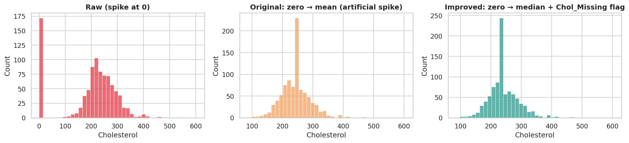
Data: hidden quality problem
918
18.7%
88%
55 / 45
patients, 11 features
cholesterol recorded as 0
disease rate when cholesterol = 0 (vs 48%)
% disease / healthy: balanced
Left to right: raw data (spike at 0) · original mean-fill (artificial spike) · improved median-fill + missing flag. Zeros mean "not measured", and that itself predicts disease.

Slide 5
Leakage-safe preprocessing pipeline
1
2
3
4
5
6
Stratified split
Zero → NaN
Median impute
IQR clipping
Scale + encode
Model
80 / 20, test set locked
+ Chol_Missing flag
learned on train only
outliers capped
Standard + one-hot
tuned by CV
Every statistic (median, IQR fences, scaler, encoder) is learned inside each CV fold — no leakage
The same pipeline object is saved and reused by the web app
Outliers: only 0.2–3% per feature, so capped rather than deleted

Slide 6
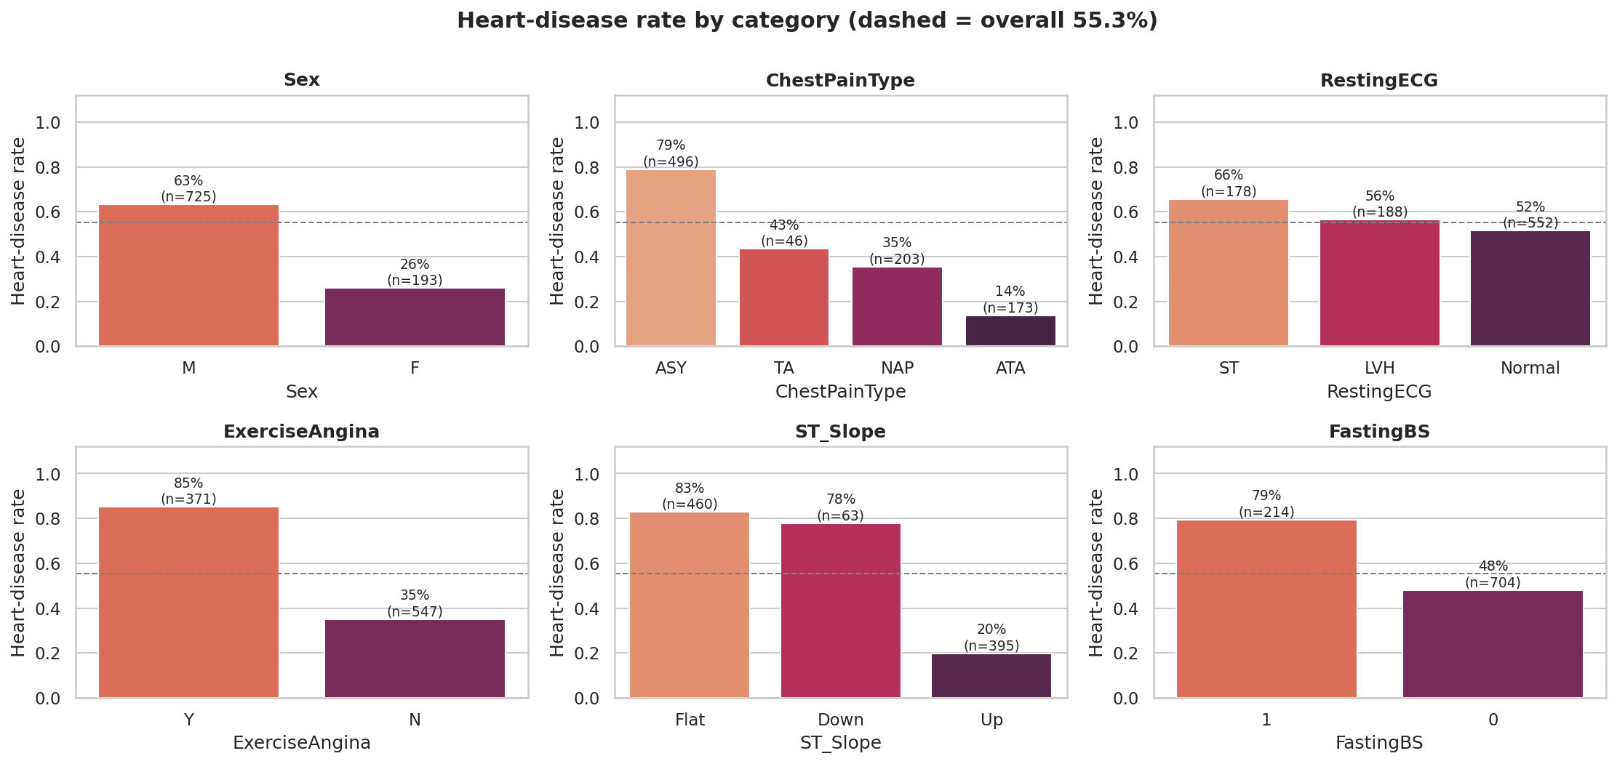
EDA: the stress test tells the story
ST slope Flat / Down: 83% / 78% disease vs 20% for Up (Cramér's V = 0.62)
Asymptomatic chest pain: 79% vs 14% for atypical angina
Exercise angina: 85% vs 35%
Men 63% vs women 26%; fasting sugar > 120: 79% vs 48%
MaxHR and Oldpeak: strongest numeric effects (r = 0.47)

Slide 7
Feature engineering earns its place
Engineered features
Chol_Missing: 90% vs 48% disease
HR_Pct_Max = MaxHR / (220 − Age)
ST_Depression: Oldpeak ≥ 1 mm (77% vs 37%)
Hypertensive, Chol_High flags
Top-14 selection: +0.004 AUC, within noise, so all features kept
FE lifts Logistic-Regression F1 from 0.863 to 0.876; clipping is neutral and kept for robustness.
A = raw B = +clip C = +FE D = +FE +clip

Slide 8
Seven algorithms, one fair protocol
Same pipeline for every model, so no leakage
RF, LR, SVM, GB cluster at AUC 0.92–0.93
Single decision tree is weakest (0.80): high variance
Hold-out test set untouched until the end

Slide 9
Tuning and final model: Random Forest
Tuned model (CV) | Recall | F1 | ROC-AUC
Gradient Boosting | 0.901 | 0.877 | 0.932
Random Forest | 0.906 | 0.878 | 0.931
Voting Ensemble (LR+SVM+RF) | 0.898 | 0.877 | 0.930
Logistic Regression | 0.889 | 0.876 | 0.926
SVM (RBF) | 0.896 | 0.874 | 0.925
KNN | 0.893 | 0.876 | 0.918
Selection rule
Declared in advance: highest CV AUC; ties within 0.002 go to higher F1
GB 0.9316 vs RF 0.9314: tie, RF wins on F1 and recall
Voting ensemble gave no gain
RF: depth 6, leaf 3, 300 trees
Chosen using cross-validation only — never the test set.

Slide 10
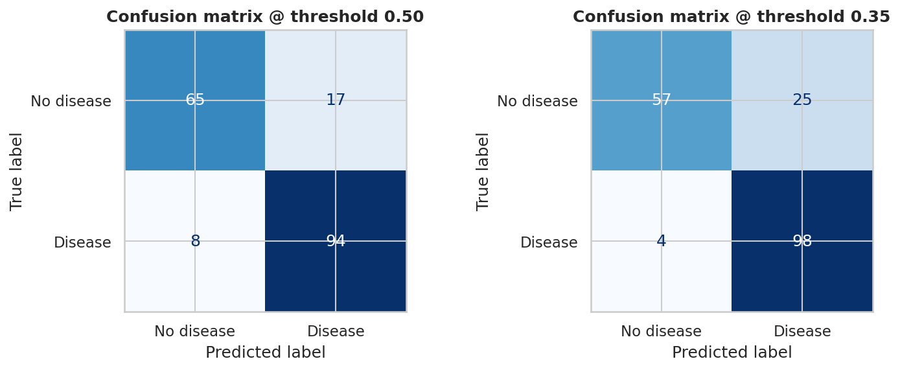
Test results: 8 of 102 sick patients missed
0.922
0.847
Recall
Precision
0.883
0.926
F1
ROC-AUC
Standard threshold 0.50: recall 0.92, specificity 0.79
High-sensitivity 0.35: recall 0.96, precision 0.80
95% bootstrap CI — recall 0.865–0.971, AUC 0.883–0.962
CV AUC 0.931 ≈ test 0.926: no optimistic tuning

Slide 11
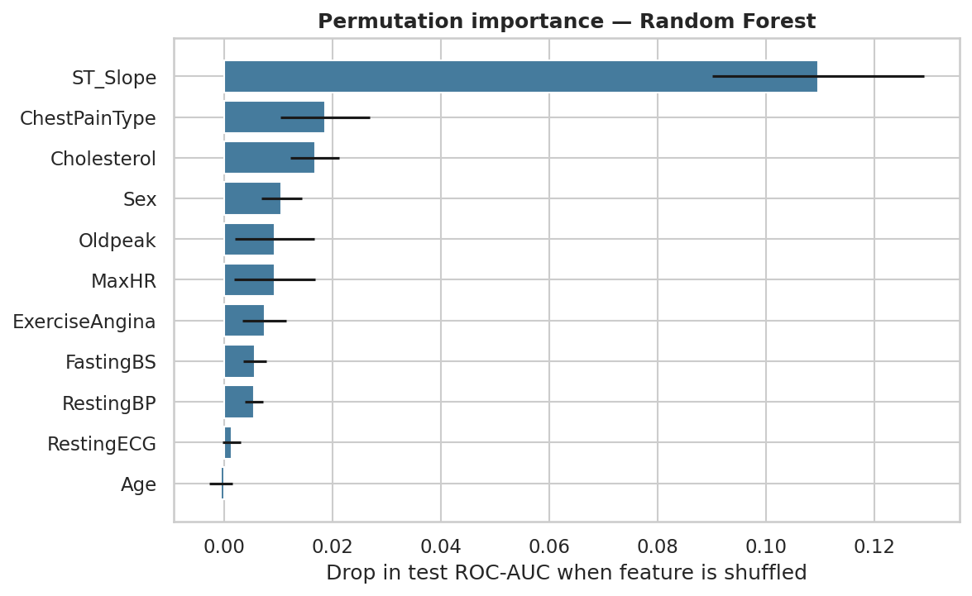
What drives the prediction
Odds ratios (logistic companion)
Cholesterol not recorded | ×3.7
Asymptomatic chest pain | ×2.9
Male | ×2.8
Flat ST slope | ×2.7
Exercise angina | ×2.2
Upsloping ST (protective) | ×0.31
ST_Slope alone costs 0.11 AUC when shuffled — 6× any other feature.

Slide 12
Where the model fails — and for whom
False negatives (8)
Subgroup recall (test)
7 of 8 have an upsloping ST segment
Median MaxHR 159 vs 125 for caught cases
Lower Oldpeak: 0.45 vs 1.5
Looks healthy on the stress test
Low risk ≠ no risk: keep the clinician in the loop
Men 0.93 · Age 60+ 0.96 · Age < 50 0.89
Women: recall 0.83 but precision 0.45
Only 38 women (6 sick) in test set
Early fairness flag: needs more female data
Probabilities are slightly compressed: read as risk ranks

Slide 13
Risk tiers turn scores into action
90.6%
3.8%
of all disease cases sit in the High tier
disease rate in the Low tier
−65%
−21%
referrals per 1,000 patients*
cost vs refer-all in high-sensitivity mode
*Assumes 20% prevalence and test sensitivity 0.92 / specificity 0.79: about 350 referrals instead of 1,000, catching 184 of 200 sick patients. In screening populations (10–30% prevalence) expected cost falls 46–71% at a 10:1 FN:FP cost ratio. At this dataset's 55% prevalence, the value is prioritisation, not cost.
Low 26% of patients · Moderate 15% · High 58%

Slide 14
Seven recommendations
1 Three-tier triage
5 Target silent high-risk groups
Low: routine · Moderate: review in weeks · High: fast-track cardiology
Men > 55, diabetics, asymptomatic patients
2 Threshold by setting
6 Clinician stays in the loop
0.50 where capacity is tight; 0.35 (recall 96%) for screening camps
Show probability; never discharge a symptomatic low-risk patient on the model alone
3 Record ST slope and angina
7 Pilot before deployment
The two strongest predictors must always be captured
Validate locally, add female data, monitor drift and subgroups
4 Mandatory lipid profile
19% have no cholesterol value and 88% of them are sick

Slide 15
Deployment, limitations, next steps
Streamlit demo
Limitations and future work
Enter 11 clinical inputs in the sidebar
Shows risk %, tier, decision and action
Standard / high-sensitivity toggle
"Why this score?" occlusion chart
Run: streamlit run app.py
Small pooled 1980s–90s data: needs local validation
Stress-test features are not available at a basic GP visit
Cholesterol missingness is not random
Next: SHAP, calibration, GP-lite model, more data

Slide 16
Thank you — questions?
Rohit Dnyaneshwar Mahale
PRN 2125UDSM2043 · TY AIDS-B
Code, report and app are in the project repository

