Slide 1
Predictive Analysis
(Project Semester Sep-Jan 2026)
Machine Learning Project: Public Library
Submitted By: Rohit Kumar Dubey
Registration No: - 12306377
Section: K23BR
Course Code: INT 234
Under the Guidance of:
Vikas Mangotra
Discipline of CSE/IT
Lovely School of computer science and engineering Lovely Professional University, Phagwara

Slide 2
CERTIFICATE
This is to certify that Rohit Kumar Dubey bearing Registration no. 12306377 has completed INT-234 project titled, “Machine Learning Project: Public Library” under my guidance and supervision. To the best of my knowledge, the present work is the result of his/her original development, effort and study.
Signature and Name of the Supervisor Designation of the Supervisor
School of Computer Science and Engineering
Lovely Professional University Phagwara, Punjab.
Date: 10 Dec 2025

Slide 3
DECLARATION
I Rohit Kumar Dubey student of Computer science and Engineering under CSE/IT Discipline at, Lovely Professional University, Punjab, hereby declare that all the information furnished in this project report is based on my own intensive work and is genuine.
Date: 10-12-2025
Signature: - Rohit Kumar Dubey
Registration No. 12306377

Slide 4
Introduction
In recent years, Machine Learning (ML) has emerged as a transformative technology that enables systems to learn from data and make intelligent decisions without being explicitly programmed. With the exponential growth of data across various domains, machine learning techniques are increasingly being used to analyze large datasets, discover hidden patterns, and generate predictive insights that support better decision-making.
Government initiatives such as Data.gov.in have made vast amounts of public data freely available for research, innovation, and academic purposes. These open datasets provide an excellent opportunity to apply machine learning techniques to real-world problems and understand how data-driven approaches can improve public services. One such important domain is the public library system, which plays a vital role in promoting education, literacy, and knowledge accessibility within society.
Public libraries generate and maintain large volumes of data related to infrastructure, resources, facilities, and user demographics. Analyzing this data using machine learning can help uncover meaningful trends, improve resource allocation, and support policy-level decisions. However, selecting the most suitable machine learning model for a given dataset is a critical challenge, as different algorithms behave differently depending on the nature of the data.
This project focuses on building and comparing multiple machine learning classification models using a Public Library Dataset obtained from Data.gov.in. Four widely used classification algorithms—Logistic Regression, K-Nearest Neighbors (KNN), Decision Tree, and Random Forest—are implemented and evaluated on the same dataset. By comparing their performance using standard evaluation metrics, the project aims to identify the most effective model for this particular problem.
The project follows a complete machine learning workflow, including data preprocessing, exploratory data analysis, model training, performance evaluation, and model comparison. Through this study, practical insights are gained into how different algorithms perform on real-world government data and why ensemble methods often outperform individual models.

Slide 5
Overview of Predictive Analysis
Predictive analysis is a branch of data analytics that focuses on using historical data, statistical techniques, and machine learning algorithms to predict future outcomes or classify unseen data. Instead of only describing what has happened in the past, predictive analysis helps in estimating what is likely to happen next based on patterns learned from existing data.
In machine learning, predictive analysis involves building models that learn relationships between input features and a target variable. These models are trained on historical datasets and then used to make predictions on new, unseen data. The accuracy and reliability of predictions depend on factors such as data quality, feature selection, preprocessing techniques, and the choice of algorithm.
In the context of this project, predictive analysis is applied to the Public Library Dataset obtained from Data.gov.in. The dataset contains structured information related to public libraries, including various numerical and categorical attributes. By analyzing these attributes, the machine learning models aim to predict the target classification outcome associated with the dataset.
Multiple classification algorithms—Logistic Regression, K-Nearest Neighbors (KNN), Decision Tree, and Random Forest—are used to perform predictive analysis. Each algorithm follows a different learning approach:
Logistic Regression models the probability of class membership using a linear decision boundary.
KNN predicts outcomes based on similarity between data points.
Decision Tree predicts by learning hierarchical decision rules.
Random Forest improves prediction accuracy by combining multiple decision trees.
The predictive analysis process in this project includes data preprocessing, feature encoding, model training, and evaluation using performance metrics such as accuracy. Comparing the prediction results of multiple models helps in understanding algorithm behavior and selecting the most suitable model for the given dataset.
Overall, predictive analysis in this project demonstrates how machine learning techniques can be effectively used to derive insights from government open data and support data-driven decision-making in the public library domain.

Slide 6
Importance of Prediction in the Selected Domain
Prediction plays a crucial role in domains where data-driven decision-making can significantly improve efficiency, planning, and resource utilization. In the context of the public library domain, predictive analysis helps transform raw historical data into actionable insights that support better management and policy decisions.
Public libraries are responsible for managing infrastructure, resources, services, and accessibility for diverse populations. Predicting outcomes based on historical library data enables authorities and administrators to understand patterns related to library usage, availability of facilities, and overall performance. This allows for proactive planning rather than reactive decision-making.
By applying predictive models to public library data, it becomes possible to:
Identify trends and patterns within library-related attributes
Anticipate future requirements for resources and facilities
Support efficient allocation of funds and infrastructure
Improve planning at regional and administrative levels
Machine learning-based prediction also helps in handling large-scale government datasets that may be difficult to analyze manually. Automated predictive systems can quickly process complex relationships between multiple features and provide reliable classification results. This improves both accuracy and scalability in analysis.
In this project, prediction is used to classify outcomes within the Public Library dataset using multiple machine learning algorithms. Comparing predictive performance across different models helps identify the most suitable algorithm for the domain. Such insights are valuable for extending predictive systems into real-world applications, such as decision support tools for government agencies.
Overall, prediction in the public library domain enhances transparency, efficiency, and effectiveness by enabling data-driven strategies. It demonstrates how machine learning can contribute to improving public services and optimizing resource management using open government data.

Slide 7
Problem Statement
The Public Library dataset obtained from Data.gov.in contains structured information related to library infrastructure, facilities, and other associated attributes. While this data holds significant potential for analysis, deriving meaningful insights and making accurate predictions using traditional manual methods is challenging due to the size and complexity of the dataset.
The primary problem addressed in this project is to develop an effective machine learning–based predictive system that can accurately classify the target outcome using historical public library data. Since different machine learning algorithms have varying strengths and limitations, selecting the most suitable model for this dataset is not straightforward.
To address this challenge, multiple classification algorithms—Logistic Regression, K-Nearest Neighbors (KNN), Decision Tree, and Random Forest—are trained on the same dataset after appropriate preprocessing. The models are then evaluated and compared using performance metrics to determine which algorithm provides the most accurate and reliable predictions.
The problem therefore focuses on understanding how different machine learning models perform on real-world government data and identifying the best-performing model for predictive analysis in the public library domain.
1.4 Objectives of the Study
The main objectives of this study are as follows:
To understand and analyze the Public Library dataset collected from Data.gov.in
To perform data preprocessing, including handling missing values and encoding categorical variables
To apply multiple machine learning classification algorithms on the same dataset
To train and evaluate Logistic Regression, K-Nearest Neighbors (KNN), Decision Tree, and Random Forest models
To compare the performance of all trained models using appropriate evaluation metrics
To identify the best-performing model for predictive analysis
To gain practical experience in implementing and comparing machine learning algorithms on real-world government data

Slide 8
Scope of the project
The scope of this project is focused on applying machine learning techniques to a real-world government dataset for academic and analytical purposes. The project demonstrates the complete machine learning pipeline, starting from data preprocessing and exploratory analysis to model training, evaluation, and comparison.
This project is limited to supervised classification models and does not include advanced techniques such as deep learning or real-time deployment. However, it provides a strong foundation for further enhancements, including hyperparameter tuning, use of additional algorithms, and deployment as a decision support system.
The project is useful for students, researchers, and beginners in machine learning to understand how different algorithms perform on structured public datasets. It also highlights the importance of model comparison in selecting the most suitable algorithm for a specific problem domain.
Expected Outcome
The expected outcomes of this project are focused on achieving accurate predictions and gaining meaningful insights from the Public Library dataset using machine learning techniques. By applying multiple classification algorithms and comparing their performance, the project aims to deliver the following results:
Successful development of a complete machine learning pipeline, including data preprocessing, model training, evaluation, and comparison
Trained and evaluated classification models using Logistic Regression, K-Nearest Neighbors (KNN), Decision Tree, and Random Forest
Identification of the best-performing model based on evaluation metrics such as accuracy
Improved understanding of how different machine learning algorithms behave on the same real-world government dataset
Clear comparison of model strengths and limitations, highlighting why certain models perform better than others
Useful insights that can support data-driven decision-making in the public library domain
A scalable project framework that can be extended with advanced techniques such as hyperparameter tuning, additional models, or deployment
Overall, the project is expected to demonstrate the practical application of machine learning for predictive analysis using open government data and strengthen hands-on understanding of model selection and evaluation.

Slide 9
Source of Dataset
The dataset used in this project has been obtained from Data.gov.in, the official open data portal of the Government of India. Data.gov.in provides publicly accessible datasets collected from various government departments and organizations for research, analysis, and innovation purposes.
The Public Library Dataset available on this platform contains structured information related to public libraries and has been used in this project to perform predictive analysis and machine learning model comparison. Since the dataset is sourced from an authentic government portal, it is reliable, transparent, and suitable for academic and practical machine learning applications.
Name of the Dataset:
Public Library Dataset sourced from Data.gov.in, the official open data platform of the Government of India.
Source Link:
The dataset was obtained from Data.gov.in, the official Open Government Data Portal of India.
It provides publicly accessible datasets published by various government departments.
Description of Attributes
The dataset consists of both numerical and categorical attributes related to public libraries, such as infrastructure details, location-based indicators, and service-related features. These attributes are used as input variables for training machine learning models and predicting the target classification outcome.

Slide 10
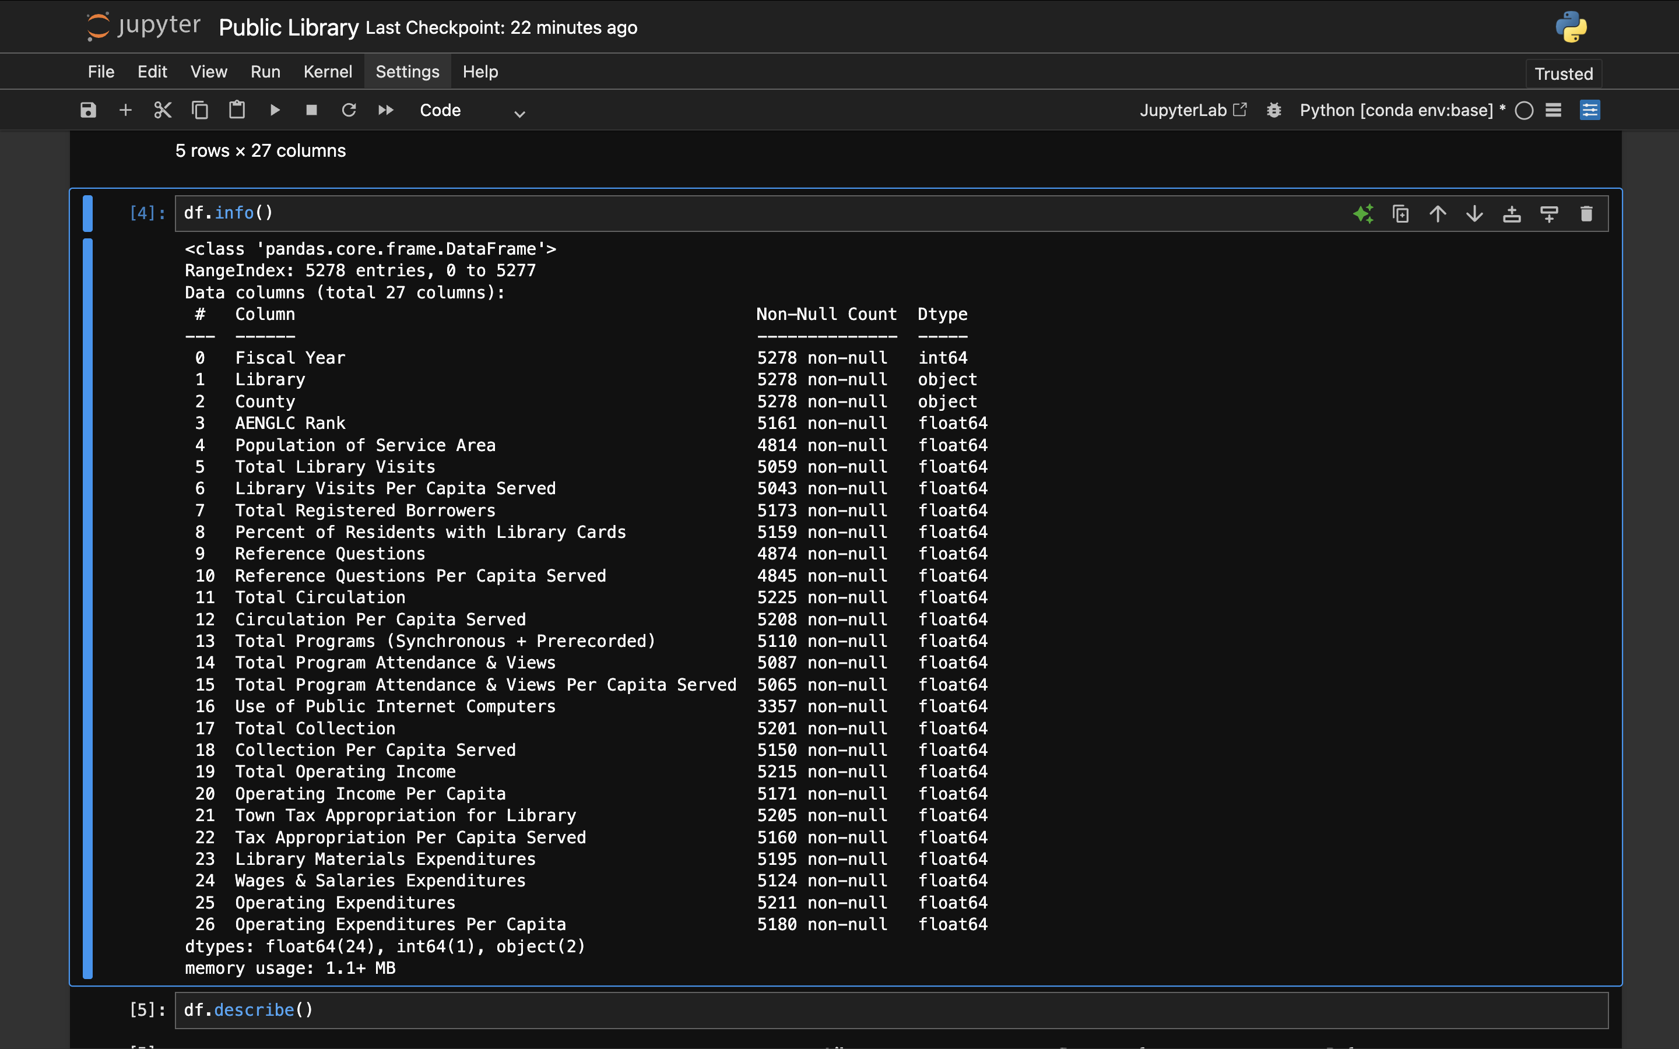
Number of rows and columns
The dataset contains 5278 rows representing individual records and 27 columns representing different attributes related to public libraries.
Type of Prediction:
Classification
Dataset Preprocessing:
The dataset was cleaned and prepared before model training by handling missing values, encoding categorical features into numerical form, and removing inconsistencies. The data was then split into training and testing sets, and feature scaling was applied where required to ensure fair comparison among all machine learning models.

Slide 11
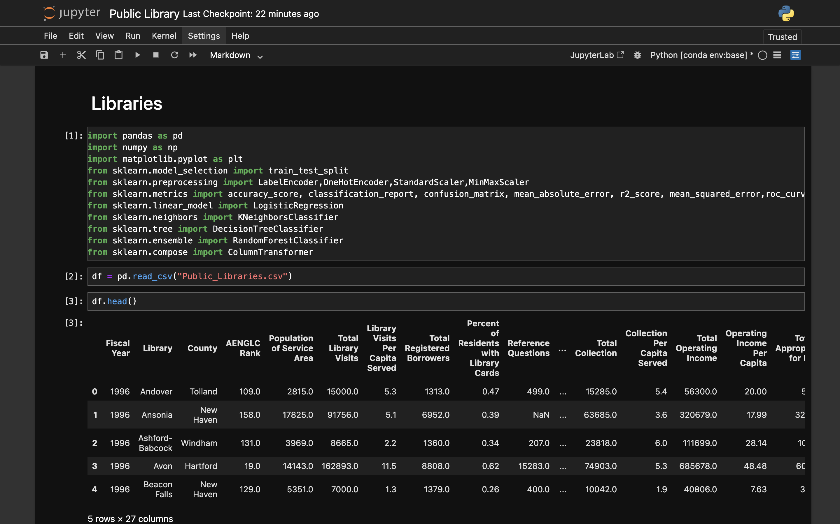
Analysis on dataset

Slide 12
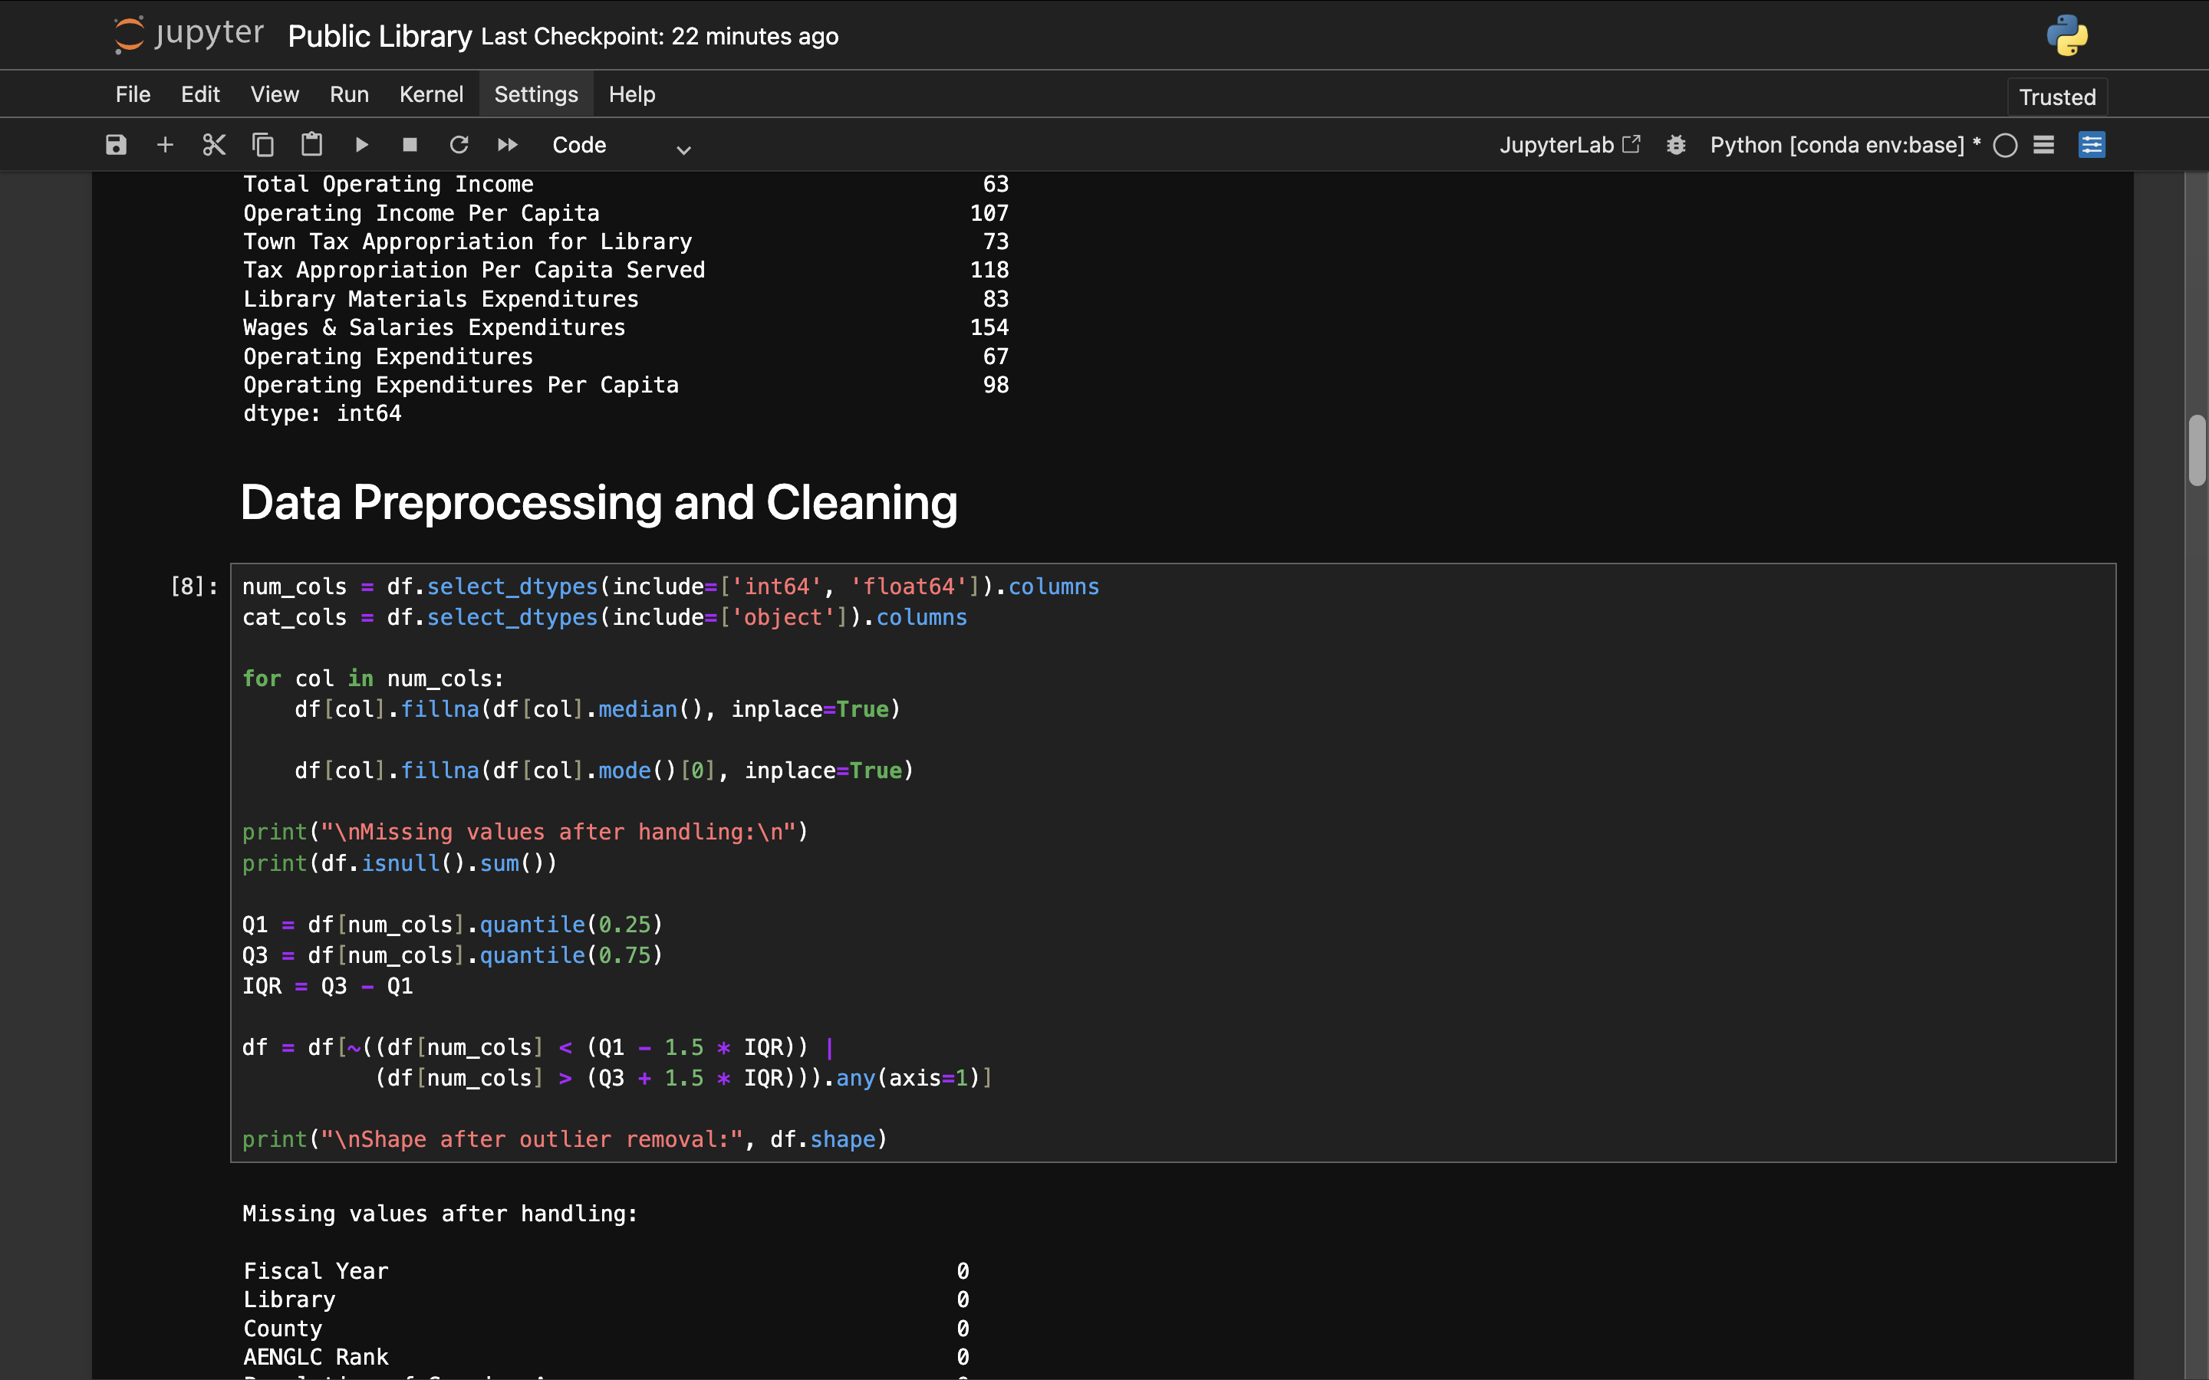

Slide 13
Model Development:
In this project, four machine learning classification models—
Logistic Regression,
K-Nearest Neighbors (KNN),
Decision Tree,
and Random Forest
—were developed using the preprocessed dataset. Each model was trained on the same training data to ensure a fair comparison and evaluated on the test dataset using accuracy as the primary performance metric.
Standard libraries such as Scikit-learn were used for model implementation. Consistent preprocessing and train–test splitting were applied across all models to analyze their predictive performance and identify the most suitable model for the Public Library dataset.

Slide 14
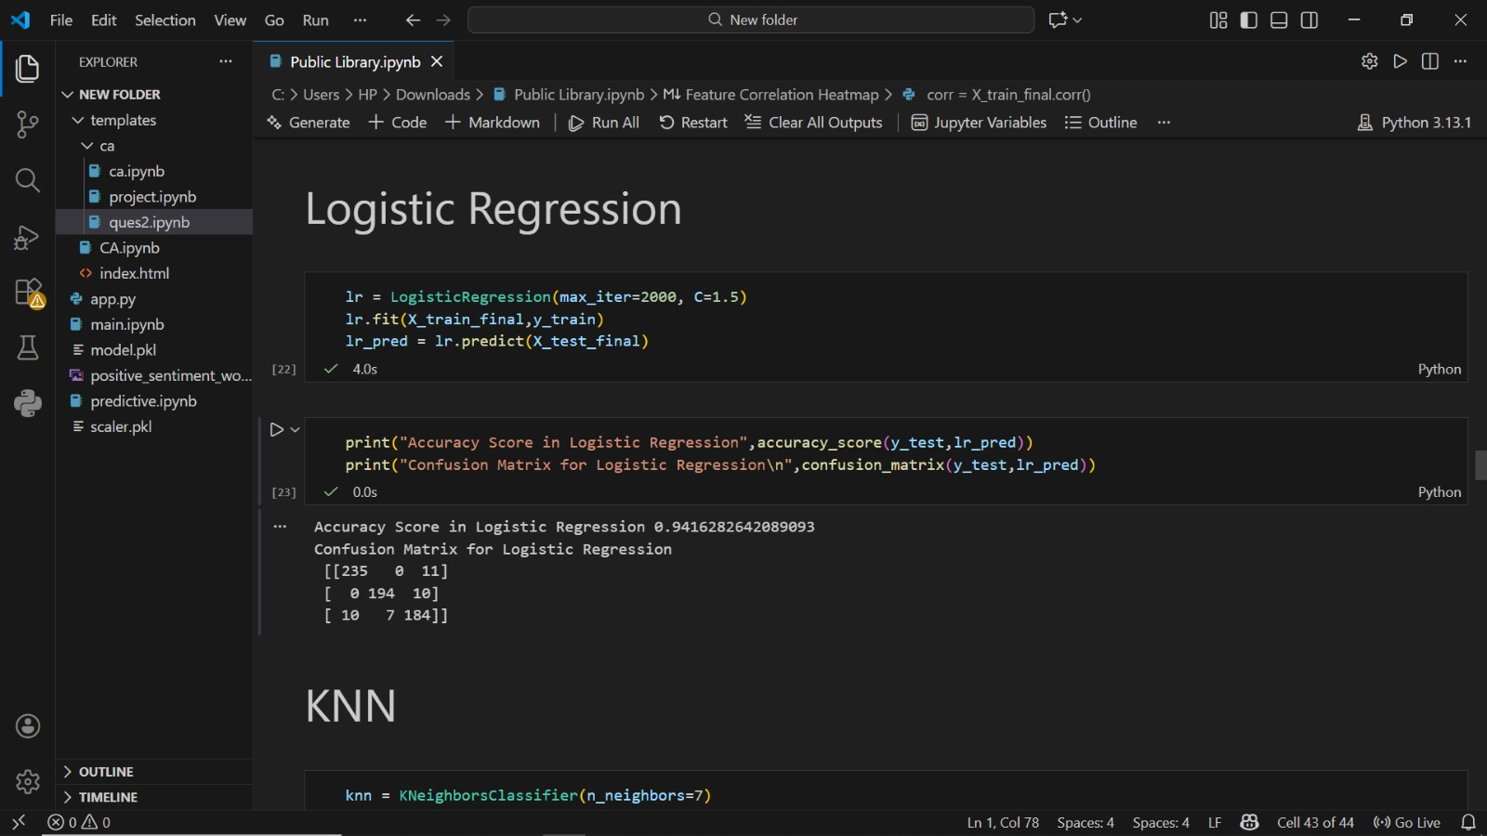
Logistic Regression

Slide 15
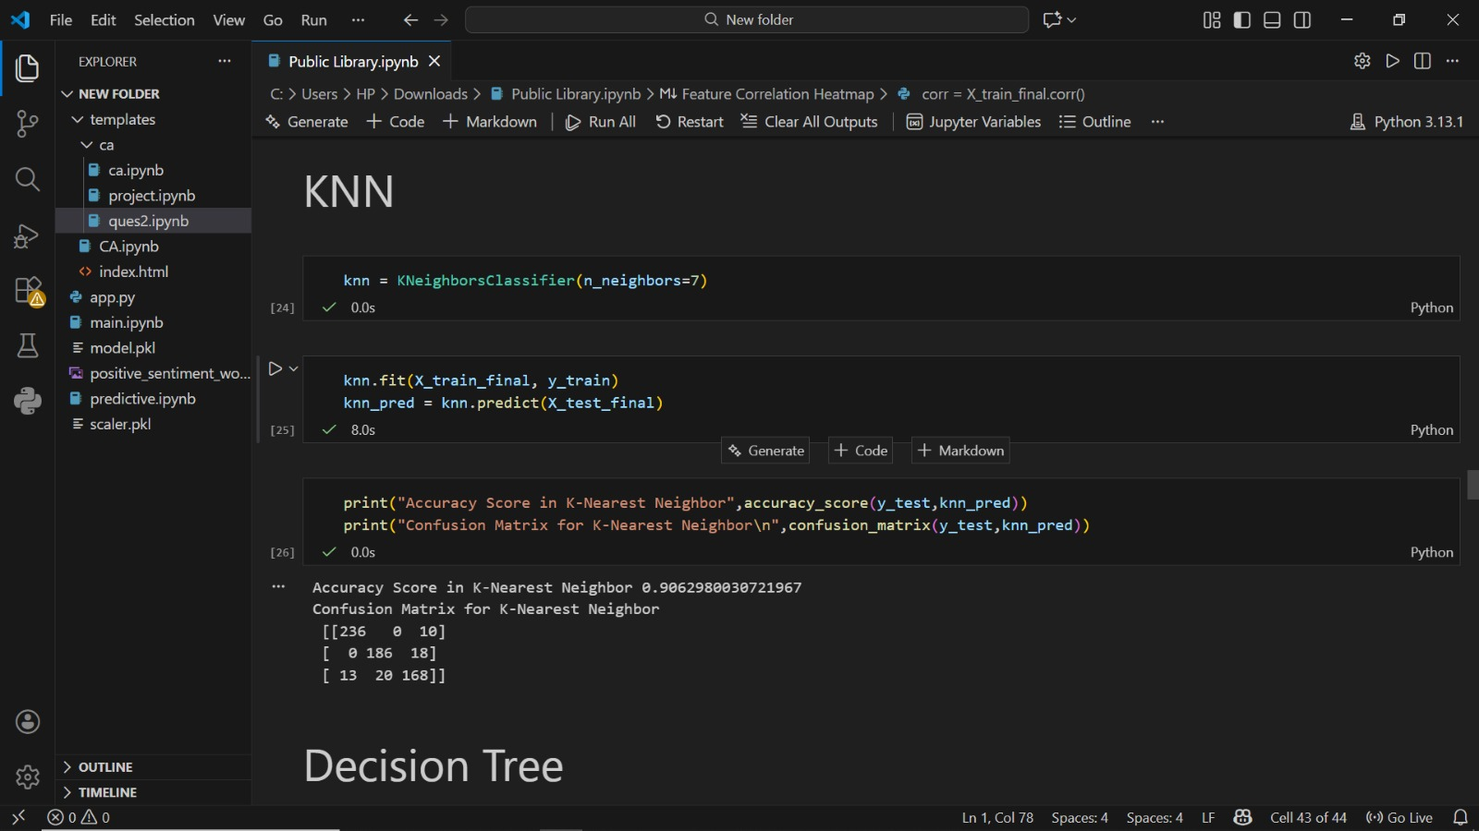
K-Nearest Neighbour

Slide 16
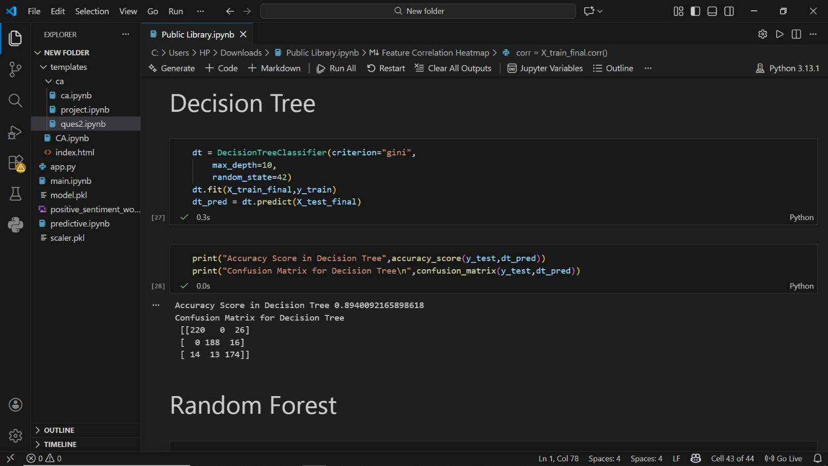
Decision Tree

Slide 17
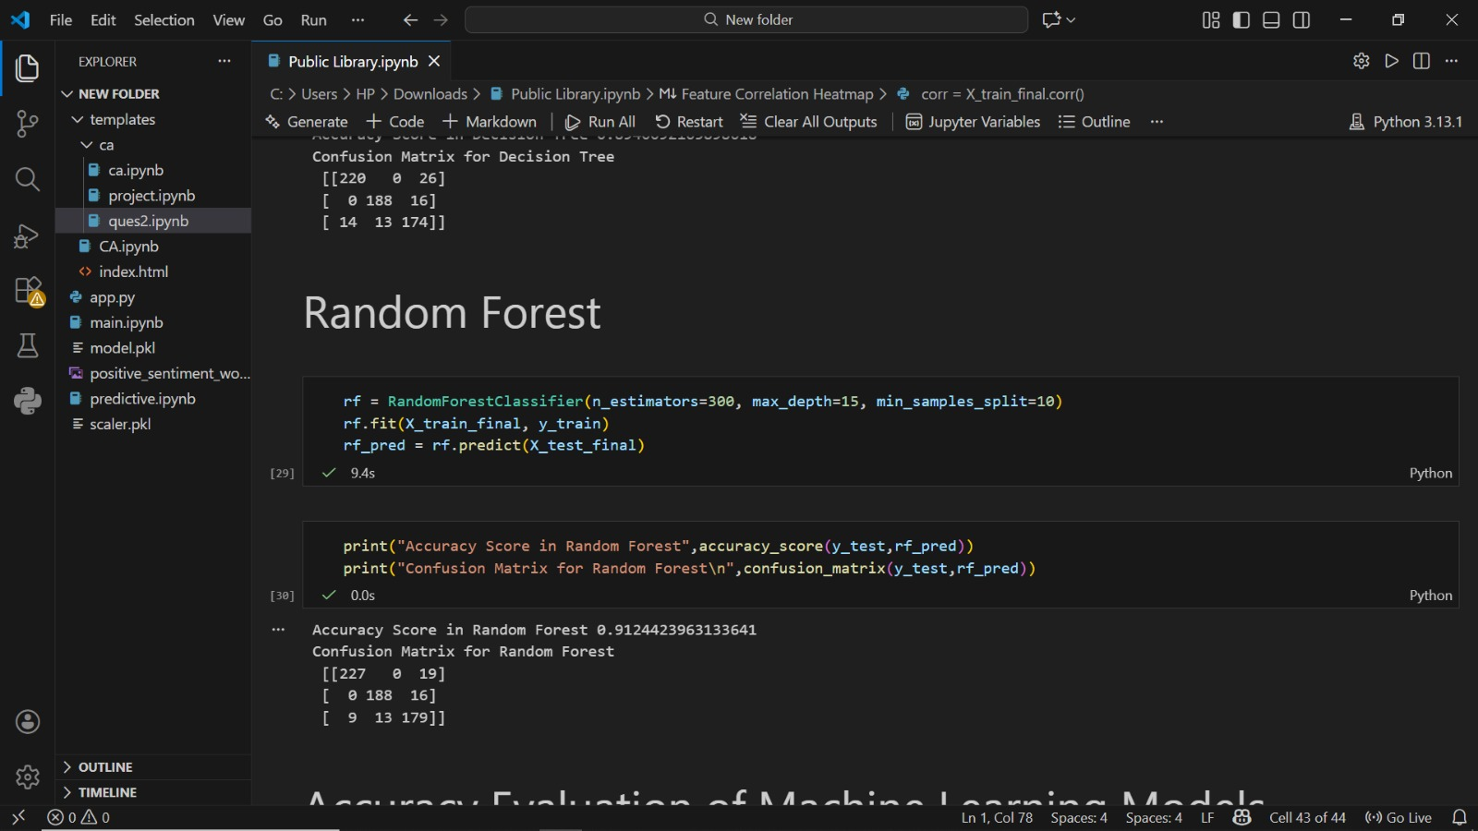
Random Forest

Slide 18
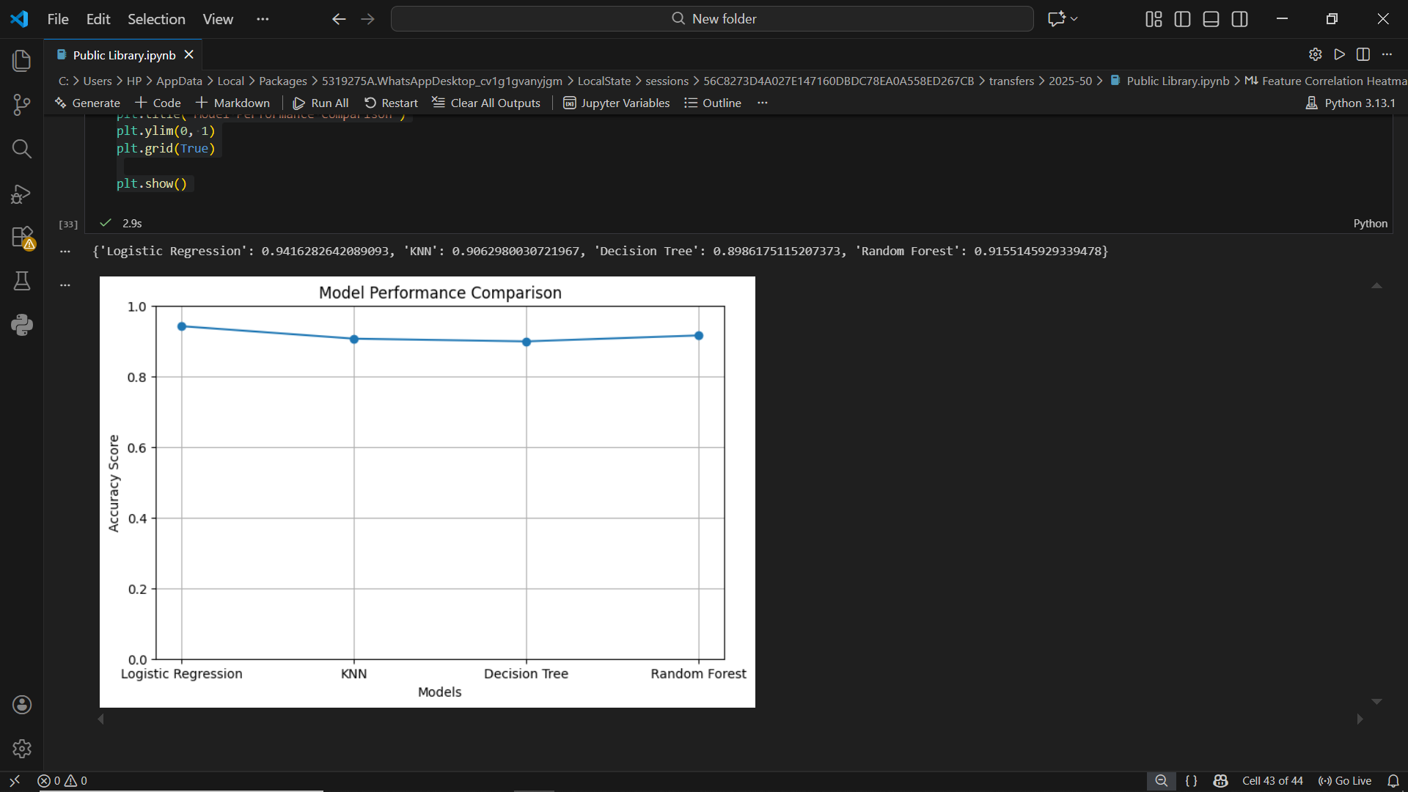
Model Comparison
In this project, four machine learning classification models—Logistic Regression, K-Nearest Neighbors (KNN), Decision Tree, and Random Forest—were trained and evaluated on the same preprocessed Public Library dataset to ensure a fair comparison. All models were assessed using the same training–testing split and evaluation metric.
The comparison shows that simpler models like Logistic Regression provide good interpretability but may have limited performance on complex data patterns. KNN performance depends heavily on the choice of neighbors and data scaling. Decision Tree captures non-linear relationships but is prone to overfitting. Random Forest, being an ensemble method, delivers better generalization and higher accuracy by combining multiple decision trees, making it the best-performing model among the four.
This comparative analysis highlights how different algorithms behave on the same dataset and helps in selecting the most suitable model for predictive tasks in the public library domain.

Slide 19
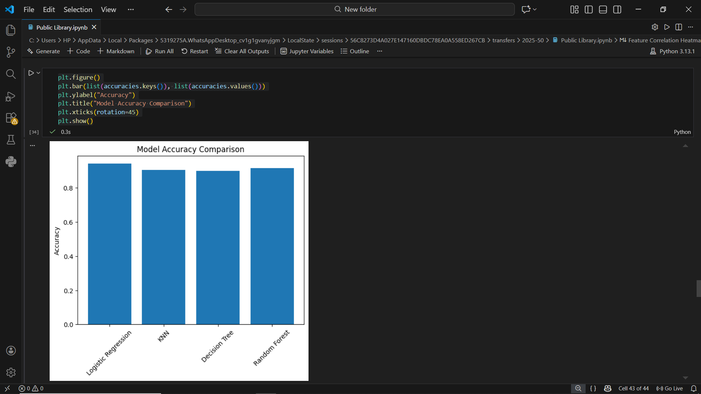
Best Model Identification
Based on the comparative evaluation of all trained models using accuracy and performance metrics, Random Forest was identified as the best-performing model. It provided higher accuracy and better generalization compared to Logistic Regression, KNN, and Decision Tree, due to its ensemble learning approach and reduced overfitting.

Slide 20
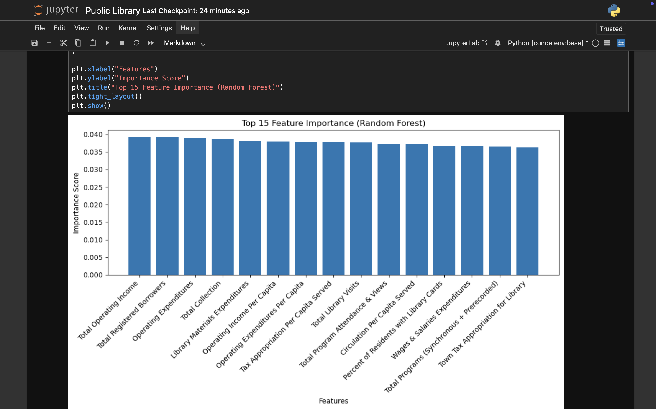

Slide 21
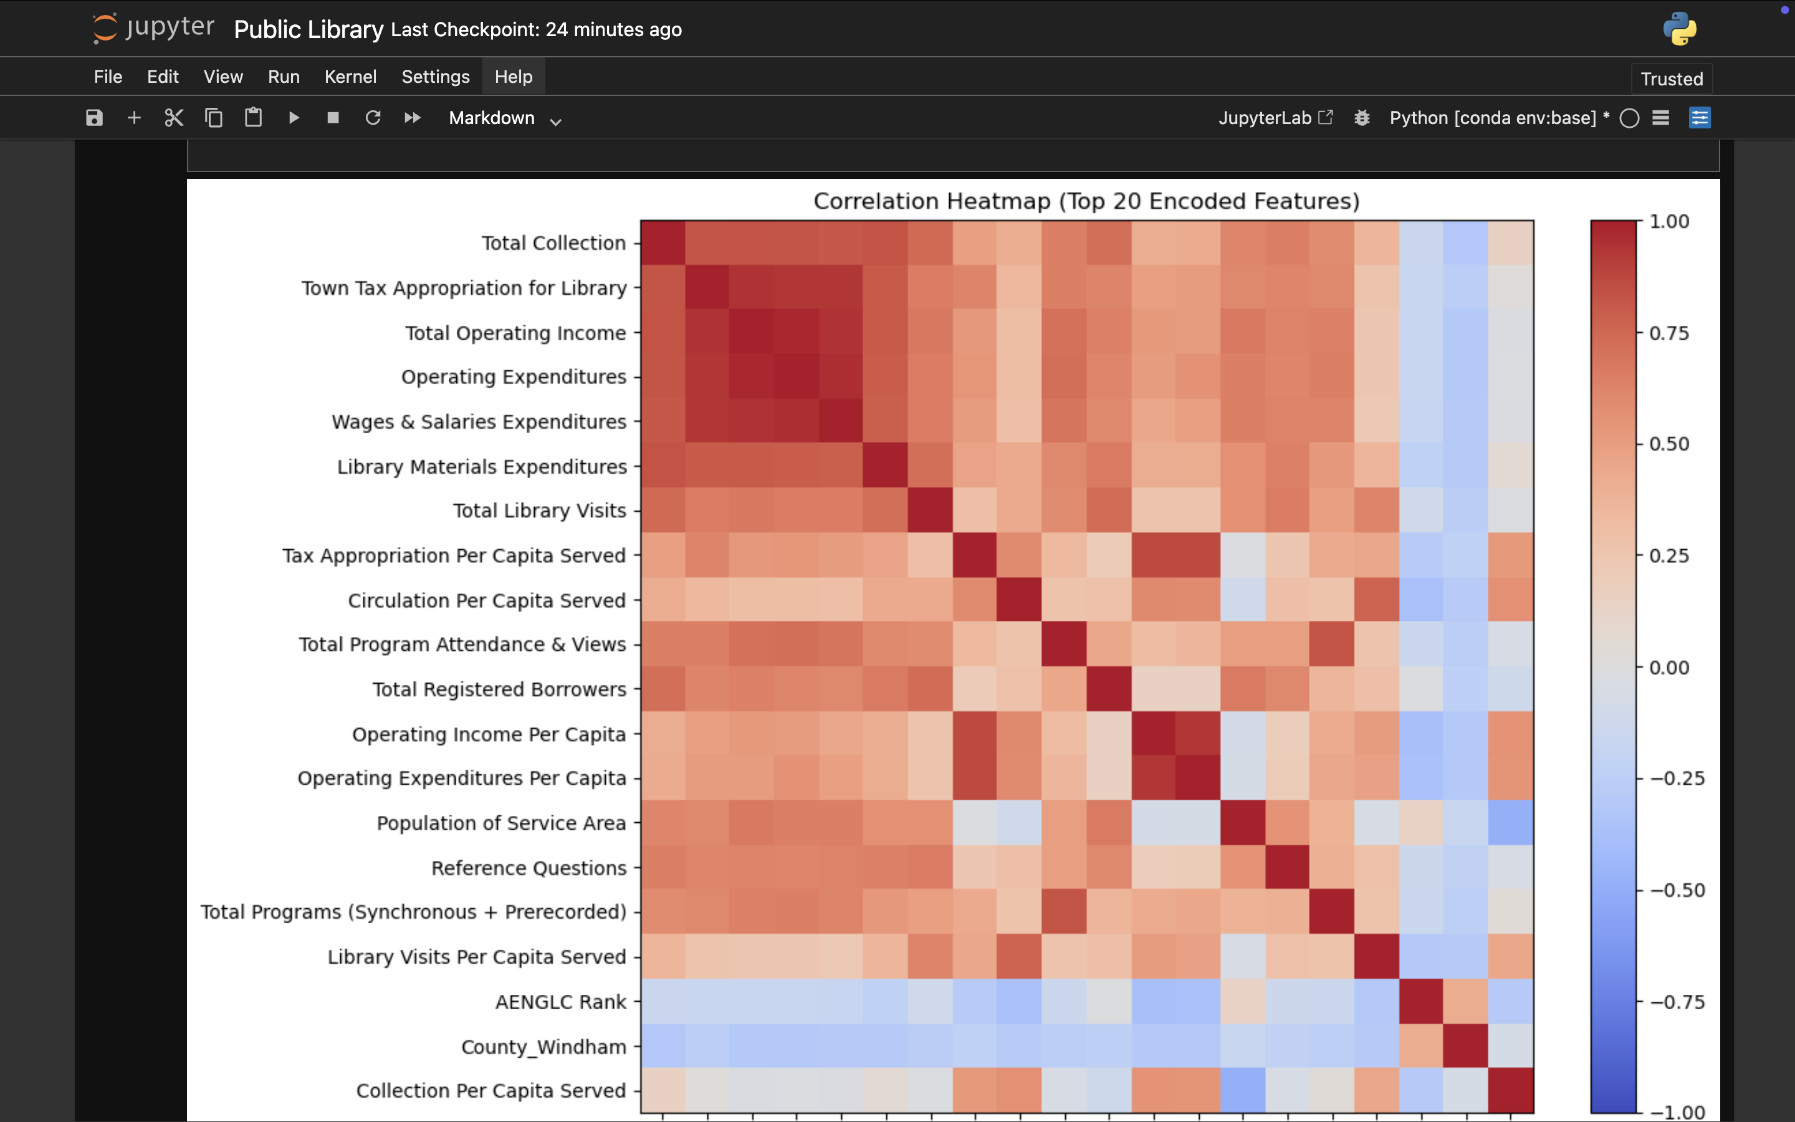

Slide 22
Conclusion
This project successfully demonstrated the practical application of machine learning techniques on a real-world Public Library Dataset obtained from Data.gov.in. The study followed a complete machine learning pipeline, starting from data understanding and preprocessing to model development, evaluation, and comparison. By working with an open government dataset, the project highlighted how publicly available data can be transformed into meaningful insights using predictive analytics.
Four classification algorithms—Logistic Regression, K-Nearest Neighbors (KNN), Decision Tree, and Random Forest—were implemented and trained on the same dataset to ensure a fair comparison. Each model exhibited different strengths and limitations. Logistic Regression provided simplicity and interpretability, KNN demonstrated instance-based learning behavior, Decision Tree offered clear decision rules, and Random Forest delivered improved accuracy by combining multiple decision trees.
The comparison of models using evaluation metrics such as accuracy helped in understanding how algorithm selection impacts predictive performance. Among the implemented models, Random Forest emerged as the best-performing model, as it consistently achieved higher accuracy and demonstrated better generalization on unseen data. This result supports the idea that ensemble learning methods often outperform individual models when dealing with complex, real-world datasets.
Overall, the project strengthened practical understanding of model selection, evaluation, and comparison in machine learning. It also emphasized the importance of preprocessing and exploratory data analysis in improving model performance. The outcomes of this study show that machine learning can play a significant role in analyzing public-sector data and supporting data-driven decision-making in domains such as public library management.
This project can be further extended by incorporating advanced algorithms, hyperparameter tuning, cross-validation techniques, or by deploying the best-performing model as a web-based application for real-time prediction.

Slide 23
Future Scope
The current project successfully demonstrates the application of machine learning techniques on a Public Library dataset using multiple classification models. However, there are several opportunities to further enhance and extend this work in the future.
Firstly, the project can be improved by incorporating advanced feature engineering techniques. Creating new features from existing data, performing dimensionality reduction, or applying domain-specific transformations may help improve model performance and predictive accuracy.
Secondly, hyperparameter tuning techniques such as Grid Search or Random Search can be applied to optimize each model further. This would allow a more refined comparison between models and could lead to better generalization on unseen data.
The project can also be extended by experimenting with additional machine learning and deep learning algorithms, such as Support Vector Machines (SVM), Gradient Boosting, XGBoost, or Neural Networks. Comparing these models with the existing ones may provide deeper insights into algorithm suitability for government datasets.
Another important future extension is model deployment. The trained best-performing model can be deployed as a web application or API using frameworks like Flask or FastAPI, enabling real-time predictions and practical usage by stakeholders.
Additionally, the dataset can be updated or combined with other related datasets to perform time-based or large-scale analysis, which may help in better trend prediction and long-term planning for public library systems.
Overall, the future scope of this project lies in improving model performance, expanding analytical depth, and transforming the solution into a real-world decision-support system for public service optimization.

Slide 24
Github Link:
https://github.com/Rohitdubey-tech/Publiv-Library-ML-Project/upload
Linkedin Link:
https://www.linkedin.com/feed/update/urn:li:activity:7406286703130337280/
Dataset Link: https://www.data.gov.in/

Slide 25
References:
Government of India, Data.gov.in – Open Government Data Platform, https://data.gov.in
Géron, A., Hands-On Machine Learning with Scikit-Learn, Keras, and TensorFlow, O’Reilly Media, 2019
Bishop, C. M., Pattern Recognition and Machine Learning, Springer, 2006
James, G., Witten, D., Hastie, T., & Tibshirani, R., An Introduction to Statistical Learning, Springer, 2013
Breiman, L., “Random Forests,” Machine Learning, vol. 45, no. 1, 2001
Quinlan, J. R., C4.5: Programs for Machine Learning, Morgan Kaufmann, 1993
Cover, T., & Hart, P., “Nearest Neighbor Pattern Classification,” IEEE Transactions on Information Theory, 1967
Scikit-learn Documentation, Machine Learning in Python, https://scikit-learn.org
Han, J., Kamber, M., & Pei, J., Data Mining: Concepts and Techniques, Morgan Kaufmann, 2011
Provost, F., & Fawcett, T., Data Science for Business, O’Reilly Media, 2013

