Slide 1

★
Costing 101
The friendly beginner's guide
What you'll get: Zero jargon. Lots of doodles. Real-world examples — pizza, coffee, AC repair.
✦
Made for someone who has never seen a costing slide in their life.

Slide 2
THE ROADMAP
What you'll learn
1
What is cost, really? Plus the 3 ingredients every cost is made of.
2
Direct vs Indirect The coffee shop trick to remember the difference.
3
The ONE formula Cost = Rate × Usage. Yes, that's it. Really.
4
Real examples Steel sheets, laser cutters, AC repair bills.
5
Why this saves money How breaking cost down helps you negotiate.
Costing 101
2 / 18

Slide 3

STEP 1
What even is "cost"?
Cost ≠ Price you pay. Cost = what it took to make it.
Imagine making a pizza. Cost is just everything you spend to make it. The dough, the cheese, the gas for the oven, the chef's time, the rent for the kitchen, and the little profit the owner keeps. Add it all up → that's the cost.
Costing 101
3 / 18

Slide 4
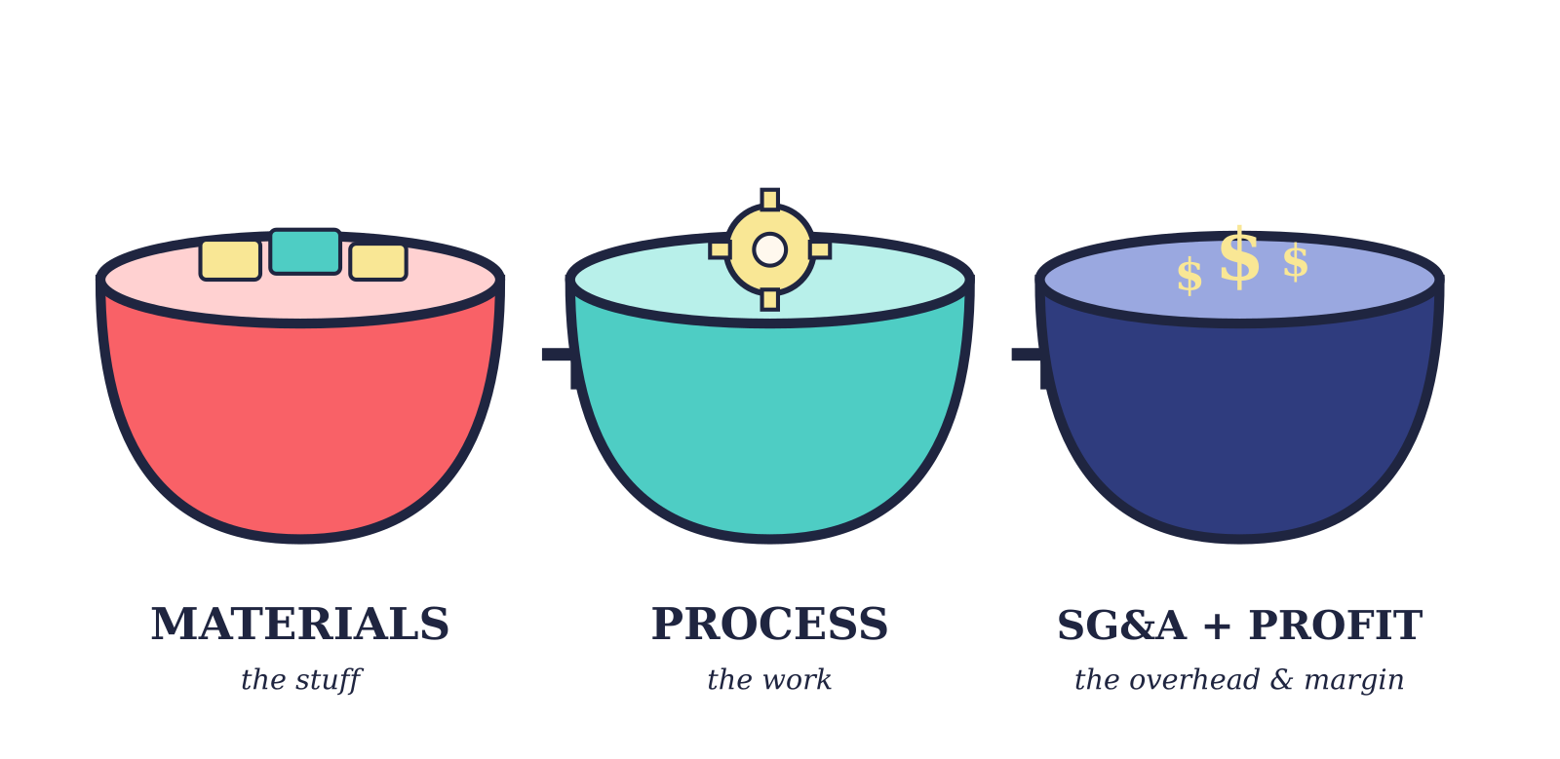
STEP 2
Every cost has 3 ingredients
→ We'll meet each one next.
Whether it's a t-shirt, a car, or a haircut — these three are always there.
Costing 101
4 / 18

Slide 5
THE STUFF
Ingredient 1 — Materials
The physical stuff that goes INTO the thing. Pizza:
dough, cheese, sauce, toppings, the box
Car:
steel, glass, paint, tires, bolts
T-shirt:
fabric, thread, the printed logo, tag
Direct Materials The main stuff (steel for a car)
Purchased Parts Bought ready-made (bolts, motors)
1
2
3
Outsourced Services Work done by someone else
4
Packaging The box, foam, plastic wrap
If you can hold it, ship it, or store it — it's a material.
Costing 101
5 / 18

Slide 6
THE WORK
Ingredient 2 — Process cost
The cost of TURNING materials into the finished thing. Two parts: 1. Direct Labor — the person actually making it. Wages + benefits + paid leave. 2. Equipment Burden — the machine running. Electricity, maintenance, tooling, rent, insurance.
Examples
1
Pizza oven baking Gas + chef's time
2
Laser cutting steel Machine + operator running
3
Painting a car Paint booth + sprayer's hours
4
Stitching a shirt Sewing machine + tailor
Costing 101
6 / 18

Slide 7
THE OVERHEAD & MARGIN
Ingredient 3 — SG&A + Profit
SG&A = Selling, General & Administrative. It's all the people and bills that keep the company alive — but they aren't making the product themselves. Think: the CEO, finance team, sales, legal, advertising, HR. Profit = what the company keeps after covering everything else. Usually 5–25% in manufacturing.
Who counts as SG&A?
Executives & finance
Sales & advertising
Legal team
HR & IT support
Office rent & utilities
They don't make the pizza — but the kitchen can't run without them.
Costing 101
7 / 18

Slide 8
STEP 3
Two flavors of cost
The same 3 ingredients apply — whether you're making a thing or doing a thing.
Manufacturing
Services
You make a physical thing.
You do something for someone.
Cost =
Cost =
Materials
+ Process (Labor + Machine)
+ SG&A + Profit
Labor (your time)
+ Consumables (parts you use)
+ Overhead (tools, vehicle, SG&A, profit)
Examples: car parts • phone case • sneakers • bread
Examples: haircut • AC repair • cleaning • delivery
Costing 101
8 / 18

Slide 9
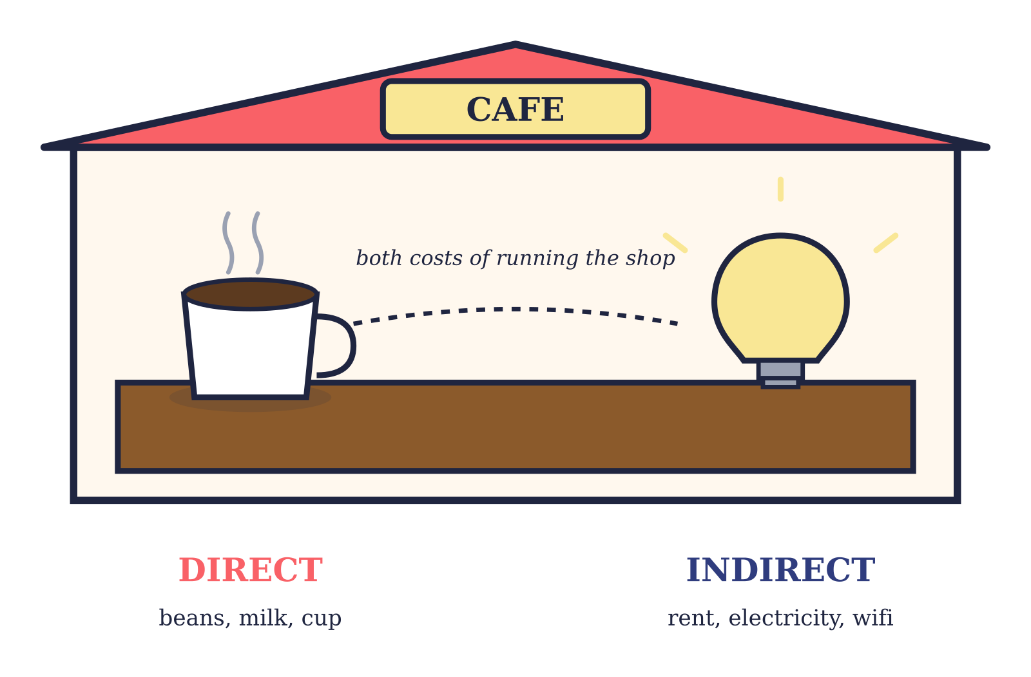
THE COFFEE-SHOP TRICK
Direct vs Indirect
DIRECT — ends up IN the product. Coffee beans go INTO the latte. Steel goes INTO the car door.
INDIRECT — helps make it happen, but isn't IN it. The shop's rent, electricity, wifi, the manager's salary.
Costing 101
9 / 18

Slide 10
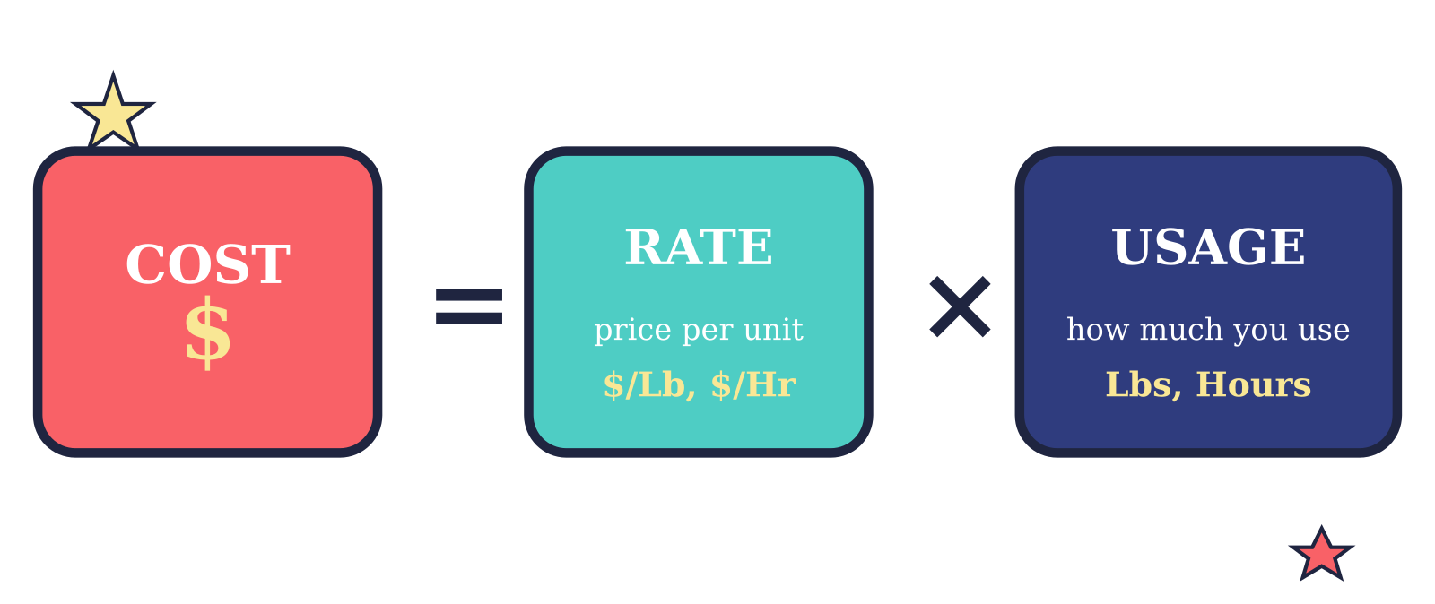
THE ONLY FORMULA YOU NEED
Cost = Rate × Usage
Two things multiplied. That's the whole game.
Works for ANYTHING — pizza, plumbing, gasoline, hotels, haircuts.
Costing 101
10 / 18

Slide 11
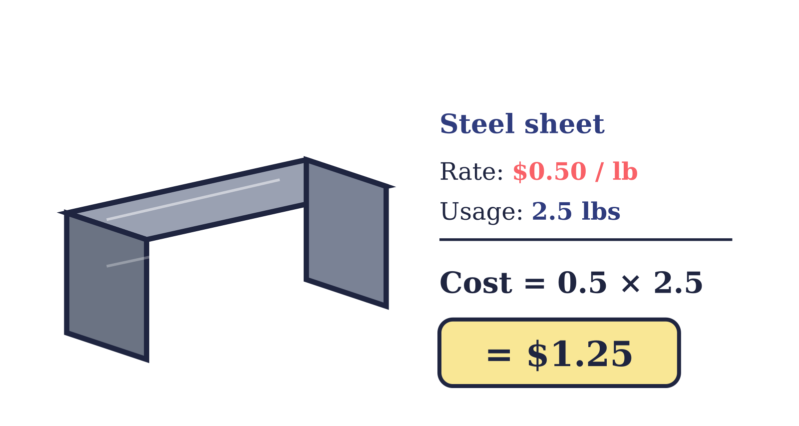
EXAMPLE 1
The formula in action — Materials
RATE is the price per unit. USAGE is how many units you used.
Steel sheet $0.50 / lb × 2.5 lbs = $1.25
Bolts $0.20 / piece × 2 pieces = $0.40
Paint $10 / lb × 0.3 lbs = $3.00
Costing 101
11 / 18

Slide 12
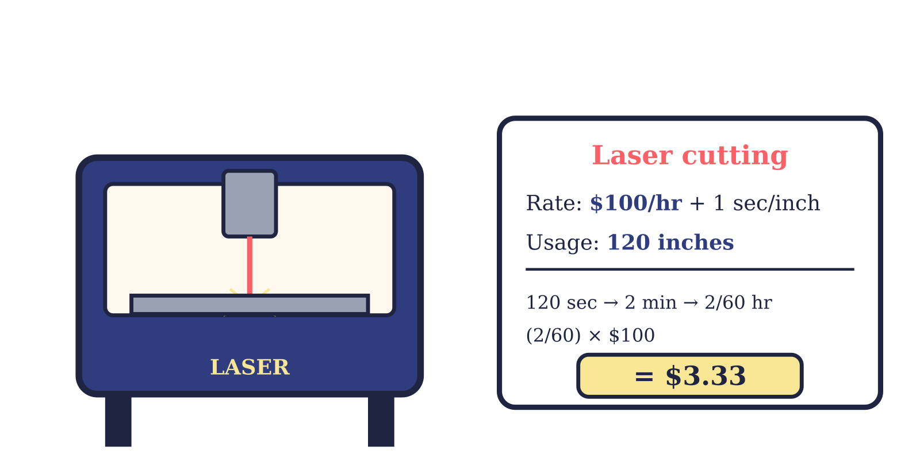
EXAMPLE 2
The formula in action — Process
Same formula. The RATE is per hour. USAGE is how long you ran the machine.
Trick: convert seconds → hours, then multiply by the hourly rate.
Costing 101
12 / 18

Slide 13
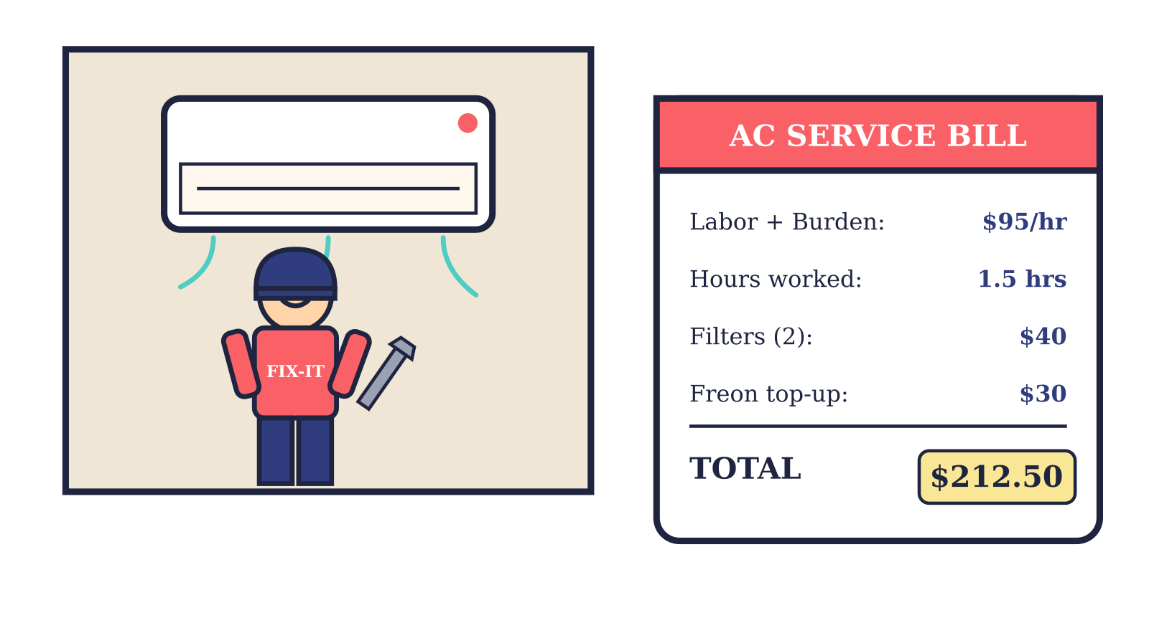
EXAMPLE 3
The formula in action — Services
Same formula again. For services, you usually pay an hourly rate + parts.
Heads-up: the $95/hr rate already bakes in the technician's tools, van, AND company profit.
Costing 101
13 / 18

Slide 14
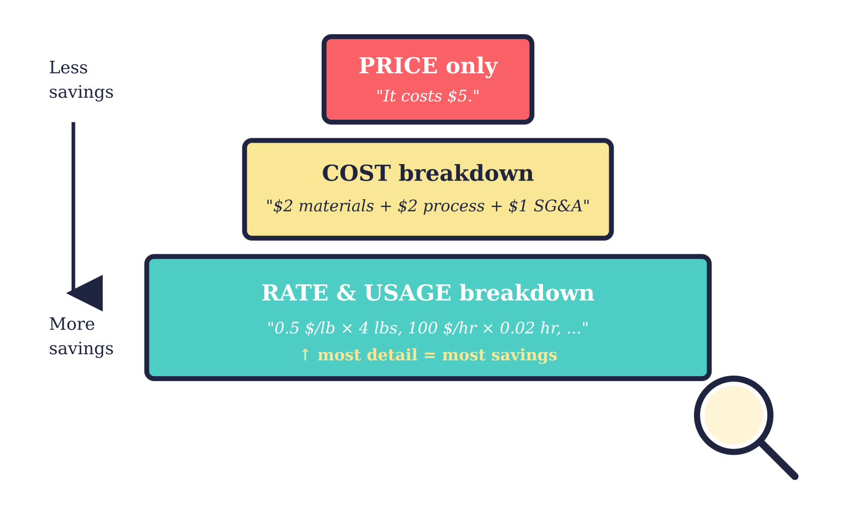
THE BIG IDEA
Why this matters: visibility = savings
The more you break a cost down, the more places you can find savings.
→ When you only know the PRICE, you can only argue "that's too much."
→ When you know the RATES, you can find exactly WHERE it's too much.
Costing 101
14 / 18

Slide 15
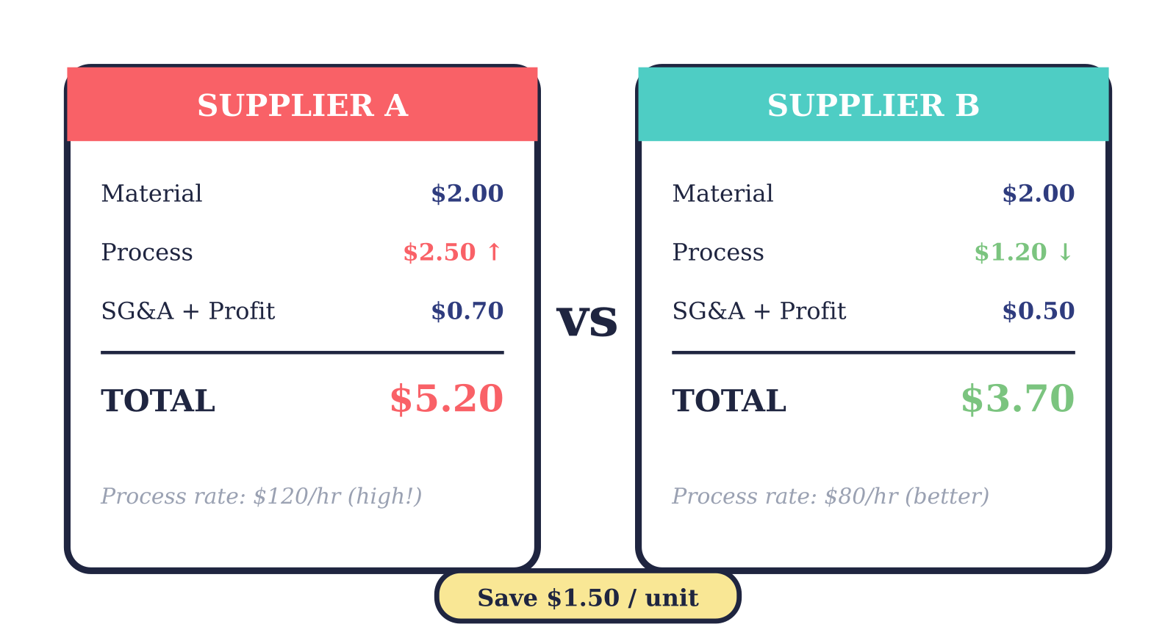
PUTTING IT ALL TOGETHER
Benchmarking in action
Two suppliers offered to make the same part. Here's what we learned:
Without the breakdown we'd see "$5.20 vs $3.70." With it, we know which lever to pull — Process.
Costing 101
15 / 18

Slide 16
CHEAT SHEET
If you remember nothing else…
①
②
Every cost has 3 parts Materials + Process + SG&A & Profit.
One formula to rule them all Cost = Rate × Usage.
③
④
Direct = in the product Indirect = around the product.
Breakdown saves money More detail = more places to negotiate.
Costing 101
16 / 18

Slide 17

QUIZ TIME
Quick check — pick your answer
1. The basic costing formula is…
A) Cost = Rate / Usage B) Cost = Rate × Usage C) Cost = Rate + Usage D) Cost = 2 × (Rate × Usage)
2. "$/Hour" is an example of a…
A) Usage B) Profit C) Rate D) Discount
3. The formula works for…
A) Only manufacturing B) Only services C) Only indirect purchases D) All of the above
4. Which one is a DIRECT material?
A) A re-usable masking plug B) The forklift fuel C) Steel billet in a forging plant D) The factory's wifi router
5. SG&A stands for…
A) Set Goal & Adjust B) Selling, General & Administrative C) Storage, Gas & Audit D) Standard Goods Accounting
→ Flip to slide 18 for the answers.
Costing 101
17 / 18

Slide 18
HIGH FIVE
Answers & you're done!
Answers
You now know costing.
B
1. Cost = Rate × Usage
Seriously. You can read a vendor quote now.
C
Next time you see a price, ask yourself:
2. "$/Hour" is a RATE
What's the material cost?
What's the process cost?
What's the SG&A + profit?
Which RATE is the highest, and why?
D
3. Works for ALL of the above
C
4. Steel billet is DIRECT material
B
5. Selling, General & Administrative
Welcome to supply chain thinking.
Costing 101
18 / 18

