Slide 1
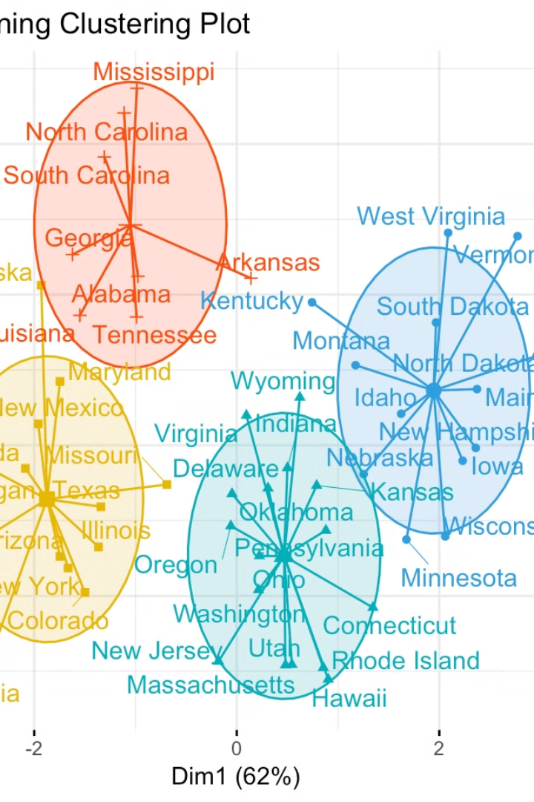


Introduction to Divisive Clustering
Divisive clustering is a method of clustering data points into distinct groups based on selected features. It starts with a single cluster containing all the data points and then divides the clusters iteratively.
by rohit gadkari

Slide 2
Features of Divisive Clustering
Top-Down Approach
Feature Selection
Complex Data Structures
It follows a top-down approach, starting with one large cluster and then dividing it into smaller sub-clusters.
Allows for the selection of specific features which then dictate the separation of data points into clusters.
Capable of handling complex data structures with varying degrees of similarity between data points.

Slide 3
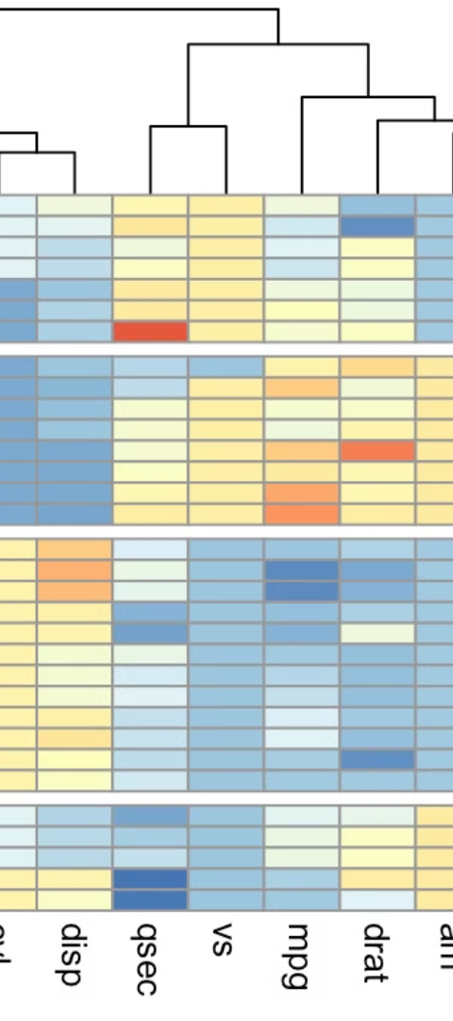
Advantages of Divisive Clustering
1
Customized Grouping
2
Refined Analysis
Enables customized and specific grouping based on chosen features, allowing for more precise analysis.
Helps in providing a deeper understanding of complex datasets by breaking them down into smaller, more interpretable subsets.
3
Topological Structures
Effective in identifying topological structures within the data, providing insights into spatial relationships.

Slide 4
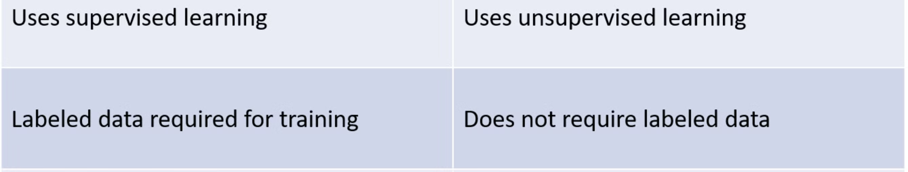
Disadvantages of Divisive Clustering
Complexity
Overfitting
Scalability
The process can become complex when dealing with large datasets or intricate data structures.
There is a risk of overfitting, meaning that the clustering might be too specific to the input data.
Not easily scalable to handle enormously large datasets, which can be a limitation in certain applications.

Slide 5
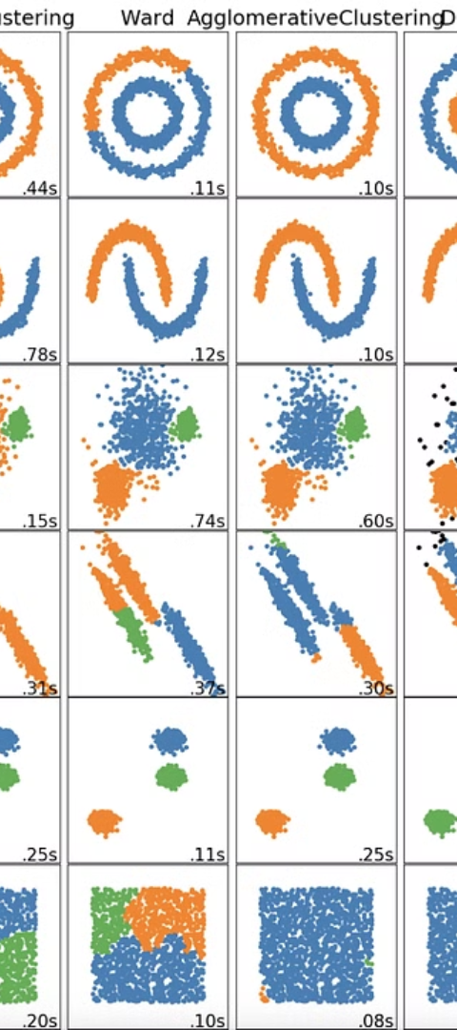
Main Implementation of Divisive Clustering
1
Data Preprocessing
Preliminary preparation of the data including normalization, cleaning, and feature selection.
2
Cluster Division
Iterative division of clusters based on selected features with the aim of creating distinct sub-groups.
3
Result Analysis
Assessment of the obtained clusters to determine their coherence and suitability for the data.

Slide 6
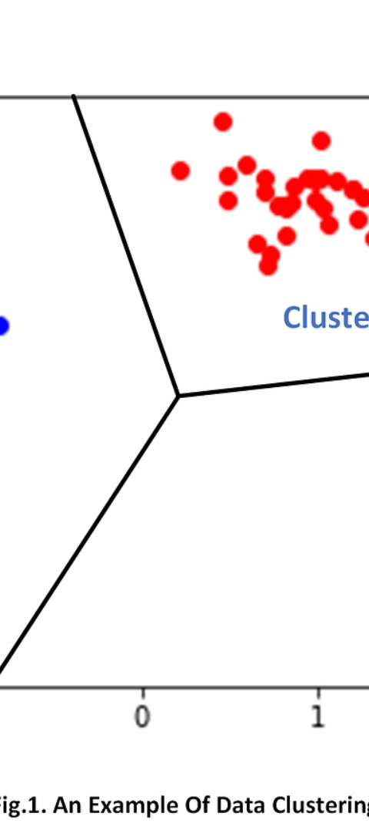



Output of Divisive Clustering
Clustering Results
Visual representations of the obtained clusters, showing the relationships and separations between data points.
Cluster Characteristics
Summary of the characteristics and parameters of each resulting cluster for further analysis.
Cluster Validation
Validation of the obtained clusters using various techniques to ensure their reliability.

Slide 7
Practical Examples of Divisive Clustering
Customer Segmentation
Biological Classification
Market Trend Analysis
Application in businesses to segment customers based on their preferences, behaviors, and demographics.
Utilized in biological research for the classification of species based on genetic and phenotypic characteristics.
Used to discern market trends by clustering consumer behaviors and preferences to identify patterns.

Slide 8
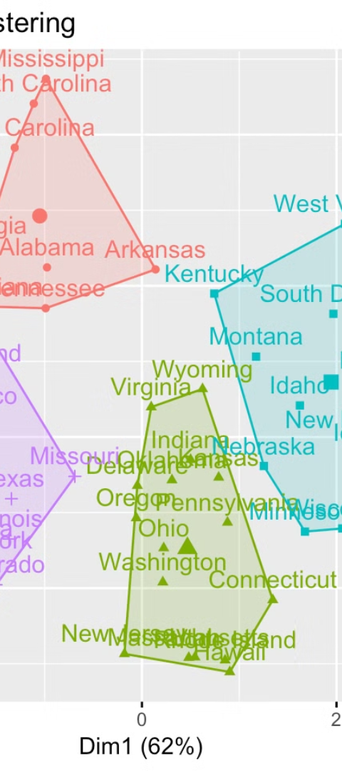
Conclusion and Summary
1
Powerful Analysis
2
Usage Scenarios
Divisive clustering provides a powerful tool for understanding complex datasets with customizable groupings.
Applicable in various domains including finance, healthcare, marketing, and environmental analysis.
3
Evolving Methodology
Continuously evolving method enhancing capabilities for handling diverse and intricate datasets.

