Slide 1
ROHITH J
Final Project
3/21/2024 Annual Review

Slide 2
PROJECT TITLE
SIGN LANGUAGE RECOGNITION USING CONVOLUTIONAL NEURAL NETWORK

Slide 3

AGENDA
Problem Statement
Introduction
Objective
Handling Gesture Variability
Applications and Impact
Future direction and Conclusion

Slide 4

PROBLEM STATEMENT
Sign language recognition is challenged by gesture variability, non-manual components integration, sparse datasets, and real-time processing demands. Existing technologies resort to manual feature engineering, lack contextual grasp, and face hurdles in scalability and generalization. However, accurate recognition systems are vital for accessibility, inclusivity, and empowerment of the deaf community. By bridging communication gaps, these systems foster inclusivity and innovation in machine learning and computer vision, shaping a more inclusive society.

Slide 5

PROJECT OVERVIEW
INTRODUCTION:
Sign language, as a vital mode of communication for the deaf and hard of hearing community, presents unique challenges in its recognition and interpretation. With the advancement of deep learning techniques, particularly Convolutional Neural Networks (CNNs), there's a promising avenue for developing robust sign language recognition systems. CNNs have demonstrated remarkable capabilities in capturing intricate spatial dependencies within visual data, making them well-suited for interpreting the complex gestures and expressions inherent in sign language.

Slide 6
OBJECTIVE:
The primary objective of this project is to develop an accurate and efficient sign language recognition system using Convolutional Neural Networks (CNNs). We aim to tackle challenges such as gesture variability, non-manual components integration, sparse datasets, and real-time processing demands. Specific objectives include designing tailored CNN architectures, handling gesture variability, integrating non-manual components, employing data augmentation, facilitating real-time processing with mechanisms like RNNs, promoting end-to-end learning, and exploring transfer learning techniques. By achieving these goals, we aspire to create a state-of-the-art system that enhances accessibility, inclusivity, and empowerment for the deaf and hard of hearing community, while driving innovation in machine learning and computer vision.

Slide 7
HANDLING GESTURE VARIABILITY
Handling gesture variability in sign language gestures using CNNs involves implementing several strategies to ensure robust recognition across different hand shapes, movements, and facial expressions. These strategies include data augmentation techniques to artificially diversify the training dataset, multi-modal learning to incorporate various sign language modalities simultaneously, and temporal information modeling through architectures like RNNs or LSTMs to capture sequential dependencies. Additionally, attention mechanisms can be employed to focus on relevant regions of interest, while transfer learning leverages pre-trained models for improved generalization. Ensemble learning combines multiple CNN models for enhanced performance, and adaptive learning rates dynamically adjust during training to navigate optimization challenges. By integrating these techniques, sign language recognition systems using CNNs can effectively handle variability, resulting in more accurate and robust recognition across diverse sign languages and variations.

Slide 8
APPLICATIONS AND IMPACT
Communication Accessibility: CNN-based sign language recognition enables real-time translation of sign language into text or spoken language, facilitating seamless communication in various contexts including educational institutions, healthcare facilities, and public services.
Digital Content Access: These systems broaden access to digital content by providing automatic captioning and translation services for online videos, educational materials, and social media platforms, thereby enhancing inclusivity in the digital realm.
Independent Information Access: Individuals who are deaf or hard of hearing gain greater independence in accessing information through CNN-based sign language recognition, allowing them to understand and engage with content without reliance on interpreters or written communication.

Slide 9
Social and Professional Inclusion: By breaking down communication barriers, CNN-based sign language recognition promotes inclusion in social and professional environments, empowering individuals to participate fully in conversations, meetings, and other interactions.
Cultural Preservation: These technologies contribute to the preservation and promotion of sign language and deaf culture by increasing awareness and understanding of sign language among the broader population, fostering appreciation and respect for linguistic diversity.
Employment Opportunities: Improved communication access facilitated by CNN-based sign language recognition enhances employment opportunities for individuals who are deaf or hard of hearing, promoting workplace inclusivity and diversity.

Slide 10
FUTURE DIRECTION AND CONCLUSION
Future directions in sign language recognition technology entail exploring advancements in deep learning architectures, such as CNNs, to further improve accuracy and efficiency. Additionally, research efforts may focus on developing multi-modal systems that integrate visual and linguistic cues for more comprehensive understanding. The incorporation of user feedback mechanisms and adaptive learning approaches can enhance system adaptability and user experience. Moreover, there's a need to address challenges related to scalability, generalization across diverse sign languages, and real-world deployment. In conclusion, CNN-based sign language recognition holds immense promise for enhancing accessibility, inclusivity, and empowerment for the deaf and hard of hearing community. By advancing technology and fostering collaboration between researchers, developers, and end-users, we can continue to drive innovation and create positive societal impact in the field of sign language recognition.

Slide 11

WHO ARE THE END USERS?
Deaf and Hard of Hearing Individuals: The primary beneficiaries of sign language recognition systems are individuals who are deaf or hard of hearing. These systems empower them to communicate more effectively with the broader community, access educational resources, participate in social and professional settings, and engage in various activities without relying solely on interpreters or written communication.
Interpreters and Translators: Sign language recognition systems can assist interpreters and translators in their work by providing real-time translation of sign language into text or spoken language. This can streamline the interpretation process and improve communication efficiency, especially in situations where professional interpreters may not be readily available.

Slide 12
Educational Institutions: Schools and educational institutions that serve deaf and hard of hearing students can benefit from sign language recognition technology by integrating it into their teaching methods and educational resources. This enables a more inclusive learning environment and enhances access to educational materials for students who use sign language as their primary mode of communication.
Healthcare Providers: Healthcare providers can utilize sign language recognition systems to improve communication with deaf and hard of hearing patients, ensuring that they receive appropriate medical care and information. This can enhance patient-provider interactions, promote better understanding of medical conditions and treatment plans, and ultimately improve health outcomes for this population.
Technology Developers and Researchers: Developers and researchers in the fields of machine learning, computer vision, and natural language processing are also end users of sign language recognition systems. They can utilize these systems to explore new algorithms, techniques, and applications, advancing the state-of-the-art in sign language recognition technology and driving innovation in related fields.

Slide 13

YOUR SOLUTION AND ITS VALUE PROPOSITION
Our solution for sign language recognition using Convolutional Neural Networks (CNNs) offers a robust and efficient approach to interpreting sign language gestures. By harnessing the power of CNNs, we accurately capture the intricate spatial dependencies within visual data, ensuring precise recognition of diverse hand shapes, movements, and facial expressions. This technology enables real-time translation of sign language into text or spoken language, fostering seamless communication and accessibility in various domains. The value proposition of our solution lies in its ability to break down communication barriers, empowering individuals in the deaf and hard of hearing community to express themselves effectively and access information independently.

Slide 14
MODELING
Data Collection: Gather a diverse dataset of sign language gestures, including various signs, expressions, and movements, with annotations indicating the corresponding linguistic representation.
Data Preprocessing: Prepare the dataset by cleaning, normalizing, and augmenting the data to improve model generalization and robustness. This may involve techniques like resizing images, standardizing lighting conditions, and introducing variations in orientation and background.
Gesture Segmentation: Segment the input video streams into individual gestures to isolate and identify each sign. This helps the model focus on recognizing and interpreting one gesture at a time, improving overall accuracy.

Slide 15
Model Training: Train the selected model using the preprocessed dataset, optimizing its parameters to minimize the difference between predicted and ground truth linguistic representations. This step involves iterative adjustments of the model's weights through techniques like backpropagation and gradient descent.
Evaluation: Assess the trained model's performance using separate validation and test datasets, measuring metrics such as accuracy, precision, recall, and F1 score. Fine-tune the model and hyperparameters based on the evaluation results to improve performance.
Deployment: Deploy the trained model to production environments, integrating it with camera-equipped devices or applications to enable real-time sign language recognition. Continuously monitor and update the model to adapt to new gestures, improve accuracy, and enhance user experience.

Slide 16
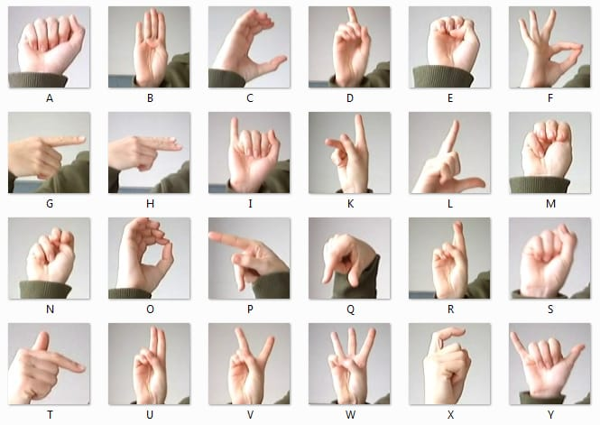
RESULTS
Code Link: https://github.com/Rohith-11511/NM-Project.git

