Slide 1




Power2Go: AI-Powered EV Rescue
Applied AI for People, Planet, Progress.
UNLEASH LLM Innovation Challenge | Final Pitch
Progress
Smart charging, diagnosis and roadside assistance—when EV users need it most.
Planet
Electro Elite
Rohith B
Vinothkumar C
Bharani RM
People
Impact track: Climate & Environment
Notes:
Slide 1: Project Title and Team Details
Project title (clear, concise and impactful)
One line tagline or value proposition
Team name
Team member names (up to 4)
You can replace the right panel with a product visual or team photo.

Slide 2
Project Definition
EV users need reliable help when charging is far away or a vehicle breaks down.
The problem
Who is affected
In Indian cities and on intercity routes, EV drivers can face low-battery emergencies, charging uncertainty and breakdowns without one place to get coordinated help.
EV car and two-wheeler owners, fleet drivers and long-distance travellers—especially those with limited access to charging or roadside EV support.
Why it matters now
As EV use grows, drivers need dependable charging and repair support. Delays can disrupt journeys, work and confidence in EV travel.
What is missing today
Station-finder apps help locate chargers, while repair and towing services are separate. Users may still need to coordinate several providers during an emergency.
Notes:
Slide 2: Project Definition
Clear definition of the problem you are solving
Who is affected by this problem?
Why is this problem important today?
Current gaps or limitations in existing solutions

Slide 3
Inspiration and Background
The idea comes from a practical gap: EV users need more than a map when their vehicle cannot continue.
“
The numbers
Power2Go was shaped around a simple question: if an EV is stranded, can one platform help decide what is needed and connect the user to the right service?
24%
Inadequate charging infrastructure
Indian EV owners identified insufficient charging infrastructure as a concern.
23%
Range anxiety
Founder-led problem framing; validate with EV drivers and service partners during pilot testing.
EV owners reported concern about their vehicle's driving range.
Research insight
21%
Charging time concerns
The product concept focuses on the gap between finding a charger and getting end-to-end emergency help. No user-survey result is claimed yet.
EV owners identified the time required to charge their vehicles as a concern.
Notes:
Slide 3: Inspiration and Background
What inspired you to work on this problem?
Any real life observation, research insight or experience
Supporting data points, trends or references (if applicable). Always cite the source.

Slide 4
Proposed Solution Overview
What makes it different
Our solution
Power2Go connects EV problem reporting with charging and roadside support.
Existing approaches | Our approach
Use separate apps to find EV charging stations and plan charging stops. | Power2Go aims to combine charging route planning with roadside assistance in one platform.
Call a towing service or mechanic when their EV breaks down. | Power2Go helps users request suitable support, such as a mobile mechanic or towing service.
Search online or ask AI chatbots for advice about EV problems. | Power2Go aims to combine AI-based initial troubleshooting guidance with a pathway to request real-world assistance.
How it solves the problem
Smart Charging: Helps drivers find suitable EV charging stations.
Route Planning: Suggests routes with charging stops.
AI Assistance: Provides initial guidance for EV problems.
Emergency Support: Connects drivers with roadside assistance.
Mobile Repair: Helps drivers request on-site mechanic services.
Easy Booking: Simplifies charging and repair service requests.
Real-Time Updates: Keeps drivers informed about service progress.
Notes:
Slide 4: Proposed Solution Overview
High level explanation of your solution
How your solution addresses the problem
Key differentiators compared to existing approaches

Slide 5
Implementation Approach and Business Model
From user report to practical assistance, with an open-source LLM supporting problem understanding.
Input
Processing
Open source LLM
Output
User value
Vehicle, battery level, location and problem description; optional photo/video.
Validate inputs; combine vehicle details, symptoms, location and available service information.
LLM interprets the report and returns structured, safety-aware preliminary guidance.
Possible issue, safety steps and suggested service: charge, mechanic or recovery.
Clearer next steps and a coordinated request instead of contacting services separately.
Key modules and data flow
Business and deployment model
Customer web app: submit request and location
AI service: classify symptoms and recommend next step
Dispatch API: find suitable support and update request status
Target users
EV drivers, fleets and charging/service partners.
Delivery
Web app first; mobile-friendly interface, with future messaging integration.
Sustainability
Potential service fee, charging margin and fleet/station partnerships; validate through pilot.
Notes:
Slide 5: Implementation Approach or Business Model (choose one or combine both)
Technical implementation: system architecture or workflow; key modules or components; data flow and processing logic.
Business or deployment model: target users or customers; value delivery mechanism; revenue model or sustainability plan (if applicable).

Slide 6
Technology Stack
LLMs and AI models
Frameworks
Data sources
Deployment
Llama-3 8B (Meta local offline runtime)
Next.js 14 (React)
User-submitted EV fault descriptions (text + photo)
Render (Cloud PaaS)
Google Gemini 1.5 Flash (Cloud LLM)
Express.js (Node.js backend)
EV charging station data (manually curated for Tamil Nadu)
GitHub Pages / Render Web Service
Web Speech Recognition API (ta, hi, te, en)
Ollama (local LLM runtime)
IndiaAI open EV datasets (reference)
Ollama on local GPU (inference)
Deterministic Semantic NLP Fallback Engine
SQLite & PostgreSQL (dual persistence)
Google Maps Geocoding API
Docker-ready for edge deployment
Notes:
Slide 6: Technology Stack
LLMs and (if used) other AI models; open source LLMs are required
Frameworks, libraries and platforms
Data sources
Deployment environment (cloud, local, APIs and so on)

Slide 7
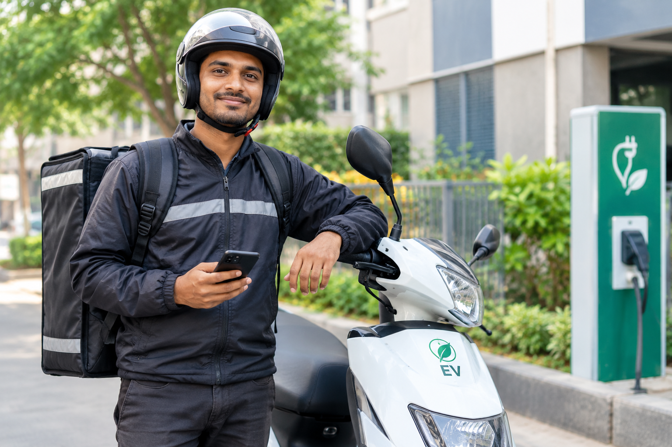
Project Utilization and Use Cases
Primary use case
Secondary use cases
Persona name
Emergency roadside rescue — Ravi's EV dies at 11 PM on a highway. He opens Power2Go, describes the issue in Tamil, AI diagnoses the fault in seconds, and a mobile charging van is dispatched to his GPS location within 15 minutes.
1) Pre-booking a charging slot at a Power2Go hub before a long trip to skip the queue. 2) Planning a Chennai-to-Madurai road trip where AI calculates exact charging stops based on battery %. 3) Fleet admin monitoring all driver breakdowns and repair costs on a single dashboard.
Ravi, the EV delivery driver
Needs
Reach a destination safely and find the right help when battery or vehicle trouble occurs.
A day with our solution
Discovers
Uses
Gets an answer
Acts on it
Today they
Search for stations, call contacts and separately arrange a mechanic or towing.
Ravi's EV stops on the road. He opens Power2Go on his phone and taps the chatbot. He types in Tamil: "என் வண்டி நின்னுடுச்சு, பேட்டரி காலி" (My vehicle stopped, battery empty).
Power Bot (Llama-3 AI) detects Tamil, understands the problem, and responds in Tamil: "பேட்டரி தீர்ந்துவிட்டது. மொபைல் சார்ஜிங் வேன் 12 நிமிடத்தில் வரும்." It auto-fills the Mobile Charging booking form.
AI confirms: Battery Depleted (Severity: HIGH). Nearest charging van is 4.2 km away. Estimated cost: ₹380. ETA: 12 minutes. Ravi taps "Confirm Booking."
The van arrives, charges Ravi's EV to 60%. He pays ₹380 via UPI inside the app, rates the service 5 stars, and is back delivering within 25 minutes of breakdown.
Also used by
Charging drivers, mechanics, recovery operators, fleets and charging stations.
Notes:
Slide 7: Project Utilization and Use Cases
Who will use this solution?
Primary and secondary use cases
Example user journey or scenario

Slide 8
Scalability and Future Roadmap
 | Now | Next 3 months | 6 to 12 months | Beyond a year
Product features | Current prototype | Improve core features | Add live tracking | Expand AI features
Reach and users | Initial testing | Small pilot group | Reach new regions | Nationwide expansion
Partnerships | Team development | Contact service providers | Partner with EV services | Build a wider network
How it scales : Expand to more users, locations, and service providers without rebuilding the platform.
Notes:
Slide 9: Scalability and Future Roadmap
How the project can scale
Potential feature expansions
Partnerships or ecosystem integration opportunities

Slide 9
Risks and Limitations
Risk or limitation | Type | Likelihood | How we handle it
Incorrect AI guidance | Technical | Medium | Provide basic guidance and recommend professional help.
Service provider unavailability | Operational | High | Inform users when support is unavailable.
Biased or inaccurate AI responses | Ethical or AI bias | Medium | Test responses and use safety guidelines.
Exposure of user location or data | Data and privacy | Medium | Limit data collection and protect user information.
Responsible AI Prioritize user safety, privacy, transparency, and reliable guidance.
Notes:
Slide 10: Risks and Limitations
Technical or operational challenges
Ethical, data or AI related concerns
Mitigation strategies
Responsible AI (fairness, transparency, data privacy and safety) is part of the evaluation, so address it directly.

Slide 10
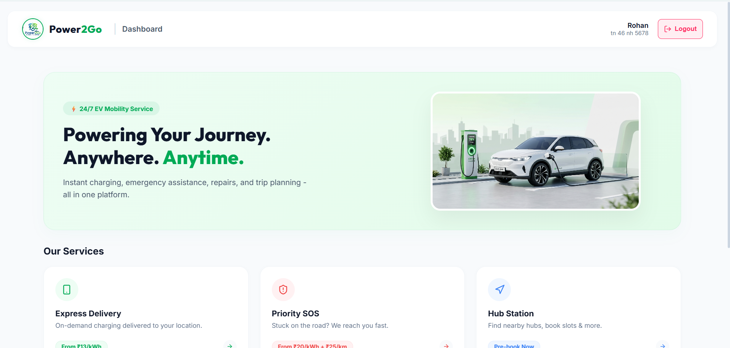
Demo or Prototype
Built so far
Unified EV assistance prototype.
Development team through manual testing.
Real-world validation with EV drivers.
Demo and code
Video link : https://drive.google.com/file/d/1ek0S4b_YZCg3Ik6AKSDF9LifDXngP0P8/view?usp=sharing
Repository link : https://github.com/Rohith-1301/Power2Go
Where we are today
Idea
Proof of concept
Working prototype
MVP
Pilot
Notes:
Slide 11: Demo or Prototype (if applicable)
Screenshots, live demo flow or recorded demo
What has been built so far
Current maturity level of the solution
Move the green marker to your current stage.

Slide 11
Power2Go brings EV charging guidance, AI-based support, and roadside assistance together in one platform to make EV journeys easier and more reliable.
What we want you to remember
Proven need
Real innovation
Ready to scale
EV drivers face charging infrastructure gaps, range anxiety, and concerns about charging time.
Combines AI-based initial EV guidance with charging support and roadside service requests.
Designed to expand with more EV users, service providers, and charging locations.
Our goal is to reduce EV range anxiety and simplify access to charging and roadside support through one smart platform.
Thank you
Electro Elite | rohithe599@gmail.com
Notes:
Slide 12: Closing and Call to Action
Key takeaway from the project
Why this project deserves recognition or support
Final impact statement

