Slide 1
MOBILE APPLICATION DEVELOPMENT IN IOS

Slide 2
Team alpha
Aishwarya Mallela
Abdul Khayyum Sahib Shaik
Rohith Chittipolu
Satwika Reddy Guntipally
Aakanksha Reddy Sunkireddy

Slide 3
Outine
Technology Stack for IOS Apps
IOS Architecture
Publishing an IOS app to App Store
Security and Privacy Issues for IOS
Advantages and Disadvantages of IOS
Summary

Slide 4
WHAT IS MOBILE APPLICATION DEVELOPMENT?
Mobile Application development is the process of creating software applications.
These Software applications are designed to run on mobile devices, such as smartphone or tablet.
Mobile application utilizes a network connection to work with remote computing resources.

Slide 5
What Is Mobile Development Stack?
Mobile Development Stack is a collection of software tools, programming languages, frameworks, APIs, and components that are required to develop a fully functional software.
Technology Stack can be categorized into following Components:
Frontend
Back-end
Development
Supporting

Slide 6
Technology Stack For IOS Apps
Programming Languages
Objective-C
Swift
IOS Mobile Development Tools
Xcode
AppCode
UI Frameworks
UIKit
SwiftUI

Slide 7
Apple iOS Features
Wi-Fi, Bluetooth, cellular connectivity along with VPN support.
Gesture Recognition.
Safari Browser
Direct access to Apple Store and the iTunes catalog of music, podcasts.
Siri's apple personal assistant.
Cross Platform communications.

Slide 8
Criteria to choose the mobile technology stack
Mobile App’s Goal
Scalability
Security
Complexity
Development Timeline

Slide 9
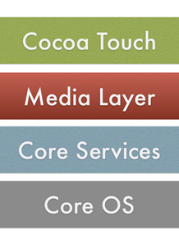
iOS Architecture
Notes:
Architecture of iOS is a layered architecture. Integration of hardware and software is called architecture. Apps do not communicate with the hardware directly. Apps communicate with hardware through a collection of well-defined system interfaces. These interfaces make it simple to write apps that work constantly on devices. There are 4 layers, lower layers gives the basic services which all applications relies on. Higher level layer gives graphics and interface related services. Each layer consists of a set of frameworks.

Slide 10

Core os
Notes:
This holds the lower-level features that most other technologies that are build upon. And these technologies are
Core Bluetooth – services related to Bluetooth.
Accelerate – services to improve the speed, performance of the application
External Accessory - this service allows us to attach to the external devices
Security Services - Services related to the security of the application.
Local Authentication – it allows the authenticated user to login and access the application.

Slide 11

Core services
Notes:
Core service layer provides essential services to the application.
Healthkit framework – New framework for handling health-related information of user
Cloud kit - Gives a medium for moving data between your app and iCloud.
Core foundation –Interfaces that gives fundamental data management and service features for iOS apps.
Core data – it provides the technology to manage the data.
Homekit – provides services related to talking and controlling connected devices in user home.
Core location – location of the application.

Slide 12

Media services
Notes:
Media Service layer name itself denotes services related to audio, video, animations, graphics etc.
UIKit Graphics – It describes high level support for designing images and used for animating the content of your views.
Core graphics – It is the native drawing engine for iOS apps and gives support for custom 2D vector and image-based rendering.
Core Animation – It is an initial technology that optimizes the animation experience of your apps.
Media Player Framework – It is a high-level framework which gives simple use to a user’s iTunes library and support for playing playlists.
AV Foundation – It is an Objective C interface for handling the recording and playback of audio and video.

Slide 13
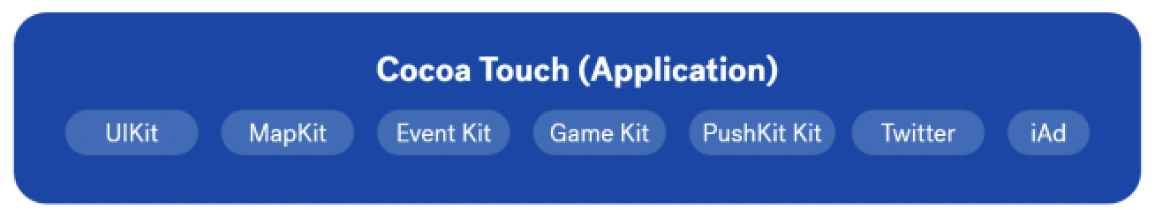
Cocoa touch
Notes:
Cocoa touch layer is user interface later, the upper most layer
UIKit – user interface through which the user interacts with the application
MapKit Framework – gives a scrollable map that you can include into your user interface of app.
EventKit framework – gives view controllers for showing the standard system interfaces for seeing and altering calendar related events
GameKit Framework – implements support for Game Center which allows users share their game related information online
PushKitFramework – provides registration support for VoIP apps.
Twitter Framework – supports a UI for generating tweets and support for creating URLs to access the Twitter service.
iAd Framework – allows you deliver banner-based advertisements from your app.

Slide 14
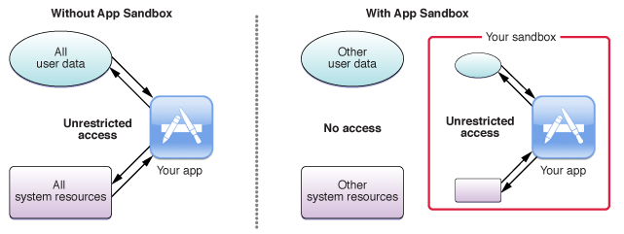
IOS APP SECURITY
Best practices for storing user data:
Secure Enclave(Coprocessor)
Apple’s App Sandbox
Notes:
All iOS devices with an A7 processor or later also have a coprocessor called the Secure Enclave. It powers iOS security features in a hardware-accelerated way.
All apps running on iOS run in a sandbox to make sure the app can only access data which is stored in the app’s unique home directory. If an app wants to access data outside of its home directory it needs to use services provided by iOS, like the ones available for accessing iCloud data or the photo album. Therefore, no other app can read or modify data from your app.
Apple’s App Sandbox is powered by UNIX’s user permissions and makes sure that apps get executed with a less privileged “mobile” user. Everything outside the app’s home directory is mounted read-only. All system files and resources are protected. The available APIs don’t allow apps to escalate privileges in order to modify other apps or iOS itself.

Slide 15
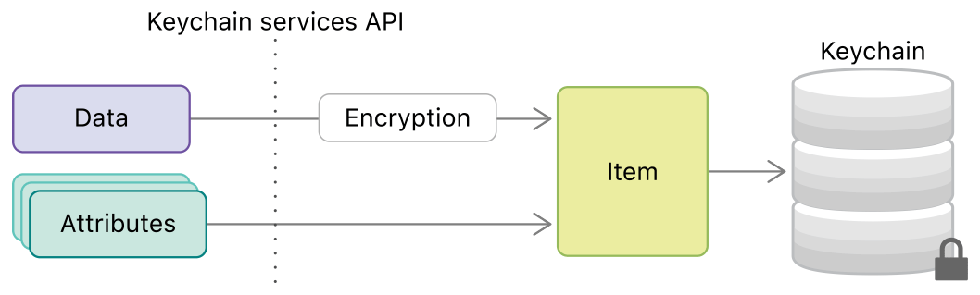
App Security
Data Protection API
Keychain
Rohith Chittipolu
Notes:
All iOS versions since iOS 4 have a built-in security feature called Data Protection. It allows an app to encrypt and decrypt the files stored in their app directory. The encryption and decryption processes are automatic and hardware-accelerated. Data Protection is available for file and database APIs, including NSFileManager, CoreData, NSData, and SQLite.
The four available protection levels include:
No protection: The file is always accessible and not encrypted at all
Complete until first user authentication: This is enabled by default and decrypts the file after the user unlocks their device for the first time. Afterward, the file stays decrypted until the device gets rebooted. Locking the device doesn’t encrypt the data again.
Complete unless open: The file is encrypted until the app opens the file for the first time. The decryption stays alive even when the device gets locked by the user.
Complete: The file is only accessible when the device is unlocked.
The keychain is your secure place to store small chunks of data. It is a hardware-accelerated secure data storage that encrypts all of its contents. It is used by the system to store data like passwords and certificates but you as an app developer have also access to this data storage.
Your app or app group has its own space in the keychain and no other app has access to it. This way, you don’t need to store encryption keys in your app and can rely on the system to provide the highest level of security.
For every keychain item, you can define specific access policies for accessibility and authentication. You can require user presence (requesting Face ID or Touch ID unlock) or that the biometric ID enrollment didn’t change since the item was added to the keychain.

Slide 16

Best Practices for Secure Data Transportation
Best Practices for Secure Data Transportation:
HTTPs
SSL Pinning
Rohith Chittipolu
Notes:
Since iOS 9, there is a new feature called App Transport Security (ATS). It improves the security of network communication in your apps. ATS blocks insecure connections by default. It requires all HTTP connections to be performed using HTTPS secured with TLS.
ATS can be configured in many ways to loosen up these restrictions. You can, therefore, allow insecure HTTP connections for specific domains or change the minimum TLS version used for HTTPS.
The system certificate trust validation checks if the certificate was signed by a root certificate of a trusted certificate authority. To circumvent this security mechanism attackers would need to explicitly trust another malicious certificate in the user’s device settings or compromise a certificate authority. The attacker could then perform a man-in-the-middle attack to read all messages sent between client and server.
o prevent these kinds of attacks an app can perform additional trust validation of server certificates. This is called SSL or Certificate Pinning. You can implement SSL Pinning by including a list of valid certificates (or its public keys or its hashes) in your app bundle. The app can, therefore, check if the certificate used by the server is on this list and only then communicate with the server.

Slide 17
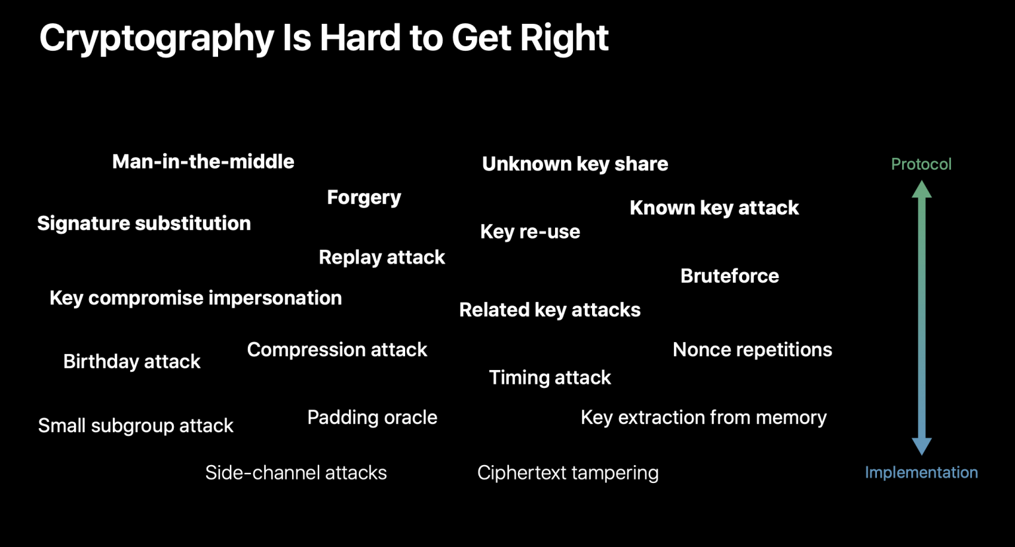
Security Features
Using Cryptographic APIs
Hashing data
Rohith Chittipolu
Notes:
Apples CryptoKit is a new API that was introduced in iOS 13 and provides lower-level APIs to perform cryptographic operations or implement security protocols.
CryptoKit is based on top of more lower-level APIs. They were available before but introduced additional risk factors since developers often used them in a wrong way.
CryptoKit also allows you to use the SecureEnclave to get cryptographically safe functions that are performant and optimized for the device’s hardware.
If you want to support older iOS versions you can use those lower-level APIs or use well known open-source third-party libraries like CryptoSwift.
Hash functions are functions that convert data of arbitrary size to fixed-size values. Good hash functions should minimize duplication of output values (so-called collisions) and be very fast to compute. Swift includes hashing functionality in the Swift Standard Library, but these functions are heavily focused on being fast and have a relative high collision rate. This makes them a good fit for perfomance-critical operations, but not so much for security related operations.

Slide 18
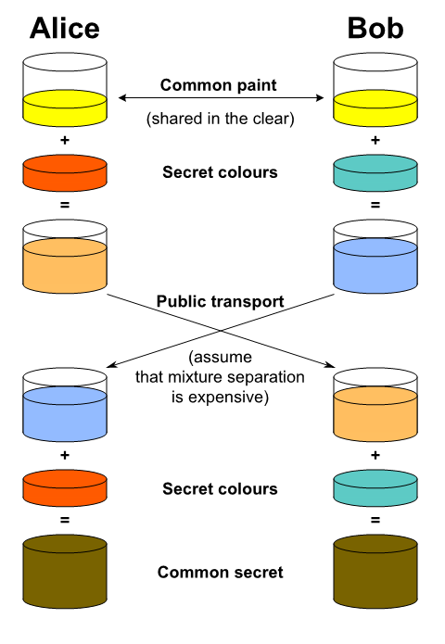
Data Storing practices
Performing Key Agreement
Rohith Chittipolu
Notes:
In a lot of cases, you will need to perform some form of key exchange to exchange cryptographic keys over an insecure channel. With key agreement protocols like Elliptic-curve Diffie–Hellman (ECDH), you can derive a common secret.
A mechanism used to create a shared secret between two users by performing NIST P-256 elliptic curve Diffie Hellman (ECDH) key exchange.

Slide 19
Publishing an app to the app store :
Create an Apple Developer Account
Preparing for review
Submitting for review
Avoiding common issues

Slide 20
Create an Apple Developer Account
Apple developer portal
Distribution certificate
App ID
Provisioning profile:
Satwika Reddy Guntipally
Notes:
To upload an app to the app store create an Apple Developer Account in apple Developer portal.
-sign in with Apple Id
-fill the enrollment form
-Pay $100 registration fee
Now, you will be able to access developer resources from Apple Developer portal.
Distribution certificate :Identifies your team and allows you to submit apps to Apple store.
AppId
It consists of two components.
-TeamId, bundleid

Slide 21
Preparing for review
App Store Review Guidelines
Human Interface Design Guidelines
Guidelines for Using Apple Trademarks and Copyrights

Slide 22
Submitting for review
Manage your submissions and communicate with App Review.
Submit items without needing a new app version.
Include multiple items in one submission
Remove items with issues and continue with items that were accepted by App Review.
Review status
Notes:
Manage your submissions and communicate with App Review on the App Review page within My Apps. You can visit the App Review page at any time, even if you don’t have active submissions or conversations.
Submit items such as in-app events, custom product pages, and product page optimization tests without needing a new app version.
Include multiple items in one submission.
Remove items with issues from your submission and continue with items that were accepted by App Review.
View a history of submissions created using the updated experience, including messages from App Review.
Review status
On average, 90% of submissions are reviewed in less than 24 hours. You’ll be notified by email of status changes. You can also check the review status of your submission in the My Apps section of App Store Connect or on the App Store Connect app for iPhone and iPad.

Slide 23
AVOIDING COMMON ISSUES
Crashes and bugs
Broken links
Placeholder content
Incomplete information
Notes:
Crashes and bugs
Submit items for review only when they’re complete and ready to be published. Make sure to thoroughly test on devices running the latest software and fix all bugs before submitting
Broken links
All links in your app must be functional. A link to user support with up-to-date contact information and a link to your privacy policy is required for all apps.
Placeholder content
Finalize all images and text before submitting for review. Items that are still in progress and contain placeholder content are not ready to be distributed and cannot be approved.
Incomplete information
Enter all of the details needed for review in the App Review Information section of App Store Connect. If some features require signing in, provide a valid demo account username and password. If there are special configurations to set, include the specifics. If features require an environment that is hard to replicate or require specific hardware, be prepared to provide a demo video or the hardware. Also, please make sure your contact information is complete and up to date.

Slide 24
Advantages of I0s MOBILE COMPUTING
Apps are simple and fast
Full use of hardware and internal functions
Support
Security to iOS consumers
Unique software development kits
Transactions
Notes:
Apps are simple and fast to run as compared to other operating systems and application types, such including web or cross-platform applications.
Native iOS apps take full use of hardware and internal functions of the devices
Native applications get full support from App Store, as soon as they are accepted
Support from the App Store supplies complete security and security to iOS consumers
Native app developers have more convenience due to availability of iOS unique software development kits (SDKs) and development tools
App Store can handle your transactions on your behalf.

Slide 25
DISADVANTAGES OF I0s MOBILE COMPUTING
More expensive
Authorization
Reduced shares.
Notes:
Native iOS projects are substantially more expensive for developers, compared to cross-platform and web applications.
If the application supports range of iOS devices, the costs of updating and maintenance are higher for the developer.
Being closed sourced, Mac OS X is needed to develop applications; they can not be established on any other OS.
The process of getting an app authorized by the App Store is long and laborious; updates also need to be App Store authorized in order to be included there.
There is no guarantee that your app will be accepted and added to the App Store database
There is also no guarantee of fast popularity of application amongst iOS users
The worldwide market share for Apple has reduced to a small 11%.
Due to variety in iOS device type, version, and application version, it is a challenging process for developer to provide full support to all the application users.
If the application produces expenditures, 30 % should go to Apple’s App Store, consisting of all the in-app purchases.

Slide 26
SUMMARY
Mobile Application Development and Application Development Stack.
Technology Stack and IOS features
Criteria to select the technology Stack.
IOS Architecture
IOS App security and its's features
Publishing an Application to App Store
Pros and Cons of Mobile Computing

Slide 27


Slide 28
MOBILE APPLICATION DEVELOPMENT IN IOS
TEAM ALPHA
Aishwarya Mallela
Abdul Khayyum Sahib Shaik
Rohith Chittipolu
Satwika Reddy Guntipally
Aakanksha Reddy Sunkireddy

